Slide 1
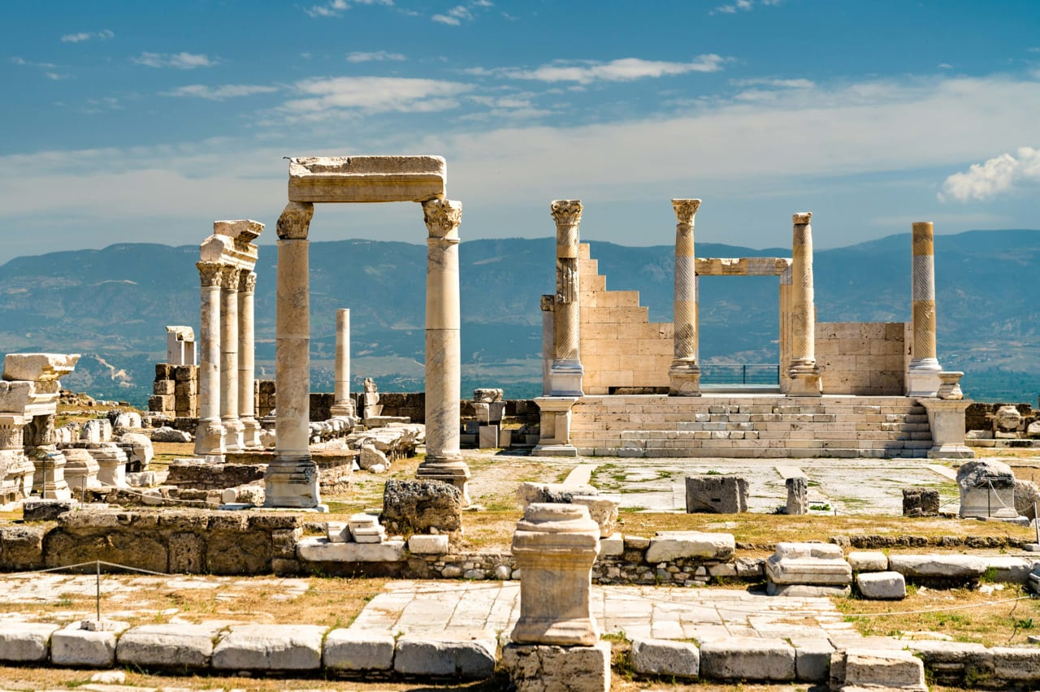
The Church of Laodicea

Slide 2
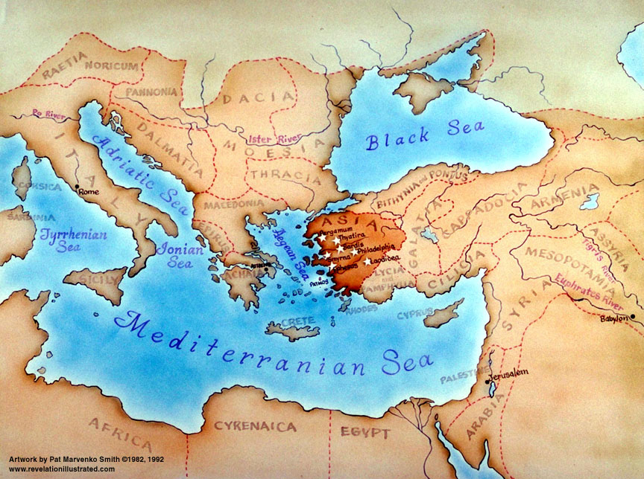

Slide 3
¹⁴ And unto the angel of the Church of the Laodiceans write;
These things says the Amen, the faithful and true witness,
the beginning of the creation of God;
¹⁵ I know your works, that you are neither cold nor hot:
I would you were cold or hot.
¹⁶ So then because you are lukewarm,
and neither cold nor hot, I will spue you out of My mouth.
¹⁷ Because you say, I am rich, and increased with goods,
and have need of nothing;
and know not that you are wretched,
and miserable, and poor, and blind, and naked:

Slide 4
¹⁸ I counsel you to buy of Me gold tried in the fire,
that you may be rich; and white raiment that you may be clothed,
and that the shame of your nakedness does not appear;
and anoint your eyes with eye salve, that you may see.
¹⁹ As many as I love, I rebuke and chasten:
be zealous therefore, and repent.
²⁰ Behold, I stand at the door, and knock:
if any man hear My voice, and open the door,
I will come i to him, I and will sup with him, and he with Me.
²¹ To him that overcomes
will I grant to sit with Me in My throne,
even as I also overcame,
and am set down with My Father in His throne.
²² He that has an ear,
let him hear what the Spirit says unto the Churches.

Slide 5
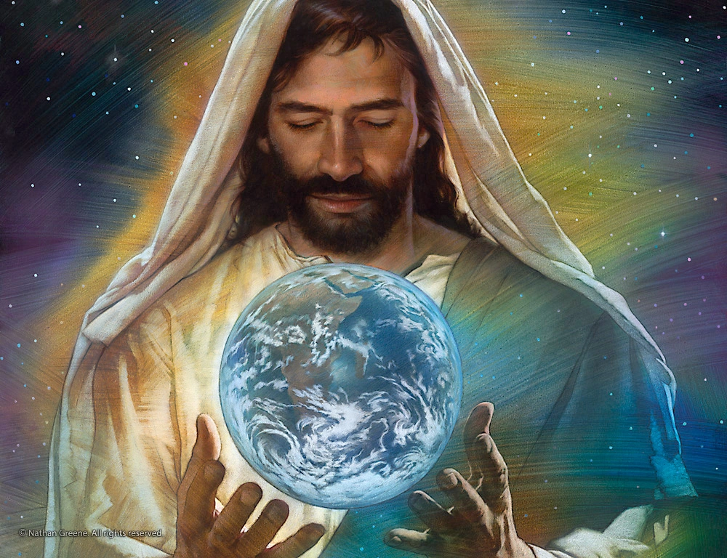
Report Card For Laodicea “The People Speak”
Jesus is the Amen, the Faithful & True Witness,
the Beginning of the Creation of God.
I know:
LUKEWARM F
Self-Deceived F
Spiritually Poor and Blind F
Naked F
Comments: Repent or I will spit you out of my mouth!
I chasten those that I love.
Buy gold tried by fire and white raiment that you will not be naked. Anoint your eyes with salve so you may see.
I am knocking at the door, will you let me come in?
Rewards: I will come in and sup with you.
Overcomers will sit with Me in My throne
He that has an ear, let him hear what the Spirit says to the Churches.

Slide 6
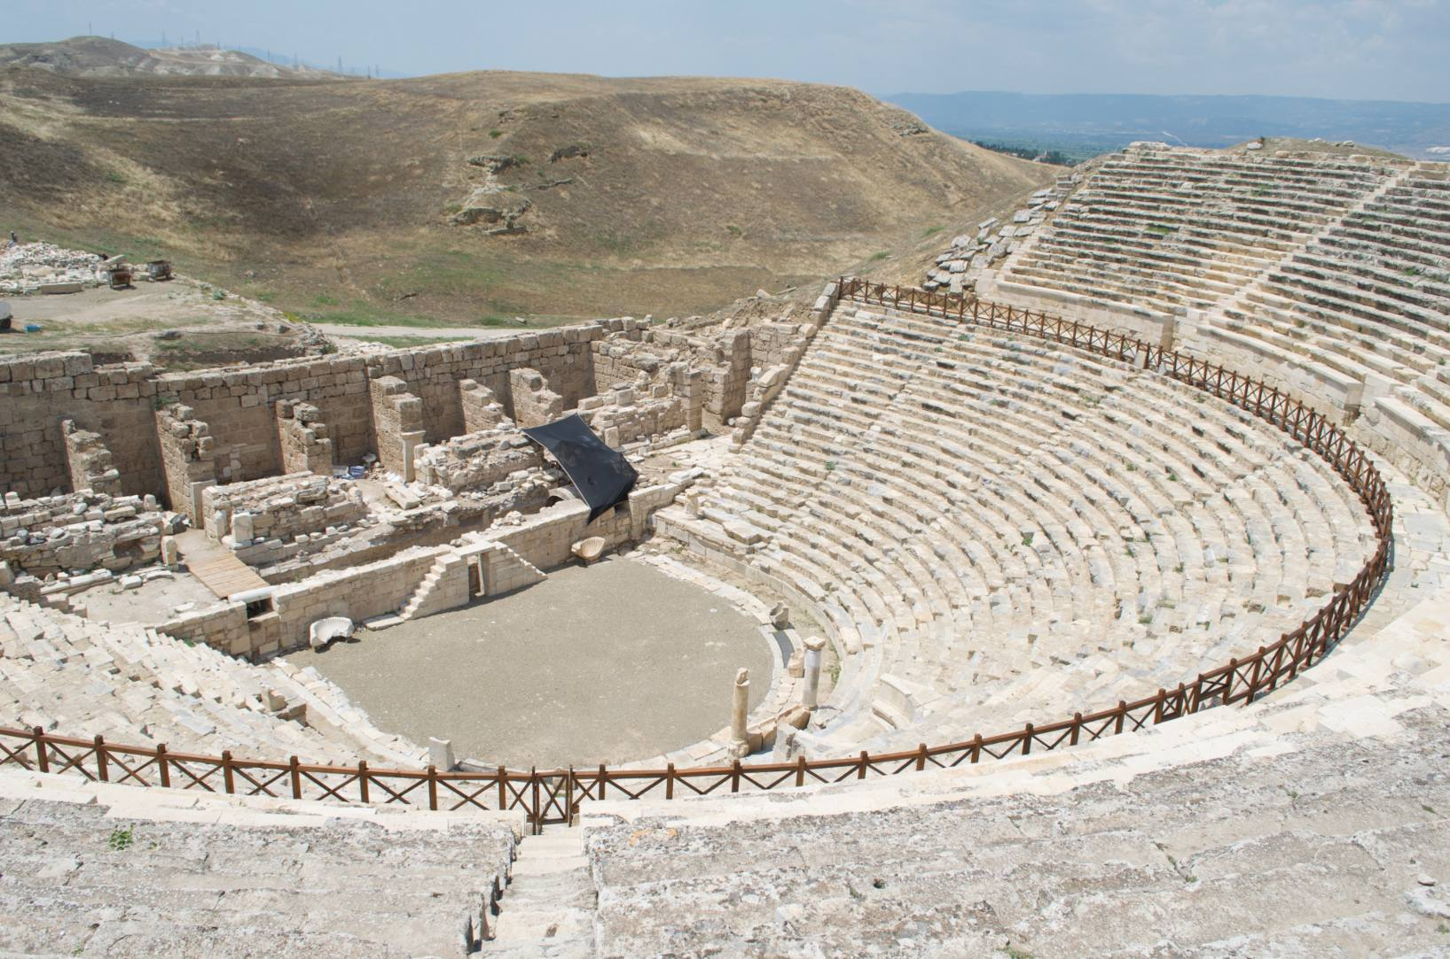

Slide 7
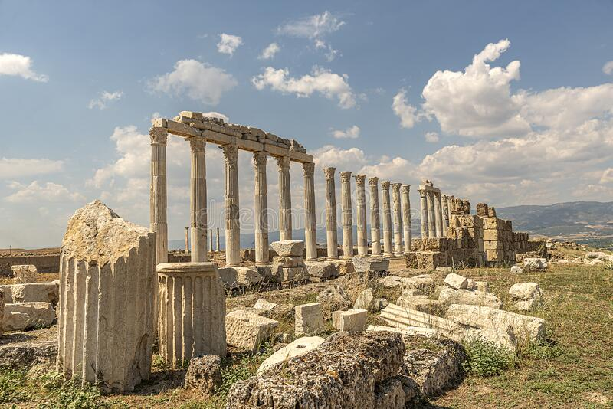
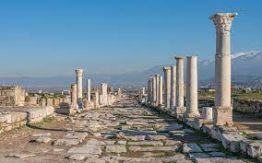

Slide 8
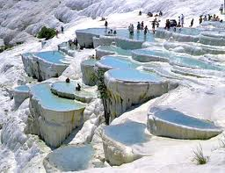
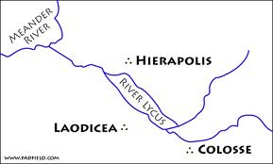
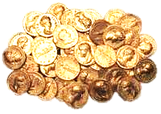
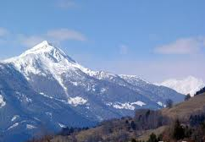
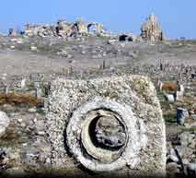
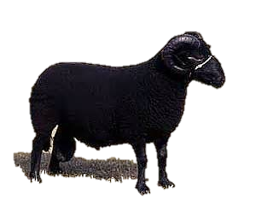
“Not Hot or Cold, but Lukewarm
I will Spit You out of My mouth”

Slide 9
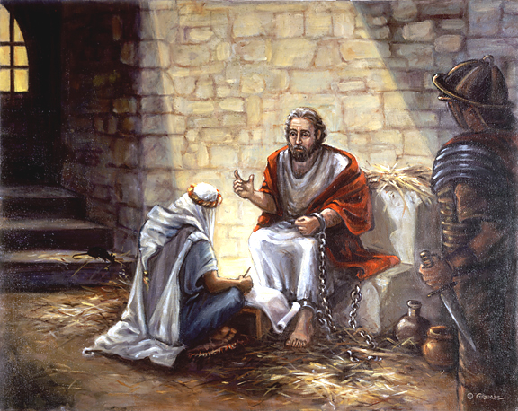
Paul wrote 4 of his strongest letters to the Churches
from prison:
Ephesians
Philippians
Colossians
Philemon
He wrote his concerns about the dangers of “falling away from the faith” to the Laodicean Church.

Slide 10
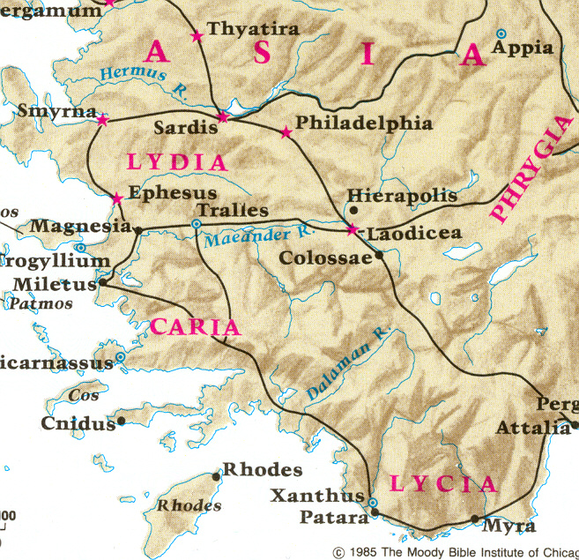
Colossians Chapter 2
Letter from Paul
1. For I want you to know how much I am struggling for you and for those at Laodicea, and for all who have not met me face to face,

Slide 11
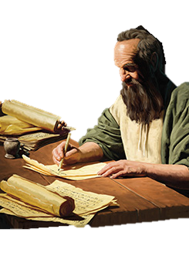
¹ Masters, give unto your servants that which is just and equal; knowing that ye also have a Master in heaven.
² Continue in prayer, and watch in the same with thanksgiving;
³ Withal praying also for us, that God would open unto us a door of utterance,
to speak the mystery of Christ, for which I am also in bonds:
⁴ That I may make it manifest, as I ought to speak
.
⁵ Walk in wisdom toward them that are without, redeeming the time.
⁶ Let your speech be always with grace, seasoned with salt,
that ye may know how ye ought to answer every man.
⁷ All my state shall Tychicus declare to you, who is a beloved brother,
and a faithful minister and fellow-servant in the Lord:
⁸ Whom I have sent unto you for the same purpose,
that he might know your estate, and comfort your hearts;
⁹ With Onesimus, a faithful and beloved brother, who is one of you.
They shall make known unto you all things which are done here.
Colossians
Chapter 4

Slide 12
¹⁰ Aristarchus my fellow prisoner salutes you, and Marcus, sister's son to Barnabas,
(touching whom ye received commandments: if he come to you, receive him;)
¹¹ And Jesus, which is called Justus, who are of the circumcision.
These only are my fellow workers unto the kingdom of God, which have been a comfort to me.
¹² Epaphras, who is one of you, a servant of Christ, salutes you, always laboring fervently for you
in prayers, that you may stand perfect and complete in all the will of God.
¹³ For I bear him record, that he has a great zeal for you,
and them that are in Laodicea, and them in Hierapolis.
¹⁴ Luke, the beloved physician, and Demas, greet you.
¹⁵ Salute the brethren which are in Laodicea, and Nymphas, and the Church which is in his house.
¹⁶ And when this epistle is read among you, cause that it be read also
in the Church of the Laodiceans; and that you likewise read the epistle from Laodicea.
¹⁷ And say to Archippus, Take heed to the ministry which you have received in the Lord, that you fulfil it
.
¹⁸ The salutation by the hand of me, Paul. Remember my bonds. Grace be with you. Amen.

Slide 13
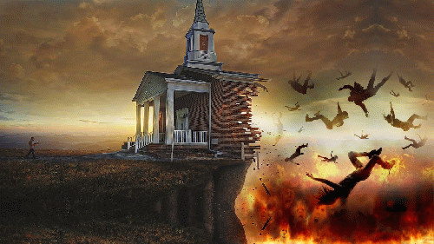
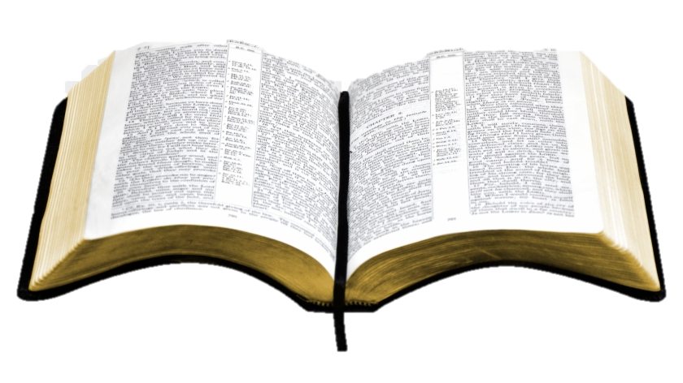
The Laodicean Age of the Church
“The Great Falling Away”

Slide 14
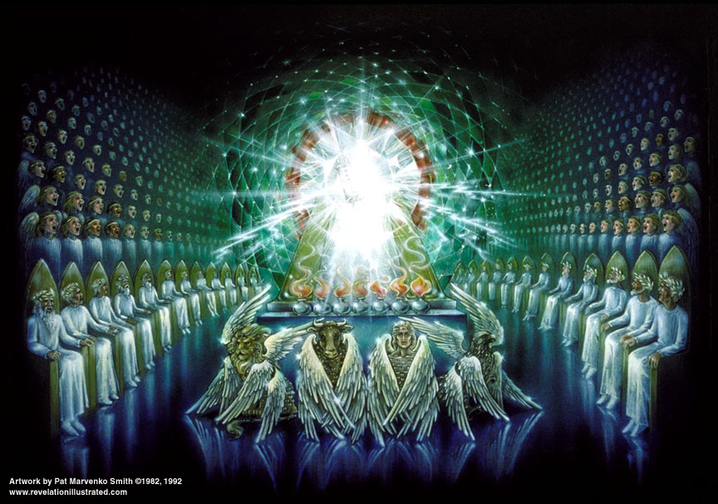
.
To Him who Overcomes will I grant to sit with Me in My throne,
even as I also overcome, and am set down with My Father in His throne
To him who overcomes, will I grant to sit with Me in My throne,
even as I also overcame, and am set down with My Father in His throne.

Slide 15
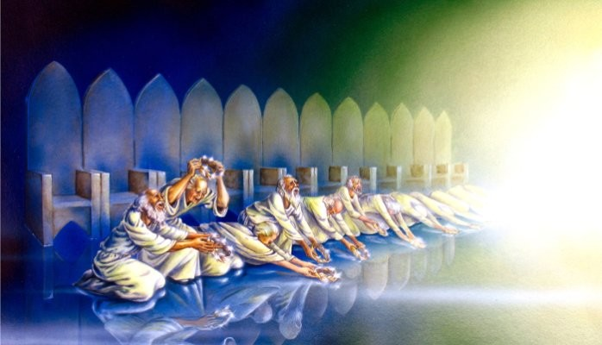
And we will worship Him day and night, Saying Blessing and Honor and glory and power, be unto Him that sits upon the throne, and unto th e Lamb forever and ever.

Slide 16
Is the Modern Church in the Age of Laodicea ?

Slide 17
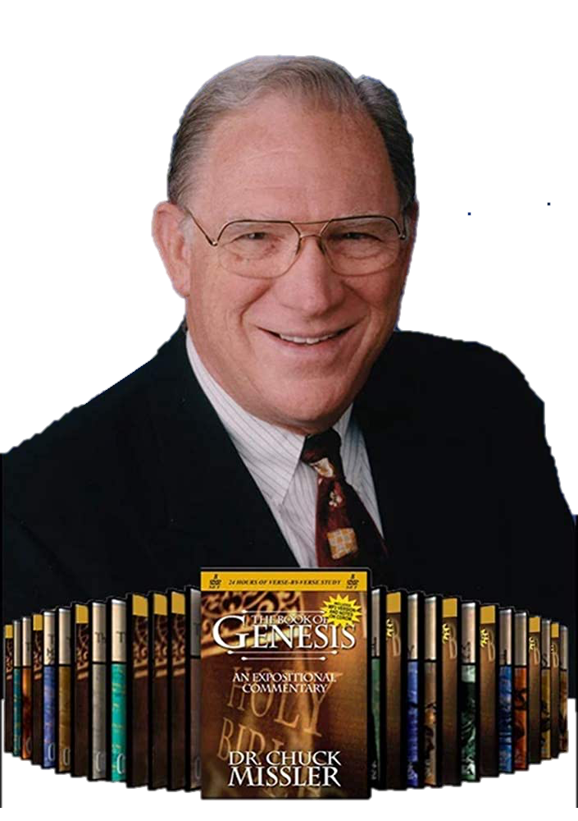
“He who has ears to hear, let him hear” Matthew 13:9
The 7 Churches of Revelation
Ephesus
Smyrna
Pergamum
Thyatira
Sardis
Philadelphia
Laodicea
The 7 Kingdom Parables
The Sower & The 4 Soils
The Wheat & The Tares
The Mustard Seed & The Birds
The Woman & the Leaven
The Pearl of Great Price
The Treasure in the Field
The Dragnet

Slide 18
Is the Laodicean Church Alive Today?
“Because you say, I am rich, and increased with goods ,and have need of nothing;
and know not that you are wretched, and miserable, and poor, and blind, and naked:”
Are there Church Movements today
that model “the Church of Laodicea?
Do Churches preach a ‘Prosperity Gospel”
“Declare Jesus died to make you rich”
Do Pastors that Promote and sell Medical Amazements?
Do Celebrity Ministers that wear Ridiculously High Priced Clothes/Shoes?
Do Mega Pastors own Jets/Cars/ Estates/ Homes…. like Movie Stars?

Slide 19
The Laodicean Age of the Church
“The Great Falling Away”

Slide 20
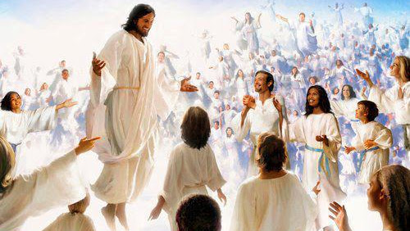
He that has an ear, let him hear what The Spirit says to the Churches
The Promise to the Overcomers - To Be Seated in Heavenly places with Him

Slide 21
O Lord, Deliver us from
The Laodicean Church

