Slide 1
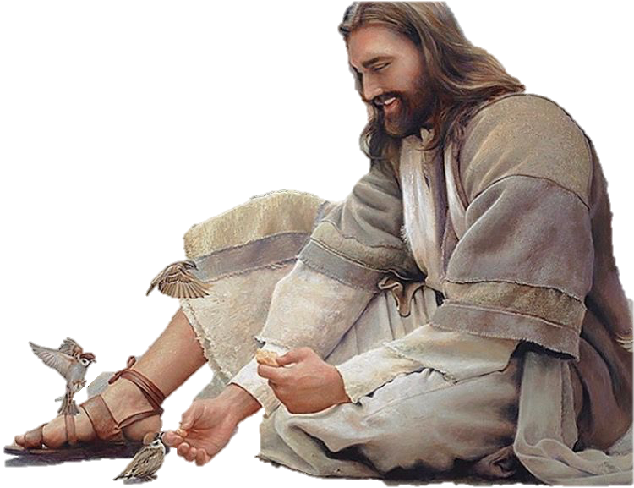
“Weddings in the Word”
Parables,
Prophecy & Patterns

Slide 2
Weddings are in the Word
From the Beginning to the End
From Genesis - Adam & Eve
To Revelation - Marriage Supper of the Lamb
Jesus 1st Miracle – The Wedding at Cana
Final Words - The Spirit & the Bride say Come

Slide 3
In Genesis
There was a marriage in the Garden - Adam & Eve

Slide 4
“And Adam said, This is now bone of my bone, and flesh of my flesh. For this reason a man shall leave his father and his mother and shall cleave to his wife and they shall be one flesh.” Gen. 2:23-24

Slide 5
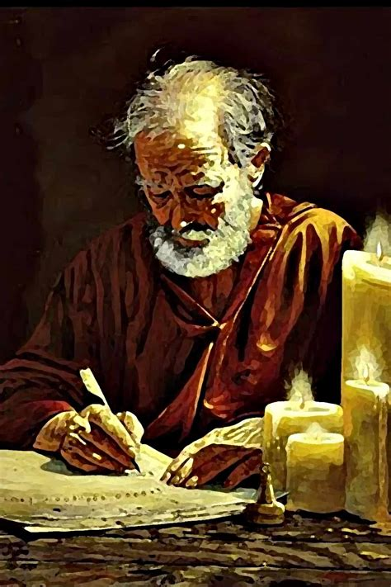
Ephesians Chapter 5:21-33
Paul teaches “Marriage & The Mystery of the Church”
Wives submit to Husbands as Head of the marriage
Just as we submit to Jesus
as head of the Church
Husbands Love your wives
As Jesus loves the Church and gave Himself for it…..
“The Church is the Bride
washed by The Word
“For this cause a man shall Leave father and mother and Cleave to his wife” quotes Genesis 2:24

Slide 6
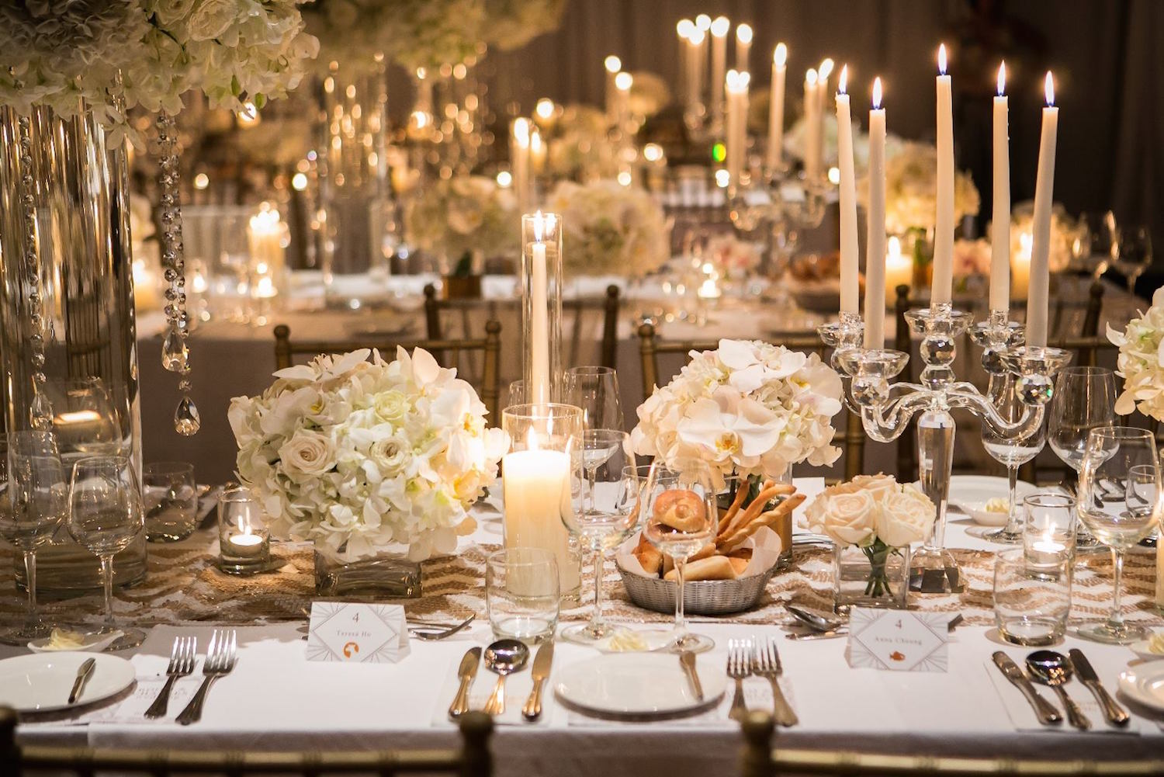
The Greatest Wedding Feast of All is Yet to Come

Slide 7
Rev Chapter 19 –”Wedding Supper of the Lamb’
7. “ Let us be glad and rejoice, and give honor to Him, for the marriage of the Lanb is come. His wife has made herself ready.
8. And to her was granted that she should be arrayed in fine linen, clean and white: for the fine linen is the righteousness of the saints.
9. And He said to me, Write, Blessed are they which are called to the Marriage Supper of the Lamb….”

Slide 8
Revelation 22:17

Slide 9
“Parables & Prophecy”
The Wedding Parables
Matthew 25:1-3 “The 10 Virgins”
Matthew 21:1-14 “ The Wedding Banquet”
Luke 12:35-48 “Faithful Servants”

Slide 10
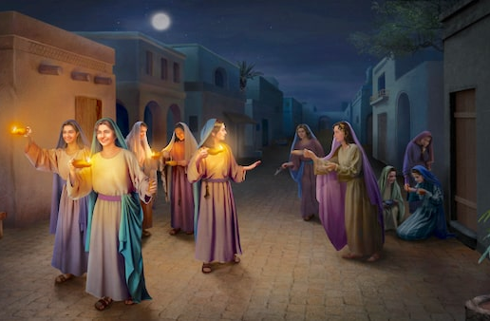
“The Parable of the 10 Virgins” - Matthew 25:1-13

Slide 11
1.Then shall the kingdom of heaven be likened to 10 virgins, which took their lamps, and went forth to meet the Bridegroom.
2. And 5 of them were wise, and 5 were foolish.
3. They that were foolish took their lamps, and took no oil with them.
4. But the wise took oil in their vessels with their lamps.
5. While the Bridegroom tarried, they all slumbered and slept.
6. And at midnight there was a cry made, Behold the Bridegroom comes, Go out to meet Him.”
7. Then all the virgins arose, and trimmed their lamps.

Slide 12
8. And the foolish said to the wise, Give us your oil; for our lamps have gone out.
9. But the wise answered, saying, Not so; lest there be not enough for us and you: but go to them that sell and buy for yourselves
10. And while they went to buy, the bridegroom came; and they that were ready went in with Him to the marriage: and the door was shut.
11. Afterward came also the other virgins saying Lord, Lord, open to us.
12. But He answered and said, Verily I say to you, I know you not.
13. Watch therefore, for you know neither the day nor the hour wherein the Son of Man comes.”

Slide 13
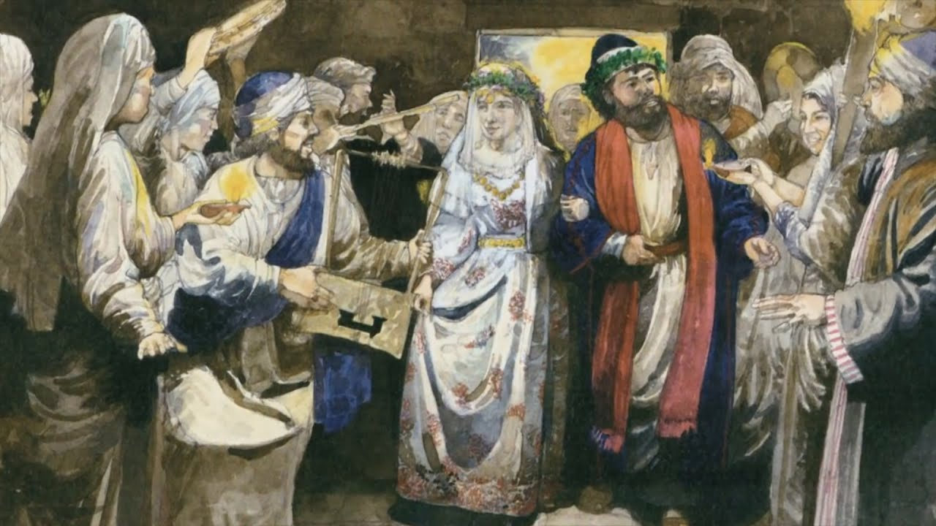
Patterns & Prophecy – “The Ancient Jewish Wedding”

Slide 14
The Wedding Patterns in Jesus’ Day
The Father picks the bride for His Son
A Helper is appointed to Present the Marriage offer.
The Bride is precious, a bridal price will be negotiated by the Helper.
The Bride will leave her house and live in the Father’s house
The Wedding Covenant is signed. Terms of the Wedding are given, along with gifts and Covenant Cup.
The betrothed bride is Baptizem and separates from her former life to prepare for her bridegroom . She anoints herself.
7. The are 2 legal parts to the Wedding – The Betrothal & The Actual
Wedding Ceremony – sometimes separated by many years

Slide 15
8. The Bridegroom leaves to prepare the honeymoon chamber
9. The Father announces when the time is right
9. At the sound of the trumpet, the Bridegroom goes to get His bride
10. There is a wedding procession usually around midnight for all those invited to the wedding
11. They enter the Father’s house, and the door is shut.
12. The Wedding Ceremony is completed and only the couple enter the special honeymoon room to consummate the marriage.
13. Meanwhile the guests continue to celebrate for one week
14. The married couple come out and the wife is introduced!

Slide 16
Weddings in the Old Testament - Prophetic Patterns
1. Adam & Eve - “Leave & Cleave”
2. Isaac & Rebekah – “The Father Picks the Bride”
3. Jacob & Rachel – “The Wedding Week”
4. Esther & The King - “Preparation of Bride – Anointing”
5. Ruth & Boaz – “The Kinsman Redeemer”

Slide 17
“Weddings in the Word”
Lord, Teach Us
Your Parables,
Prophecy & Patterns

