Slide 1
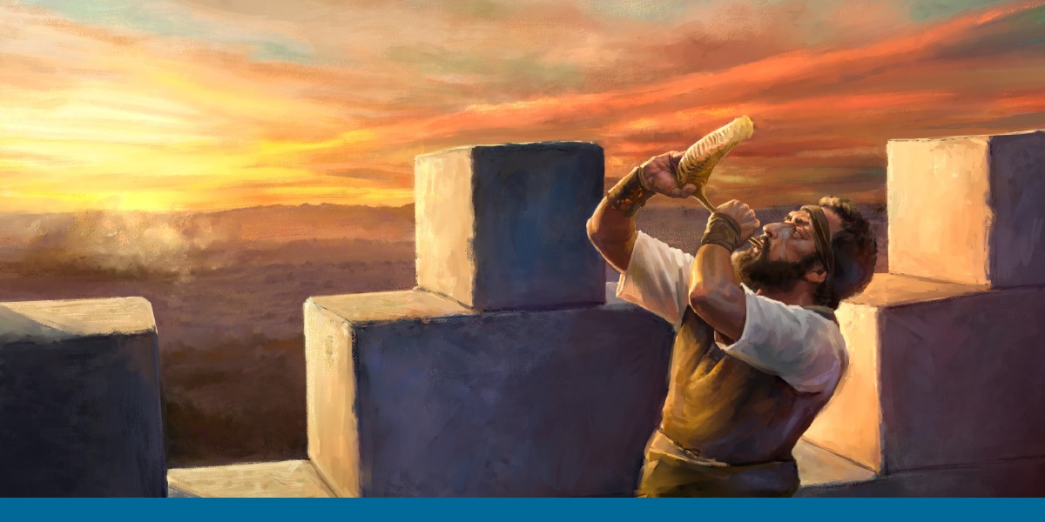
“Wake up the Watchmen”
“Walking Worthy Before the Lord”

Slide 2
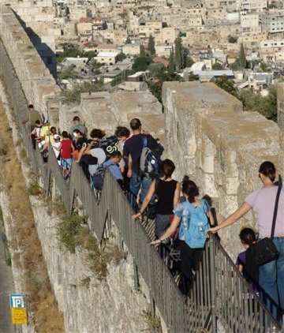
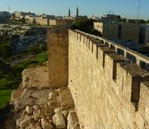
Remembering the Prophet Ezekiel’s Words
On the Walls of Jerusalem
“The Ramparts Walk”

Slide 3
Danger from the Enemy
Comes in 2 Forms
#1. Physical Danger
Ezekiel 33:1-6
#2. Spiritual Danger

Slide 4
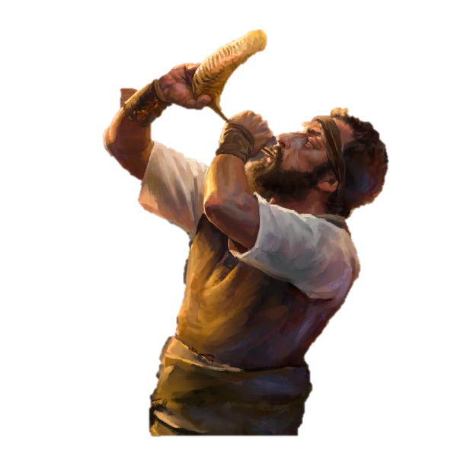
Ezekiel Chapter 33:1-6
Again the word of the Lord came to me, saying,
Son of man, speak to the children of your people, and say to them, When I bring the sword upon a land, if the people of the land take a man of their coasts, and set him for their watchman:
3. If when he sees the sword come upon the land, he blow the trumpet, and warn the people;
4. Then whosoever hears the sound of the trumpet, and takes not warning; if the sword come and take him away, his blood shall be upon his own head.

Slide 5
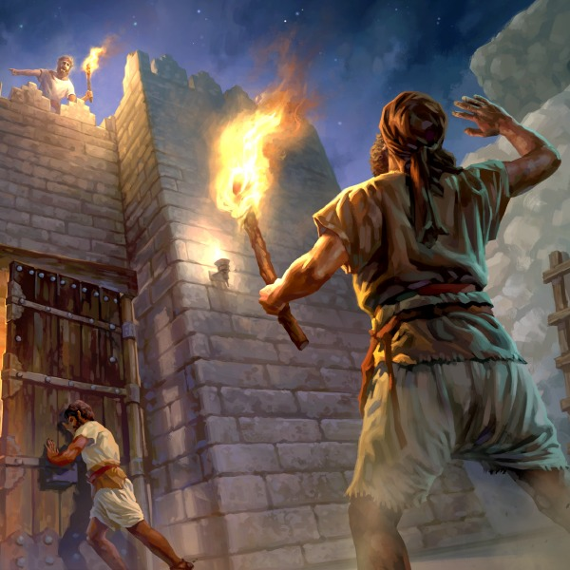
5. He heard the sound
of the trumpet
and took not warning; his blood shall be upon him. But he that takes warning
shall deliver his soul.
6. But if the watchman
see the sword come and doesn’t blow the trumpet, and the people are not warned; if the sword come, and take any person from among them, he is taken away in his iniquity; but his blood I will require
at the watchman's hand.

Slide 6
Danger from the Enemy
Comes in 2 Forms:
#1 Physical Danger
#2. Spiritual Danger
Ezekiel 33:8-20
Ezekiel 18

Slide 7
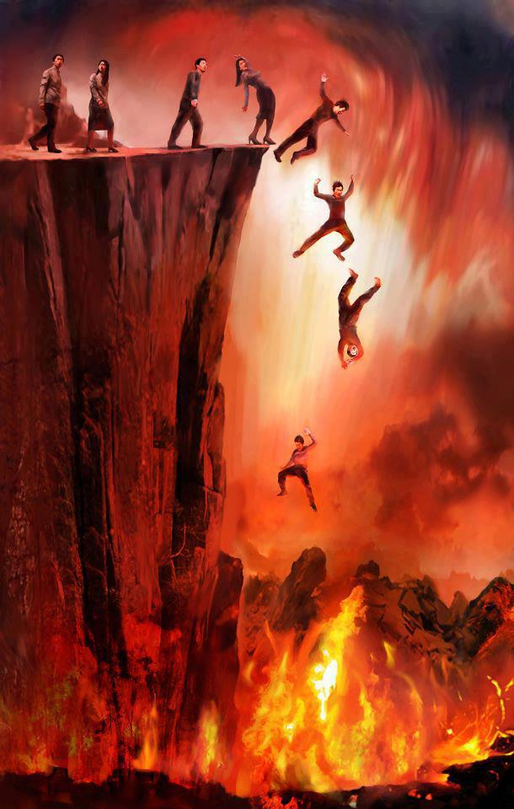
8 When I say to the wicked,
Wicked man, you shalt surely die;
if you do not speak
to warn the wicked from his way, that wicked man shall die in his iniquity; but his blood will
I require at your hand.
9 Nevertheless, if you warn
the wicked of his way
to turn from it;
if he does not turn from his way,
he shall die in his iniquity;
But you have delivered your soul.
Wake up, O Watchmen
What are we doing
….. to Win the Lost?

Slide 8
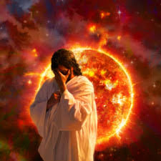
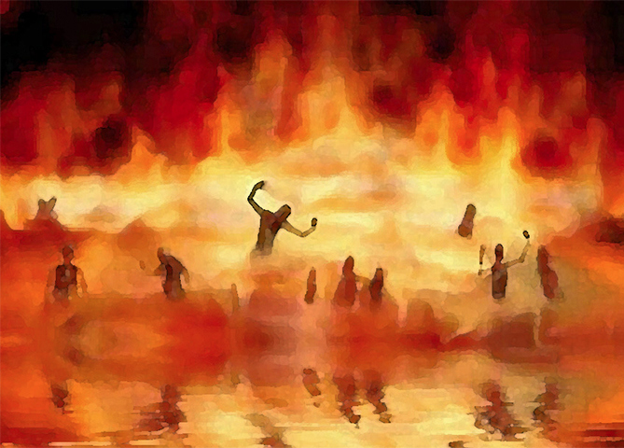
11. Say unto them,
As I live, says
the Lord God,
I have no pleasure
in the death
of the wicked;
but that the wicked turn from his way and live:
turn ye, turn ye
from your evil ways;
for why will you die,
O house of Israel?

Slide 9
12. Therefore, son of man, say to the children of your people,
The righteousness of the righteous
shall not deliver him in the day of his transgression:
as for the wickedness of the wicked,
he shall not fall thereby in the day
that he turns from his wickedness;
Neither shall the righteous be able to live for his righteousness in the day that he sins.
13. When I shall say to the righteous, that he shall surely live;
if he trust to his own righteousness, and commit iniquity,
all his righteousness shall not be remembered;
but for his iniquity that he has committed,
he shall die for it.

Slide 10
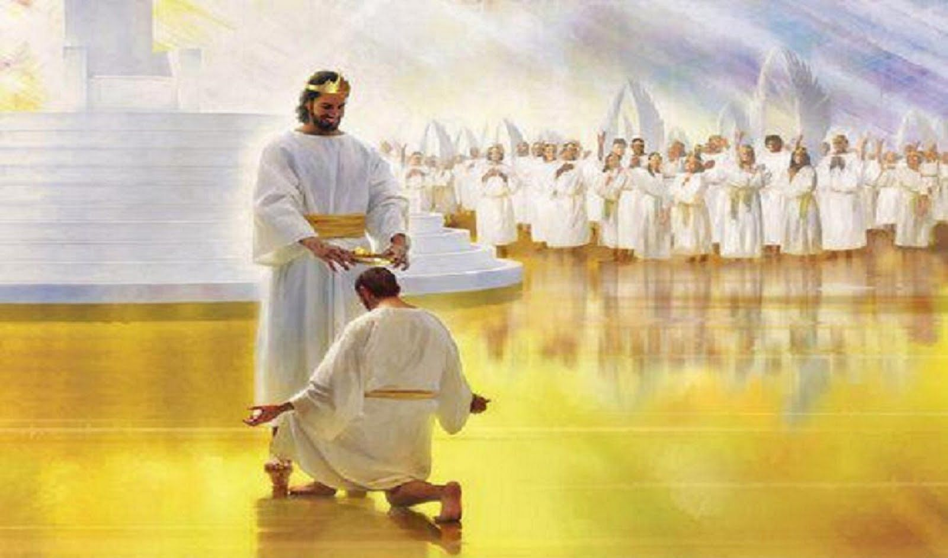
18. When the righteous turns from his righteousness, and commits iniquity, he shall even die thereby.
19. But if the wicked turn from his wickedness,
and do that which is lawful and right, he shall live thereby

Slide 11
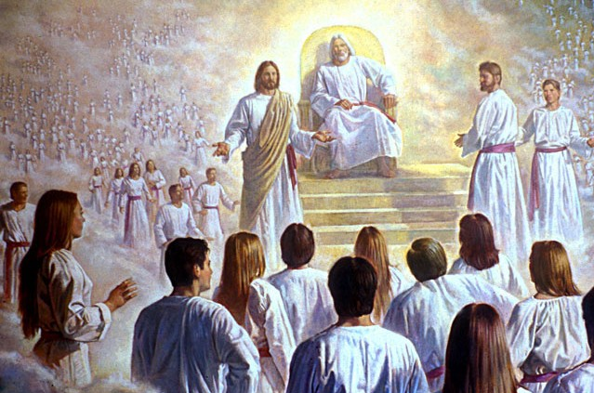
20. Yet you say, The way of the Lord is not equal.
I will judge you every one after his ways

Slide 12
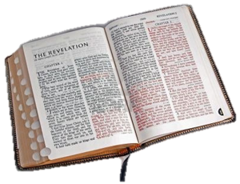
Where Is there a Message
in the New Testament
About the Watchmen in the Church?

Slide 13
Jesus ‘ Message to The Church of Sardis Revelation. 3: 1-8

Slide 14
“And to the Angel of
The Church of Sardis write,
These things says He
Who has the 7 Spirits of God
and the 7 stars.
“I know your works,
that you have a name that you live,
and you are dead.
2. Be watchful and strengthen
the things which remain,
that are ready to die:
For I have not found your works
perfect before God.

Slide 15
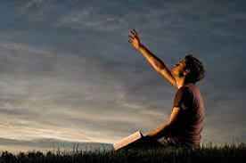
3. “Remember therefore how you have received and heard.
Hold fast and Repent.
If you therefore shall not watch, I will come upon you as a thief,
and you will not know what hour I will come upon you.

Slide 16
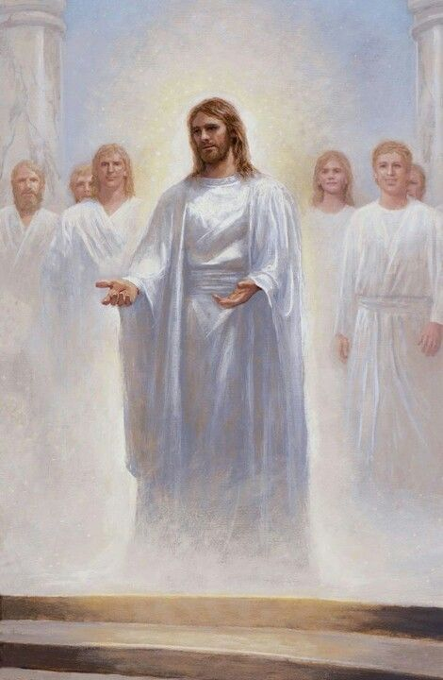
5. “He that overcomes,
the same will be clothed
in white raiment,
and I will not blot his name
out of Heaven,
but I will confess his name
before My Father,
and before the angels.

Slide 17
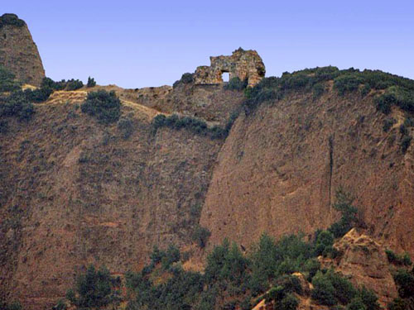
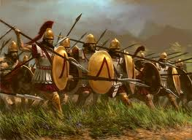
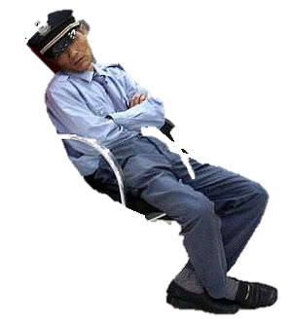
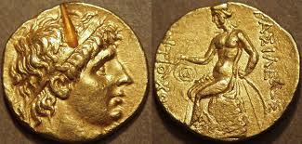
Ancient Sardis
“Asleep…Almost Dead”
The Day of the Lord will come like a Thief in the Night.

Slide 18
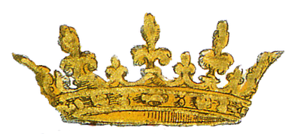
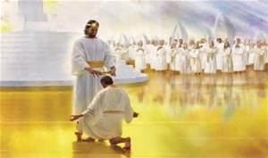
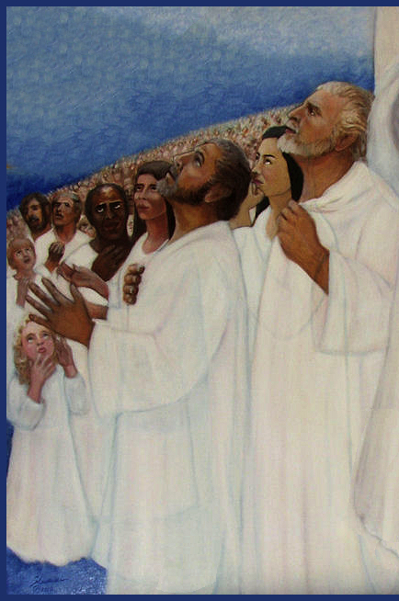
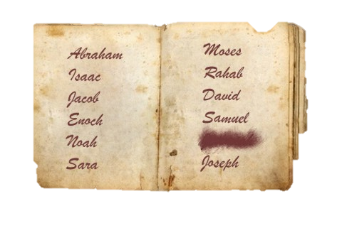

Slide 19
Can Names Be Blotted Out
in the Bible?
#1. Revelation 3:5 Sardis
#2. Revelation Chapter 7:4-8
#3 Revelation 22:18-19
Old Testament - Genesis 7:4; 7:23; Exodus 17:14, 32:32-33; Number5:23;
Deut 9:14, 25:6; 25:19; 29:20; Judges 21:17; 2 Kings 14:27; 2 Kings 21:13; Nehemiah 4:5, 13:14; Psalms 9:5; 52:1; 51:9, 69:28 Psalms 109:13-14;
Proverbs 6:33, 30:20; Isaiah 25:8; 44:22; Jeremiah 18:23,
New Testament - Acts 3:19; Colossians 2:14, Rev 3:5; 7:17; 21:4; 22:18-19

Slide 20
The Day of the Lord
comes as
Only to Those who are asleep,
To those who are lukewarm
To Those who are living like the world
“Laodecian”

Slide 21
First Thessalonians
Chapter 5
1.But of the times and the seasons, brethren,
ye have no need that I write unto you.
2 For yourselves know perfectly that the day of the Lord so cometh as a thief in the night.
3 For when they shall say, Peace and safety;
then sudden destruction cometh upon them,
as travail upon a woman with child;
and they shall not escape.
4.But you, brethren, are not in darkness,
so that Day will overtake you like a thief

Slide 22
.
5. Ye are all the children of light,
and the children of the day:
we are not of the night, nor of darkness.
6. Therefore let us not sleep, as do others; but let us watch and be sober.
7. For they that sleep sleep in the night;
and they that be drunken are drunken in the night.

Slide 23
.
8. But let us, who are of the day, be sober,
putting on the breastplate of faith and love;
and for an helmet, the hope of salvation.
9. For God hath not appointed us to wrath,
but to obtain salvation by our Lord Jesus Christ,
10. Who died for us, that, whether we wake or sleep, we should live together with Him.
11. Wherefore comfort yourselves together,
and edify one another, even as also you do.

Slide 24
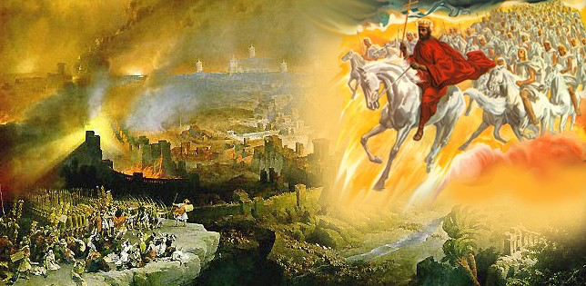
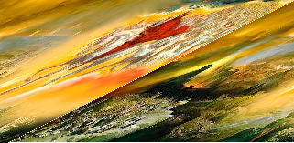
The Day of the Lord is the Tribulation!

Slide 25
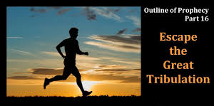
Jesus teaches us how to
Wake-up
Strengthen what Remains
Remember everything God has done for us
Repent
Overcome and Obey the Word

Slide 26
Remember Your Reward
for Waking Up and Watching
Jesus will make sure Your Name is written in the Lamb’s Book of LIfe
Not Blotted Out
Jesus will Confess Your Name
Before God and all the Angels
He will dress you in a white robe
And Welcome you to Live with Him
Forever

Slide 27
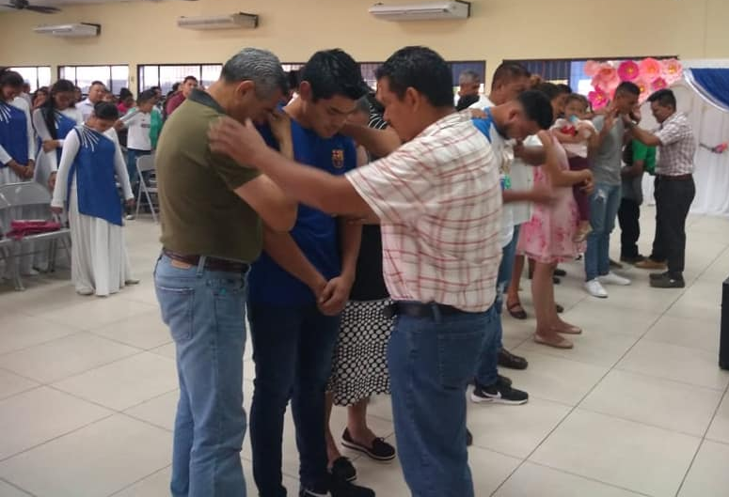
.
“Watch therefore, and pray always,
that you may be counted worthy to escape all these things that shall come to pass,
and to stand before the Son of man” Luke 21:36

Slide 28
Halleljuah, the Thief has No Power over US!
For We are Blood-Bought, Holy Ghost Filled, Covenant-Sealed,
Worshipping in Spirit and in Truth,
Lovers & Doers of the Word!

Slide 29
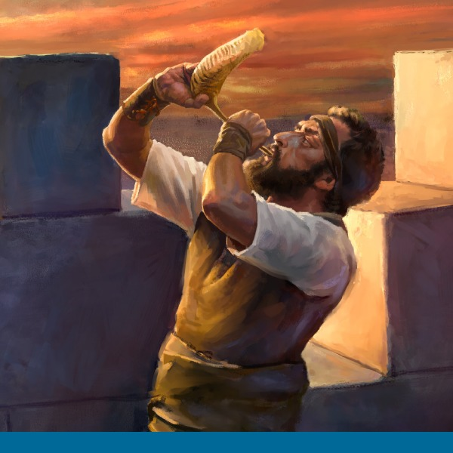
We are
Your
Mighty Watchmen
And We
Are Awake!

