Slide 1
Studying the End Times Searching for Treasure
UnRaveled – Revealing Truth About the End Times

Slide 2
Bible Prophecy is the Absolute Proof of God’s Love
Only He Can Tell the Future
God Always Keeps His Promises!
The Book of Revelation is the Book of Blessing
Each Chapter Unravels God’s Plan
Jesus is Coming Again
He wants His Precious Church to know the Future
Not to Scare Us/ To Prepare Us
Warning to Church: Strong Preaching – Strong Repentance
Comfortable Preaching - Comfortable Sin
Enjoy the Service – Enjoy the World
The Spirit of God is preparing us for the Coming King

Slide 3
Revelation – The Simple Version
Ch 1 The Vision and the Believers’ Blessing
Ch 2- 3 7 Love Letters to The 7 Churches
Ch 4-5 Come Up, God’s Throne Room
Ch 6-19 The Tribulation, Anti-Christ, Armageddon
Jesus Comes on a White Horse to Rule
Ch 20 Great White Throne Judgment, Millennial Reign
Ch 21-21 New Heavens, New Earth, New Jerusalem
Eternity - Back to Genesis and the Garden
God’s Perfect Plan

Slide 4
God’s Heart is For People - Harvest Time - Souls
The Book of Revelation – 4 People Groups
The Church - Rapture Pre-Trib - Blessing
The Jews - Tribulation before Salvation
The Tribulation Saints - Tribulation
The Wicked - Judgment & Lake of Fire

Slide 5
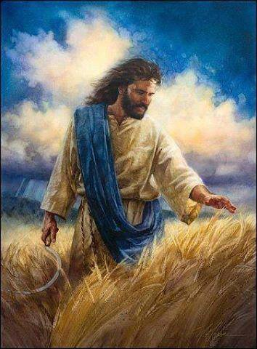
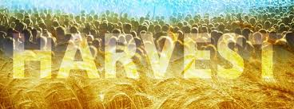
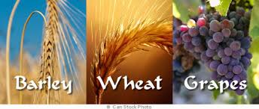
Israel Has 3 Main Harvests
Barley - Pre-Tribulation Rapture
Wheat - Mid-Tribulation Rapture
Grapes - End-Tribulation Rapture

Slide 6
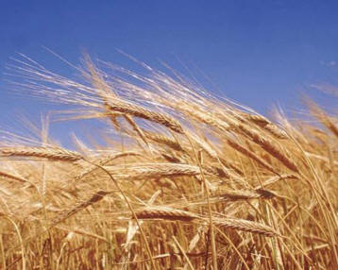
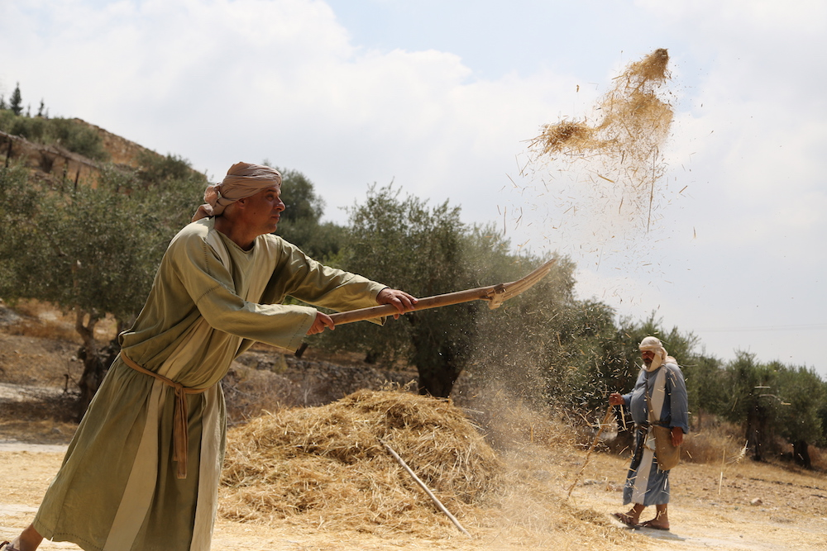
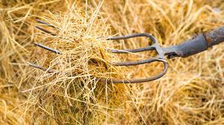
The Barley Harvest is First!
As is a Soft Grain, first cut with a Scythe then winnowed with a Fork. When it is thrown up in the air, the wind separates the grain from the chaff! Sounds like a Rapture of Believers

Slide 7
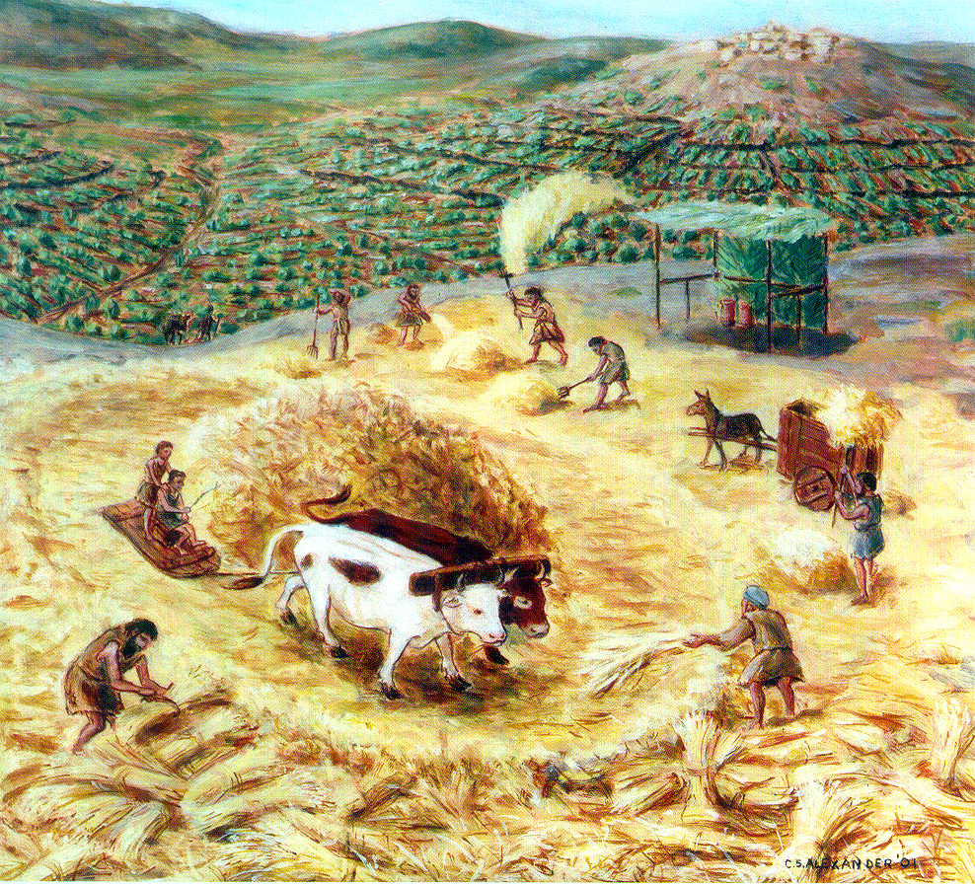
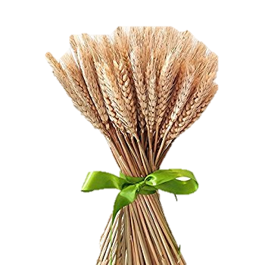
Israel’s Middle Wheat Harvest
Threshing with a Tribulum

Slide 8
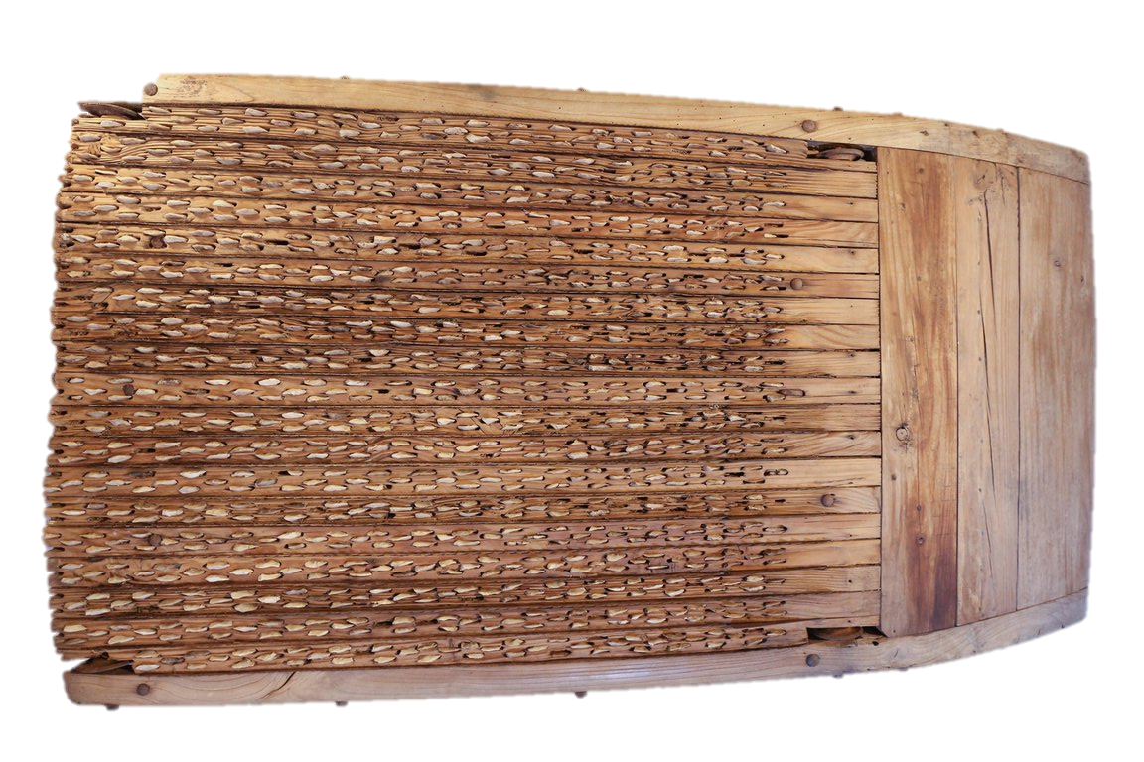
The steps for harvesting wheat are different than barley. Because it has a hard outer stalk that must be crushed to release the grain, it is laid on a threshing floor where a special sled with blades underneath is pulled over the wheat.
Then the grain is winnowed with a fork and the chaff is separated from the wheat. The grain is gathered into the barn and the chaff is burned in the fire. What a picture of the hard-hearted people who will go into the Tribulation!

Slide 9
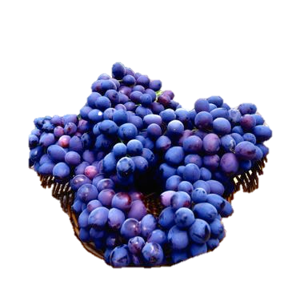
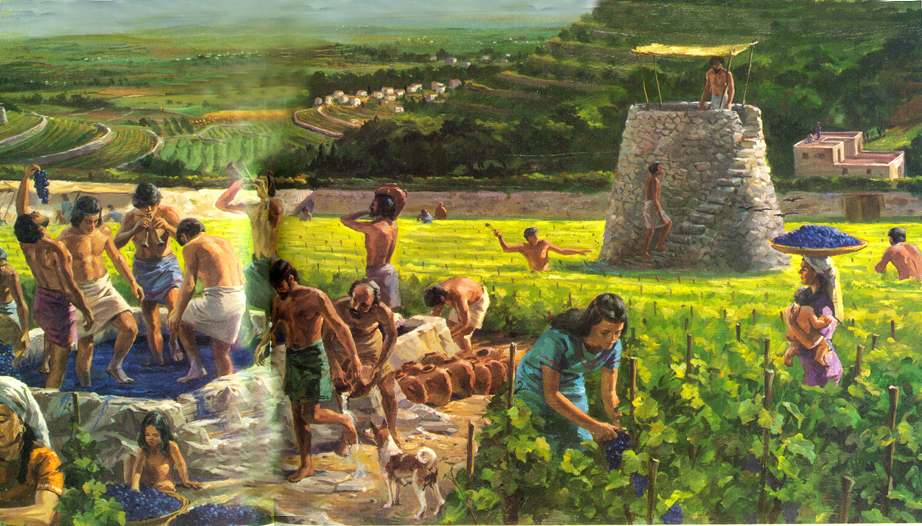
The grape Harvest is at the final harvest
Usually around Yom Kippur
The grapes are trampled in a wine vat until the blood runs out!

Slide 10
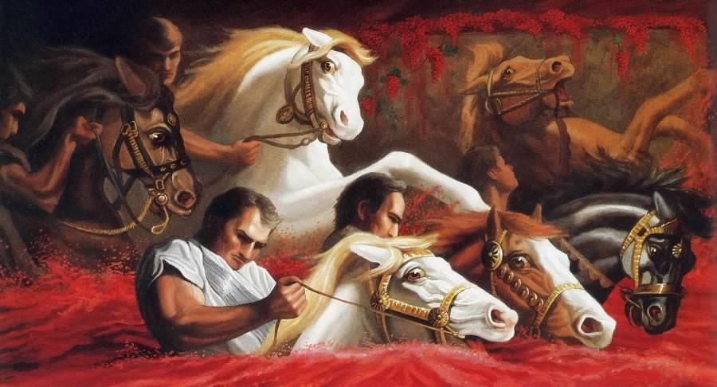
Rev. 14:19 “And the angel thrust in his sickle into the earth, and gathered the vine of the earth, and cast it into the great winepress of the wrath of God.
20. And the winepress was trodden without the City, and blood came out of the winepress even to the horses bridles….”

Slide 12
Part 1 - The Unraveled Series
God’s Focus on Jerusalem as a Super Sign
God Counts Time
If we want to learn about the End Times,
We need to go to the Beginning
Before Israel or Jerusalem existed,
God came to Abram with a Covenant of Blessing

Slide 13
.d
God promised Abram in Gen 12:2-3
“I will make you a great nation, I will bless you and make your name great: and you shall be a blessing. I will bless those that bless you and curse those that curse you: in you shall all the families of the earth be blessed.”
God Keeps His Promises!
The World’s 3 Greatest Blessings come from the Jews
Our Savior - Jesus is Jewish
Our Bible - Jewish authors inspired by Holy Spirit
3. The Church – started with all Jewish Believers -Pentecost
A Jewish King will One Day Rule the whole Earth!

Slide 14
.
The more we read the Old Testament, we learn of Israel’s sad history
He Blessed them…… they left Him for other gods
They cried Out in trouble…… He Rescued them
over and over again,
They rejected His Word….. would not hear His prophets
Ultimately they rejected Jesus as Messiah of Israel - 1st Coming
God scattered them to the 4 corners of the earth
For 2000 years they were persecuted wherever they lived
Without a Homeland, without a Temple and Priests,
without a Future and without hope,
But God gave them promises of Restoration & Return
Hosea 5:15-6:3

Slide 15
Prophetic Time:
When will these Prophesies Happen?
Hosea 5:15-6:3 2 Prophetic Days
5:15 “I will go and return to My place, until they acknowledge their offence and seek My face: in their affliction, they will seek me early.
6:1 “Come and let us return to the Lord, for He has torn and He will heal us; He has smitten and He will bind us up.
6:2 “After 2 days He will revive us: in the 3rd Day He will raise us up, and we shall live in His sight.”
6:3 Then we shall know, if we follow on to know the Lord: His going forth is prepared as the morning; (Jesus 1st and 2nd Coming) and He shall come to us as the rain,
As the former and the latter rain on the earth.”

Slide 16
2 Peter 3:8
“But, Beloved, do not be ignorant of this one thing, that One Day with the Lord is as 1000 years, And 1000 years as one day.”
Psalm 90:4
“For 1000 years in Your sight are but as yesterday when it is past,
and as a watch in the night.”

Slide 17
Prophetic Time
in
Joel Chapter 3
1. “For Behold, in those days, and at that time, when I shall bring again (the 2nd time) the captivity of Judah and Jerusalem.”
2. I will gather all nations and will bring them down in the Valley of Jehoshaphat, and will plead with them there for My People and for My heritage Israel, whim they have scattered among the nations
And parted, divided My Land.
3. And they have cast lots for My people, and have given a boy for a harlot, and sold a girl for wine, that they might drink.
Joel’s Prophecy can’t be fulfilled until after 1948 and 1967
The Harlot drinking the wine is Mystery Babylon – Rev Ch. 17-18

Slide 18
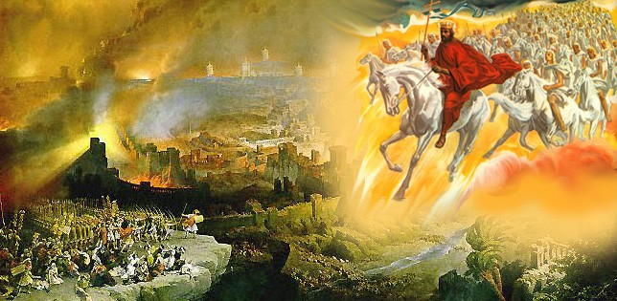
‘”Behold, I will make Jerusalem a cup of trembling to all the people round about, then they shall be in the siege both against Judah and against Jerusalem. And in that Day will I make Jerusalem a burdensome stone for all people; all that burden themselves with it shall be cut in pieces, though all the people of the earth be gathered against it. Zechariah 12:2-3

Slide 19
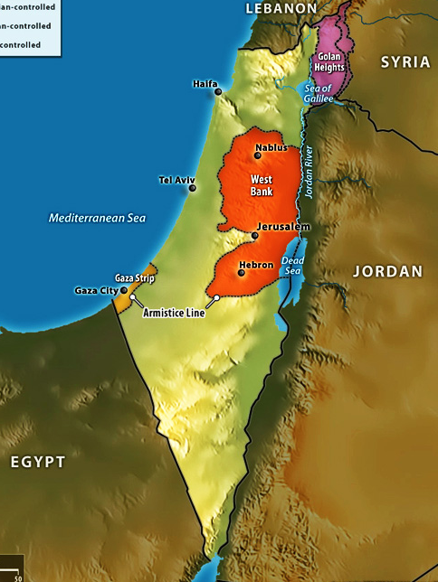
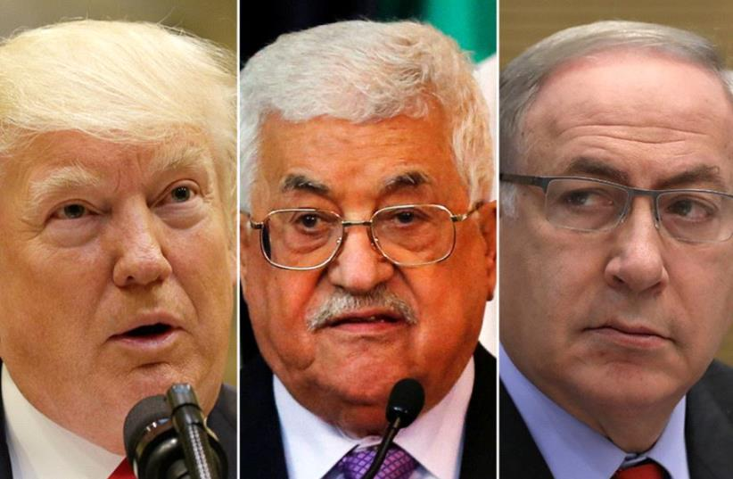
“The Deal of the Century” July 2020
“Parting My land
is the ongoing
‘Middle East
Peace Process’

Slide 20
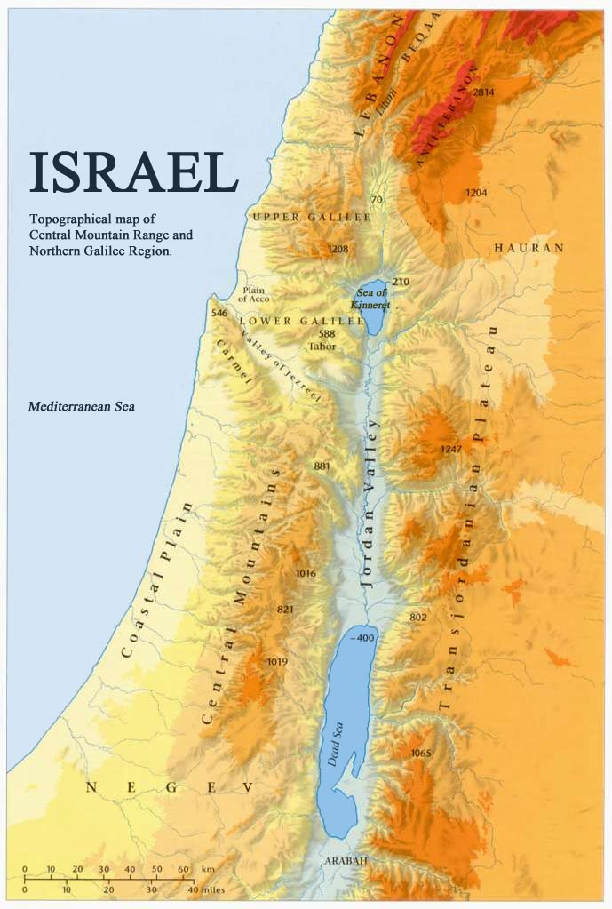
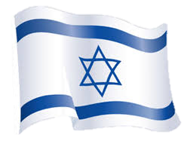
God has a Covenant with the Land
God has a Covenant with the People
But the Jews can’t enter Heaven without Jesus as their Messiah!
A Super Sign of the Times
The Modern State of Israel
The Return of the Jews
Battle over Jerusalem Now

Slide 21
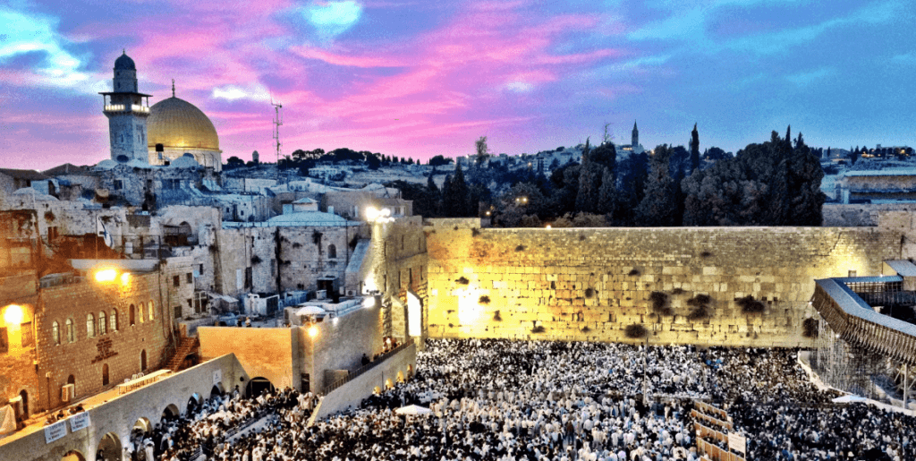
When is Jesus Coming Again
“When the Lord shall build up Zion,
He shall appear in His Glory” Ps 102:16
When is Jesus Coming Again?
“Zion” is Jerusalem

Slide 22
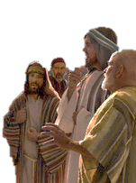
Matthew 24 – Jesus Prophesies A Coming Time. While teaching His disciples about the End Times, the Great Tribulation, and the Coming of the Son of Man, He says God will gather His elect with the sound of a great trumpet. If we learn the parable parable of the fig tree, we can see He is referring to the future re-birth of modern Israel with branches and leaves…1948
Jesus says“ This Generation will not pass away, until all these things be fulfilled” 24:32

Slide 23
Jerusalem is the Most
Mentioned City in the Bible
767 times
Jerusalem is Center of all the Nations
Ezekiel 5:5
Jerusalem is the Place Where God
Cut Covenants with His People

Slide 24
Jerusalem is the Place of Jesus’ Crucifixion
Jerusalem is the Place Jesus Ascended
When Jesus Returns, He will put His feet on the Mt. of Olives - Jerusalem
Your forever home will be in the New Jerusalem

Slide 25
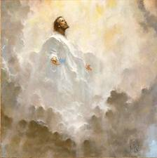
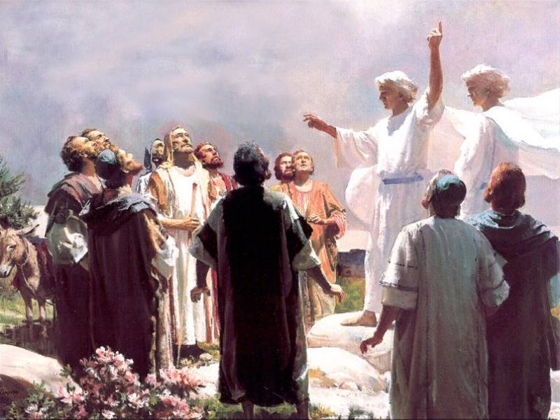
He Ascended from the Mt. of Olives
“And after He had spoken these things, while they beheld, He was taken up; and a cloud received Him out of their sight.
And while they looked steadfastly toward Heaven as He went up, behold 2 men stood by them in white apparel, which also said, You men of Galilee, why stand you gazing up to Heaven? Acts 1:9-12
This same Jesus, which is taken up from you to Heaven, shall so come in like manner as you have seen Him go into Heaven;
Then they returned to Jerusalem from the Mt. called Olivet, which is from Jerusalem a sabbath’s day journey.”

Slide 26
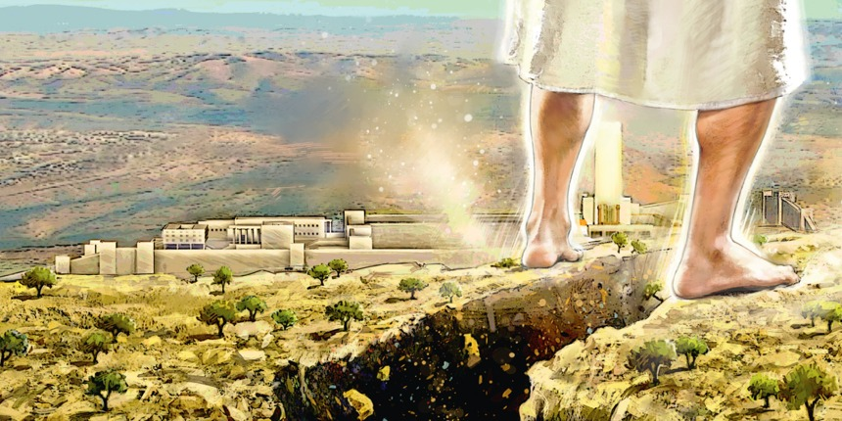
And He’s Coming Back to Jerusalem - the Mount of Olives!
Zechariah 14: 3-4
“Then shall the Lord go forth and fight against those nations, as when He fought in the Day of battle. And His feet shall stand on the Mt. of Olives, which is before Jerusalem on the east, and the Mt. of Olives shall cleave in the midst thereof.”

Slide 27
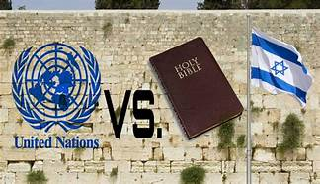
God warns us the Nations Will be Angry
When the Jews are back in their Land
When They come against Israel,
God will pour out His Anger on them

Slide 28
“ Why do the heathen rage,
And the people imagine a vain thing? The Kings of the earth set themselves
And the rulers take counsel together
Against the Lord and His Anointed, saying
‘Let us break their bands asunder
And cast away their cords from us
He that sits in the Heavens shall laugh:
The Lord shall have them in derision
Then shall He speak to them in His wrath,
And vex them in His sore displeasure
Psalm 2

Slide 29
Psalm 2
“Yet have I set My King upon My Holy hill of Zion
I will declare the decree: the Lord has said to Me,
You are My Son; This day have I begotten You.
Ask Me and I will give You the heathen for Your inheritance,
and the uttermost parts of the earth for Your possession”
“Kiss the Son, lest He be angry
And you perish from the way,
When His Wrath is kindled but a little Blessed are all They that put their trust in Him.”

Slide 30
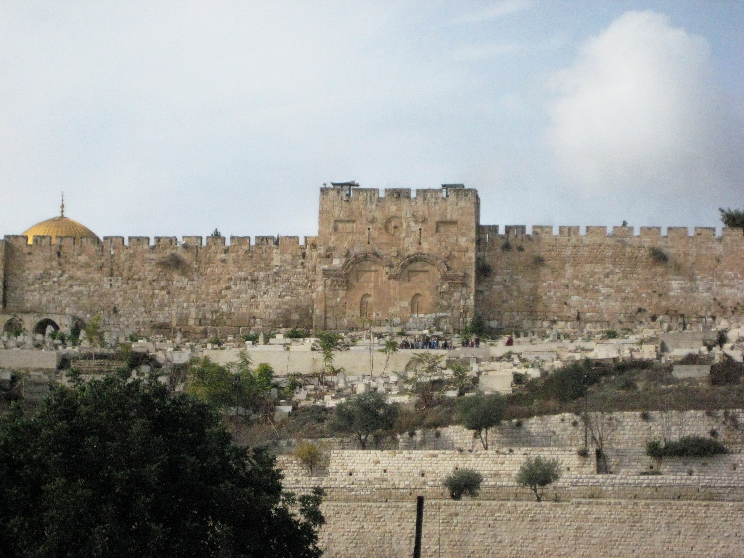
Jesus is Coming Back to Jerusalem
To Defeat God’s Enemies
And To Rescue His Brethren…The Jews
They Will Receive Jesus as Messiah
The Church will not be fighting this battle

Slide 31
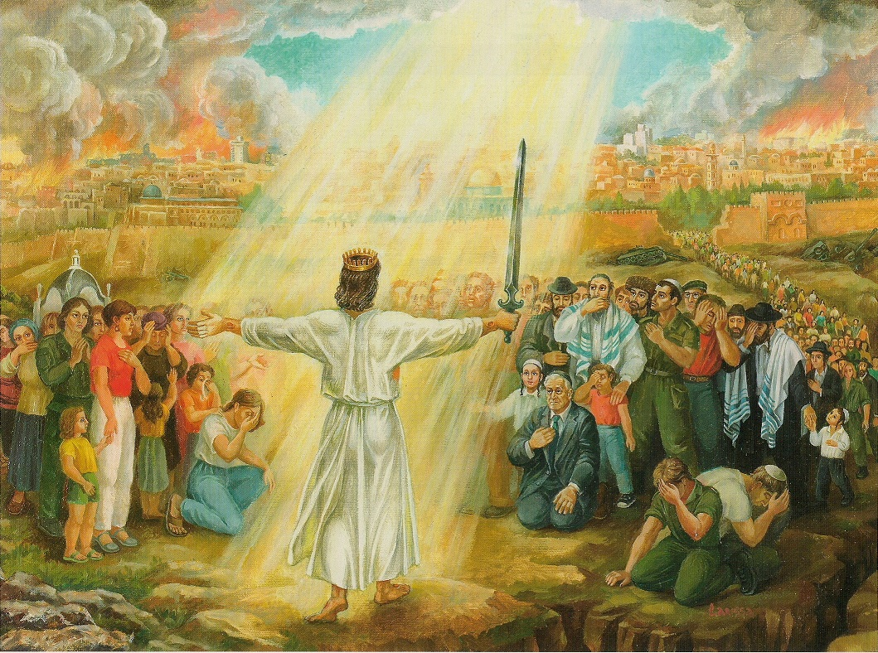
“And I will pour out on the House of David and upon the inhabitants of Jerusalem, the Spirit of Grace and of supplications and they shall look on
Me whom they have pierced, and they shall mourn for Him as one mourns
for their only son, one that is in bitterness for his firstborn” Zechariah.12:10

Slide 32
Revelation 19:11-13
“And I saw heaven opened and behold a white horse, and He that sat upon him was called Faithful and True, and in righteousness He does judge and make war.
His eyes are a flame of fire, and on His head are many crowns, that no man knew, but He himself.
And He was clothed in a vesture dipped in blood, and His Name is the Word of God.

Slide 33
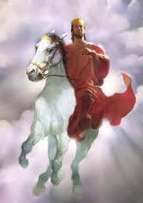
Isaiah 63:1-6
Who is this who comes from Edom, with dyed garments from Bozrah?
Who is glorious in His apparel, travelling in the greatness of His strength?
I that speak in righteousness, mighty to save.
Why are You red in your apparel & your garments,
like him that treads in the winefat?
“I have trodden the winepress alone; & of the people
there was none with Me: for I will treat them in My
anger & trample them in My fury; & their blood shall
be upon My garments, & I will stain all My raiment.
“For the Day of Vengeance is in My heart, & the year of My redeemed is come. And I looked & there was none to help; & I wondered that there was none to uphold; therefor My own right arm brought salvation to Me; and My fury, it upheld me.
And I will tread down the people in My anger & make them drunk in My fury; and I will bring their strength down to the earth.”

Slide 34
Isaiah 34:1 “Come near, you nations, to hear: and listen people, Let the earth hear and all that is therein, the world and all things that come forth of it.
2.For the Indignation of the Lord id upon all nations, and His fury is upon all their armies; He has utterly destroyed them, He has delivered them to slaughter.
4. And all the host of heaven shall be dissolved, and the heavens shall be rolled together as a scroll: and all their host shall fall down, as a leaf falls off from the vine, and as a falling fig from the fig tree. Rev 6 :13 – The 6th Seal
5. For My sword shall be bathed in heaven. Behold is shall come down upon Edom, upon the people of My curse, to judgment..
8. For it is the Day of the Lord/s vengeance and the year of recompense for the controversy over Zion.”

Slide 35
Huge Good News
for the Believer & for The Church
The Tribulation is designed by God
to bring Israel to The Messiah
They will be saved and receive Him when He Comes
The Tribulation is NOT for the Church –
Unless you are Lukewarm
Laodecian
Living like the World
Spiritually Asleep
It’s High Time to Awake from sleep! Romans 13:11

Slide 36
Church Family
The Teaching of Bible Prophecy makes us Understand
How Precious our Salvation in Jesus Is
If You got saved last week
Of You have known God for 50 years
It is the Same Truth,
He is Our Savior, Our Healer, Our Provider
Our Protector
And He is also Our Deliverer

Slide 37
1 Thessalonians 5:9

Slide 38
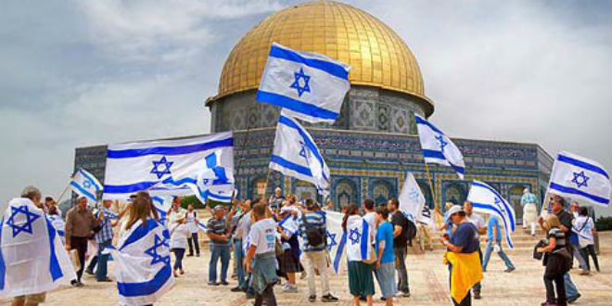
Modern Day Miracles in Jerusalem!
The Return of the JewsTo Israel from over 140 Nations!
“I will gather my outcasts from the 4 corners of the Earth” Isaiah 11:12

Slide 39
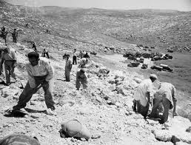
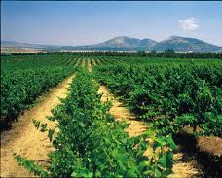
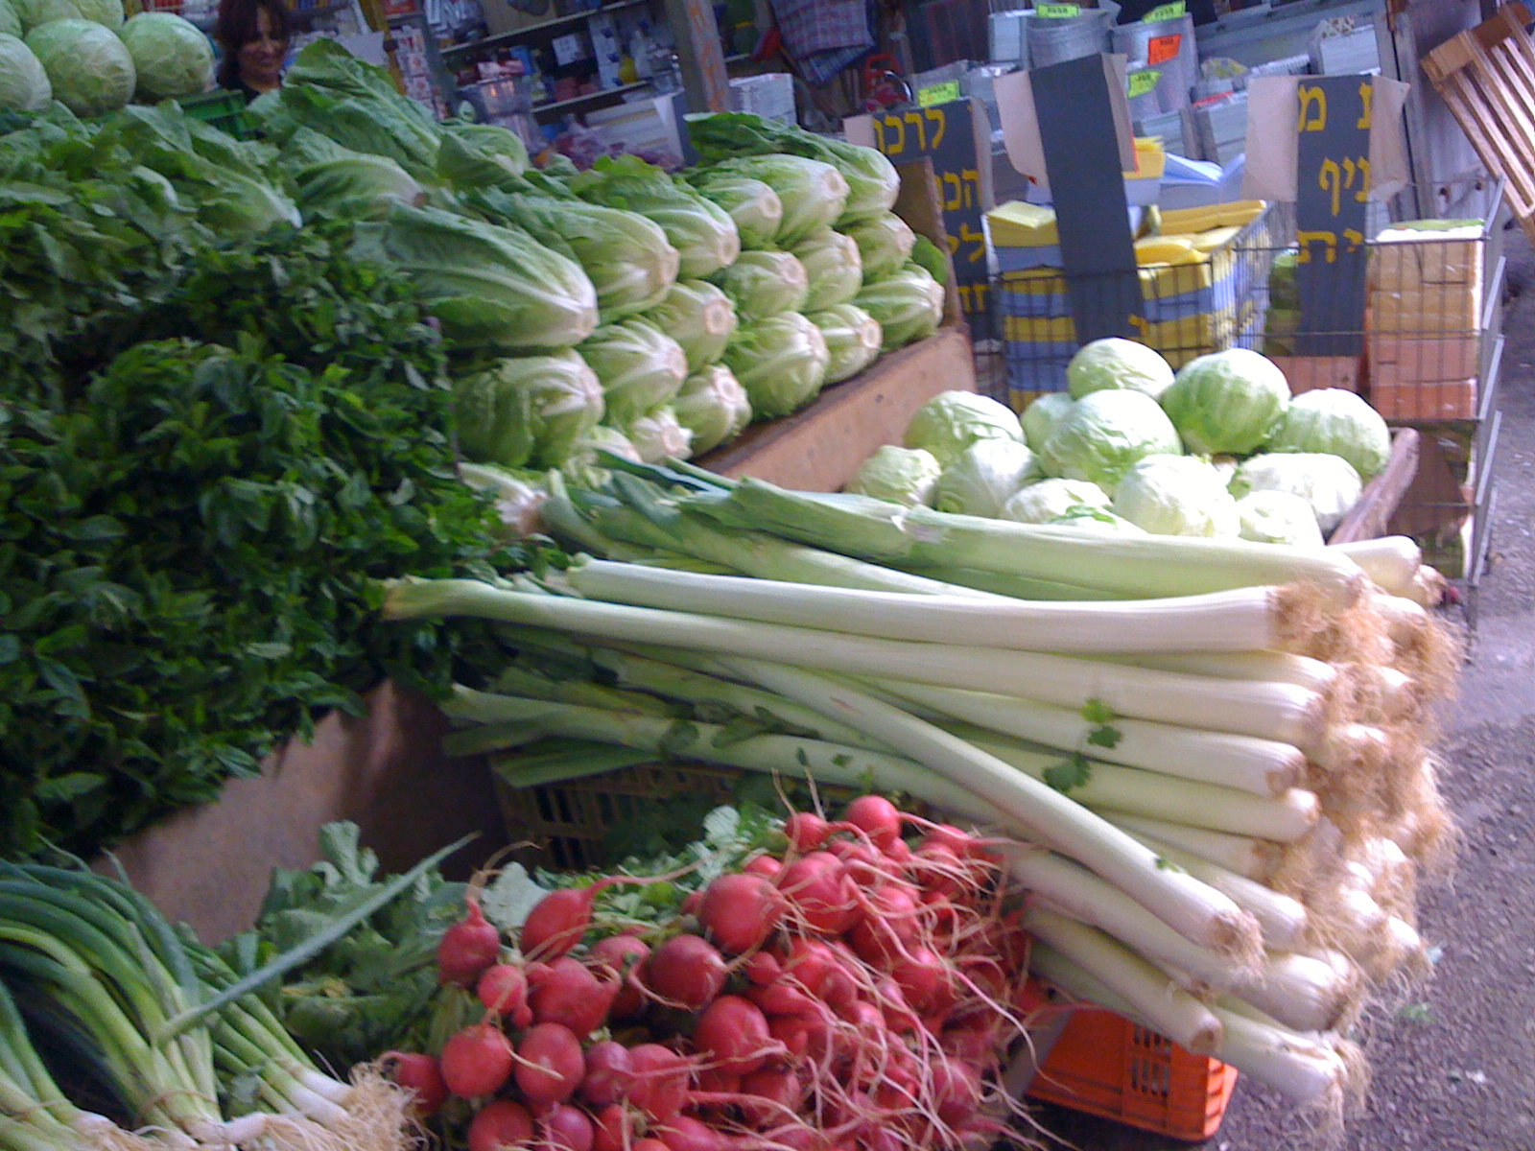
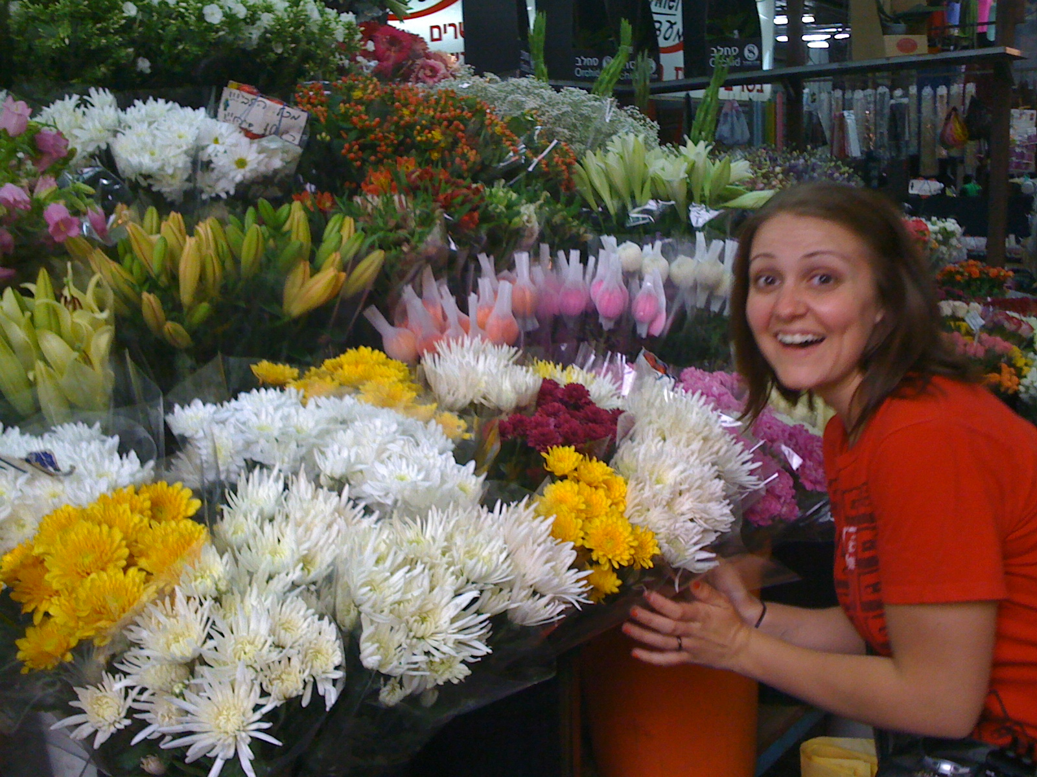
“And I will bring again the captivity of My people Israel, & they shall build the waste cities & inhabit them; & they shall plant vineyards & drink the wine; they shall also make gardens & eat the fruit of them.” Amos 9:14-15
“I will plant them upon their land and they shall no more be pulled up out of their land I have given them.”

Slide 40
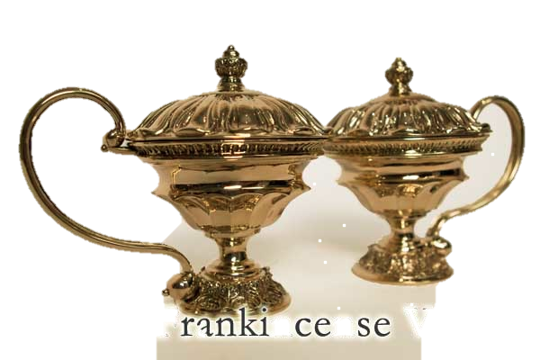
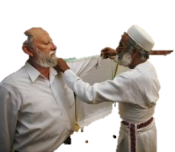
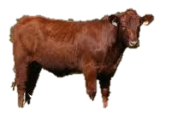
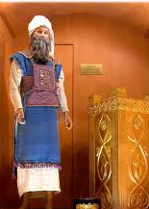
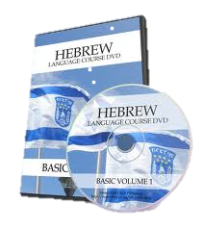
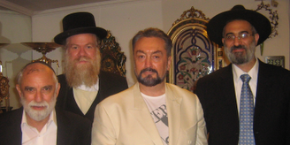
Levite’s Garments Recreated!
Red Heifer for
Temple Purification
Holy Temple Vessels
“The Restitution of All Things”
Acts 3:21
High Priest’s Crown, Robes, & Ephod
Sanhedren Re-established
Hebrew Language

Slide 41
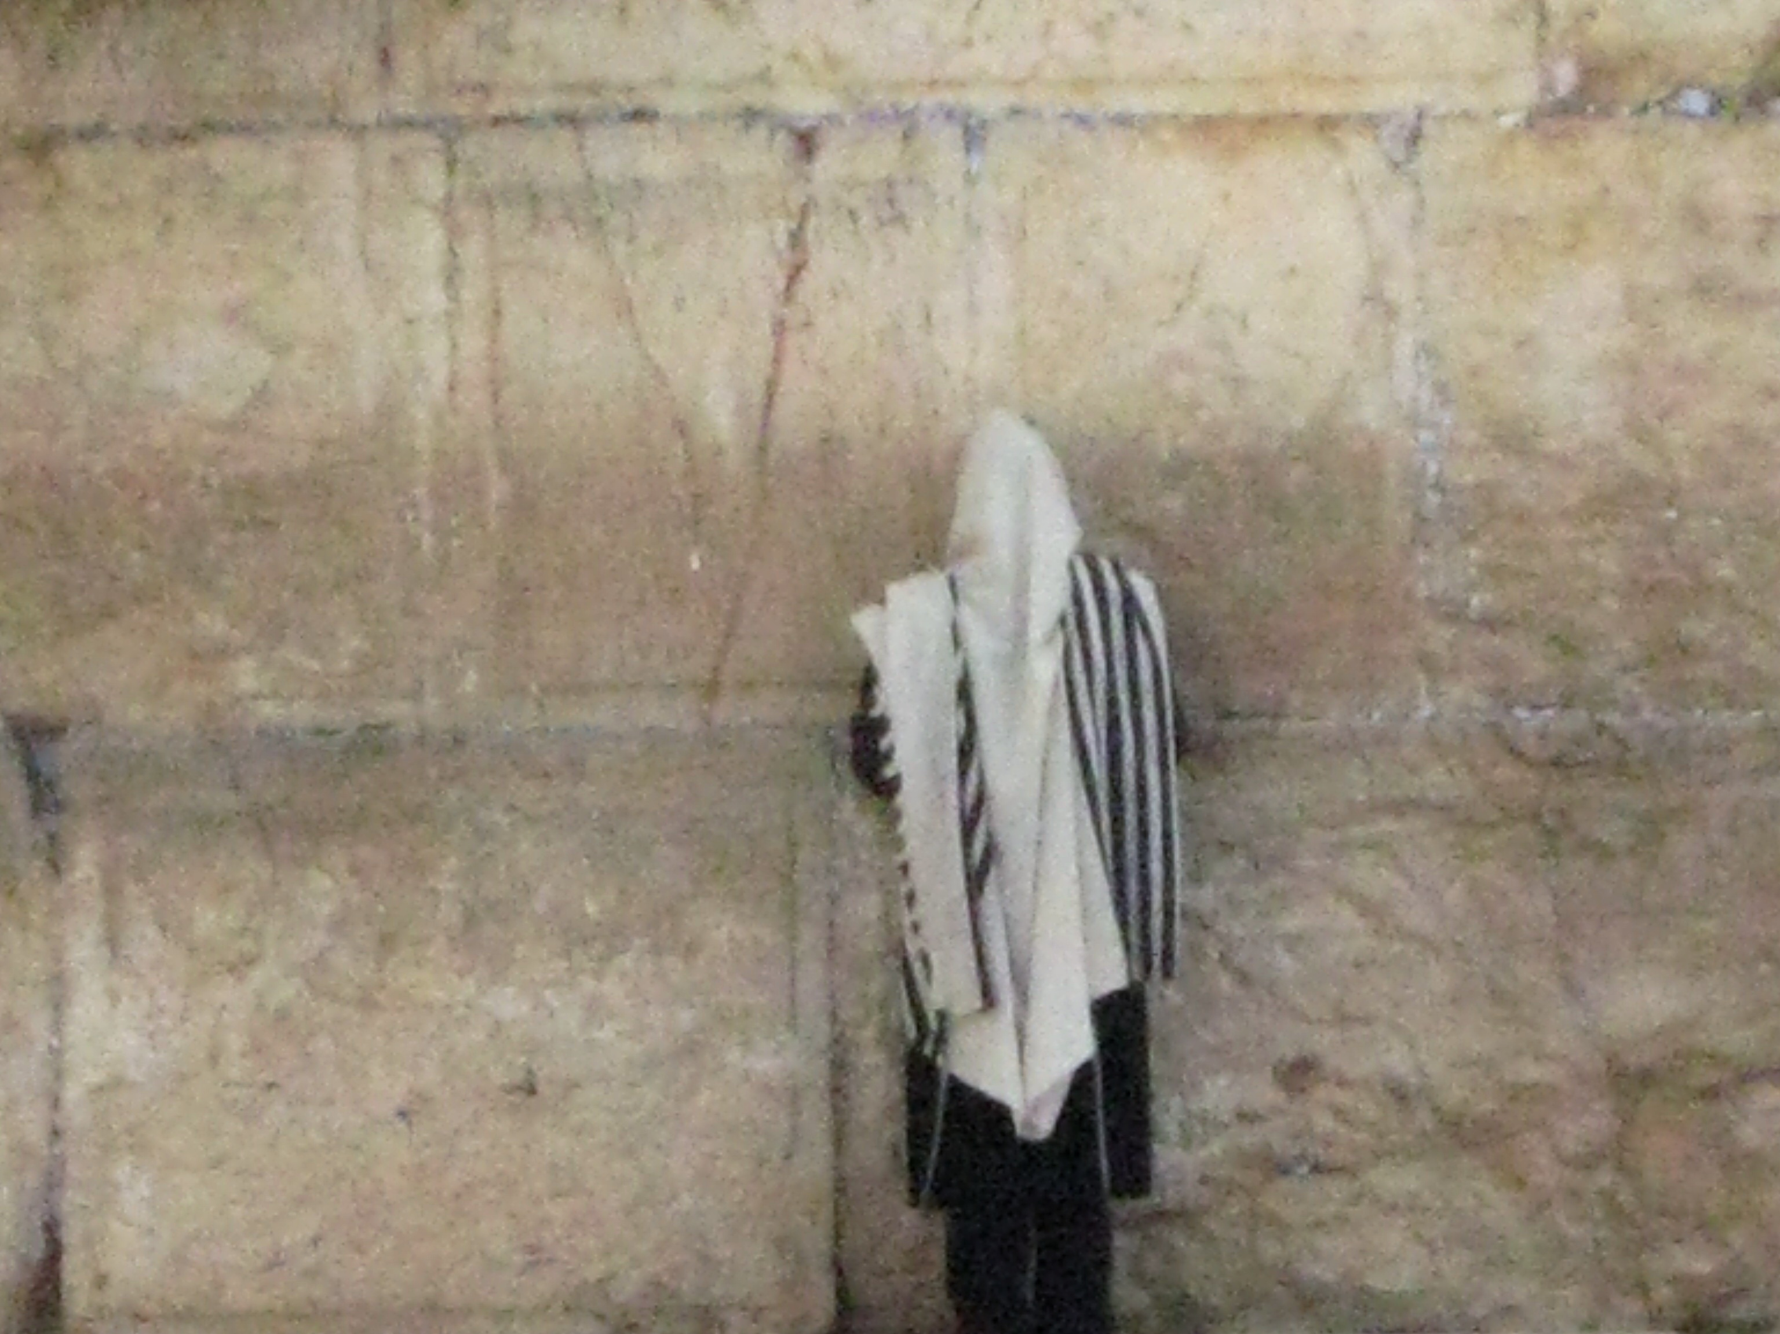
Israel is getting ready for the Messiah
They have an appointed Day for Salvation – The Day of the Lord
Jesus said to them, “ You will not see Me again, until you say Blessed is He who comes in the Name of the Lord.” Matt 23:39
Today is the Day of Salvation
Are You Ready!

