Slide 1
“The Great Separation”

Slide 2
In the Beginning……..
God’s Creation Brings Perfect Order
The Spirit of God moved
God spoke
God’s Order…. Separates all the Void and Emptiness
Light ….. Separated from Darkness
Waters above…. separated from waters below
Sun, Moon & stars…. separated light from darkness
Adam & Eve separated….. fom animals in creation
Work separated from Rest ….the Sabbath

Slide 3
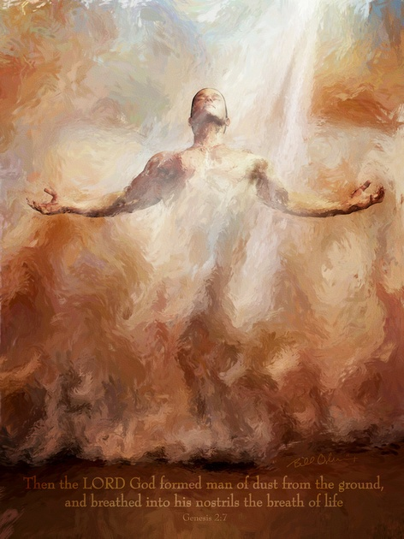
God separated man from the dust and breathed His Spirit into Adam
Adam was clothed in
the supernatural light of His Presence.
Adam was then
separated out from all the animals, birds and fish
by God
and given dominion to take care of God’s creation
the earth!

Slide 4
There were many trees in the Garden -only 2 were separated out by God..
“The Lord God commanded the man, of every tree of the garden you may freely eat; but the tree of the knowledge of good and evil, you shall NOT
eat ot it, for the day you eat of it, you shall surely die.” Genesis 2:16-17

Slide 5
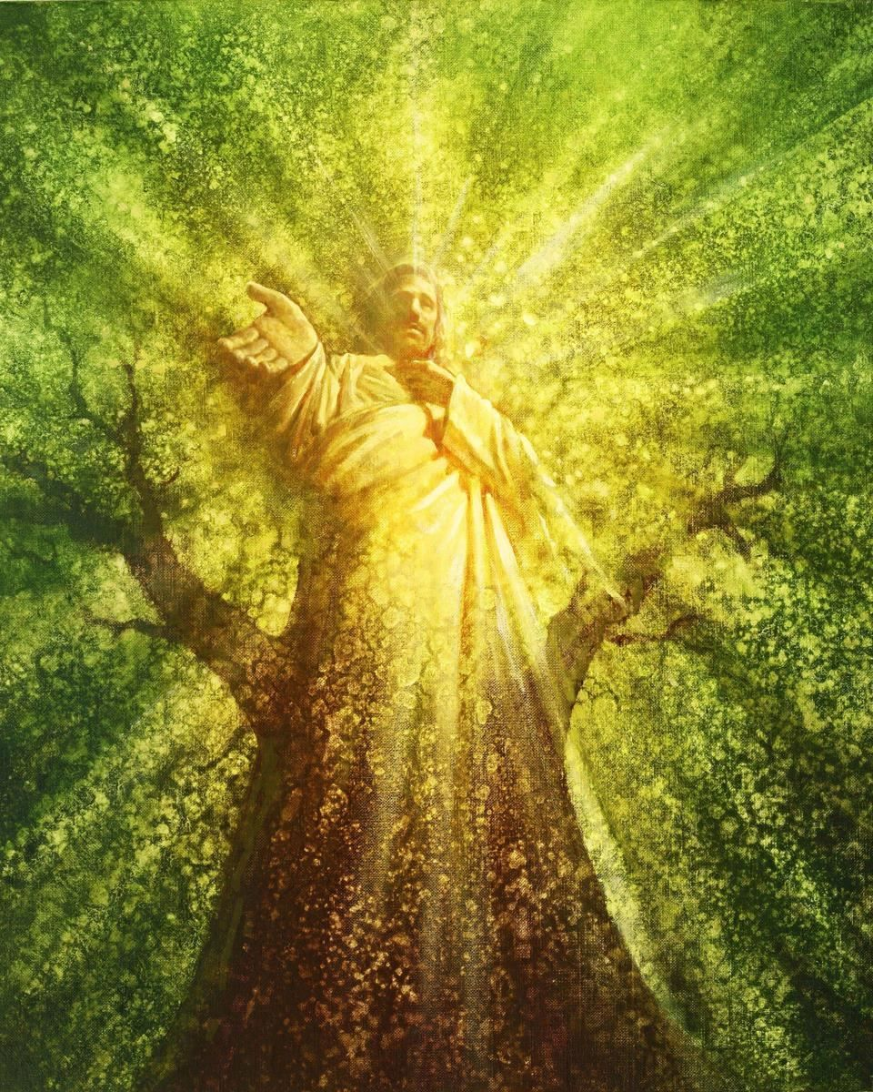
JESUS is
the Tree of Eternal Life
“therefore the Lord God sent him forth from the garden of Eden; to til the ground from whence he was taken. So He drove out the man, and He placed chreubim at the east of the Garden of Eden, and a flaming sword which turned every way, and to keep the Tree of Life.” Gen 3:23-24
After Sin enters the world through Adam and Eve, God separates them from the Garden and
from the Tree of Life
Now they are also separated from the Presence of God

Slide 6
From the Beginning, we were created to be in God’s Presence

Slide 7
God separated a rib from Adam
to create Eve

Slide 8
Separation involves Leaving before you can cleave – Becoming One
like Jesus & The Church
“Therefor shall a man leave (separate) his father and mother, and shall cleave unto his wife, and they shall be ONE flesh”
Genesis 2:23

Slide 9
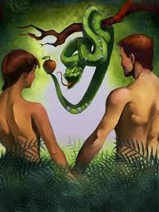
“Because of sin,
God separated
Adam and Eve out
of His perfect Creation
“Therefore the Lord God sent him forth from the Garden of Eden,
to till the ground from
whence he was taken.”
Therefore He drove
Out the man…..
Genesis 3:22-23

Slide 10
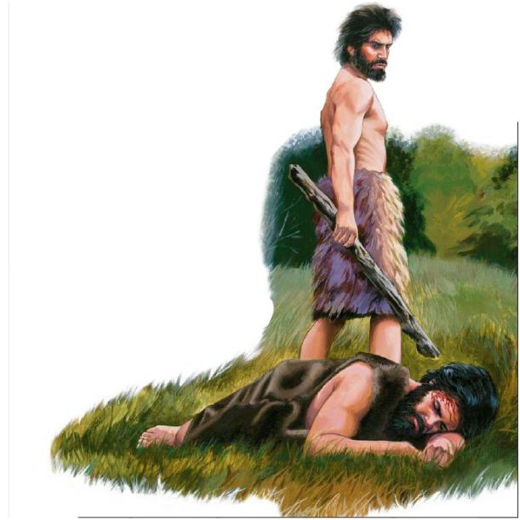
Adam and Eve had 2 sons, Cain and Abel
Abel brought the right offering
But God did not accept Cain’s offering
So Cain killed his brother in anger
And then lied to God about Abel’s murder
God separated Cain
from the Garden
and from His presence –
Genesis Chapter 4
Again God removed the sinner

Slide 11
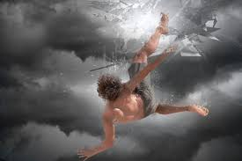
God had already separated Lucifer out of Heaven –
Sin & Rebellion are removed from God’s Presence Ezekiel 28:18
Jesus said, “I saw Satan fall like lightning”……Luke 10:18

Slide 12
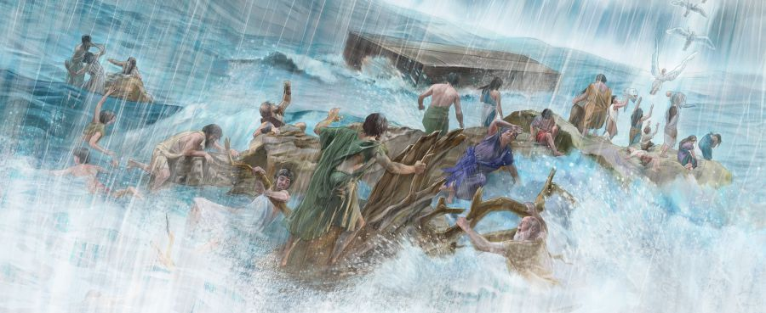
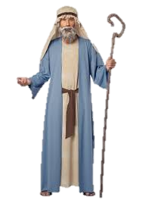
God saw that the wickedness of men was great in the earth,
and that every imagination of the thoughts of his heart was to do evil continuously…it repented the Lord that He had made man
and it grieved Him in His heart.” Genesis 6:5-6
God separated out one righteous man & his family - Noah

Slide 13
God’s Holiness and Righteousness
causes Separation
At first God separates the Unrighteous
from the Righteous For Judgment
The Flood
Sodom & Gomorrah
The 10 Plagues
But God also separates the Righteous
from the Unrighteous Before Judgment
Enoch
Noah
Lot
Abram
Moses

Slide 14
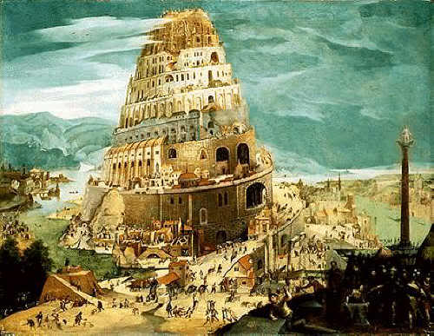
“Now nothing will be restrained from them,
Let us go down and confuse their language
So the Lord scattered them…” Genesis 10
God separated their
Languages!

Slide 15
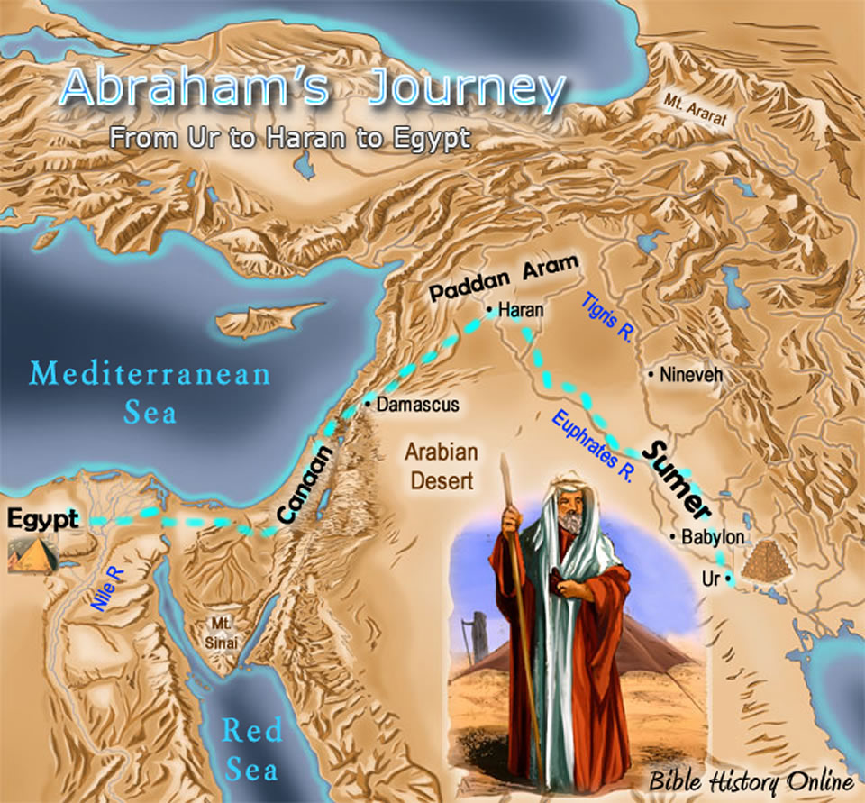
“God told Abram “Get out of your country and from your kin, and from your father’s house, to a Land I will show you.”
And I will make you a great nation, and I will bless you and make your name great, and you shall be a blessing
I will bless those that bless you and curse those that curse you & in you shall all the families of the earth be blessed.” Gen 12:1-3

Slide 16
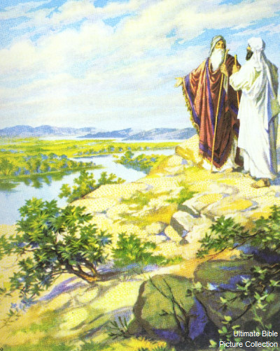
Abram is separated from Lot –
Genesis 13:14-15
“And the Lord said to Abram, after Lot was separated to him, Lift up now your eyes, and look toward the place where you are, north, south, east and west.
For the Land which you see, I will give it to you and to your seed forever.”

Slide 17
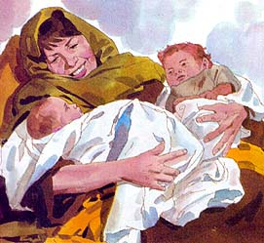
Genesis 25:21-27 Esau & Jacob
‘And Isaac entreated the Lord for his wife
because she was barren:
the Lord was entreated of him.
Rebekah his wife conceived and the children
struggled together within her;
and she said, If it be so, why am I thus?
And she went to enquire of the Lord.
And the Lord said to her,
2 nations are in your womb,
and 2 manner of people shall be separated from your bowels;
and the one people shall be stronger than the other people;
and the elder shall serve the younger.
And when her days to be delivered were fulfilled,
behold, there were twins in her womb.
And the first came out red, all over like an hairy garment;
and they called his name Esau.
And after that came his brother out and his hand took hold on Esau's heel;
and his name was called Jacob:
Isaac was 60 years old when she bare them. “
.

Slide 18
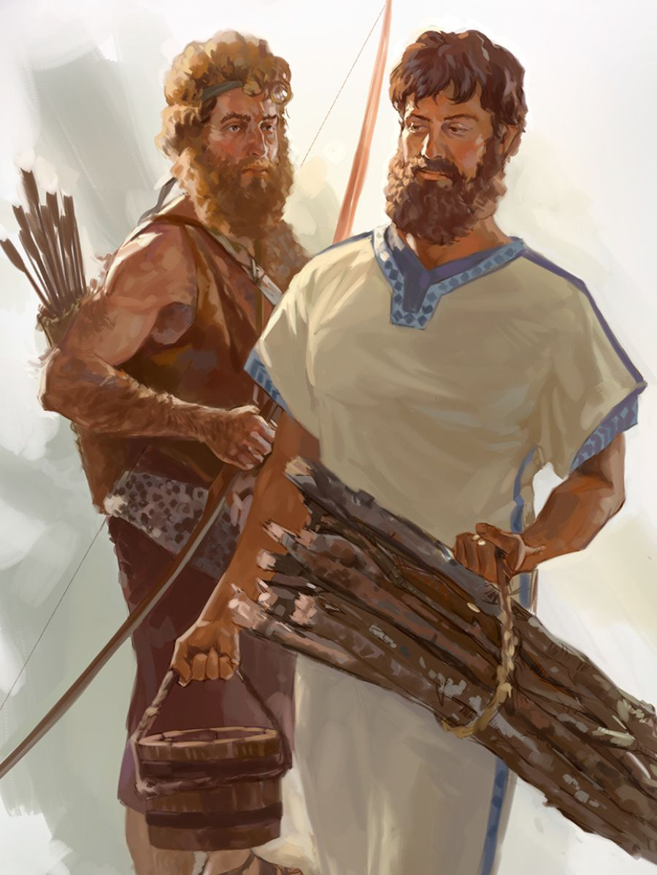
And the boys grew:
and Esau was a cunning hunter, a man of the field;
and Jacob was a plain man dwelling in tents.
“And Isaac loved Esau, because he ate his venison:
but Rebekah loved Jacob.”

Slide 19
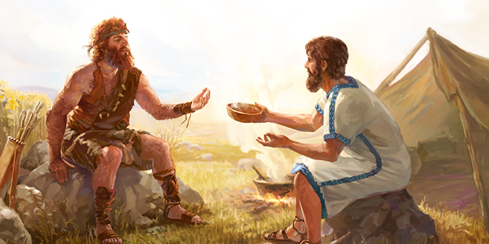
“And Jacob cooked pottage: Esau came from the field, and he was faint:
Esau said to Jacob, Feed me, I pray, with that same red pottage; for I am faint: therefore was his name called Edom. Jacob said, Sell me this day your birthright. And Esau said, Behold, I am at the point to die: what shall this birthright profit me?
And Jacob said, Swear to me this day; so Esau swore to Jacob:
and he sold his birthright to Jacob. Then Jacob gave Esau bread and stew of lentils; Esau ate and drank, rose up and went his way: thus Esau despised his birthright”

Slide 20
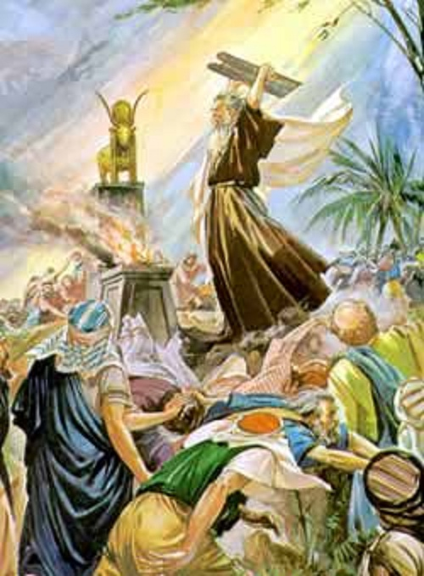
After Moses’s anger at the Golden Calf worship,
Moses separated
the righteous Levites from the rebellious party group
Death came to 3000
Even to their brothers, their neighbors, and their friends
Genesis Chapter 32

Slide 21
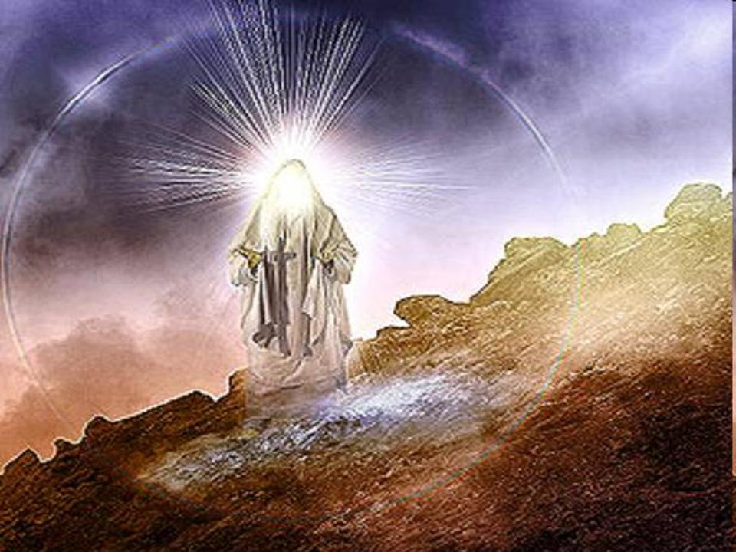
God said, My Presence shall go with you.” And Moses said, If Your Presence does not go with me, do not carry us up . For how shall it be known here that I and Your people have found grace in Your sight. Is it not that You go with us? So shall we be separated,
I and Your People, from all the people on the face of the earth.” Exodus 33:`15-16

Slide 22
The Secret to Joy and Victory - Re United with Him in His Presence

Slide 23
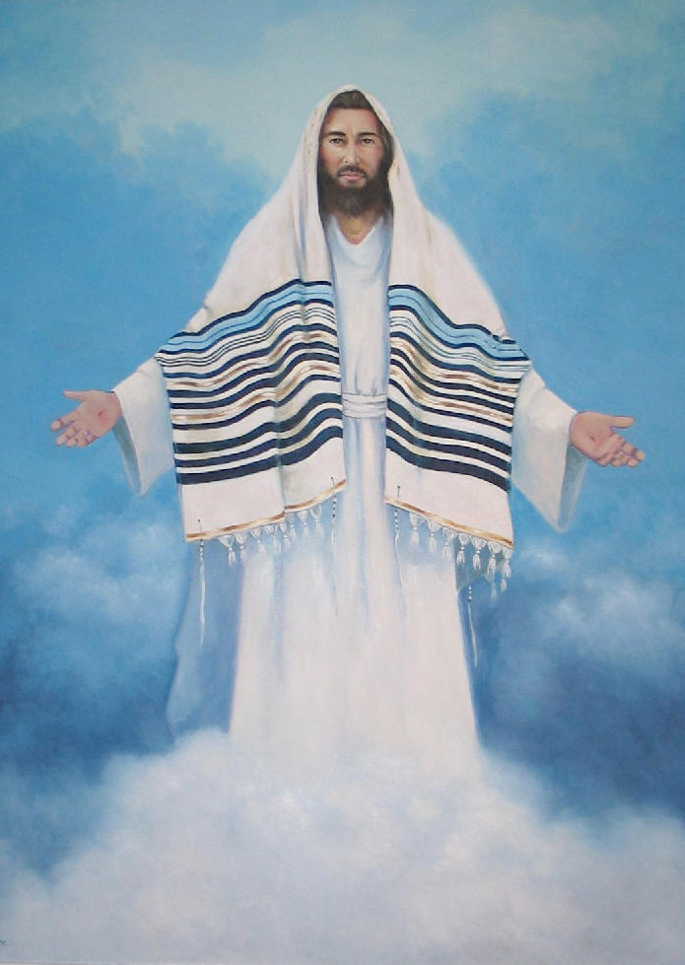
Only the Blood of Jesus
Separates Us from our Sin
Until true Separation takes place,
Real Sanctification won’t take place

Slide 24
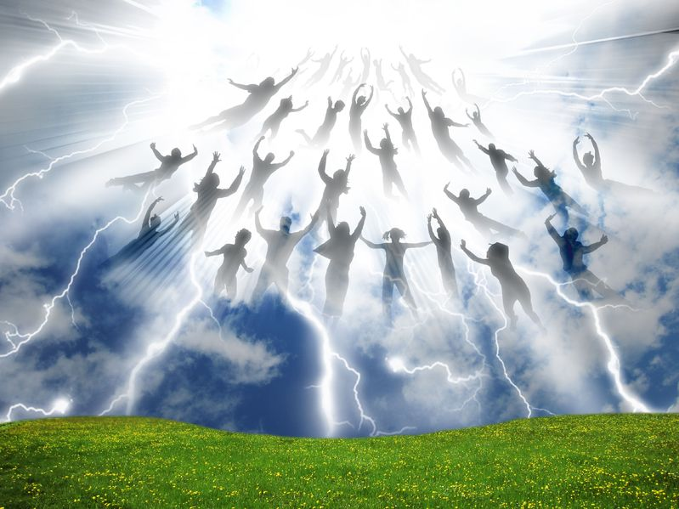
The Greatest Separation is Yet to Come
1 Corinthians 15:50-54 1 Thess 4:13-18

Slide 25
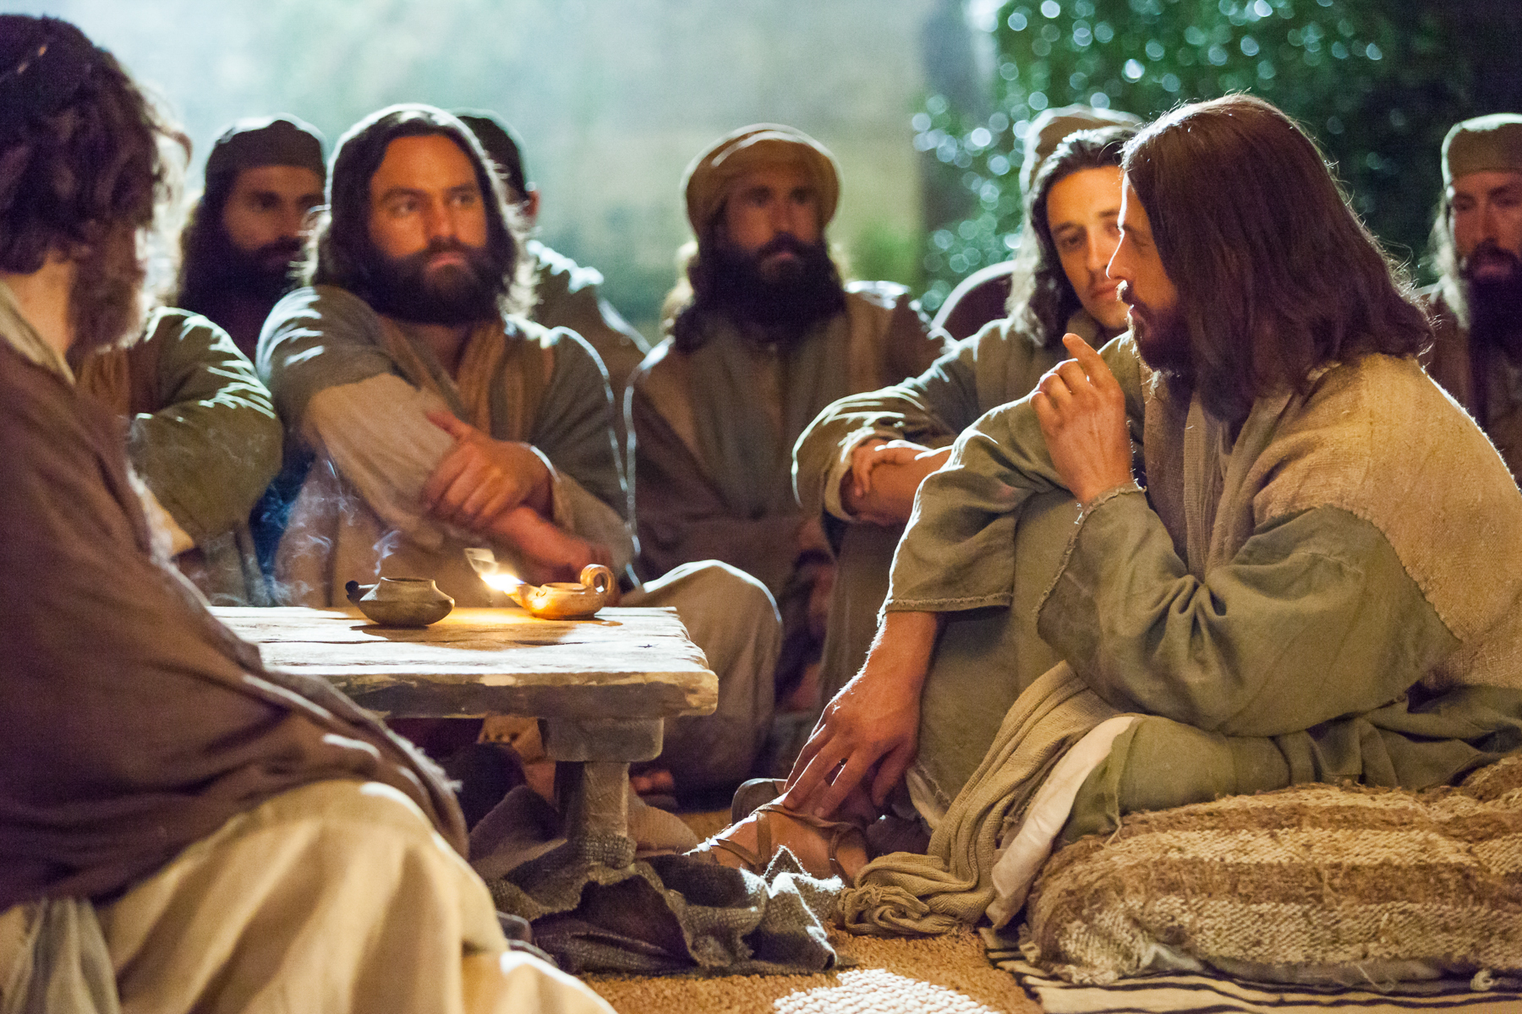
The Coming Separation - Jesus explains 3 Parables

Slide 26
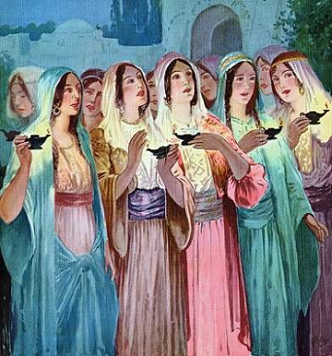
Parable of the 10 Virgins
Matthew 25
All Virgins
All Asleep
Wise or Foolish
Oil in Lamps
Bridegroom Comes
Door Shut
Enter In,
or
Depart from Me!

Slide 27
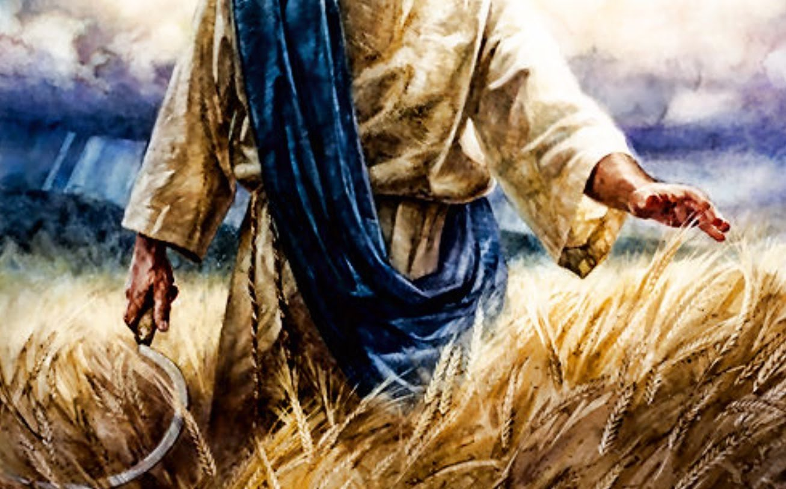
The Wheat and the Tares - Matthew 13:24-30

Slide 28
Separation of Sheep from the Goats – Matthew 25:31-46
Judged on How You treat Jesus’ Brethren …The Church?... Or the Jews?

Slide 29
