Slide 1
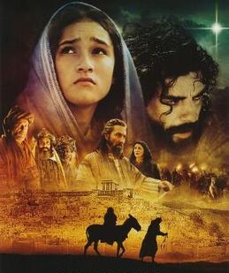
The Greatest Miracle
in the Whole World
Is “The Incarnation”
When God Takes on Flesh
Jesus was Born as a Man
Yet Still Fully God
The Christmas Story
Starts with a Virgin
Who Conceives a Child

Slide 2
“Therefore the Lord himself shall give you a sign;
Behold a virgin shall conceive and bear a son, and shall call His name Immanuel.”
Isaiah 7:14
“Immanuel” – God With Us

Slide 3
The Miracle of the Virgin Birth
The Virgin Birth shows us that our Redeemer is fully God, and fully a man—yet without sin. Jesus was born supernaturally not by an earthly father,
but of a heavenly Father. Conceived uniquely in a woman by the power of the Holy Spirit, Jesus is forever guarded from original sin. If Jesus was born of natural parents, He would have inherited a sin nature from Adam. He could not be the sinless Savior of all mankind. The Virgin Birth is the supernatural means of the Incarnation, when God became flesh and lived among us.
Jesus is not only a man, but He is the divine Son of God.
He is uniquely the God-man—the only one who can accomplish salvation.
He is Immanuel—God with us

Slide 4
The Virgin Birth - Prophesied in Genesis 3:15
“And I will put enmity between thee and the woman,
and between your seed and her seed;
It shall bruise thy head
And you shall bruise His heel.”

Slide 5
The Virgin Birth in Jeremiah 31:22
“ How long will you go about, O you backsliding daughter?
For the Lord has created a new thing in the earth,
A woman shall compass a man.”
“Compass” – to surround, to have or accomplish,
to cause something to take place
This definition certainly hints that this “new thing” the Lord
is creating is something unique and never done before; specifically, the Lord will cause a woman who has never
known a man, to give birth to the Messiah.

Slide 6
The Whole World’s Focus is on Christmas Trees, Lights, & Gifts

Slide 7
We know that Jesus’ Birth did not occur in December
Most Like During September/October
according to many Clues in the Bible
The Greatest Miracle probably did happen in December
When Jesus was conceived in the womb of a Virgin
We Call this “The Incarnation”

Slide 8
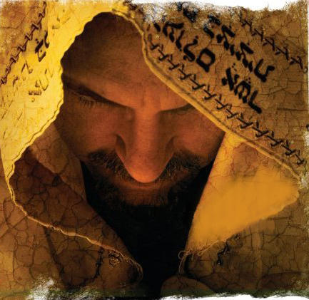
Our Focus is on HIM
According to the Scriptures,
God’s Greatest Gift
to the Whole World
Is His Only Son Jesus
Who is God in the Flesh
He is God with Us
Jesus is Israel’s Messiah,
He is Our Savior
& Our Coming King

Slide 9
John 1:14
“And the Word became Flesh and Dwelt among Us,
and we have seen His glory
as of the Only Son from the Father,
full of Grace and Truth

Slide 10
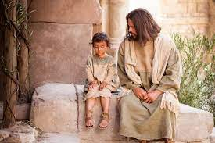
When Jesus Became Flesh, He never ceased being God
Rather Jesus took on human flesh and lived Among Us
He Lived as a Man like Us and was Still God at the Same Time
.
“He Dwelt Among Us” – “He Tabernacled” - “He Pitched His Tent”

Slide 11
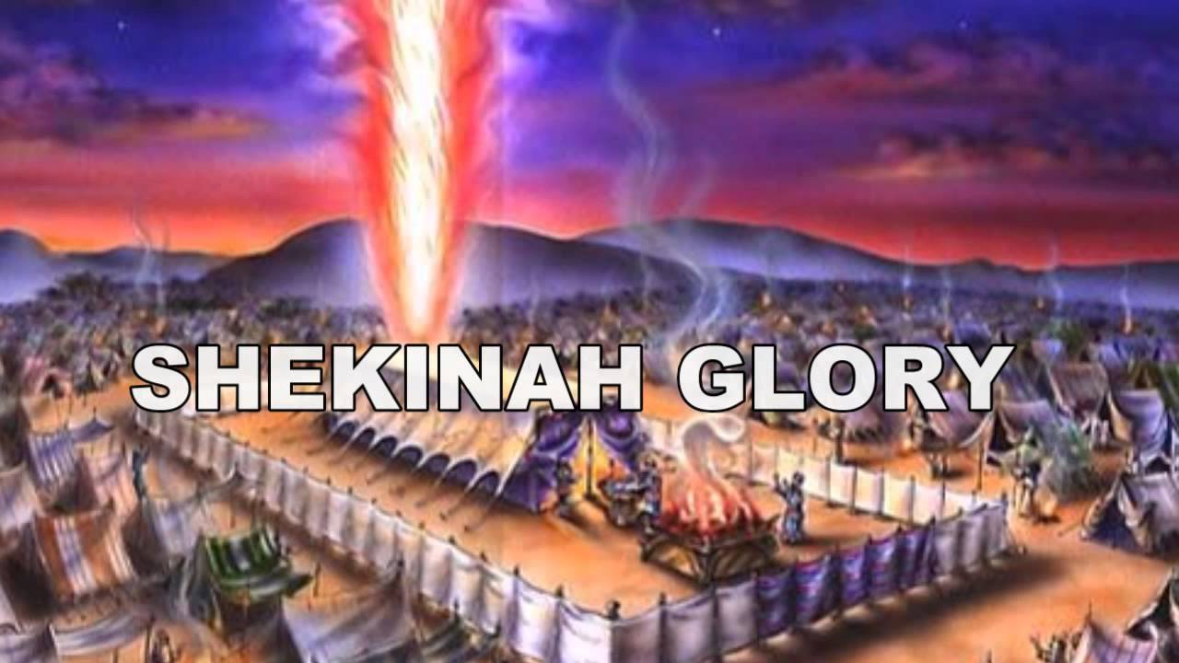
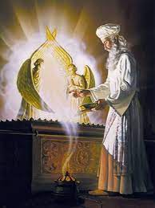
In the past, God manifested His Presence to His People
in the Old Testament by Tabernacles and Temples
Jesus Fulfilled all the Old Testament Symbolism –
Indwelt by the Holy Spirit, He now lived among men as the living Presence of God!
He isThe Incarnation - God Made Flesh, and Immanuel – God with Us

Slide 12
Philippians 2:6-11
⁶ Who, being in the form of God, thought it not robbery to be equal with God:
⁷ But made Himself of no reputation, and took upon Him the form of a servant, and was made in the likeness of men:
⁸ And being found in fashion as a man, He humbled Himself, and became obedient unto death, even the death of the cross.
⁹ Wherefore God also has highly exalted Him, and given Him a name which is above every name:
¹⁰ That at the name of Jesus every knee should bow, of things in heaven,
and things in earth, and things under the earth;
¹¹ And that every tongue should confess that Jesus Christ is Lord,
to the glory of God the Father.

Slide 13
KENOSIS Heresy -
Do Not fall for Wrong Doctrine taught by so many television pastors
Jesus did NOT empty (get rid of) His divine nature to exist only as a man. We are NOT equal to Him in Word or in power.
He is Forever God and Yet He Came to Us as a Man
Colossians 2:9 ”For in Him dwells all the fulness of the Godhead bodily”
Hebrews 13:8 “Jesus Christ the same yesterday, and today, and for ever”

Slide 14
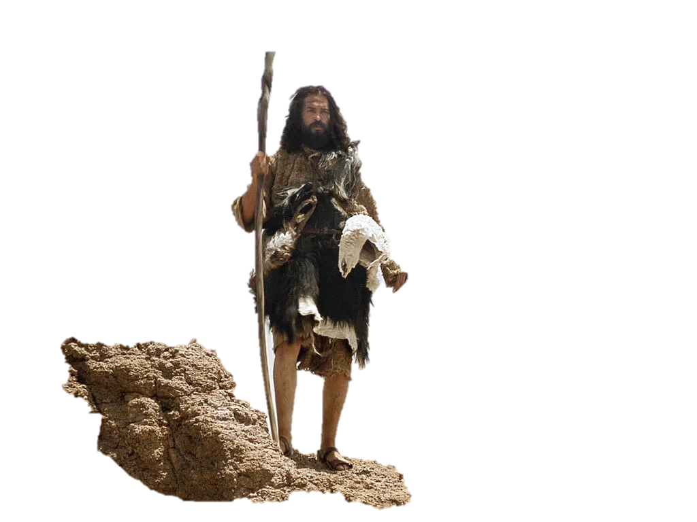
Let’s Start in Luke 1:5-10 with Zecharias & Elizabeth
“The Birth of John the Baptist”
⁵ There was in the days of Herod, the king of Judaea,
a certain priest named Zacharias, of the course of Abijah:
and his wife was of the daughters of Aaron, and her name was Elisabeth.
⁶ And they were both righteous before God, walking in all the
commandments and ordinances of the Lord blameless
⁷ And they had no child, because that Elisabeth was barren,
and they both were now well stricken in years.
⁸ And it came to pass, that while he executed the priest's office
before God in the order of his course,
⁹ According to the custom of the priest's office, his lot
was to burn incense when he went into the Temple of the Lord.
¹⁰ And the whole multitude of the people were praying without at the time of incense.

Slide 15
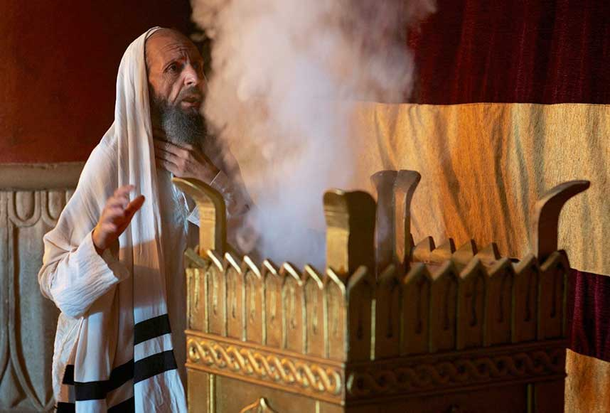
Luke 1:11 -14 An Angel Visits Zacharias
¹¹ And there appeared unto him an angel of the Lord standing on the right side of the altar of incense.
¹² And when Zacharias saw him, he was troubled, and fear fell upon him.
¹³ But the angel said to him, Fear not, Zacharias: for your prayer is heard;
and your wife Elisabeth shall bear you a son,
and you shall call his name John.
¹⁴ And you shalt have joy and gladness;
and many shall rejoice at his birth
¹⁵ For he shall be great in the sight of the Lord, and shall drink neither wine nor strong drink; and he shall be filled with the Holy Ghost, even from his mother's womb.

Slide 16
The Angel Prophesies
to Zacharias
¹⁶ And many of the children of Israel shall he turn to the Lord their God.¹⁷ And he shall go before Him in the spirit and power of Elias, to turn the hearts of the fathers to the children,
and the disobedient to the wisdom of the just;
to make ready a people prepared for the Lord.
¹⁸ And Zacharias said to the angel, Whereby shall I know this? For I am an old man, and my wife well stricken in years
¹⁹ And the angel answering said to him, I am Gabriel, that stand in the presence of God; I am sent to speak to you, to show you these glad tidings
²⁰ And, behold, you shall be dumb, and not able to speak, until the day that these things shall be performed, because you believed not my words, which shall be fulfilled in their season.

Slide 17
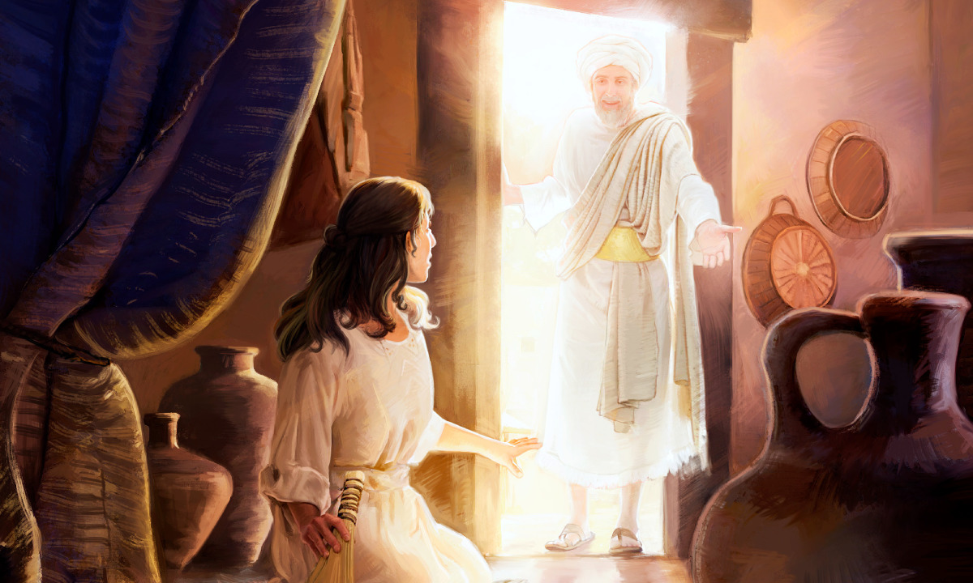
Now Gabriel Appears to Mary
Luke 1:26-38
And in the 6th month the angel Gabriel was sent from God to a city of Galilee, named Nazareth, to a virgin espoused to a man whose name was Joseph, of the house of David; and the virgin's name was Mary.
And the angel came unto her, and said, Hail, you that are highly favored, the Lord is with you: blessed are you among women.
And when she saw him, she was troubled at his saying, and cast in her mind what manner of salutation this should be.
And the angel said to her, Fear not, Mary: for you have found favor with God. Behold, you shall conceive in your womb, and bring forth a son, and shalt call his name JESUS. He shall be great and shall be called the Son of the Highest: and the Lord God shall give to Him the throne of his father David:
And He shall reign over the house of Jacob forever; of his kingdom there shall be no end

Slide 18
Then said Mary to the angel, How shall this be, seeing I know not a man?
The angel answered and said to her, The Holy Ghost shall come upon you, and the power of the Highest shall overshadow you: therefore that holy thing which shall be born of you shall be called the Son of God.
Behold, your cousin Elisabeth, she has also conceived a son in her old age: and this is the 6th month with her, who was called barren. For with God nothing shall be impossible.
And Mary said, Behold the handmaid of the Lord; be it unto me according to your word. And the angel departed from her.

Slide 19
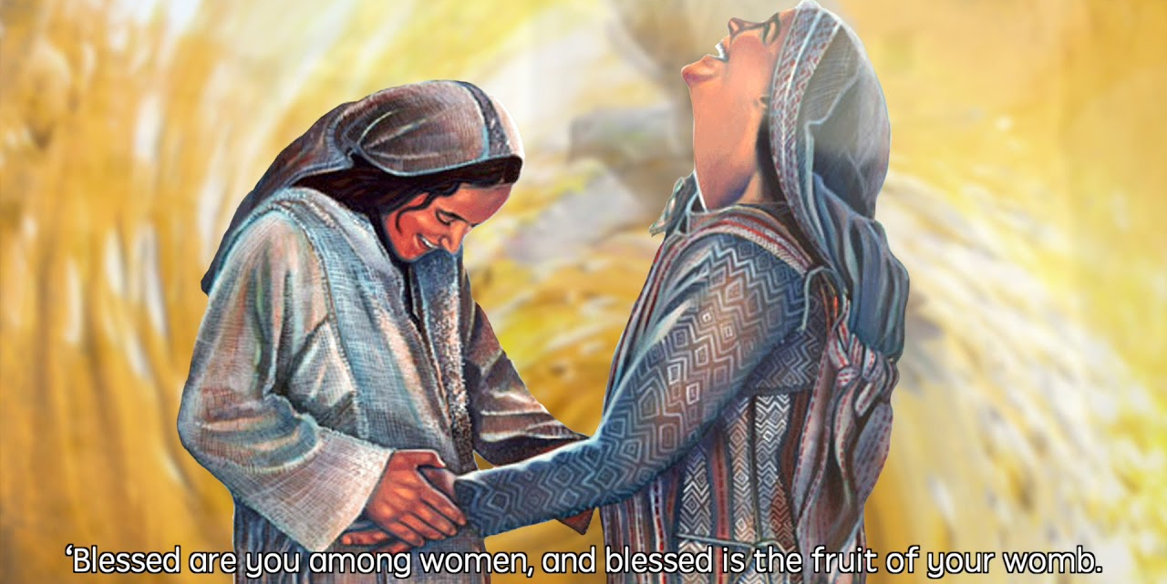
39-44 Mary arose in those days and went to the hill country in haste unto a city in Judah and entered into Zacharias’ house to greet Elizabeth. When Elizabeth heard Mary’s greeting, the babe leapt in her womb; and Elizabeth was filled with the Holy Ghost. And she spoke with a loud voice, Blessed are you among women and blessed is the fruit of thy womb. And whence is this to me, that the mother of My Lord should come top me?
For lo, as soon as the voice of your salutation sounded in my ears, the babe leaped in my womb for joy.

Slide 20
And Mary said, My soul doth magnify the Lord,
And my spirit has rejoiced in God my Savior.
For He has regarded the low estate of his handmaiden:
for, behold, from henceforth all generations shall call me blessed.
For He that is mighty has done to me great things; holy is His name. His mercy is on them that fear Him from generation to generation.
He has shewed strength with His arm;
He has scattered the proud in the imagination of their hearts.
He has put down the mighty from their seats,
and exalted them of low degree.
He has filled the hungry with good things;
and the rich He has sent empty away.
He has helped His servant Israel, in remembrance of His mercy;
As He spake to our fathers, to Abraham, and to His seed forever.

Slide 21
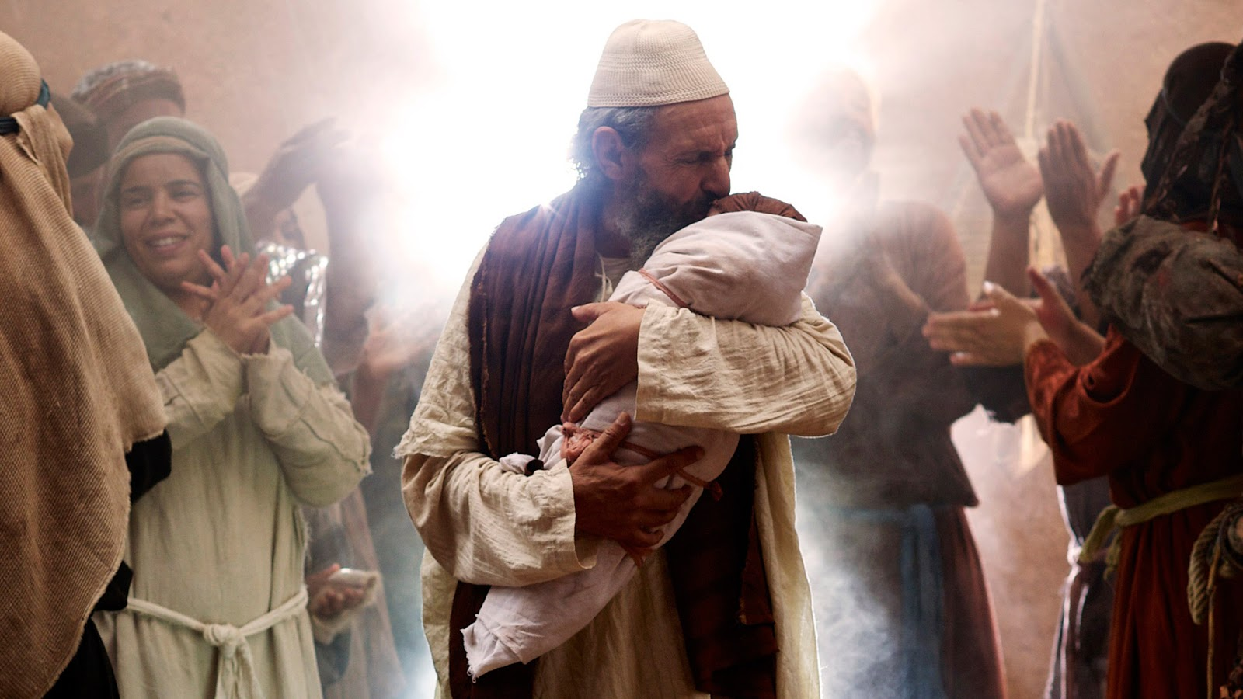
Mary stayed with Elizabeth 3 months then returned home. Elizabeth have birth to a son whom she named John. Zecharias wrote, ‘His name is John.’ His tongue was loosed immediately and he began to praise God

Slide 22
Luke 1 : 57-80
Zechariah was struck dumb until Elizabeth gives birth to John
Immediately Zechariah was filled with the Holy Ghost and begins to prophesy
God has raised up “a horn of salvation” in the House of David
Just as He spoke by His prophets
He (Messiah) shall save us from our enemies
God remembers His Covenant with Abraham
This child John shall be a prophet of the Most High
This child shall prepare the way of the Messiah
The Messiah will grant salvation by remission of their sins
The Messiah will give light to those who sit in darkness
80. The child John grew and waxed strong in spirit, and was in the desert
til the day of his shewing to Israel

Slide 23
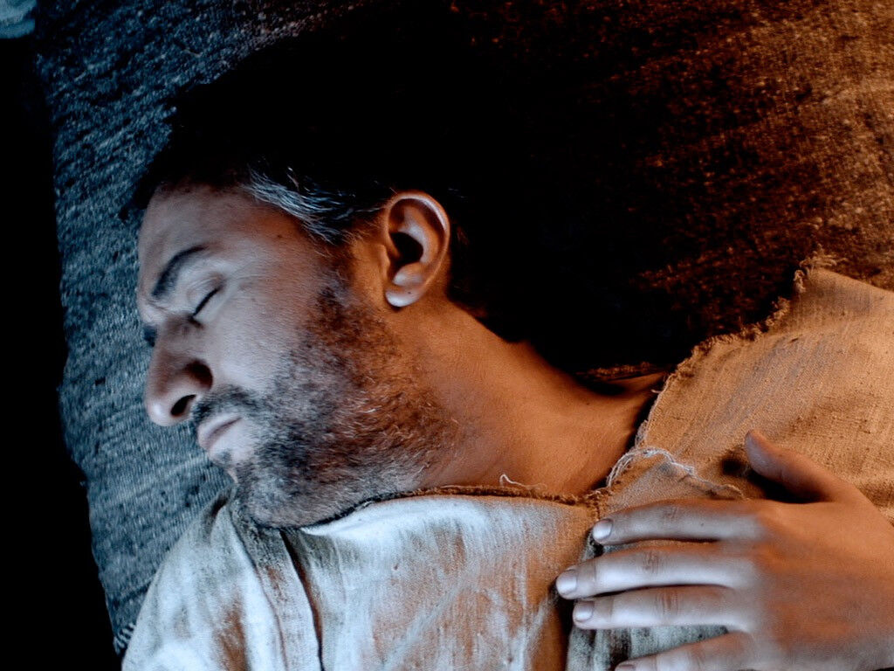
Matthew 1:18-20
The Angel appears also to Joseph in a dream
Now the birth of Jesus Christ was on this wise:
when his mother Mary was espoused to Joseph, before they came together,
she was found with child of the Holy Ghost.
Then Joseph her husband, being a just man,
and not willing to make her a public example,
was minded to put her away privately.
While he was thinking on these things, an angel of the Lord appeared to him in a dream, saying, Joseph, son of David, fear not to take to you Mary your wife: for that which is conceived in her
is of the Holy Ghost.
And she shall bring forth a son,
and you shalt call his name Jesus:
for He shall save His people from their sins.

Slide 24
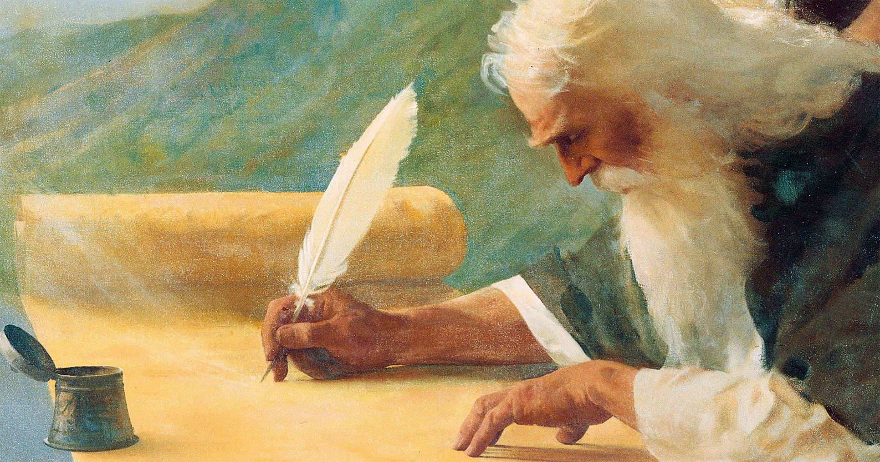
Matthew 1:22-23 “Now all this was done, that is might be fulfilled
which was spoken of the Lord by the prophet, saying,
“Behold a virgin shall be with child and shall bring forth a son and they shall call his name Emmanuel, which being interpreted is God with us.”
Isaiah 7:14
“Therefore the Lord himself shall give you
a sign; Behold a virgin shall conceive and
bear a son, and shall call his name Immanuel.”

Slide 25
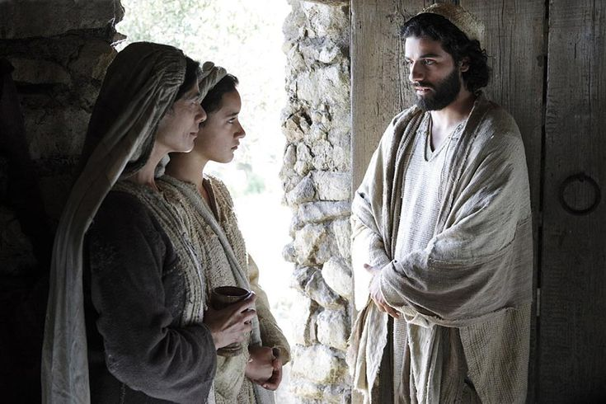
Matthew 1:24-25
An Angel Appears to Joseph
And Joseph being raised from sleep, did as the angel of the Lord had bidden him, and took Mary as his wife.
He knew her not until he had brought forth her firstborn son…..

Slide 26
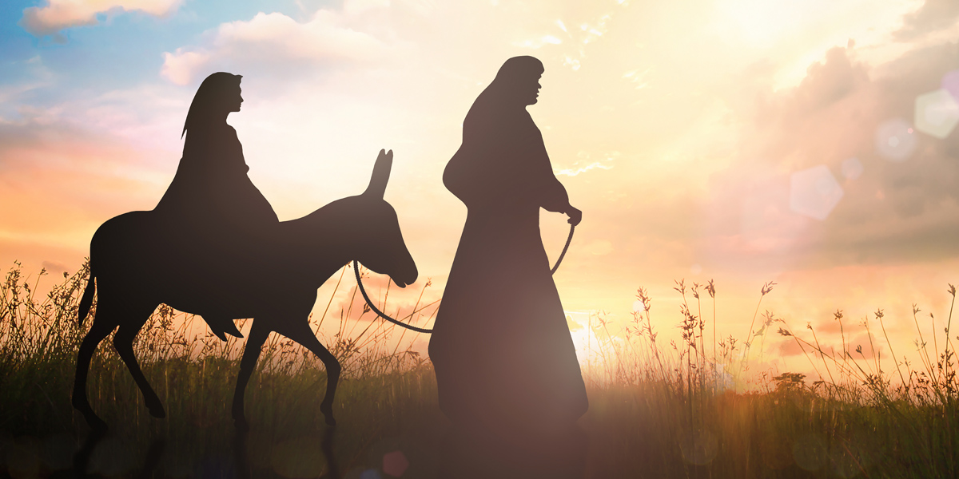
Luke Chapter 2;1-3
And it came to pass in those days, that there went out a decree from Caesar Augustus that all the world should be taxed. (And this taxing was first made when Cyrenius was governor of Syria.) And all went to be taxed, everyone into his own city.
Joseph and Mary travel over 70 miles
From Nazareth to Bethlehem
Walking with a donkey
Through desert,
Over mountains
Thru Valleys

Slide 27
And Joseph also went up from Galilee, out of the city of Nazareth, into Judea, unto the city of David,
which is called Bethlehem; (because he was of the house and lineage of David:)
To be taxed with Mary his espoused wife, being great with child.
Luke 2:4-5

Slide 28
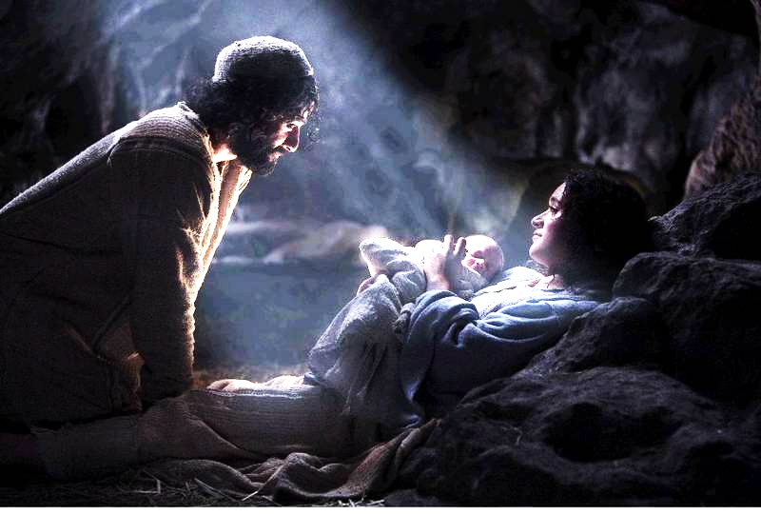
Luke 1:6-7
“And so it was,
while they were there, the days were accomplished that she should be delivered.
And she brought forth her firstborn son, wrapped him in swaddling clothes, and laid him in a manger
For there was no room for them in the inn”

Slide 29
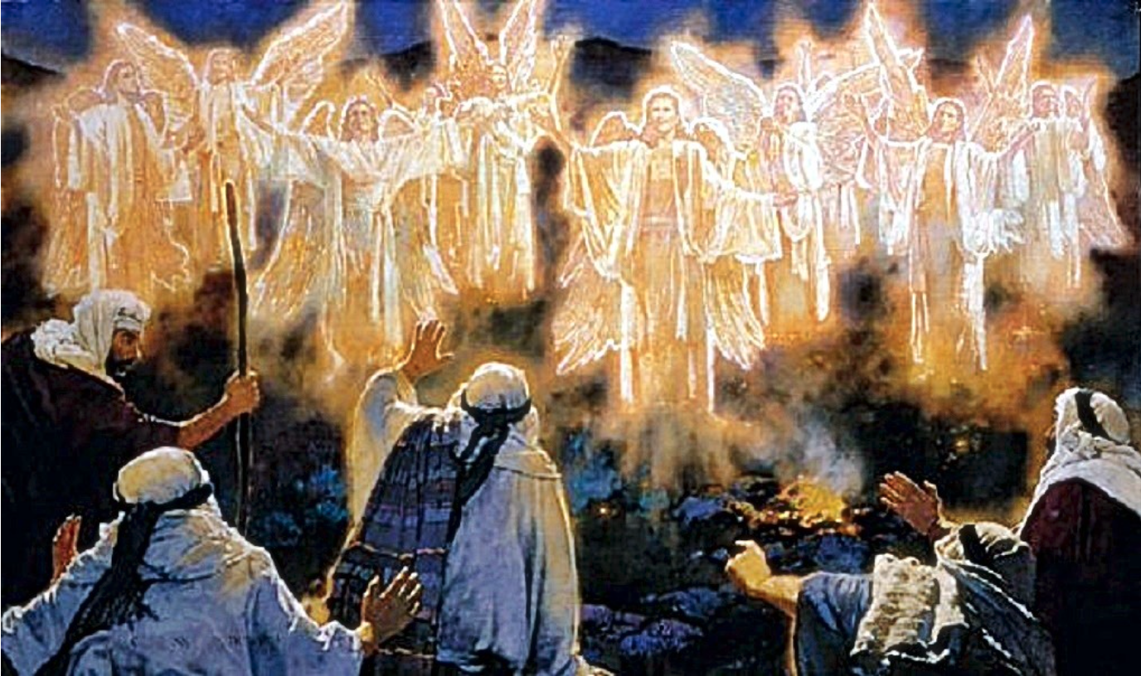
Luke 2:8-9 “And there were in the same country shepherds abiding in the field, keeping watch over their flock by night. And lo, the angel of the Lord came upon them, and the glory of the Lord shone round about them: and they were sore afraid:

Slide 30
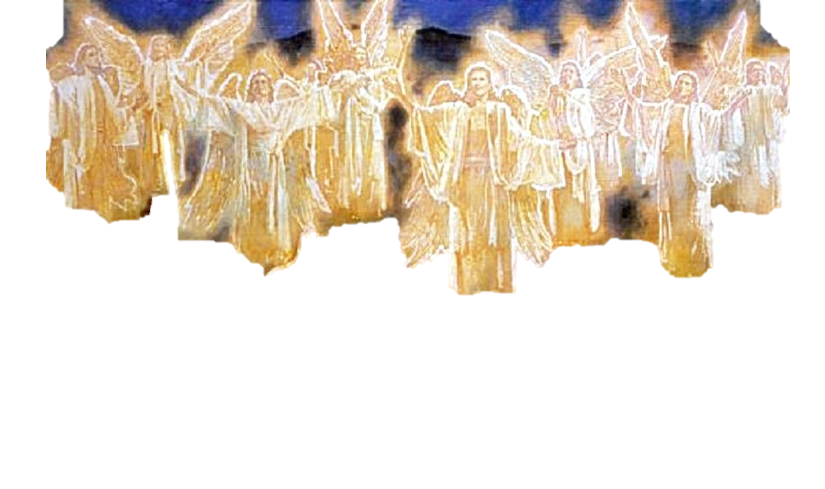
Luke Chapter 2:10-13
“And the angel said to them, Fear not; for behold, I bring you good tidings of great joy, which shall be unto all people. For unto you is born this day in the City of David a Savior, which is Christ the Lord.
And this shall be a sign unto you; You shall find the baby wrapped in swaddling clothes, lying in a manger”
And suddenly there was with the angel a multitude of the heavenly host praising God and saying, “Glory to God in the highest, and on earth peace, goodwill toward men.”

Slide 31
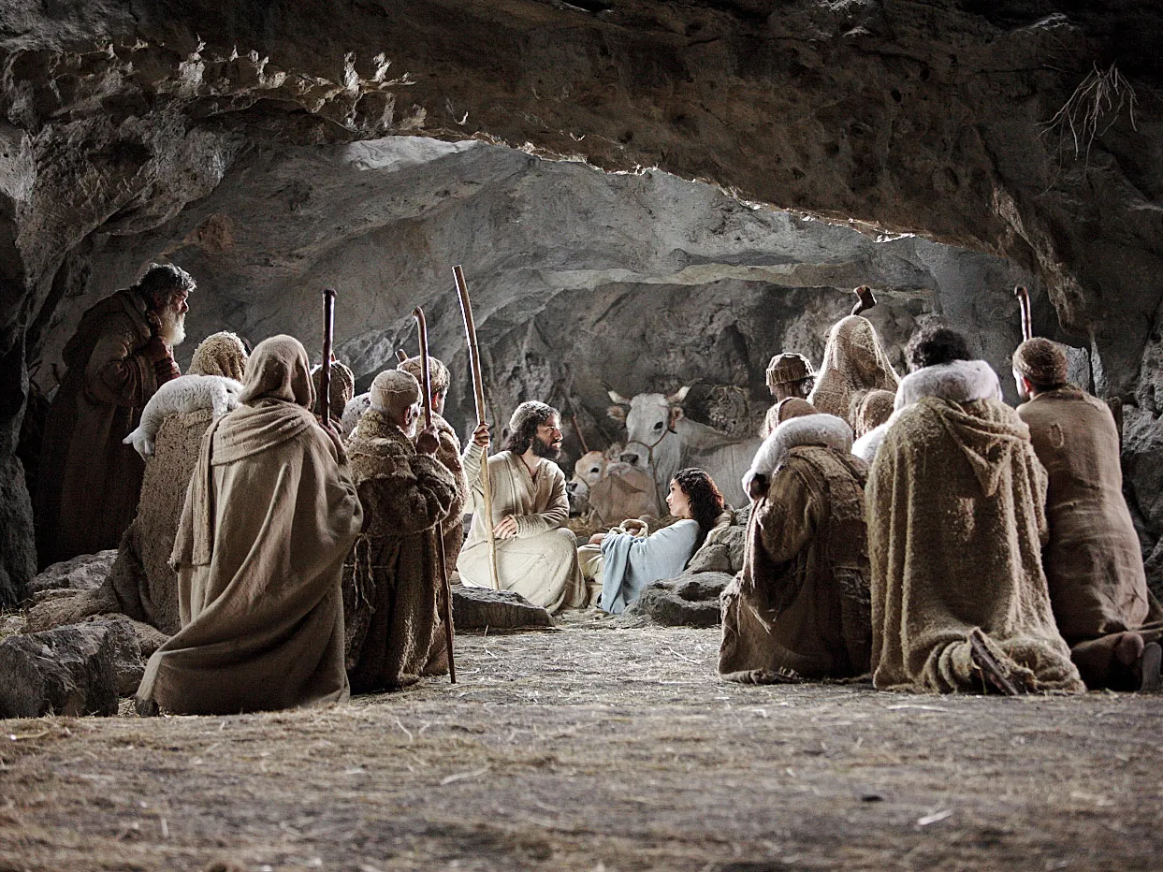
15.”And is came to pass, as the angels said one to another, Let us now to even to Bethlehem, and see this thing which has come to pass, which the Lord has made know to us.
16.And they came and found Mary and Joseph and the babe lying in a manger.
I7.When they had seen it, they made know abroad all those things which were told them concerning this child.”
18.And all that heard it wondered at those things which were told them by the shepherds.

Slide 32
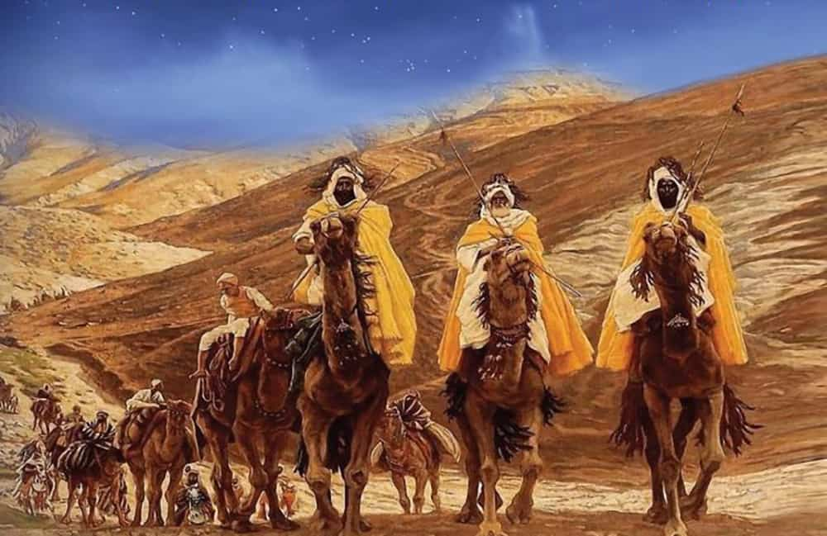
“Now when Jesus was born in Bethlehem of Judea in the days of Herod the King, behold there came wise men from the east to Jerusalem, saying “Where is he that is born King of the Jews: For we have seen His star in the east and are come to worship him.” Matthew 2:1-2

Slide 33
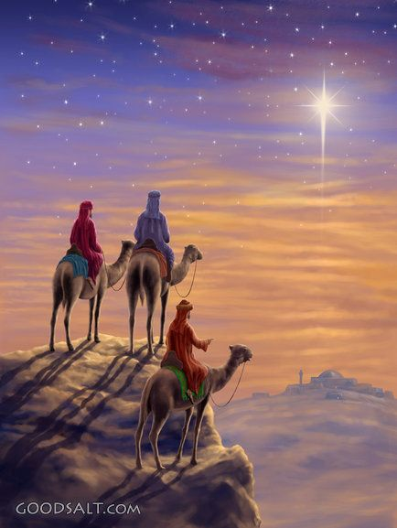
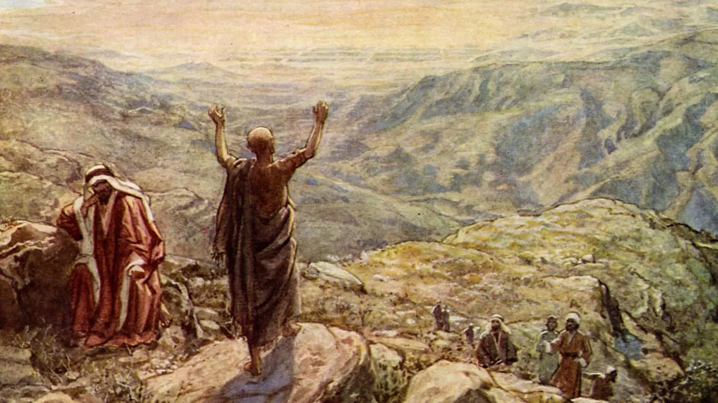
Balaam Prophesies - Numbers 24:17
“I shall see Him, but not now: I shall behold Him, but not nigh:
there shall come a Star out of Jacob, and a Scepter shall rise out of Israel, and shall smite the corners of Moab, and destroy all the children of Sheth.”

Slide 34
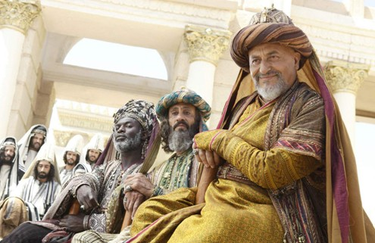
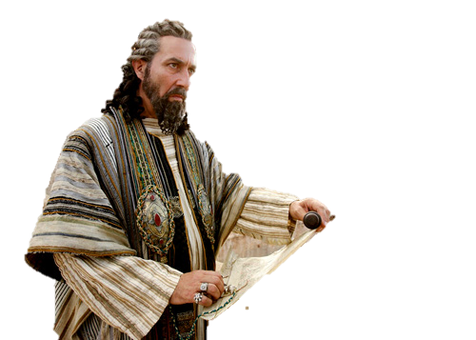
Herod gathers all the chief priests and the scribes and demands to know –
“Where shall this Christ be born?” Matthew 2:3
They say, ‘In Bethlehem of Judea: for thus it is written by the prophet “And you, Bethlehem, in the land of Judah, are not the least among the princes of Judah: for out of you shall come a Governor, that shall rule My people Israel.” Matthew 2:4-5

Slide 35
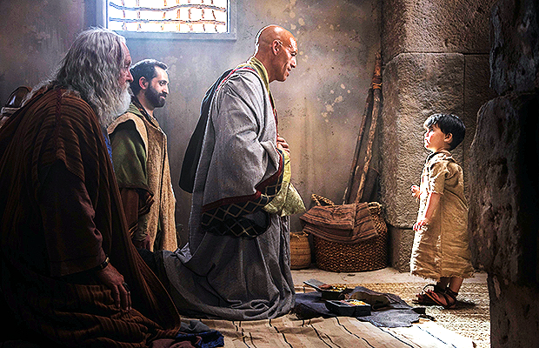
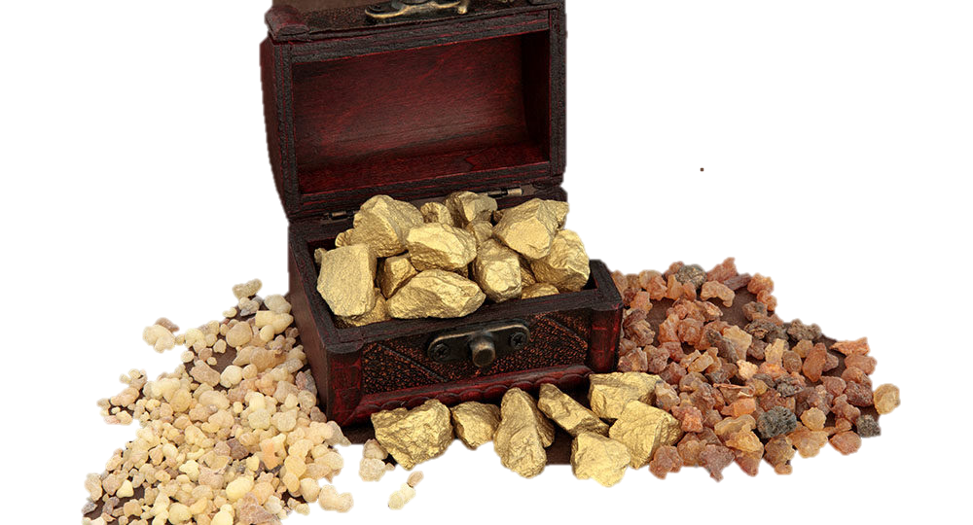
11.“And when they came into the house, they saw the young child with Mary his mother, and fell down and worshipped him: and when they had opened their treasures, they presented him gifts; gold, frankincense, and myrrh.
12. “And being warned of God in a dream that they should not return to Herod, they departed into their own country another way.”

Slide 36
The Angel of the Lord Warns Joseph Again in a Dream Matthew 2:13
“And when they were departed, behold, the angel of the Lord appeared to Joseph in a dream, saying
“Arise and taken the young child
and his mother and flee to Egypt.
Be there until I bring you word:
for Herod will seek the young child
to destroy him.”

Slide 37
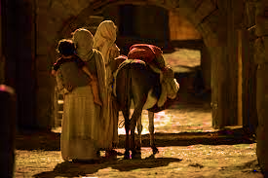
14. When Joseph arose , He took the young child and his mother by night and departed to Egypt
15. And was there until the death of Herod: that it might be fulfilled which was spoken of the Lord by the prophet, saying, “Out of Egypt have I call My son.” Hosea 11:1

Slide 38
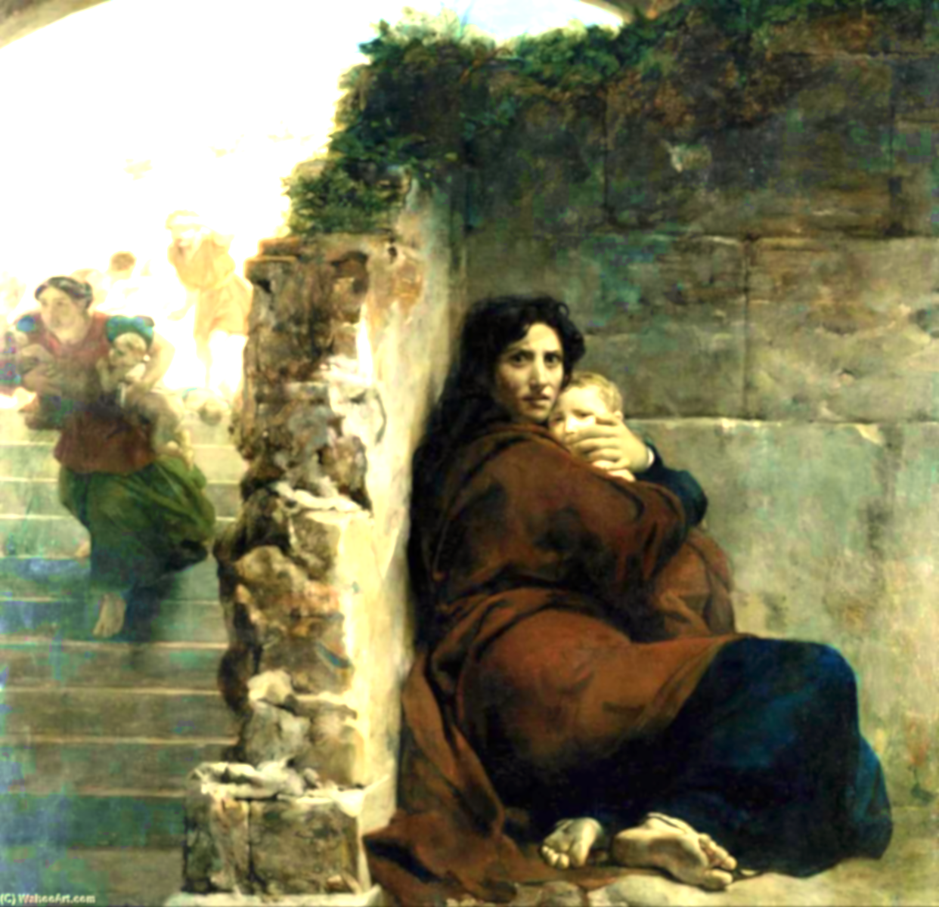
“16. Then Herod, when he saw that he was mocked by the wise men, was exceeding wroth, and sent forth, and slew all the children that were in Bethlehem, and in all the coasts thereof, from
2 years old and under, according to the time which he had diligently inquired of the wise men"
“Then was fulfilled which which was spoken
by the prophet Jeremiah, saying, Jeremiah 31:15
In Ramah was there a voice heard,
Lamentation and weeping and great mourning
Rachel weeping for her children,
And would not be comforted Because they are not.

Slide 39
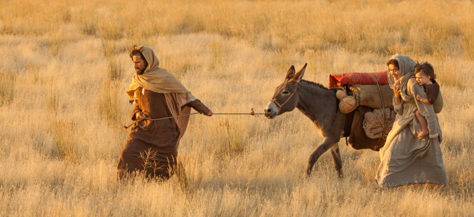
An Angel Appears in Another dream to Joseph - In Egypt
20. “Arise, take the young child and his mother and go to the Land of Israel: for they are dead which sought the young child’s life.
21.Joseph arose and took young child and his mother
and came to the Land of Israel.”

Slide 40
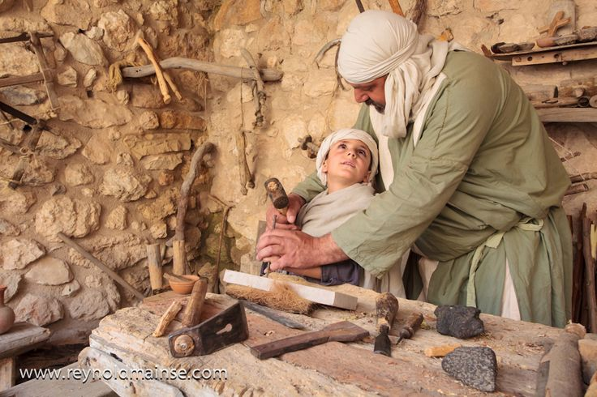
22. When Joseph heard that Archelaus did reign in Judea in the room of his father Herod,
he has afraid to go there. Being warned in a dream, he turned aside into the parts of Galilee
23. And he came and dwelt in a City called Nazareth: That it might be fulfilled which was spoken by the prophets, ‘He shall be called a Nazarene.” Jeremiah 23:5-6; Isaiah 11:1

Slide 41
Hebrews 1:1-2
1 God, who at sundry times and in divers manners spoke in time past
unto the fathers by the prophets,
² Has in these last days spoken unto us by his Son,
whom He has appointed heir of all things,
by whom also He made the worlds;

Slide 42
”The Incarnation” When God Became Man ” - The Prophet, Priest & Coming King

