Slide 1
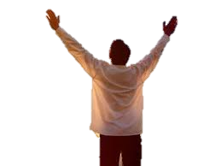
Awesome

Slide 2
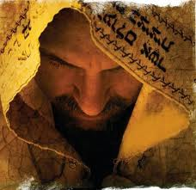
‘
“Waiting on the Lord ”
Psalm 40:1-3
“The Fear
of the Lord”
“And He has put a new song in my mouth, even praise to our God, and many shall see it, and fear and trust the Lord.”

Slide 3
Psalm 40:1 “ I waited patiently
for the Lord.
He inclined unto me
and heard my cry.”
2. He brought me up also
out of a horrible pit
He set my feet upon a rock
and established my goings
3. And He has put a new song
in my mouth
even praise to our God
Many shall see it and fear
and shall trust in the Lord.
Preparation -
is Word Time
is Prayer Time
Dedication –
Real Salvation =
“The Call of God”
Inspiration –
Worship Him
with your Life
The Fear of the Lord

Slide 4
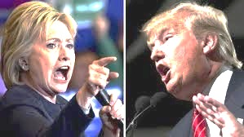
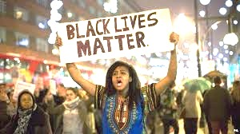
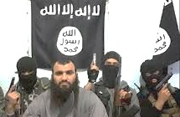
When we watch the news today and see the violence, the hatred, and lawlessness abound, it is easy for our hearts to be troubled. We can not stick our heads in the sand and say, ’God’s got this, I don’t need to worry.”
The Word of God is clear – we are to watch and pray …bringing our petitions before God, trusting completely in His love and care.

Slide 5
The key to completely trusting in God’s love and care is to understand ………. we work out our own salvation by fear & trembling!
Phillippians 2:12
Wherefore, My beloved,
as you have always obeyed,
not as in my presence only,
but now much more in my absence,
work out your own salvation
with fear and trembling.
“The Fear of the Lord”
“Those that Tremble
at His Word”

Slide 6
The Fear of the Lord is NOT being scared
of an angry and impersonal God!
It is the reverence and awe of His Majesty as the only Living God, the overwhelming desire to please Him, to follow after His holiness and righteousness
and to trust in His goodness!
The Fear of the Lord causes us
to depart from evil
We can’t understand truly
the Fear of the Lord
without the Holy Spirit!

Slide 7
The Fear of the Lord is: (Over 100x in the Old Testament)
Over 40x in the New Testament
Wisdom and to depart from evil is understanding Job 28:28
Clean, Enduring forever Psalm 19:9
The Beginning of Wisdom Psalm 111:10; Prov 1:7
Those who hate knowledge chose not the Fear of the Lord Prov. 1:29
Hates evil, Pride, Arrogance , & Evil Ways Prov 8:13
Strong Confidence; His children shall have a place of refuge Prov 14:26
Better than great treasure and trouble Prov. 15:16
The Instruction of Wisdom –Before Honor is Humility Prov.15:33
Causes men to depart from evil Prov. 16:6
Tends to Life, Satisfaction, - will not be visited with evil Prov 19:23
Brings riches, honor and life by humility Prov. 22:4
Prolongs Days, Evil days are shortened Prov 10:27
Our Children shall have a place of refuge Prov 14:26
Is God’s Treasure – strength of our salvation Isaiah 33:6

Slide 8
When we want the Presence of God in our midst, He wants to meet with us.
We determine how close
Our relationship with Him will be!
According to James 4:7-8
We take the first step towards Him
then He takes a giant step towards us!
“ Submit yourselves therefore to God,
Resist the devil, and he will flee from you;
“Draw nigh to God,
and He will draw nigh to you”

Slide 9
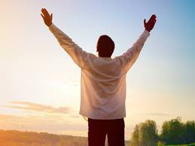
We can’t come into the House of God and expect the Presence of God in our Churches when we are foolish:
laughing and joking, chatting,
going in and out, getting up and down
drinking coffee, eating
visiting with friends
text messaging
sleeping
Psalm 89:7
“God is greatly to be praised
and to be held in reverence
by those all around Him

Slide 10
God does everything in Perfect Order
He first Displays His Glory to Man
Men then Fear the Lord and Worship Him
When they lose the Fear of the Lord
Judgment comes …. To the same degree that
they experienced His Glory
In the Garden – Genesis 3 -Adam and Eve walked in the presence of God
Heard His voice, clothed in innocence, yet chose sin
Immediately sent out of Garden, sin nature enters into mankind
In the Tabernacle - Leviticus 10:1-3 - Moses anoints priesthood, sacrifice is consumed by a holy fire, God’s glory appears to all the people who shout and fall on their faces, The same day Nadab and Abihu offered profane incense in the Holy Place -
the same holy fire from God devoured them …
In the Temple …2nd Chronicles 5:13-14. . Solomon dedicates Temple
Temple priesthood has divine order
God’s glory comes so great in a cloud
that priests can’t continue to minister

Slide 11
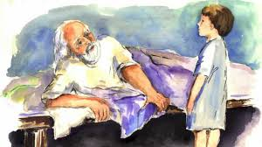
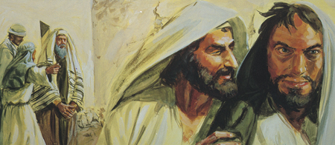
Now what happens when God’s divine order is not kept
What happens when the Priests don’t fear the Lord
1 Samuel Chapter 2 - Eli the High Priest & Little Samuel
Eli has corrupted the Priesthood by allowing his
2 wicked sons to minister Hophni & Phineas
Little Samuel is being trained in the House of God by the Eli
the High Priest as a spiritual son to hear and to fear God.
Samuel loves the Lord and also honors Eli who is raising him.

Slide 12
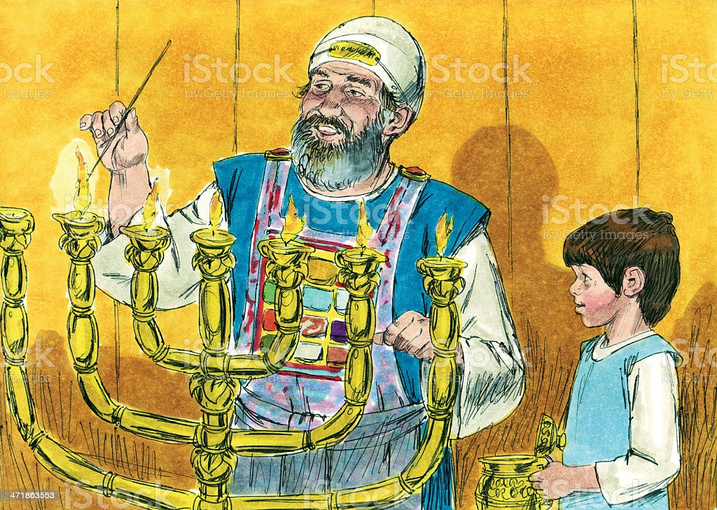
Yet God calls Samuel to warn Eli of coming judgment because of his sons.
1 Samuel 3: 12-14 “I will perform against Eli all things which I have spoken concerning His house: when I begin, I will also make an end.
I have told him I will judge his house forever for the iniquity that he knows;
because his sons made themselves vile and he did not restrain them.
Therefore I have sworn that to the house of Eli, that the iniquity of the house of Eli shall not be purged with sacrifice nor with offering forever.”

Slide 13
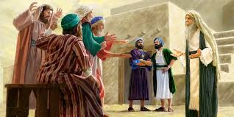
Israel’s High Priest Eli Allows His 2 Sons – Hophni & Phineas
to Corrupt the Ministry 1 Samuel Chapter 2:12 -17
In Leviticus 7:34, we learn that the priests were allotted “the breast of the wave offering and the thigh” of the Israelites’ peace offerings. This was ‘their priestly due’ since priests weren’t paid any salary for their work.
Hophni and Phinehas were raised in full knowledge of the Law of the Lord. Yet when they were in position of ministry, this didn’t stop the lusts of the flesh and the abuse to the people. Since they had no fear of God, they did not repent What happens when evil is reported in ministry and no action is taken?

Slide 14
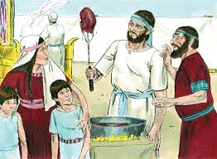
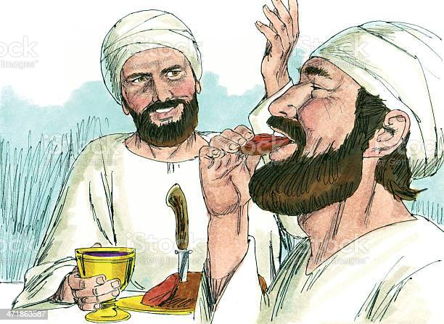
Hophni and Phinehas weren’t content with the priests’ portion. They devised a system where they would thrust a fork “into the pan or kettle, or cauldron, or pot” and take additional meat for themselves.
Instead of waiting for the meat to be completely roasted and the fat burned, they took the meat while it was still roasting. They also threatened any righteous Jews who pointed out their wickedness.
“No, but you shall give it to me now; and if not, I will take it by force. Now the sin of the young men was very great before the Lord, for they despised the offering of the Lord.” 1 Samuel 2:17

Slide 15
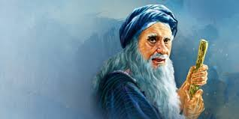
“Now Eli was very old and heard all that his sons did to all Israel, and how they lay with the women that assembled at the door of the Tabernacle.” (vs22)
Eli rebuked them,
but he did not remove them! (23-25)
So God sent a prophet to remind Eli
of the holy calling of priests, offerings, and of God’s Temple. (27-29)
“Eli, why do you kick at My sacrifice & My offering, which I commanded in My Holy Place? You honor your sons above Me, you make yourself fat with the best of all the offerings of My people Israel…” 1 Sam. 2:29

Slide 16
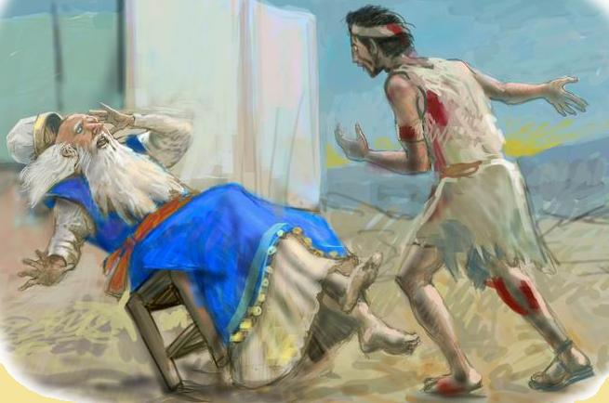
“I will honor those that honor Me, and I will despise those that lightly esteem Me.”
“Behold, the days will come that I will cut off your arm, & the arm of your father’s house, & there shall not be an old man in your house.” 2:31
“And this shall be a sign to you, that shall come upon your 2 sons Hophni & Phineas; in one day they both shall die.” 2:34

Slide 17
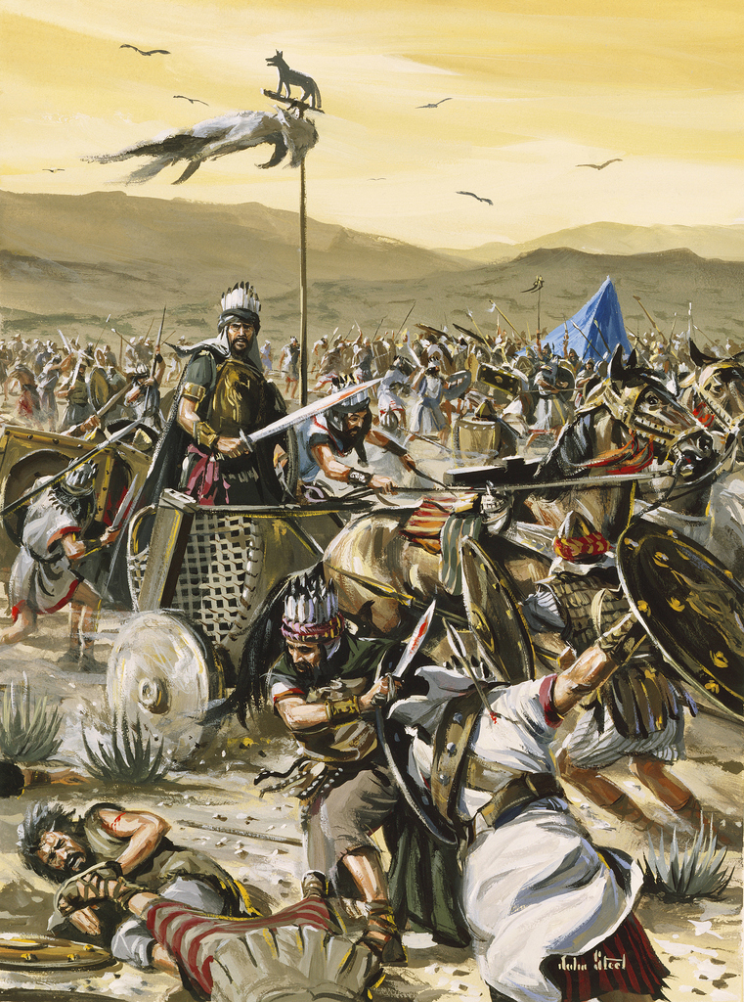
No Fear of God Brings Judgment
1 Samuel Chapter 4
In war against the Philistines, 4,000 Israelites are killed. The people sent for the Ark of the Covenant from Shiloh – Hophni & Phineas accompanied the Ark to the battle. When the Philistines defeat Israel, they kill Eli’s 2 sons and captured the Ark of the Covenant
As soon as this news reached Eli of the slaughter of 30,000 Israelites, the death of his 2 sons, & the capture of the Ark - he fell backwards in shock and broke his neck.
His daughter-in-law went into labor and named her son Ichabod saying ‘The Glory has departed from Israel, for the Ark is taken

Slide 18
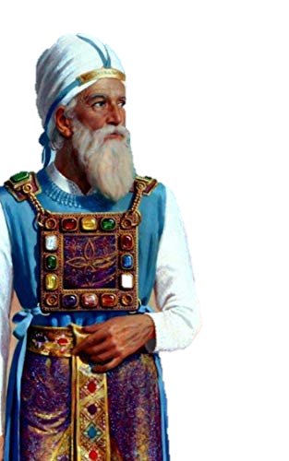
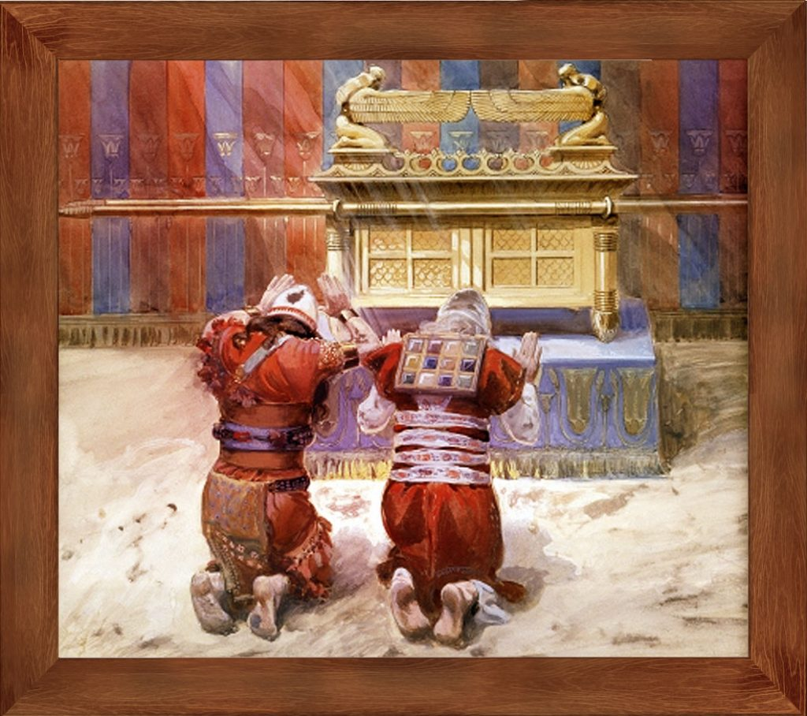
No Fear of God in the Assembly of God–
After Repeated Mercy comes Judgment!
For Eli, Israel’s High Priest
Loss of God’s Presence
Loss of Protection
Loss of Position
Loss of Life – Eli & his sons

Slide 19
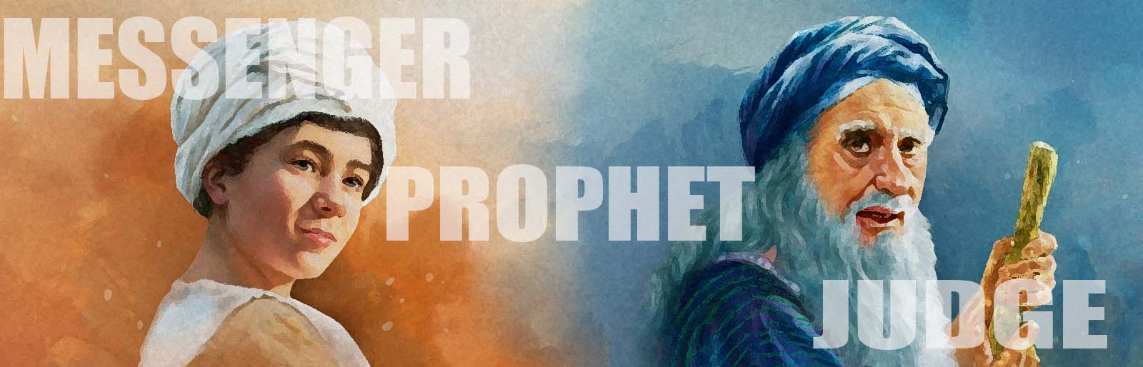
For Samuel – a man who feared the Lord all of his days
Ministers in God’s Presence
Hears the Voice of the Lord
Raised to Position as God’s Prophet to all of Israel
Anoints Israel’s first King - Saul
Anoints Israel’s greatest King - David

Slide 20
Does God’s Order Hold True in the New Testament?
Does the Fear of the Lord bring Blessing or Curse?
If We desire the Praise of Men…
Then we will fear men
If We fear Men, then we will serve men
For we will serve what we fear
Knowing “that Perilous times will come..” 1 Timothy 3
“That men will be lovers of self….. more than lovers of God”
Instead
“We may boldly say, The Lord is my helper,
I will not fear what man can do to me.” Hebrews 13:6

Slide 21
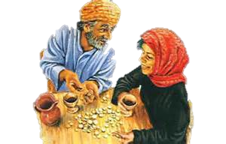
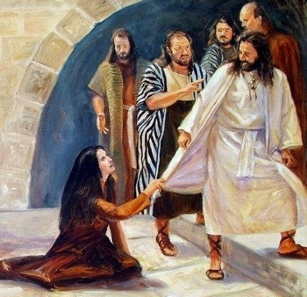
In the New Testament – God’s Righteous Judgment
separates those who Fear the Lord from those who do not!
And One Woman who Got it Right – The Woman with the Issue of Blood – Mark 5:25
Ananias and Sapphira
Acts 5:1-11

Slide 22
After the Holy Spirit fell in Acts Chapter 2, there were great signs and wonders and many were added to the Church. New believers sold their lands & houses and gave the $$ to the Apostles so that there was no lack.
“But a certain man named Ananias with his wife Sapphira sold a possession & kept back a portion of the price: Sapphira was privy to it, and he brought a certain part and laid it at the apostles’ feet.”
“But Peter said, “Ananias why has satan filled your heart to lie to the Holy Ghost and to keep back part of the land price? While it remained, was it not your own? After it was sold, was it not in your power? Why have you conceived this in your heart? You have not like to men, but to God.”

Slide 23
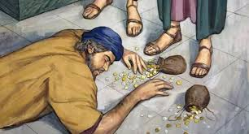
“Ananias heard these words, fell down and gave up the ghost: and great fear fell on all them that heard. And young men arose and carried him out
and buried him.”
Just 3 hours later, Sapphira got the exact same questions
and she repeated the very same lies!
“Then Peter said, How is it that you agreed together to tempt the Spirit of the Lord? Behold, the feet of those who buried your husband are at the door and they shall carry you out!”

Slide 24
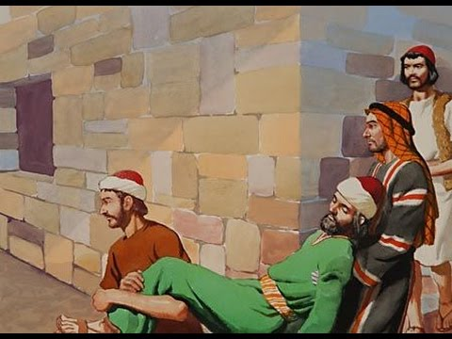
Acts 5:11 – Death of Ananias & Sapphira “And great fear fell upon all the Church,
and upon as many as heard these things”
Loss of God’s Presence
Loss of Property
Loss of Position in the Church
Loss of Life – he and his wife

Slide 25
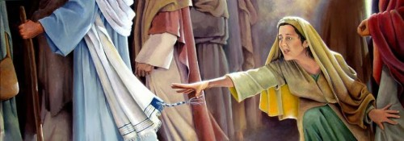
“And a certain woman, which had an issue of blood for 12 years. And had suffered many things of many physicians, and had spent all that she had and was not better but grew worse, when she heard of Jesus, came in the press behind and touched the hem of His garment. For she said, If I may but touch the hem of His clothes, I shall be whole.” Mark 5:25-34
“And strait away the fountain of her blood was dried up;
and she felt in her body that she was healed of that plague.
Jesus knew that healing had gone out from Him and asked, who touched my clothes?
He looked around to see her!

Slide 26
But the woman fearing & trembling, knew what was done in her, came and fell down before Him, and told Him the truth.” And Jesus said, “Daughter,
your faith has made you whole; go in peace,
and be whole of this plague.”
Supernatural Healing
Supernatural Faith
Remembered forever in the Bible
Part of Jesus’ Ministry

Slide 27
“Therefore, work out your own salvation with fear and trembling!” Philippians 2:12

Slide 28
Is there such an emphasis on Speaking
the Love of God in the Church today
that we have neglected Teaching
the Fear of God?
If God’s Love is not Balanced
with the Fear of God
Apostasy and Error will Grow
If the Fear of God is not married
with the Love of God
The wrong Fruit will surely grow
“Behold therefore the goodness and severity (fear) of God: on them which fell, severity (fear); but toward you goodness, if you continue in His goodness: otherwise you shall also be cut off.” Rom 11:23-24

Slide 29
If we choose ‘the Fear of the Lord’
We will not need to fear
God’s Judgment in the End Times!
If we tremble at His Word now, we will not need to tremble at His 2nd Coming
or in the Tribulation!

Slide 30
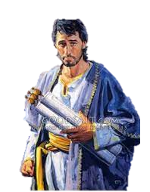
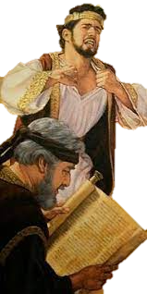
Without the Word of God constantly put in our hearts and consistently declared from our pulpits,
we will not know the Fear of the Lord.
Israel’s Kings were commanded to read the Bible all the days of the lives!
¹⁸ And it shall be, when the King sits upon the throne of his kingdom,
that he shall write a copy of this Law in a book
out of that which is before the priests the Levites:
¹⁹ And it shall be with him, and he shall read therein all the days of his life: that he may learn to fear the Lord his God,
to keep all the words of this Law and these statutes, to do them:
²⁰ That his heart be not lifted up above his brethren,
and that he turn not aside from the Commandment,
to the right hand, or to the left: to the end that he may prolong his days in
his kingdom, he, and his children, in the midst of Israel” Deuteronomy 1:18-20

Slide 31
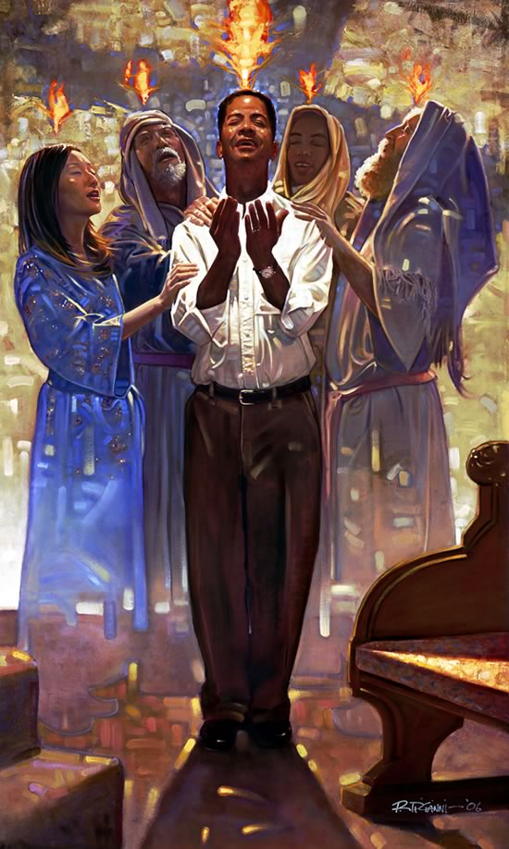
Without the Holy Spirit there is no fear of the Lord there is no lasting change
He is “our Helper”
We will not understand how to work out our salvation on our own…without Him!
“Receive ye the Holy Ghost”
We can speak with other tongues and be edified
We can led by the Spirit of God

Slide 32
Awesome

