Slide 1
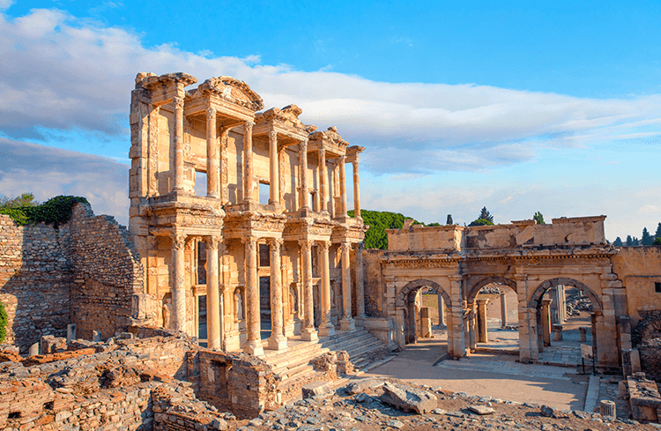
The Church of Ephesus

Slide 2
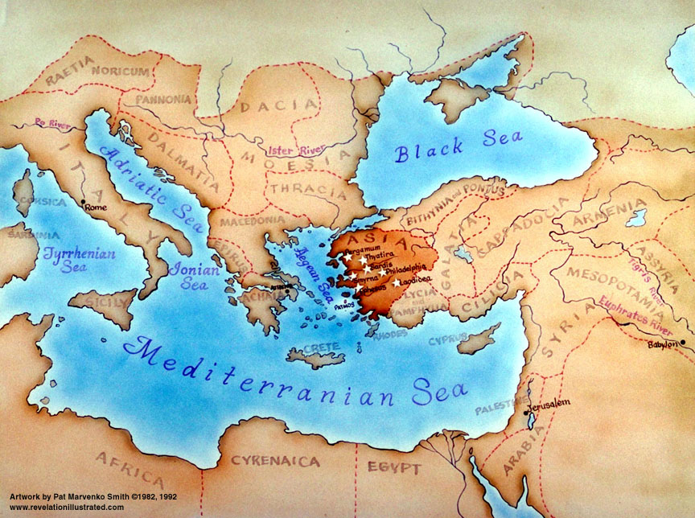

Slide 3
Revelation 2:1-8
¹ Unto the angel of the Church of Ephesus write;
These things says He that holds the 7 stars in His right hand,
who walks in the midst of the 7 golden candlesticks;
² I know your works, and your labor, and your patience,
and how you can’t bear them which are evil;
and you have tried them which say they are apostles,
and are not, and have found them liars:
^{3 m} And have born, and have patience, and for My name's sake
have labored, and have not fainted.

Slide 4
6 Nevertheless I have somewhat against you,
because you hast left your first love.
⁵ Remember therefore from whence you are fallen, and repent,
and do the first works; or else I will come unto you quickly,
and will remove your candlestick out of his place,
except you repent.
⁶ But this you have, that you hate the deeds of the Nicolaitanes
which I also hate.
⁷ He that has an ear, let him hear what the Spirit says to the Churches To him that overcomes will I give to eat of the tree of life,
which is in the midst of the paradise of God.

Slide 5
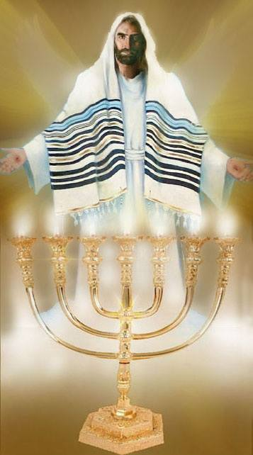
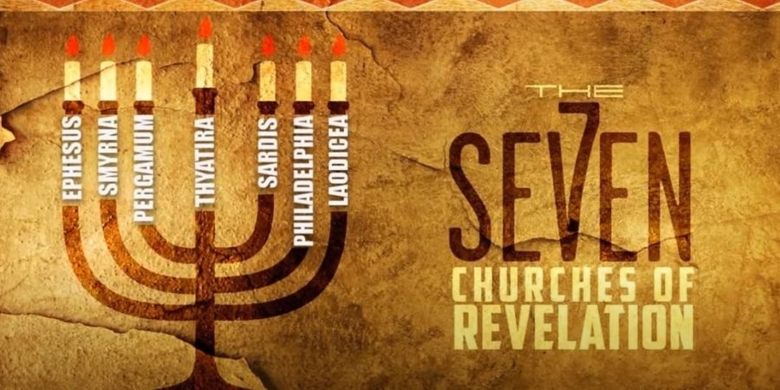
“These things says Jesus
that holds the 7 stars
in His right hand
Jesus who walks in the midst
of the 7 golden candlesticks;

Slide 6
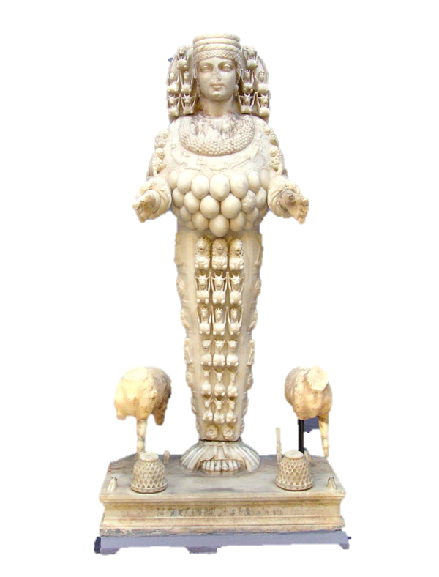

Slide 7
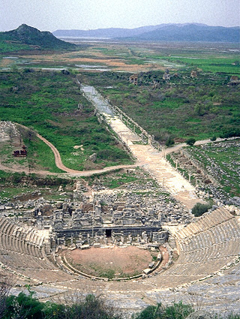
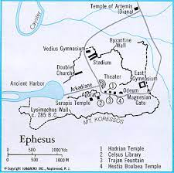
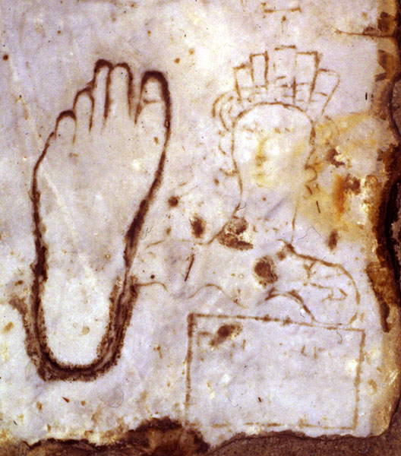
Thousands of sailors arriving by ship at the harbor of Ephesus would disembark and walk down the marble street. Giant columns with pagan gods topped braziers of fire pointed the way. At the top of the street was an advertisement directing men right to the many brothels used as temple worship

Slide 8
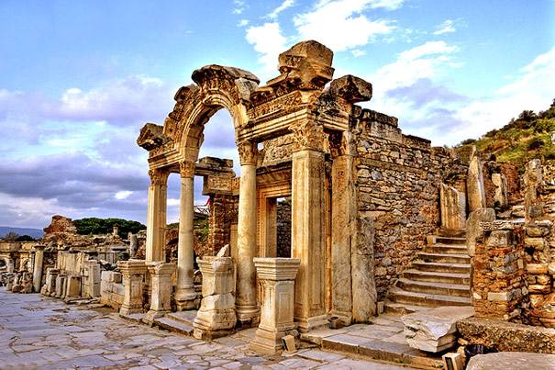
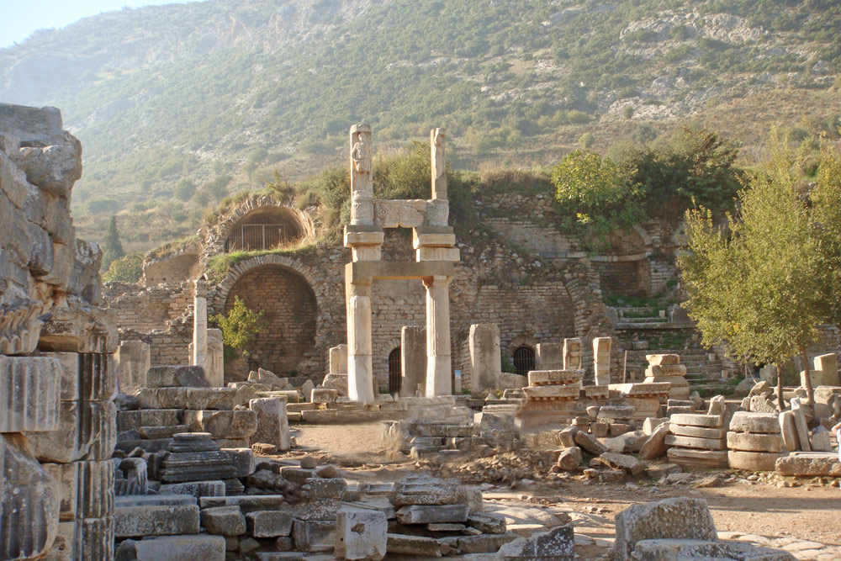
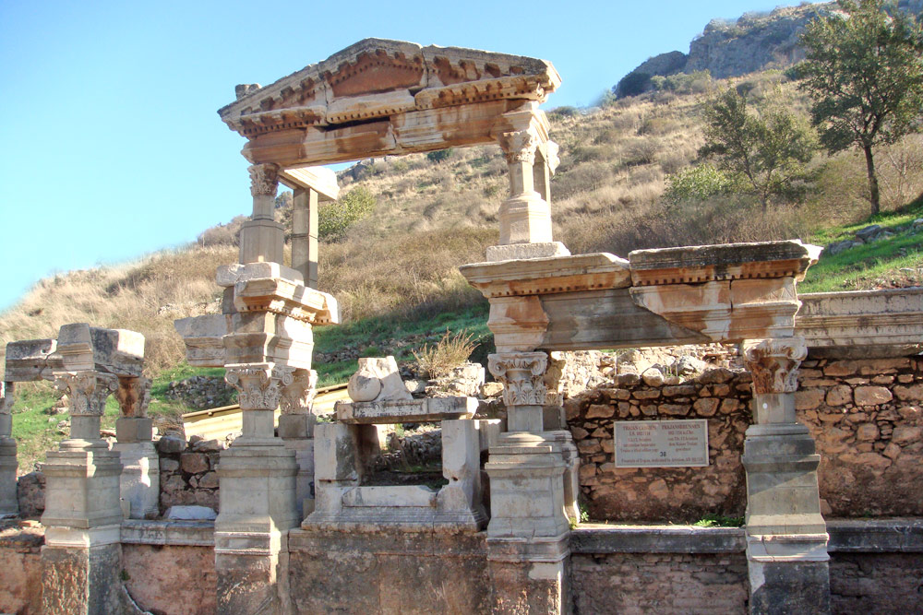
Ancient Ephesus – Roman Emperor Cult Worship
All Temples Decorated with Pagan God & Goddesses
Men Bow Down & Offer Incense
#1. Emperor Trajan – Medusa, Tyche, Dionysis, Athena, Apollo, Artemus/Diana
#2. Emperor Hadrian – Dionysis
#3. Emperor Domitian
#1
#3
#2

Slide 9
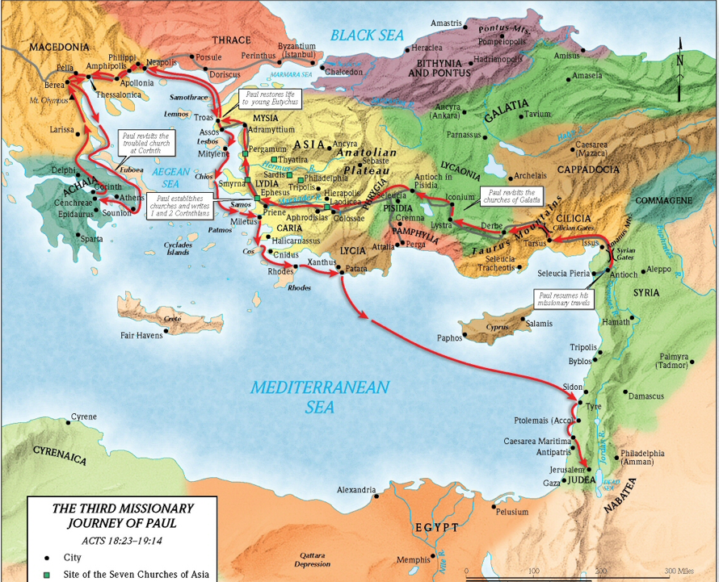
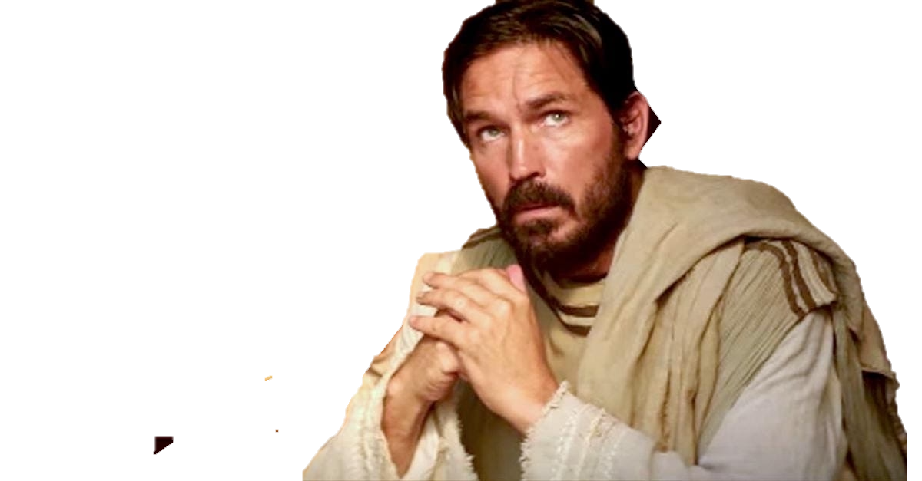
Paul’s main ministry in Ephesus happened on 3rd missionary trip
from Spring 52- Fall 53AD
Acts 18:23–20:38

Slide 10
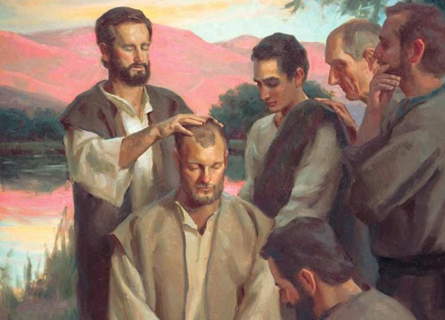
Acts 19 - Paul Arrives in Ephesus - Holy Spirit Baptism
¹ And it came to pass, that, while Apollos was at Corinth, Paul having passed through the upper coasts came to Ephesus: and finding certain disciples,
² He said to them, Have you received the Holy Ghost since ye believed? And they said to Him, We haven’t so much as heard whether there be any Holy Ghost.
³ And He said to them, To what then were you baptized?
And they said, Unto John's baptism.
⁴ Then said Paul, John verily baptized with the
baptism of repentance, saying to the people,
that they should believe on Him which should come
after him, that is, on Christ Jesus.
⁵ When they heard this,
they were baptized in the name of the Lord Jesus
.
⁶ And when Paul had laid his hands upon them, the Holy Ghost
came on them; and they spoke with tongues, and prophesied
⁷And of all the men were about 12.

Slide 11
Paul taught in the Synagogue 3 months – Then 2 years more at School of Tyrannus
Acts Chapter 19
⁸ And he went into the synagogue, and spoke boldly for the space of 3 months,
disputing and persuading the things concerning the Kingdom of God.
⁹ But when divers were hardened and believed not, but spoke evil of that Way
before the multitude, he departed from them, and separated the disciples,
disputing daily in the school of one Tyrannus.
¹⁰ And this continued by the space of 2 years;
so that all they which dwelt in Asia heard
the word of the Lord Jesus, both Jews and Greeks.
¹¹ And God wrought special miracles by the hands of Paul:
¹²So that from his body were brought to the sick
handerchiefs or aprons, and the diseases departed from them,
and the evil spirits went out of them.

Slide 12
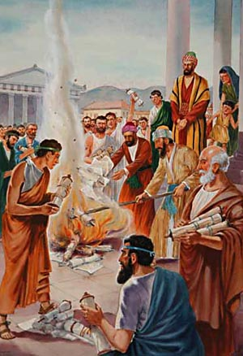
¹³ Then certain of the vagabond Jews, exorcists, took upon them
to call over them which had evil spirits the name of the Lord Jesus,
saying, We adjure you by Jesus whom Paul preaches.
¹⁴ And there were 7 sons of one Sceva, a Jew,
and chief of the priests, which did so.
¹⁵ And the evil spirit answered and said, Jesus I know,
and Paul I know; but who are you?
¹⁶ And the man in whom the evil spirit was leaped on them,
and overcame them, and prevailed against them,
so that they fled out of that house naked and wounded.
¹⁷ This was known to all the Jews and Greeks dwelling at Ephesus;
fear fell on them all; the name of the Lord Jesus was magnified.
¹⁸ Many that believed came and confessed and shewed their deeds.
¹⁹ Many of them also which used curious arts brought their books
together, and burned them before all men: and they counted the
price of them, and found it 50,000 pieces of silver.
²⁰ So mightily grew the word of God and prevailed.

Slide 13
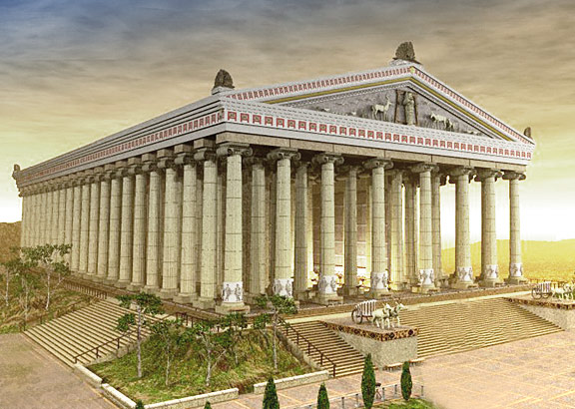
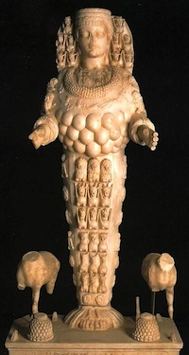
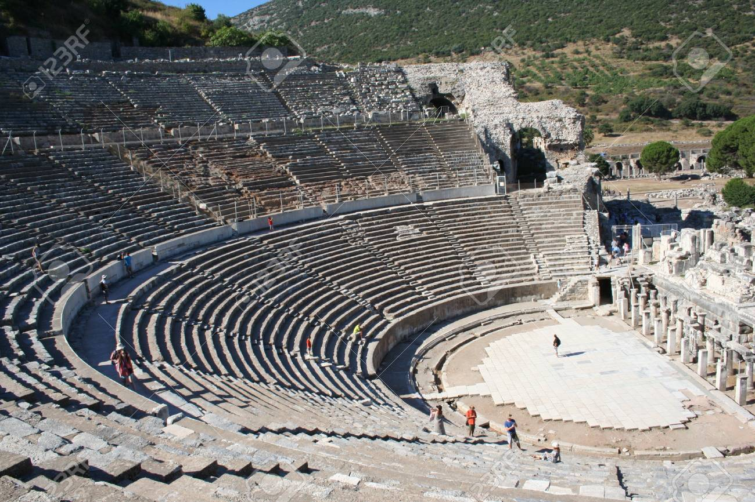
²⁴ For a certain man named Demetrius, a silversmith, which made silver shrines for Diana, brought no small gain
to the craftsmen;²⁵ whom he called together with the workmen of like occupation, and said,
Sirs, you know that by this craft we have our wealth.²⁶ Moreover ye see and hear, that not alone at Ephesus, but almost throughout all Asia, this Paul has persuaded and turned away much people, saying that they be not gods, which are made with hands:²⁷ So that not only this our craft is in danger to be set at nought; but also that
the Temple of the great goddess Diana should be despised, and her magnificence should be destroyed,
whom all Asia and the world worships.
²⁸ When they heard these sayings, they were full of wrath, and cried out, saying, Great is Diana of the Ephesians.
²⁹ And the whole city was filled with confusion: and having caught Gaius and Aristarchus, men of Macedonia,
Paul's companions in travel, they rushed with one accord into the theatre.

Slide 14
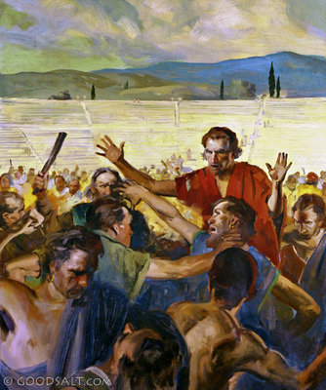
The Riot at Ephesus
³⁰ And when Paul would have entered into the people,
the disciples suffered him not.
³¹ And certain of the chief of Asia,
which were his friends, sent to him,
desiring him that he would not adventure
himself into the theatre.
³² Some therefore cried one thing, and some another:
for the assembly was confused:
and the more part knew not wherefore
they were come together.
³³ And they drew Alexander out of the multitude,
the Jews putting him forward.
Alexander beckoned with the hand,
and would have made his defence to the people.
³⁴ But when they knew he was a Jew,
all with one voice about the space of 2 hours cried out,
Great is Diana of the Ephesians.

Slide 15
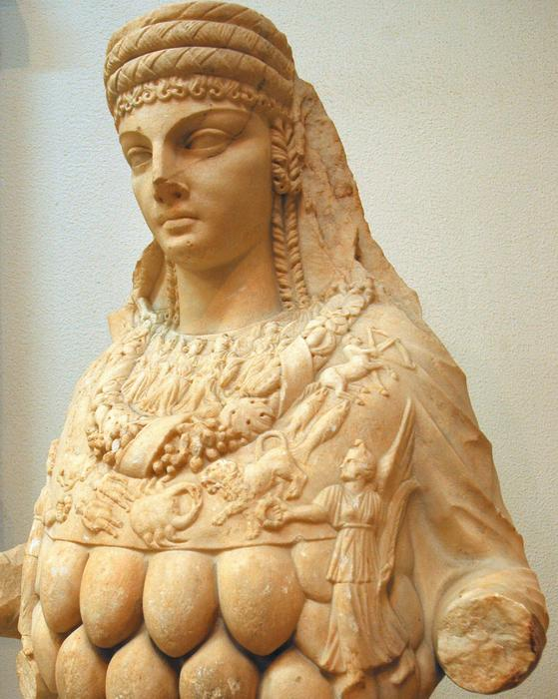
³⁵ And when the town clerk had appeased the people, he said, You men of Ephesus,
what man is there that knows not how that the city of the Ephesians is a worshipper
of the great goddess Diana, and of the image which fell down from Jupiter?
³⁶ Seeing then that these things can’t be spoken against,
you ought to be quiet, and to do nothing rashly.
³⁷ For ye have brought hither these men, which are neither robbers
of churches, nor yet blasphemers of your goddess.
³⁸ Wherefore if Demetrius, and the craftsmen which are with him, have
a matteragainst any man, the law is open, and there are deputies:
let them implead one another.
³⁹ But if ye enquire any thing concerning other matters,
it shall be determined in a lawful assembly.
⁴⁰ For we are in danger to be called in question for this day's uproar,
there being no cause whereby we may give an account of this concourse.
⁴¹ And when he had thus spoken, he dismissed the assembly.

Slide 16
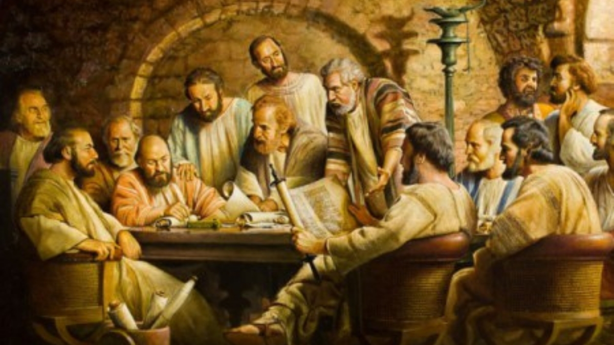
Paul Warns Church Leaders at Ephesus
¹⁷ And from Miletus he sent to Ephesus,
and called the elders of the church.
¹⁸ And when they were come to him,
he said unto them, Ye know, from the first day
that I came into Asia, after what manner
I have been with you at all seasons,
¹⁹ Serving the Lord with all humility of mind,
and with many tears, and temptations,
which befell me by the lying in wait of the Jews:
²⁰ And how I kept back nothing that was profitable unto you, but have shewed you, and have taught you publicly, and from house to house,
²¹ Testifying both to the Jews, and also to the Greeks, repentance toward God,
and faith toward our Lord Jesus Christ.
²² And now, behold, I go bound in the spirit unto Jerusalem, not knowing the things that shall befall me there: ²³ Save that the Holy Ghost witnesses in every city, saying that bonds and afflictions abide me.

Slide 17
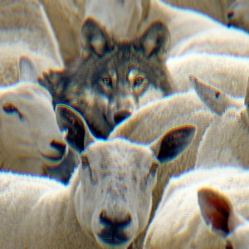
²⁴ But none of these things move me, neither count I my life dear unto myself,
so that I might finish my course with joy, and the ministry,
which I have received of the Lord Jesus, to testify the gospel of the grace of God.
²⁵ And now, behold, I know that you all, among whom I have gone preaching
the kingdom of God, shall see my face no more.
²⁶ Wherefore I take you to record this day, that I am pure from the blood of all men.
²⁷ For I have not shunned to declare unto you all the counsel of God.
²⁸ Take heed therefore to yourselves, and to all the flock,
over the which the Holy Ghost has made you overseers,
to feed the Church of God, which He has purchased with His own blood.
²⁹ For I know this, that after my departing shall grievous wolves
enter in among you, not sparing the flock.
³⁰ Also of your own selves shall men arise, speaking perverse things,
to draw away disciples after them.

Slide 18
³¹ Therefore watch, and remember, that by the space of 3 years
I ceased not to warn every one night and day with tears.
³² And now, brethren, I commend you to God, and to the word of His grace, which is able
to build you up, and to give you an inheritance among all them which are sanctified.
³³ I have coveted no man's silver, or gold, or apparel. ³⁴ Yea, you yourselves know, that these hands have ministered unto my necessities, and to them that were with me.
³⁵ I have showed you all things, how that so laboring you ought to support the weak, and to remember the words of the Lord Jesus, how He said, It is more blessed to give than to receive.

Slide 19
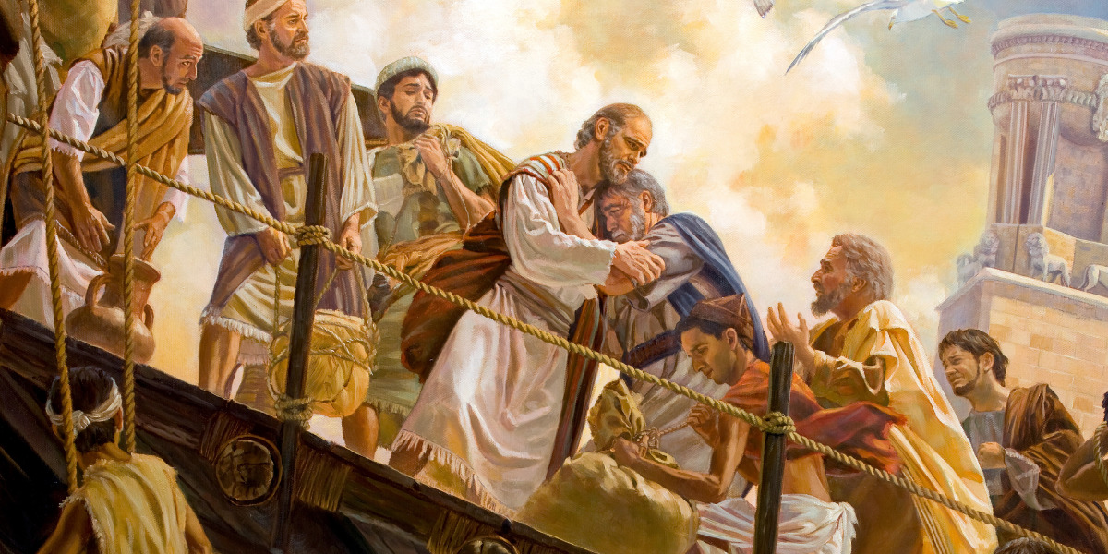
³⁶ And when he had thus spoken, he knelt down, and prayed with them all.
³⁷ And they all wept sore, and fell on Paul's neck, and kissed him,
³⁸ Sorrowing most of all for the words which he spoke, that they should see his face no more.
And they accompanied him unto the ship.

Slide 20
Paul’s ministry time in Ephesus in Spring 52- Fall 53AD
gave him insight into the spiritual climate in that city.
While in prison around 61 AD, Paul wrote
A wonderful strengthening letter to the Church
The Book of Ephesians
Chapter 1 “Our Inheritance in Him”
Chapter 2 “Our Salvation from Sin”
Chapter 3 “The Dispensation of Grace”
Chapter 4. “Oneness in Christ”
Chapter 5 “Marriage Compared to Jesus & His Church”
Chapter 6 “Spiritual Warfare”

Slide 21
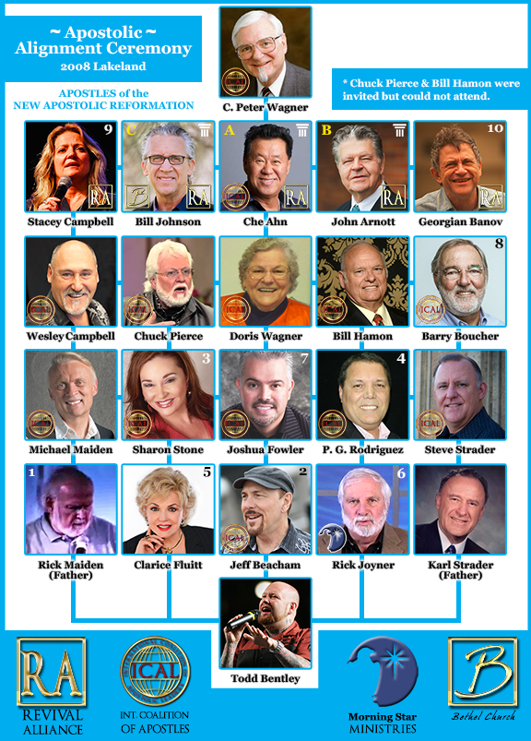
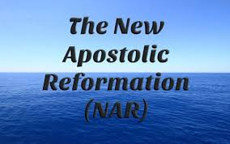
² I know your works, and your labor, and your patience,
and how you can’t bear them which are evil;
and you have tried them which say they are apostles,
and are not, and have found them liars:

Slide 22
The Apostle Paul “ Names” 8 Deceivers
1 – Phygellus – 2 Tim 1:15 2 – Hermogenes – 2 Tim 1:15 3 – Hymenaeus 2 Tim 2:17 4 – Philetus – 2 Tim 2:17 5 – Jannes – 2 Tim 3:8 6 – Jambres – 2 Tim 3:8 7 – Demas – 2 Tim 4:10 8 – Alexander the Coppersmith – 2 Tim 4:14
Romans 16:17-18
“MARK THEM which cause DIVISIONS & OFFENCES CONTRARY to the DOCTRINE which you have learned; and AVOID them. For they that are such SERVE NOT
our Lord Jesus Christ, but their OWN BELLY (personal interests); and by GOOD WORDS & FAIR SPEECHES
( smooth talk) DECEIVE the HEARTS of the SIMPLE
( the innocent, unsuspecting, naive, undiscerning).”
If a certain Bible Teacher continually Teaches error (re: Essential Christian Doctrine,etc) after they, the Bible Teacher or Professing Christian, has been warned by the Body of Christ of this Error— it would be very UNLOVING & BIBLICALLY INCORRECT if we, God’s People, didn’t lovingly WARN other FELLOW BROTHERS & SISTERS in Christ (like Jesus, Peter, Paul, etc. See below: (Naming names below) of these BIBLICAL ERRORS. We are to WARN others out of LOVE for the TRUTH (Eph 4:15, Jude 1:1-4) & for the ETERNAL SAFETY of God’s People, His Flock (Acts 20:28-32, 1 Peter 5:2-4, John 10). We Warn others of the DANGERS of these Teachings &/or False Teachers who are PREACHING & TEACHING things that are CONTRARY to God’s Word

Slide 23
Rev. 2:6 ’But this you have, that you hate the deeds of the Nicolaitanes which I also hate ‘.
Who are the Nicolaitanes? What are their deeds?
What are their doctrines?
Nicolaitane is a Greek word made of 2 root words - Nikos (to conguer) Laos (the People)
The Nicolaitanes by definition are elite spiritual leaders who rule over the people yet suppress them. Two 1st Century Church leaders (Iraneus & Hippolytus) write the Nicolaitanes are the spiritual descendants of Nicolas, a deacon (Acts 6:5). Nicolas was not a Jew, but a pagan from Antioch who got saved and put in ministry by the disciples, but later apostasized. He taught a doctrine of compromise - that total separation between Christianity and the practice of occult paganism was not essential. This doctrine made a separation between soul and spirit: your deeds in the flesh do not matter, because your spirit is saved. This is Gnosticism!
Yes, the Nicolaitanes have continued throughout the Church Age. Catholic popes over the centuries have subdued the people, and today’s mega pastors are following their example.
Celebrity pastors/modern Church growth movements promote shortened messages devoid of sin, no concept of hell or God’s coming judgment. This conquers the people yet suppresses the Truth.

Slide 24
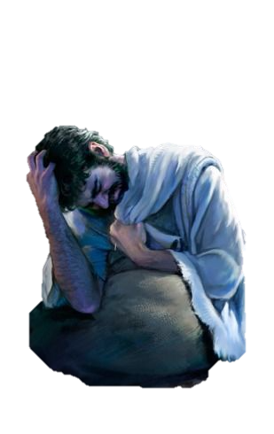
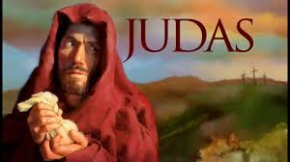
6 Nevertheless I have somewhat against you, because you have left your first love.
Leaving your first love
⁵ Remember therefore from whence you are fallen, and repent, and do the first works;
or else I will come unto you quickly, and will remove your candlestick out of his place,
except you repent.
True Repentace (Metanoia) vs. Worldly Sorrow (Metamelomai)
Metanoia
Meta – To Change
Nous – Mind
Change of Heart & Life
Turn Back to God
Focus on God’s Forgiveness & Acceptance
Hope Restored, Trusting in God’s Power
Metamelomai
Meta – Change
Mellow – Feeling
Change of Feeling, Remorse
Turn away from God
Focus on My Failure & Rejection
Hopeless & Powerless to Change
PAUL
2nd CorIn. 7:10 “For godly sorrow (metanoia) works repentance to salvation not to be repented of: but the sorrow of the world (metamelomei) works death.”

Slide 25
To him that overcomes will I give to eat of the Tree of Life, which is in the midst of the paradise of God.

Slide 26
Revelation 22: 1-2
¹ And he shewed me a pure river of water of life,
clear as crystal, proceeding out of the throne of God and of the Lamb.
² In the midst of the street of it, and on either side of the river, was there the tree of life, which bare 12 manner of fruits, and yielded her fruit every month: and the leaves of the tree were for the
healing of the nations.

Slide 27
The Church of Ephesus
Coming Back to Our First Love

