Slide 1
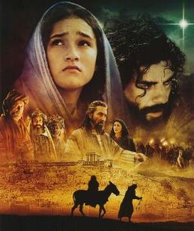
s
“The Christmas Story”
“As it is Written
in the Word”
From Genesis to Revelation
Behold Jesus Messiah

Slide 2
Genesis 3:15
“And I will put enmity between thee and the woman, and between your seed and her seed;
It shall bruise thy head
And you shall bruise His heel.”

Slide 3
“Therefore the Lord himself shall give you a sign;
Behold a virgin shall conceive and bear a son, and shall call his name Immanuel.”
Isaiah 7:14

Slide 4
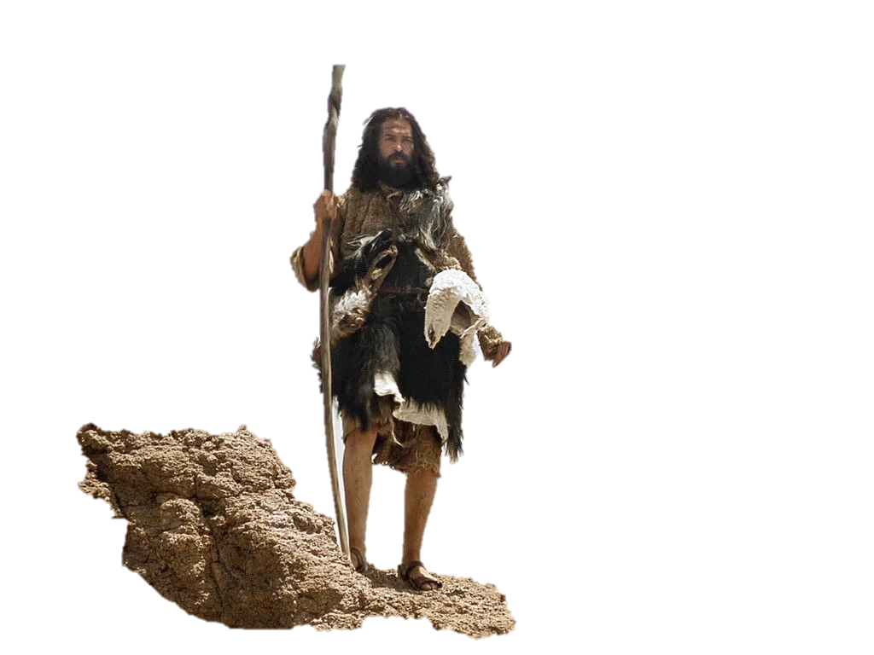
Let’s Start in Luke Chapter 1
Zechariah & Elizabeth
The Birth of John the Baptist

Slide 5
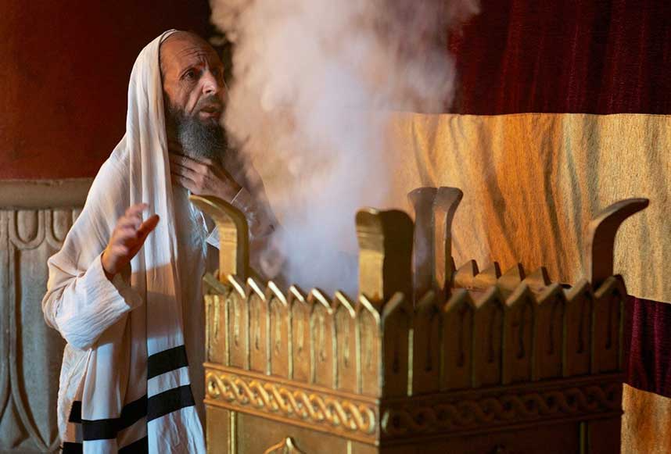
An Angel Visits Zacharias
Luke 1:5-25
While he ministers
in the Temple during
the 8th course of Abijah
1 Chronicles 24:10
If we can know when
John was born,
We can know when Jesus was born!

Slide 6
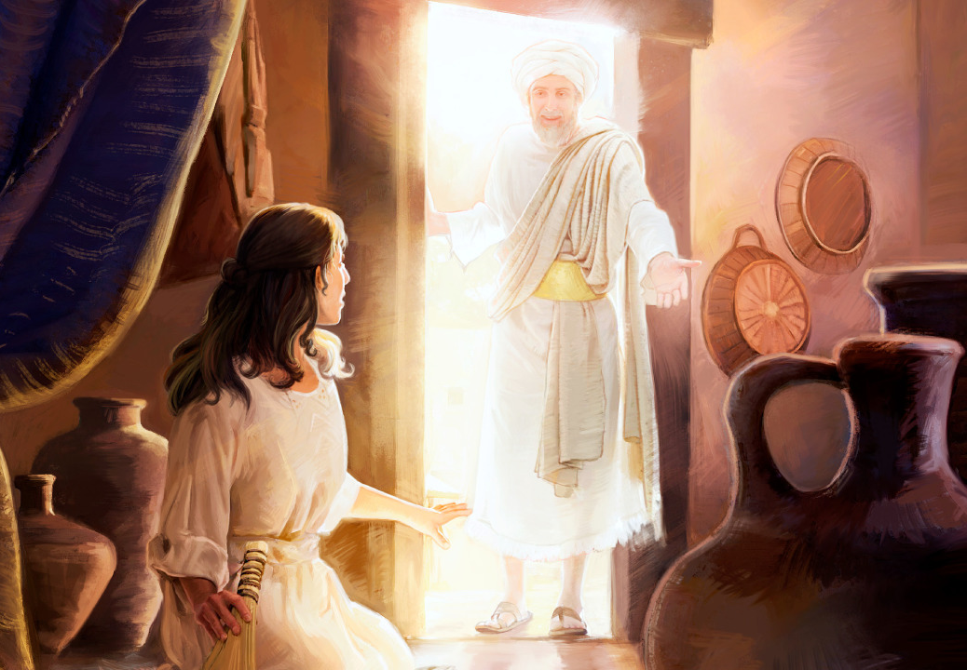
An Angel Appears to Mary
Luke 1:26-38

Slide 7
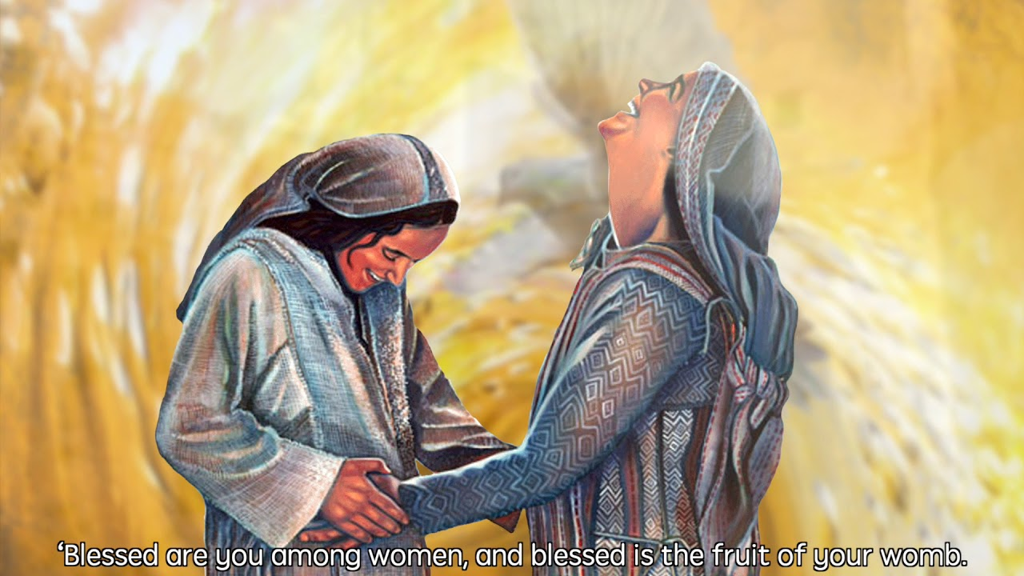
39-41 Mary arose and went to the hill country in haste and entered into Zacharias’ house to greet Elizabeth
When Elizabeth heard Mary’s greeting, the babe leapt in her womb; and Elizabeth was filled with the Holy Ghost.

Slide 8
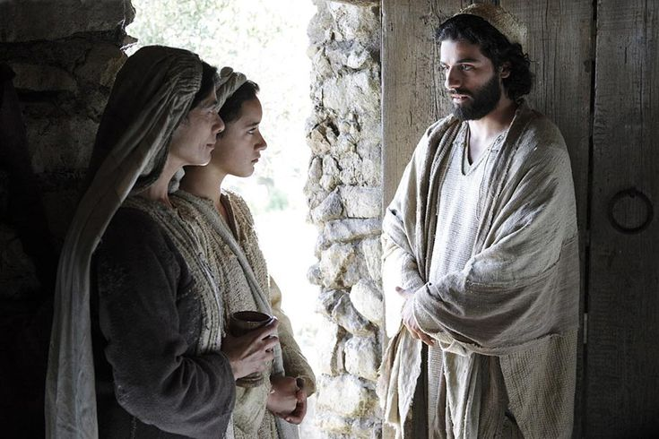
Matthew 1:24-25
An Angel Appears to Joseph
And Joseph being raised from sleep, did as the angel of the Lord had bidden him, and took Mary as his wife.
He knew her not until he had brought forth her firstborn son…..

Slide 9
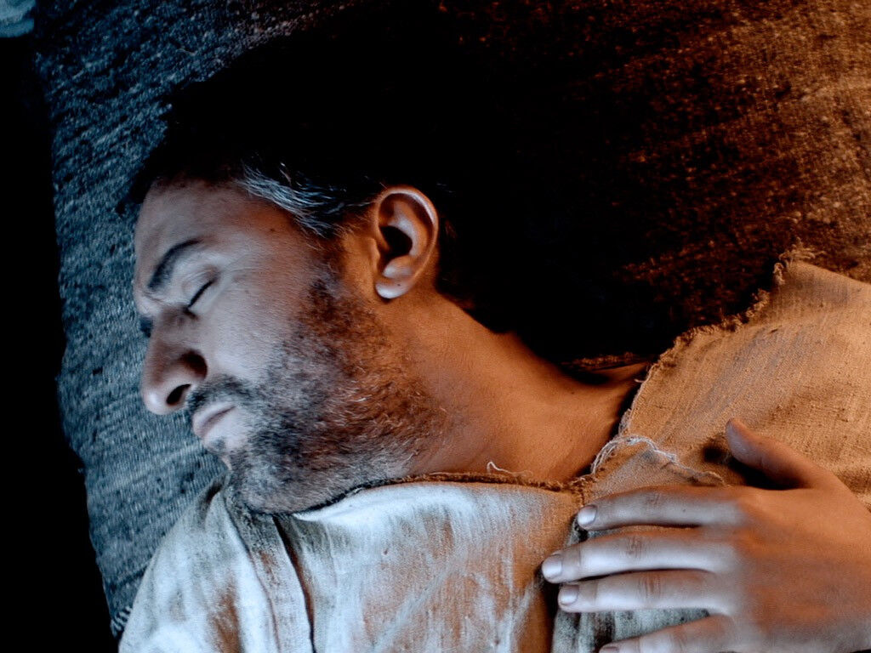
Matthew 1:19-20
Then Joseph her husband, being a just man, and not willing to make her a public example, was minded to put her away privately.
While he was thinking on these things, an angel of the Lord appeared to him in a dream.

Slide 10
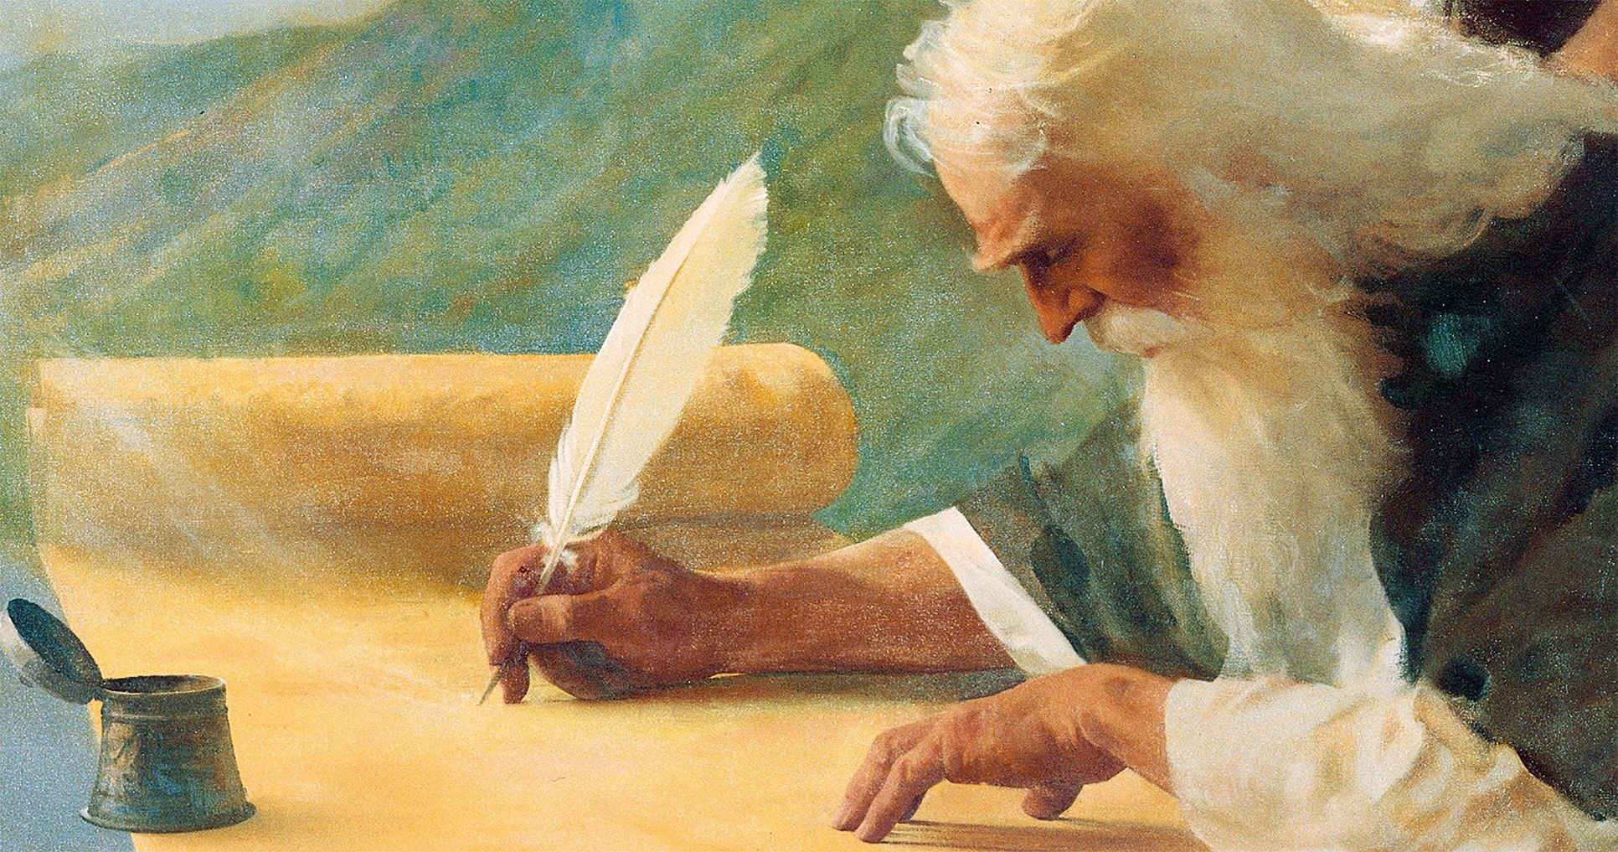
Matt 1:22-23 “Now all this was done, that is might be fulfilled which was spoken of the Lord by the prophet, saying:
“Behold a virgin shall be with child, and shall bring forth a son
and they shall call his name Emmanuel, which being interpreted is God with us.”
“Therefore the Lord himself shall give you a sign;
Behold a virgin shall conceive and bear a son, and shall call his name Immanuel.”
Isaiah 7:14

Slide 11
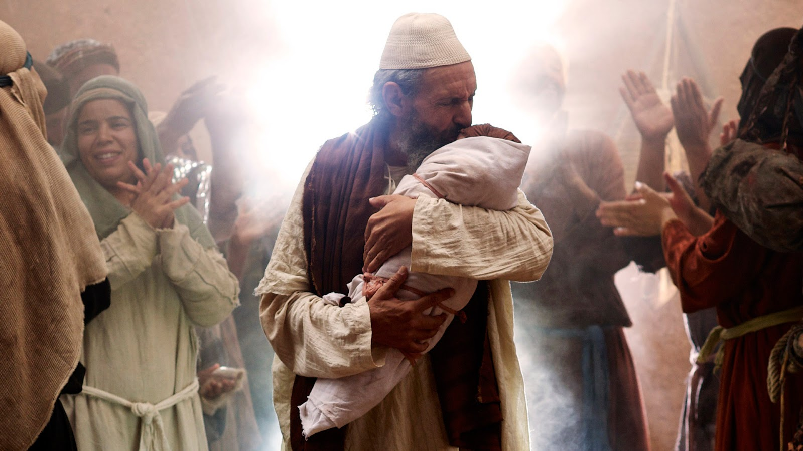
Luke 1:57-80 Zechariah Prophesies at John’s Birth

Slide 12
Luke 1 : 57-80
Zechariah is struck dumb until Elizabeth gives birth to John (vs 57)
Immediately Zechariah was filled with the Holy Ghost and beings to prophesy
God has raised up “a horn of salvation” in the House of David
Just as He spoke by His prophets
He (Messiah) shall save us from our enemies
God remembers His Covenant with Abraham
This child John shall be a prophet of the Most High
This child shall prepare the way of the Messiah
The Messiah will grant salvation by remission of their sins
The Messiah will give light to those who sit in darkness
80. The child John grew and waxed strong in spirit, and was in the desert
til the day of his shewing to Israel

Slide 13
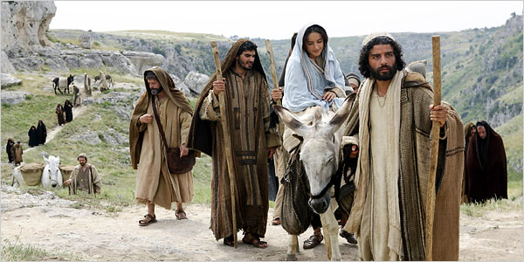
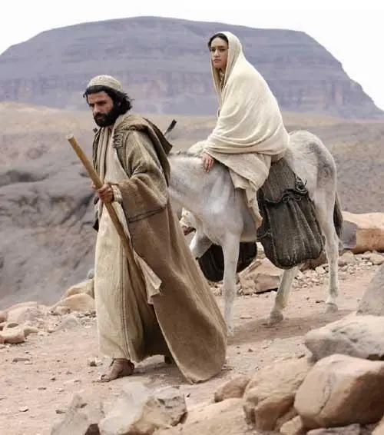
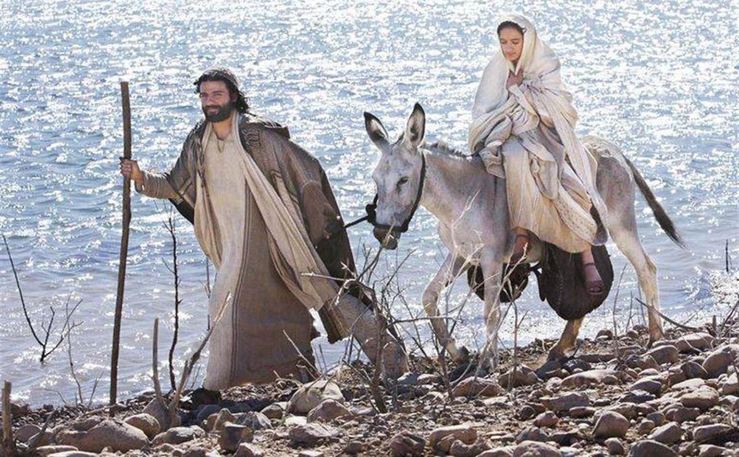
Luke 2:1-20
“And all went out to be taxed everyone to
his own city. Joseph also went up from Galilee, out of Nazareth to Judea, unto the City of David, which is called Bethlehem.”

Slide 14
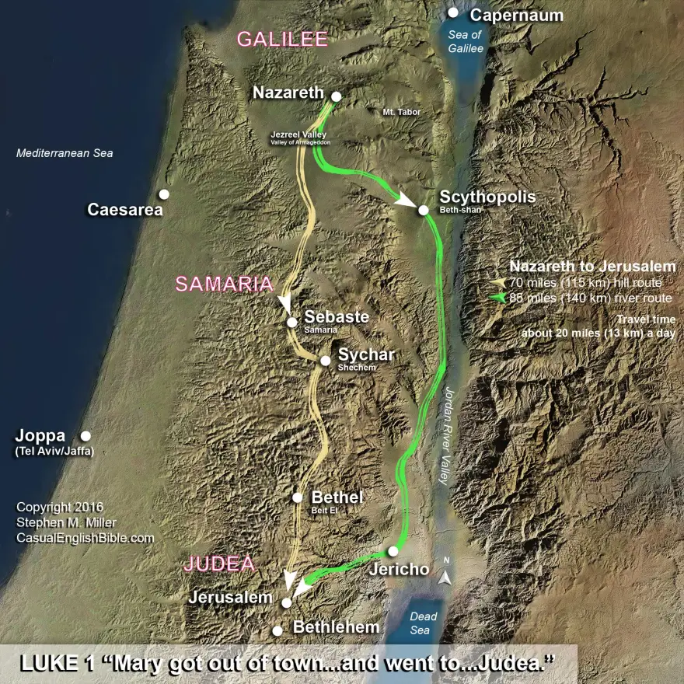
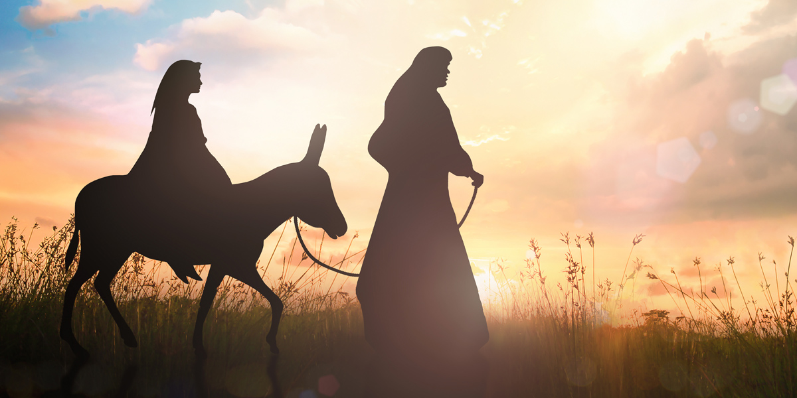
Joseph and Mary travel over 70 miles
From Nazareth to Bethlehem
Walking with a donkey
Through desert,
Over mountains
Thru Valleys

Slide 15
…There was no room for them in the inn”

Slide 16
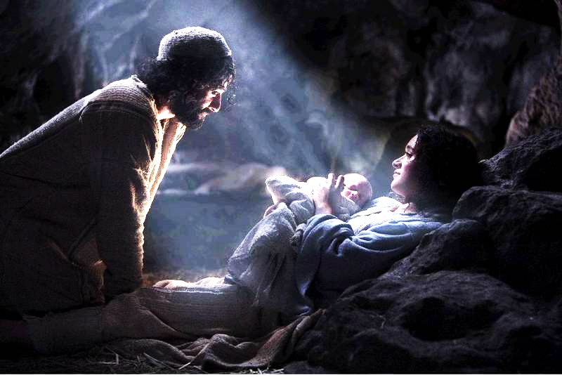
Luke 1:6-7
“And so it was,
while they were there, the days were accomplished that she should be delivered.
And she brought forth her firstborn son, wrapped him in swaddling clothes, and laid him in a manger
For there was no room for them in the inn”

Slide 17
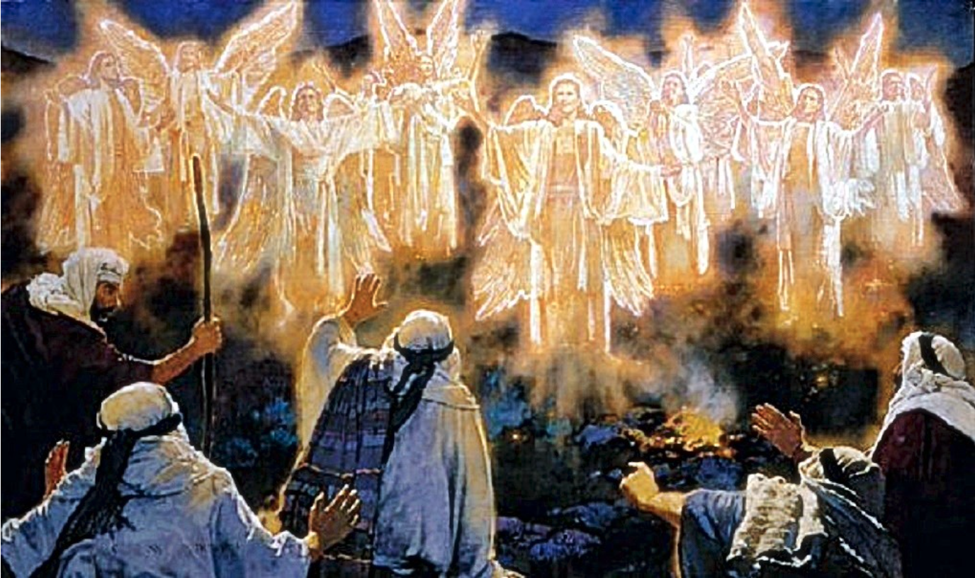
Luke 2:8-9 “And there were in the same country shepherds abiding in the field, keeping watch over their flock by night. And lo, the angel of the Lord came upon them, and the glory of the Lord shone round about them: and they were sore afraid:

Slide 18
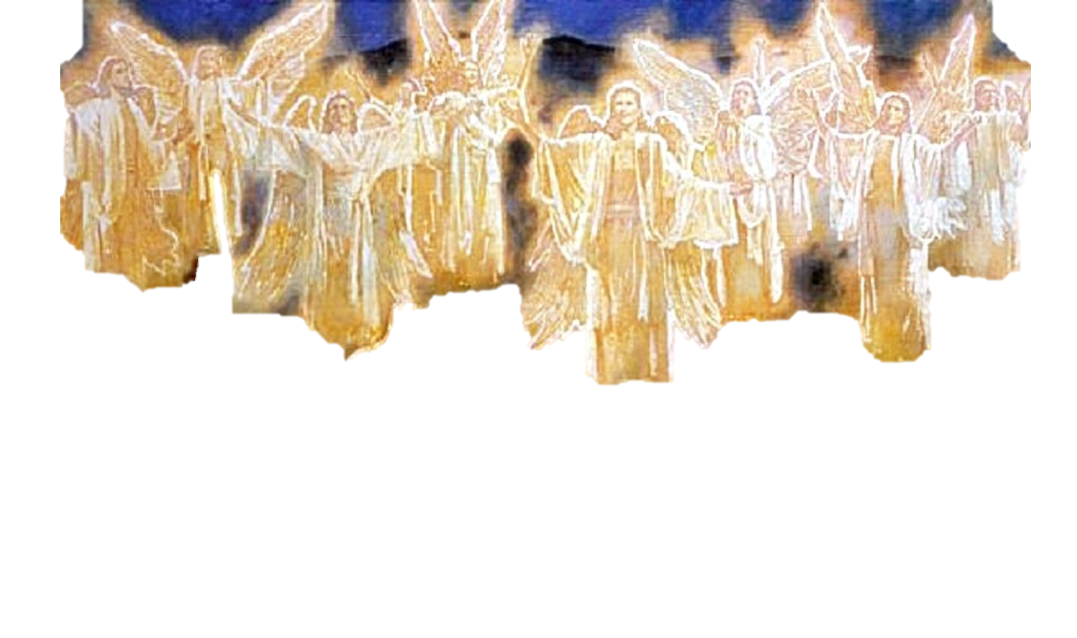
Luke Chapter 2
10. “And the angel said to them, Fear not; for behold, I bring you good tidings of great joy, which shall be unto all people. 11. For unto you is born this day in the City of David a Savior, which is Christ the Lord. 12. And this shall be a sign unto you; You shall find the baby wrapped in swaddling clothes, lying in a manger”
13. And suddenly there was with the angel a multitude of the heavenly host praising God and saying, “Glory to God in the highest, and on earth peace, goodwill toward men.”

Slide 19
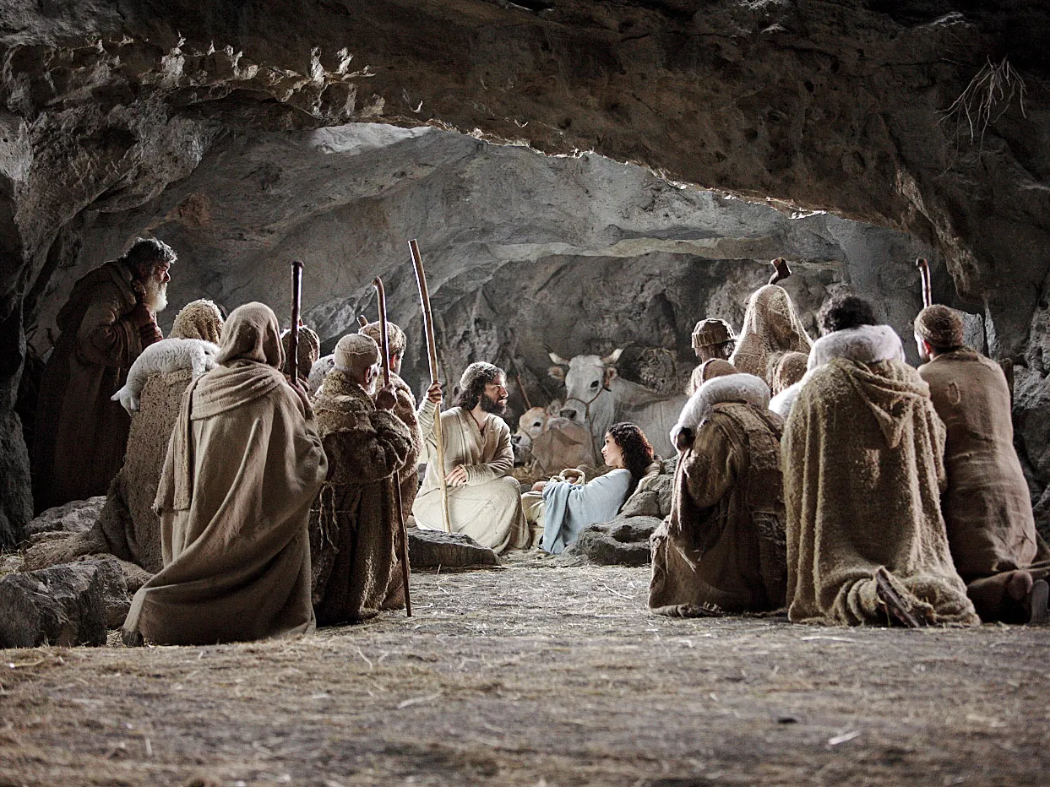
15.”And is came to pass, as the angels said one to another, Let us now to even to Bethlehem, and see this thing which ahs come to pass, which the Lord haws made know to us.
16.And they came and found Mary and Joseph and the babe lying in a manger.
I7.When they had seen it, they made know abroad all those things which were told them concerning this child.”
18.And all that heard it wondered at those things which were told them by the shepherds.

Slide 20
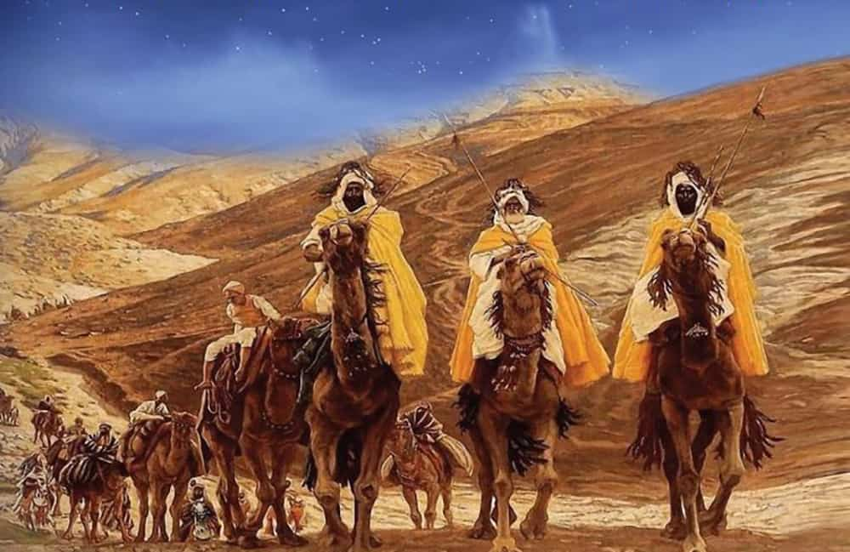
“Now when Jesus was born in Bethlehem of Judea in the days of Herod the King, behold there came wise men from the east to Jerusalem, saying “Where is he that is born King of the Jews: For we have seen his star in the east and are come to worship him.” Matthew 2:1-2

Slide 21
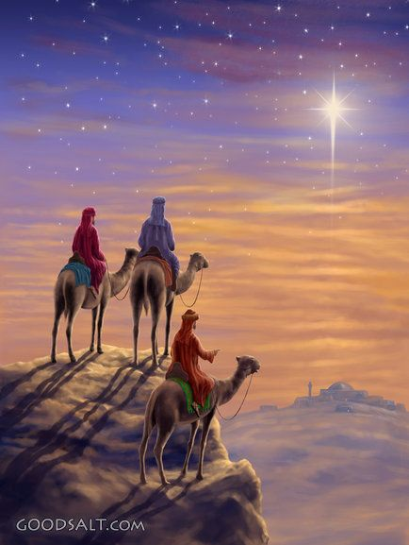
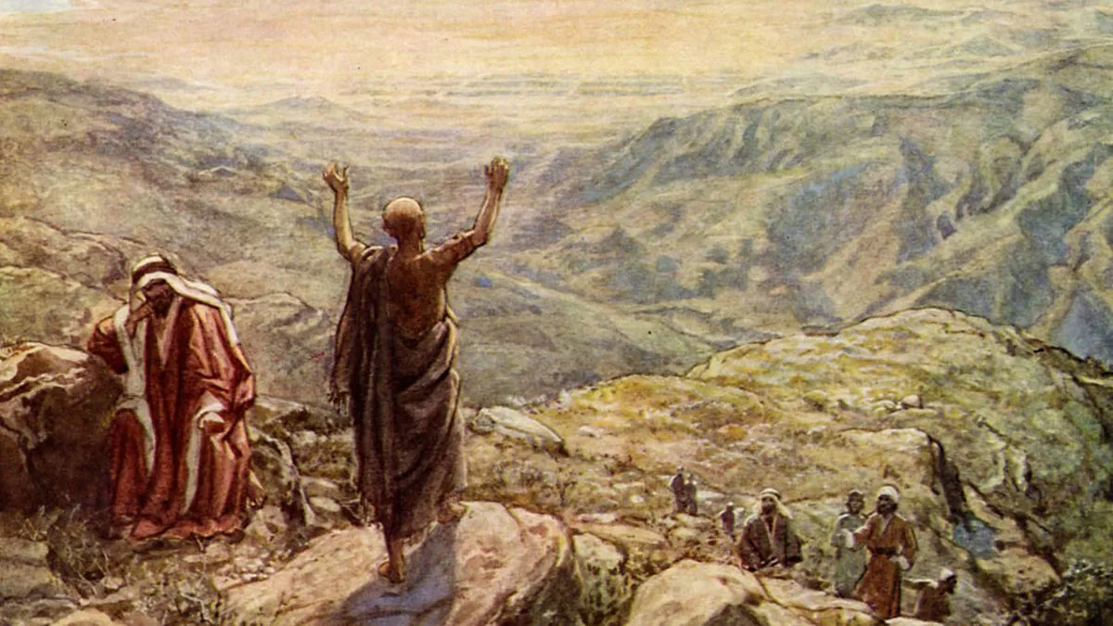
Balaam Prophesies - Numbers 24:17
“I shall see Him, but not now: I shall behold Him, but not nigh:
there shall come a Star out of Jacob, and a Scepter shall rise out of Israel, and shall smite the corners of Moab, and destroy all the children of Sheth.”

Slide 22
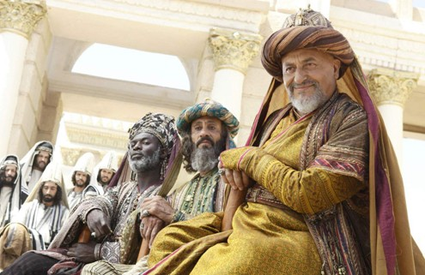
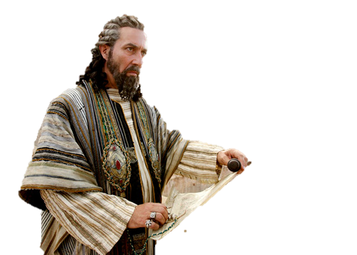
Herod gathers all the chief priests and the scribes and demands to know –
“Where shall this Christ be born?” Matthew 2:3
They say, ‘In Bethlehem of Judea: for thus it is written by the prophet “And you, Bethlehem, in the land of Judah, are not the least among the princes of Judah: for out of you shall come a Governor, that shall rule My people Israel.” Matthew 2:4-5

Slide 23
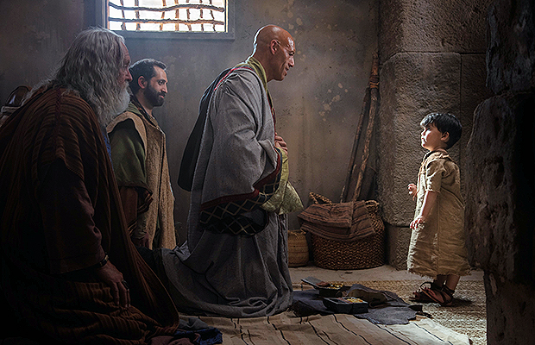
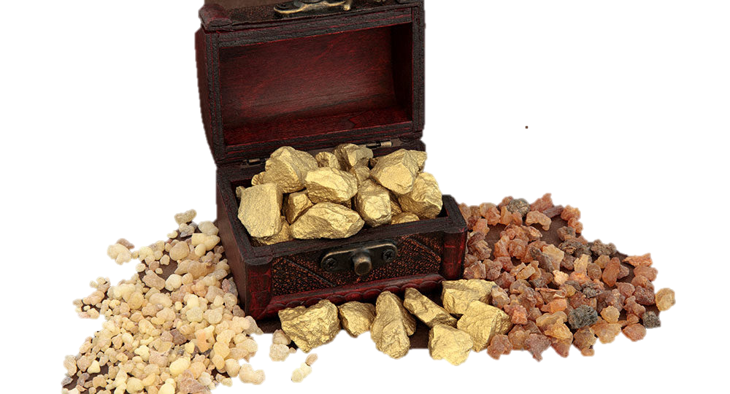
11.“And when they came into the house, they saw the young child with Mary his mother, and fell down and worshipped him: and when they had opened their treasures, they presented him gifts; gold, frankincense, and myrrh.
12. “And being warned of God in a dream that they should not return to Herod, they departed into their own country another way.”

Slide 24
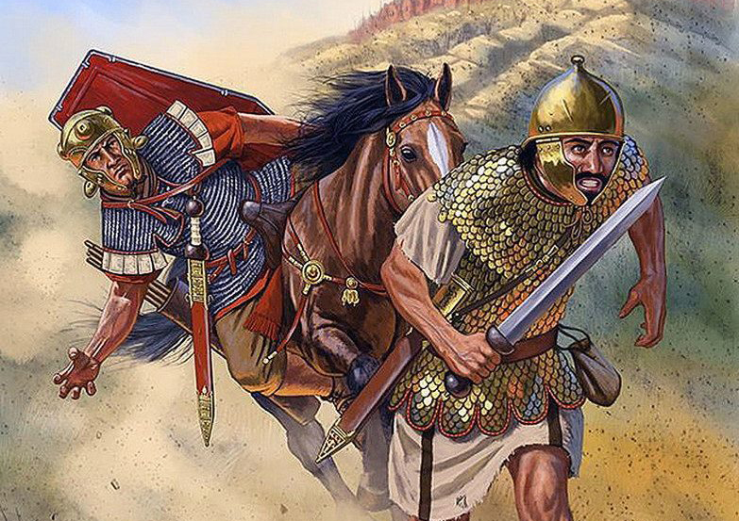
13. “And when they were departed, behold, the angel of the Lord appeared to Joseph in a dream, saying “Arise and taken the young child and his mother and flee to Egypt. Be there until I bring you word: for Herod will seek the young child to destroy him.”

Slide 25
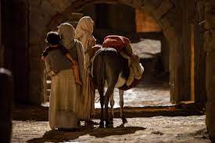
14. When Joseph arose , He took the young child and his other by night and departed to Egypt
15. And was there until the death of Herod: that it might be fulfilled which was spoken of the Lord by the prophet, saying, “Out of Egypt have I call My son.” Hosea 11:1

Slide 26
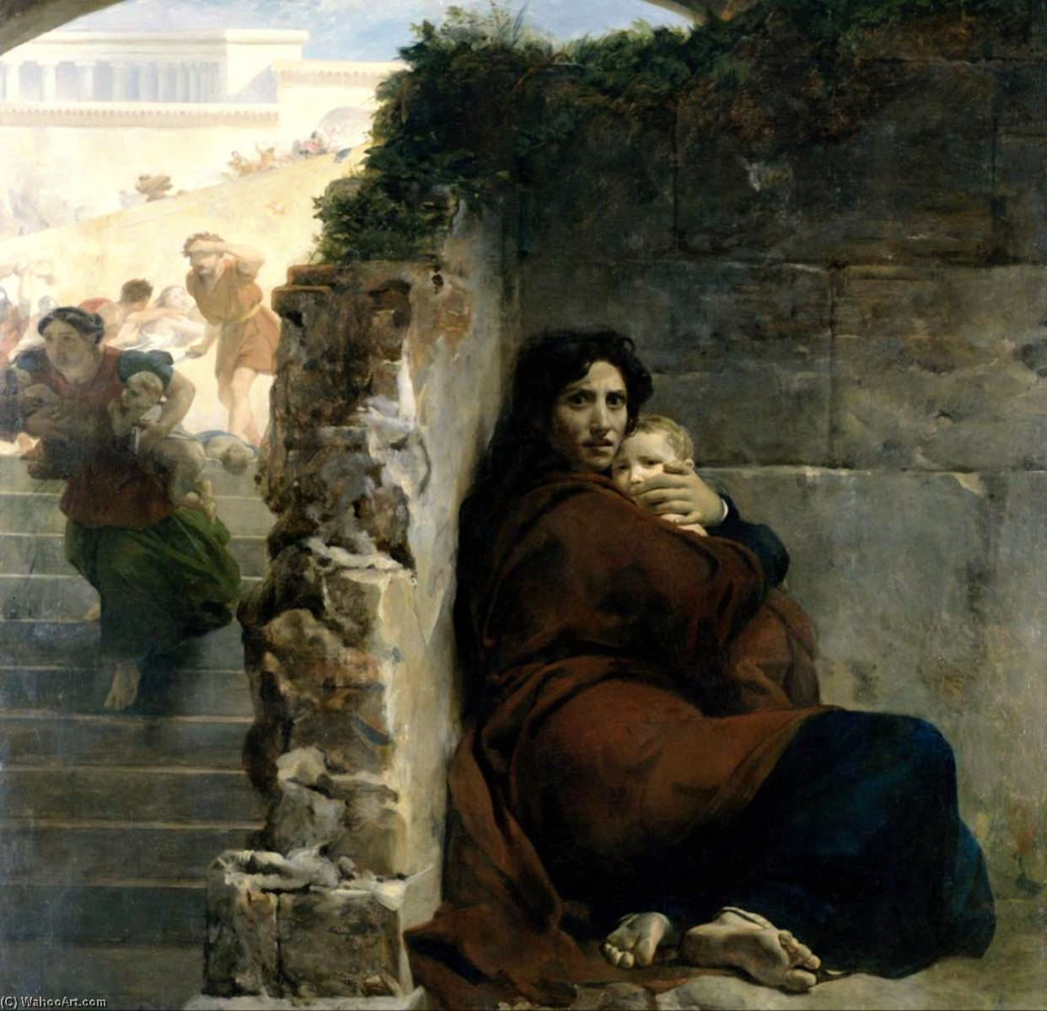
“16. Then Herod, when he saw that he was mocked by the wise men, was exceeding wroth, and sent forth, and slew all the children that were in Bethlehem, and in all the coasts thereof, from
2 years old and under, according to the time which he had diligently inquired of the wise men"
“Then was fulfilled which which was spoken
by the prophet Jeremiah, saying, Jeremiah 31:15
In Ramah was there a voice heard,
Lamentation and weeping and great mourning
Rachel weeping for her children,
And would not be comforted Because they are not.

Slide 27
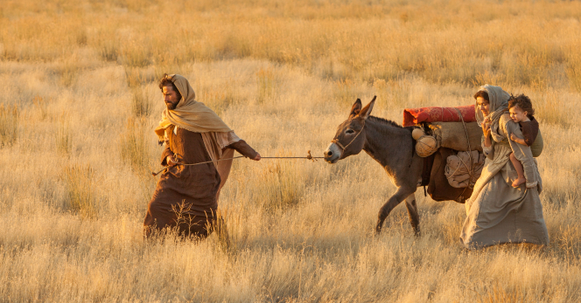
An Angel Appears in Another dream to Joseph - In Egypt
20. “Arise, take the young child and his mother
and go to the Land of Israel: for they are dead
which sought the young child’s life.
21.Joseph arose and took young child and his mother
and came to the Land of Israel.”

Slide 28
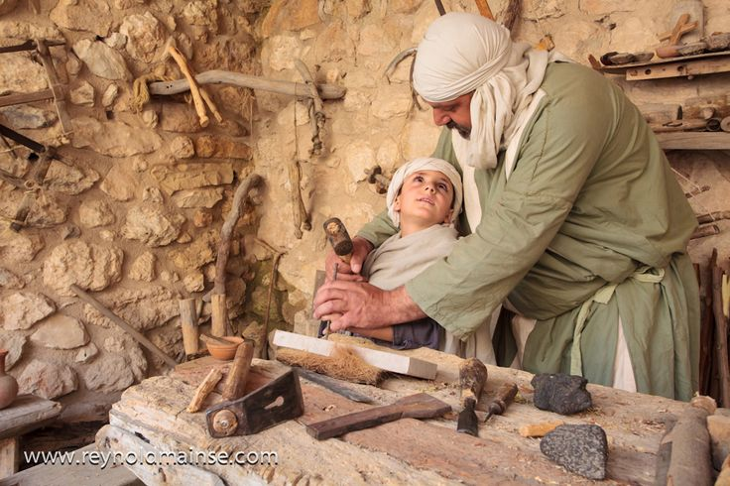
22. When Joseph heard that Archelaus reigned in Judea after his father Herod, he has afraid there. Being warned in a dream, he turned aside to the Galilee
23. And he came and dwelt in a City called Nazareth: That it might be fulfilled which was spoken by the prophets, ‘He shall be called a Nazarene.” Jeremiah 23:5-6, Isaiah 11:1

Slide 29
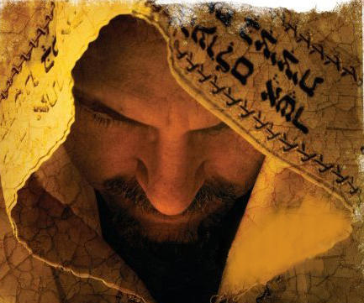
Behold Jesus Messiah – He is Prophet, Priest & Coming King

