Slide 1
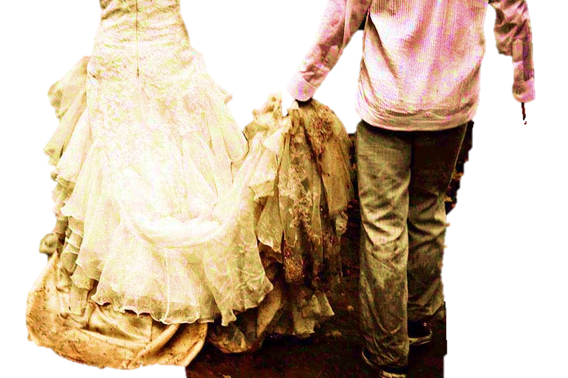
“Spots, Blemishes and Wrinkles - Not Me”
Part 3

Slide 2
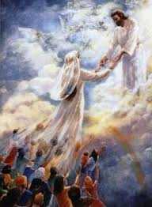
Jesus Christ is coming Soon for His Church,
A Church Saved by His Blood, And Washed by His Word
A Church full of His Glory
Walking in His Spirit
A People full of Faith
Fervent in Prayer
Anointed by His Holy Spirit
Appointed to Great Works!
That’s US!

Slide 3
A Church Without Spot, Blemish or Wrinkle
“Husbands,
love your wives
even as Christ
also loved the Church
And gave Himself for it,
Ephesians 5:25

Slide 4
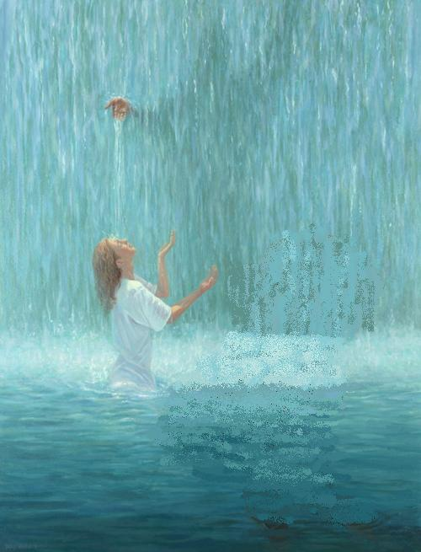
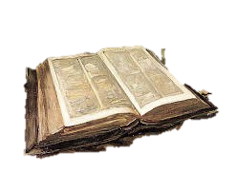
“That He might sanctify it
and cleanse it by the washing of the water by the Word,
“That He might present it to Himself
A glorious Church,
not having spot or wrinkle,
or any such thing,
But that the Church should be holy & without blemish.”
Ephesians 5:26-27

Slide 5
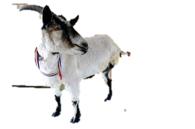
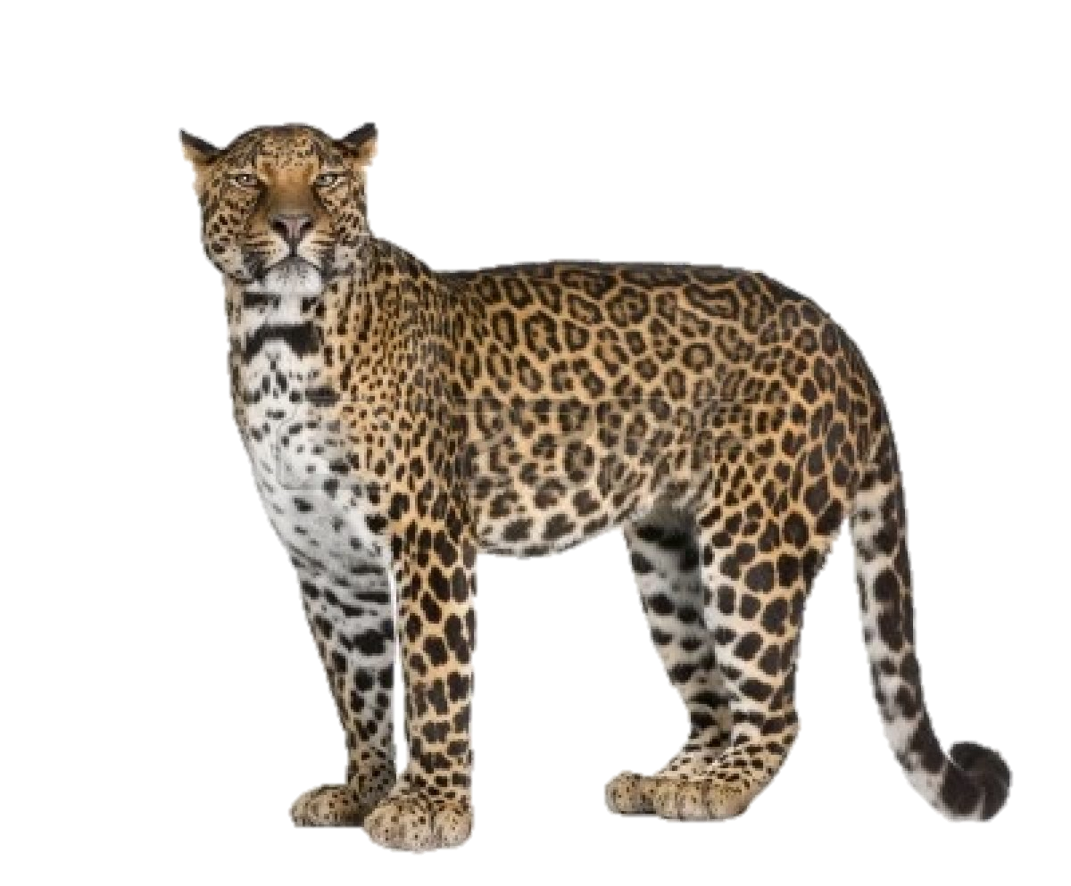
We’ve Studied “Blemishes”
We’ve Examined “Spots”
Now let’s look at “Wrinkles”

Slide 6
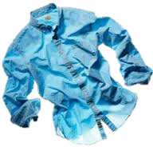
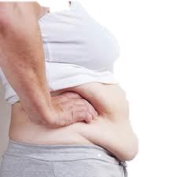
A wrinkle is caused when external pressure
causes a crease or a fold: the original state changes to something very different.
Wrinkles are also caused by “excessive living.”
As a prosperous nation, when we over-indulge ourselves, we become overweight and inactive. As we discipline ourselves with a healthy diet, excess disappears. But if we fail to exercise, wrinkles will take the place of the fat!
As it is in the natural, so it is in the Spirit
Being driven by the desires of our flesh will always fight being led by the Holy Spirit…After being gloriously saved, can we entangle ourselves in sin again?
Not if the Holy Spirit rules over our flesh!

Slide 7
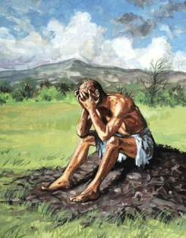
“And you have filled me with wrinkles, which is a witness against me:
And my leanness rising up in me bears witness to my face.” Job 16:8
The Book of Job
Wrinkle = qamat (7059)
To be snatched away prematurely
To be seized, cut down, to bind
“Have you marked the old way which the wicked men have trodden? Which were cut down out of time, whose foundation was overflown with a flood”
Job 22:15-16

Slide 8
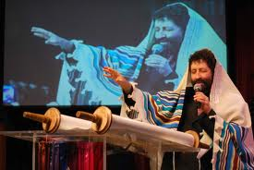
Will the prosperous American Church
get fat on all God’s blessings,
Then like Israel forsake and forget Him?
“Repent,
Come back to Me!”

Slide 9
What Happened When Israel forgot God?
Psalm 106:13-15 “They soon forgot His works; they waited not for His counsel: But lusted exceedingly in the wilderness & tempted God in the desert. And He gave Israel their request, but He sent leanness into their soul”

Slide 10
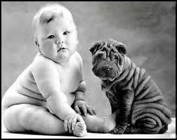
So, How do we get rid of wrinkles?

Slide 11
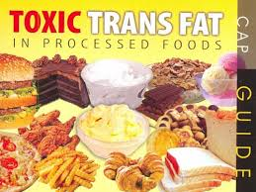
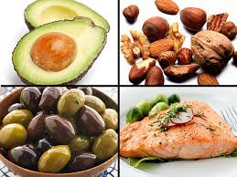
First we might need to learn from the Bible
about FATS…..
There are good fats and bad fats!

Slide 12
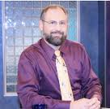
Likewise in the Old Testament
there are good and bad FATS!

Slide 13
1. Dashen (1878 Hebrew) “fat, anointed”
Prov 28:25 “He that puts his trust in the Lord shall be made fat.”
Prov 13:4 “The soul of the diligent shall be made fat.”
Prov 11:25 “The liberal soul shall be made fat:
and he that waters shall be watered also himself.”
Prov 15:30 “The light of the eyes rejoices the heart
and a good report makes the bones fat.”
Psalm 23:5 “You prepare a table before me in the presence of my enemies: you anoint my head with oil; my cup runs over.”
Isaiah 34:6 “The sword of the Lord is filled with blood;
it is made fat with fatness, and with the blood of goats and lambs,
with the fat of the kidneys of rams.”

Slide 14
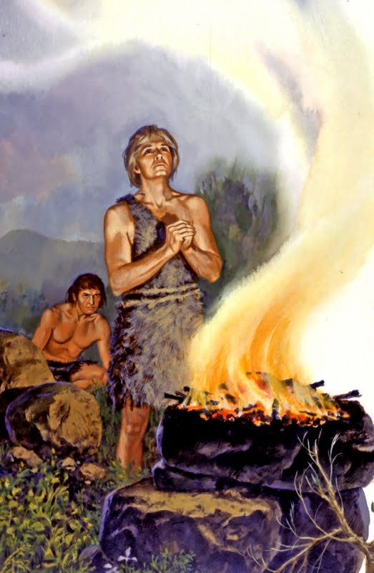
2. Cheleb (Hebrew 2459) “fat, the rich or best part”
Gen 4:4 “And Abel, he also brought of the firstlings
of his flock and of the fat thereof.
Gen. 45:18 “And take your father & your households
& come to Me: And I will give you the good of the land
of Egypt, and you shall eat the fat of the land”
Leviticus 3:9-10 “And he shall offer the peace offering’
sacrifice made by fire to the Lord; the fat thereof & the
whole rump shall he take off hard by the backbone,
the fat that covers the inwards,& all the fat that is upon
the inwards, a the 2 kidneys,& the fat upon them which is by the flanks, and the caul above the liver, with the kidneys shall he take away”
Leviticus 3:16 “It is the food of the offering made by fire for a sweet savor; all the fat is the Lord’s”

Slide 15
Deut. 32:13-15 :He made him ride on high places of the earth, so that he might eat the increase of the fields. And He made him to suck honey out of the rock, and oil out of the flinty rock, butter from cows, and milk from sheep, with fat (best) of lambs, and rams of the sons of Bashan, and goats, with fat (best) of kidneys of wheat. And you drank the blood of the grape.
Psalm 17:10 “they are enclosed in their own fat: with their mouth they speak proudly.”
Psalm 73:7 “Their eyes stand out with fatness: they have more than heart could wish”
Ps 119:70 “their heart is as fat as grease; but I delight in Your Law.”
Isa. 34:6 “the sword of the Lord is filled with blood, it is made fat with fatness & with the blood of lambs & goats, with the fat of the kidneys of rams: for the Lord has a sacrifice in Bozrah & a great slaughter in the Land of Edom.”
Ezek 39:19 You shall eat fat til you be full & drink blood till you are drunk, of my sacrifice which I sacrificed for you”

Slide 16
3.Shaman (H 8080) “To grow fat, robust, lusty, gross,
glow shiny with oil, anoint ”
Gen 49:18 “Out of Asher his bread shall be fat & he shall yield royal delight’
Ex 29:21 “Then shall you take the anointing oil & pour it on his head & anoint him
Deut 32:15 “But Jeshurun (Israel) grew fat & kicked. You grew fat (gross), thick, and covered with fatness.. Then he forsook God who made him and lightly esteemed the Rock of his salvation.”
Isa 6:10 “Make this peoples’ heart fat & make their ears heavy & shut their eyes, lest they see with their eyes & hear with their ears & understand with their heart, and convert, and be healed.”
Jer 5:28 “They are waxen fat, they shine: yes, they overpass the deed of the wicked: the judge not the cause, the cause of the fatherless, yet they prosper; and the right of the needy they do not judge.”

Slide 17
4. Mashman (H 4924) “Fat, rich, fertile, robust”
Gen.27:28 “therefore God give you of the dew of heaven & the fatness of the earth, & plenty of corn & wine”
Isaiah 17:4 “And in that day, it shall come to pass, that the glory of Jacob shall be made thin, and the fatness of his flesh shall wax lean.”
Isaiah 10:16 “Therefore shall the Lord, the Lord of hosts, send among His fat ones leanness; & under His glory He shall kindle a burning like the burning of a fire.”
Dan 11:24 “He shall enter peaceably even upon the fattest places of the province; & he shall do that which his father have not done, nor he fathers’ fathers; he shall scatter among them the prey & spoil & riches, yes, and he shall forecast his devices against the strongholds, even for a time”

Slide 18
5. Taphash ( H 2954) “Fat, insensitive, thick-headed
Psalm 119:70 “Their heart is as fat as grease, but I delight in Your Law”

Slide 19
So, How do we get rid of wrinkles?

Slide 20
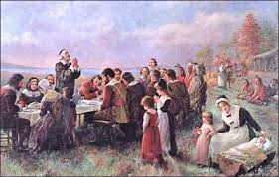
Remember the Lord and what He has done for America

Slide 21
