Slide 1
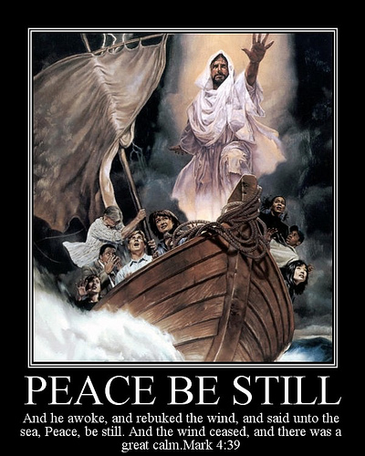
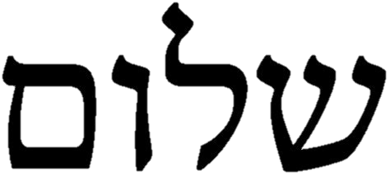
“Shalom”
“Peace in the Midst
of Any Storm”

Slide 2
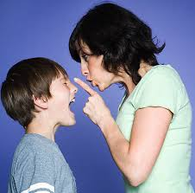
When the Bible says “Peace or Shalom”
It means so much
More than…….
NO more War
No Screaming in Your House!
.

Slide 3
GOD’s Meaning for SHALOM
PEACE
Is Much Deeper and Stronger

Slide 4
Today in Israel, Shalom is the both hello greeting
and the fond goodbye
Shalom means Peace in every area of your life, in your
home, in your family, in your body, in your friendships
Jerusalem is made up of 2 Hebrew root words
Jireh – “Our God will provide”
Shalom - “Peace”
Jesus is the Prince of Peace - Isaiah 9:6
“For unto us a child is born, unto us a Son is given:
and the government shall be upon His shoulder:
and His name shall be called Wonderful, Counselor, The mighty God, The everlasting Father, the Prince of Peace.”

Slide 5
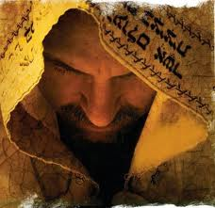
GOD Wants to Give Us
His Shalom Peace
He sent His only Begotten Son Jesus to Bring us true Peace. ..Peace with God, Peace with Ourselves, Peace with Others
Jesus is Our Shalom
First we have to know
There is a Sin Problem
“For all have sinned and fall short of the glory of God”

Slide 6
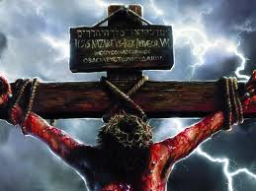
Sin Separates Man from God
Placing Faith in Jesus
Restores Our Peace with God
Jesus’ Death on a Cross 2,000 years ago destroyed Sin’s bondage
We inherited this sin nature from the 1st man Adam in the Garden
“ As by one man’s disobedience (Adam) many were made sinners, so by the obedience of one (Jesus), shall many be made righteous.
Therefore being justified by faith we have peace with God through our Lord Jesus Christ” Romans 5:1

Slide 7
We Need a Little Hebrew Lesson
To Really Understand Shalom
Every Hebrew Word
in the Bible
Is Made Up of 3 Letters Called Roots
They Each Have Spiritual Meanings!
Put together they give
a wonderful spiritual picture
of Bible truths

Slide 8
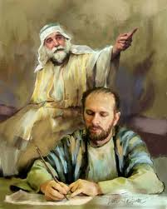
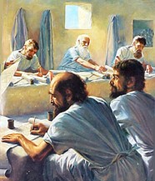
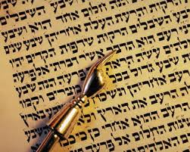
Hebrew is a Supernatural Language
We don’t study Hebrew to become Jews…
We want God’s
Supernatural
Truth!
“For then I will return to the people a pure Language, that they may call upon the Name of the Lord, to serve Him with one consent.” Zephaniah 3:9

Slide 9
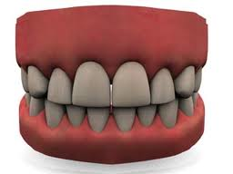
Shin
ש
Word Picture –Teeth
Means - All Consuming

Slide 10
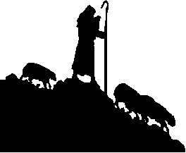
Lamed
ל
Symbol: Shepherd’s Staff
Meaning: Leader
Authority
Instruction

Slide 11
Vav
ו
Symbol : The Nail
Meaning: Hooked to

Slide 12
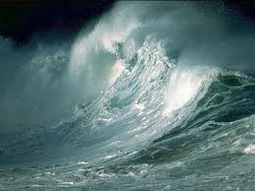
Mem
Symbol: Waves
Meaning: Chaos:

Slide 13
SHALOM
Shalom = That which destroys
the Authority of Chaos in Our Lives!

Slide 14
Shalom = Wholeness
You can Trust
The Holy Spirit
to Bring Wholeness
to Every Area
of Your life

Slide 15
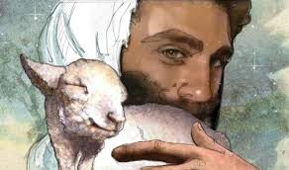
“Be Thou Made Whole…”
Healing
Blessing & Safety
Righteousness
The Fear of the Lord
Hearing God’s Voice
Financial Provision Lack of Strife in Home
Business Blessing
Victory in Battle
Restful Calm
Covenant Promises
Accountability
Restored Relationships
Truth and Not Lies
Spiritual Order
Completeness
Trusted Friends
Answered Prayers
Spiritual Discernment
Holy Ghost Quickening
Open Heaven
Prophetic Revelation

Slide 16
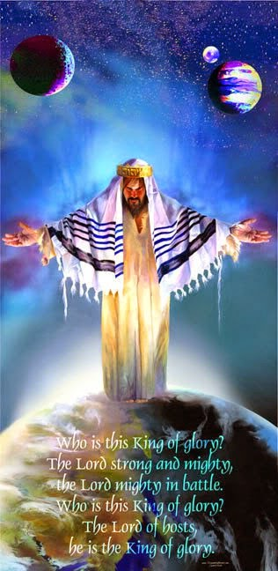
What Does Peace with God mean?
How can We Walk in Peace
in all of the Storms of Life…
How can We walk in Peace
with those who hurt & offend us?
How can we trust God
in the days we are living in?
Before Jesus returns……
as the King of Glory
That’s where Faith comes in
There will be no Lasting Peace
in this world
Until He Comes
He is the Prince of Peace .

Slide 17
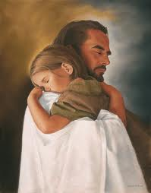
Only When we have Peace with God
Shalom
Can we Truly Understand the
Supernatural Love
of the Father

Slide 18
Only when we have the Peace of God,
His Shalom
Can We Learn to Trust the
Leading of
The Holy Spirit
Without Fear or
Condemnation

Slide 19
Hold Fast to the Promises in God’s Word
Psalm 119:165 “Great peace have they that love thy Law
And nothing shall offend them”
Isaiah 26:3 “ You will keep him in perfect peace, whose mind is stayed on Thee, because He trusts in thee.”
Exodus 14:14 “The Lord shall fight for you,
and you shall hold your peace.”
Jeremiah 29:11 “For I know the thoughts that I think toward you, says the Lord, thoughts of peace and not of evil, to give you an expected end.
”

Slide 20
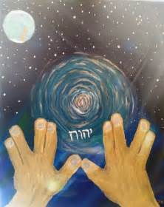
Numbers 6:26
“The Lord bless you and keep you.
The Lord make His face to shine upon you
and be gracious to you.
The Lord lift up His countenance upon you
and give you peace.”
Psalm 4:8
“ I will lay down in peace and sleep for only You Lord, make me dwell in safety.”
Isaiah 57:21
“There is no peace, says my God, to the wicked.”
.

Slide 21
We See Jesus As Shalom
in the New Testament
Jesus Walking in Peace
with His Enemies…
Jesus Granting Peace
to Hurting People…
Jesus Speaking Peace
to Those in Fear…
At His Birth - Juke 2
To His Disciples - Mark 4:35-41
To a sick Woman - Luke 7:37—50
To a Woman in Sin - Luke 8:43-48
Announcing the Coming Holy Spirit
John Chapters 14 & 16

Slide 22
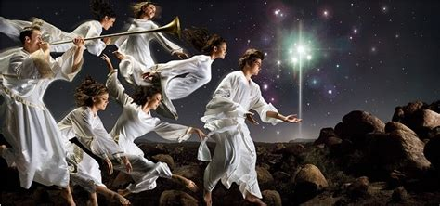
Luke 2 12-14 “And this shall be a sign to you, You shall find the babe wrapped in swaddling clothes, lying in a manger.
And suddenly there was with the angel a multitude of heavenly host praising God, saying, Glory to God in the highest and on earth peace, good will towards men”

Slide 23
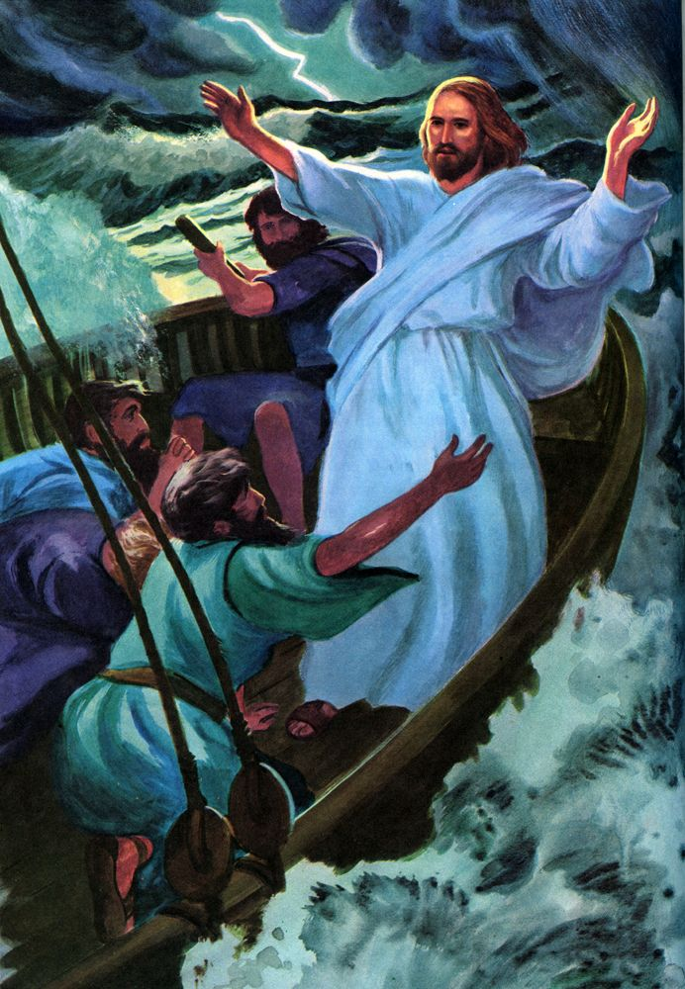
Mark 4:35-39 “And the same day
at even, Jesus said, Let’s pass over to the other side.
When they had sent away the multitude, they went into the ship..
And there arose a great storm…
and the waves beat into the ship,
so that now it was full
And Jesus was in the back part of the ship, asleep on a pillow. They awoke Him saying, Master do You not care that we perish?
And Jesus arose and rebuked the wind, and said to the sea,
Peace, be still. And the wind ceased there was a great calm.
l

Slide 24
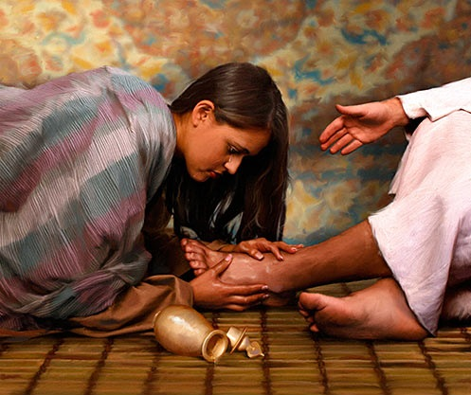
.
“Behold a woman in the city, who was a sinner, when she knew that Jesus sat to eat in the Pharisee’s house, brought an alabaster jar of ointment
And stood at His feet weeping, and began to wash His feet with tears, and wiped them with her hair, and kissed His feet and anointed them with oil”
This started a huge argument with the Pharisee about this woman because she was a sinner. Jesus contrasts her heart of repentance and love with the heart of the Pharisee, declaring her sins were forgiven, because she loved much..
“Jesus said to her, Your sins are forgiven, Your faith has saved you:
Go in Peace” Luke 7:36-50:

Slide 25
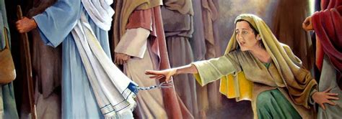
A certain Woman with an issue of blood for 12 years
No physicians could heal her, she just got worse
When she heard Jesus had come, she risked everything, saying
If I could just touch His garment, I shall be whole
Immediately she was healed
Jesus knew that virtue had gone out of Him, asked,
Who touched my clothes?
When the woman told Jesus the truth in fear and trembling, He said,
Daughter, your faith has made you whole, go in peace!.”

Slide 26
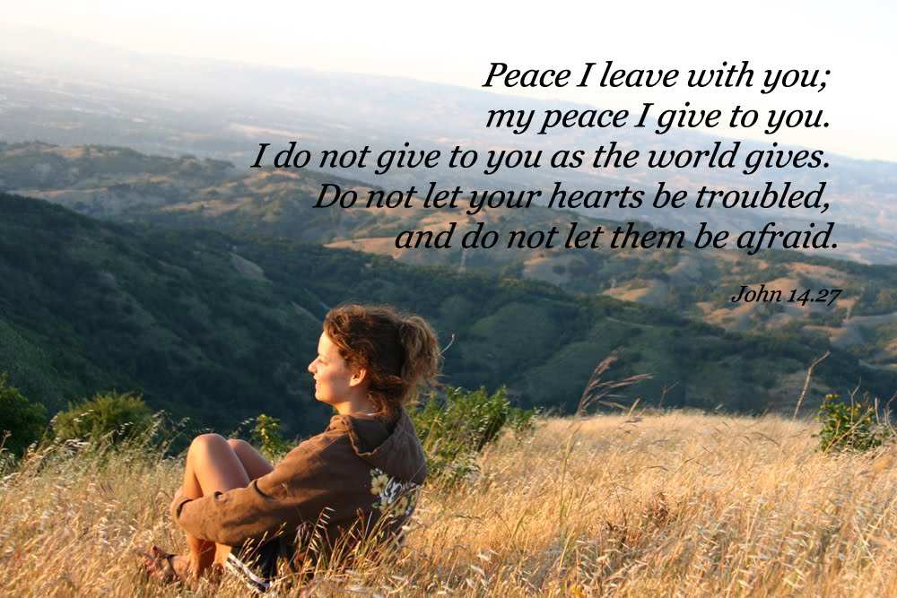
John 14:27

Slide 27
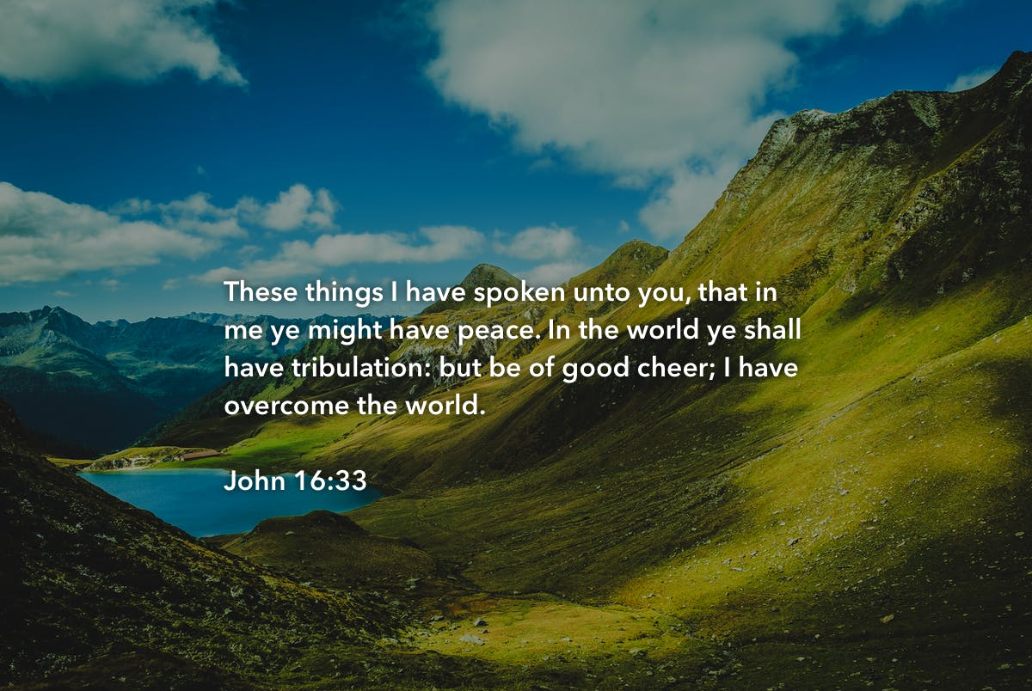

Slide 28
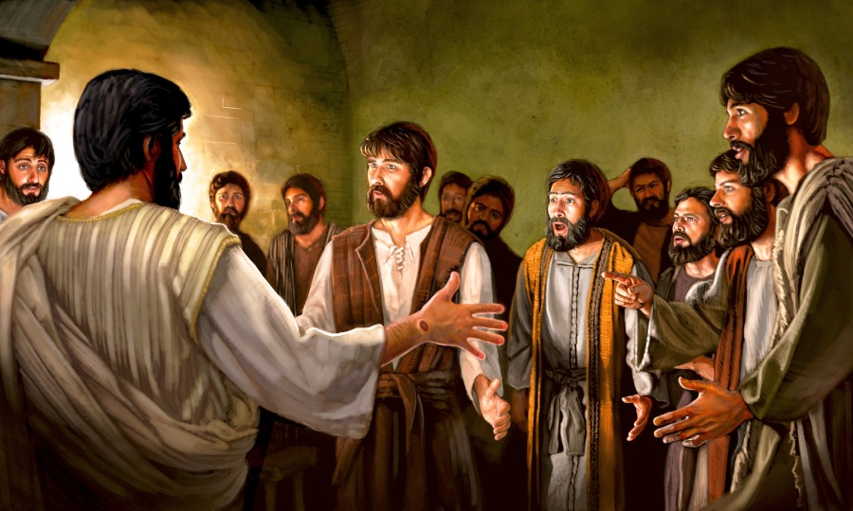
After His resurrection, “Then at the same day at evening – the 1st day fo the week, when the doors were shut where the disciple were assembled for fear of the Jews, Jesus came and stood in the midst, saying Peace be unto you.” John 20:19—29
J

Slide 29
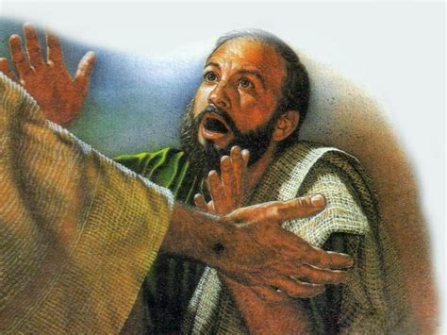
And 8 days later ….Again with the doors shut, Jesus enters the room, saying Peace be unto you. Then said he to Thomas who doubted, Reach your finger here and behold My hands and thrust it into My side. Do not doubt, but believe.” John 20:19-29

Slide 30
And for Believers – So Much More Peace
Romans 5:1 – “Thereby being justified by faith, we have peace with God through our Lord Jesus Christ.”
Romans 8:6 “For to be carnally minded is death:
but to be spiritually minded is life and peace”
Romans 10:15 “And how shall they preach,
except they be sent:
As it is written ,
How beautiful are the feet of them
that preach the gospel of peace
through our Lord Jesus Christ.”

Slide 31
Romans 14:17 “For the kingdom of God
is not meat and drink;
but righteousness, and peace,
and joy in the Holy Ghost”
Galatians 5:22 “But the fruit of the Spirit is:
love, joy, peace, long-suffering, gentleness,
goodness, faith, meekness, temperance,
against such there is no law.”
Hebrews 12:14 “Follow peace with all men, and holiness:
without which no man shall see the Lord.”

Slide 32
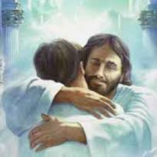
Philippians 4:6-7
“Be careful for nothing: but in everything by prayer and supplication with thanksgiving
let your requests be made know to God.
And the peace of God that passes all understanding, shall keep your hearts and minds through Christ Jesus.”

Slide 33
1.. Have Peace with God
We can’t continue to live in sin
Find an Altar and Repent
2. Live at Peace with Others
Forgive, Forgive, Forgive
3. Be A Peace Maker-
We’re given Ministry of Reconciliation
4. Live a Life of Integrity
Do what is right
5.Control Your Thoughts –
Don’t let the enemy rule your mind
Cast down vain imaginations
6.Travel Light – Lay down your baggage
Get rid of every weight
Romans 12:1 – every besetting sin
7. Practice Obedience
8.Cast your Care
9. Experience His Power
10. More Prayer, More Power, More Peace

Slide 34
“Shalom”
“Jesus is our Peace
in the Midst
of Any Storm”

