Slide 1
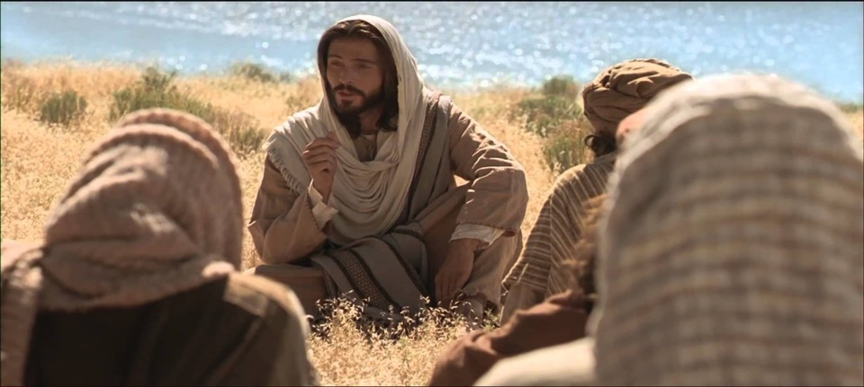
God’s Prophetic Times & Seasons
“The 7th Day”
Sabbaths, Shemitahs, & Jubilee Cycles
Jesus is Lord of the Sabbath

Slide 2
God’s 7th Day Prophetic Pattern
#1 For Days - Weekly Sabbath
#2 For Weeks - Pentecost
#3 For Months – 7th Month Tishrei
#4 For Years - Shemitah
#5 For Weeks of Years – Jubilee
#6 For Millenium - 7,000 years
Work is Allowed for 6
Rest Comes on the 7th

Slide 3
The 7th Day
God Finished His Work of Creation in 6 Days
and then He Rested
He Blessed & Sanctified the 7th Day as Holy
A Sabbath Day to Rest and Not Work
Genesis 2:1-3
Likewise God commanded all the People
“Remember the Sabbath Day – To Keep it Holy”
“Rest & Do no Work – Delight in the Lord”
Leviticus 23:1-3, Exodus 20:8-11; Deuteronomy 5:12-15; Isaiah 58:13
The 7th Day is called “The Sabbath of Days”

Slide 4
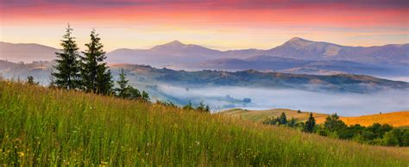
“Thus the heavens and the earth were finished, and all the host of them.
And on the 7th Day God ended all His work which He had made;
and He rested on the 7th Day from all His work which He had made
And God blessed the 7th Day and sanctified it..” Genesis 2:1-3

Slide 5
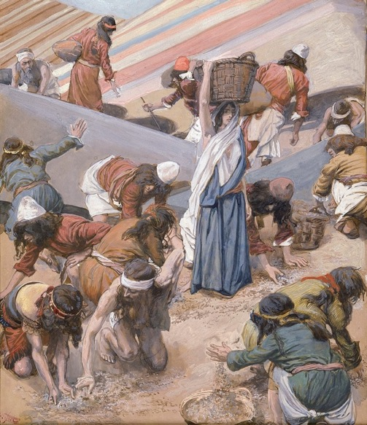
Remember the Manna in the Wilderness? Sabbath Keeping = Trusting God
Exodus Chapter 16 – The Israelites Complain to Moses and Aaron
”You have brought us forth into this wilderness to kill this whole assembly with hunger”
God promises to rain bread from heaven. The people are to gather an omer of manna every day, and on the 6th day they are to gather 2x as much.
The 7th they were not allowed to gather
The Sabbath was declared holy to the Lord and they were to rest:gather it; eating the extra.
“Six days you shall it; but on the 7th day, which is the Sabbath, in it there shall be none.” Exodus 16:26

Slide 6
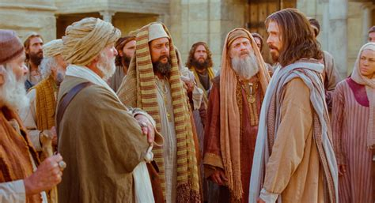
There was Constant Controversy Between Religious Leaders & Jesus Over the Sabbath
Not Keeping Sabbath was a serious offense in Israel
Exodus 31:14-15 Death Penalty for Breaking Sabbath

Slide 7
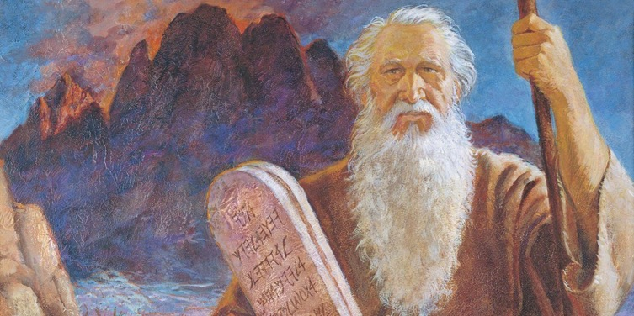
Exodus 31:12-13 “And the Lord spoke to Moses saying, Speak also to the children of Israel, saying, Verily My Sabbaths you shall keep, for it is a sign between Me and you throughout your generations; that you shall know that I am the Lord that does sanctify you.”
14. You shall keep the Sabbaths therefore: for it is holy unto you; everyone that defiles it shall surely be put to death” for whosoever does any work therein, that soul shall be cut off from among the people. 15. Six days work may be done, but in the 7th is the Sabbath of rest, holy to the Lord, whosoever does any work in the Sabbath day shall surely be put to death.”

Slide 8
How do you Honor the Lord
and Keep the Sabbath?
The Religious Leaders Constantly Condemned Jesus
He Healed on the Sabbath
He Picked Grain and Ate it with His Disciples
Then Jesus said to them……
Mark 2 :27-28
“ The Sabbath was made for man,
And not man for the Sabbath
Therefore, the Son of Man is Lord also of the Sabbath”

Slide 9
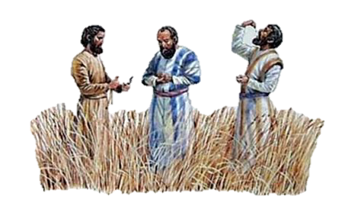
Luke 6:1-6 “It came to pass on the 2nd Sabbath after the first, that Jesus went through the fields and His disciples picked and ate grains of corn, rubbing them in their hands. And certain Pharisees said to them, Why are you doing unlawful acts on the sabbath?
Jesus reminded them that even King David did the same when he was hungry, and even went took the showbread from the Temple to eat which is only lawful for the priests in the Temple to do, saying
“The Son of Man is Lord also of the Sabbath”

Slide 10
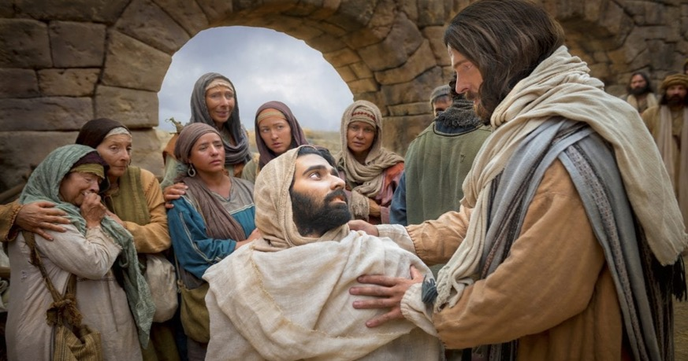
Jesus Heals on the Sabbath -
A Man with a Withered Hand - Mark 3:1-6
A Woman Bent over for 18 years – Luke 13:10-17
A Man with dropsy - Luke 14:1-6
Man at Pool of Bethesda - John 5:1-18

Slide 11
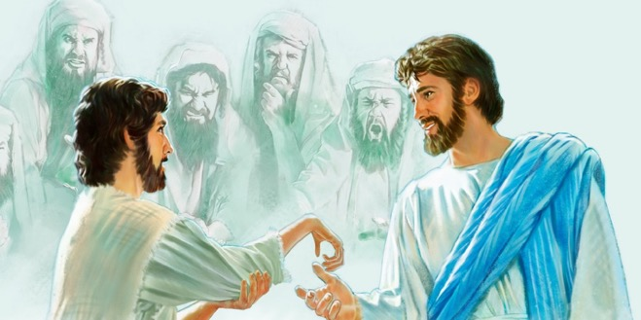
Matthew 12:9-14
“And when he was departed thence, He went forth into their synagogue.
And behold, there was a man which had his hand withered. And they asked Him, saying, Is it lawful to heal on the Sabbath days? that they might accuse Him.
And He said to them, what man shall there be among you, that shall have 1 sheep, and if it fall into a pit on the Sabbath day, will he not lay hold on it, and lift it out? How much better is a man than a sheep: Wherefore it is lawful to do well on Sabbath days.
They He said to the man, Stretch forth your hand. And he stretched if forth;
and it was restored whole, like as the other. Then the Pharisees went out, and held a council against Him, how they might destroy Him.

Slide 12
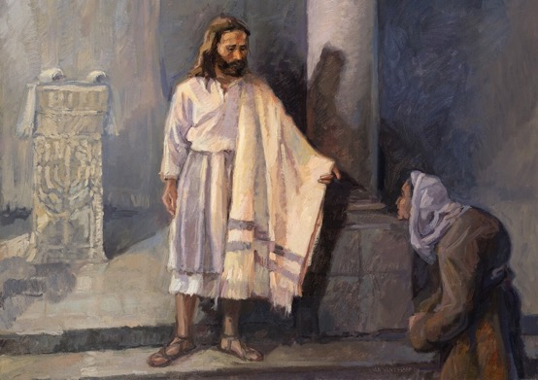
Luke 13:10-13 “Jesus was teaching in one of the synagogues on the Sabbath. And behold, there was a woman with a spirit of infirmity 18 years, and was bowed together, and could in no wise lift herself up. When Jesus saw her, He called her to Him, and said to her, ‘Woman, you are loosed from this infirmity.’ He laid His hands on her: and immediately she was made straight and glorified God.”
The ruler of the Synagogue was angry that Jesus healed her on the Sabbath.
Jesus answered, You hypocrite, do you not loose your ox on the Sabbath from the stall and lead him to water? Ought not this woman, a daughter of Abraham. whom Satan has bound for 18 years , be loosed on this Sabbath day? (13: 14-16)

Slide 13
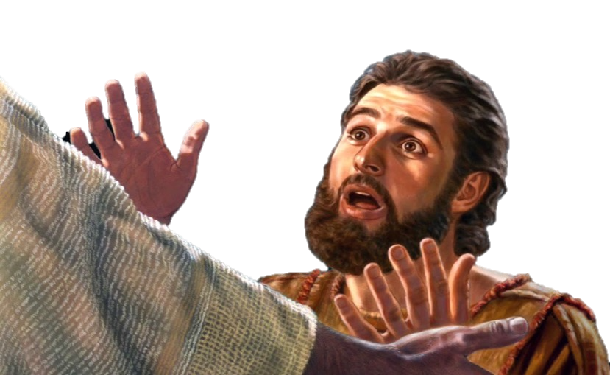
Luke 14:1-4 “ And it came to pass as He went to the the house of one of the chief Pharisees to eat bread on the Sabbath day, that they watched Him. And behold there was a certain man before Him which had the dropsy.
Jesus, answering spoke unto the lawyers and Pharisees, saying, Is it unlawful to heal on the Sabbath day? And they held their peace. Jesus took him and healed him and let him go.”

Slide 14
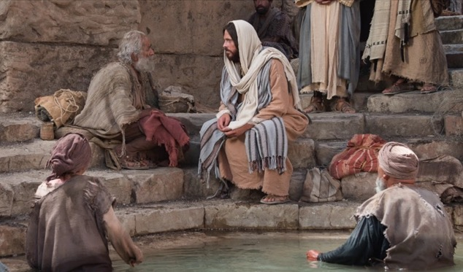
Jesus
Jesus Heals a Man at the Pool of Siloam
John 5:5-9 And a certain man was there, which had an infirmity 38 years. When Jesus saw him, and knew that he had been now a long time in that case, He said to him, ‘Will you be made whole?’ The impotent man said, ‘I have no man to put me in the pool: but while I am coming, another steps down before me.
Jesus said to him, ‘Rise, take up your bed and walk.’ Immediately the man
was made whole, took up his bed, walked: the same was on the Sabbath day.
From this day on, the enraged Jews plot to kill Jesus because He healed on the Sabbath, and declared God was His Father

Slide 15
The Church is NOT Commanded to Keep the Sabbath
Acts 15 – Peter, James and Paul have a huge discussion on what rules the Gentile believers should be required to follow
Acts 15:24 “Forasmuch as we have heard, that certain men which went out from us have troubled you with words, subverting your souls, saying, You must be circumcised and keep the Law: to whom we gave NO such commandment.”
New Gentile Believers Should:
Abstain from pollutions of idols
Abstain from Fornication
Abstain from things strangled and from blood
The Early Church met on the 1st Day of the Week – on Sunday
Acts 20:7 1 Corinthians 16:1-2 Sunday – Day of His Resurrection

Slide 16
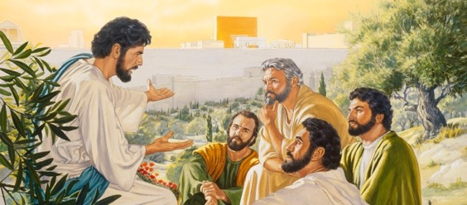
Matthew 24 - ”Sabbath Keepers” – A Key To Who Will be in the Tribulation
Jesus teaches His Disciples on the Mt. of Olives about the End Times - Matt 24
¹⁵ When you therefore shall see the abomination of desolation, spoken of by Daniel the prophet, stand in the Holy Place, (whoso reads let him understand)
¹⁶ Then let them which be in Judaea flee into the mountains:
¹⁷ Let him which is on the housetop not come down to take anything out of his house:¹⁸ Neither let him which is in the field return back to take his clothes.
¹⁹ And woe unto them that are with child, and to them that give suck in those days!
²⁰ But pray that your flight be not in the winter, neither on the Sabbath day:
²¹ For then shall be great tribulation, such as was not since the beginning of the world to this time, no, nor ever shall be.

Slide 17
#2 The Sabbath of Weeks - Pentecost
The Day after 7 x 7 Weeks = 50 Shavuot / Pentecost Leviticus 23:15-23
“And you shall count from the morrow after the Sabbath, from the day you brought the first fruit sheaf of the wave offering, 7 sabbaths shall be complete. Even to the morrow after the 7th sabbath shall you number 50 days”
From Exodus to Acts

Slide 18
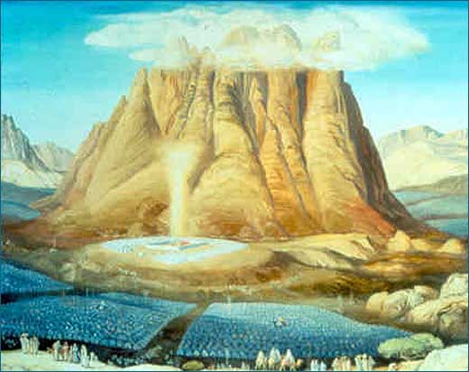
“And it came to pass on the 3rd day in the morning, there were thunders and lightnings, and a thick cloud upon the Mt, and the voice of the trumpet exceeding loud , so that all the people in the camp trembled. And Moses brought the people forth to meet with God.
Mt. Sinai was all together in smoke, because the Lord descended in fire: and the smoke ascended as the smoke of a furnace, and the whole Mt. quaked greatly.” Ex. 19:16-18
Notes:
There is a long period between Firstfruits and the next feast. It is in the middle of the Spring Feasts and the Fall Feasts. Pentecost is 50 days after Firstfruits. We know it to have happened in Acts Ch 2. But in Exodus, in the summer (May/June), Moses is camped at Sanai with the Israelites. God tells Moses to get ready, sanctify the people, and go to the top of the moutain. Moses goes up, God comes down, and the glory of God in a cloud comes, and takes Israel for a wife that day. There is a mighty shaking, and fire fell from heaven. Exactly on this same day in the New Testament, there was a shaking and tongues of fire, and the Spirit of God came. God keeps time, on His calendar, which is explained and kept by the appointed days (festivals) that HE put in place.

Slide 19
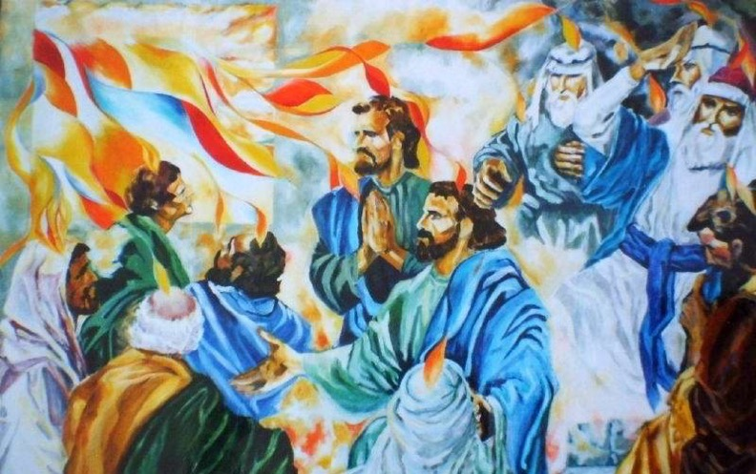
‘And when the Day of Pentecost was fully come, they were all of one accord in one place, and suddenly there came a sound fom heaven as a rushing mighty wind, and there appeared cloven tongues as of fire and sat upon each of them. And they were all filled with the Holy Ghost….”
Acts Chapter 2

Slide 20
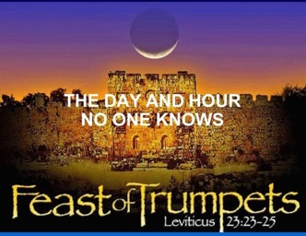
#3 The Sabbath of Months – the 7th Month
Sept-Oct. has 4 High Sabbaths – Holiest Month

Slide 21
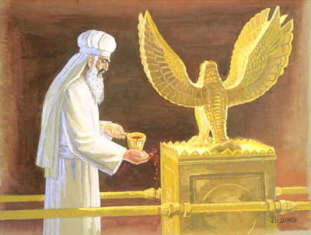
On the Holiest Day, Yom Kippur, in the Holiest City – Jerusalem,
the Holiest man – The High Priest in the Holiest Place – The Temple,
Enters into The Holy of Holies …to sprinkle the Blood, to meet with God.

Slide 22
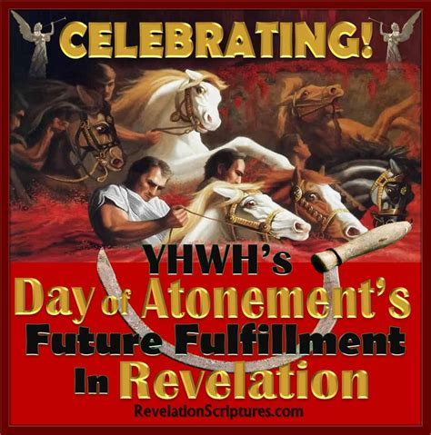
Jesus Is Always
on Time!
1. Passover 2.Unleavened Bread
3. First Fruits
4. Pentecost
5. Trumpets
6. Atonement
7. Tabernacles

Slide 23
#4 The Sabbath of Years - Shemitah
Special Sabbath Cycle every 7 Years
The Shemitah is God’s 7 year Calendar for Israel
The Tribulation is a 7 year Cycle – Shemitah
God’s Punishment for Israel Disobeying the Shemitah
For 490 Years
Was Israel’s 70 Year Captivity by Babylon
“Daniel’s 70 Weeks Prophecy – Another Shemitah Cycle
Supernatural Rest and Release for Obedience
…..or God allows Israel’s Enemies to Invade & Conquer

Slide 24
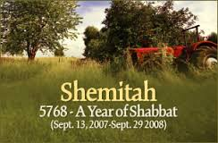
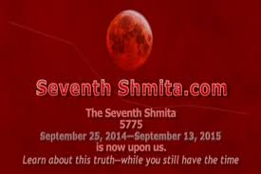
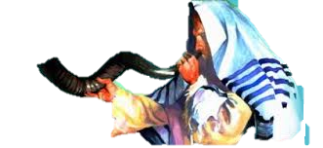
The Sabbath of the Land -The Shemitah
Starts the 1st Day of Feast of Trumpets
Every 7th Year God Declares a Release
The Land gets a Rest – no planting
The People get a Rest - no work
The Animals get a Rest – no work
The Poor, Orphans & Strangers –
get any harvest that grows in fields
All Debt is Cancelled
The Land & Harvest are holy to the LORD

Slide 25
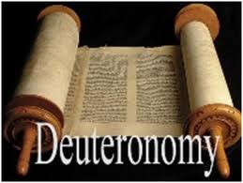
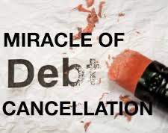
Deuteronomy 15:1-6
“All Debt Released”
The Shemitah
1 “At the end of 7 years you shall make a release.
2. Every creditor that lends to his neighbor shall release it;
he shall not exact it of his neighbor, or of his brother,
because it is called the Lord’s release
3.Of a foreigner you may exact it again,
but that which is yours with your brother you shall release.
4.Save when there be no poor among you;
for the Lord shall greatly bless you in the Land which the Lord
your God gave you for an inheritance to possess it.
5.Only if you carefully listen to the voice of the Lord your God,
to observe to do all these commandments which I command you this day. 6.For the Lord your God blesses you, as He promised you:
you shall lend to many nations, but not borrow and
you shall reign over many nations, but they shall not reign over you.”

Slide 26
Deuteronomy 15:1-6
“All Debt Released”
The Shemitah
Deuteronomy 15:12-15
“ If your kinsman, a Hebrew man or woman, is sold to you, then he shall serve 6 years, but in the 7th year, you shall let him go free. When you set him free, you shall not send him away empty-handed. You shall furnish him liberally from your flock and from your threshing floor and from your wine vat: you shall give to him as the Lord your God has blessed you.”
Leviticus 25: 39-43
If a country man or yours becomes so poor with regard to you that he sells himself to you, you shall not subject him to a slave’s service. He shall be to you as a hired man, as if he was a stranger, he shall serve with you until the year of Jubilee He shall then go out from you, he and his sons with him, and shall go back to his family, that he may return to the property of his forefathers.
Leviticus 25: 54-55
If he is not redeemed by these 3 things, he shall still go out in the year of Jubilee,

Slide 27
#5 The Sabbath of Sabbaths – Jubilee
The Year after 7 Years x 7 = Every 50 Years
Jubilee – “A Day to Proclaim Liberty to All”
God reckons Time from Creation to Messianic Kingdom
By Sabbaths, By Shemitahs, and by Jubilees
From the Garden to the New Heaven & New Earth
A Jubilee Occurs every 50th Year
on The Day of Atonement - Yom Kippur
The Tribulation is a Yom Kippur Service – a Jubilee Calendar
Jesus is Coming to Redeem the Nation of Israel
He will Gather all Israel at the Sound of the Great Trumpet

Slide 28
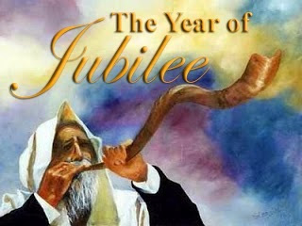
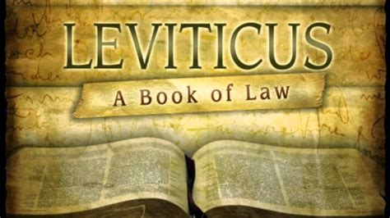
Chapter 25
8 “And you shall number 7 sabbaths of years to you, 7 times 7 years; and the space of the 7 sabbaths of years shall be 49 years to you.
9. Then shall you cause the trumpet of the jubile to sound on the 10th day of the 7th month ( Yom Kippur) in the Day of Atonement shall you make the trumpet sound throughout all your land.
10. And you shall make holy the 50th year, and proclaim liberty through all the land to all the inhabitants thereof: it shall be a jubile to you; and you shall return every man to his possessions, and you shall return every man to his family.”

Slide 29
11. You shall have the 59th year as a Jubilee;
you shall not sow nor reap its aftergrowth,
nor gather in from its untrimmed vines.
12. For it is a Jubilee: it shall be holy to you.
You shall eat its crops out of the field.
13. On the year of Jubilee, each of you shall
return to his own property.
Chapter 25
23.The Land, moreover, shall not be sold permanently, for the Land is Mine, for you are but strangers and sojourners with Me.
24.Thus for every piece of your property, you are
to provide for the redemption of the Land.
25. If your fellow countryman becomes so poor that
he has to sell part of his property, then his nearest
kinsman redeemer is to come and buy back, what
his relative sold. If a man has no kinsman, and
recovers his means to buy back, he shall calculate
the years since its sale and refund the amount to the
man to whom he sold it and so return his property
.
28. But if he has not found sufficient means to get it back for himself, then what he has sold shall remain in the hands of its purchaser until the year of Jubilee. At the Jubilee, it shall revert, and he may return to his property.

Slide 30
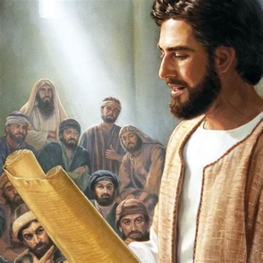
At His First Public Sermon
on the Sabbath In Nazareth
Jesus Declares His Ministry
Is the fulfillment of The Jubilee
The Old Testament Teaching on Jubilee:
Leviticus 25:10 “And you shall consecrate
the 50th year, and proclaim liberty throughout
all the Land – to all the inhabitants. It shall be a Jubilee Year for you.
Each shall return to his posessions and each shall return to his family.”
Now hear the exact words Jesus spoke from Isaiah 61
He proclaims why He came, what He came to do at His 1st Coming
He omits the words that proclaim what He will do at His 2nd Coming!

Slide 32
To proclaim Liberty (Yovel) = To Proclaim the Jubiliee

Slide 33
Genesis 6:3 God said He would not continue to strive with mankind. “ Yet his days would be 120 Years.”
Could this be a Jubilee Count Down?
120 Jubilee Years x 50 = 6,000 Years

Slide 34
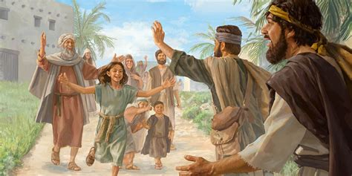
Jubilee – God’s Time to Proclaim Liberty & Restoration
No Sowing or Reaping
The poor may glean in the fields
Selling or Buying is calculated by time left until Jubilee: everything returns to rightful owner at Jubilee
Any poor man is to be relieved and redeemed
No interest is to be charged
The poor may sell himself as a slave, but must be well-treated and released with his family on Jubilee
Everything returns to its rightful owner!

Slide 35
#6 The Sabbath of Millenium - 7000 Years

Slide 36
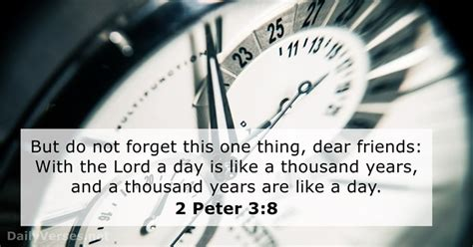
Back to Genesis 2:2-3 Work for 6 days (6,000 years) and the 7th Day is a Day of Rest (1,000 year Millennial Reign = 7,000 years)
Psalm 90:4
“For 1,000 years in Your sight are but as yesterday, and as a watch in the night.”

