Slide 1
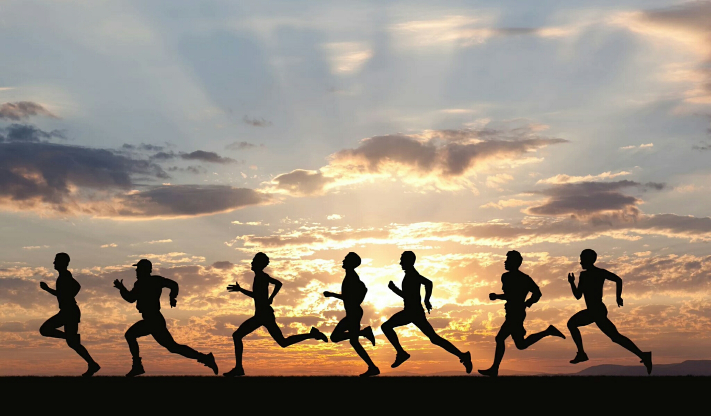
Running the Race to Win the Prize
Living to Finish

Slide 2
As soon as we say,
“God, Here am I”
We start running the Race the moment we get saved!

Slide 3
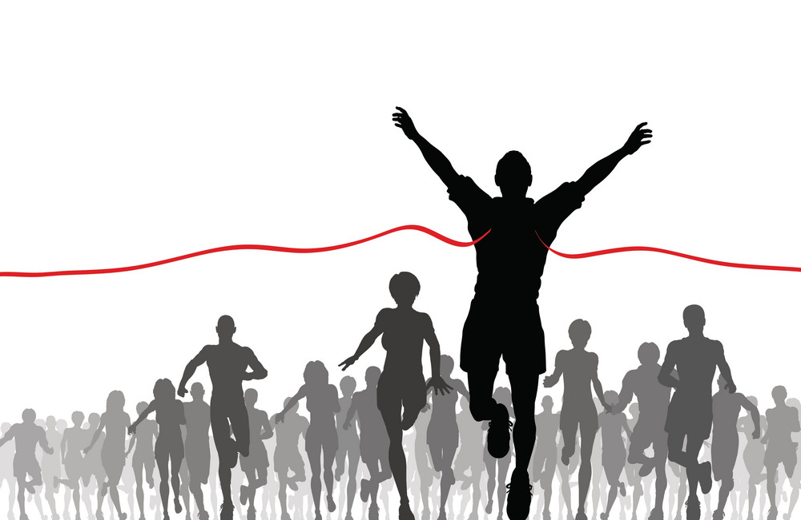
We all run the race by Faith in Jesus
Our Salvation is the Starting place
But it is Our Finish
that Counts for Eternity!

Slide 4
As a Believer,
this race is NOT
a one time event
This Race represents Our whole lives - from Start to Finish
To Win the Race
We just keep taking …the Next Step

Slide 5
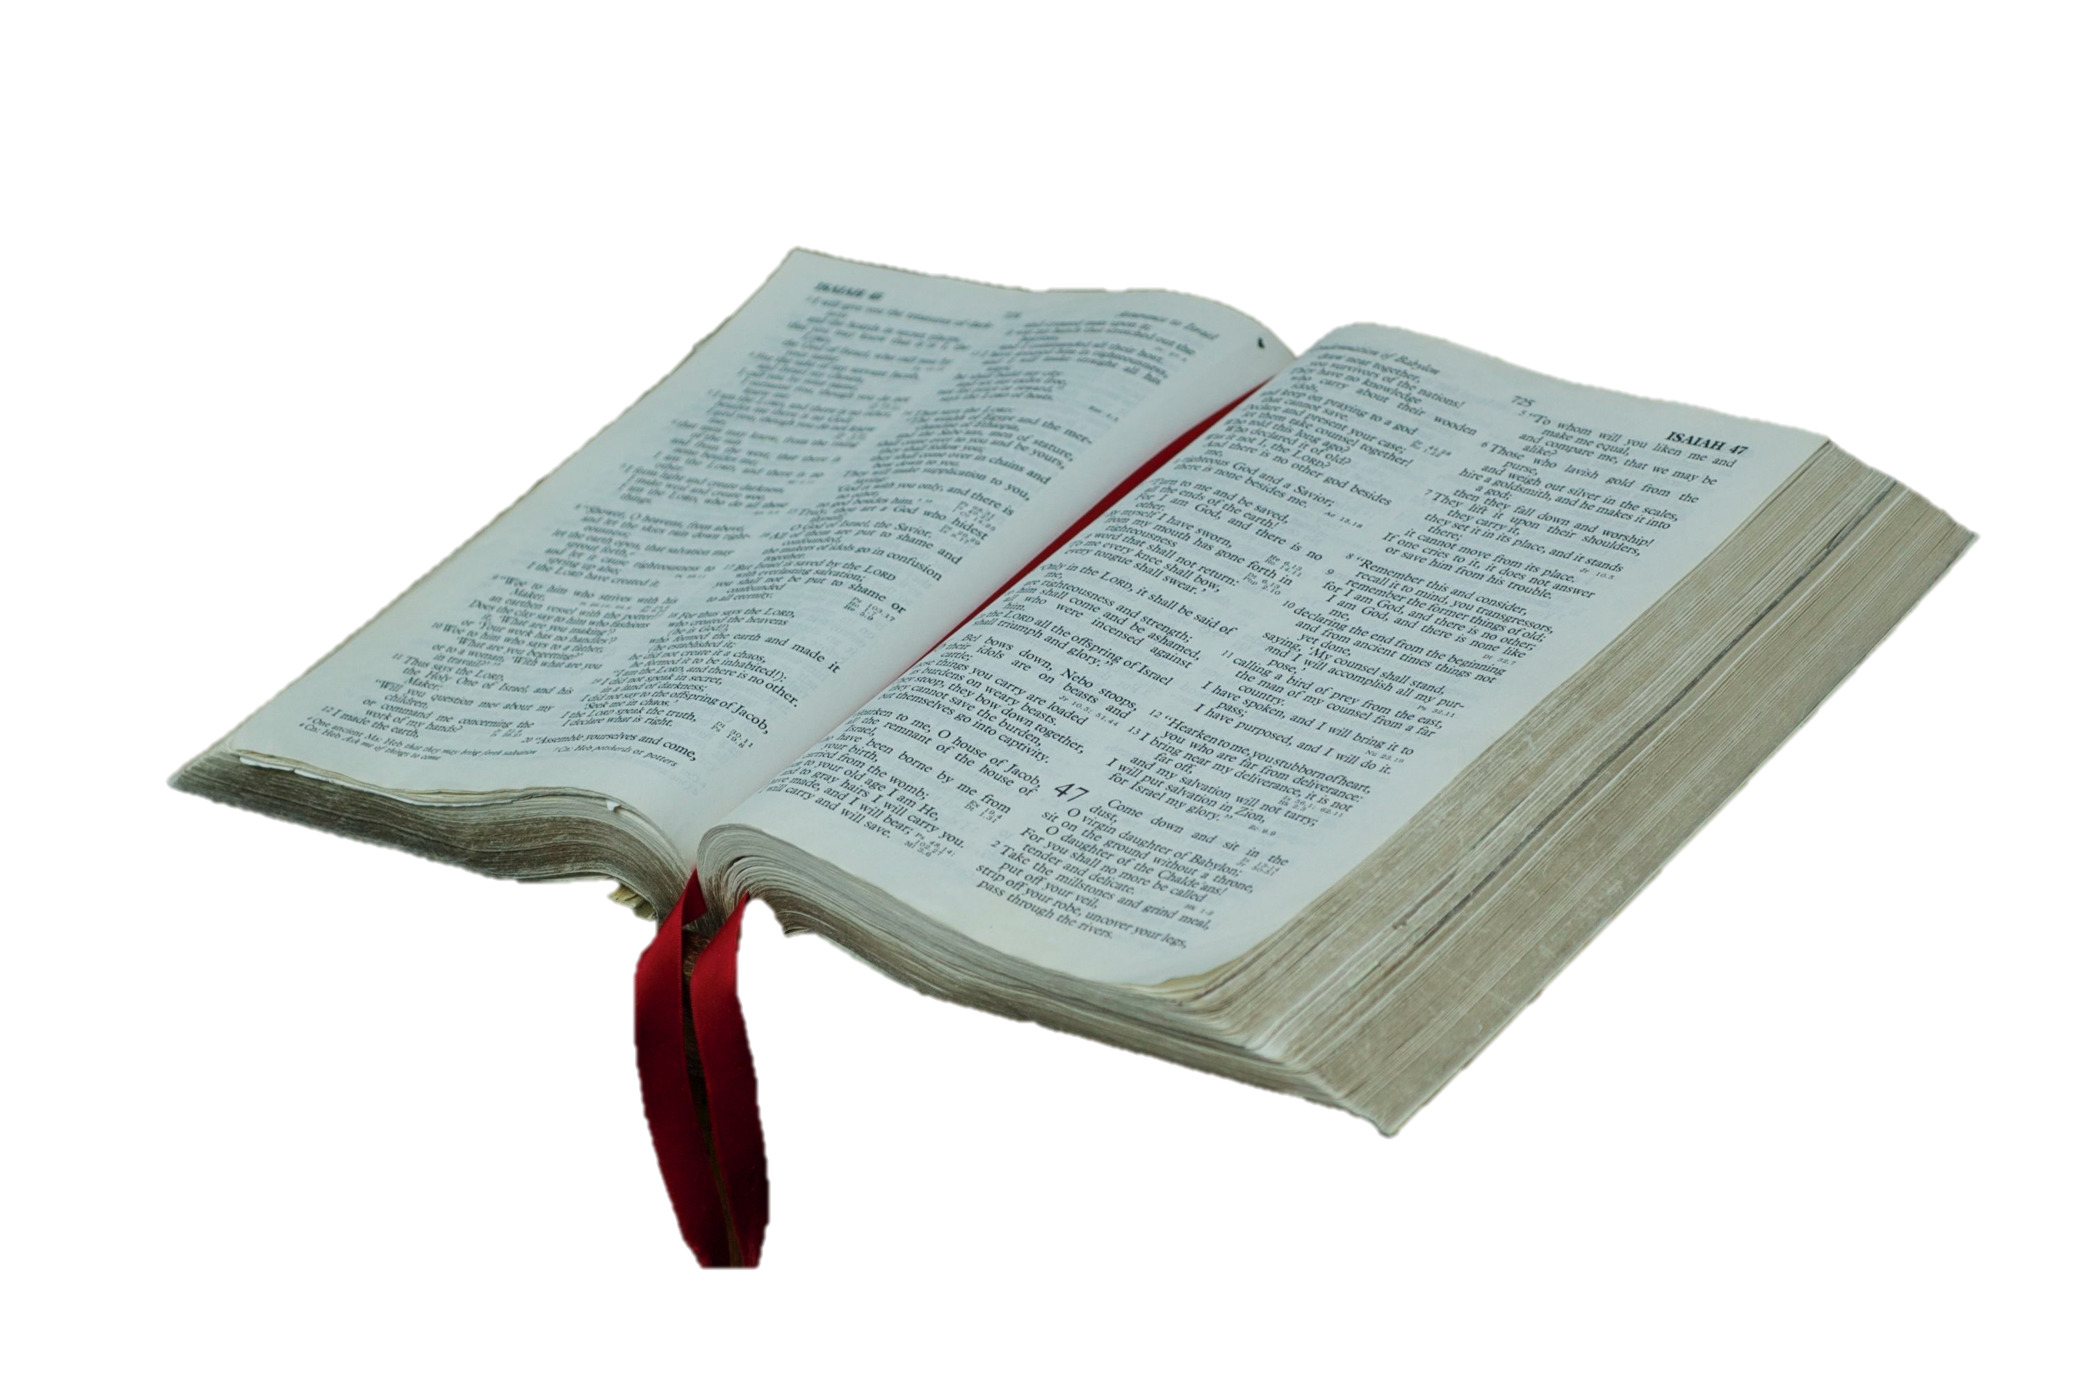
The Bible has a lot to say
about Running the Race
It is the Race of FAITH
Let’s Live to Finish
“He that endures to the end,
shall be saved.”
Matthew 24:13

Slide 6
Hebrews 12:1-2
Wherefore seeing that we also are compassed about
with so great a cloud of witnesses,
Let us lay aside every weight
and the sin that does so easily overtake us
Let us run with endurance the race
that is set before us,
Looking unto Jesus
the Author and Finisher of our faith”
24 Know ye not that they which run in a race run all, but one receiveth the prize? So run, that ye may obtain. 25And every man that striveth for the mastery is temperate in all things. Now they do it to obtain a corruptible crown; but we an incorruptible. 26I therefore so run, not as uncertainly; so fight I, not as one that beateth the air: 27But I keep under my body, and bring it into subjection: lest that by any means, when I have preached to others, I myself should be a castaway.

Slide 7
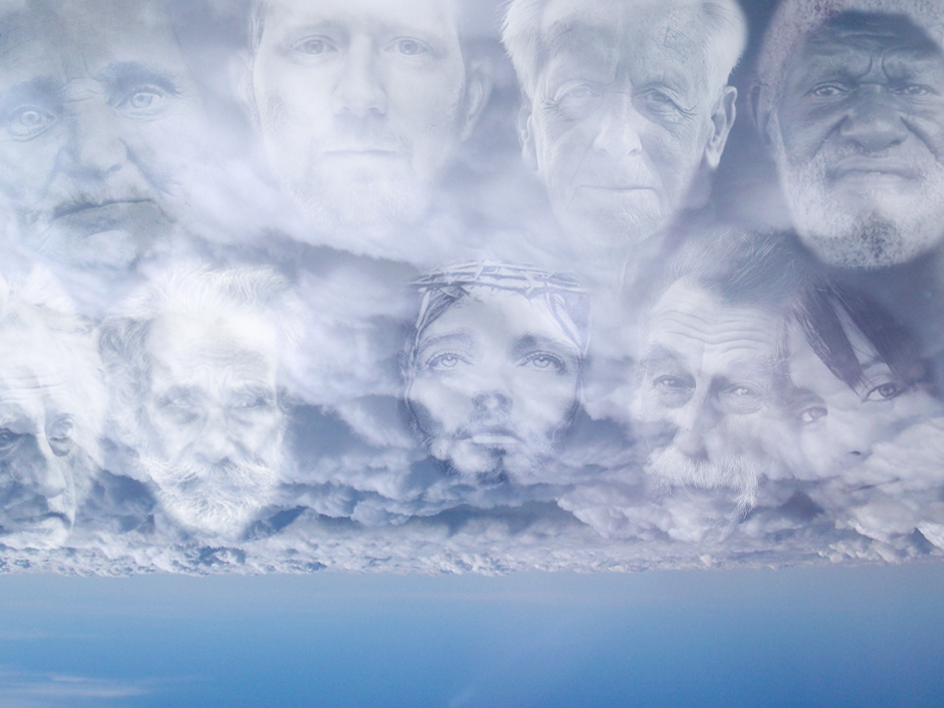
“Wherefore seeing that we also
are compassed about with so great a cloud of witnesses,
Let us lay aside every weight
and the sin that does so easily beset us
Let us run with endurance the race
that is set before us,
Looking unto Jesus,
the Author and Finisher of our faith”
Hebrews 12:1-2

Slide 8
We have a whole cheering section of saints
who have gone before us The Hall of Faith in Hebrews 11
.
We have a Loving Church Family and Pastors
who are coaching us through right now Life’s challenges

Slide 9
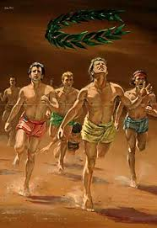
1 Corinthians 9:24-25
“Know you not that they which run in a race all run, but one receives the prize?
So run, that you may obtain. And every man that strives for the mastery is self-controlled in all things.
Now they do it to obtain a corruptible crown, but we an incorruptible crown .”

Slide 10
God promises Rewards for Those who Finish the Race

Slide 12
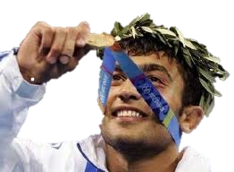
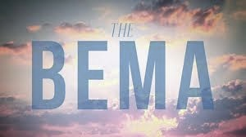
Let’s talk about The Bema Seat
Rewards & Believers

Slide 13
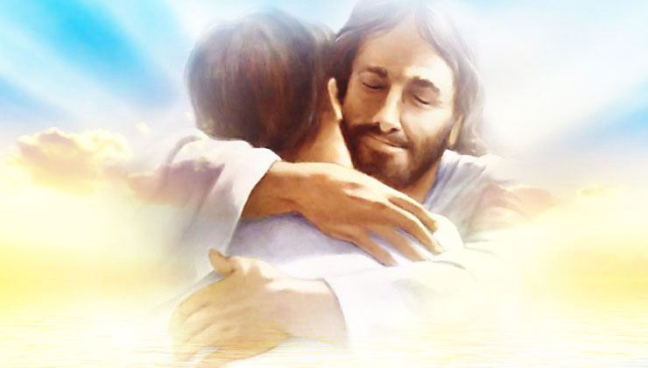
“We are confident, I say & willing rather to be absent from the body & to be present with the Lord. Wherefore we labor, that whether present or absent,
we may be accepted by Him. For we must all appear before the Judgment Seat of Christ, that every one may receive the things done in his body according to that he has done, whether it be good or bad.” 2 Corin.5:8-10

Slide 14
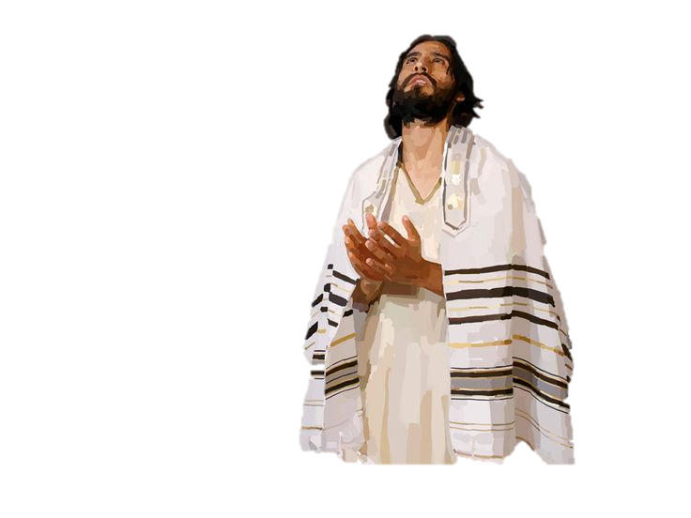
Romans Chapter 14 Truths
Romans 14:10 “For we shall all stand before
the Judgment Seat of Christ.”
Those that are weak in faith…. be merciful
Don’t judge another by what he eats or drinks
Don’t judge another on what day he worships
No Man lives unto himself - no man dies unto himself
Don’t judge your brother or have contempt for him
“Every knee shall bow to Me - every tongue shall confess to God”
“ Everyone of us shall give an account of ourselves to God”.

Slide 15
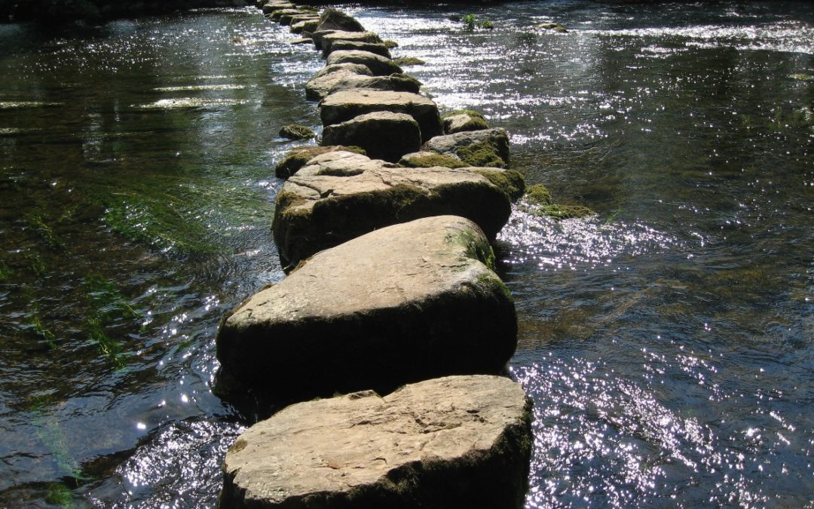
A Stumbling Block?
Or a Stepping Stone!
Romans 14:13 “Let us not judge one another anymore. Let no man
put a stumbling block or an occasion to fall in his brother’s way.”

Slide 16
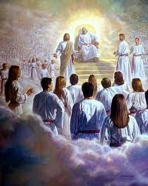
Jesus will examine Every Believer’s Life
to Hand out rewards
for our deeds,
for Our words,
And Our faithfulness!
Timing is Everything!
There are 2 Judgments
For 2 Different Groups!
At 2 Different Times!
Judgments are linked to the 1st and 2nd Resurrections!

Slide 17
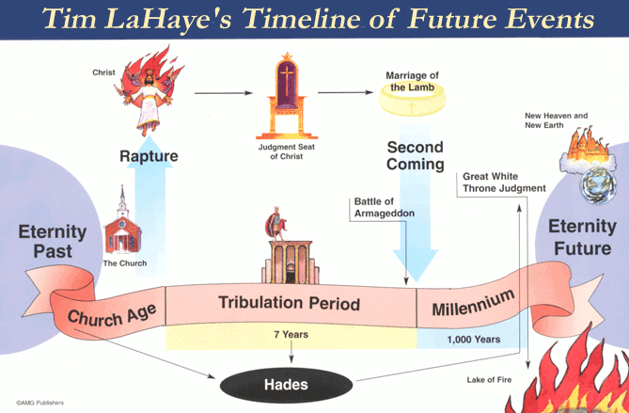
2 Different Judgments – If you are at the 1st Judgment, You will not be at the 2nd Judgment

Slide 18
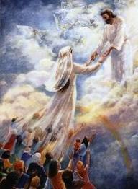
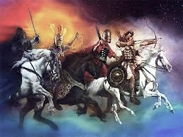
We Get to Choose Our End Time Events!
The Great Tribulation
For Unbelievers-
The Rapture
For Believers

Slide 19
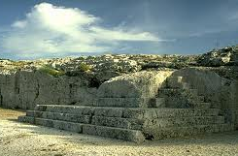
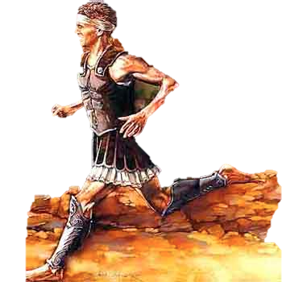
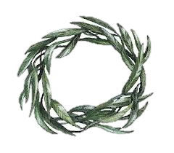
The Bema Seat
Raised Platform at Olympic Games
Victor Crowned with Garland
“Running the Race for the Prize”

Slide 20
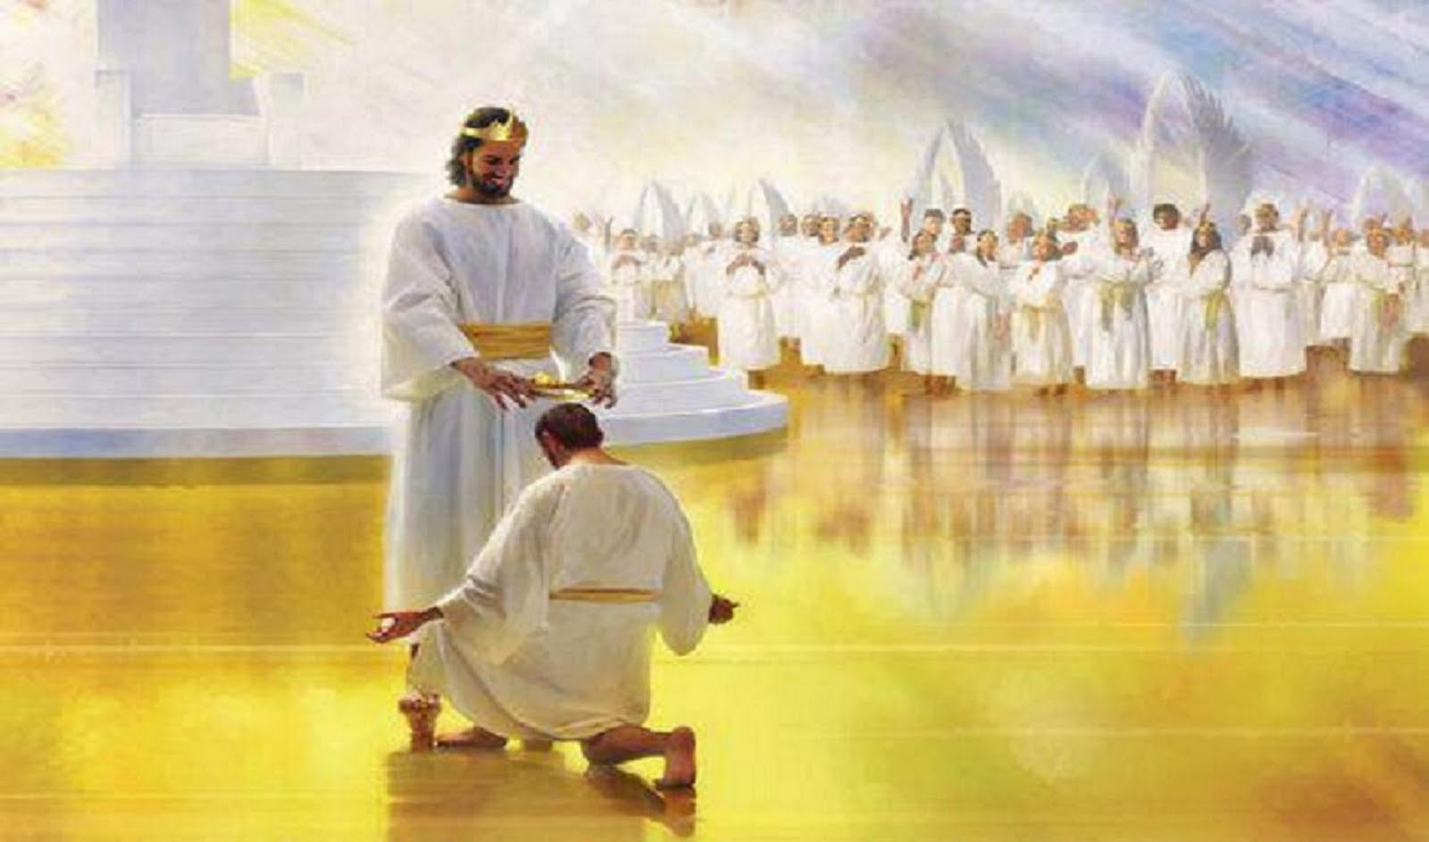
What about The Crowns!

Slide 21
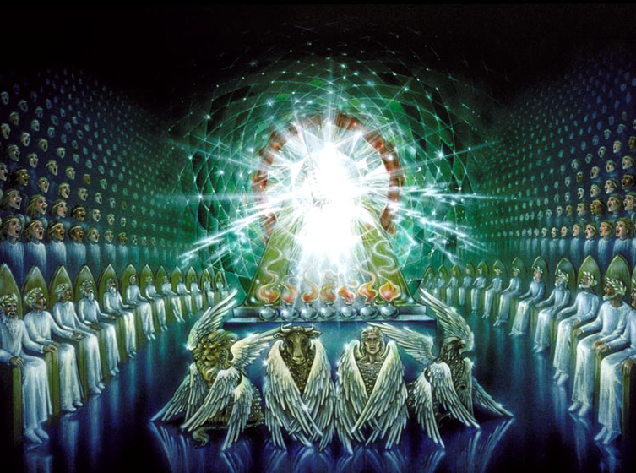
Crowns Revelation 4:4
24 Elders clothed in white
with gold Crowns

Slide 22
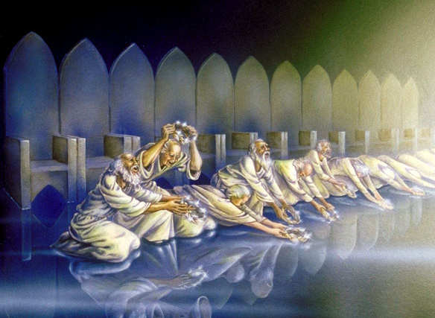
“You are Worthy, O Lord…You have redeemed us by Your Blood, You have made us kings and priest to our God.” Rev. 5:9-10
The 24 Elders Cast Their Crowns
before God Almighty Rev. 4:10-11

Slide 23
First the Rapture Happens – Believers in Heaven
Believers will Stand before Jesus at the Bema Seat
to Receive Rewards
The 1st Judgment and the 1st Resurrection
After The Tribulation Happens on the Earth
After Jesus’ Millennial Reign
The Great White Throne Judgment– Revelation 20
Unbelievers appear in the 2nd Resurrection – The 2nd Death
Eternity without God and Jesus

Slide 24
Don’t forget We are running for the Prize! Not only do we get
to spend Eternity with Jesus – He has Rewards for Us!

Slide 25
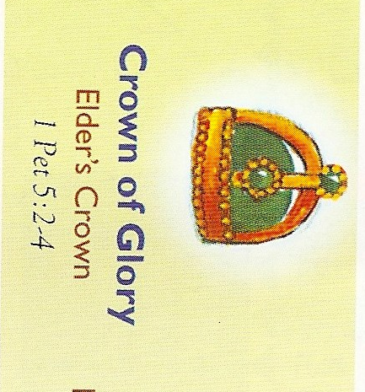
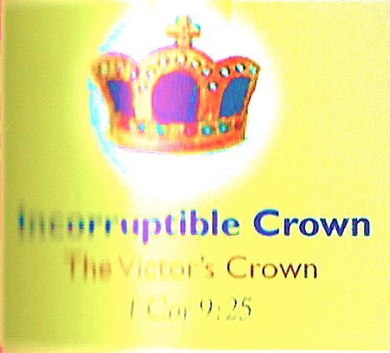
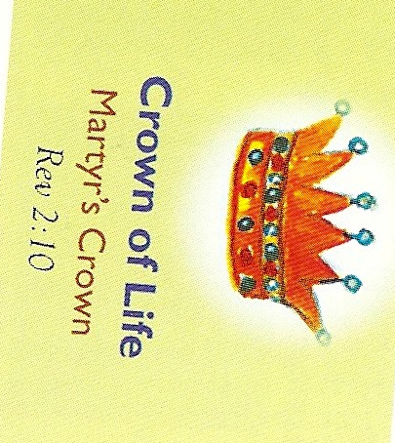
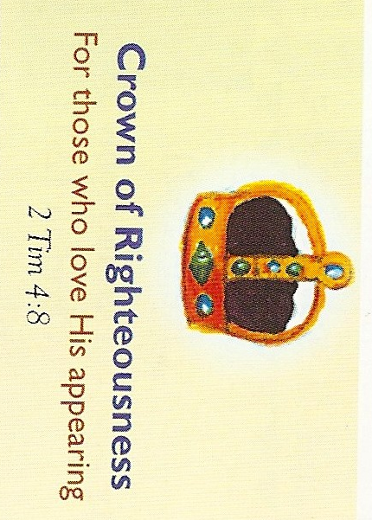
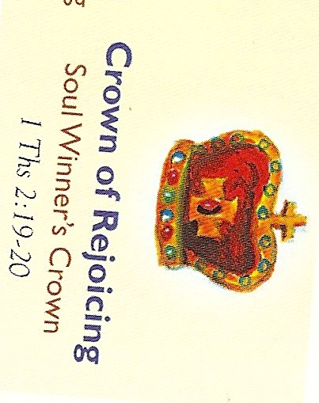
The 5 Crowns
Incorruptible Crown
The Victor’s Crown
1 Corinthians 9:25

Slide 26
“For what is our hope, or joy or crown of rejoicing? Are not even you in the presence of our Lord Jesus Christ at His Coming? For YOU are our glory and joy.”

Slide 27
Pastors & Leaders
“Feed the flock of God which is among you, taking oversight thereof, not by constraint but willingly; not for filthy lucre, but of a ready mind; neither as being lords over God’s heritage, but being examples to the flock. And when the chief Shepherd shall appear, you shall receive a crown of glory that does not fade away.”

Slide 28
Incorruptible Crown
The Victor’s Crown
1 Corinthians 9:25
“Every man that strives for mastery is temperate in all things.
Now they do it to obtain a corruptible crown;
But we an incorruptible crown.”

Slide 29
“There is laid up for me a crown of righteousness, which the Lord, the righteous Judge, shall give ME at that day: and not to me only, but to all those also who love His appearing.”

Slide 30
“Fear none of those things which you shall suffer: Behold the devil shall cast some of you into prison, that you may be tried: and you shall have tribulation 10 days;
Be faithful unto death, and I will give you a crown of Life.”

Slide 31
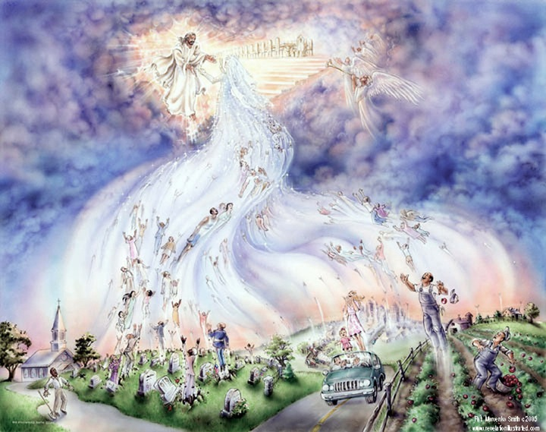
Believers’ Reward - Joy of the Lord right now
The Rapture Coming Soon

Slide 32
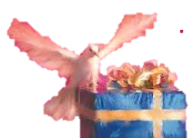
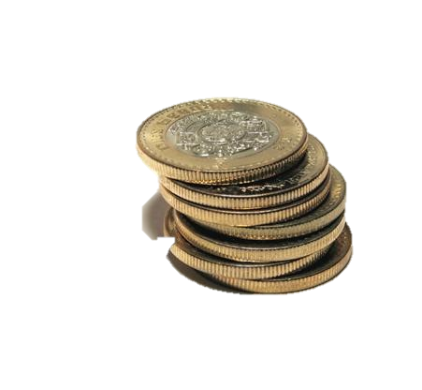
The Bema is the Believers’ Awards Ceremony In Heaven!
Aren’t we Saved by Grace?
Yes, we are saved by grace
“ unto good works” Eph.. 2:10
We have all been given “gifts”
“The Parable of the Talents”
Matthew 25:14-30

Slide 33
Back to Running the Race to Win the Prize

Slide 34
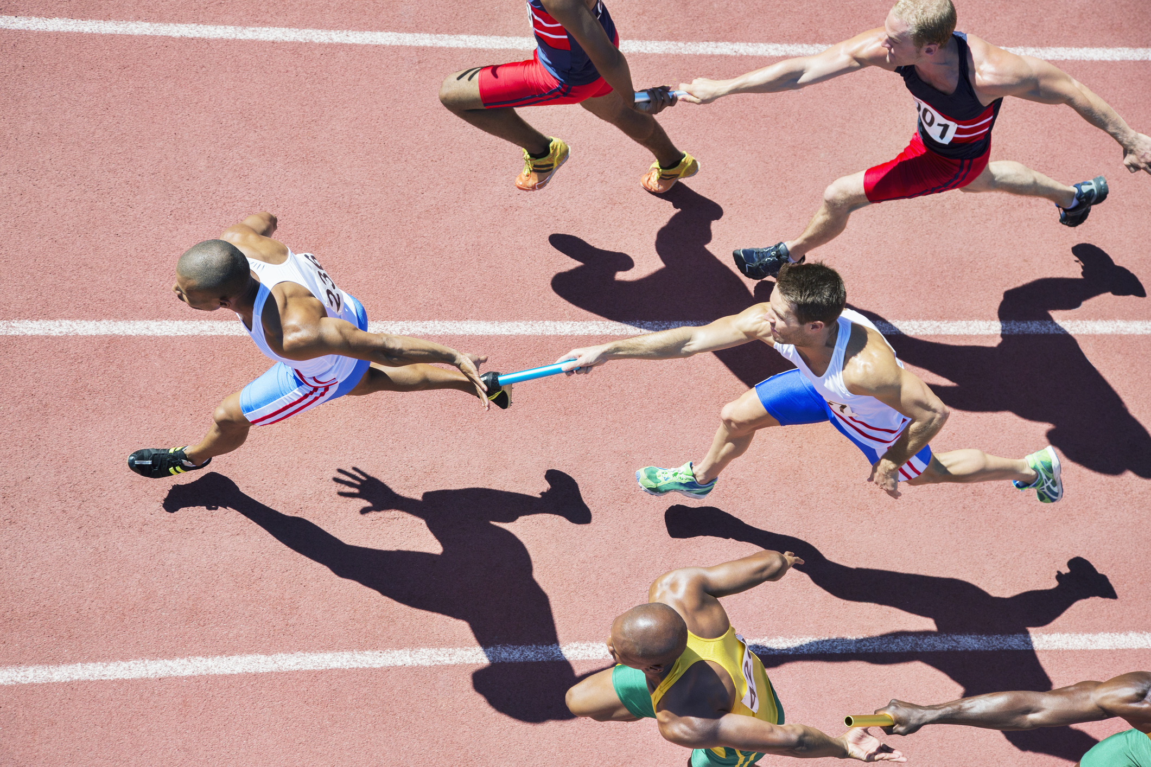
Doing Ministry Together is Better
Let’s Look at Relay Races
Every Runner completes their assignment to Win as a Team.

Slide 35
In Relay Races, each runner keeps a strong focus.
They train not only for hours, but for years….
For the BIG Race
#1. Everything Depends on Teamwork
#2. Get a Good Start
#3. Stay in Your Lane
#4. Hand off the Baton
We must pass on our Faith to others

Slide 36
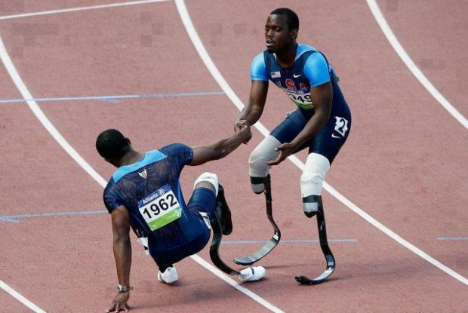
“ Though a just man may fall 7 times, he will get back up .
But the wicked will fall into ruin” Proverbs 24:16
While we are running the race of faith, sometimes we fall down…..
Praise God for those whom come to help us get back up …….

Slide 37
Let’s look at some men and women
in the Bible
to see how they ran the race of Faith

Slide 38
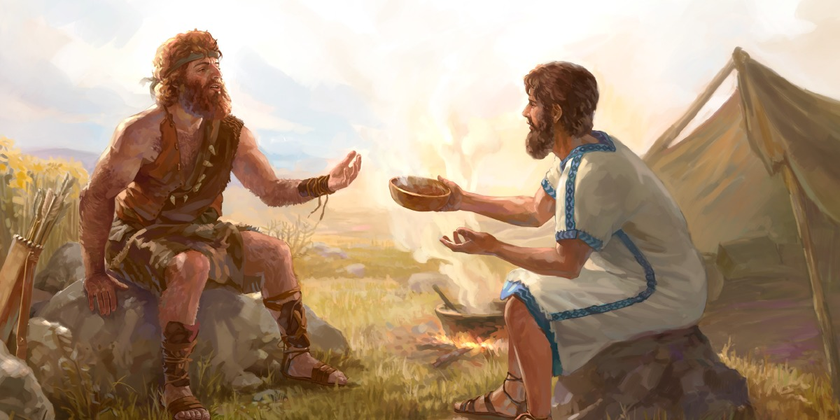
nsider
Consider Esau –
Given the birthright of the firstborn …. privileged
his father’s favorite…. a mighty hunter….
24 Know ye not that they which run in a race run all, but one receiveth the prize? So run, that ye may obtain. 25And every man that striveth for the mastery is temperate in all things. Now they do it to obtain a corruptible crown; but we an incorruptible. 26I therefore so run, not as uncertainly; so fight I, not as one that beateth the air: 27But I keep under my body, and bring it into subjection: lest that by any means, when I have preached to others, I myself should be a castaway.
Genesis 25: 29-34 Sold out for Food – Followed His Flesh

Slide 39
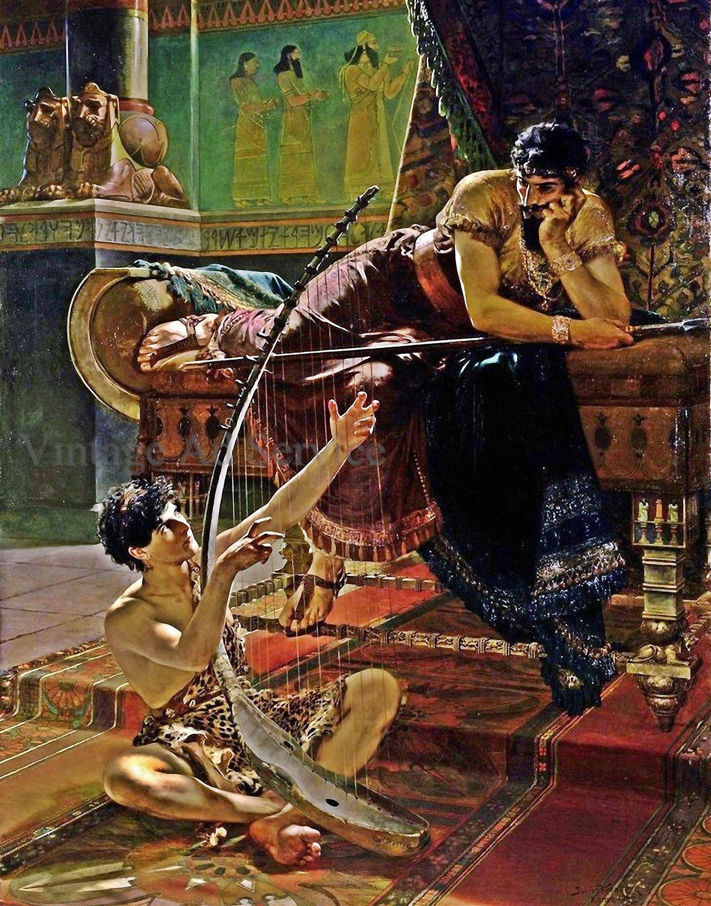
King Saul
Handsome & anointed,
Not anyone like him, Commander of armies, Prophesies by the Spirit
24 Know ye not that they which run in a race run all, but one receiveth the prize? So run, that ye may obtain. 25And every man that striveth for the mastery is temperate in all things. Now they do it to obtain a corruptible crown; but we an incorruptible. 26I therefore so run, not as uncertainly; so fight I, not as one that beateth the air: 27But I keep under my body, and bring it into subjection: lest that by any means, when I have preached to others, I myself should be a castaway.
1 Samuel Chapters 9 – 31
2Samuel Chapters 1-22
1 Chronicles 8-26
Disobeys the Lord,
consults a witch,
loses the anointing,
loses the Kingship,
tries to kill David
and even his own son!

Slide 40
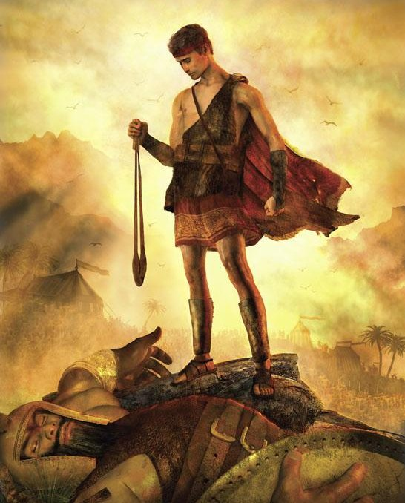
David
A Man after God’s Own Heart
Throughout
OldTestament
& New Testament
Samuel, Saul, Goliath, Jonathan, Uriah, Bathsheba, Solomon
…and so much more
Psalm 51
24 Know ye not that they which run in a race run all, but one receiveth the prize? So run, that ye may obtain. 25And every man that striveth for the mastery is temperate in all things. Now they do it to obtain a corruptible crown; but we an incorruptible. 26I therefore so run, not as uncertainly; so fight I, not as one that beateth the air: 27But I keep under my body, and bring it into subjection: lest that by any means, when I have preached to others, I myself should be a castaway.

Slide 41
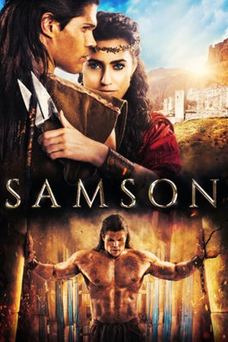
Chosen
Anointed,
Mighty Warrior
Set Apart by God
from birth
Supernatural Strength
A huge weakness
Betrayed
Humiliated
Judges Chapters 13-16
Redeemed

Slide 42
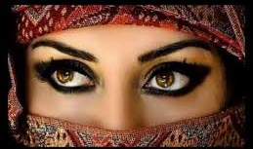
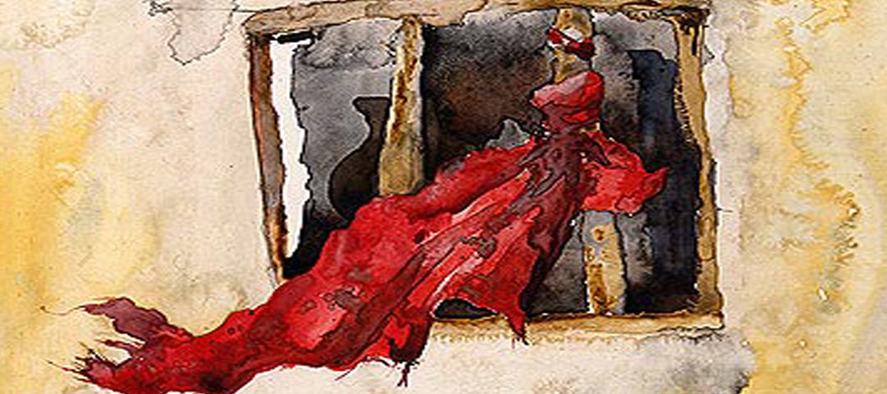
Rahab
Most famous harlot
in Jericho
Joshua Chapter 2
Mathew Chapter 1

Slide 43
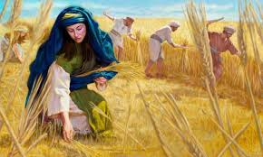
Ruth - a Moabite woman and a foreigner,leaves country and family and any hope of a husband, to follow the God of Israel

Slide 44
Running the Race to Win the Prize
Standing on God’s Promises
Living to Finish

