Slide 1
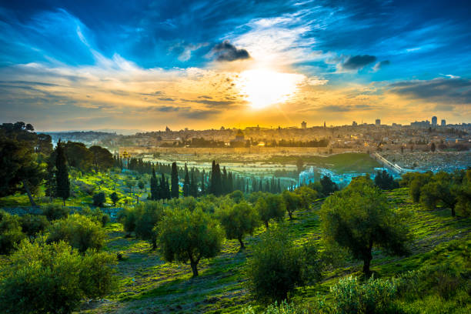
“The Revelation Generation”
To Whosoever who Has, More will be Given!

Slide 2
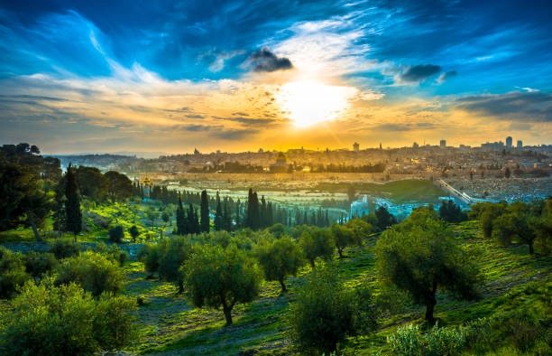
#1. Jerusalem is the Center of the Garden of Eden
It all Starts in Genesis

Slide 3
What if……
The Exact Place Adam Lost the Battle and His Fellowship with God in the Beginning
Is the Same Place Jesus, the 2nd Adam Will Restore He will Defeat the Enemy Forever
and Restore All Fellowship To God at the End
When He Returns to Defeat the Enemy Forever

Slide 4
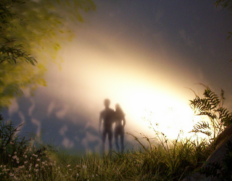
In the Beginning, everything in the Garden was Perfect.
God created and blessed Adam and Eve
He gave them dominion over all His Creation.
Genesis 1:28 No Sin, No Sickness, No Separation!

Slide 5
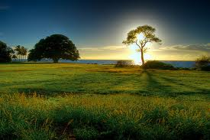
God told them of 2 Specisl Trees in the Garden
The Tree of the Knowledge of Good and Evil
The Tree of Life
“Adam, of every tree of the Garden, you may freely eat, BUT of the Tree of the Knowledge of Good and Evil, you shall NOT eat of it: for in the day that you eat of it, you shall surely die.” Genesis 2 :16-17

Slide 6
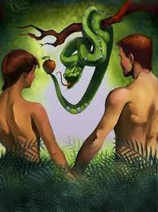
Genesis 3:6-7
“And when the woman saw that the tree was good for food, and that it was pleasant to the eyes, and a tree to be desired to make one wise, she took fo the fruit and did eat, and gave also to her husband with
her; and he did eat.
“And the eyes of them both were opened, and they knew that they were naked,
and they sewed fig leaves together,
and made themselves aprons.”

Slide 7
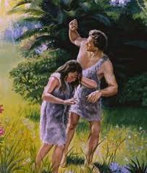
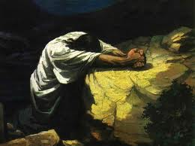
What if…..both events take place in the same Garden
Just as Adam and Eve were in great agony after experiencing the consequences of sin - Separated from God’s Presence!
Adam and Eve were full of grief when they were evicted from the Garden because of sin
So Jesus was full of grief in over the great price He would soon pay for all our sins.

Slide 8
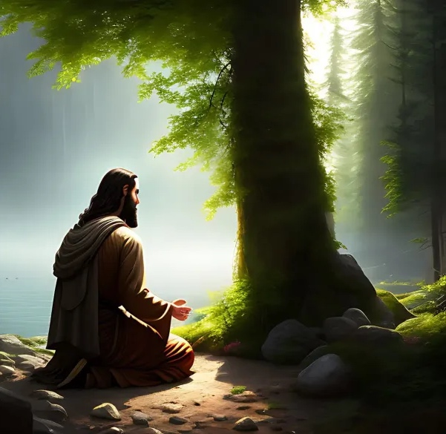
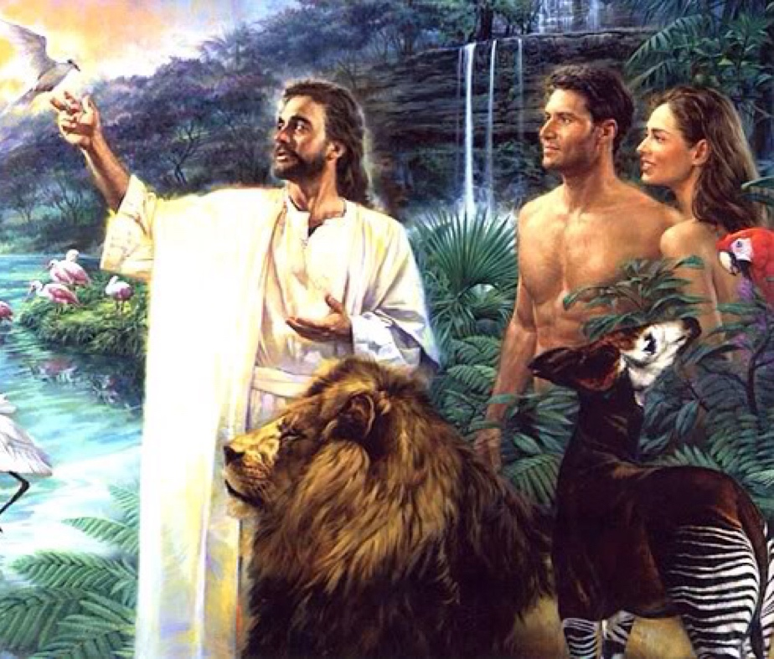
Is the very same the very Garden
God fellowshipped with Adam and Eve
In the cool of the day
What if Garden Jesus so often fellowshipped with His Father

Slide 9
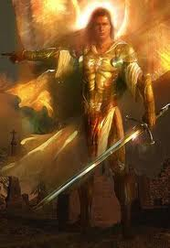
“So He drove out the man;
and He placed Cherubim
at the east of the Garden of Eden,
and a flaming sword
which turned every way ,
to keep the way of theTree of Life Genesis 3:23
The Cherubim guard
the Presence Of God

Slide 10
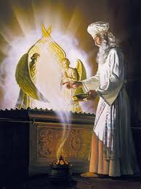
The Next Place we see these Cherubim
Guarding God’s Presence
Will be the Holy Temple n Jerusalem
Behind the Veil & atop the Ark of the Covenant
Only on the Holiest Day
- The Day of Atonement –
Only in the Holiest City
-In Jerusalem –
Only the holiest man
- the High Priest of Israel –
Can enter the Holiest Place
To meet with God
“Face-to-Face”

Slide 11
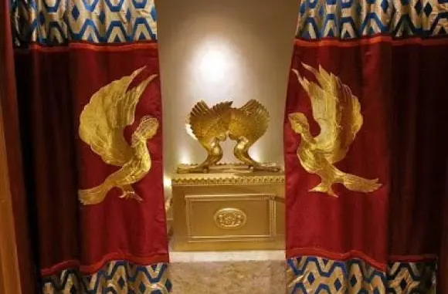
Notice the 2 Cherubim on the Veil guarding the Holy Place
Just like in the Garden of Eden. …..They are protecting the Presence of God!

Slide 12
The Discovery of the City of Adam
Across the Jordan from Jerusalem
Close to Jericho

Slide 13
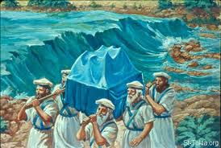
The Book of Joshua Chapter 3: 14-16
Joshua 3: 14-16
" And it shall come to pass,
as soon as the soles of the feet
of the priests that bear
the ark of the LORD,
the LORD of all the earth,
shall rest in the waters of Jordan,
that the waters of Jordan shall be
cut off from the waters
that come down from above;
and they shall stand upon a heap.
“And it came to pass, when the people removed from their tents, to pass over Jordan, and the priests bearing the Ark of the Covenant before the people; And as they that bare the ark were come unto Jordan, and the feet of the priests that bare the ark were dipped in the brim water,
(for Jordan overflowed its banks all the time of harvest,) That the waters which came down from above stood and rose up upon a heap very far from the city Adam, that is beside Zaretan”

Slide 14
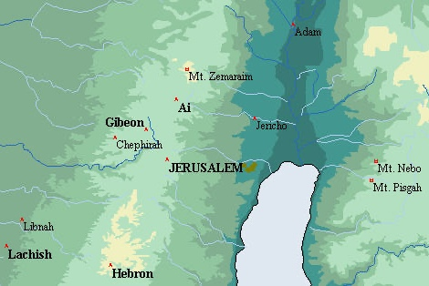
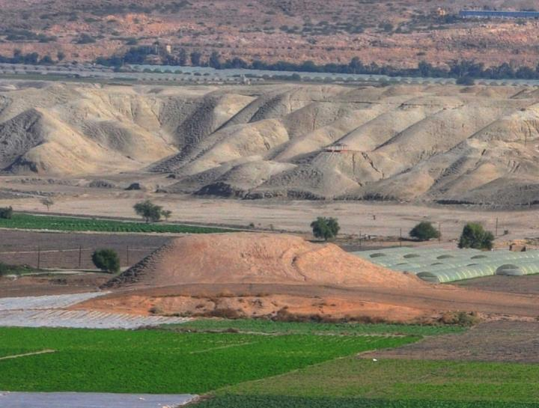
The City of Adam is 6,000 years old Tel Damieh in Jordan!
“The waters which came down from above stood and rose up upon a heap
very far from the city of Adam, which is beside Zaretan.” Joshua 3:16

Slide 15
Any More Clues in the Bible
that Jerusalem is the Center
of the Garden of Eden?
What about the 4 Rivers in Genensis ?

Slide 16
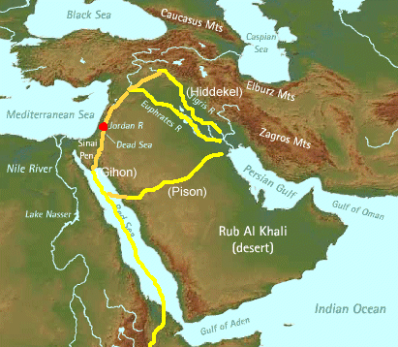
“And a River ran out of Eden to water the Garden, and from thence it parted becoming 4 heads: the Pison, the Gihon, the Hidekel and the Euphrates” 2:1-14
The Tigris and Euphrates
frame the Mesoptamia Area,
while the Pison and the Gihon
are now subterranean rivers,
all originating from
The Garden of Eden.
Ezekiel 47:1-12 describes
the supernatural River
that will flow from
the Temple of God
and heal the land of Israel.
Revelation 22:1-2
declares the same!

Slide 17
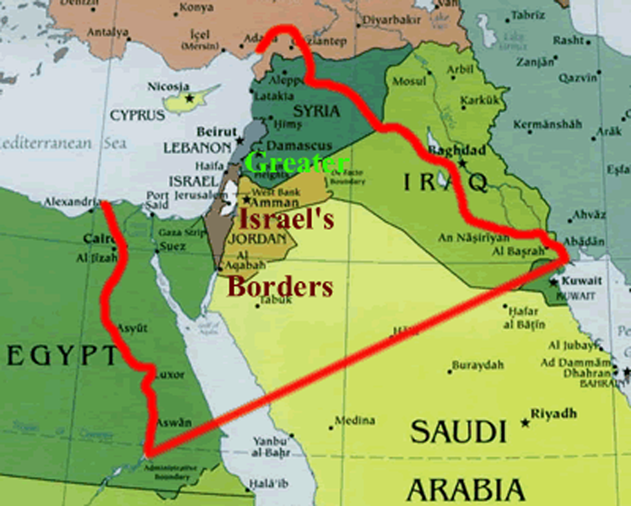
The Eternal Land Covenant God Cut with Abram
Genesis 15:18
“In the same day the LORD
made a covenant
with Abram, saying ‘
Unto your seed
have I given this Land,
from the River of Egypt
unto the great river,
the Euprates.”

Slide 18
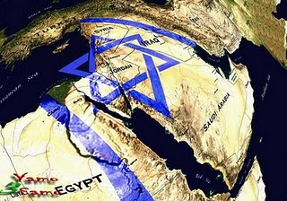
These Same Rivers also Mark the Boundaries of New Jerusalem – Revelation 21:16
“And the city lies foursquare, the length is as large as the breadth: and he measured the City with the reed, 12,000 furlongs. The length and the breadth and the height of it are equal.” 1500 miles x 1500 miles x 1500 miles!

Slide 19
l
#2. Israel’s Beginning Enemies are Israel’s End Time Enemies
God’s Election, Covenants, & Blessing
Is the Root of a 6000 year old Hatred
That Began in Genesis
And Continues until this Day
God gave a Land Covenant & Spiritual Inheritance
to Abraham, Isaac, & Jacob – To Israel, To the Jews
The Descendants of Ishmael hate the seed of Isaac
The Descendants of Esau hates the seed of Jacob

Slide 20
Reuben · Simeon · ·
Levi Judah ·
Dan · Naphtali · Gad ·
Asher · Issachar
Zebulon
Joseph Benjamin
“Jews”

Slide 21
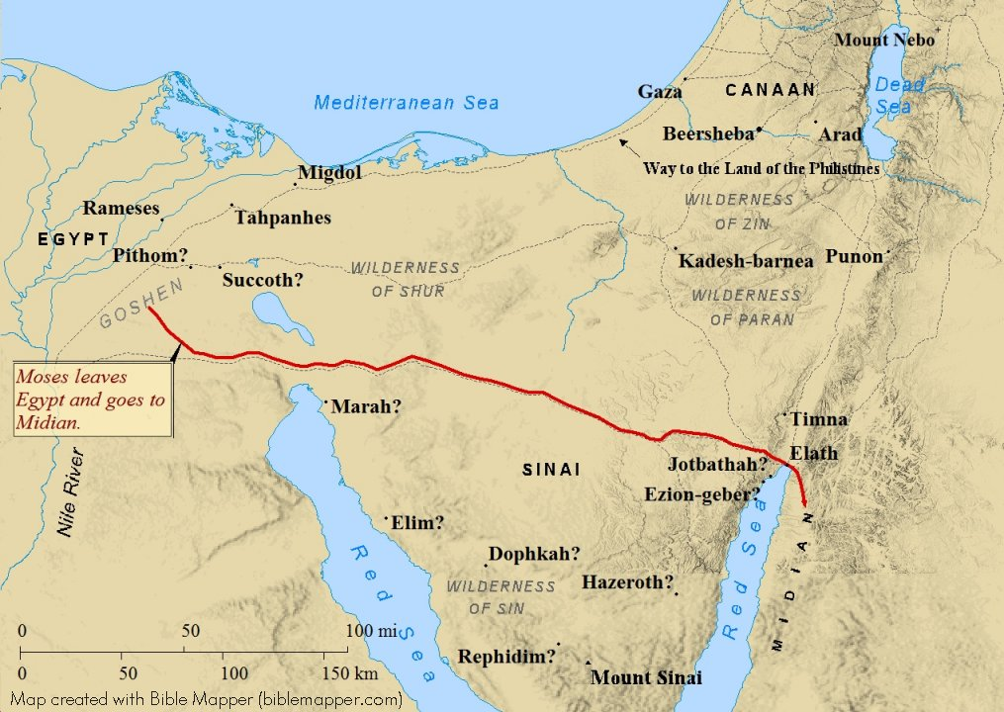
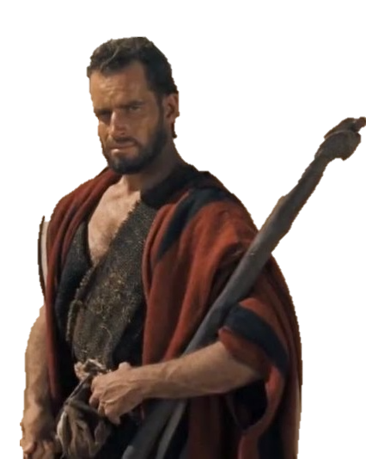
#3 -The Mountain of God was in Midian /Saudi Arabia….not Egypt

Slide 22
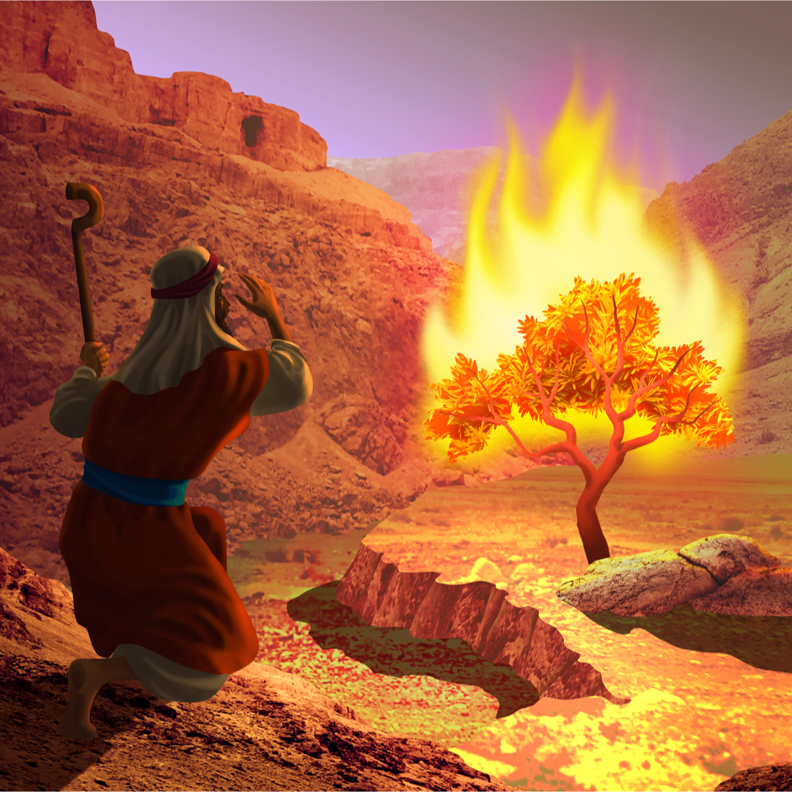
Exodus Chapter 3 Moses & The Burning Bush
1. Now Moses kept the flock of Jethro his father-in-law, the priest of Midian: and he led the flock to the backside of the desert, and came to the Mt. of God, even to Horeb.
² And the Angel of the Lord appeared to him in a flame of fire out of the midst of a bush: and he looked, and, behold, the bush burned with fire,
and the bush was not consumed.
³ And Moses said, I will now turn aside,
and see this great sight, why the bush is not burnt.
⁴ And when the Lord saw that he turned aside to see, God called unto him out of the midst of the bush,
and said, Moses, Moses. And he said, Here am I.

Slide 23
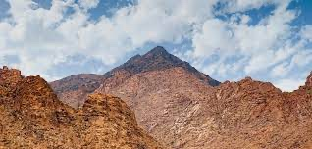
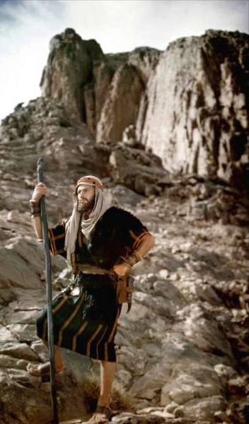
¹⁰ Come now therefore, and I will send you to Pharaoh,
that you may bring forth My people the children of Israel out of Egypt.
¹¹ And Moses said to God, Who am I, that I should go to Pharaoh,
and that I should bring forth the children of Israel out of Egypt?
¹² And He said, Certainly I will be with you; and this shall be a token to you,
that I have sent you: When you have brought forth the people out of Egypt,
You shall serve God upon this mountain.

Slide 24
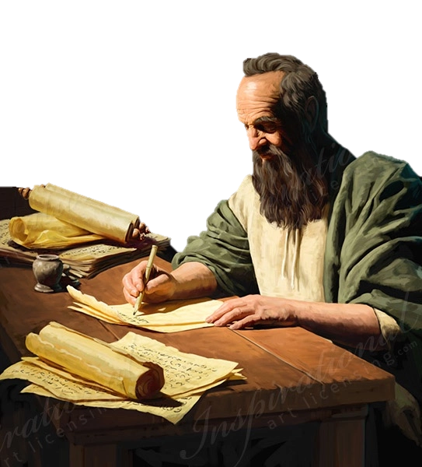
According to Paul the Apostle
“For this Hagar is Mt. Sinai in Arabia,
and answers to Jerusalem
which now is,
and is in bondage
with her children”
Galatians 4:25

Slide 25
#4. The Real Crossing of the Red Sea
Proves where the Real Mountain of God Is

Slide 26
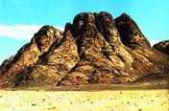
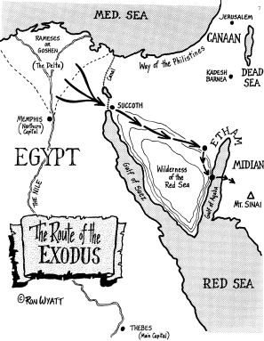
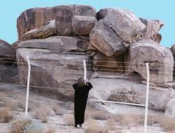
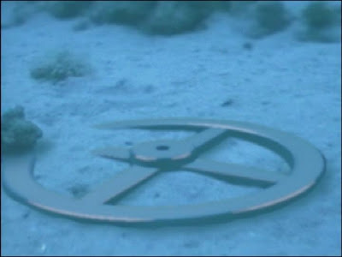
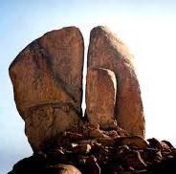
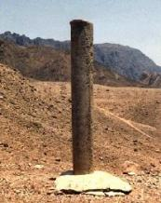
“For this Hagar is Mt. Sinai in
Arabia, and answers to Jerusalem which now is,and is
in bondage with her children” Galatians 4:25
Recent Discovery

Slide 27
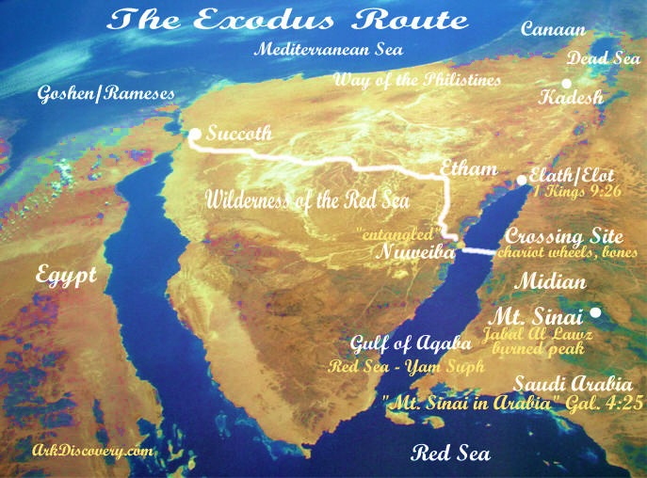
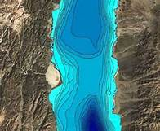
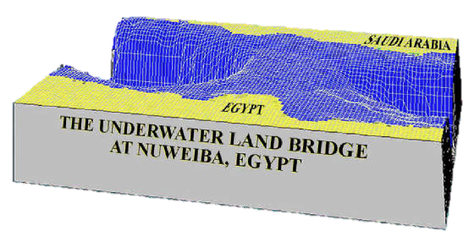
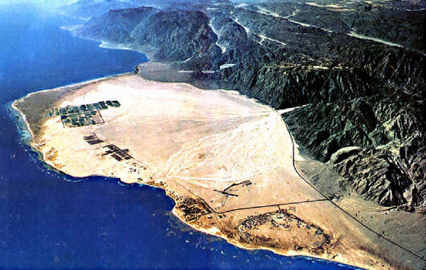
God carries way oIsrael on Eagle’s Wings when there is no other f escape

Slide 28
#5. The Leader of the Gog/Magog Battle
is Turkey not Russia

Slide 29
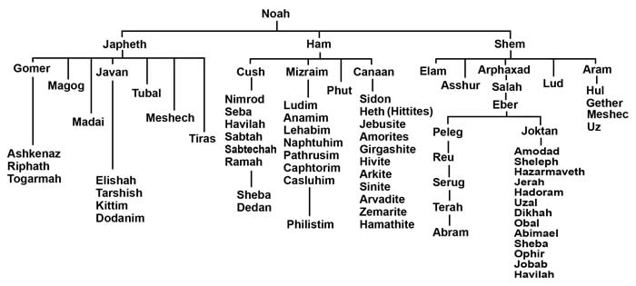
38:1-2 “And the voice of the Lord came to me, saying, Son of man, set your face against Gog,
the land of Magog, the chief prince of Meshech & Tubal, and prophesy against him.
And say, ‘I am against you, O Gog, chief prince of Meshech & Tubal.’
Who is Gog? Where is Magog?
Genesis 10 “The Table of Nations”

Slide 30
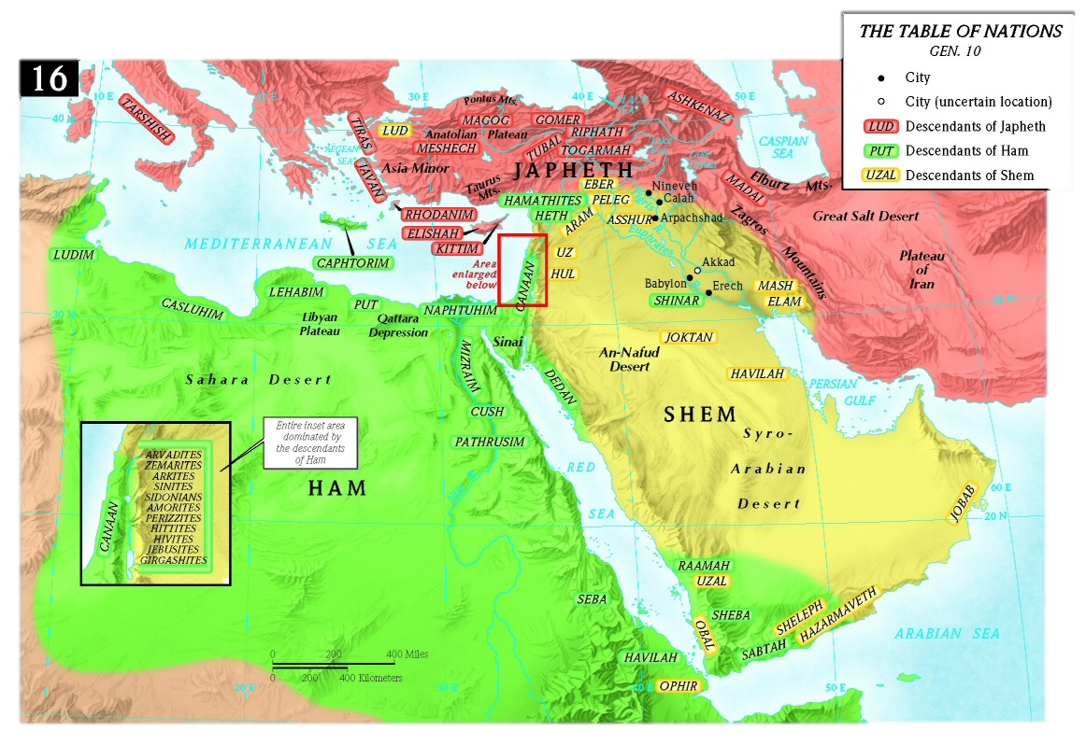
Turkey is the Land of Gog, Meschek & Tubal

Slide 31
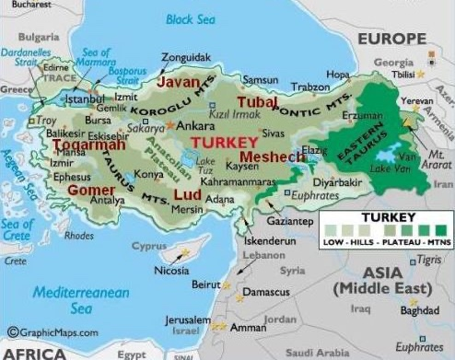
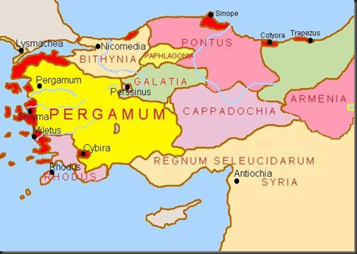
GOG is a Hebrew name…Gimel Vav Gimel
meaning “The most proud of the proud”
translated “mountain”
is a strong prince over Turkey, not Russia
GOG in Sumerian language means “darkness” Turkey (Pergamum) is where satan’s throne is located!
Revelation 2:13 (Letter to Pergamum)
“I know your works and where you dwell,
Even where satan’s throne is:
And you hold fast My name, even in those days wherein Antipas was My faithful martyr,
who was slain among you, where satan dwells.”

Slide 32
Rosh = Head, Chief, Top, in Hebrew
a Noun or an Adjective
NO WHERE ELSE in the Bible is it
used as a place called Russia
Chief Prince = Chief Principality Ephesians 6:12
Gog & Magog War happens before Millenium
Satan is bound the 1000 years in the Pit Revelation 20:3
At end of 1000 years, Satan is loosed Revelation 20:7
Gog & Magog gather nations to battle Revelation 20:8

Slide 33
The Chief Principality is Highest Power
Ruler of Darkness of this World
Spiritual Wickedness in High Places
Ephesians 6:12
GOG is a demonic spirit
that inhabits men

Slide 34
6. The Battle of Gog/Magog is Armageddon
19 Parallel Events
It is NOT a Pretribulation Event
It is the Main Event

Slide 35
#1. God calls Gog “the Prophesied One” Ezekiel 38:17
#2. Jesus Christ will be present on Earth. Ezekiel 38:20; Revelation 19:11-15
#3 God gathers the Birds of the Air to Dine on the Wicked - Ezekiel 39:4; 17-20; Rev. 19:17-21
#4. Great Hailstones Fall at End of Both Battles - Ezekiel 38:22; Revelation 16:21
#5. In Both Battles, the Armies are confused and Attack each other – Ezek 38:21; Zechariah 14:13
#6. A Great Earthquake will Shake the Land – Ezekiel 38:18-20, Rev 16:18-19
#7. Israel shall know their God and their Messiah after Gog/Magog Battle –Ezekiel 39:22, 28-29
#8. The King of the North - The Anti-Christ - Ezekiel 38:15; Ezekiel 39:2; Daniel 11:40; Joel 2:20
#9 The Anti Christ is also called the Assyrian – Micah 5:5-6; Isaiah 10:5,12, 24-25; Isaiah 30:31
#10. Both Gog and Anti Christ come at time of Israel’s security – Ezekiel 38:11; Daniel 11:24

Slide 36
#11. Both Gog and Anti-Christ share same Alliance of Nations – Ezekiel 38:5-6; Daniel 11:43
#12. Both Gog and Anti-Christ come to take spoil and plunder - Ezek 38:10-13; Dan. 11:24; Isa. 10:5-7
#13 Both Gog and Anti-Christ destroyed at End of Battle – Ezekiel 39:11; Daniel 7:11
#14. Christ is physically Present in Israel at End of both Battles - Ezekiel 38:20; Ezekiel 39:21;
Zechariah 12:10; Zechariah 14:3-4; Revelation 1:6; Revelation 17:4
#15. God’s Name will no Longer be Profaned - Ezekiel 38:23; Ezekiel 39:7-8; 22; Revelation 21:3; 22:4
#16. God’s Spirit is Poured out on Israel after Both Battles – Ezekiel 39:29; Zechariah 12:10
#17. The Weapons of War are Destroyed after Both Battles – Ezekiel 39:9; Isaiah 2:4
#18. God says, ‘It is Done’ After Both Battles – Ezekiel 39:8; Revelation 16:17
#19. The Stench of the Carcases after Both Battles - Ezekiel 39:11; Isaiah 34:3; Joel 2:20

Slide 37
#7. The Bible reveals an Islamic Anti-Christ
not a European Anti-Christ
The Final Beast Is from the Middle East

Slide 38
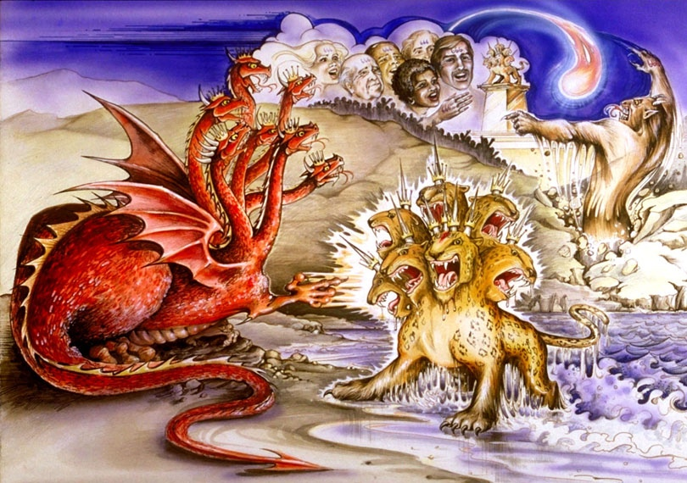
Revelation 13:1
“And I stood on the sand of the sea and saw a beast rise up
out of the sea,
having 7 heads
and 10 horns,
and upon his horns 10 crowns,
& upon his heads
the name
of blasphemy.”

Slide 39
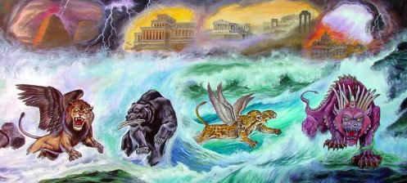
2. “And the beast which I saw was like a leopard & his feet were as the feet of a bear, & his mouth
as the mouth of a lion: & the dragon gave him his power & his throne and great authority.”
Daniel Chapter 7 Defines the Anti-Christ Kingdom
Babylon
Greece
Fierce Final Beast
Medes/Persia

Slide 40
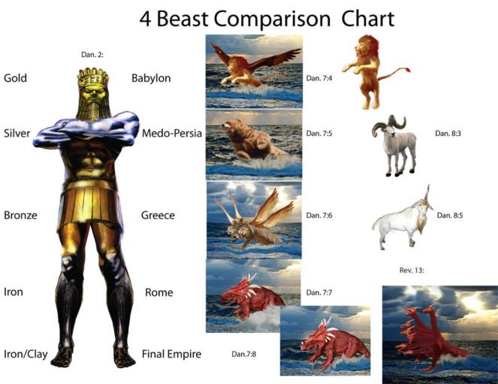
Comparing Daniel 2, Daniel 7 & Daniel 8

Slide 41
The 4 Beasts are the Same 4 Kingdoms as:
Modern Bible Maps
Look into the Future
Anti-Christ
Kingdom

Slide 42
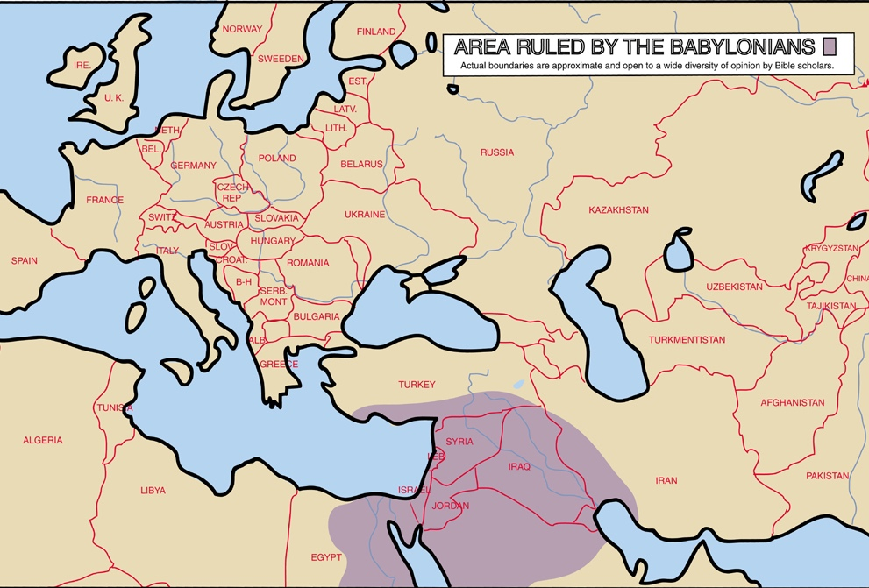
Babylonian Empire

Slide 43
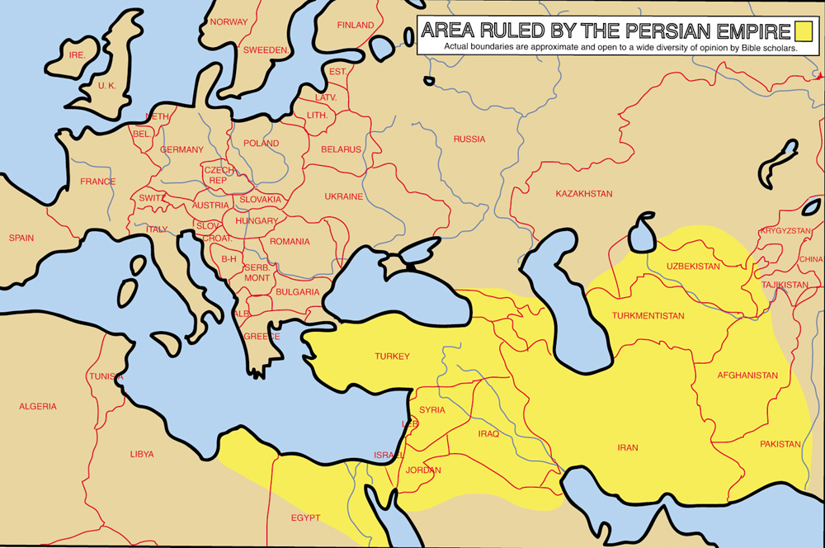
Persian Empire

Slide 44
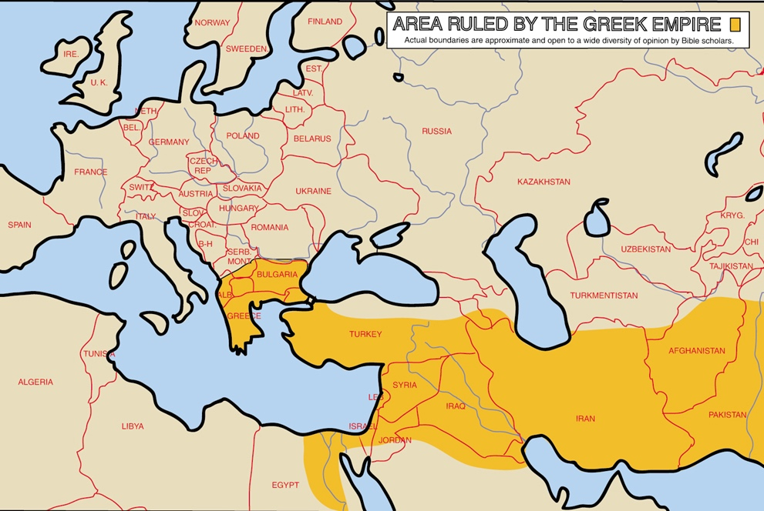
Greek Empire

Slide 45
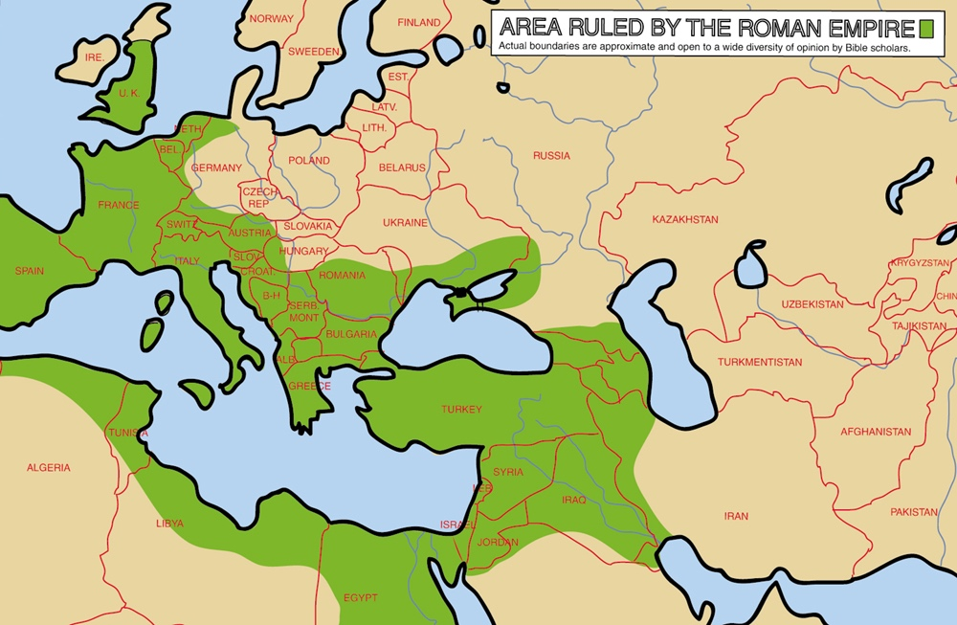
Roman Empire

Slide 46
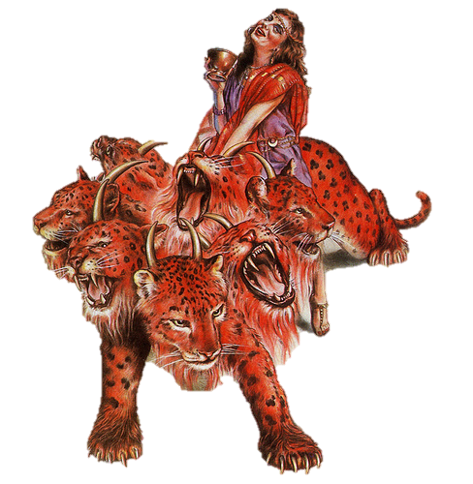
Woman riding the Beast with 7 Heads
Mystery Babylon, the Great Harlot
False Religion Controlling 7 Kingdoms
In Bible Prophecy
Kingdoms = Heads = Mountains
Kingdoms are Empires

Slide 47
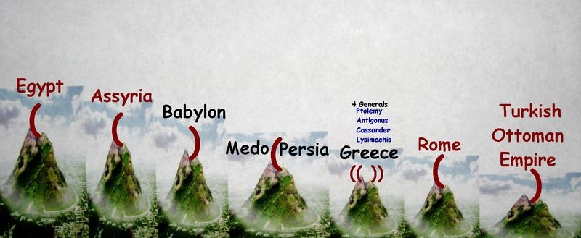
Revelation 13:3 “ And I saw one of his heads as it were wounded to death,
& his deadly wound was healed: & all the world wondered after the beast.”
Islam
1
7
5
2
4
3
6
“And here is the mind that has wisdom: The 7 heads are 7 mountains, on which the woman sits. And there are 7 kings: 5 are fallen and one is, and the other is not yet come & when he comes, he must continue a short space. And the beast that was and is not, even he is the 8th & is of the 7 and goes into perdition.
Revelation 17:14 describes the 8th Mt. as the Anti-Christ!!

Slide 48
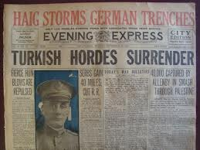
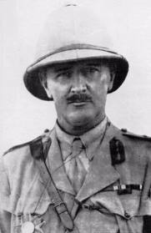
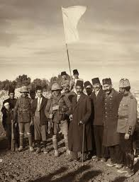
World War 1
Ottoman Turkish Empire surrenders Jerusalem
to Gen. Allenby 1917
after 400 years of rule
The Allied Christian victors divided up the Ottoman Empire between themselves
Islam suffers a “mortal head
Wound that must be healed”
as the World power in 1924
At the hands of the Christians

Slide 50
Revelation 17:1-3 “Come hither, & I will show you the judgment of the great whore that sits on many waters: with whom the kings of the earth have committed fornication, & The inhabitants of the earth have been made drunk with the wine of her fornication. And he carried me away in the Spirit into the wilderness ( desert). I saw a woman (Islam) sitting upon a red -colored beast. ” Revelation 17:1-3
Saudia Arabia is the
desert of the seas!

Slide 51
The Kaabah In Makkah - The Black Stone
Dressed & Worshipped like a Woman
Muslim Woman in Burka
Writing on her forehead
Rev. 17:6 “Upon her forehead was a name written, Mystery Babylon the great, the mother of harlots
and abominations of the earth. And when I saw her, I wondered with great admiration (terror).”

Slide 52
Gen. 12:1-3 “God said to Abram.
“Get you out of your country, and from your kindred, and from your father’s house, to a land that I will show you.
And I will make you a great nation & bless you & you shall be a blessing.
I will bless those that bless you and curse him that curses you“
Notes:
This is an ancient carving of Molech. Abram lived in Iraq, and the people around him served this god. As you can see, it is the moon god. It is the same symbol on top of every mosque. The same god of Genesis

Slide 53
Isaiah 24:6 Describes Armageddon
The Curse that is Coming
in the End Times is ALLAH
Islam is the Harlot Religion and Government and Finance
Therefore has the curse h423 אלה 'alah
devoured h398 אכל 'akal
the earth, h776 ארץ 'erets
and they that dwell h3427 ישב yashab
therein are desolate: h816 אשם 'asham
therefore the inhabitants h3427 ישב yashab
of the earth h776 ארץ 'erets
are burned, h278 חר charar
and few מזער miz`ar
men h582 אנוש 'enowsh
left. H760 שאר

Slide 54
#8 The Mark of the Beast
Is a Badge of Loyalty to a Harlot Religion
Not a Chip
Not a www computer code
Not Artificial Intelligence
Not Scanning or Banking code
Not Covid vaccine

Slide 55
11. “And I behold another beast coming up out of the earth;
and he had 2 horns like a lamb, and he spoke as a dragon.
12. And he exercises all the power of the 1st beast,
whose deadly wound was healed.
13. And he does great wonders, so that he makes fire come down
from heaven in the earth in the sight of men.
14. And deceives them that dwell on the earth, by the means of those miracles
which he had power to do in the sight of the beast:
saying to them that dwell on the earth, that they should make an image to the beast,
which had the wound by a sword and did live.
15. And he had power to give life to the image of the beast,
that the image of the beast should both speak ,
and cause that as many as wound not worship the image of the beast should be killed.
“The False Prophet” Revelation 13:11-15

Slide 56
Rev. 13:16-18 “And he causes all both small and great, rich and poor, free and bond, to receive a mark on their right arm or on their forehead – that no man might buy or sell unless he had that mark, or the name of the beast or the number of his name.
Here is wisdom. Let him that has understanding count the number of the beast for it is the number of a man and his number is 666.”

Slide 57
God revealed to John these symbols to record for us in the Book of Revelation as the mark for the coming Anti-Christ. Assumed to be the Greek alphabet letters Chi, Xi and Stigma - they also have numerical values. Bible scholars added these together = 666.

Slide 58
The Symbol
for Allah
Symbol for Muhammed
Symbol for Muhammed
and on the arm

Slide 59
Jesus’ 2nd Coming as Victorious King
Revelation Chapter 19 tells Us When
The Prophet Isaiah Tells us Who, Where, Why

Slide 60
Revelation 19:11-16
King of Kings
Lord of Glory
Avenger of Blood
He Comes to Make War with His Enemies
He defends Israel
Blood on His Garments
Isaiah 63
The Army of God is Coming with Him

Slide 61
“And I saw heaven open, and behold a white horse, and He that sat upon him was called faithful & true
And in righteousness He does judge and make war.His eyes were as a flame of fire,
& on His head were many crowns;
&He had a name written that
no man knew, but He himself.
And He was clothed in a vesture dipped
In blood: and His Name is called
The Word of God” Revelation 19:11-13

Slide 62
Isaiah 63:1-6
Who is this who comes from Edom, with dyed garments from Bozrah?
Who is glorious in His apparel, travelling in the greatness of His strength?
I that speak in righteousness, mighty to save.
Why are You red in your apparel & your garments,
like him that treads in the winefat?
“I have trodden the winepress alone; & of the people
there was none with Me: for I will treat them in My
anger & trample them in My fury; & their blood shall
be upon My garments, & I will stain all My raiment.
“For the Day of Vengeance is in My heart, & the year of My redeemed is come.
And I looked & there was none to help; & I wondered that there was none to uphold;
therefor My own right arm brought salvation to Me; and My fury, it upheld me.
And I will tread down the people in My anger & make them drunk in My fury;
and I will bring their strength down to the earth.”

Slide 63
#9. The Importance of Understanding Edom –
God’s Judgment of Edom in End Times
Edom is Esau
Isaiah 63:1-6
Isaiah 34:1-8
Obadiah
Romans 9

Slide 64
Isaiah 34:1-7 – God’s Anger with Edom
¹Come near, ye nations, to hear; and hearken, ye people: let the earth hear, and all that is therein; the world, and all things that come forth of it.
² For the indignation of the Lord is upon all nations, and his fury upon all their armies: he hath utterly destroyed them, he hath delivered them to the slaughter.
³ Their slain also shall be cast out, and their stink shall come up out of their carcases, and the mountains shall be melted with their blood.
⁴ And all the host of heaven shall be dissolved, and the heavens shall be rolled together as a scroll: and all their host shall fall down, as the leaf falls off from the vine, and as a falling fig from the fig tree.
⁵ For My sword shall be bathed in heaven: behold, it shall come down upon Idumea, and upon the people of My curse, to judgment.
⁶ The sword of the Lord is filled with blood, it is made fat with fatness, and with the blood of lambs and goats, with the fat of the kidneys of rams: for the Lord hath a sacrifice in Bozrah, and a great slaughter in the land of Idumea.
⁷ And the unicorns shall come down with them, and the bullocks with the bulls; and their land shall be soaked with blood, and their dust made fat with fatness.
⁸ For it is the Day of the Lord's vengeance, and the year of recompences for the controversy of Zion.

Slide 65
“Isaiah 34: 6 ”The sword of the Lord is filled with blood; it is made fat with the fatness, & with the blood of lambs and goats, with the fat of ram’s kidneys: for the Lord has a sacrifice in Bozrah, & a great slaughter in the land of Edom. For it is the Day of the Lord’s Vengeance”

Slide 66
#10. The Release of Satan after the Millennium
Revelation 20
There will a difference in the roles played by Israel & the Church during the Millennium
Satan is released to deceive Israel,
not the Glorified Saints

Slide 67
Revelation 20 – Christ’s Millennial Reign
¹ And I saw an angel come down from heaven, having the key of the bottomless pit and a great chain in his hand.
² And he laid hold on the dragon, that old serpent,
which is the Devil, and Satan, and bound him 1000 years,
³ And cast him into the bottomless pit, and shut him up,
and set a seal upon him, that he should deceive the nations
no more, till the 1000 years should be fulfilled:
and after that he must be loosed a little season.
⁴ And I saw thrones, and they sat upon them, and judgment was given unto them: and I saw the souls of them that were beheaded for the witness of Jesus, and for the Word of God, and which had not worshipped the beast, neither his image, neither had received his mark upon their foreheads, or in their hands; and they lived and reigned with Christ 1000 years.
⁵ But the rest of the dead lived not again until the 1000 years were finished. This is the 1st Resurrection.
⁶ Blessed and holy is he that has part in the 1st Resurrection: on such the 2nd death has no power, but they shall be priests of God and of Christ, and shall reign with Him 1000 years.

Slide 68
Different Views of the Millennium
Among Churches
Challenge Truth About End Time
#1. Jesus comes after Tribulation to set up 1,000 year reign
Church is present during Tribulation, no Rapture
#2. Rapture of Church happens before Tribulation. Jesus returns with Church after the Battle of Armageddon. Then He begins His 1000 reign. The True Church is not present during Tribulation. God has 2 distinct and separate plans: one for Israel and one for The Church.
#3. Most Churches today believe they are in the Millennium now as the Church Age which extends to the 2nd Coming: no Anti-Christ, no Rapture Tribulation, no future Israel as a modern nation. Partners with preterism – Book of Revelation fulfilled in 70AD. Final Church Age – World wide Revival. Gospel must be successfully spread over whole earth by Church. Jesus can only return when Church has conquered all. “Dominion Now – Bethel – Joel’s Army – NAR
#4. Promoted by Augustine in 3rd Century - all symbolic – NO Millennium. JESUS is reigning in our hearts now. OT prophesies are fulfilled only by the Church. Replacement Theology – Christian Left Wing – Social Justice

Slide 69
30 AD
Jesus’ 1000 Year Reign
New Heaven, New Earth in New Jerusalem,
Our Eternity with God and Jesus
Church Rapture
Jesus’ 2nd Coming

Slide 71
God will establish a Kingdom here on earth that Jesus will rule for 1000 years.
The Millennial Kingdom has 2 groups of inhabitants:
#1. Glorified Believers raptured prior to the Tribulation. They can’t be deceived
by satan. They do not marry or have children.
The Church, whose bodies were either resurrected or changed at the Rapture
1 Thessalonians 4:13–18; 1 Corinthians 15:21–23, 51–53;
Tribulation martyrs Revelation 20:4–6
Old Testament saints are also resurrected Daniel 12:2
#2. People with mortal bodies who survive the Tribulation. They marry and have children. They are capable of being deceived by satan.

Slide 72
1. Jesus Christ, as the first fruits- 1 Corinthians 15: 20 & 23
2. Certain OT saints came out of their tombs when
Jesus was resurrected & were seen by many –
Matthew.27:50-53
3. The Rapture of Church – Pre-Tribulation
1 Corinthians. 15:52,
I Thess. 4:13-18
4. The 2 Mighty Witnesses - Revelatioj 11:8
During the Tribulation –
5. The 144,000 in Heaven’sThrone Room – Rev. 14:1-5
6. The Tribulation Saints wave palm branches
Rev. 20:4-6 Reign with Christ during Millennium –
7. Old Testament Saints - Part of 1st Resurrection
1st Resurrection has Several Stages

Slide 73
Revelation 20:7-9
Israel in the Millennium
“After the 1000 years, satan will be loosed out of his prison,& shall go out to deceive the nations that are in the 4 quarters of the earth, Gog & Magog, to gather them together to battle: their number is as the sand of the sea. They go up on the breadth of the earth and surround the camp of the saints & the beloved city. Fire comes down from God out of heaven and devours them.”

Slide 74
“Their number is as the sand of the sea..”
The Israelites
Genesis 22:17 That in blessing I will bless thee, and in multiplying I will multiply thy seed as the stars of the heaven, and as the sand which [is] upon the sea shore; and thy seed shall possess the gate of his enemies;
Genesis 32:12 And you said, I will surely do you good, and make your seed as the sand of the sea, which cannot be numbered for multitude.
Samuel-2 17:11 Therefore I counsel that all Israel be generally gathered unto you, from Dan even to Beersheba, as the sand that [is] by the sea for multitude; and that you go to battle in your own person
1Kings 4:20 Judah and Israel were many, as the sand which is by the sea in multitude,
eating and drinking, and making merry.
Hebrews 11:12.” And so from one man, and he as good as dead, came descendants
as numerous as the stars in the sky and as countless as the sand on the seashore.”

Slide 75
The Church (Glorified Bodies) Rules & Reigns
with Christ during the Millennium
Revelation 5:8 ”And when he had taken the book, the 4 beasts and 24 elders fell down before the Lamb, having every one of them harps, and golden vials full of odors, which are the prayers of saints.
⁹ And they sung a new song, saying, You are worthy to take the book, and to open the seals thereof: for You were slain, and have redeemed us to God by Your blood out of every kindred, and tongue, and people, and nation”
Rev. 20:4 “ And I saw thrones, and they sat upon them, and judgment was given unto them: and I saw the souls of them that were beheaded for the witness of Jesus, and for the Word of God, and which had not worshipped the beast, neither his image, nor had received his mark upon their foreheads, or in their hands; and they lived and reigned with Christ 1000 years. ⁵ But the rest of the dead lived not again until the 1000 years were finished. This is the 1st Resurrection. ⁶ Blessed and holy is he that has part in the 1st Resurrection: on such the 2nd death has no power, but they shall be priests of God and of Christ, and shall reign with Him 1000 years.
2 Timothy 2:11-12 “ It is a faithful saying: For if we be dead with Him, we shall also live with Him:
¹If we suffer, we shall also reign with Him: if we deny Him, He also will deny us:

Slide 76
1st Corinthians 6:2-3 ”Do ye not know that the saints shall judge the world?
and if the world shall be judged by you, are you unworthy to judge the smallest matters?
³ Know you not that we shall judge angels? How much more things that pertain to this life?
Matthew 19:28 “And Jesus said to them, “Truly I say to you, that you who have followed Me,
in the regeneration when the Son of Man will sit on His glorious throne,
you also shall sit upon 12 thrones, judging the 12 tribes of Israel.”
Luke 22:29-30 “And just as My Father has granted Me a kingdom, I grant you that you may eat
and drink at My table in My kingdom, and you will sit on thrones judging the 12 tribes of Israel.
Colossians 3:4 ”When Christ, who is our life, shall appear, then shall you also appear with Him in glory.

Slide 77
Israel and Jerusalem are God’s focus during the Millennium
God’s Covenant Promises to Israel come to Fulfillment during the Millennium.
Jesus, Son of David, will be worshipped as King on David’s throne in an expanded Millennial Temple.(Ezekiel Chapters 40-48)
All nations will come up for the Feast of Tabernacles: and there will be animal sacrifices.

Slide 78
Isaiah 11 – Messiah’s Millennial Reign
¹ And there shall come forth a rod out of the stem of Jesse, and a Branch shall grow out of His roots:
² And the Spirit of the Lord shall rest upon Him, the Spirit of wisdom and understanding, the Spirit of counsel and might, the Spirit of knowledge and of the fear of the Lord;
³ And shall make Him of quick understanding in the fear of the Lord: and He shall not judge after the sight of His eyes, neither reprove after the hearing of His ears:
⁴ But with righteousness shall He judge the poor, and reprove with equity for the meek of the earth: and He shall smite the earth: with the rod of His mouth, and with the breath of His lips shall He slay the wicked.
⁵ And righteousness shall be the girdle of His loins, and faithfulness the girdle of His reins.
⁶ The wolf also shall dwell with the lamb, and the leopard shall lie down with the kid;
and the calf and the young lion and the fatling together; and a little child shall lead them.
⁷ And the cow and the bear shall feed; their young ones shall lie down together:
and the lion shall eat straw like the ox.
⁸ And the sucking child shall play on the hole of the asp,
and the weaned child shall put his hand on the cockatrice' den.
⁹ They shall not hurt nor destroy in all My holy mountain:
for the earth shall be full of the knowledge of the Lord, as the waters cover the sea.

Slide 79
Micah 4:1-3. ¹But in the last days it shall come to pass, that the Mountain of the House of the Lord shall be established in the top of the mountains, and it shall be exalted above the hills; and people shall flow unto it.
² And many nations shall come, and say, Come, and let us go up to the mountain of the Lord, and to the House of the God of Jacob; and He will teach us of His ways, and we will walk in His paths: for the Law shall go forth of Zion, and the Word of the Lord from Jerusalem.
³ And He shall judge among many people, and rebuke strong nations afar off; and they shall beat their swords into plowshares, and their spears into pruninghooks: nation shall not liftup a sword against nation, neither shall they learn war anymore.
Jesus’ Millennial Reign
Isaiah 2:2-4 And it shall come to pass in the last days, that the mountain of the Lord’s House shall be established in the top of the mountains, and shall be exalted above the hills; and all nations shall flow unto it.³ And many people shall go and say, Come, and let us go up to the Mountain of the Lord,
to the House of the God of Jacob; and He will teach us of His ways, and we will walk in His paths:
for out of Zion shall go forth the Law, and the Word of the Lord from Jerusalem.
⁴ And He shall judge among the nations, and shall rebuke many people: and they shall beat their swords into plowshares, and their spears into pruninghooks: nation shall not lift up sword against nation, neither shall they learn war anymore.

Slide 80
Israel in the Millennium
Isaiah 65:25. “The wolf and the lamb will graze together, and the lion will eat straw like the ox; and dust will be the serpent’s food.
They will do no evil or harm in all My Holy Mountain,” says the Lord.
Zechariah 14:16-21 “Then it will come about that any who are left of all the nations that went against Jerusalem will go up from year to year to worship the King, the Lord of hosts, and to celebrate the Feast of Booths. And it will be that whichever of the families of the earth does not go up to Jerusalem to worship the King, the Lord of hosts, there will be no rain on them. If the family of Egypt does not go up or enter, then no rain will fall on them; it will be the plague with which the Lord smites the nations who do not go up to celebrate the Feast of Tabernacles.”

Slide 81
#11. The 7 Feasts of the Lord
The Prophetic Pattern of Jesus 1st and 2nd Coming

Slide 83
x
God’s Appointed Times
Genesis 1:14
“And God said Let there be light in the firmament of the heaven to divide the day from the night … and let them be for signs and for seasons, and for days, and for years.”
Seasons – Moedim
The Feasts of the Lord

Slide 84
The Lamb of God
3 Spring Festivals
Feast of Pentecost
May/June – I Day
God’s Appointed Times
1st Coming
Leviticus 23
September/October
Holy Spirit Power
2nd Coming
The Lion of Judah
3 Fall Festivals
September/October

Slide 85
>
Jesus is Always on Time
1. Passover - Crucifixion 2. Unleavened Bread -Burial
3. First Fruits - Resurrection
50 Days
4. Pentecost
Holy Ghost Baptism
5. Trumpets
6. Atonement
7. Tabernacles
Rapture
Tribulation
Reign of Messiah

Slide 86
Prophecy in Proverbs 7
¹⁹ For the goodman is not at home, He is gone a long journey
Jesus is the Goodman
He has been gone for 2000 years
²⁰ He has taken a bag of money with Him,
and will come home at the day appointed. (Yom Keseh)
Yom Keseh – The Feast of Trumpets - “The Hidden Day”
“No Man Knows the Day or the Hour”
Matt 24:36 “But of that day and hour knows no man,
no, not the angels of heaven, but My Father only.”

Slide 87
“The Day No Man Knows the Hour”
is the Feast of Trumpets
Luke 12:37-41
Luke 12:42
Matthew 25:8-13
Matthew 24:44
Matthew 24:50
I Thess.5:1-5
Acts 1:7-8
Mark 13:32-37
Revelation 3:1-3

Slide 88
The Feast of Trumpets – So Many Clues
“The Last Trump”
“The Hidden Day”
“The Day of Judgment”
“The Time of Jacob’s Trouble”
“The BirthPangs of Messiah”
“ The Day of Remembrance”
“Marriage of Messiah”
“ The Coronation of the King”

Slide 89
“In a moment,
in the Twinkling of an eye”
When the moon is in conjunction
called the new moon,
the sky is black for several days…
The Moon Blinks and closes its eye…
No one actually knew the time the first sliver of the new moon would reappear
The Feast of Trumpets
has always been known as
“No Man Knows the Day or the Hour”

Slide 90
“1 Corinthians 15:51-52”Behold, I show you a mystery: we shall not all sleep, but we shall all be changed. In a moment, in the twinkling of an eye, at the last trump: For the trumpet shall sound, and the dead in Christ shall be raised incorruptible, and we shall be changed”

Slide 91
The Book of Revelation points to
The Tribulation as a Yom Kippur Service
Jesus is Officiating as High Priest
To Redeem the Nation of Israel
This is the time of Jacob’s Trouble
The Tribulation is not Intended for the Church

Slide 92
‘And in the midst of the 7 candlesticks one like the Son of man, clothed with a garment down to the foot, girt about the paps with golden girdle” Revelation 1:13

Slide 93
Now with the Incense from the Golden Altar and the blood of the sacrifice He begins
“The Walk”
No one can touch the High Priest until
after sprinkles the blood on the Mercy Seat behind the Veil.
“I will meet with you between the cherubim”
“Touch Me Not”
“And when He had opened the 7th seal
there was silence in heaven about the
space of half an hour.” Revelation 8:1

Slide 94
Sprinkle the Blood 7x down
Leviticus 16:14, 15
“And he shall take the blood of the sacrifice and sprinkle it with his finger upon the Mercy Seat eastward;
and before the Mercy Seat shall he sprinkle the blood 7 times.”

Slide 95
“
Revelation 8:3-4
“And another angel came amd stood at the altar, having a golden censer; and there was given to him much incense,
that he should offer it with the prayers
of the saints upon the golden altar
which was before the throne.
And the smoke of the incense, which came with the prayers of the saints, ascended up before God out of the angel’s hand. And the angel took the censer, and filled it with fire, and cast
it to the earth: there were voices and thunderings and lightnings,
and an earthquake.”
In Revelation Jesus is Conducting the Temple Service on Yom Kippur!
For Israel’s Redemption as a Nation

Slide 96
#12 Is Everyone in ‘the Church’ Raptured
Before the Tribulation?
Not According Jesus’ Warning to:
5 out of the 7 Churches in the Book of Revelation

Slide 97
The Rapture is The Father’s Reward
For the Remnant
The Keys are those who repent
For Faithfulness
For Righteousness For Readiness
Not so for:
The Laodicean Church
The Lukewarm Church
The Loose Living Church
The Dead Church
The Woke Church
The Compromised Church
“Those who accept Anything
Will Stand for nothing’

Slide 98
Jesus’ Warning to the Church of Ephesus
6 Nevertheless I have somewhat against you,
because you hast left your first love.
⁵ Remember therefore from whence you are fallen, and repent,
and do the first works; or else I will come unto you quickly,
and will remove your candlestick out of his place,
except you repent.
⁶ But this you have, that you hate the deeds of the Nicolaitanes
which I also hate.
⁷ He that has an ear, let him hear what the Spirit says to the Churches To him that overcomes will I give to eat of the tree of life,
which is in the midst of the paradise of God.

Slide 99
Jesus to the Church of Pergamum
¹⁴ But I have a few things against you,
because you hast there them that
hold the doctrine of Balaam,
who taught Balak to cast a stumbling block
before the children of Israel,
to eat things sacrificed unto idols,
and to commit fornication.
¹⁵ So have you also them that hold
the doctrine of the Nicolaitanes,
which thing I hate.
¹⁶ Repent; or else I will come unto you quickly,
and will fight against them
with the sword of My mouth.

Slide 100
^{1.} And unto the angel of the Church in Sardis write; These things says
He that has the 7 Spirits of God, and the 7 stars; I know thy works,
that you have a name that you live, and are dead.
² Be watchful, and strengthen the things which remain, that are ready to die: for I have not found your works perfect before God.
³ Remember therefore how you have received and heard,
and hold fast, and repent. If therefore you shalt not watch,
I will come on you as a thief, & you shalt not know what hour I will come upon you.
⁴ You hast a few names even in Sardis which have not defiled their garments; and they shall walk with Me in white: for they are worthy.
⁵ He that overcomes, the same shall be clothed in white raiment;
and I will not blot out his name out of the Book of Life,
but I will confess his name before my Father, and before His angels.
⁶ He that has an ear, let him hear what the Spirit says unto the Churches.

Slide 101
Jesus to Church of Thyatira
²² Behold, I will cast her into a bed, and them
that commit adultery with her into great tribulation,
except they repent of their deeds.
²³ And I will kill her children with death;
and all the churches shall know
that I am he which searches the reins and hearts:
and I will give unto every one of you according to your works.
²⁴ But unto you I say, and unto the rest in Thyatira,
as many as have not this doctrine,
and which have not known the depths of Satan,
as they speak; I will put upon you none other burden.
²⁵ But that which ye have already hold fast till I come.

Slide 102
¹⁴ And unto the angel of the Church of the Laodiceans write;
These things says the Amen, the faithful and true witness,
the beginning of the creation of God;
¹⁵ I know your works, that you are neither cold nor hot:
I would you were cold or hot.
¹⁶ So then because you are lukewarm,
and neither cold nor hot, I will spue you out of My mouth.
¹⁷ Because you say, I am rich, and increased with goods,
and have need of nothing;
and know not that you are wretched,
and miserable, and poor, and blind, and naked:

Slide 103
¹⁸ I counsel you to buy of Me gold tried in the fire,
that you may be rich; and white raiment that you may be clothed,
and that the shame of your nakedness does not appear;
and anoint your eyes with eye salve, that you may see.
¹⁹ As many as I love, I rebuke and chasten:
be zealous therefore, and repent.
²⁰ Behold, I stand at the door, and knock:
if any man hear My voice, and open the door,
I will come in to him, I and will sup with him, and he with Me.
²¹ To him that overcomes
will I grant to sit with Me in My throne,
even as I also overcame,
and am set down with My Father in His throne.
²² He that has an ear,
let him hear what the Spirit says unto the Churches.

Slide 104
“The Revelation Generation”
To Whosoever Has, More will be Given!

