Slide 1
Revealing

Slide 2
Teaching About the Coming Rapture
Causes Discussion, Dissension, & Debate
The Rapture is God’s Removal of His People
from Earth to Heaven
In their Glorified Bodies
At the End of the Church Age
Some are Resurrected from the Grave
and Some are Resurrected while Alive
“ The Snatching Away of the Saints”

Slide 4
The rapture of the church is not an incidental but a fundamental doctrine of the New Testament. It is the greatest hope that Christ gave to the church. The biblical writers speak of it as a blessed hope (Tit 2:13), a purifyin
The Rapture of the Church is a fundamental Hope of New Testament Believers
A Blessed Hope (Titus 2:13) “ Looking for that blessed hope, and the glorious appearing
of the great God and our Savior Jesus Christ”
A Purifying Hope (1 John 3:2-3) ”Beloved, now are we the sons of God, and it does not yet appear what we shall be: but we know that when He shall appear, we shall be like Him, for we shall see
Him as He is. And every man that has this hope in him purifies himself, even as He is pure”
A Comforting Hope (1 Thess 4:16-18) “ For the Lord Himself shall descend with a shout, with the voice of the archangel, and with the trump of God: and the dead in Christ shall rise first, then we which remain, shall be caught up together with them in the clouds, to meet the Lord in the air: and so shall we ever be with the Lord. Wherefore comfort one another with these words.”
A Confirming Hope (1 Corinthians 1:7-8) “So that you come behind in no gift; waiting for the coming of our Lord Jesus Christ” Who shall also confirm you unto the end, that you may be blameless in the Day of our Lord Jesus Christ.”
A Sure Hope (2 Pet. 1:19) “We also have a more sure word of prophecy;
whereunto you do well that you take heed, as unto a light that shines in a dark place,
until the day dawn, and the day star arise in your hearts.

Slide 5
Raptures/Resurrections by Prophecy & By Pattern
are found from Genesis to Revelation
Old Testament Hebrew “ Natzal”
Latin Translation “Rapto/ Rapiemur”
Greek New Testament “ Harpazo”
“The Catching Away”

Slide 6
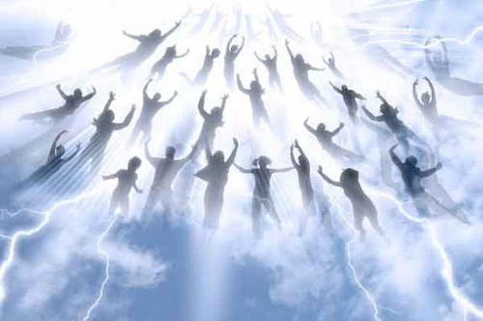
The Future Rapture /Resurrection is Clearly Taught
What about the Timing? When Will it Happen?

Slide 7
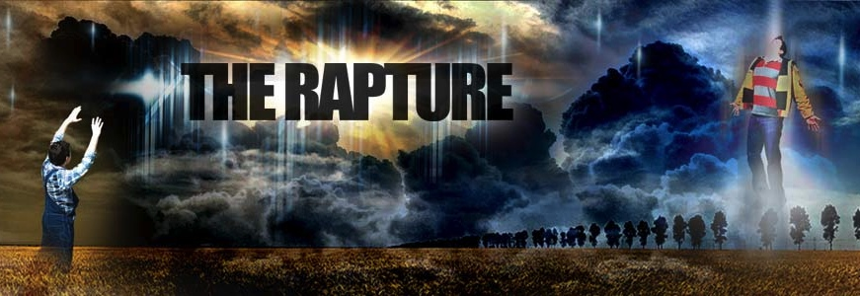
Presenting the Father’s Great Love for the Church
Removed
Before the Tribulation

Slide 8
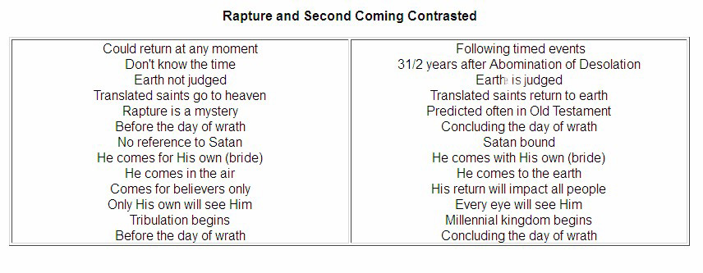
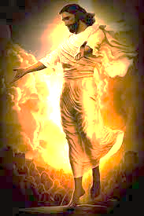

Slide 9
The Rapture Debate
#1. No Rapture Mentioned in Bible
#2. Future Literal Pre-Tribulation Rapture
#3. Mid Tribulation Rapture
#4. Pre-Wrath Rapture – End of Tribulation
#5. Post Tribulation Rapture
#6. Partial Rapture – Not everyone is going

Slide 10
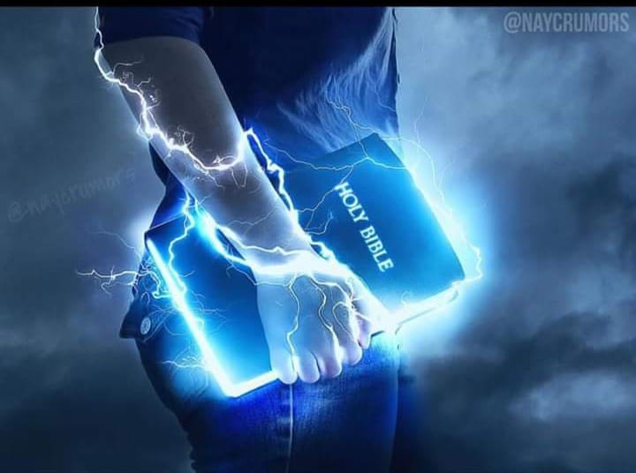
All of our Clues
Come from the Scriptures

Slide 11
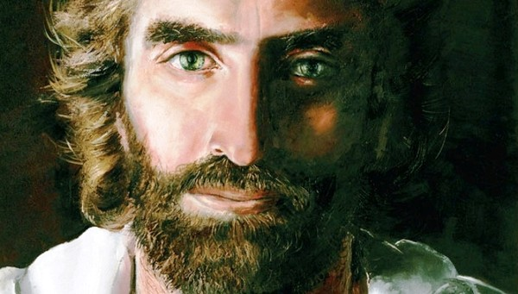
Where does Jesus first refer to the Rapture in the Scriptures?
During the Last Supper, the Passover, Jesus teaches His own about His soon departure and the Rapture to come!
He only reveals this after Judas has departed to betray Him.
John 14:1-3
“Let not your heart be troubled:
you believe in God, believe also in Me.
In My Father’s house are many mansions: If it were not so, I would have told you.
I go there to prepare a place for you.
And if I go to prepare a place for you,
I will come again and receive you unto Myself
that where I am, there you may be also.”

Slide 12
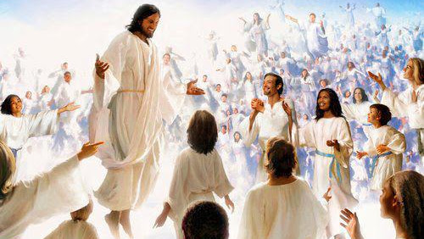
“1 Corinthians 15:51-52”Behold, I show you a mystery: we shall not all sleep, but we shall all be changed. In a moment, in the twinkling of an eye, at the last trump: For the trumpet shall sound, and the dead in Christ shall be raised incorruptible, and we shall be changed”

Slide 13
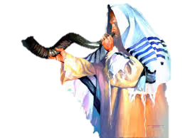
1 Thessalonians 4:14-18 Rapture /Harpazo
“ For if we believe that Jesus died and rose again,
even so them also which sleep in Jesus will God bring with him.
For this we say unto you by the word of the Lord,
that we which are alive and remain unto the coming of the Lord
shall not prevent them which are asleep.
For the Lord himself shall descend from heaven with a shout,
with the voice of the archangel,
and with the trump of God:
and the dead in Christ shall rise first:
Then we which are alive & remain shall be caught up
together with them in the clouds,
to meet the Lord in the air:
and so shall we ever be with the Lord.
Wherefore comfort one another with these words.” –

Slide 14
Other Verses with Harpazo - “The Snatching Away”
Acts 8:39 “And when they had come up out of the water, The Spirit of the Lord caught away Phillip, that the eunuch saw him no more, and he went away rejoicing.'
1 Corinthians 12:2 “ I know a man in Christ above 14 years ago, whether in the body I can not tell,
or whether out of the body, I can not tell, God knows: such a one caught up to the 3^{rdm} Heaven.
1 Corinthians 12:4 “How that he was caught up to paradise and heard unspeakable words,
which is not lawful for man to utter.”
Revelation 12:5. “And she brought forth a man child, who is to rule all the nations with a rod of iron,
and her child was caught up to God and unto His Throne.

Slide 15
Clues to the Timing of Rapture/ 1st Resurrection
Progression of the Book of Revelation
Chapter 2-3 The 7 Letters to the 7 Churches
Chapter 4:1 The Open Door
Chapter 5 The 24 Elders
Chapter 11:11-12 The 2 Mighty Witnesses
Chapter 14:1 The Tribulation Saints
Chapter 14:14-20 The Last Reaping

Slide 16
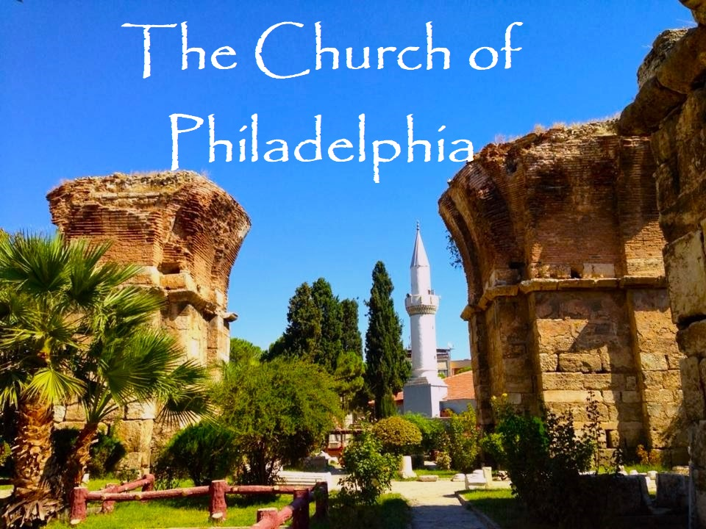
The Church of Philadelphia “The Lover of the Brethren” Revelation 3:10
“Because you have kept the word of my patience, I also will keep you from (ek- out of) the hour ( the entire age ) of temptation (Tribulation), which shall come upon all the world, to try them that dwell upon the earth.” Earth dwellers – lovers of the world

Slide 18
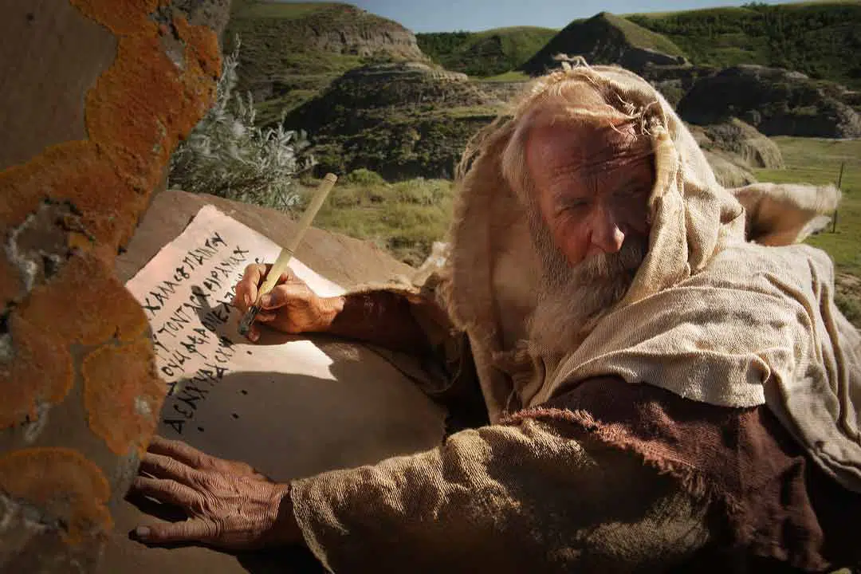
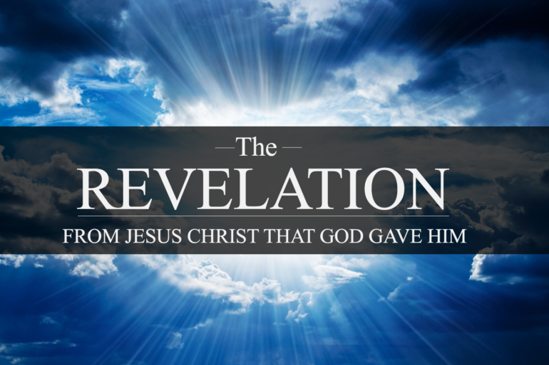
Chapter 1 John ‘s Vision of the End Times
Chapters 2-3 Church is Mentioned 19 x
Chapters 4-5 Throne Room
Chapter 6-19 Tribulation, No Mention of Church
Chapter 20 Jesus’ Millennial Reign
Chapter 21-22 Eternity – New Heaven, New Earth

Slide 19
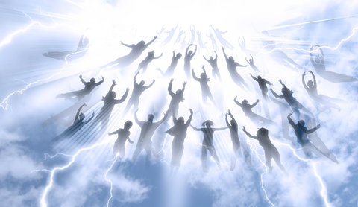
Is Everyone in ‘the Church’ Raptured Before the Tribulation?
Not According Jesus’ Warning :
To 5 of the 7 Churches in the Book of Revelation

Slide 20
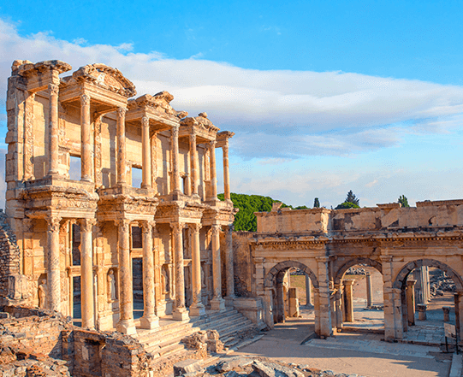
The Church of Ephesus
Revelation 2:1-6
⁴ Nevertheless I have somewhat against you, because you
have left your first love
.
⁵ Remember therefore from whence you are fallen
and repent,
and do the first works;
or else I will come to you quickly,
and will remove your candlestick out of his place,
except you repent.

Slide 21
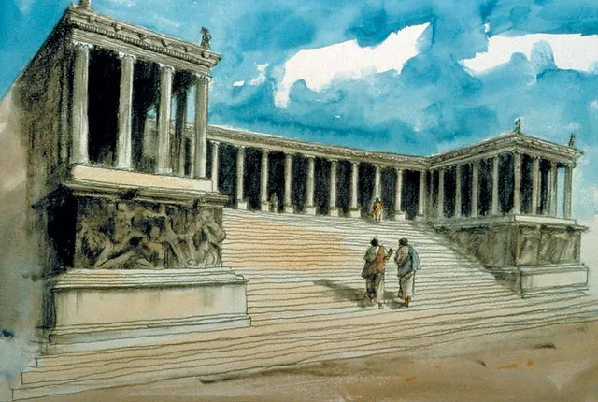
The Church of Pergamum
Revelation 2
¹⁴ But I have a few things against you, because you hast there them that hold the doctrine of Balaam,
who taught Balak to cast a stumbling block before the children of Israel, to eat things sacrificed unto idols,
and to commit fornication. ¹⁵ So have you also them that hold the doctrine of the Nicolaitanes, which thing
I hate.¹⁶ Repent; or else I will come unto you quickly, and will fight against them with the sword of My mouth.

Slide 22
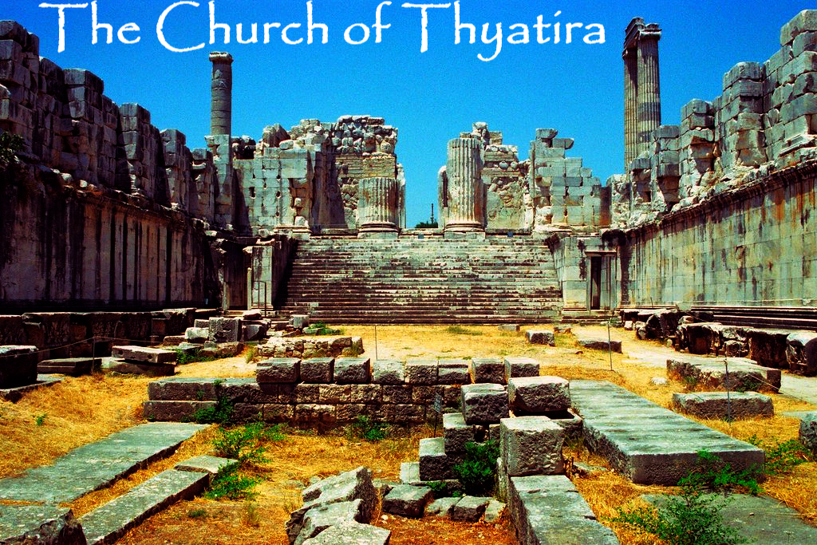
Rev. 2: 21 ”Notwithstanding I have a few things against you because you suffer that woman Jezebel, which calls herself a prophetess, to teach and to seduce My servants to commit fornication and to eat things sacrificed unto idols.²² Behold, I will cast her into a bed, and them that commit adultery with her into great tribulation, except they repent of their deeds.²³ And I will kill her children with death; and all the churches shall know that
I am he which searches the reins and hearts: and I will give unto every one of you according to your works”

Slide 23
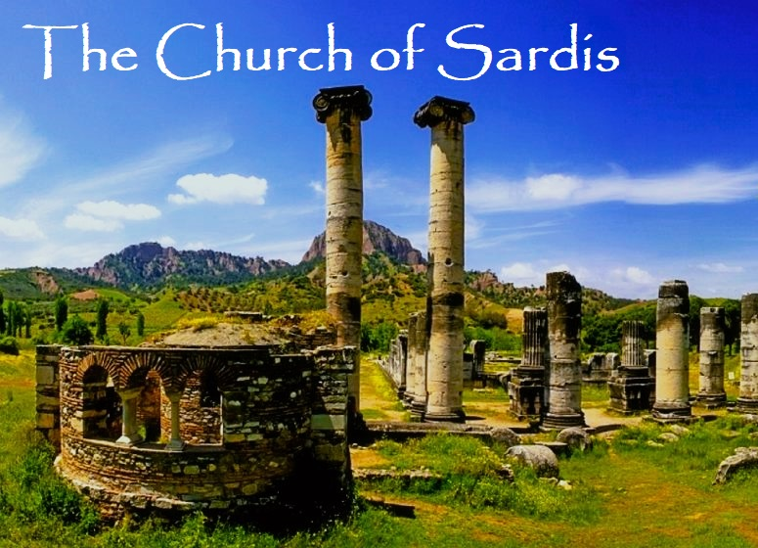
Revelation 3:1-5
² Be watchful, and strengthen the things which remain, that are ready to die: for I have not found your works perfect before God.
³ Remember therefore how you have received and heard, and hold fast, and repent If therefore you shall not watch,
I will come on you as a thief, and you shall not know what hour I will come upon you.
You have a few names even in Sardis which have not defiled their garments; they shall walk with Me in white: for they are worthy.
⁵He that overcomes, the same shall be clothed in white raiment; and I will not blot out his name out of The Book of Life,
but I will confess his name before My Father, and before His angels.

Slide 24
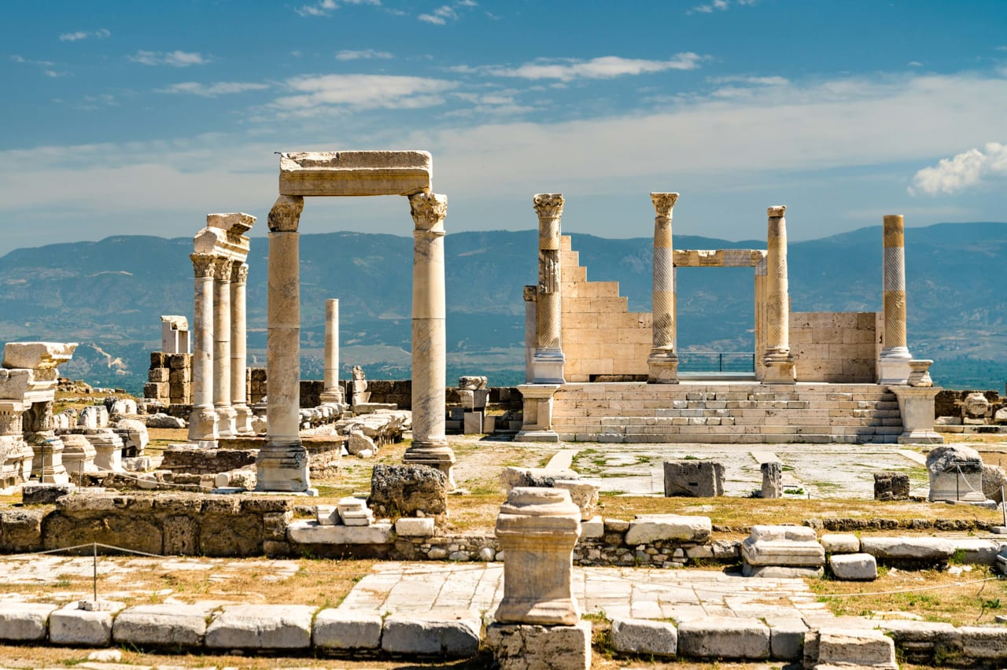
The Church of Laodicea Revelation 3:16-19
¹⁶ So then because you are lukewarm, and neither cold nor hot,
I will spue you out of My mouth
¹⁷ Because you say, I am rich, increased with goods, have need of nothing; and know not that you are wretched, and miserable, poor, and blind, and naked:
¹ I counsel you to buy of Me gold tried in the fire, that you may be rich; and white raiment that you may be clothed and that the shame of your nakedness does not appear; and anoint your eyes
with eye salve, that you may see
.⁹ As many as I love, I rebuke & chasten: be zealous therefore, and repent.

Slide 25
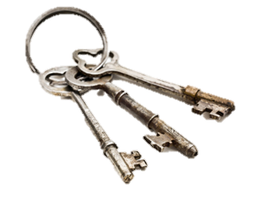
The Rapture is The Father’s Reward
For the Remnant
The Keys are those who Repent
for Faithfulness
for Readiness
for Righteousness
Not so for:
The Laodicean Church
The Lukewarm Church
The Loose Living Church
The Dead Church
The Woke Church
The Compromised Church
“Those who accept Anything
Will Stand for nothing’

Slide 26
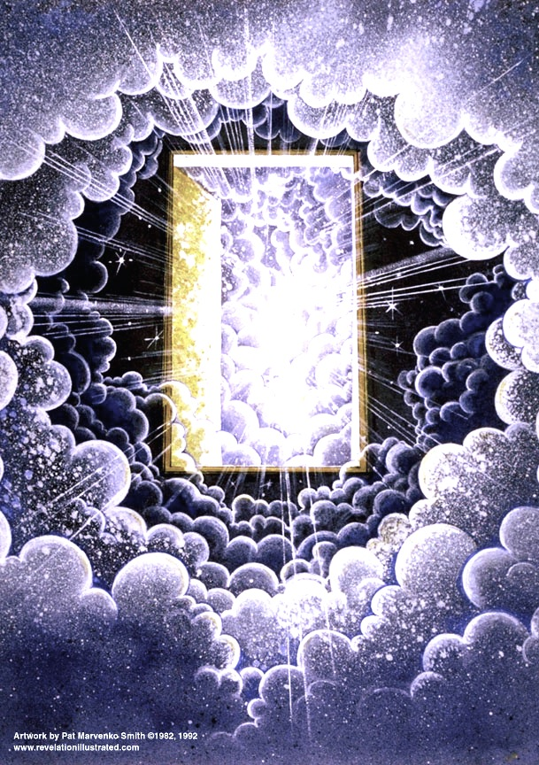
Revelation Chapter 4
(John is taken up to see the Throne Room)
¹After this I looked, and, behold, a door was opened in heaven: and the first voice which I heard was as it were of a trumpet talking with me; which said, Come up hither, and I will shew you things which must be hereafter.
² And immediately I was in the spirit: and, behold, a throne was set in heaven, and one sat on the throne.

Slide 27
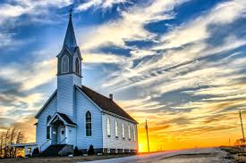
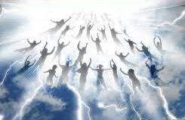
“Come up Hither”
Whenever we read “Come Up Hither”
Someone is getting Raptured!
Revelation Chapter 4 – The Church before the Tribulation
Revelaton Chapter 11 – The 2 Mighty Witnesses during Tribulation

Slide 28
Revelation Chapter 5 - We Meet the 24 Elders
Seated on Thrones,
Dressed in White with Overcomer’s Crowns
They Sing the song of the Redeemed
In Heaven Before the Tribulation Starts
^{7.} And the Lamb came and took the book out of the right hand of Him that sat upon the throne
⁸ And when He had taken the book, the 4 beasts and 24 elders fell down before the Lamb, having every one of them harps, and golden vials full of odors, which are the prayers of saints
.⁹ And they sung a new song, saying, You are worthy to take the book, and to open the seals thereof: for You were slain, and have redeemed us to God by Your blood out of every kindred, tongue, people and nation.
¹⁰ And have made us to our God kings and priests: we shall reign on the earth.

Slide 29
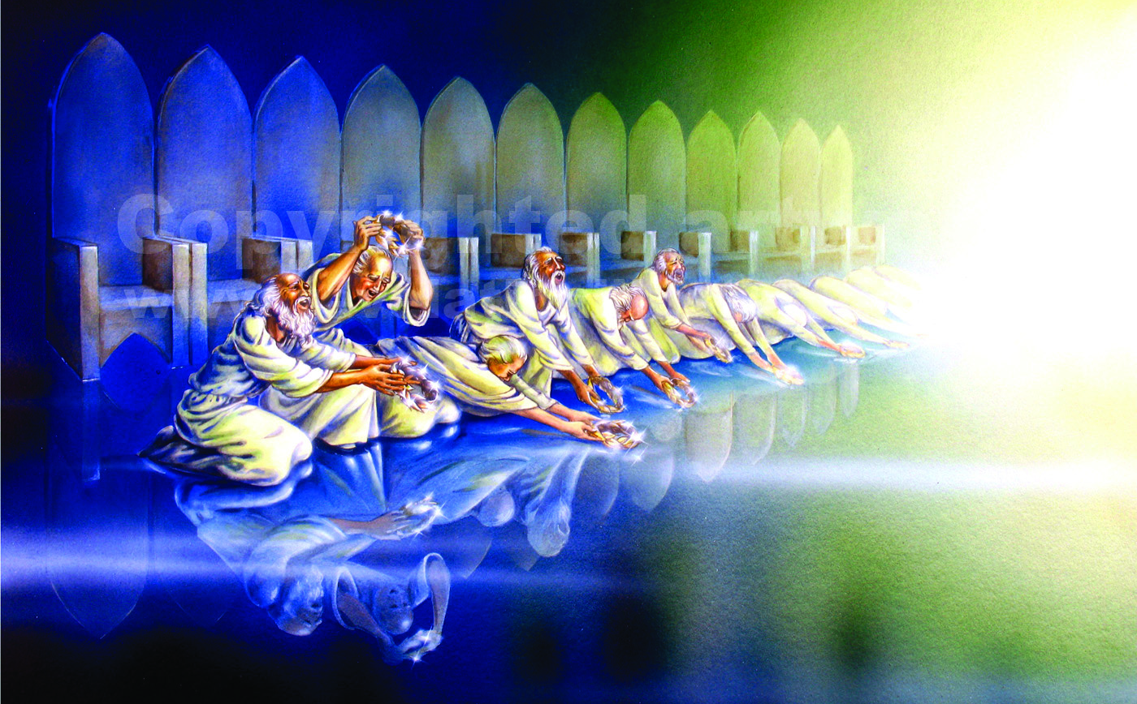

Slide 30
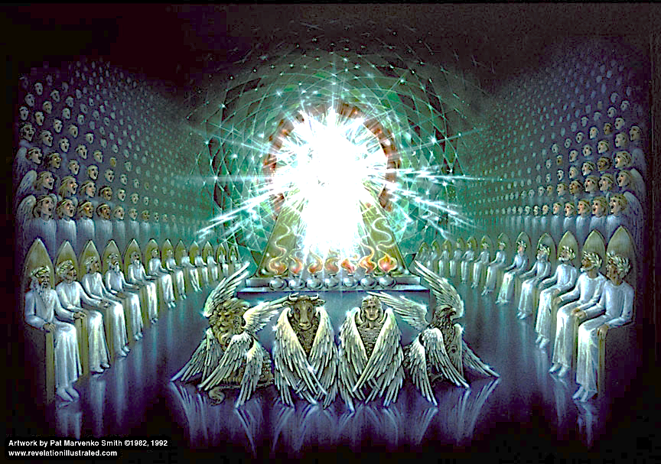

Slide 31
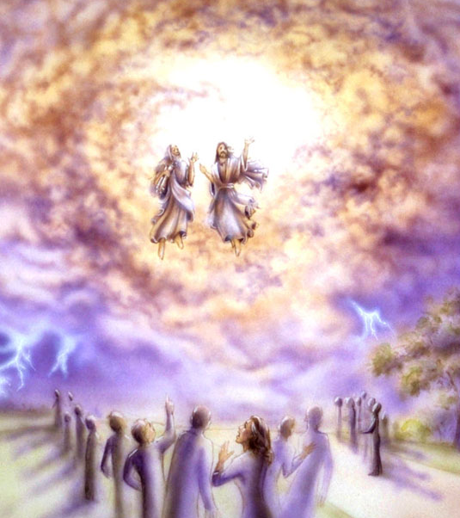
⁷ And when they shall have finished their testimony, the beast that ascends out of the bottomless pit shall make war against them, and shall overcome them, and kill them.⁸ And their dead bodies shall lie in the street of the great city, which spiritually is called Sodom and Egypt, where also our Lord was crucified.
⁹ And they of the people and kindreds and tongues and nations shall see their dead bodies 3 ½ days and shall not suffer their dead bodies to be put in graves.¹⁰ And they that dwell upon the earth shall rejoice over them, and make merry, and shall send gifts one to another; because these two prophets tormented them that dwelt on the earth.
¹¹ And after 3 ½ days the Spirit of life from God entered into them, and they stood upon their feet; great fear fell upon them which saw them.¹² And they heard a great voice from heaven saying to them, Come up hither. And they ascended up to heaven in a cloud; their enemies beheld them.
Revelation 11 “2 Mighty Witnesses”
Mid Tribulation Rapture

Slide 32
Discussion over the Timing of the Rapture
What if all the Positions are True?
Prophetic Pattern - The 3 Harvest Cycles in Israel
A Pre-Tribulation Rapture Found in Revelation 4-5
A Mid -Tribulation Rapture Found Revelation 11
A End Tribulation Rapture found in Revelation 14

Slide 33
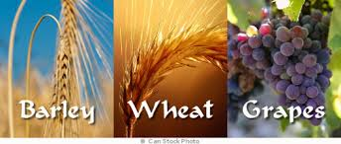
Israel’s Agricultural Cycles are a Resurrection Pattern
Linked to the Feasts of the Lord
Spring Feasts Summer Feast Fall Feasts
Passover Pentecost Trumpets
Unleavened Bread Atonement
First Fruits Tabernacles

Slide 34
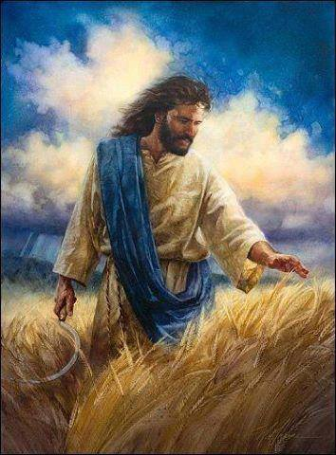
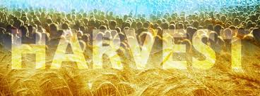
Israel’s. 3 Main Harvest Cycles
Barley - Pre-Tribulation Rapture
Wheat - Mid-Tribulation Rapture
Grapes - End-Tribulation Rapture

Slide 35
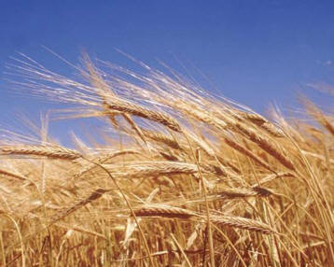
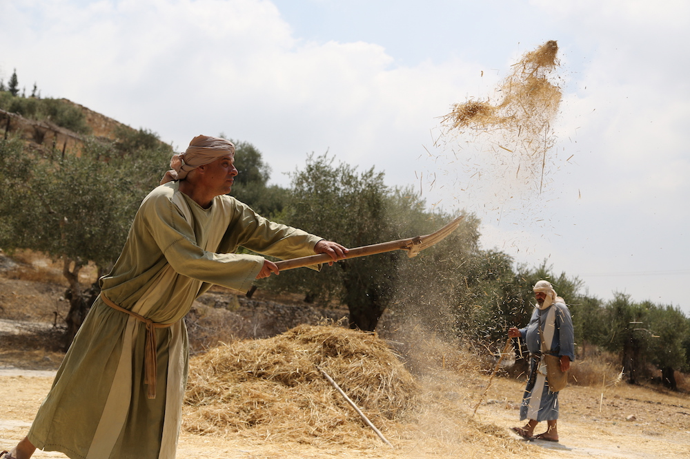
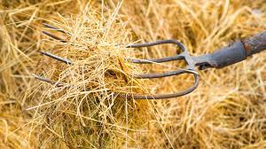
The Barley Harvest is First!
Happens in Spring (March)
Barley is a soft Grain,
first cut with a Scythe
then winnowed with a Fork.
When it is thrown up in the air,
the wind separates
the grain from the chaff!
Sounds like a Rapture of Believers

Slide 36
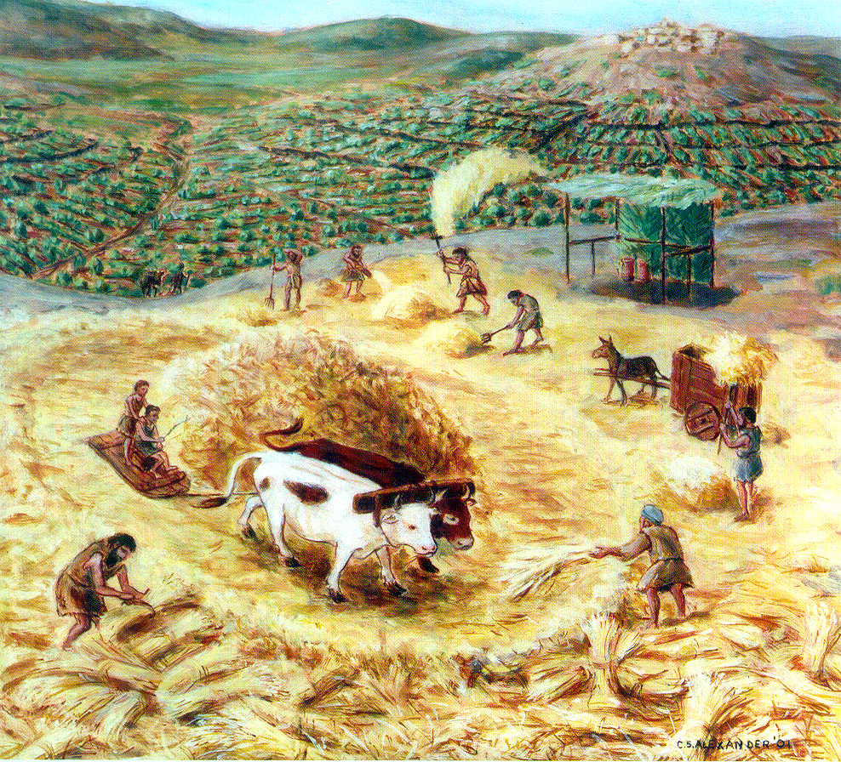
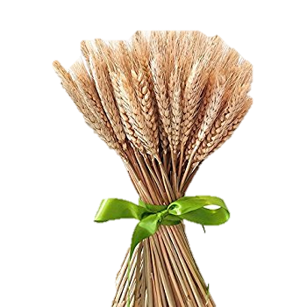
Israel’s Middle Harvest
Around Pentecost
Wheat is threshed with a Tribulum

Slide 37
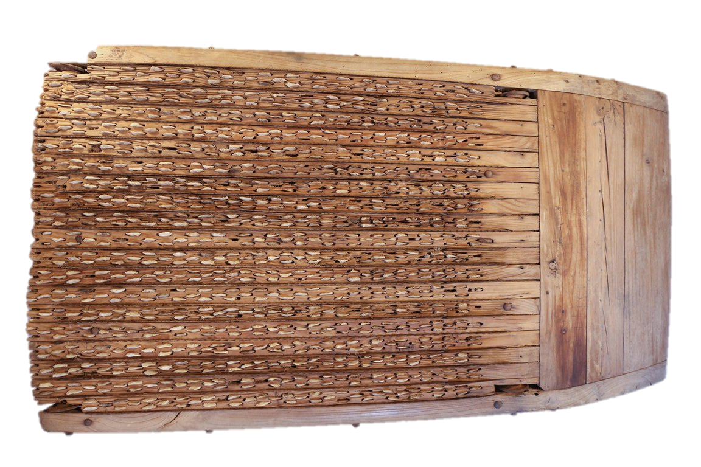
The steps for harvesting wheat are different than barley. Because it has a hard outer stalk that must be crushed to release the grain, it is laid on a threshing floor where a special sled with blades underneath is pulled over the wheat.
Then the grain is winnowed with a fork and the chaff is separated from the wheat. The grain is gathered into the barn and the chaff is burned in the fire. What a picture of the hard-hearted people who will go into the Tribulation

Slide 39
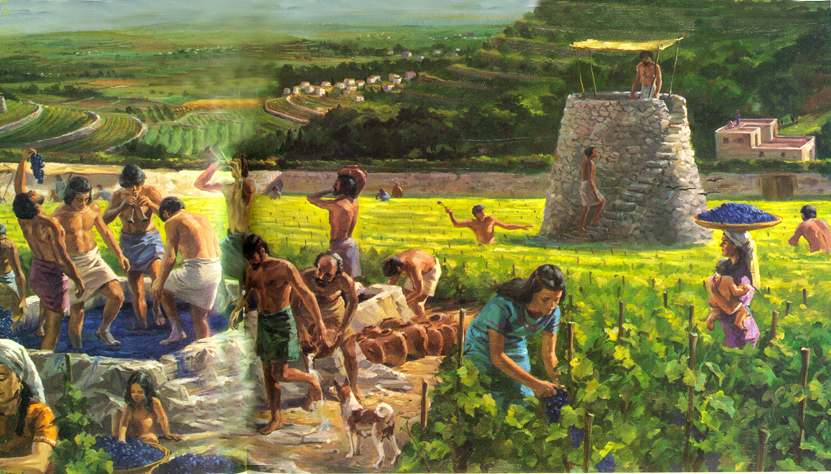
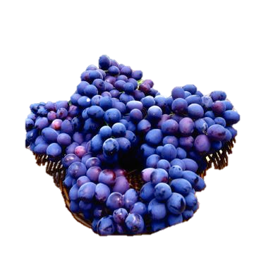
The grape Harvest is at the final harvest - usually around Yom Kippur
The grapes are trampled in a wine vat until the grape juice (the blood ) runs out!

Slide 40
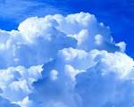
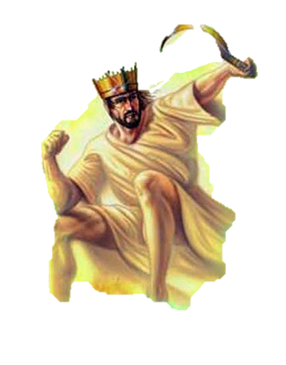
Revelation 14: 14-16 - Jesus First Reaps a Harvest
“And I looked and behold a white cloud,
& upon the cloud one sat like the Son of man, having on His head a golden crown,
and in His hand a sharp sickle.”
And another angel came out of the Temple, crying with a loud voice to him that sat
on the cloud, ‘thrust in your sickle and reap,
for the time is come for You to reap:
for the harvest of the earth is ripe.”
And He that sat on the cloud
thrust in his sickle on the earth;
and the earth was reaped.”

Slide 41
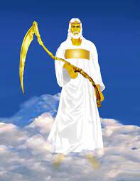
Another Angel Reaps a 2nd Harvest
Revelation 14:18-20
18. “And yet another angel came out of the Temple which is in heaven,
he also having a sharp sickle
19. And another angel came out from the altar, which had power over fire;
and cried with a loud voice to him that had the sharp sickle, saying
Thrust in your sharp sickle and gather the clusters of the vine of the
earth: for her grapes are truly ripe.
20. And the angel thrust in his sickle into the earth,
and gathered the vine of the earth,
and cast it into the great winepress of the wrath of Almighty God.”

Slide 42
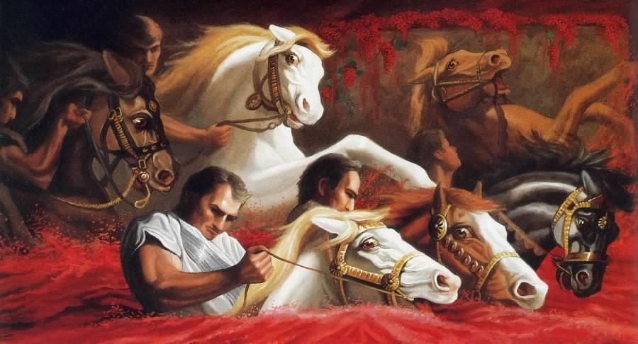
Revelation 14:19 “And the angel thrust in his sickle into the earth, and gathered the vine of the earth, and cast it into the great winepress of the wrath of God. 20. And the winepress was trodden without the City, and blood came out of the winepress even to the horses’ bridles….”

Slide 43
We believe in a Pre-Tribulation Rapture for true

Slide 44
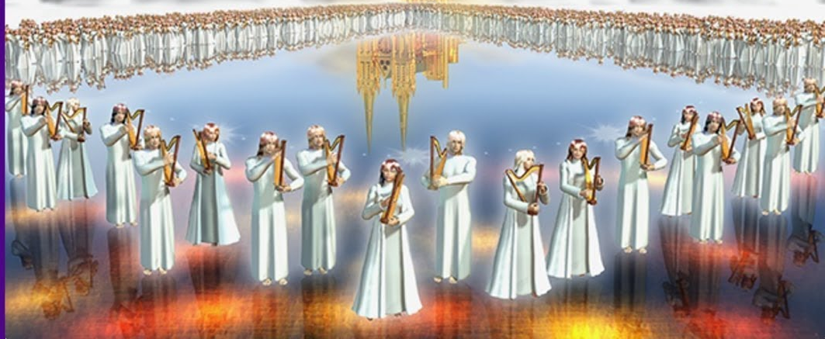
144,00 - Another Resurrection - Revelation 14:1-3
”And I looked, and lo, a Lamb stood on Mt. Zion, and with Him, 144,000 having His Father’s Name written in their foreheads. And I heard a Voice from Heaven, as the voise of many waters, and as a Voice of great thunder: and I heard the voice of harpers harping with their harps. And they suant as it were a new song before the throne and before the 4 beasts and the 24 elders: and no man could learn that song but the 144,00 which were redeemed from the earth

Slide 45
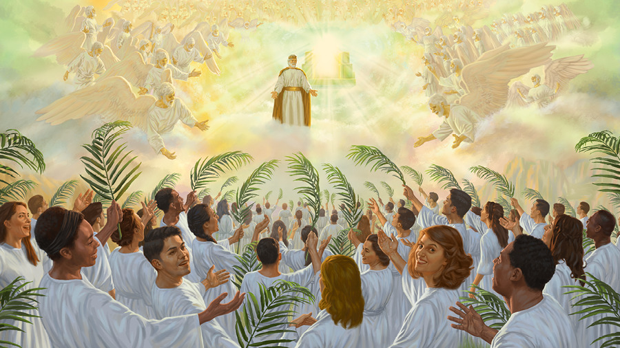
Revelation 20:4 - Tribulation Saints Resurrected
⁴ And I saw thrones, and they sat upon them, and judgment was given unto them: and I saw the souls of them that were beheaded for the witness of Jesus, and for the Word of God, and which had not worshipped the beast, neither his image, neither had received his mark upon their foreheads, or in their hands; and they lived and reigned with Christ 1000 years.

Slide 46
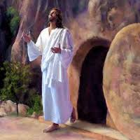
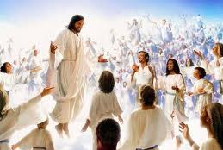
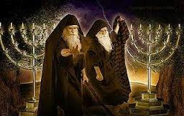
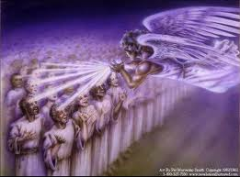
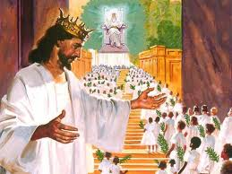
1. Jesus Christ, as the first fruits- 1 Corinthians 15: 20 & 23
2. Certain OT saints came out of their tombs when
Jesus was resurrected & were seen by many –
Matthew.27:50-53
3. The Rapture of Church – Pre-Tribulation
1 Corinthians. 15:52,
I Thess. 4:13-18
4. The 2 Mighty Witnesses - Revelation 11:8
During the Tribulation –
5. The 144,000 in Heaven’sThrone Room – Rev. 14:1-5
6. . The Tribulation Saints wave palm branches
Rev. 20:4-6 Reign with Christ during Millennium –
7. Old Testament Saints - Part of 1st Resurrection
1st Resurrection has Several Stages

Slide 47
Wonderful Treasure in the Feasts of the Lord
The Trumpet Sound Points to the Rapture

Slide 48
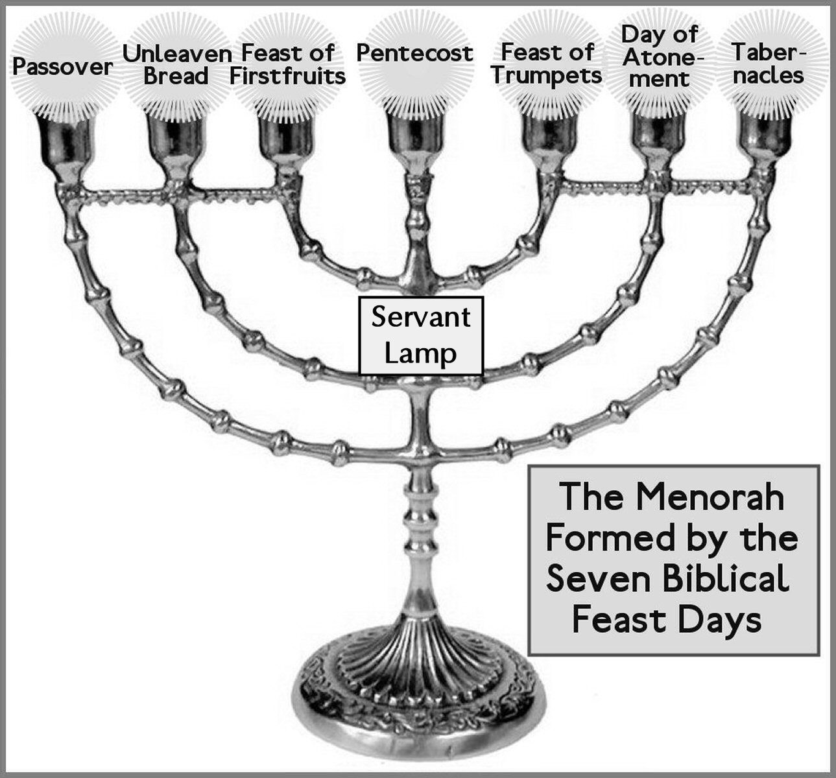
The Feast of Trumpets
is a Prophetic Picture
of the Rapture
before theTribulation

Slide 49
“1 Corinthians 15:51-52”Behold, I show you a mystery: we shall not all sleep, but we shall all be changed. In a moment, in the twinkling of an eye, at the last trump: For the trumpet shall sound, and the dead in Christ shall be raised incorruptible, and we shall be changed”

Slide 50
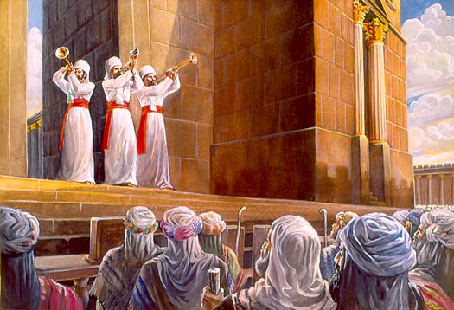
On the Feast of Trumpets, Priests blow a special pattern of 99 Sounds
The 100th Last Sound is the longest“the Last Trumpet- Tekiah Ha Gadol”

Slide 51
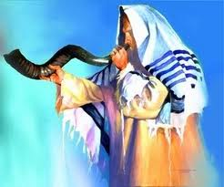
The Feast of Trumpets – So Many Clues
“The Last Trump”
“The Hidden Day”
“The Twinkling of an Eye
“The Day of Judgment”
“The Time of Jacob’s Trouble”
“The BirthPangs of Messiah”
“ The Day of Remembrance”
“Marriage of Messiah”
“ The Coronation of the King”

Slide 52
1 Thessalonians 4:14-18 Rapture /Harpazo
“ For if we believe that Jesus died and rose again,
even so them also which sleep in Jesus will God bring with him.
For this we say unto you by the word of the Lord,
that we which are alive and remain unto the coming of the Lord
shall not prevent them which are asleep.
For the Lord himself shall descend from heaven with a shout,
with the voice of the archangel,
and with the trump of God:
and the dead in Christ shall rise first:
Then we which are alive & remain shall be caught up
together with them in the clouds,
to meet the Lord in the air:
and so shall we ever be with the Lord.
Wherefore comfort one another with these words.” –

Slide 53
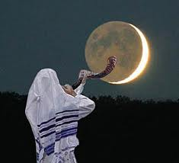
“The Day No Man Knows the Hour”
is the Feast of Trumpets
Luke 12:37-41
Luke 12:42
Matthew 25:8-13
Matthew 24:44
Matthew 24:50
I Thess.5:1-5
Acts 1:7-8
Mark 13:32-37
Revelation 3:1-3

Slide 54
“In a moment,
in the Twinkling of an eye”
When the moon is in conjunction
called the new moon,
the sky is black for several days…
The Moon Blinks and closes its eye…
No one actually knew the time the first sliver of the new moon would reappear
The Feast of Trumpets
has always been known as
“No Man Knows the Day or the Hour”

Slide 55
Prophecy in Proverbs 7
¹⁹ For the goodman is not at home, He is gone a long journey
Jesus is the Goodman
He has been gone for 2000 years
²⁰ He has taken a bag of money with Him,
and will come home at the day appointed. (Yom Keseh)
Yom Keseh – The Feast of Trumpets - “The Hidden Day”
“No Man Knows the Day or the Hour”
Matt 24:36 “But of that day and hour knows no man,
no, not the angels of heaven, but My Father only.”

Slide 56
Prophetic Patterns of Rapture/Resurrections
In the Old Testament
Starts in Genesis with Enoch & Noah

Slide 57
God Removed Enoch Supernaturally
Before Judgment of the Flood
Genesis Chapter 5
²¹ And Enoch lived 65 years, and begat Methuselah:
²² And Enoch walked with God after he begat Methuselah 300 years, and begat sons and daughters:
²³ And all the days of Enoch were 365 years:
²⁴ And Enoch walked with God:
and he was not; for God took him.

Slide 58
Only Noah & His Family were Saved in the Ark through the Time of the Flood

Slide 59
Luke 17:26-30
²⁶ And as it was in the days of Noah, so shall it be also in the days of the Son of man.
²⁷ They did eat, they drank, they married wives, they were given in marriage, until the day that Noah entered into the ark, and the flood came, and destroyed them all.
²⁸ Likewise also as it was in the days of Lot; they did eat, they drank, they bought,
they sold, they planted, they built;
²⁹ But the same day that Lot went out of Sodom it rained fire and brimstone from heaven, and destroyed them all.
³⁰ Even thus shall it be in the day when the Son of man is revealed.

Slide 60
The Angel told Lot God would not destroy the City until Lot & His Family were Removed
Genesis 19:12-13
¹² And the men said to Lot, Have
you here any besides? Son in law,
and your sons, and your daughters,
and whatsoever you have in the city,
bring them out of this place:
¹³ For we will destroy this place, because the cry of them is waxen great before the face of the Lord; and the Lord has sent us to destroy it.
²² Haste, escape thither; for I can’t do anything till you be come thither. Therefore the name of the city
was called Zoar.

Slide 61
God Caught Elijah Up to Heaven
2 Kings Chapter 22
¹¹ And it came to pass, as they still went on, and talked, that, behold, there appeared a chariot of fire, and horses of fire, and parted them both asunder;
and Elijah went up by a whirlwind into heaven.
¹² And Elisha saw it, and he cried, My father, my father, the chariot of Israel, and the horsemen thereof. And he saw him no more: and he took hold of his own clothes, and rent them in 2 pieces.

Slide 62
Scriptures from the Old Testament
“Hidden in Day of Trouble”
“Protected During the Day of God’s Wrath”

Slide 63
Isaiah 26:19-21
“Your dead shall live; Together with my dead body they shall arise. Awake and sing, you who dwell in dust;
For your dew is like the dew of herbs,
And the earth shall cast out the dead.
Come, my people, enter your chambers,
and shut your doors behind you;
Hide yourself, as it were, for a little moment,
until the indignation is past.
For behold, the Lord comes out of His place
to punish the inhabitants of the earth for their iniquity;
The earth will also disclose her blood
And shall no more cover her slain.”

Slide 64
Zephaniah 2:3 “Seek the Lord, all you meek of the earth, Who have upheld His justice.
Seek righteousness, seek humility.
It may be that you will be hidden in the day of the Lord’s anger.”
Psalm 27:5 “For in the time of trouble He shall hide me in His pavilion;
In the secret place of His Tabernacle He shall hide me;
He shall set me high upon a rock.”
Psalm 57:1 “Be merciful to me, O God, be merciful to me! For my soul trusts in You;
And in the shadow of Your wings I will make my refuge,
until these calamities have passed by.”

Slide 65
How Great is the Father’s Love
“Prophecy, Protection & The Presence of God”
Psalm 91 – The Rapture & The Tribulation
Cathy Bentley - www.connectedtotheword.org

Slide 66
Psalm 91 – The Rapture / Natzal
¹ He that dwells in the secret place of the most High
shall abide under the shadow of the Almighty.
² I will say of the Lord, He is my refuge and my fortress:
my God; in Him will I trust.
³ Surely He shall deliver you from the snare of the fowler,
and from the noisome pestilence.
⁴ He shall cover you with His feathers, and under His wings shall you trust:
His truth shall be your shield and buckler.
⁵ You shalt not be afraid for the terror by night;
nor for the arrow that flies by day;
⁶ Nor for the pestilence that walks in darkness;
nor for the destruction that wastes at noonday.

Slide 67
⁷ A 1000 shall fall at thy side, and 10,000 at your right hand;
but it shall not come nigh you.
⁸ Only with your eyes shalt you behold and see the reward of the wicked.
⁹ Because you have made the Lord, which is my refuge,
even the most High, your habitation;
¹⁰ There shall no evil befall you, neither shall any plague come nigh your dwelling.
¹¹ For He shall give His angels charge over you, to keep you in all your ways.
¹² They shall bear you up in their hands, lest you dash your foot against a stone.
¹³ You shall tread upon the lion and adder:
the young lion and the dragon shall you trample under feet.

Slide 68
Psalm 91 – The Rapture / The Natzal
¹⁴ Because He has set His love upon me, therefore will I deliver him:
I will set him on high, because he has known My Name.
¹⁵ He shall call upon me, and I will answer him:
I will be with him in trouble; I will deliver him, and honor him.
¹⁶ With long life will I satisfy him, and show him My Salvation (My Jesus )

Slide 69
The Wedding
Before the Wrath
The Ancient Jewish Wedding
A Picture of the Rapture

Slide 70
The Ancient Jewish Wedding
The Father Picks the Bride for His Son
A Marriage Broker /Helper is Called to Negotiate
Since the Bride will leave her family and move into the Father’s House,
a Bridal Price will be offered for her
4. A Written Contract will be offered with all the legal terms – The Ketubah
5. There are 2 parts to the Marriage: The Betrothal & The Chuppah
6. The Bride must Consent to the legal terms Ketubah
7. Gifts are given and a Covenant Cup is drunk,
8. The Bridegroom returns to His Father’s House to prepare the Bridal Chamber

Slide 71
9. The Bride separates and goes into the Mikveh
10. She Anoints herself in preparation for the formal wedding
11. The Father decides it is Time and a Trumpet is blown
12. The Groom, dressed as a King leaves to get His bride
13. The Bride hears the Trumpet, dresses in her wedding clothes, and takes a lamp
She goes to meet the Bridegroom
14. Together they enter into the Father’s House with the invited guests
The Door is shut
15. The Formal Wedding takes place under the Chuppah
16. They retire to the Bridal Chamber to consummate the wedding
17. The Wedding feast lasts 7 days
18. The Groom comes out to introduce His Wife, and they live together forever

Slide 73
Revealing

