Slide 1
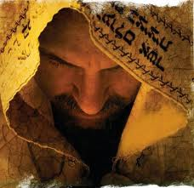
“Waiting on
the Lord”
Psalm 40:1
Preparation
Dedication
Inspiration

Slide 2
Psalm 40:1 “ I waited patiently
for the Lord.
He inclined unto me
and heard my cry.”
2. He brought me up also
out of a horrible pit
and set my feet upon a rock
and established my goings
3. And He has put a new song
in my mouth
even praise to our God
Many shall see it and fear
and shall trust in the Lord.
Preparation -
is Word Time
is Prayer Time
Dedication –
Radical Salvation to
“The Call of God”
Inspiration –
Worship Him
with your Life

Slide 3
The Bible declares there will be “a Generation”
that will see “the signs of the times”
right before Jesus returns in Power & Glory.
Known as…. “This Generation”
God wants to use Me & YOU

Slide 4
The Bible declares there will be “a Generation”
that will see “the signs of the times”
right before Jesus returns in Power & Glory.
Known as…. “This Generation”
God wants to use Me & YOU

Slide 5
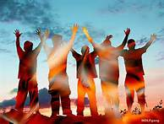
“The End Time
Anointing”
Just for Us…….
“The End time Generation”
Part 3
“Raise Your Praise Level”

Slide 6
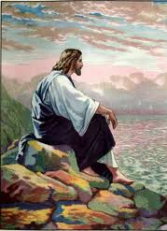
Jesus gave special instructions to those who will witness the signs immediately before
the Tribulation!
” “Ha Dor Ha Acharon
“This generation shall not pass, till all these things be fulfilled”
Matthew 24:34

Slide 7
The 3 Decrees
Understand God’s Plan
for Jerusalem, for the Jews,
and for the Land of Israel
Apostasy is Coming!
Take Heed!
Praise God for His Goodness

Slide 8
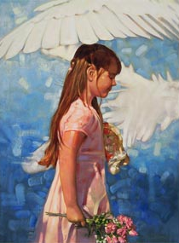
Psalm 78:4,6 “That His People Might Praise His Works”
1 .Give ear, my people, to My Law:
incline your ears to My words.
2. I will open My mouth in a parable:
I will utter dark sayings of old:
3. Which we have heard and known,
and our fathers have told us.
4. We will not hide them from our children,
showing the generation to come
the praises of the Lord & His strength
& His wonderful works that He has done
.
5. For He established a testimony in Jacob
and appointed a Law in Israel, which He commanded our fathers,
that they should make them known to their children:

Slide 9
Praise Activates the Anointing

Slide 10
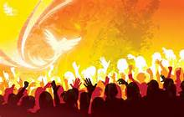
Our Words Have Power in the Spirit Realm
When Our Praise Goes up
The Glory Comes Down

Slide 11
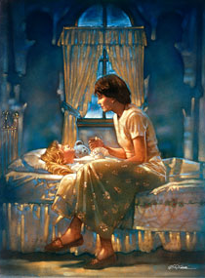
Tell our children
how good He is!
“
6. “That the generation to come
might know them,
even the children
which should be born;
who should arise &
declare them
to their children:
7. That they might set
their hope in God
& not forget
the works of God,
keeping His Commandments

Slide 12
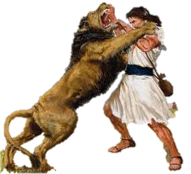
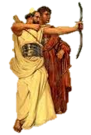
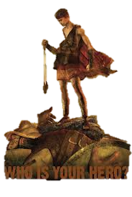
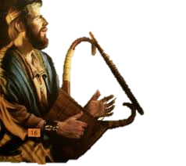
David, the Lion Killer
David,
the Blood Covenant Partner
Praise will Help You
Dance like David did!
David, the
Giant Killer
David, the demon chaser

Slide 13
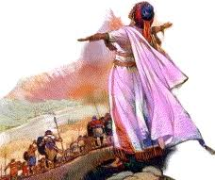
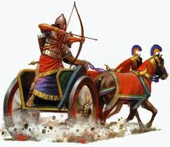
Praise will help you Lead Like Deborah did!

Slide 14
Stood against the Enemy Rebuilt the Wall
When You take back Don’t let Anyone
the enemy stole Steal Your Praise!
And Rebuild your Life

Slide 15
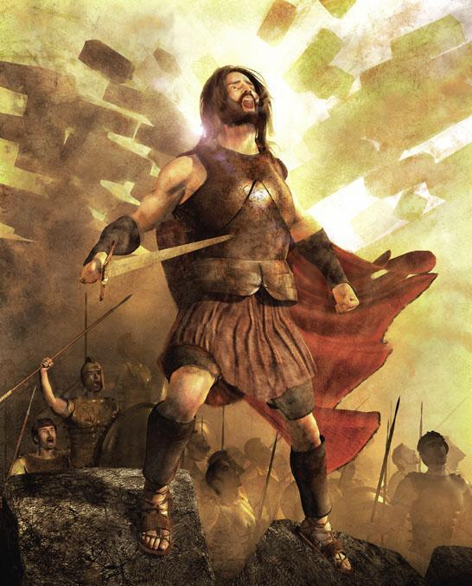
When Your Walls
Come Tumbling Down
and
God Defeats the Enemy
“Your Jericho Moment”
No one can stop you from Praising Jesus

Slide 16
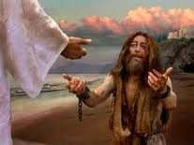
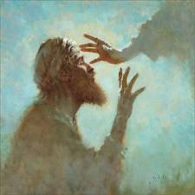
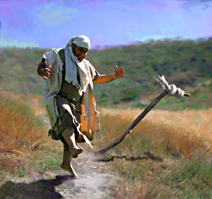
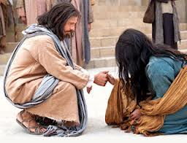

Slide 17
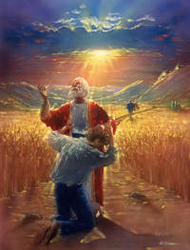
When Your Prodigal Son Comes Home
Don’t let Anyone
Stop you from
Praising the Lord
For His Goodness1

Slide 18
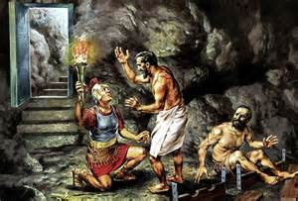
Like Paul and Silas, Praising God sets us FREE from bondage!

Slide 19
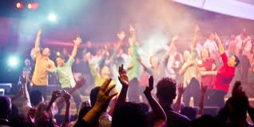
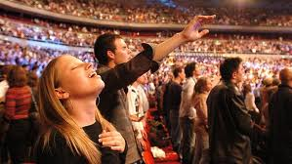
Talk About God’s Goodness in Every Church

Slide 20
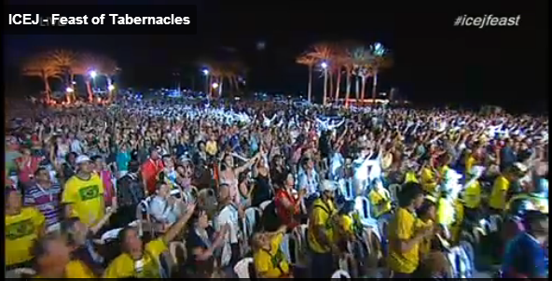
Tell the Whole World About His Wonderful Works

Slide 21
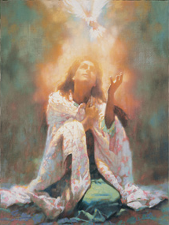
The Baptism
Of the Holy Spirit
Will Raise your
Praise Level

Slide 22
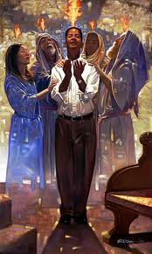
God has Appointed Us
The End Time Generation
and Anointed Us
with Holy Ghost Power
For a Last Great Work
by His Spirit

Slide 23
“The End Time
Anointing
Is For Me”
I’m Raising
My Praise Level

