Slide 1
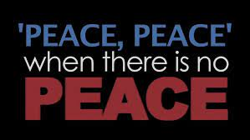
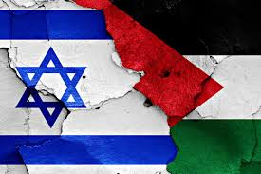
‘Middle East Peace, Propaganda & Prophecy

Slide 2
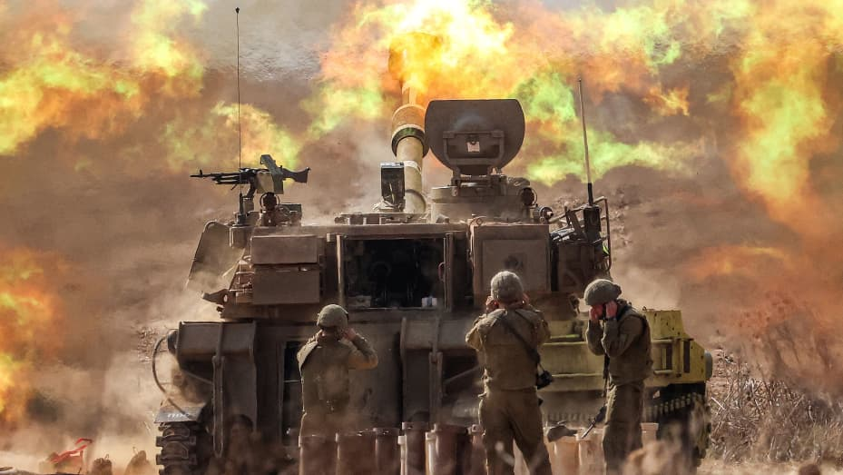
Is a Middle East Peace Treaty Coming to End Israel’s 2023 War?

Slide 3
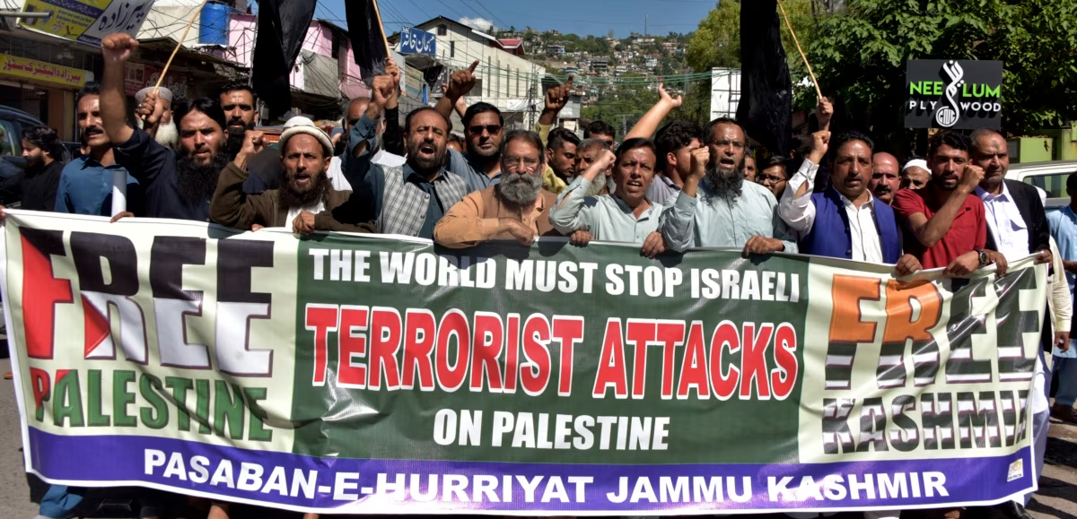
Already Leaders of Nations, of Churches, of Finance are Demanding Peace

Slide 4
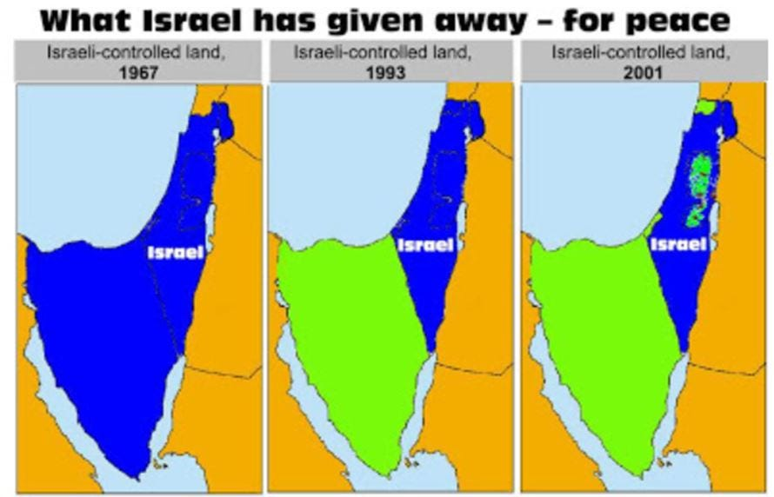
Has Land for Peace in Israel Ever Work?

Slide 5
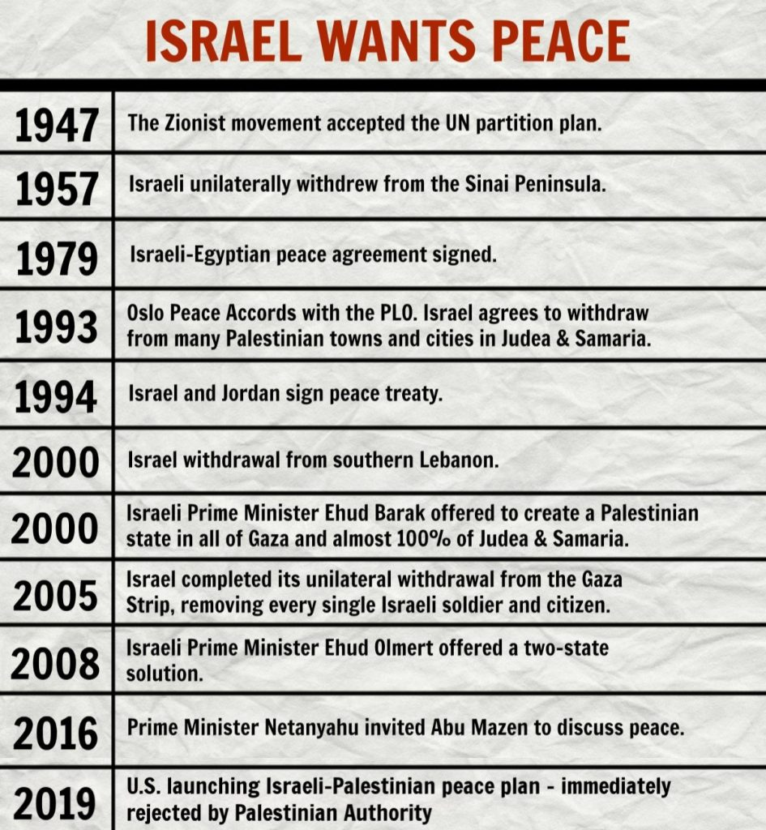
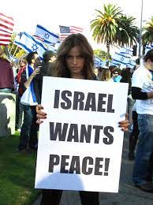

Slide 6
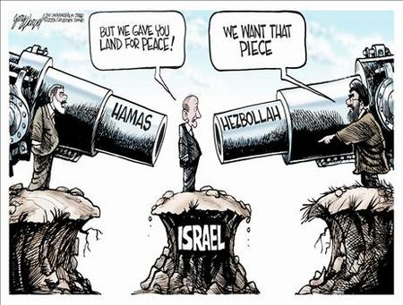

Slide 7
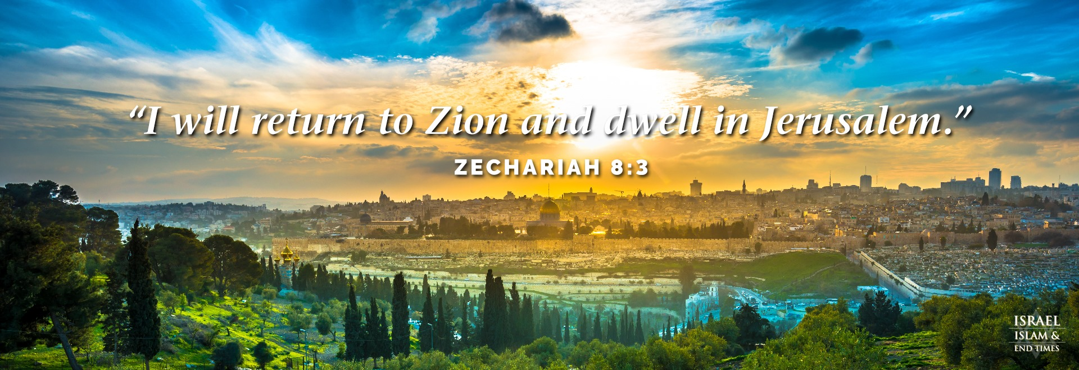
What Does GOD say About Israel’s Land?

Slide 8
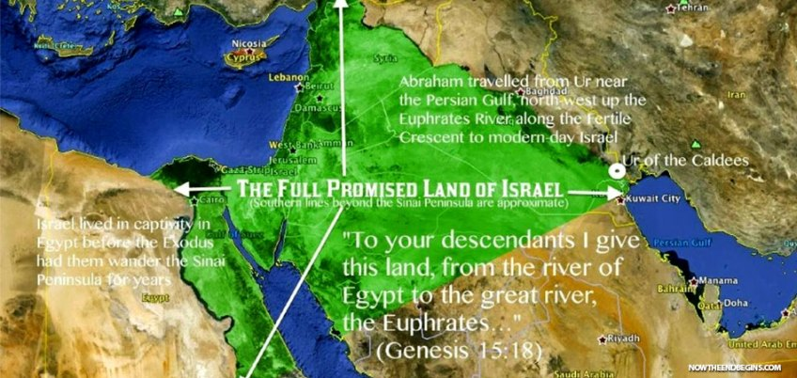
Genesis 15:18 “To your descendants I give this Land from the River of Egypt to the great river, the Euphrates” An Everlasting, Unconditional Covenant
Genesis 12:7; 13:15; 24:7; 26:4; Deuteronomy 1:8; 11:24; 34:4; Joshua 1:4; Isaiah 27:12

Slide 9
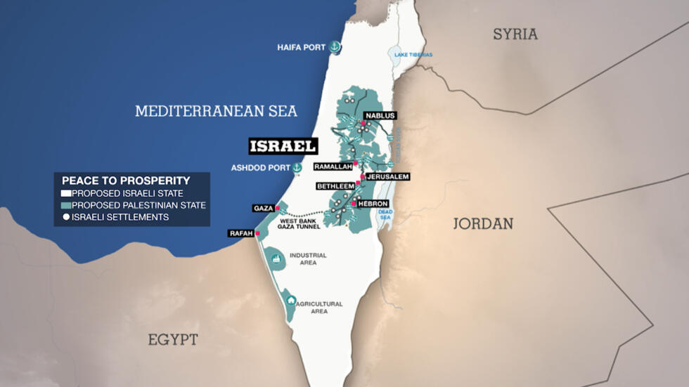
Proposed Peace Plan
2023

Slide 11
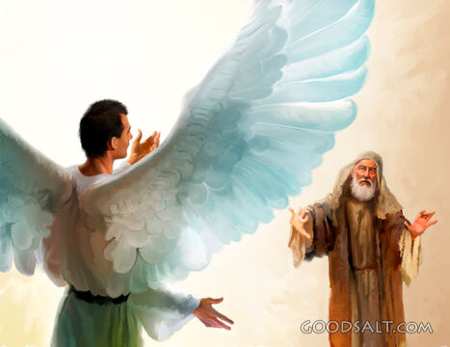
²⁴ 70 weeks determined upon thy people and upon thy holy city, to finish the transgression, and to make an end of sins, and to make reconciliation for iniquity, and to bring in everlasting righteousness, and to seal up the vision and prophecy, and to anoint the most Holy.
²⁵ Know therefore and understand, that from the going forth of the commandment to restore and to build Jerusalem unto the Messiah the Prince shall be 7 weeks, and threescore and 2 weeks: the street shall be built again, and the wall, even in troublous times.
²⁶ And after threescore and two weeks shall Messiah be cut off, but not for himself: and the people of the prince that shall come shall destroy the city and the sanctuary; and the end thereof shall be with a flood, and unto the end of the war desolations are determined.
²⁷ And he shall confirm the covenant with many for one week: and in the midst of the week he shall cause the sacrifice and the oblation to cease, and for the overspreading of abominations he shall make it desolate, even until the consummation, and that determined shall be poured upon the desolate.
Gabriel was sent to Daniel with a time-table & prophecy:
The Anti-Christ will make and then break a Peace Treaty

Slide 12
30 AD
26 AD

Slide 13
The Book of Revelation

Slide 14
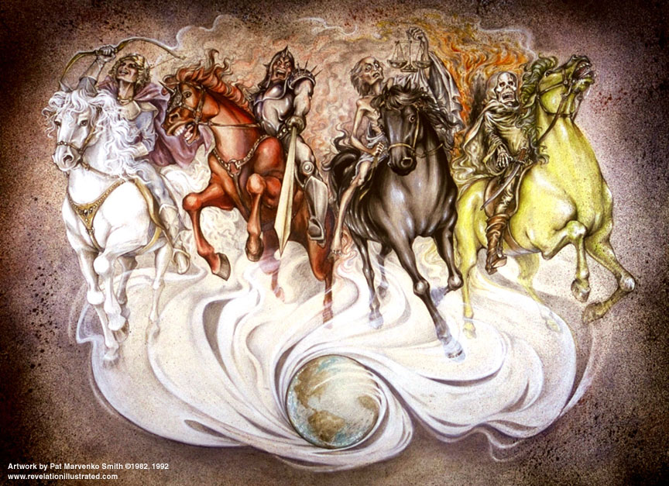
Revelation 6:1-2 “And I saw when the Lamb opened one of the seals, and I heard, as it were the noise of thunder, one of the four beasts saying, Come and see .² And I saw, and behold a white horse: and he that sat on him had a bow; and a crown was given unto him: and he went forth conquering, and to conquer.

Slide 15
Hear the Word of the Lord
“When they cry Peace and Safety, Destruction Comes”
Ezekiel 7:25; 13:10;
Jeremiah 4:10; 6:13-14; 8:9; 14:19
Daniel 8:25;
Micah 3:5
Isaiah 48:22
1 Thessalonians 5:3
Revelation 6:4

Slide 16
God Promises Us Peace in Him Jesus is Our Peace
Isaiah 26:3
Psalms 4:8; 122:6
Proverbs 12:20
Matthew 10:34-35.
John 14:27; 16:23; 16:33;
Romans 5:1; 10:15; 10:25; 14:7; 15:13
Galatians 5:22. James 3:18
Ephesians 2:14-15; 4:3; 6:15
1 Thessalonians 5:23
2 Thessalonians 3:16
Philippians 4:7-9 1 Peter 3:11
Hebrews 12:14
1 Corinthians 14:33
2 Corinthians 13:11
Colossians 1:20; 3:15

Slide 17
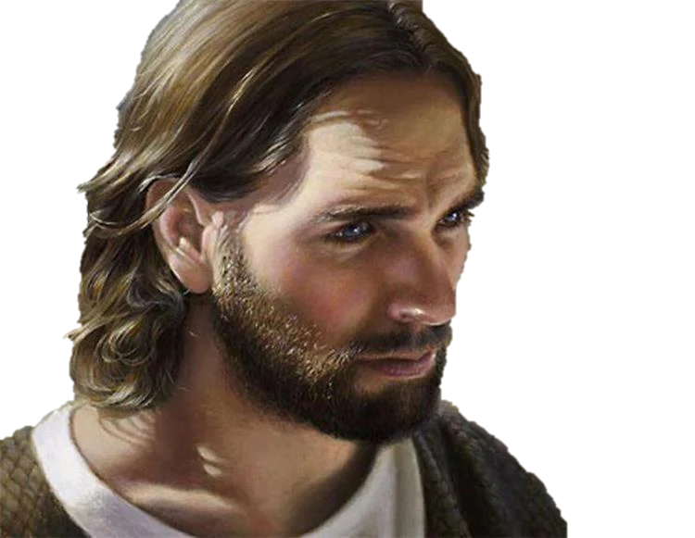
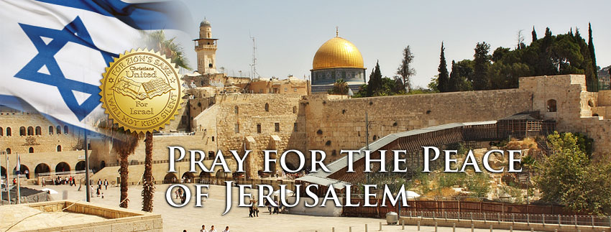
s
When we Pray for the Peace of Jerusalem
We are praying for the Messiah to Come
There will be NO Peace in the Middle East Until Jesus Comes as the Prince of Peace

