Slide 1
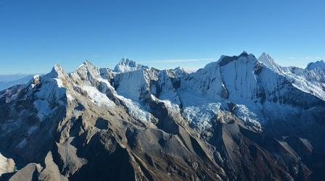
Key Words to Understanding Bible Prophecy
Mountains = Kingdoms = Heads

Slide 2
The Book of Revelation Gives Timing of Events
Old Testament Parallel Verses Give Details: Who, Where, Why, and How
Isaiah Chapter 2:2 “God’s Kingdom will Rule over all over Kingdoms”
^{2 “} And it shall come to pass in the last days, that the mountain of the Lord's house shall be established in the top of the mountains, and shall be exalted above the hills; and all nations shall flow unto it.”
Mountain = Kingdom/Empire
Hills = Smaller Countries/Nations
Ezekiel 34:6 The Jews were Scattered over every kingdom, into every nation.
^{6 ”}My sheep wandered through all the mountains, and upon every high hill: yea, my flock
was scattered upon all the face of the earth, and none did search or seek after them.”
Jeremiah 51:25 “God will destroy the Babylonian Empire”
²⁵ Behold, I am against you, O destroying mountain, says the Lord, which destroy all the earth: I will stretch out My hand upon you, and roll you down from the rocks, & will make you a burnt mountain.”

Slide 3
Psalm 46:1-3;6 “God will Judge the Nations, the Kingdoms, and all Unsaved People
^{1 “}God is our refuge and strength, a very present help in trouble. ² Therefore will not we fear, though the earth be removed, and though the mountains be carried into the midst of the sea;
³ Though the waters thereof roar and be troubled, though the mountains shake with the swelling thereof. .. (The heathen people roar, the Nations rage, the Kingdoms are destroyed )
⁶ The heathen raged, the kingdoms were moved: He uttered His voice, the earth melted.”
Daniel 2:34-35 “Jesus will Return to Set up His Kingdom & Destroy Forever these Kingdoms
^{34 “}You saw until a stone was cut out without hands, which smote the image upon his feet that were of iron and clay, and broke them to pieces.
³⁵ Then was the iron, the clay, the brass, the silver, and the gold, broken to pieces together, and became like the chaff of the summer threshing floors; and the wind carried them away, that no place was found for them: and the stone that smote the image became a great mountain, and filled the whole earth. (Jesus is the stone, the great mountain is His future Kingdom on earth)

Slide 4
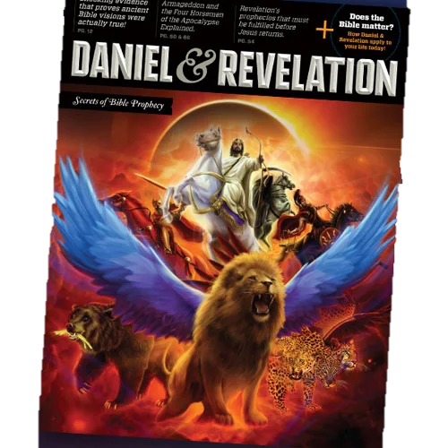
“Mountains as Kingdoms”
This Key Unlocks Bible Prophecy
Connects Daniel & Revelation
The Book of Revelation
Chapter 13
The Beast Coming out of the Sea
The Book of Daniel
Chapters 2 - The Metal Statue
Chapters 7 & 8
The 4 Beasts Rising out of the Sea

Slide 5
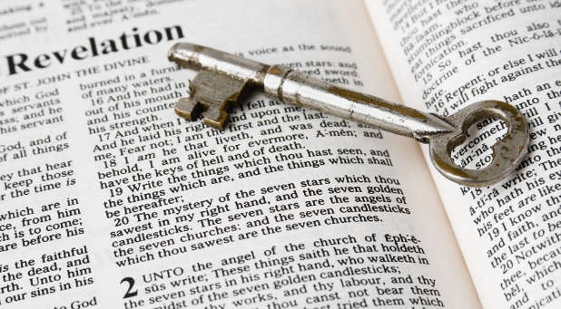
Let’s Start in Revelation Chapter 13
“The Beast who Rises up out of the Sea”
The Coming Coalition of Anti-Christ Nations

Slide 6
Revelation 13:1 “And I stood on the sand of the sea and saw a beast rise up out of the sea,
having 7 heads & 10 horns, and upon his horns 10 crowns, & upon his heads the name of blasphemy.”

Slide 7
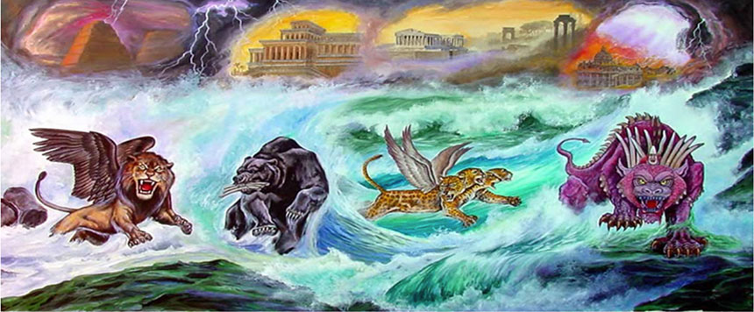
2. “And the beast which I saw was like a leopard & his feet were as the feet of a bear,
& his mouth as the mouth of a lion: & the dragon gave him his power & his throne and great authority.”
Medes/Persia
Greece
Fierce Final Beast
Babylon

Slide 8
³ And I saw one of his heads as it were wounded to death; (Head = Kingdom) and his deadly wound was healed: and all the world wondered after the beast.
⁴ And they worshipped the dragon which gave power unto the beast: and they worshipped the beast, saying, Who is like unto the beast? Who is able to make war with him?
⁵ And there was given unto him a mouth speaking great things and blasphemies; and power was given unto him to continue 42months.
⁶ And he opened his mouth in blasphemy against God, to blaspheme His name, and His Tabernacle, and them that dwell in heaven.
⁷ And it was given unto him to make war with the saints, and to overcome them: and power was given him over all kindreds, and tongues, and nations.
⁸ And all that dwell upon the earth shall worship him, whose names are not written in the Book of Life of the Lamb that was slain from the foundation of the world.

Slide 9
All we have to do is Identify Prophetic Symbols
Who/ What is the Bear?
Who/ What is the Lion ?
Who/What is the Leopard?
Daniel Chapter 7 describes these Beast Empires
Final Beast

Slide 11
To Overturn these Popular Teachings of End Times
No “The Revived Roman Empire”
No “The Coming European Anti-Christ”
No “The Pope as the False Prophet”
No “The Coming One World Government”
Modern Bible Maps
Look into the Future
&
Clearly Identify these Kingdoms
as An Islamic Anti-Christ
Called “The Middle East Beast”

Slide 12
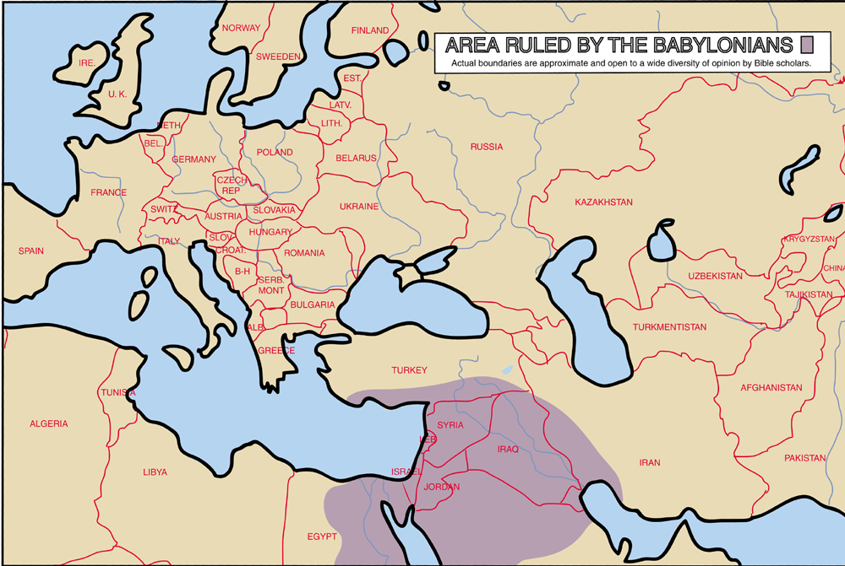
Babylonian Empire

Slide 13
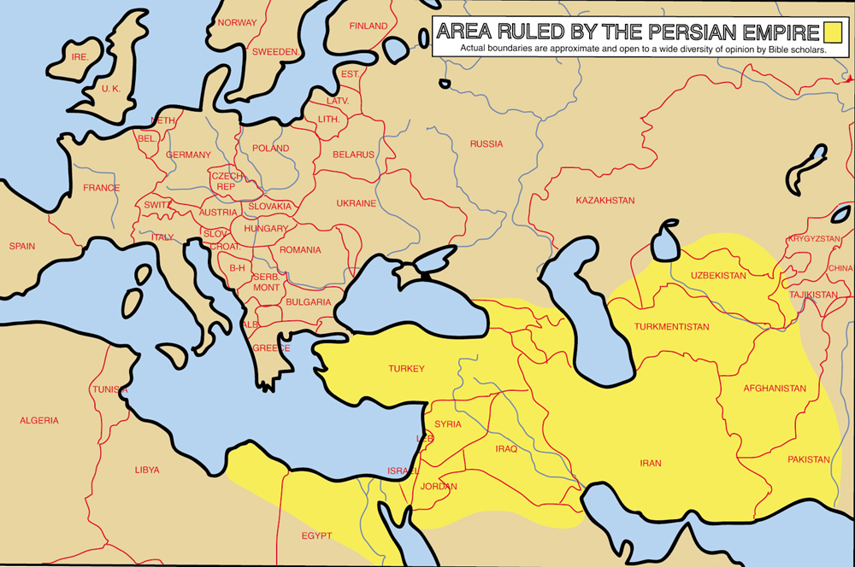
Persian Empire

Slide 14
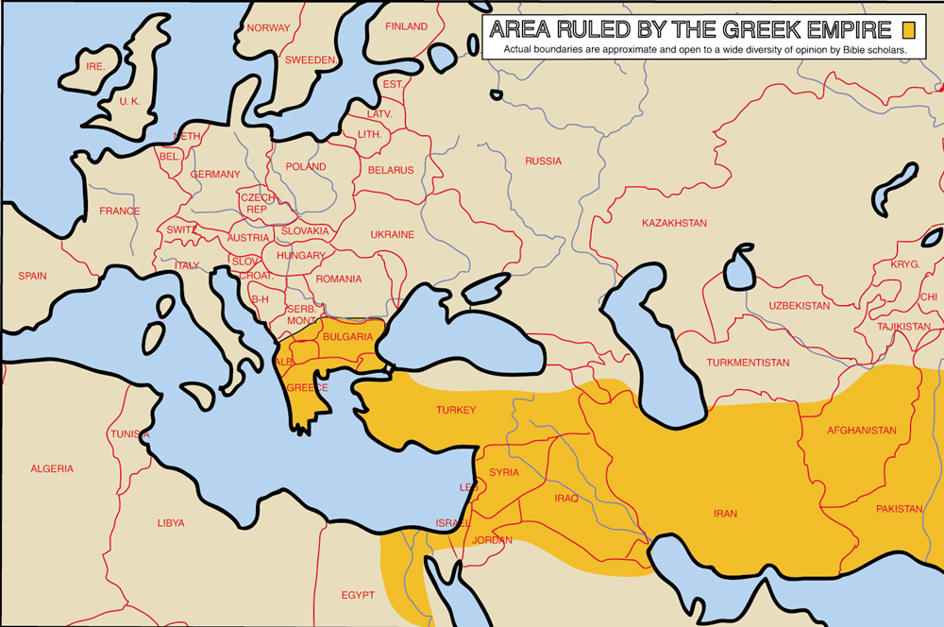
Greek Empire

Slide 15
Let’s Go to Revelation Chapter 17-18
To Identify the Harlot Who Rides the Beast
Seated on 7 Mountains
Mystery Babylon is a false Religion
Who is given power over nations by Satan

Slide 16
The Trumpet Judgments Point to Timing of Events
Revelation Chapters 17 -18 Revealing the Identity of Mystery Babylon – A End Time False Religion

Slide 17
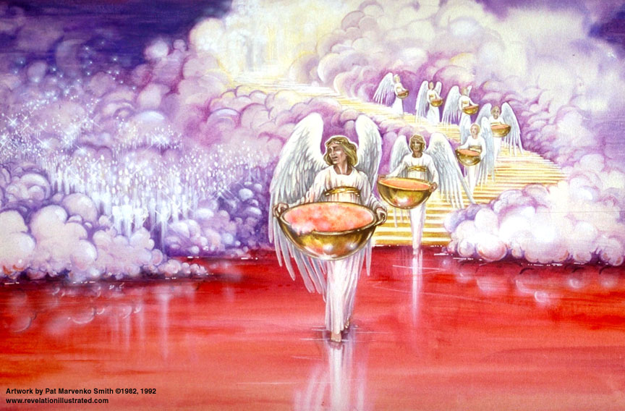
Revelation 17 – Mystery Babylon
1. And there came one of the 7 angels which had the 7 bowls and talked with me, saying,
“Come hither and I will show you the judgment of the great whore that sits on many waters.
2. With whom the kings of the earth have committed fornication, and the inhabitants of the earth have been made drunk with the wine of her fornication.

Slide 18
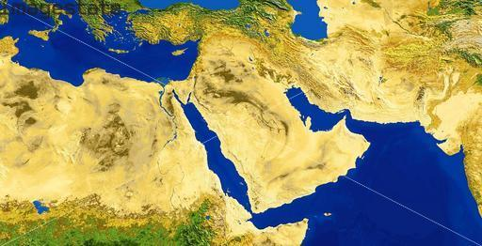
“Come hither, and I will show you the judgment of the great whore that sits on many waters: with whom the kings of the earth have committed fornication, and the inhabitants of the earth have been made drunk with the wine of her fornication. And he carried me away in the Spirit into the wilderness. (desert)
Saudi Arabia is
the desert of the seas

Slide 19
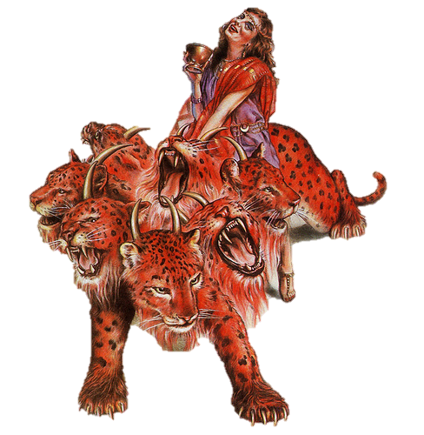
3. “And he carried me away in the Spirit into the wilderness (desert): and I saw a woman sit upon a scarlet colored beast, full of names of blasphemy, having 7 heads and 10 horns.
4. And the woman was was arrayed in purple and scarlet color, and decked with gold and precious stones and pearls, having a golden cup in her hand full of the abominations and filthiness of her fornication.”
5. And upon her head was a name written, Mystery Babylon the Great, the mother of Harlots and Abominations of the Earth.
6. And saw the woman was drunken with the blood of the saints, and with the martyrs of Jesus: and when
I saw her I wondered greatly.”

Slide 20
Woman riding the Beast with 7 Heads
In Bible Prophecy, A Woman = A Religion
A Pure Bride or a Wicked Harlot
Mystery Babylon is the Great Harlot
A False Religion Controlling 7 Kingdoms
In Bible Prophecy
Kingdoms = Heads = Mountains
7 Heads = 7 Empires
10 Horns = 10 Future Rulers
Little Horn = Anti-Christ

Slide 21
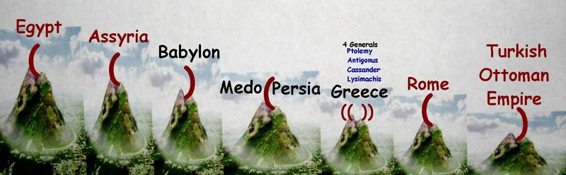
Revelation 13:3 “ And I saw one of his heads as it were wounded to death,
and his deadly wound was healed: and all the world wondered after the beast.
Islam
1
2
3
4
5
6
7
“And here is the mind that has wisdom: The 7 heads are 7 mountains, on which the woman sits. And there are 7 kings: 5 are fallen and one is, and the other is not yet come & when he comes, he must continue a short space. And the beast that was and is not, even he is the 8th and is of the 7 and goes into perdition.
Revelation 17:14 describes the 8th Mountain as the Anti-Christ Kingdom

Slide 22
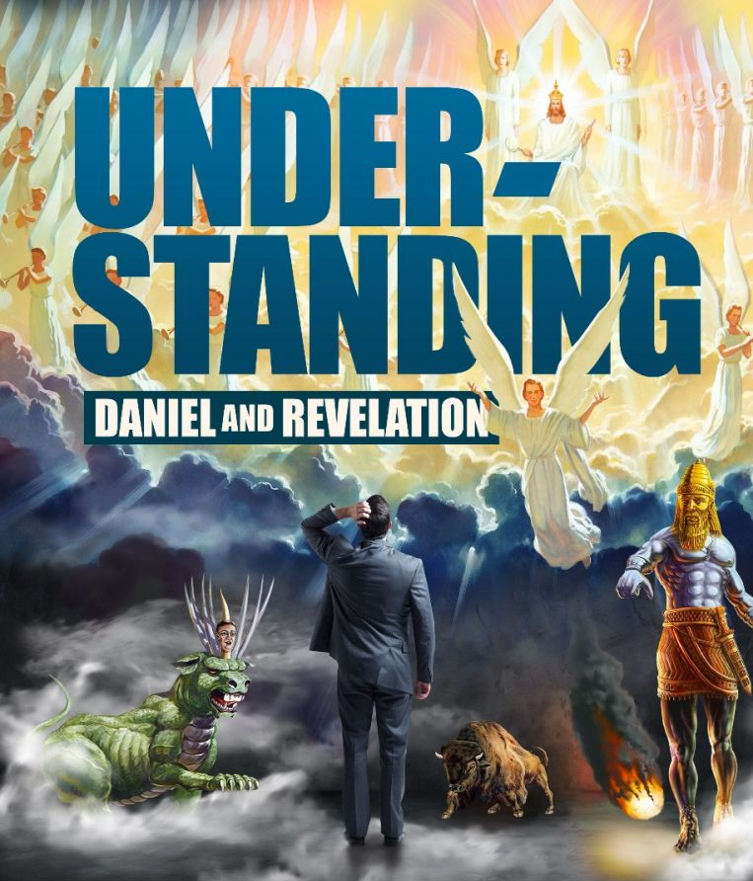
Each Book Reveals the Other
The Book of Revelation is Open
The Book of Daniel is Sealed
until the End Times
The Closer we are to Jesus’ Return
The More God will Reveal & Unseal

Slide 23
Daniel Chapter 2 – God gives Nebuchadnezzar a Dream
King Nebuchadnezzar had a troubling dream of a great Statue
Only Daniel can interpret the dream with God’s help
The dream describes Coming World Empires in exact order
World history has proven the Accuracy of Daniel’s interpretation
Daniel Chapter 7 – God gives Daniel a Dream of Beast Empires
These Empires have Existed in the Past
They will Re-emerge as One – The final Anti-Christ Kingdom

Slide 24
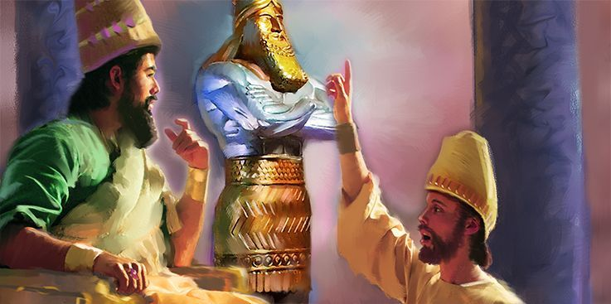
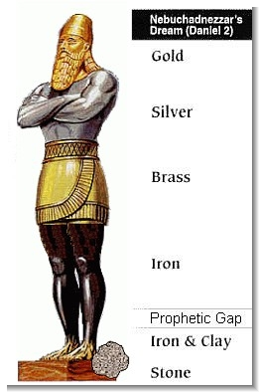
31. You, O King, saw and behold a great image. This great image whose
brightness was excellent stood before you: the form thereof was terrible.
32.This image’s head was of a fine gold, his breast and arms of silver,
his belly and his thighs of brass,
33. His legs of iron, his feet part of iron and part of clay.”
34. You saw until a stone that cut out without hands, which smote the image
upon his feet that were of iron and clay, and broke them into pieces.
35. Then was the iron, the clay, the brass, the silver, and the gold
broken to pieces together, and became like the chaff of the summer
threshing floors; and the wind carried them away: and the stone that
smote the image became a great Kingdom and filled the whole earth.

Slide 25
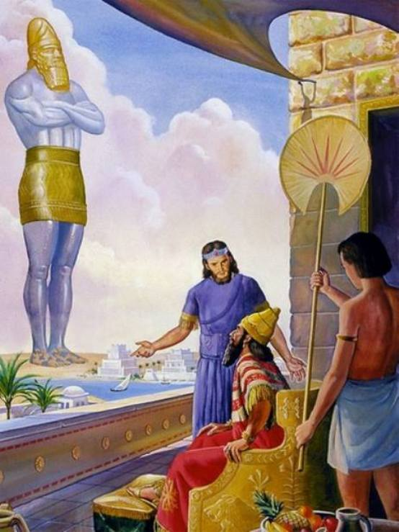
^{37 “}You, O king, are a king of kings: for the God of heaven has given you a kingdom, power, & strength, & glory.
³⁸ And wheresoever the children of men dwell, the beasts of the field & the fowls of the heaven has He given
into your hand, and has made you ruler over them all. You are this head of gold.
³⁹ And after you shall arise another kingdom inferior to you, and another 3rd kingdom of brass, which shall bear rule over all the earth.
⁴⁰ And the 4th Kingdom shall be strong as iron: forasmuch as iron breaks in pieces & subdues all things: and as iron
that breaks all these, shall it break in pieces and bruise.

Slide 26
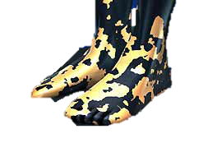
Daniel Chapter 2
Identify the 10 Toes = The 10 Kingdoms of the Anti-Christ
41. Whereas you saw the feet & toes, part of potters' clay, & part of iron, the kingdom shall be divided;
but there shall be in it of the strength of the iron, forasmuch as you saw the iron mixed with miry clay.
42. And as the toes of the feet were part of iron, and part of clay,
so the kingdom shall be partly strong, and partly broken.
43. And whereas you saw iron mixed
with miry clay, they shall mingle themselves with the seed of men:
but they shall not cleave one to another even as iron is not mixed with clay.
“Mixed and Mingle” in Hebrew give Identity
Used 4x to describe this Anti-Christ Kingdom
that will mix with mankind but not cleave
“Mix, Mixed, and Mingle”
#6151 Strongs = Arab

Slide 27
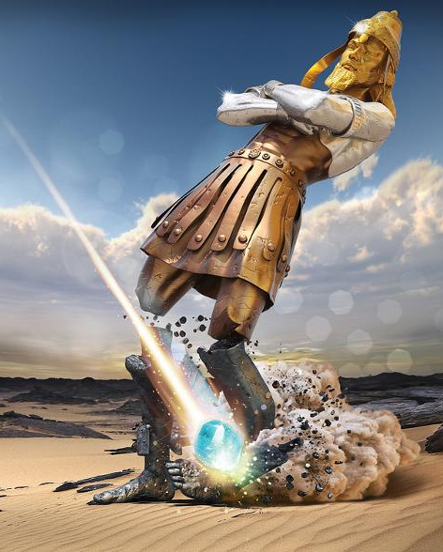
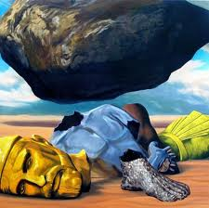
Daniel 2:44 “And in the days of these Kings shall the God of Heaven set up a Kingdom, which shall never be destroyed: and the Kingdom shall not be left to other people, but it shall break in pieces and consume all these kingdoms, and it shall stand forever.

Slide 28
45. “Fore as much as you saw that the stone was cut out of the Mountain without hands, and that it broke in pieces the iron, the brass, the clay, the silver, and the gold; the great God has made known to the King what shall come to pass hereafter.” 46. The dream is certain: the interpretation thereof is sure.”
The Mountain that crushes all the beast Kingdoms is The Kingdom of God
The Stone Cut without Hands
is Jesus Christ
Jesus will reign
at the End of the Age
And God ‘s Kingdom
will be established forever

Slide 29
Daniel’s Vision in Chapter 7 – Coming Beast Empires
^{I} 1n the 1st year of Belshazzar King of Babylon Daniel had a dream and visions
of his head upon his bed :then he wrote the dream and told the sum of the matters.
² Daniel spoke and said, I saw in my vision by night, and, behold, the 4 winds of the heaven strove upon the great sea (gentile nations/Mediterranean)
³ And 4 great beasts came up from the sea, diverse one from another.
⁴ The 1st was like a lion & had eagle's wings: I beheld till the wings thereof were plucked, and it was lifted up from the earth, and made stand upon the feet as a man, and a man's heart was given to it.
⁵ And behold another beast, a 2nd like to a bear, and it raised up itself on one side, and it had 3 ribs
in the mouth of it between the teeth of it: they said thus unto it, Arise, devour much flesh.
⁶ After this I beheld, and lo another like a leopard, which had upon the back of it 4 wings of a fowl; the beast had also 4 heads; and dominion was given to it.
⁷ After this I saw in the night visions, and behold a 4th beast, dreadful and terrible, and strong exceedingly; and it had great iron teeth: it devoured and broke in pieces, and stamped the residue with the feet of it:
and it was diverse from all the beasts that were before it; and it had 10 horns.

Slide 30
The Great Sea = Gentile Nations/ The Mediterranean Sea 4 Beasts rising from Sea = 4 metals
10 Horns = Power, 10 Future Rulers The Little Horn = A/C
Final Beast
Babylon
Persia
Greece

Slide 31
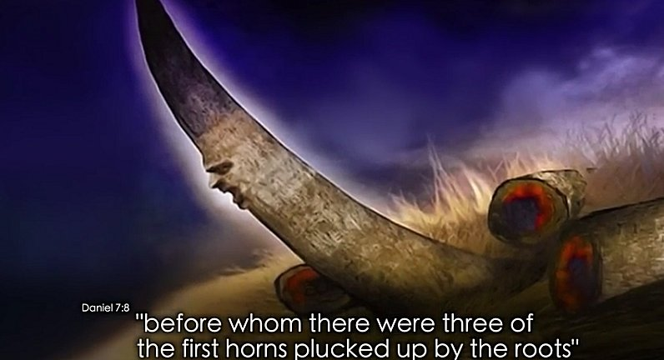
⁸ I considered the horns, and, behold, there came up among them another little horn,
before whom there were 3 of the first horns plucked up by the roots: and behold,
in this horn were eyes like the eyes of man, and a mouth speaking great things.
⁹ I beheld till the thrones were cast down, and the Ancient of days did sit, \ whose garment was white as snow, and the hair of His head like the pure wool: His throne was like the fiery flame, and His wheels as burning fire.
¹⁰ A fiery stream issued and came forth from before Him: thousand thousands ministered unto Him, and 10,000 x 10,000 stood before Him: the judgment was set & the books were opened. (Rev. 20)
¹¹ I beheld then because of the voice of the great words which the horn spoke: I beheld even till the beast was slain & his body destroyed, & given to the burning flame.
¹² As concerning the rest of the beasts, they had their dominion taken away:
yet their lives were prolonged for a season and time.
¹³ I saw in the night visions, and behold, one like the Son of man came with the clouds of heaven, and came to the Ancient of days, and they brought him near before Him.
¹⁴ And there was given him dominion, and glory, and a kingdom, that all people, nations,
and languages, should serve him: His dominion is an everlasting dominion,
which shall not pass away, and His kingdom that which shall not be destroyed.
Little Horn
Anti-Christ

Slide 32
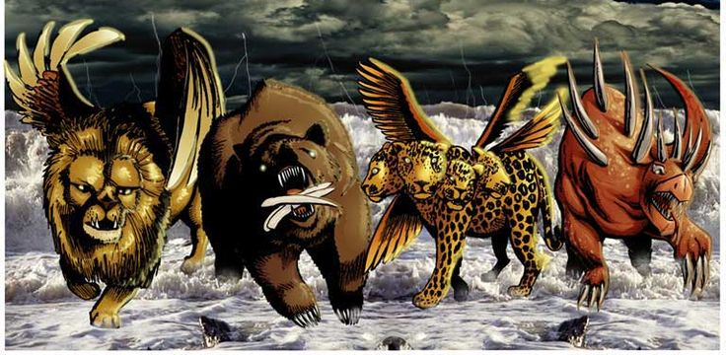
¹⁵ I Daniel was grieved in my spirit in the midst of my body, & the visions of my head troubled me.
¹⁶ I came near to one of them that stood by, and asked him the truth of all this. So he told me, and made me know the interpretation of the things.
¹⁷ These great beasts, which are 4 kings that shall arise out of the earth.
¹⁸ But the saints of the most High shall take the kingdom, and possess the kingdom for ever, even for ever and ever.
¹⁹ Then I would know the truth of the 4th beast, which was diverse from all the others,
exceeding dreadful, whose teeth were of iron and his nails of brass;
which devoured, broke in pieces, and stamped the residue with his feet;
²⁰ And of the 10 horns that were in his head, & of the other which came up, & before whom 3 fell; even of that horn that had eyes & a mouth that spoke very great things, whose look was more stout than his fellows.²¹ I beheld and the same horn
made war with the saints, and prevailed against them;
²² Until the Ancient of days came, and judgment was given to the saints of the most High;
and the time came that the saints possessed the kingdom.

Slide 33
²³ Thus he said, The 4th beast shall be the 4th kingdom upon earth, which shall be diverse from all kingdoms, and shall devour the whole earth, and shall tread it down, and break it in pieces.
²⁴ And the 10 horns out of this kingdom are 10 kings that shall arise: another shall rise after them; and he shall be diverse from the first, and he shall subdue 3 kings.
²⁵ And he shall speak great words against the most High, and shall wear out the saints
of the most High, and think to change times and laws: they shall be given into his hand
until a time and times and the dividing of time. ( 3 ½ Years – Half of the 7 year Tribulation)
²⁶ But the judgment shall sit, and they shall take away his dominion,
to consume and to destroy it unto the end.
²⁷ And the kingdom and dominion, and the greatness of the kingdom under the whole heaven, shall be given to the people of the saints of the Most High, whose kingdom is an everlasting kingdom, and all dominions shall serve and obey him.

Slide 34
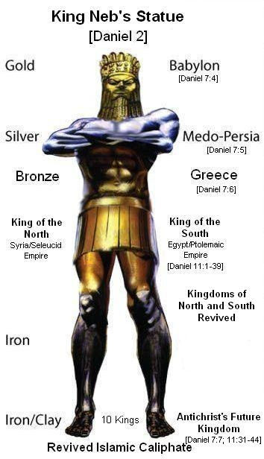
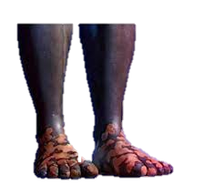
The Wild Beast Kingdoms
In Daniel Chapter 7
All Point to ISLAM
Look Again at Daniel Chapter 2
The Metal Statue = Same Beast Kingdom
Focus on the Feet and Toes – Final Kingdom
10 Toes = 10 Future Kings under Anti-Christ

Slide 35
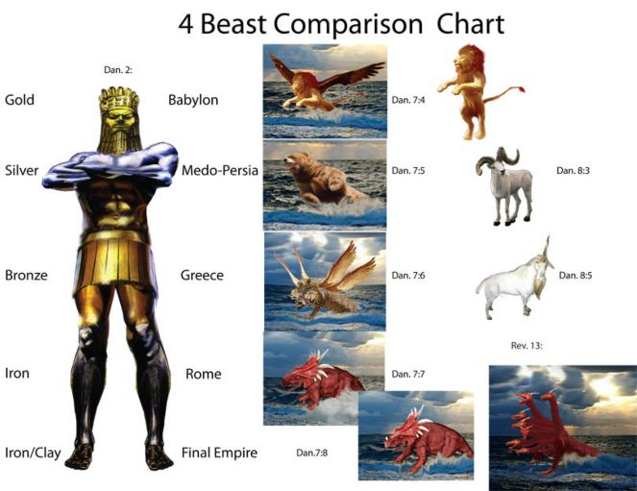
Comparing Daniel 2, Daniel 7 & Daniel 8

Slide 36
Babylonian Empire

Slide 37
Persian Empire

Slide 38
Greek Empire

Slide 39
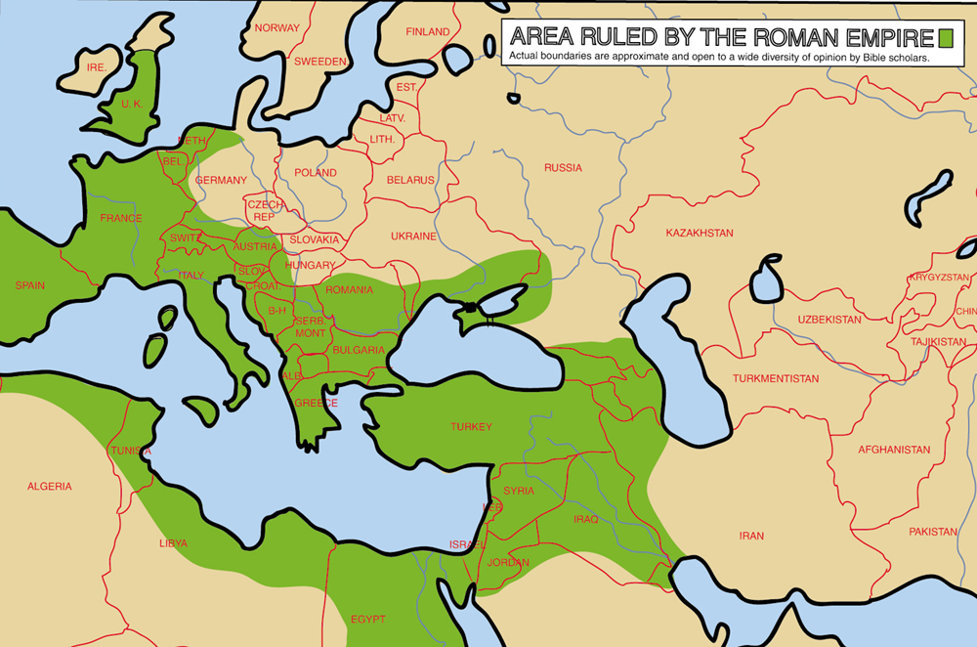
Roman Empire

Slide 40
So many great Mountain Verses for Believers
The Good News of God’s Kingdom
Micah 4:1 “But in the Last Days it shall come to pass, the Mountain of the Lord shall be established in the top of the mountains, and it shall be exalted above the hills, and people shall flow to it.
Isaiah 52:7 “How beautiful upon the mountains are the feet of him that brings good tidings, that publishes peace; that brings good tidings of good things, that publishes salvation; that says to Zion, Thy God reigns!”
Isaiah 55:12 “For you shall go out with joy and be led forth with peace: the mountains and the hills shall break forth before You into singing, and all the trees of the field will clap their hands."
Mark 11:23. “ For verily I say to you, that whosoever shall say to this mountain, be thou removed and be cast into the sea; and shall not doubt in his heart, but shall believe that those things which he says shall come to pass, He shall have whatsoever he says.”

Slide 41
Key Words to Understanding Bible Prophecy
Mountains = Kingdoms = Heads

