Slide 1
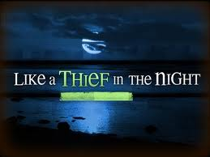
The Enemy Comes….
Islam is the
End Time Enemy

Slide 2
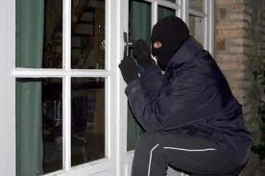
“If a THIEF be found breaking up, and be smitten that he die, there shall no blood be shed for him” Exodus 22:2

Slide 3
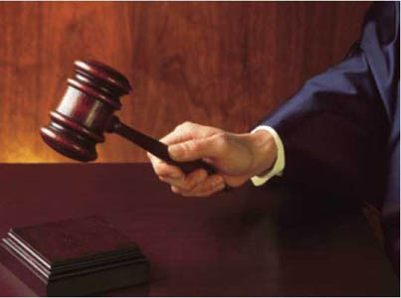
“If a man shall deliver unto his neighbor money or stuff to keep, and it shall be stolen out of the man’s house, if the THIEF be found, let him pay double.”
Exodus 22:7

Slide 4
When the devil steals from you: your joy,
your finances,
your children, your health, your peace, your dreams…..
and you catch him….
Then you can ask the LORD to restore DOUBLE!

Slide 5
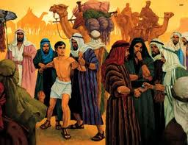
“If a man be found stealing any of his brethren of the Children of Israel and makes merchandise of him, or sells him; then that THIEF shall die; and you will put away evil from among you.”
Deuteronomy 24:7

Slide 6
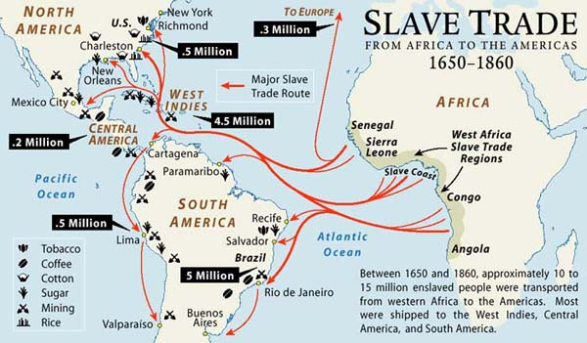
The Slave trade has always been controlled by Arabs! History records over
15 million enslaved: Africans, White Europeans, Jews, Armenians, Asians, Hindus, Catholics, & other muslims…. Islam = Submission = Slavery

Slide 7
en
If Islam is the religion of Satan,
Bringing slavery & death!
Jesus Christ came to
Set all the Captives free.
He wants to save the Muslims
Since We are Free indeed,
Walking in His liberty, His peace, His joy,
His hope, His, goodness, His self-control,
His mercy & forgiveness
We will pray for the muslims to find Jesus!

Slide 8
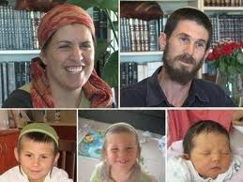
“The murderer rising with the light kills the poor and needy, and in the NIGHT is as a THIEF”
Job 24:14

Slide 9
If Islam is the Religion of Death
And all infidels must be killed: Christians, Jews, Hindus, Buddhists, and pagans…..then all apostate moslems must be killed, it is surely the religion of satan…Everyone dies because the enemy hates LIFE!
And Jesus loves LIFE. Every man and woman is created in the image of Almighty God so every life is precious.
Jesus died so that all might be saved!

Slide 10
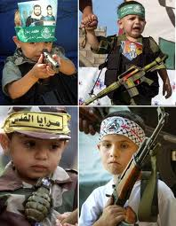
“They were children of fools, yes, children of base men: they were viler than the earth….I would have disdained to set them with the dogs of my flock, …..they were driven forth by men as after
a THIEF….
They hate me and spit on me”
Job 30: 1-10 paraphrased

Slide 11
If satan hates Order and loves Chaos, then those under his domain will cause Chaos. Peace will be far from them. Allah is the god of War and the Sword and Chaos and Death!
Our Father in Heaven created Order and loves Peace. All those who choose to follow Jesus will walk in Peace and find order in their lives. They will follow after Life!

Slide 12
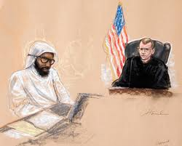
“Whosever is partner with a THIEF hates his own soul;
he hears cursing and bewrays it not.” Proverbs 29:24

Slide 13
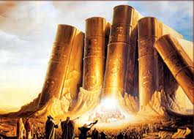
“But they like men have transgressed the covenant:
they have dealt treacherously against Me.” Hosea 6:7
“When I would have healed Israel, then the iniquity of Ephraim was discovered and the wickedness of Samaria” for they commit falsehood; and the THIEF comes in, and the troop of robbers spoil without.” Hosea 7:1

Slide 14
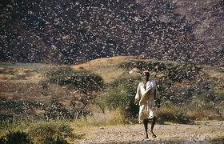
“They shall run to and fro in the city; they shall run upon the wall, they shall climb up on the houses, they shall enter in the window
like a THIEF.” Joel 2:9 The Locust Army Rev. 9

Slide 15
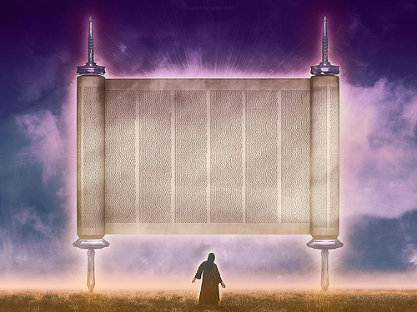
“Then he said to me, ‘This is the curse (allah) that goes forth over the face of the whole earth: everyone that STEALS shall be cut off as on this side of it; and everyone that blasphemes shall be cut off as on that side of it” Zechariah 5:3

Slide 16
“I will being it forth, says the LORD of Hosts, and it shall enter into the house of the THIEF, and into the house of him that swears falsely by My Name: and it shall remain in the midst of his house, shall consume it with timber thereof and the stones thereof.” Zechariah 5:4

Slide 17
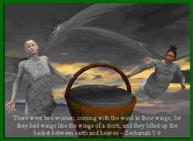
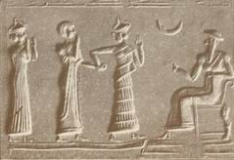
The Woman in the Ephah
Zechariah 5:5-11
False Religon - Wickedness
Barrels Used for Economic Wealth
Set Up on Base
in Babylon
Carried by 2 Women/ Stork Wings
The Flying Cranes of Islam are Allah’s Daughters and Consorts
Al –Lat
Al – Uzza
And Manat!

Slide 18
“But know this, if the Goodman of the House had known in what watch the THIEF would come, he would have watched, and would not have suffered his house to be broken up.”
Matthew 24:43 Luke 12:39 1 Thessalonians 5:2 2 Peter 3:3

Slide 19
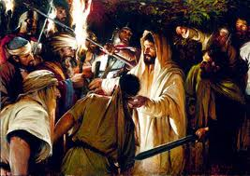
“In that same hour Jesus said to the multitudes (the chief priests and captains of the Temple, and the elders), ‘Are you come out as against a THIEF with swords and staves to take Me? I sat daily with you in the Temple. And you laid no hold on Me” Matt 26:55; Mark 14:48; Luke 22:52

Slide 20
“Sell what you have and give alms; provide yourselves bags which do not grow old, a treasure in Heaven that fails not, where no THIEF approaches, nor moth corrupts.”
Luke 12:33

Slide 21
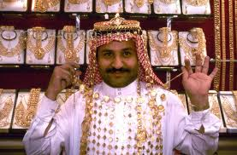

Slide 22
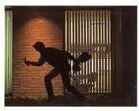
“Verily, verily, I say to you, ‘He that enters not by the door into the sheepfold, but climbs up some other way, the same is a THIEF and a robber.” John 10:1

Slide 23
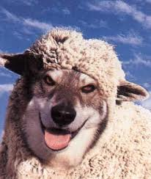
“All that ever came before Me are THIEVES and Robbers;
but the sheep did not hear them.” John 10:8
“The THIEF comes to kill, steal, and destroy:
I am come that they might have life, and they might have it
more abundantly.”
John 10:10

Slide 24
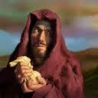
This Judas said, not that he cared for the poor;
but because Judas was a THIEF, and had the bag,
and carried what was put in it.” John 12:6

Slide 25
“For you yourselves know perfectly that the Day of the Lord comes as a THIEF in the night. But you, brethren, are not in darkness so that Day should overtake you as a THIEF.”
1 Thessalonians 5:2 and 5:4

Slide 26
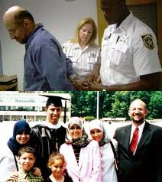
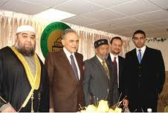
“But let none of you suffer as a murderer,
or a THIEF, or as an evildoer, or an a busybody in other
men’s matters.”
1 Peter 4:15

Slide 27
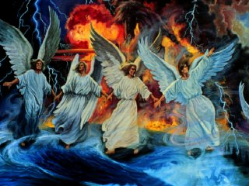
“But the Day of the Lord will come as a Thief in the Night; in which the Heavens shall pass away with a great noise, & the elements shall melt with fervent heat, the earth also & the works that are there shall be burned up.” 2 Peter 3:10
Isa. 24: 6; 51:6; Matt 24:35,43; Mark 13:31; Rev. 3;3; 16;15; 20:11

Slide 28
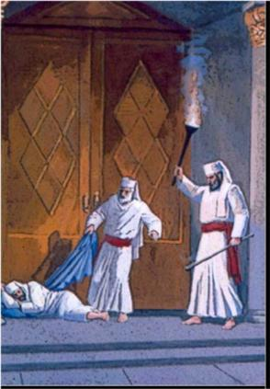
xs
“Behold, I come as a THIEF. Blessed is he that watches, and keeps His garments lest he walk naked, and they see his shame.” Revelaton 16:15
The High Priest is known as the Thief in the Night. Each priest was assigned a special watch during the night to guard The Temple and make sure no enemy profaned its holiness and that the Menorah lights never went out. Any priest found sleeping on duty would have his clothes burned and be removed from office!

Slide 29
So to sum it all up……
Satan is the Thief
Who will be caught unaware
In His traps
And fail to escape
the Great Tribulation?

Slide 30
The Unsaved who Love the World & Hate the Gospel
Those Not Watching, in Prayer - Indifferent, Asleep
The Lukewarn Church and Ladodecian Church
The Emergent Church, Post-Modern, New Imaging
The Chrislam Church
The Politically Correct, Social Justice Churches
The Anti-Israel, Pro-Palestian Churches, Inter-Faith
The Carnal Church who Will Not Be Led by the Spirit
The Wide Door Church of Anything Goes
The Universalist Churches
Is it Possible to be In a Church
And Not Be Living for God
In Holiness and Righteousness?

Slide 31
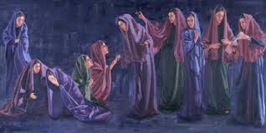
What about the Parable of the 10 Virgens? - Matthew 25
5 are Ready, Watching, Waiting, Full of Oil…..
5 are Foolish, Not Ready, Not Watching, Not Prepared – Not enough Oil
The DOOR was shut to them! “Depart from Me, I never knew you”

Slide 32
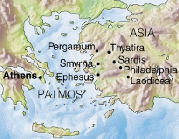
Only 2 Churches do not receive Warnings! Smyrna and Philadelphia!

Slide 33
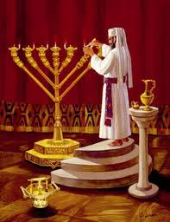
Jesus is Cleaning His Church in the 7 Letters to the Churches. The Church of Sardis is almost dead!
“Remember therefore how you have received and heard, and hold fast, and repent. Therefore if you shall not watch, I will come on you as a THIEF in the night, and you will not know what hour I come upon you.”
Revelation 3:3
He gives strong warning to Ephesus. Pergamos, Thyatire, Sardis and Laodecia!

Slide 34
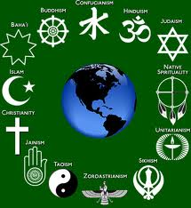
Just What
is Apostasy?
The Emergent Church
The Post-Modern
Church
The Liberal Church
The InterFaith Church

Slide 35
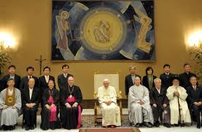
Global Religions Worship Together as Unity & Inter-Faith Groups

Slide 36
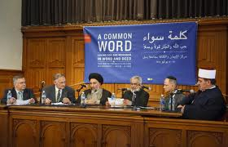
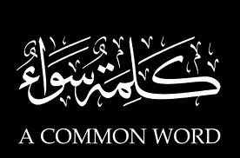
http://www.google.com/search?hl=en&q=interfaith+meetings+assissi&gs_sm=3&gs_upl=1940l14787l0l15126l45l29l9l7l7l0l115l2174l27.2l45l0&bav=on.2,or.r_gc.r_pw.,cf.osb&biw=1280&bih=595&um=1&ie=UTF-8&tbm=isch&source=og&sa=N&tab=wi&ei=M4E5T4THF9G_2QXWscGNAg#
All Anti-Israel Pro-Palestinian PEACE Churches

Slide 37
Any International Governments & Agencies - Any Global Banks - Any International Companies
that are:
ANTI-GOD and ANTI-CHRIST
ANTI -Israel
ANTI-Bible
Anti-Family
Pro-Abortion Pro -Slavery Pro-Palestinian
Pro-Socialism Pro-Communism Pro-Marxism
Pro-Humanism Pro-Choice Pro-Gay Rights
Pro-Ecumenism InterFaith, Unity, Social Justice

Slide 38
Halleljuah, the THIEF has No Power over US!
For We are Blood-Bought, Holy Ghost Filled, Covenant-Sealed,
Worshipping in Spirit and in Truth,
Lovers & Doers of the Word!

Slide 39
The Enemy Comes….
Jesus Is Coming Soon to Destroy the Thief forever

