Slide 1
Jesus Is Better – “The New Birth”

Slide 2
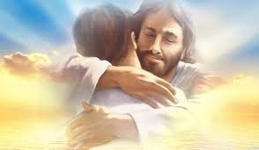
Hebrews 6:1-2
“Therefore leaving the principles of the doctrine of Christ,
let us go on to perfection; not laying again the foundation of
repentance from dead works, and of faith towards God,
of the doctrine of baptisms, and of laying on of hands,
and of resurrection of the dead, and of eternal judgment.”

Slide 3
We want to Grow in God ..
to become Mature
What basic doctrines of Christ
should we know?

Slide 4
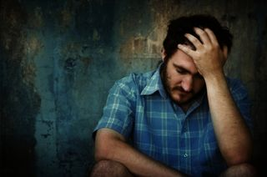
1.Repent –Metamelomai
Outward change
What is Repentance?
2. Repent – Metanoia
Inward Change
True Repentance – Turning away, a complete change
of mind of those who have come to hate their sins, a conviction that brings Godly sorrow and produces
real heart change – transformation

Slide 5
What is Faith?
Faith - Putting complete trust in
So fully persuaded, so confident that we are compelled to ACT

Slide 6
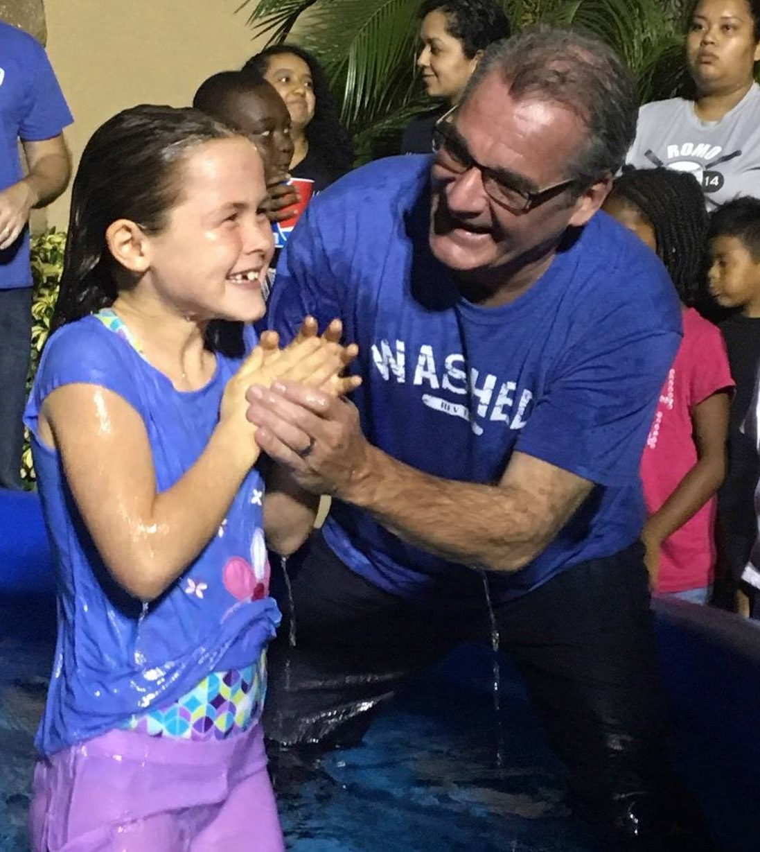
What are Baptisms? baptizmo – Total immersion
There are 3 Baptisms mikvah – total immersion
#1. Baptism by Water
done by men
Romans 6:3 “Know you not, that as many of us as were baptized into
Jesus Christ were baptized into His death. Therefore we are buried with Him by Baptism unto death; that as Christ was raised up from by the glory of the Father even so we should walk in newness of life”

Slide 7
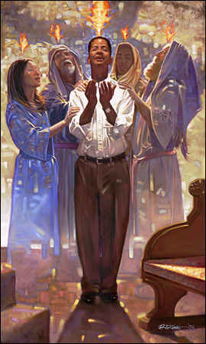
#2 –Baptism of Holy Ghost
By Fire
with Evidence of Speaking
in Tongues
Acts 1:8 “But you shall receive power after that the Holy Ghost is come upon you; and you shall be witnesses unto Me in Jerusalem and in all Judea and in Samaria and unto the uttermost part of the earth.”

Slide 8
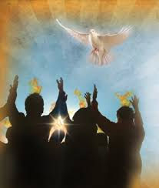
Where can we Study People getting Born Again in the Bible?

Slide 9
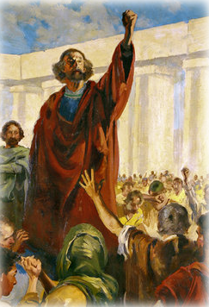
# 1 Peter Boldly Preaches
the Gospel
Acts 2:14-36
“You men of Israel, hear these words, Jesus of Nazareth, a man approved of God among you by miracles and wonders and signs, which God did by Him in the midst of you as you yourselves also know.
Him, being delivered by the counsel and foreknowledge of God, you have taken and by wicked hands have crucified and slain,….
Whom God has raised up having loosed the pains of death, because it was not possible that he could be held by it….
This Jesus has God raised up of which we are all witnesses…

Slide 10
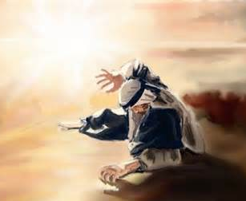
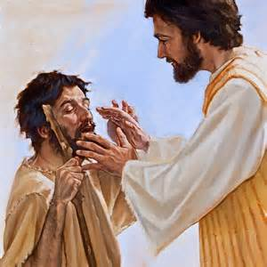
#2. Saul on Damascus Road
Acts Chapter 9
“And Ananias went his way and entered the house and put his hands on him and said, brother Saul, the Lord, even Jesus that appeared to you in the way as you came, sent me to you, that you may receive your sight, and be filled with the Holy Ghost. And immediately there fell from his eyes as it had been scales and he received sight forthwith, arose and was baptized.” 9:17-18

Slide 11
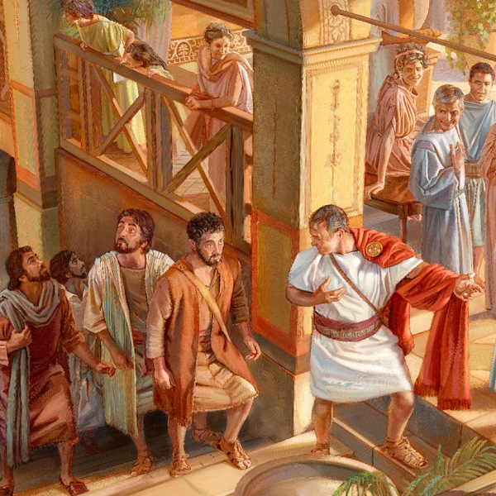
#3 Peter preaches to House of Cornelius - Acts Chapter 10
“When Peter spoke these words, the Holy Ghost fell on all them which heard the Word. And they of the circumcision were astonished, as many as came with Peter, because that on the Gentiles was poured out the gift of the Holy Ghost. For they heard them speak with other tongues.& magnify God. Then answered Peter,
‘Can any man forbid water, that these should not be baptized, which have received the Holy Ghost as we did?
Acts 10”44-47

Slide 12
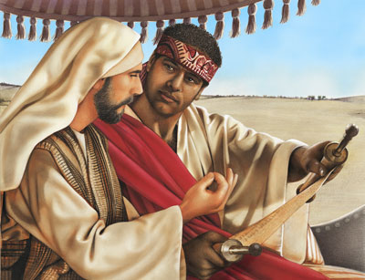
Phillip preaches JESUS to the
Ethiopian eunuch
From Isaiah 53
Acts 8:35-38
“Then Phillip opened his mouth and began at that same Scripture and PREACHED to him JESUS. And as they went o their way, they came to a certain water: and the eunuch said, ‘See, here is water, what does hinder me to be BAPTIZED? Phillip said
‘If you believe with all your heart, you may.’ He answered and said, I BELIEVE that Jesus Christ is the Son of God.’ (Phillip baptized him right then) Acts 8:35-38

Slide 13
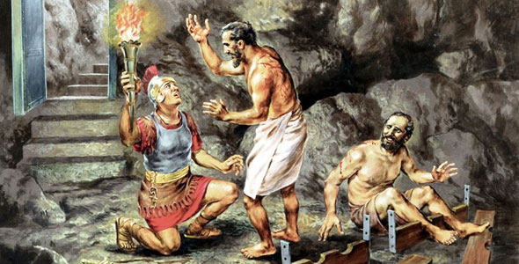
Acts 16 :16-33 New Birth for the the prison guard and his family
The prison guard fell down before Paul and Silas and said, ‘Sirs, what must I do
to be saved? And they said, BELIEVE on the Lord Jesus Christ, and you shall be saved and all your household. And they spoke to him the Word of the Lord, and to all his house.” Straightway he was BAPTIZED, he and all his house.”

Slide 14
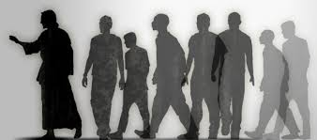
“True Discipleship & The New Birth”
Repent…. Believe...Be Baptized… Receive the Holy Ghost

