Slide 1
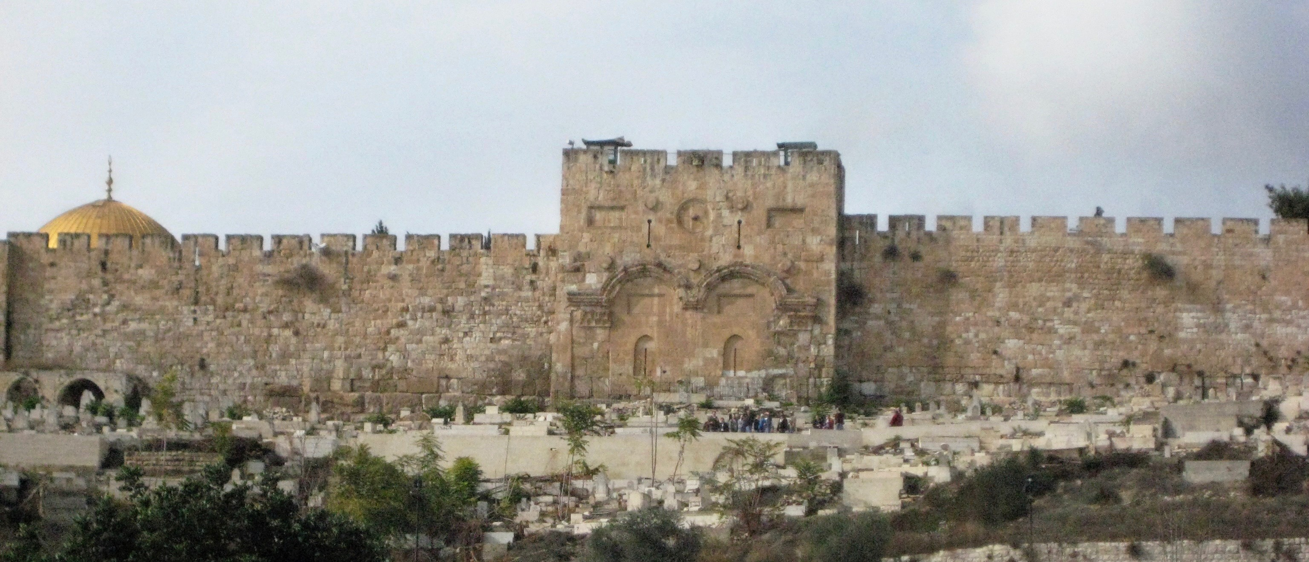
“Jerusalem – The Prophetic Sign”
Prophetic Places, Patterns, People, & Time

Slide 2
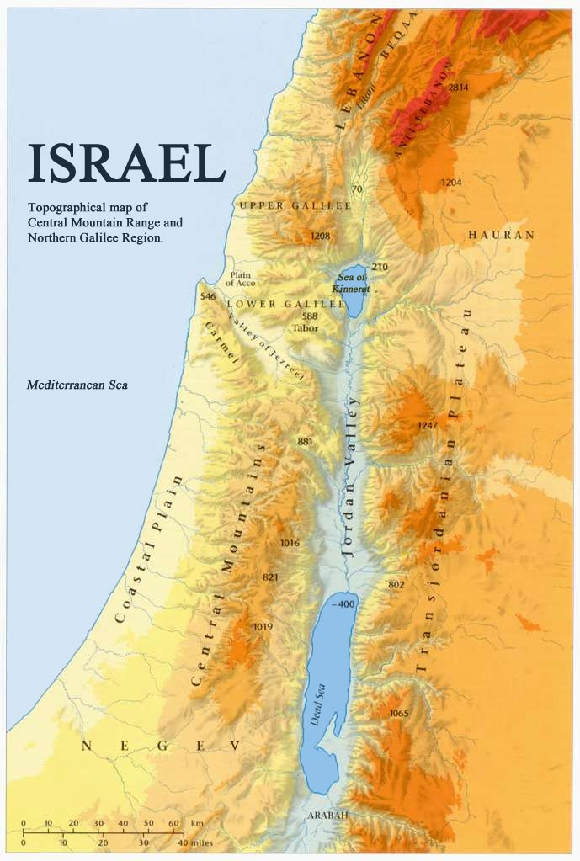
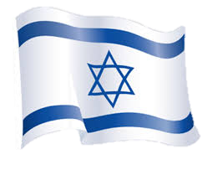
A Prophetic Place
A Major Sign:
The Modern State of Israel
&
Battle over Jerusalem Now

Slide 3
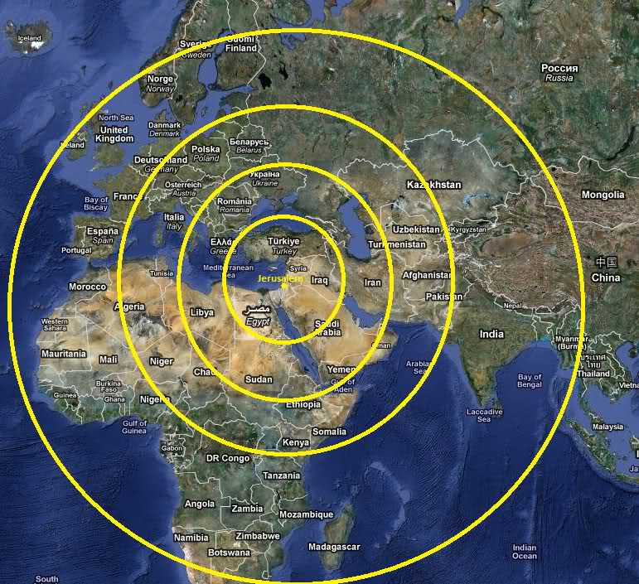
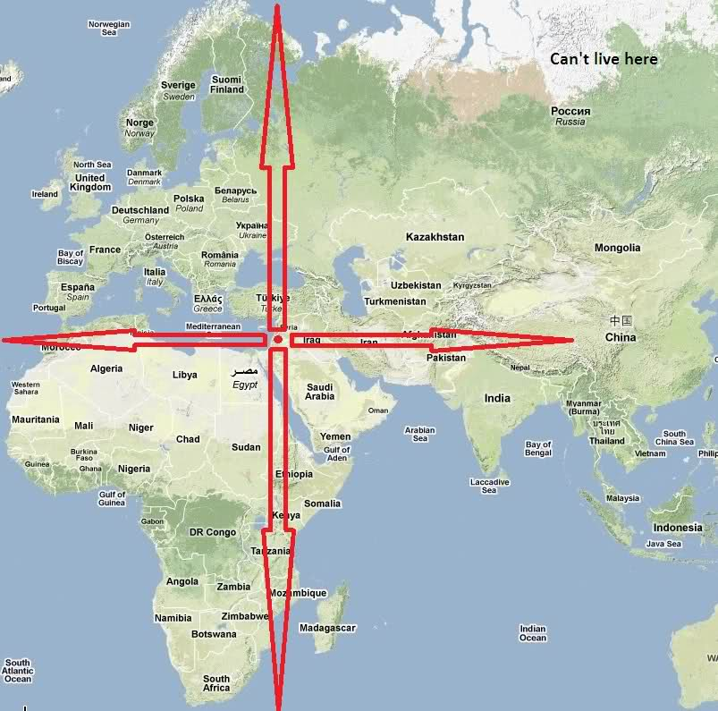
God Says Jerusalem
Is the Center of the World
And Bible Prophecy
“This is Jerusalem: I have set it in the midst of the nations and countries that are round about her.” Exeziel 5:5

Slide 4
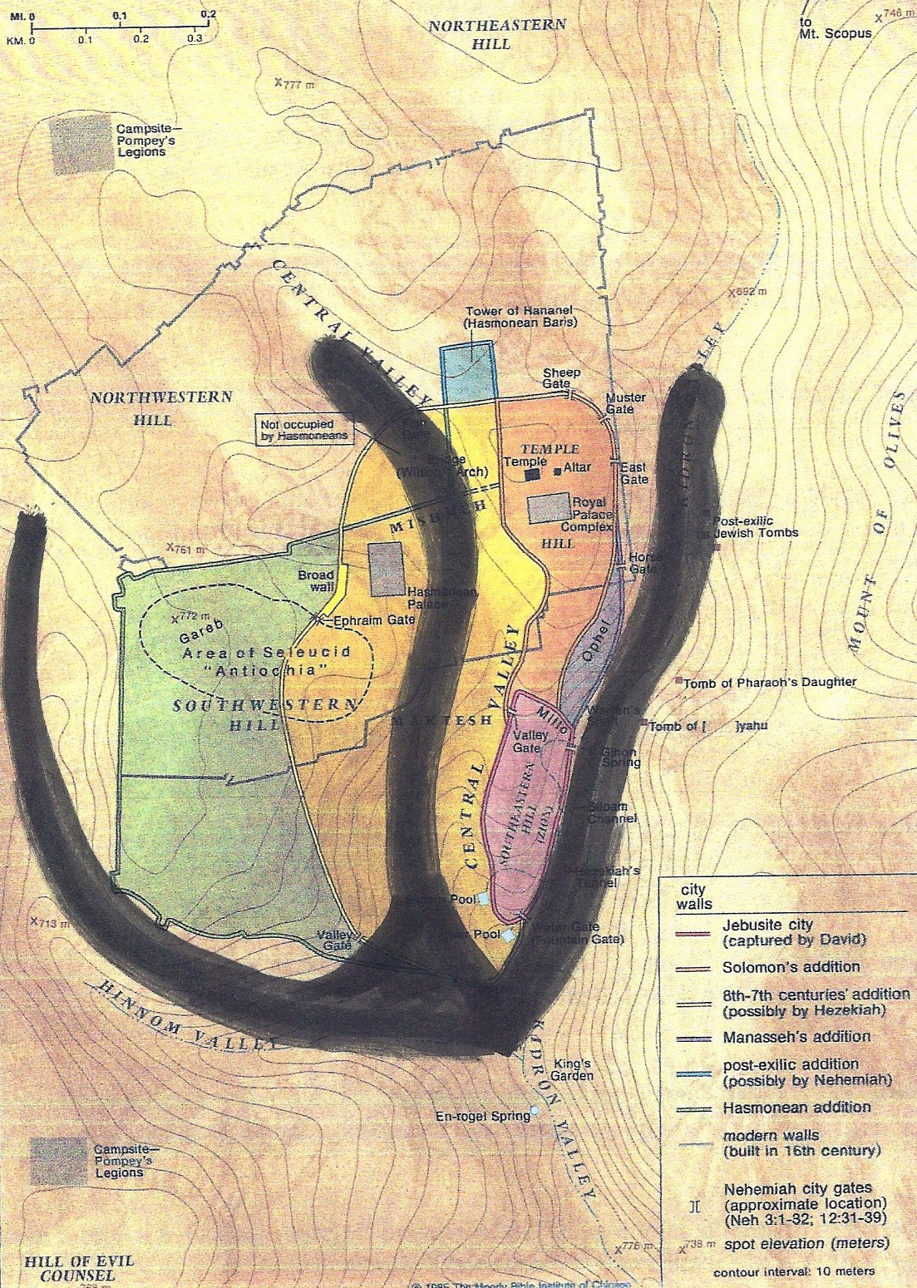
Prophetic
Patterns
God says He put His Name in Jerusalem
“ Jireh +Shalom ”

Slide 5
Why is Jerusalem the Most
Mentioned City in the Bible?
767 times
Why is Jerusalem so Important to God?
Why is Jerusalem the Focus of Bible Prophecy?

Slide 6
Jerusalem –God’s Prophetic Sign
City of David 2 Samuel 6:10; 1 Kings 11:27; 2 Chronicles 8:11
City of God Psalm 46:4; Psalm 87:3
City of Judah 2 Chronicles 25:28
City of Joy Jeremiah 49:25
City of Peace Hebrews 7:2
City of Praise Jeremiah 49:25
City of Righteousness Isaiah 1:26
City of the Great King Psalm 48:2; Matt 5:35
City of the Lord Isaiah 60:14
City of Truth Zechariah 8:3
Faithful City Isaiah 1:26
Gate of My People Obad 1:13; Micah 1:9
Green Olive Tree Jeremiah 11:16
Holy City Neh. 11:1, 18; Isa 48:2, 52:1; Matt. 4:5, 27:53; Rev. 11:2
Holy Mountain Isa. 11:9, 56:7, 57:13, 65:25, 66:20; Ezek 20:40; Dan 9:16,20; Joel 2:1, 3:17; Zeph 3:11; Zech 8:3
Throne of the Lord Jeremiah 3:17
Zion 1 Kings 8:1; Isaiah 60:14; Zech.9:13

Slide 7
Why Do All the Nations Rage Over Who Controls Jerusalem?
Because Jesus is Coming Back
To Rule and Reign in Jerusalem

Slide 8
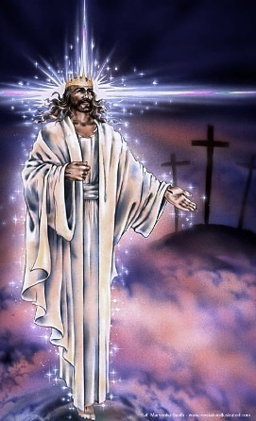
Psalm 2:1-5
“ Why do the heathen rage, And the people imagine a vain thing? The Kings of the earth set themselves And the rulers take counsel together,
Against the Lord And His Anointed, saying ‘Let us break their bands asunder, And cast away their cords from us”
He that sits in the Heavens shall laugh: The Lord shall have them in derision
Then shall He speak to them in His wrath, And vex them in His sore displeasure

Slide 9
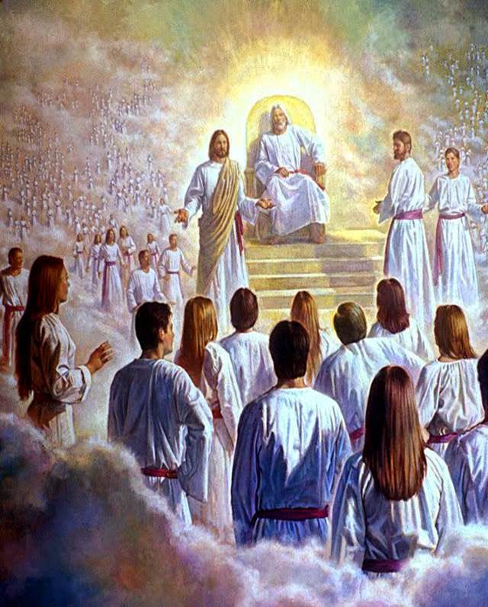
Psalm 2:6-8
“Yet have I set My King
upon My Holy hill of Zion
I will declare the decree:
the Lord has said to Me,
You are My Son;
This day have I begotten You.
Ask Me and I will give You
the heathen
for Your inheritance,
and the uttermost parts
of the earth
for Your possession”

Slide 10
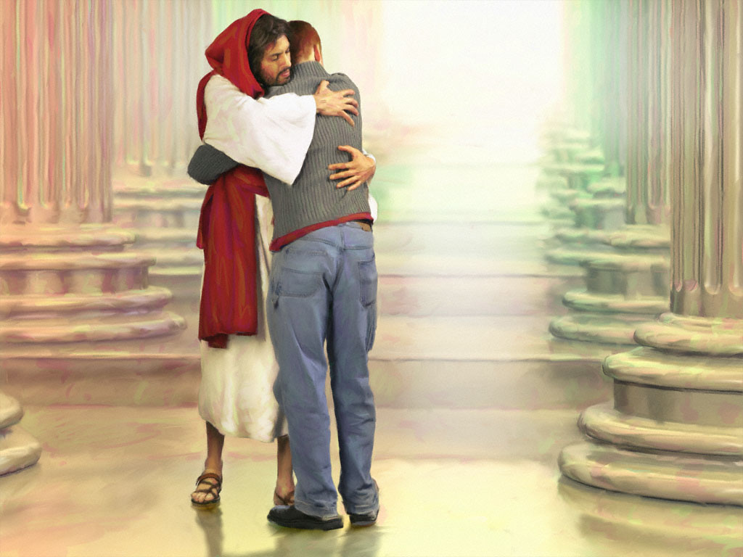
“Kiss the Son, lest He be angry And you perish from the way,
When His Wrath is kindled but a little.
Blessed are all they that put their trust in Him.” Psalm 2:9-12
“Kiss the Son, lest He be angry And you perish from the way,
When His Wrath is kindled but a little.
Blessed are all they that put their trust in Him.” Psalm 2:9-12

Slide 11
Where Did God’s Covenants take Place?
Abraham with Melchizedek
God with Abraham
God with Jacob
God with Jesus
Prophetic Patterns & Places

Slide 12
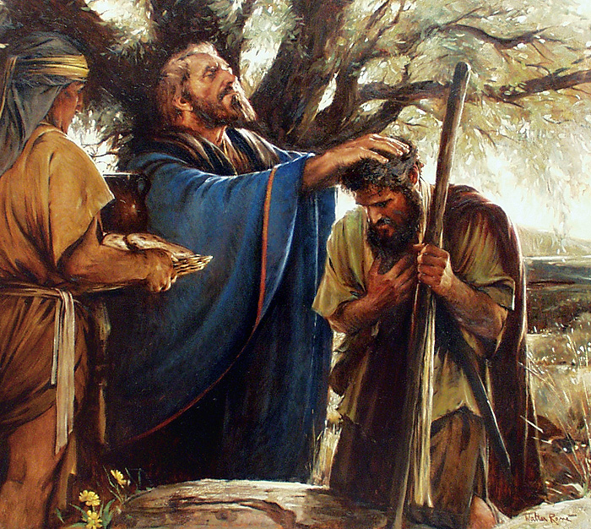
Genesis 14: 18-20
Abram meets Melchizedek in Jerusalem and pays him tithes after his victory!
“And Melchizedek, King of Salem, brought them bread and wine: for he was the priest of the Most High God . And he blessed Abraham.”

Slide 13
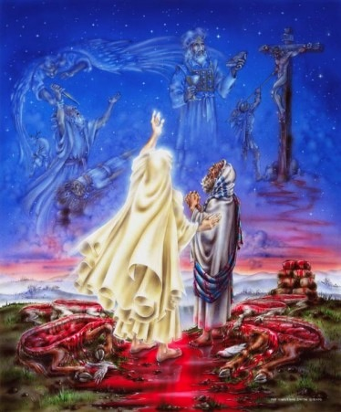
Genesis 15:9-18
“And God said to Abram, ‘Take Me a heifer 3 years old, a she-goat of 3 years old, a ram 3 years old & a turtledove and a young pigeon”
And he took all these, and divided them in the midst, and laid each piece against the other: but he did not divide the birds”
And when the fowls came down on the carcases, Abram drove them away. And when the sun was going down, a deep sleep fell upon Abram: and lo, a horror of great darkness fell on him.”( vs. 9-12)
“And it came to pass, that when the sun went down, and it was dark, behold a smoking furnace, and a burning lamp that passed between those pieces. “ Jesus (vs. 17)

Slide 14
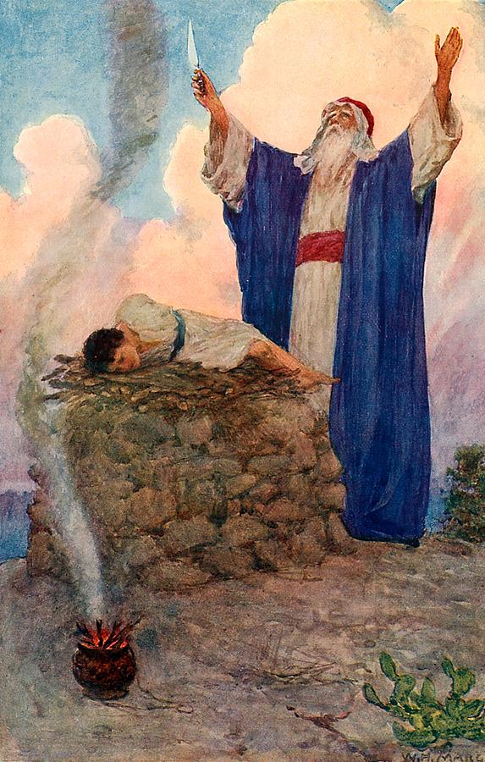
Abraham offered his son in the same place God offers His Son
Genesis 22
“And it came to pass after these things that God did tempt Abraham, and said to him Abraham: and he said, ‘Behold, here I am. And He said, Take now your son, your ONLY son Isaac, whom you love, and get to the land of Moriah: and offer him there for a burnt offering on one of the mountains which I will tell you of.”
Mt. Moriah is the Temple Mt.
In Jerusalem!

Slide 15
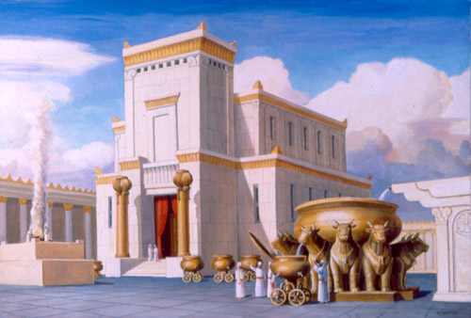
1st Holy Temple
King Solomon

Slide 16
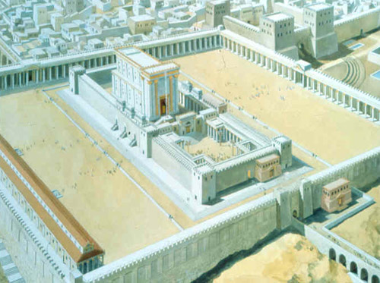

Slide 17
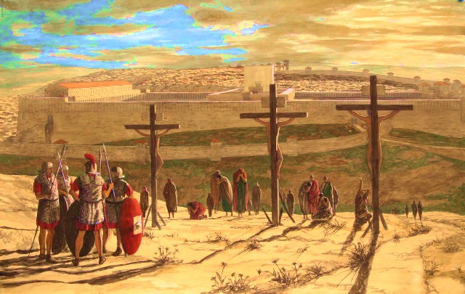

Slide 18
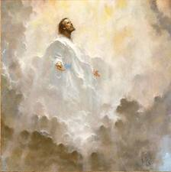
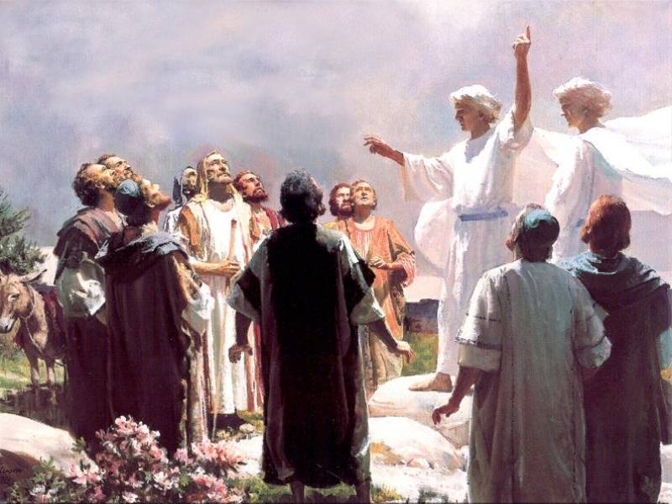
He Ascended from the Mt. of Olives
“And after He had spoken these things, while they beheld, He was taken up; and a cloud received Him out of their sight.
And while they looked steadfastly toward Heaven as He went up, behold 2 men stood by them in white apparel, which also said, You men of Galilee, why stand you gazing up to Heaven? Acts 1:9-12
This same Jesus, which is taken up from you to Heaven, shall so come in like manner as you have seen Him go into Heaven;
Then they returned to Jerusalem from the Mt. called Olivet, which is from Jerusalem a sabbath’s day journey.”

Slide 19
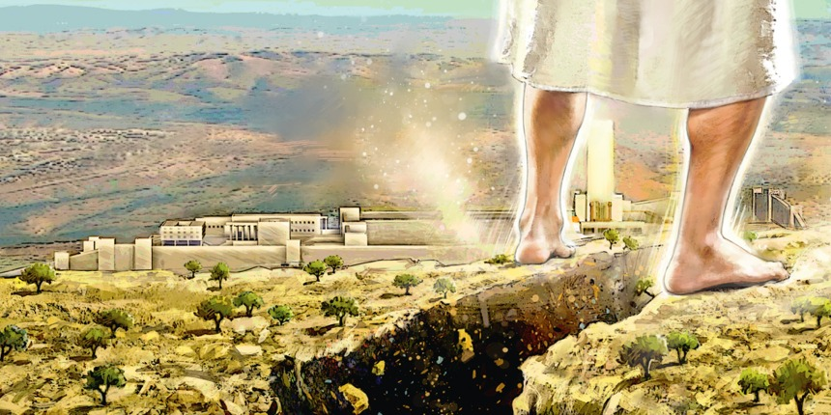
And He’s Coming Back to the Mount of Olives!
Zechariah 14: 3-4
“Then shall the Lord go forth and fight against those nations, as when He fought in the Day of battle. And His feet shall stand on the Mt. of Olives, which is before Jerusalem on the east, and the Mt. of Olives shall cleave in the midst thereof.”

Slide 20
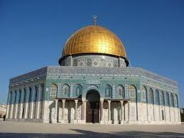
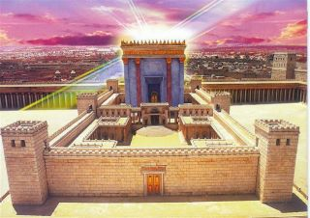
Satan will set up his anti-christ as God on the Holy Mt. in Jerusalem during the Tribulation
and demand to be worshipped
The Abomination of Desolation will be removed-
Jesus will Reign from the Future Temple and God’s Glory will cover the Nations!

Slide 21
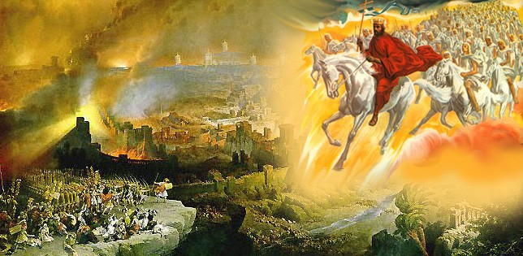
“Behold, I will make Jerusalem a cup of trembling to all the people round about, then they shall be in the siege both against Judah and against Jerusalem. And in that Day will I make Jerusalem a burdensome stone for all people; all that burden themselves with it shall be cut in pieces, though all the people of the earth be gathered against it. Zechariah 12:2-3

Slide 22
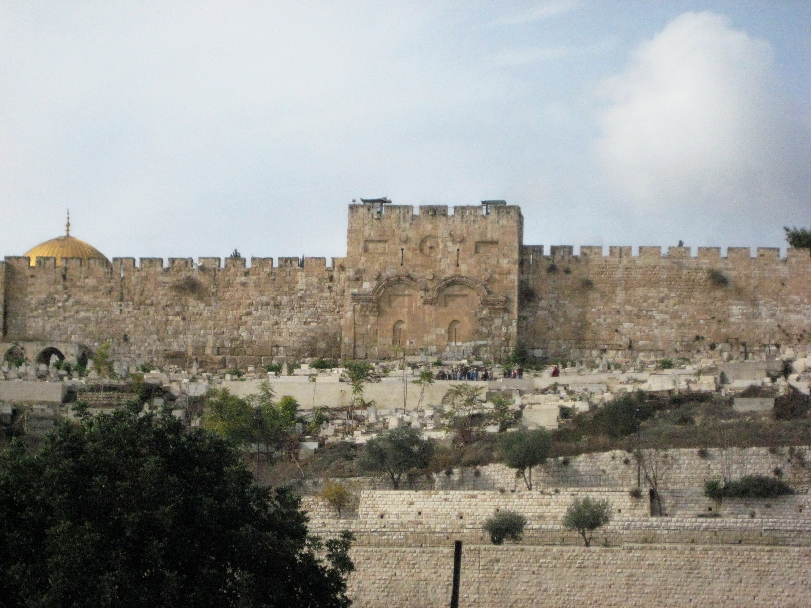
Jesus is Coming Back to Jerusalem
To Defeat God’s Enemies
And To Rescue His Brethren…The Jews
A Future Holy Temple Here Again

Slide 23
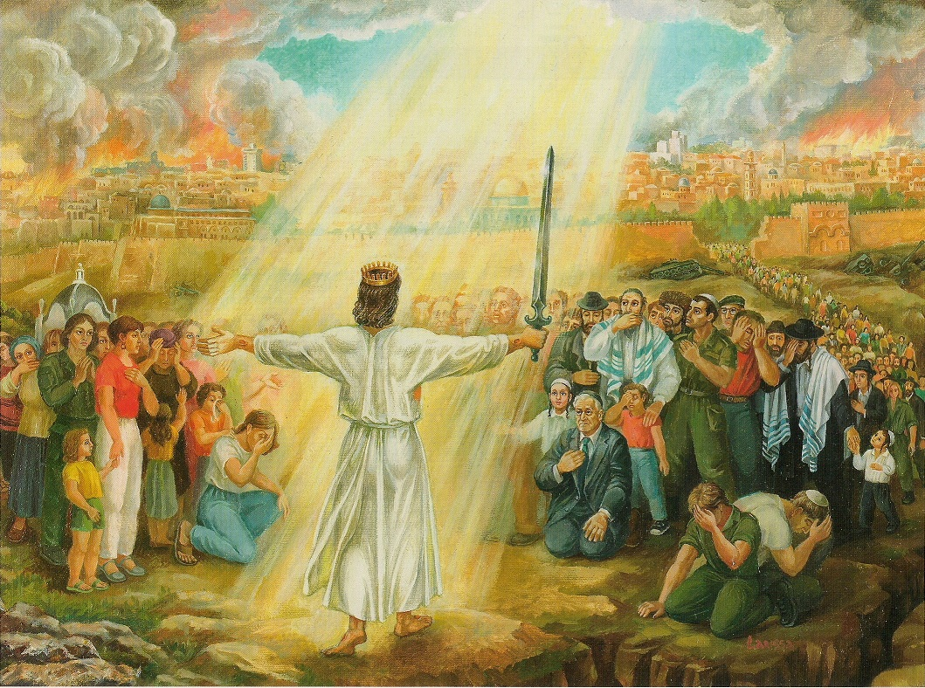
“And I will pour out on the House of David and upon the inhabitants of Jerusalem, the Spirit of Grace and of supplications and they shall look upon Me whom they have pierced, and they shall mourn for Him.” Zech.12:10

Slide 24
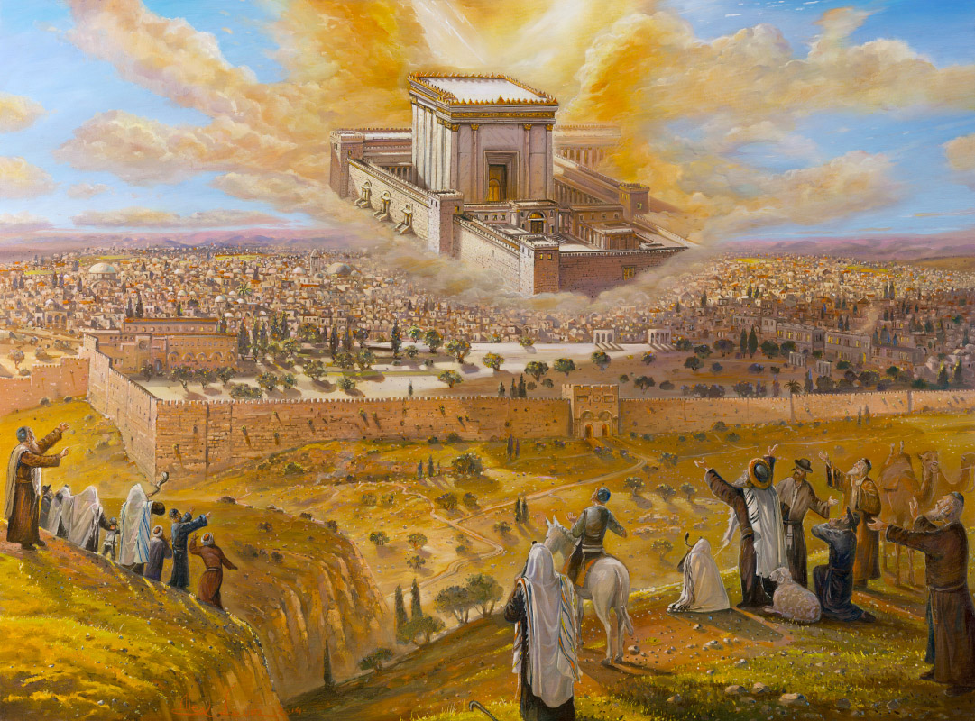

Slide 25
Huge Good News
for the Believer & The Church
The Tribulation is designed by God
to bring Israel to The Messiah
Salvation to the Jews!
Not for the Church – Salvation is TODAY
Unless you are Lukewarm
Laodecian
Living like the World
Spiritually Asleep
It’s High Time to Awaken from sleep!

Slide 26
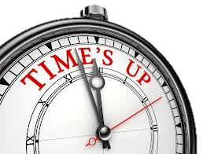
Prophetic Time
in
Joel Chapter 3
1. “For Behold, in those days, and at that time, when I shall bring again (the 2nd time) the captivity of Judah and Jerusalem.”
1st Captivity – Nebuchadnezzar King of Babylon in 606 BC
Re-gathered to Jerusalem 70 years later – 536 BC
2nd Captivity – Romans in 70 AD
Judah) Jews re-gathered in 1948!
1st 1 Destruction of Jerusalem 586 BC
Rebuilt 516 BC _ Ezra & Nehemiah
2nd Destruction of Jerusalem – 70 AD
Back in Hands of Jews 2nd time – 1967
Joel’s Prophecy can’t be fulfilled until after 1948 and 1967

Slide 27
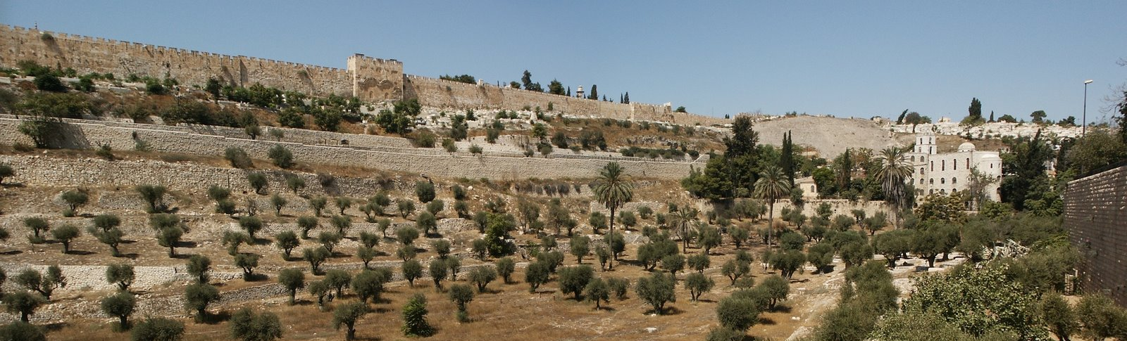
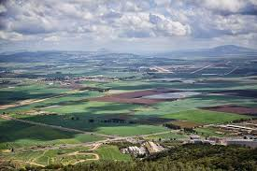
2. “I will gather all nations, and will bring them down to the Valley of Jehoshaphat, The Kidron Valley - Battle of Armageddon
“ and will plead with them there for
My people & for My heritage Israel”
The End Time Battle is
over the Jews and Jerusalem!

Slide 28
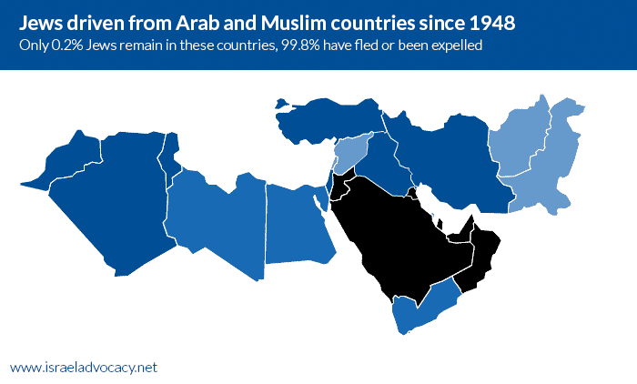
“Whom they have scattered among the nations,
And have divided My Land”
99% Jews Forced to Leave

Slide 29
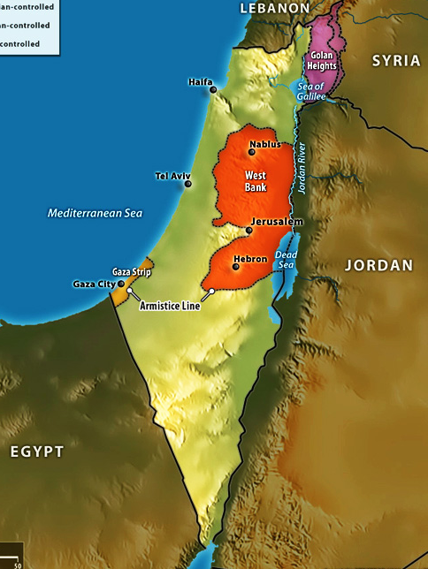
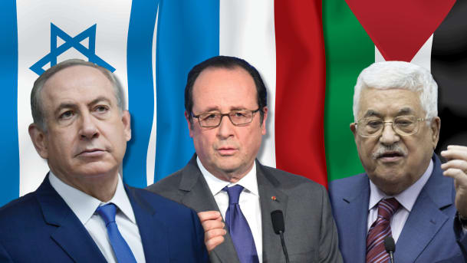
“Parting My land
is the ongoing
‘Middle East
Peace Process’

Slide 30
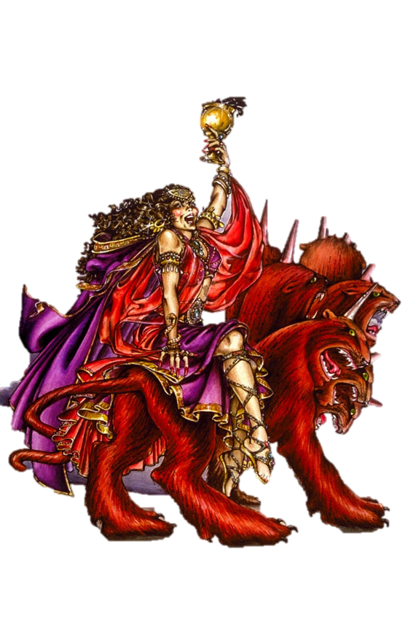
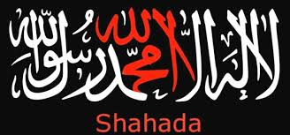
3.“And they have cast lots for My People (Israel); and they have given a boy for a harlot and sold a girl for wine, that they might drink.”
The Harlot drinking wine
is Mystery Babylon Revelation 17 -18
End Time Beast
is Islam

Slide 31
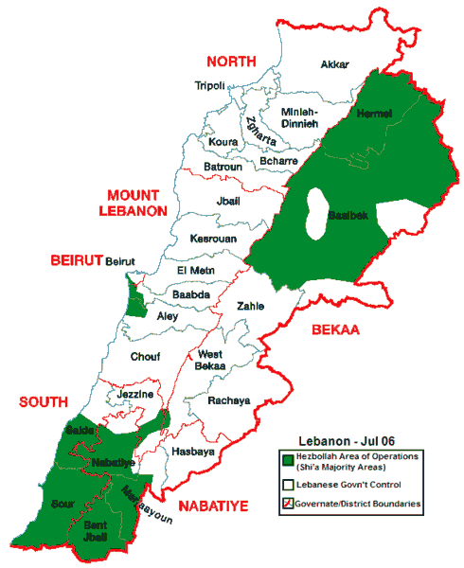
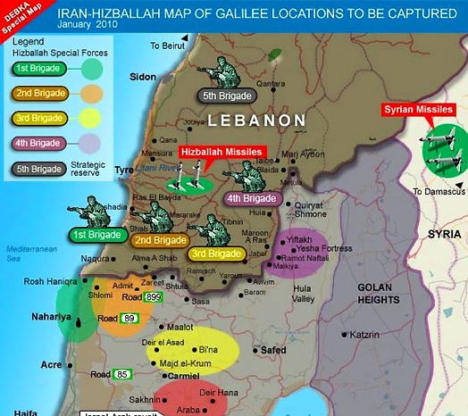
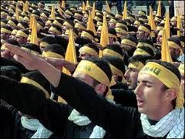
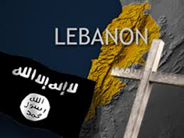
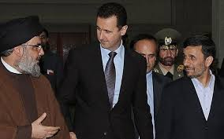
-
“Yes and what have you to do with Me,
O Tyre and Zidon?” Joel 3:4
This is Lebanon - Home of Hezbollah - Shiite Terrorists & now ISIS

Slide 32
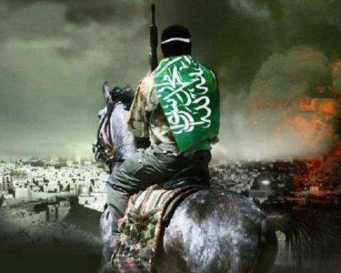
Joel 3:11 “Assemble yourselves and come all ye heathen, and gather you together round about. Cause your mighty ones to come down here, O Lord”.
“And He gathered them together into a place called in the Hebrew tongue Armageddon”
Revelation 16:16

Slide 33
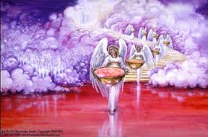
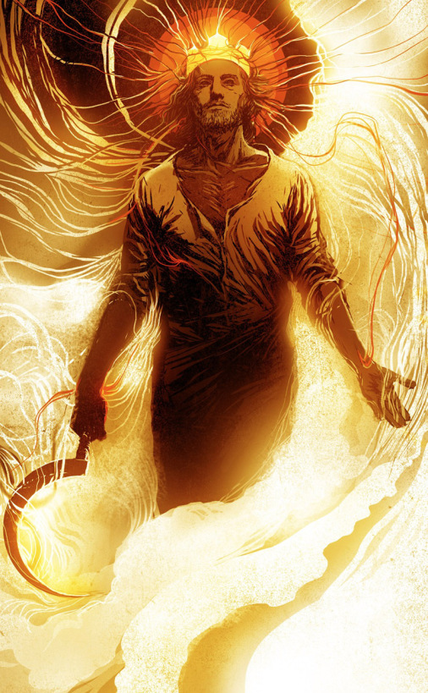
“”Let the heathen be awakened, and come up to the Valley of Jehoshaphat; For there I will sit to Judge all the heathen round about.”
Joel 3:12-13 Rev 14:15
“Put in the sickle
for the harvest is ripe.
Come, get you down:
for the press is full,
the vats overflow;
For their wickedness is great.”

Slide 34
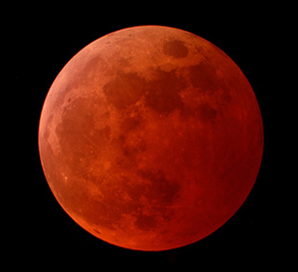
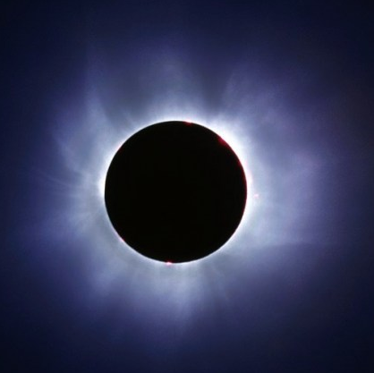
“Multitudes, multitudes, in the valley of decision. For the day of the Lord is near…
The sun and the moon shall be darkened
and the stars shall withdraw their shining.”
“The Day of the Lord”
Joel 3:14-15
God is describing Solar
and Lunar Eclipses:
Joel 2:30;2:10
Isaiah 13:9-10; 24:21-23; 60:19
Ezek 32:7
Matt 24:29
Mark 13:24
Luke 21:25-28
Acts 2:19,20
Rev 6:12,13

Slide 35
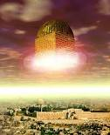
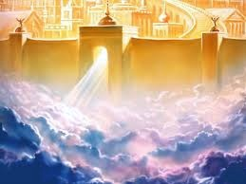
New Jerusalem comes down From Heaven to Earth- Rev. 21
The Plan of God comes full circle!
We are restored back to the Garden of Eden!

Slide 36
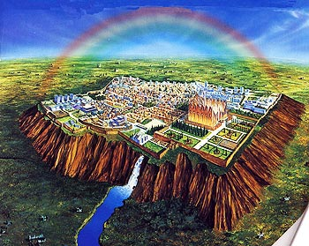
“And he showed me a pure river of water of Life, clear as crystal, preceding out of the throne of God and the Lamb. In the midst of the street and on either side of the river, there was the tree of Life….Rev. 22:1-2 The same Tree of Life in the Garden of Eden!
Zech. 14:9-11
Welcome to Your Forever Home – New Jerusalem – Heaven Comes to Earth!

Slide 37
A Prophetic People = The Harvest
The Book of Revelation – 4 People Groups
The Church - Rapture Pre-Trib - Blessing
The Jews - Tribulation
The Tribulation Saints - Tribulation
The Wicked - Judgment & Lake of Fire

Slide 38
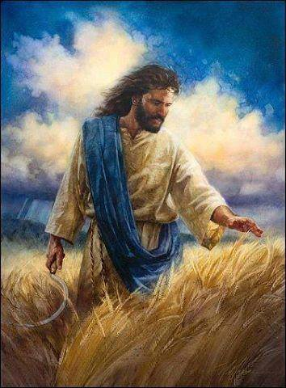
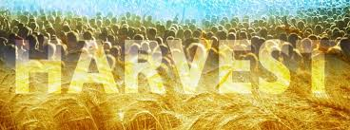
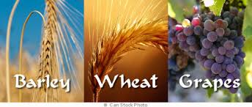
Is there is a Prophetic Pattern
of End Time Harvest
In Israel’s 3 Main Harvests ?
Barley - Pre-Tribulation Rapture
Wheat - Mid-Tribulation Rapture
Grapes - End-Tribulation Rapture

Slide 39
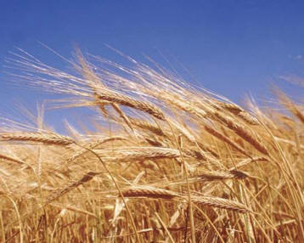
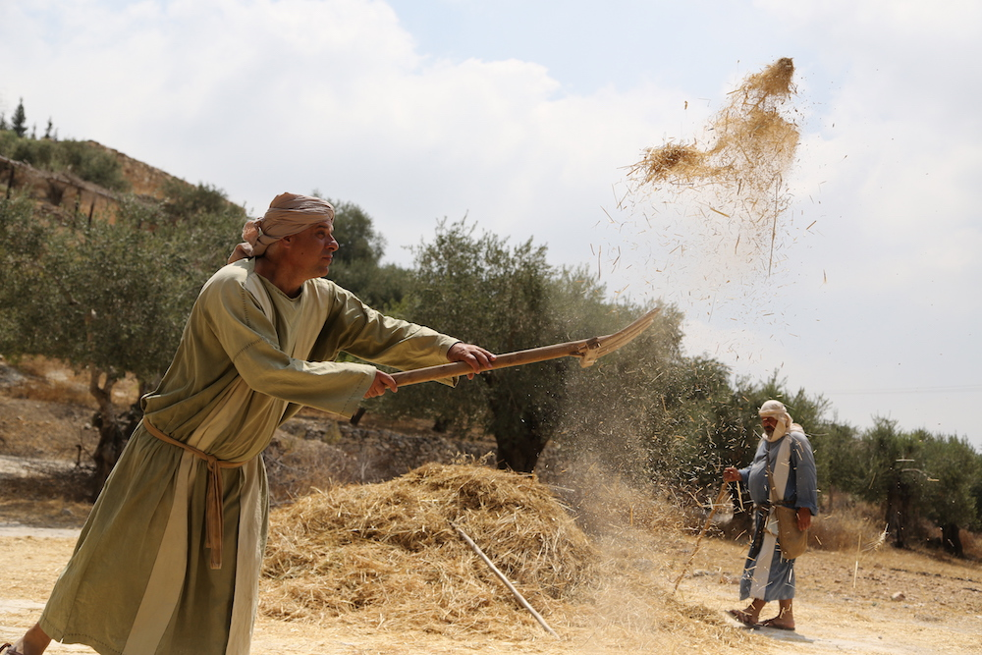
The Barley Harvest is First!
As is a Soft Grain, first cut with a Scythe then winnowed with a Fork. When it is thrown up in the air, the wind separates the grain from the chaff! Sounds like a Rapture of Believers

Slide 40
Israel’s Middle Wheat Harvest
Threshing with a Tribulum

Slide 41
The steps for harvesting wheat are different than barley. Because it has a hard outer stalk that must be crushed to release the grain, it is laid on a threshing floor where a special sled with blades underneath is pulled over the wheat.
Then the grain is winnowed with a fork and the chaff is separated from the wheat. The grain is gathered into the barn and the chaff is burned in the fire. What a picture of the hard-hearted people who will go into the Tribulation!

Slide 43
The grape Harvest is at the final harvest
Usually around Yom Kippur
The grapes are trampled in a wine vat until the blood runs out!

Slide 44
Rev. 14:19 “And the angel thrust in his sickle into the earth, and gathered the vine of the earth, and cast it into the great winepress of the wrath of God.
20. And the winepress was trodden without the City, and blood came out of the winepress even to the horses bridles….”

Slide 46
When is Jesus Coming Again
“When the Lord shall build up Zion,
He shall appear in His Glory”
When is Jesus Coming Again?
“Zion” is Jerusalem

Slide 47
Modern Day Miracles in Jerusalem!
The Return of the JewsTo Israel from over 140 Nations!
“I will gather my outcasts from the 4 corners of the Earth” Isaiah 11:12

Slide 48
“And I will bring again the captivity of My people Israel, & they shall build the waste cities & inhabit them; & they shall plant vineyards & drink the wine; they shall also make gardens & eat the fruit of them.” Amos 9:14-15
“I will plant them upon their land and they shall no more be pulled up out of their land I have given them.”

Slide 49
Levite’s Garments Recreated!
Red Heifer for
Temple Purification
Holy Temple Vessels
“The Restitution of All Things”
Acts 3:21
High Priest’s Crown, Robes, & Ephod
Sanhedrin Re-established
Hebrew Language

Slide 50
Israel is getting ready for the Messiah
Let’s Get Ready!

