Slide 1
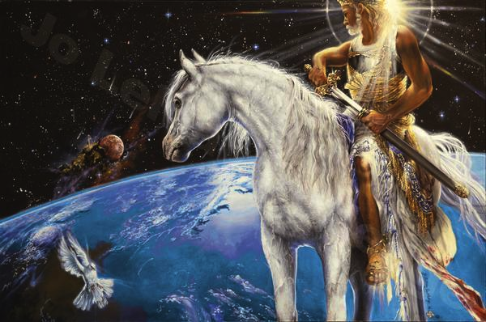
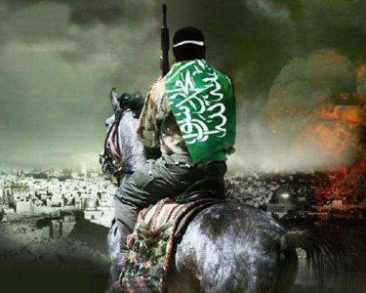
Treasures In Isaiah
“Kalah Charas”
“Prophecies of Christ & Anti-Christ”

Slide 2
Treasures from Isaiah – The Most beloved prophecies about Jesus Christ coming as Messiah are closely followed by verses about the coming Anti-Christ as “the Assyrian”

Slide 3
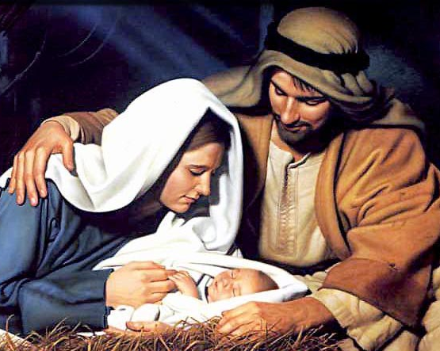
Micah 5:2 “But you, Bethlehem Ephratah, though you are small among the thousands of Judah, yet out of you shall He come that shall be ruler in Israel; whose goings forth have been from of old, from everlasting.”

Slide 4
Micah 5:3 “therefore He (Messiah) shall give them up ( the chosen People) until the time that she which travails (Israel) has brought forth; then the remnant of His brethren (The modern day re-gathering of the Jews) shall return to the children of Israel.
5. And He (Messiah) shall be our peace, when the Assyrian shall come into our Land; and when he shall tread in our palaces…”
The Assyrian Anti-christ
6. They shall lay waste the land of Assyria with the sword & the land of Nimrod in the entrances thereof; then shall He deliver us from the Assyrian when he comes into our land & treads within our borders.

Slide 5
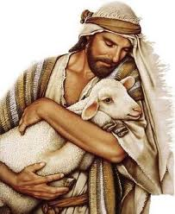
2. “The people that walked in darkness
have seen a great Light: they that dwell
in the land of the shadow fd death,
upon them has the Light shone.
6.”For unto us a Child is born,
unto us a Son is given:
and the government shall
be upon His shoulder:
and His name shall be called
Wonderful, Counselor, the Mighty God,
the everlasting Father, the Prince of Peace.
7. “Of the increase of His government
and peace there shall be no end,
upon the throne of David & upon His Kingdom,
to order it & to establish it with judgment
& with justice from henceforth even forever.
The seal of the Lord of Hosts
shall perform this”
Isaiah 9: 2,6,7
Beautiful Verses
of Coming Messiah

Slide 6
Very Next Chapter in Isaiah describes the Anti-Christ
Isaiah 10:5-6 “O Assyrian, the rod of My anger & the staff in their hand
is My indignation. I will send him against a hypocritical nation and against the people of My wrath will I give him a charge, to take a spoil,
and to take a prey and to tread them down like the mire of the streets.”

Slide 7
The Hebrew words for “the Destruction Decreed”
Is an important marker in Bible Prophecy
Every place it is used is about the End Times & The Anti-Christ!
“Kalah Charas”
Isaiah 10:22 “The Assyrian coming to destroy Israel
Isaiah 10:23 “The Assyrian”
Isaiah 28:22 Israel’s Covenant with Death
Daniel 9:26 Daniels 70 Weeks Prophecy
Daniel 9:27 Daniel’s 70 Weeks Prophecy / The Anti-Christ
Daniel 11:36 The King that exalts Himself – The Anti Christ

Slide 8
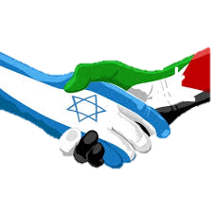
Right after Israel makes
a Covenant with Death and Hell
“The Middle East Peace Treaty”
Isaiah 28:15-20
Isaiah 28:21-22 “For the Lord shall rise up as in Mt. Perazim,
He shall be wroth as in the Valley of Gibeon,
that He may do His work, His strange work.
Now therefore, be not mockers, lest your bands be made strong; for I have heard from the Lord God of Hosts a consumption,
ever determined (kalah Charas) upon the whole earth.”

Slide 9
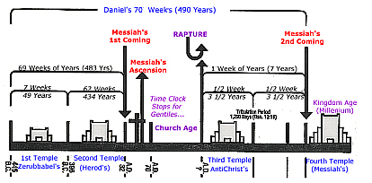
Daniel 9:26 “After 62 weeks, shall Messiah be cut off, but not for Himself; and the people of the prince that shall come, shall destroy the City and the sanctuary: and the end thereof shall be with a flood, and to the end of the war desolations are determined. (Kalah Charas)
Daniel 9:27 “And He shall confirm the covenant with many for one week:
& in the midst of the week he shall cause the sacrifice and the oblation to cease, & for the overspreading of abominations he shall make it desolate, & that determined (kalah Charas) shall be poured out upon the desolate.

Slide 10
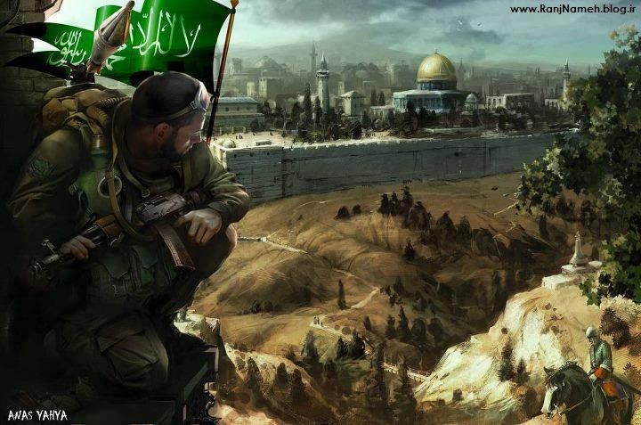
“And the king (anti-Christ) shall do according to his will; & he shall exalt himself above every god and shall speak marvelous things against the God of gods
and he shall prosper until the indignation be accomplished,
for that which is determined shall be done Kalah Charas” Daniel 11:36

Slide 11
Certain Hebrew Idioms act as Markers
for End Time Bible Prophecy Events!
“The Abomination of Desolation”
Daniel 9:23,25, 27; Daniel 12:11; Matthew 24:15;
“His Goings Forth”
Hosea 6:3; Micah 5:2; Isaiah 13:10; Psalms 19;6
“The Destruction Decreed” “Kalah Charas”
“In that Day” “The Day of the Lord”
“Birth pangs, Woman in Childbirth, Travailing”
“Former and Latter Rain”
Deut. 11:14; Joel 2:23; Hosea 6:3, Jer. 5:24; James 5:7
“Destroy with the Breath of His Mouth”
Isaiah 11:1-4; Isaiah 30:31-33; 2 Thess. 2:8; Revelation 1:16
Notes:
He is ready and waiting, watching.

Slide 12
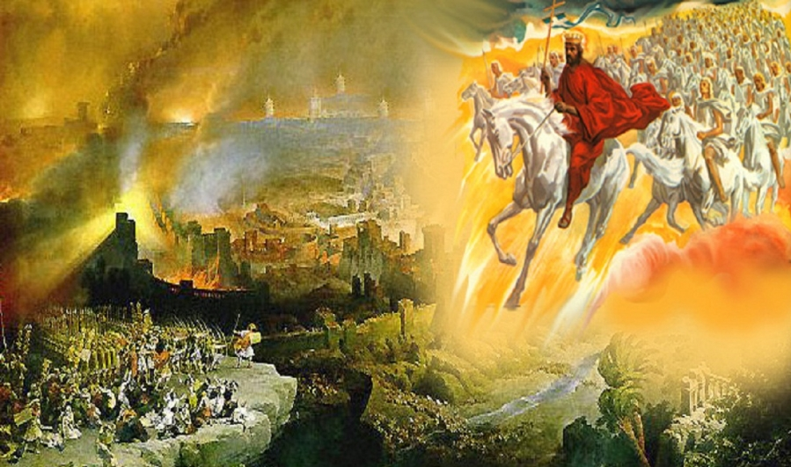
A shoot will come up from the stump of Jesse; from his roots a Branch will bear fruit. The Spirit of the Lord will rest on Him – the Spirit of wisdom & understanding , the Spirit of counsel & of power, the Spirit of knowledge and of the fear of the Lord- and He will delight in the fear of the Lord> He will not judge by what He sees with His eyes, or decide by what He hears with His ears, but with righteousness shall He judge the poor and reprove with equity for the meek of the earth: and He shall smite the earth with the rod of His mouth, and with the breath of His lips shall He slay the wicked” Isaiah 11:4

Slide 13
What will happen to the Assyrian
Anti-Christ in the End?
Now Watch for the Hebrew idioms
as Bible Prophecy markers
of the Anti-Christ

Slide 14
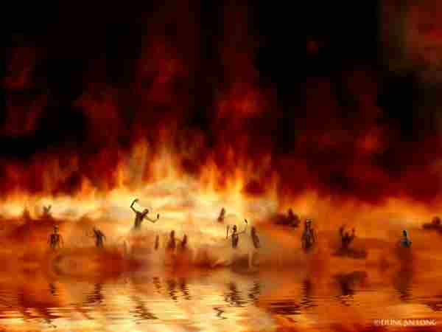
“For through the voice of the Lord shall the Assyrian be beaten down, which smote with a rod. And every place where the grounded staff shall pass, which the Lord shall lay upon him, it shall be with tabrets and harps: and in battles of shaking will he fight with it. For Tophet is ordained of old, yes, for the king it is prepared; He has made it deep and large: the pile thereof is fire and much wood: the breath of the Lord, like a stream of brimstone, does kindle it.” Isaiah 31-33
“And the devil that deceived them was cast into the Lake of fire and brimstone, where the beast and the false prophet are,
and shall be tormented day and night for ever and ever” Revelation 20:10

Slide 15
“And then the lawless one will be revealed, whom the Lord Jesus will overthrow with the breath of His mouth and destroy by the splendor of His Coming. Even him, whose coming is after the working of satan with all power and signs and lying wonders 2 Thessalonians 2:8-9

Slide 16
The Assyrian & The End Times
Isaiah 14:24-27
“The Lord of hosts has sworn, saying Surely as I have thought,
so shall it come to pass; and as I have purposed, so shall it stand.
That I will break the Assyrian in My land
and up on My mountains tread him under foot:
then shall his yoke depart from off them,
and his burden depart from off their shoulders.
This is the purpose that is purposed upon the whole earth:
and this is the hand that is stretched out upon all nations.
For the Lord of hosts has purposed, and who shall disannul it?
And His hand is stretch out and who shall turn it back?

Slide 17
“And I saw heaven opened & behold a white horse & He that sat upon him was called Faithful and True and in Righteousness He does judge & make war. His eyes were as a flame of fire & on His head were many crowns; and He had a name written, that no man knew but He himself.
And He was clothed with a vesture dipped in blood: & His name is called The Word of God. The armies which were in heaven followed Him
on white horses, clothed in fine linen,
white & clean.
Out of His mouth goes a sharp sword, that with it He shall smite the nations: He shall rule them with the rod of iron: and He treads the wine press
of the fierceness and wrath
of Almighty God.”
“And He has on his vesture and on His thigh a name written, King of Kings
And Lord of Lords.” Rev. 19:11-16

