Slide 1
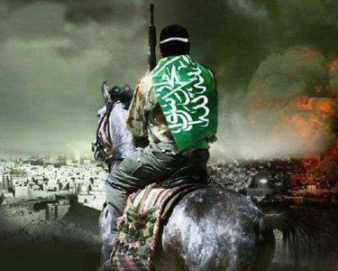
Gog’s Endtime War Against Israel
Ezekiel 38-39

Slide 2
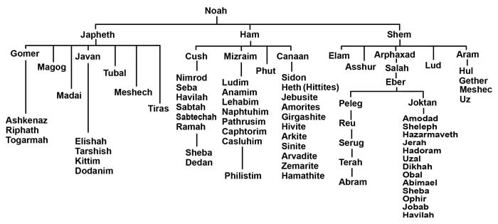
38:1-2 “And the voice of the Lord came to me, saying, Son of man,
set your face against Gog, the land of Magog, the chief prince
of Meshech & Tubal, and prophesy against him. And say,
‘I am against you, O Gog, chief prince of Meshech & Tubal.’
Who is Gog? Where is Magog?
Genesis 10 “The Table of Nations”

Slide 3
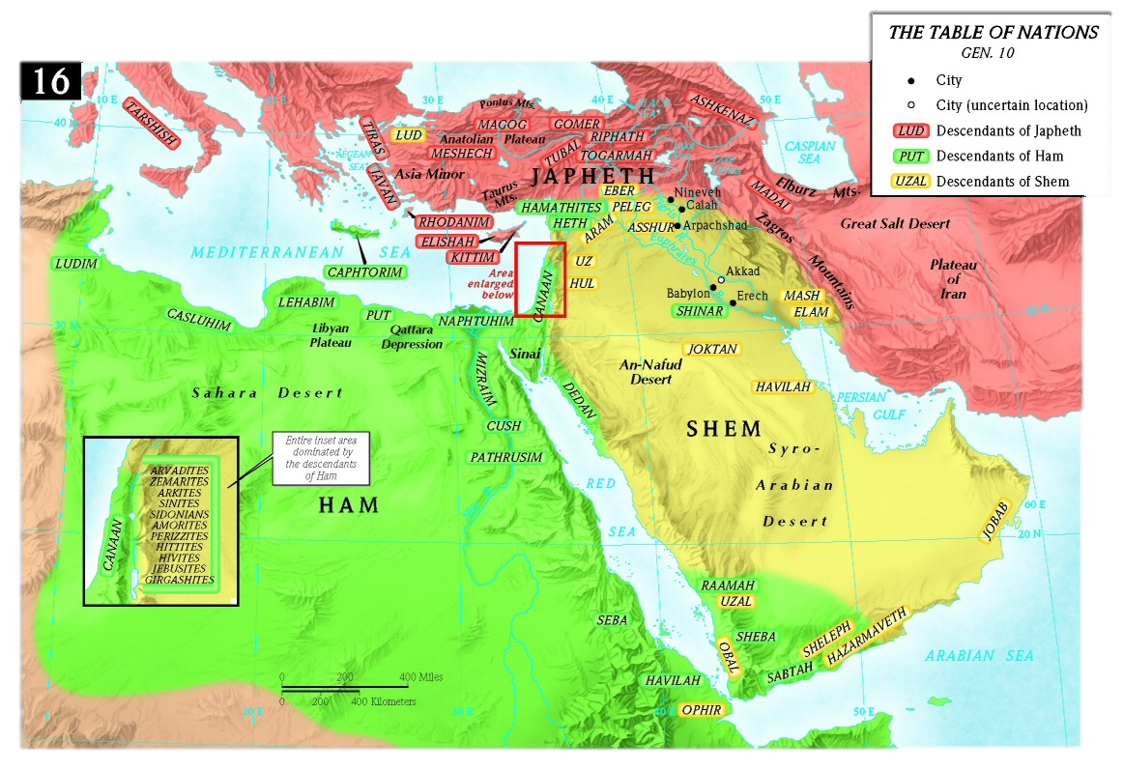
Bible Maps - “Where is MaGog, Land of Gog?” - Turkey

Slide 4
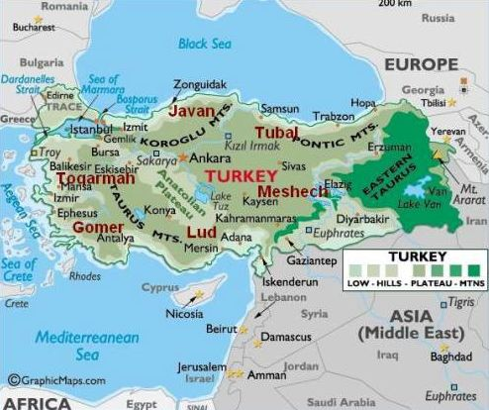
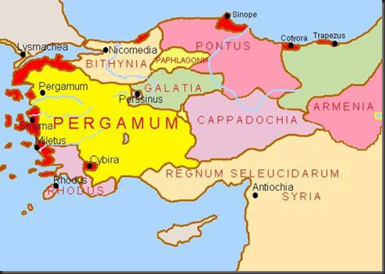
GOG is a Hebrew name…Gimel Vav Gimel
meaning “The most proud of the proud”
translated “mountain”
is a strong prince over Turkey, not Russia
GOG in Sumerian language means “darkness” Turkey (Pergamum) is where satan’s throne is located!
Rev. 2:13 (Letter to Pergamum) “I know your works & where you dwell, even where satan’s throne is: & you hold fast My name, even in those days wherein Antipas was My faithful martyr, who was slain among you, where satan dwells.”

Slide 5
Rosh = Head, Chief, Top, in Hebrew
a Noun or an Adjective
NO WHERE ELSE in the Bible is it
used as a place = Russia
Chief Prince = Chief Principality Ephesians 6:12
Gog & Magog War happens before Millenium
Satan is bound the 1000 years in the Pit Rev. 20:3
At end of 1000 years, Satan is loosed Rev. 20:7
Gog & Magog gather nations to battle Rev.20:8

Slide 6
The Chief Principality, Highest Power
Ruler of Darkness of this World
Spiritual Wickedness in High Places
GOG is a demonic spirit
that inhabits men

Slide 7
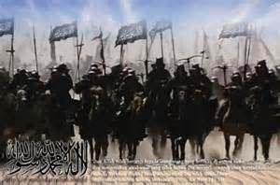
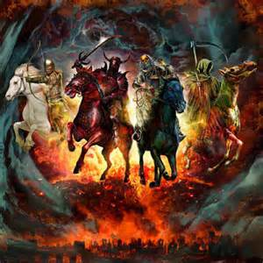
4. ‘And I will turn you back & put hooks in your jaws & I will bring you forth & all your army, horses & horsemen - all of them clothed with all sorts of armor, even a great company with bucklers & shields, all of them holding swords.’

Slide 8
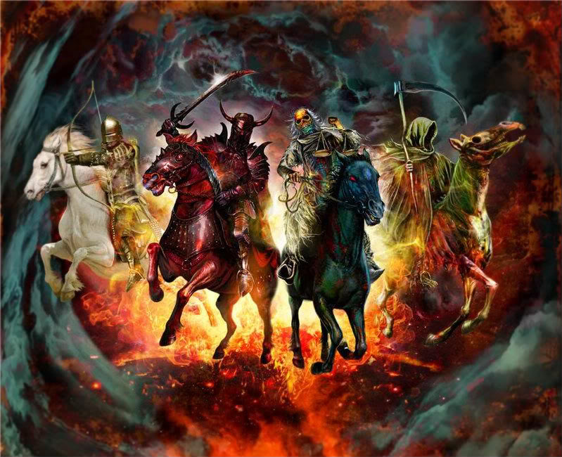
Sounds just like……The 4 Horsemen of the Apocalypse

Slide 9
This is exactly what God says about Leviathan, the dragon from the sea.– Is Leviathan another name for GOG? …. The Anti-Christ?
Job 3:8 Let them curse it that curse the day,
who are ready to raise up their mourning (leviathan)
Job 41:1 Can you draw out leviathan with an hook?
or his tongue with a cord which you let down?
Ps 74:14 You brake the heads of leviathan in pieces
and gave him to be meat to the people inhabiting
the wilderness.
,
Ps 104:26 There go the ships: there is that leviathan,
whom you have made to play therein.
Isaiah 27:1 In that day the LORD with his sore & great & strong sword shall punish leviathan, the piercing serpent, even leviathan that crooked serpent and He shall slay the dragon that is in the sea,

Slide 10
A Hook in the Jaw of Gog…
A Hook in the Jaw of Leviathan….
Leviathan is the Beast from the Sea
The Anti-Christ is the Beast
from the Sea
Anti-Christ = Gog = Leviathan

Slide 11
Rev. 13:1 “As I stood on the sand of the sea & saw a beast rise up out of the sea have 7 heads & 10 horns & upon his horns 10 crowns, & on his heads the name of blasphemy. The beast I saw was like a leopard & his feet were as the feet of a bear & his mouth like the mouth of a lion, & the dragon gave him his power & his throne & great authority.”

Slide 12
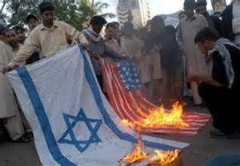
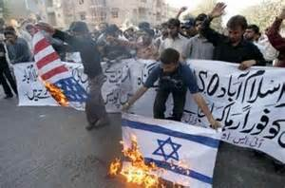
Who make up Gog’s Army?
Why do they hate Israel?

Slide 13
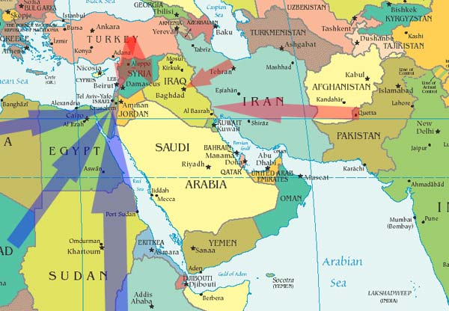
5. Persia, Ethiopia (Kush), & Libya with them: all of them with shield & buckler;
6. Gomer & all of his bands; the house of Togarmah of the north quarters,
& many people with you.

Slide 14
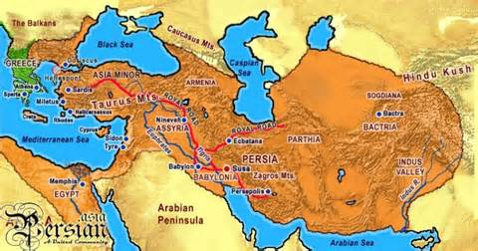
Persian Empire Modern Day Countries: Iran, Iraq, Turkey, Syria, Albania, Bulgaria, Greece, Macedonia, Armenia, Israel, Lebanon, Jordan, Afghanistan, Pakistan, Turkmenistan, Uzbekistan, Daghestan, Kakzkishan, Kyrygystan, Baluchistan, Abkhazia, Chechnya, Azerbaijan, Bahrain, Oman, United Arab Emirates, Kuwait, Egypt, Libya, Yemen …..All Islamic Today!
Notes:
Modern Day countries in the Ancient Persian Empire

Slide 15
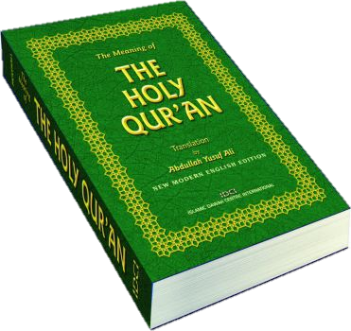
All of Gog’s many nations listed are modern day muslim countries
who are guided by the Qur’an

Slide 16
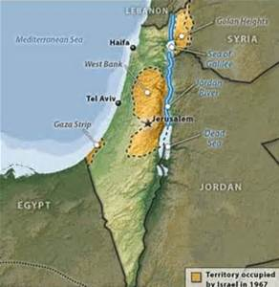
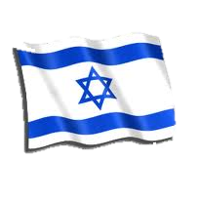
7. Be prepared & prepare for yourself you & all your company that are assembled to you & be a guard to them.
The Miracle
of Israel
8. After many days you shall be visited: in the latter years you shall come into this land that is brought back from the sword & is gathered out of many people, against the mountains of Israel, which have always been waste, but it is brought forth out of the nations.

Slide 17
9. You shall ascend & come like a storm, you shall be like a cloud to cover the land, you & all your bands & many people with you.
10. Thus says the Lord God, It shall come to pass, that at the same time things shall come to your mind & you shall think an evil thought.
11. And you shall say,
I will go up to the land
of unwalled villages:
I will go to them
that are at rest,
that dwell safely,
all of them dwelling
without walls & having
neither bars nor gates.

Slide 18
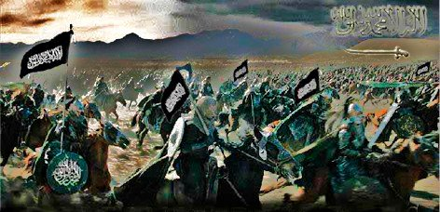
12. To take a spoil & to take a prey; to turn your hand upon the desolate places that are now inhabited & upon the people that are gathered out of the nations, which have gotten cattle & goods,
that dwell in the midst of the land.

Slide 19
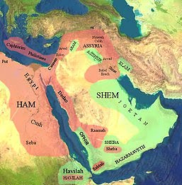
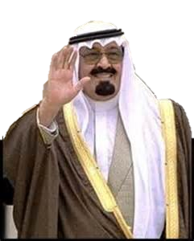
13. Sheba & Dedan & the merchants of Tarshish,
with all the young lions thereof - shall say to you,
“Are you come to take a spoil?
Have you gathered your company to take a prey?
…..To carry away silver & gold?
To take away cattle & goods?
…… to take a great spoil?

Slide 20
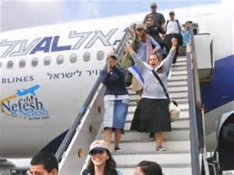
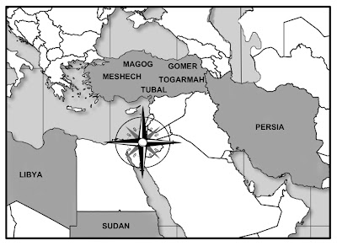
14. Therefore son of man,
prophesy & say to Gog,
Thus says the Lord God;
In that day, when My people
of Israel dwell safely –
shall you not know it?
15. And you shall come up from your place out of the north parts, you & many people with you, all of them riding upon horses,
a great company & a mighty army

Slide 21
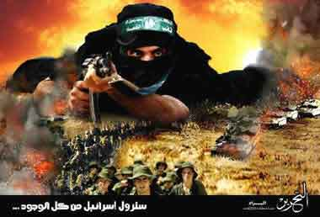
16. And you shall come up against My people of Israel
as a cloud to cover the Land; it shall be in the latter days:
& I will bring you against My Land, that the heathen may know ME,
when I am sanctified in you, O Gog, before their eyes

Slide 22
17. Are you he of whom I have spoken
in old time by My servants the prophets of Israel, which prophesied
in those days many years that I would bring you against them?
Is Gog
the Anti-christ?
There are over 150 verses about the Anti-christ written by almost all the
Old Testament prophets: Here are some of his nicknames: Adversary
Idol Shepherd Wicked One
The Assyrian Man of the Earth
Bloody & deceitful Man Prince of Tyre
Crooked Serpent Proud Man
Little Horn Rod of God’s Anger
Head of North Countries, Vile Person
King of Princes Son of Perdition
Merchant Mighty Man Man of Sin
Prince that shall come Lawless One
Head over many countries Destroyer
King of Babylon Prince of Darkness

Slide 23
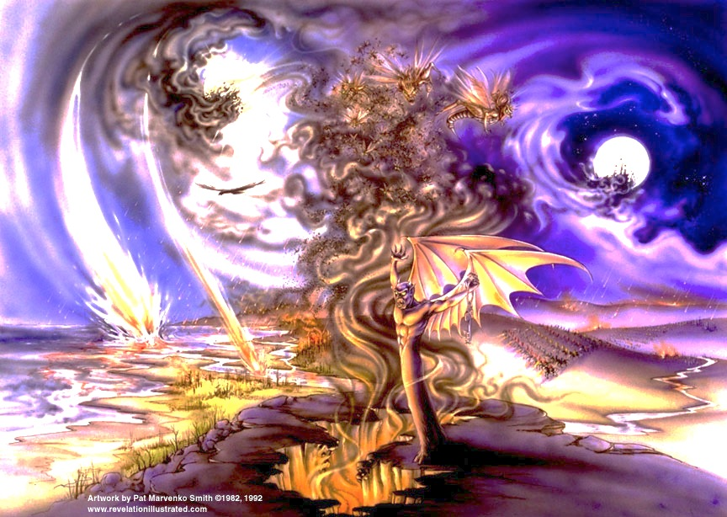
Revelation 9:3 “And out of the smoke came forth locusts on the earth & authority was given to them, as scorpions of the earth have authority.”
Rev 9:11 “And they had a king over them, the angel of the bottomless pit, whose name in the Hebrew tongue is Abaddon, but in Greek his name is Apollyon.”

Slide 24
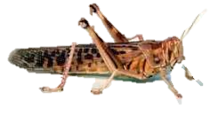
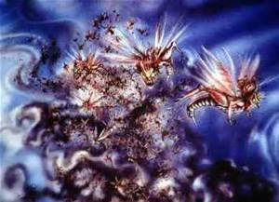
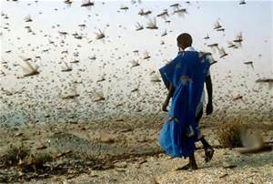
Amos 7:1 “Thus the Lord showed me & behold a swarm of locusts
were coming & behold, one of the young devastating locusts
was Gog, the King.” Septuagint LXX
Numbers 24:7 “He shall pour the water out of his buckets
& his seed shall be in many waters
& his king shall be higher than Agag (Gog)
& his kingdom shall be exalted.”

Slide 25
18-19. And it shall come to pass at the same time when Gog shall come against the Land of Israel, says the Lord God,
that My fury shall come up in My face.
For in My jealousy & in the fire of My wrath have I spoken.
Surely in that day there shall be a great shaking in the Land.

Slide 26
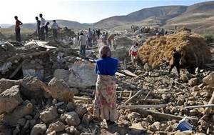
20. So that the fishes of the sea
& the fowls of the heaven
& the beasts of the field
& all creeping things that creep on the earth,
& all the men that on the face of the earth
shall shake at My presence
& the mountains shall be thrown down
& the steep places shall fall
& every wall shall fall to the ground.

Slide 27
Sounds Like an Earthquake……
Sounds like…. The Day of the Lord

Slide 28
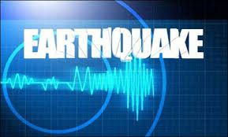
End Time Earthquake Prophecies
Haggai 2:6 For thus says the LORD of hosts;
Yet once,it [is] a little while & I will shake
the heavens & the earth & the sea & the dry [land];
Haggai 2:7 And I will shake all nations,
and the desire of all nations shall come:
and I will fill this house with glory,
says the LORD of hosts. Jesus in Person
Ezekiel 38:20 So that the fishes of the sea & the fowls of the heaven & the beasts of the field &all creeping things that creep upon the earth & all the men that [are] on the face of the earth shall shake at My Presence & the mountains shall be thrown down & the steep places shall fall
& every wall shall fall to the ground.
Joel 3:16 The LORD also shall roar out of Zion & utter His voice from Jerusalem; & the heavens & the earth shall shake: but the LORD will be the hope of His people & the strength of the children of Israel.

Slide 29
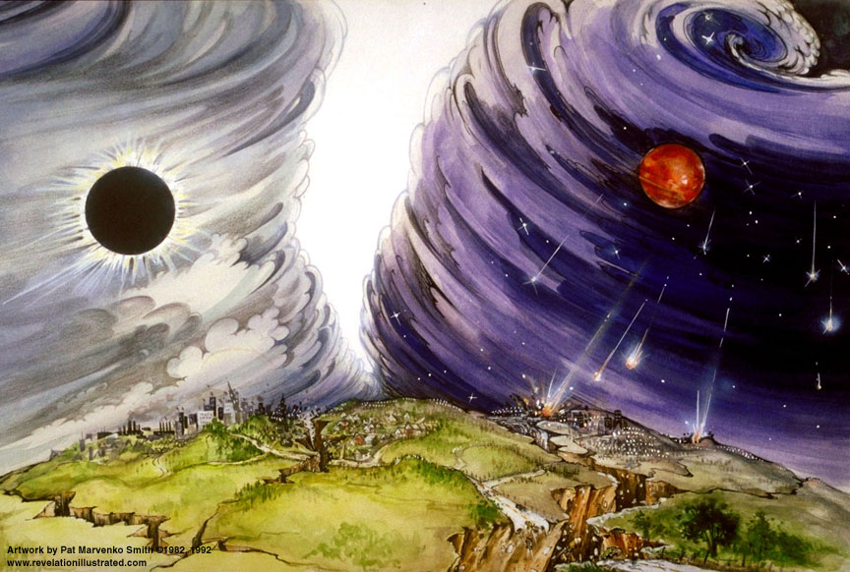
Zechariah 14:5 And you shall flee [to] the valley of the mountains; for the valley of the mountains shall reach unto Azal: yes, you shall flee, like as you fled from before the earthquake in the days of Uzziah king of Judah: and the LORD my God shall come &all the saints with you. JESUS Messiah!
Revelation 6:12 “And I beheld when He had opened the 6th seal & lo
there was a great earthquake; the sun became black as sackcloth of hair
and the moon became as blood;”

Slide 30
Revelation 8:5 And the angel took
the censer &filled it with fire of
the altar & cast [it] into the earth:
& there were voices & thundering,
and lightening, and an earthquake.
Revelation 11:13 And the same hour
was there a great earthquake &
1/10th part of the city fell & in the
earthquake were slain 7000 men:
and the remnant were frightened & gave glory to the God of heaven.
Revelation 11:19 And the Temple of God was opened in heaven, and there was seen in His Temple the Ark of His testament: and there were lightnings & voices, and thunderings & an earthquake & great hail.
Revelation 16:18 And there were voices, and thunders & lightnings;
and there was a great earthquake, such as was not since men were upon the earth, so mighty an earthquake.

Slide 31
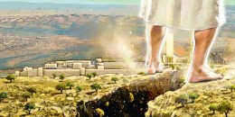
Zechariah 14:3 “Then shall the LORD go forth & fight against those nations, as when he fought in the day of battle. 4. And His feet shall stand in that day upon the mount of Olives, which [is] before Jerusalem on the east & the mount of Olives shall cleave in the midst thereof toward the east & toward the west, [and there shall be] a very great valley; and half of the mountain shall remove toward the north, and half of it toward the south.”

Slide 32
Back to Ezekiel 38
and
Gog & Magog

Slide 33
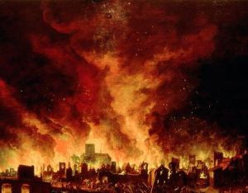
And I will call for a sword against him
throughout all my mountains, says the Lord God.
Every man’s sword shall be against his brother
I will plead with him with pestilence & with blood
I will rain on him & on his bands
& on the many people what are with him –
an overflowing rain & great hailstones, fire & brimstone
The Day of the Lord

Slide 34
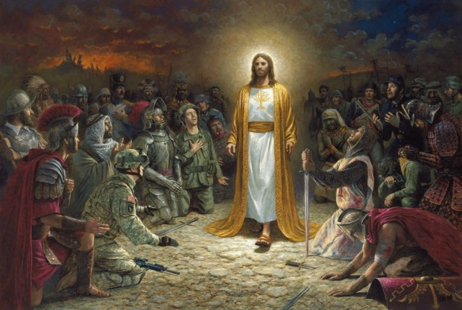
Thus I will magnify Myself & sanctify Myself; & I will be known in the eyes of many nations & they shall know that I AM the Lord.

Slide 36
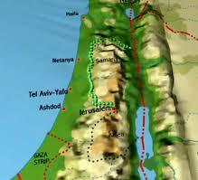
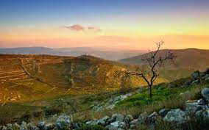
Ezekiel Chapter 39 Gog’s Destruction
1-2. Therefore, son of man, prophesy against Gog and say,
‘Thus says the Lord God; Behold I am against you, O Gog, the chief prince of Meshech and Tubal: and I will turn you back & leave but 1/6th part of you & will cause you to come up from the North parts & will bring you on the mountains of Israel.

Slide 37
3-4. And I will smite your bow out of your left hand & will cause your arrows to fall out of your right hand. You shall fall on the mountains of Israel, you and all your bands, & the people that is with you: I will give you to all the ravenous birds or every sort & to the beasts of the field to be devoured.

Slide 38
5-6. You shall fall on the open field: for I have spoken it, says the Lord God. And I will send a fire on Magog & among them that dwell carelessly in the isles: & they shall know that I AM the Lord.

Slide 39
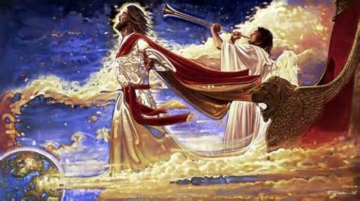
7-8. “So will I make My Holy Name known in the midst of My people Israel; & I will not let them pollute My Holy Name any more: & the heathen shall know that I AM the Lord, the Holy One of Israel. Behold, it is come & it is done, says the Lord God’ this is the Day whereof I have spoken.”

Slide 40
9. “And they that dwell in the cities of Israel shall go forth & shall set on fire & burn the weapons, both the shields & the bucklers, the bows & the arrows, & the hand staves & spears & they shall burn them with fire 7 years.
10. So that they shall take no wood out of the field, nor cut down any out of the forests; for they shall burn the weapons with fire: & they shall spoil those that spoiled them & rob those that robbed them, says the Lord God.”

Slide 41
11. “And it shall come to pass I that day, that I will give to Gog a place there of graves in Israel, the valley of the passengers on the east of the sea: & it shall stop the noses of the passengers: & there shall they bury Gog & all his multitude: & they shall call it the Valley of Hamon-Gog.
12.And 7 months shall the house of Israel be burying them that they may cleanse the Land. 13. Yes, all the people of the Land shall bury them;
& it shall be to them a renown the Day that I shall be glorified,
says the Lord God.

Slide 42
14. “ And they shall sever out men of continual employment, passing through the land to bury with the passengers those that remain upon the face of the earth – to cleanse it. After the end of 7 months shall they search.”
15. And the passengers that pass through the land, when any see a man’s bone. Then he shall set a sign by it, till the buriers have buried it in the valley of Hamon-gog. 16. And also the name of the city shall be Hamonah. Thus shall they cleanse the land.

Slide 43
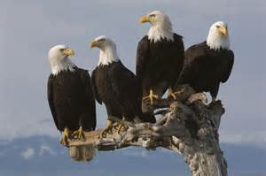
17. “And you, son of man, thus says the Lord; Speak to every feathered bird and to every beast of the field, Assemble yourselves and come; gather yourselves on every side to My sacrifice that I do sacrifice for you, even a great sacrifice on the mountains of Israel, that you may eat flesh & drink blood.
18-19. You shall eat the flesh of the mighty & drink the blood of the princes of the earth, of rams, of lambs, of goats, of bullocks, all of them fatlings of Bashan. And you shall eat until you be full & drink blood until you be drunk, of My sacrifice which I have sacrificed for you.”

Slide 44
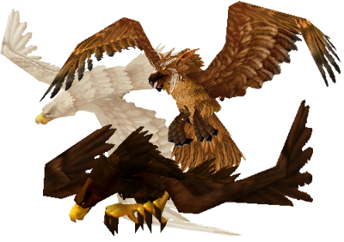
“Thus you shall be filled at My table
with horses & chariots,
with mighty men & with all men of war,
says the Lord God.”
“And I saw an angel standing in the sun; and he cried with a loud voice, saying to the fowls that fly in the midst of the heaven, ‘Come & gather yourselves together unto the great supper of GOD.
That you may eat the flesh of kings & the flesh of captains & the flesh of horses& & of them that sit upon them & the flesh of men, both free & bond, both small & great.
And I saw the beast & the kings of the earth & their armies, gathered together to make war against Him that sat on the horse & against His army!
And the beast was taken & with him the false prophet that wrought miracles before him, with which he deceived them that had received the mark of the beast & them that worshipped his image. There both were cast alive into a Lake of Fire burning with brimstone. The remnant were slain with the sword of Him who sat on the horse, which sword proceeded out of His mouth & all the fowls of the air were fill with their flesh>’ Revelation 19:17-21

Slide 45
Isaiah 34 tell you WHO God will destroy....and WHY
1. “Come near you nations to hear; and hearken you people:
Let the earth hear & all that is therein, the world & all things that come forth out of it. 2.For the Indignation of the LORD is upon all nations, & His fury is upon all their armies: He has utterly destroyed them He has delivered them to the slaughter. 3.Their slain shall also be cast out & their stink shall come up out of their carcases & the mountains shall be melted with their blood.
4.And the host of heaven shall be dissolved & the heavens shall be rolled up together as a scroll: and all their host shall fall down, as the leaf falls off from the vine, & as a falling fig from the fig tree.
5. For My sword shall be bathed in heaven: behold, it shall come down upon Edom & upon the people of My curse, to judgment. 6. The sword of the Lord is fill with blood, it is made fat with fatness & with the blood of lambs & goats, with the fat of kidneys & rams: for the Lord has a sacrifice in Bozrah & a great slaughter in the land of Edom.
8. For it is the Day of the Lord’s vengeance & the Year of recompences
for the controversy of ZION

Slide 46
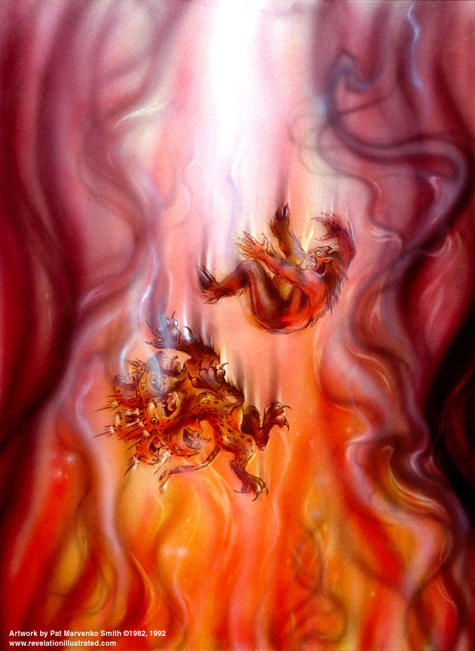
And Revelation 19 tells you WHEN – after the Tribulation
“And I saw an angel standing in the sun; and he cried with a loud voice, saying to the fowls that fly in the midst of the heaven, ‘Come & gather yourselves together unto the great supper of GOD.
That you may eat the flesh of kings & the flesh of captains & the flesh of horses& & of them that sit upon them & the flesh of men, both free & bond, both small & great.
And I saw the beast & the kings of the earth
& their armies, gathered together to make war
against Him that sat on the horse & against His army!
And the beast was taken & with him
the false prophet that wrought miracles before him,
with which he deceived them that had received
the mark of the beast & them that worshipped
his image. There both were cast alive into a
Lake of Fire burning with brimstone.
The remnant were slain with the sword
of Him who sat on the horse, which sword
proceeded out of His mouth & all the fowls
of the air were fill with their flesh” Rev. 19:17-21

Slide 47
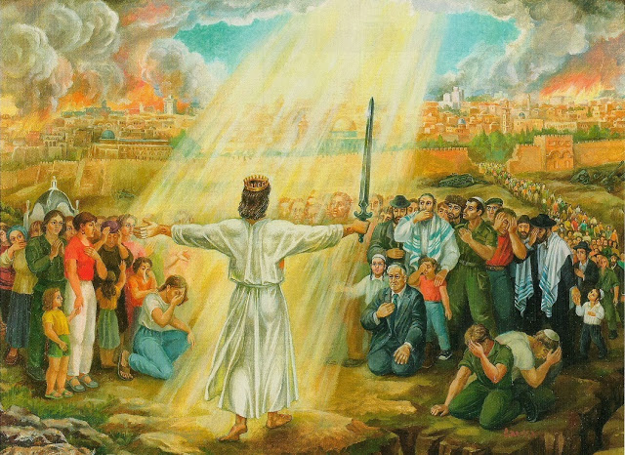
21-22. “And I will set My Glory among the heathen & all the heathen shall see My judgment that I have executed & My hand that I have laid upon them. So the house of Israel shall know that I AM the Lord their God from that day & forward.

Slide 48
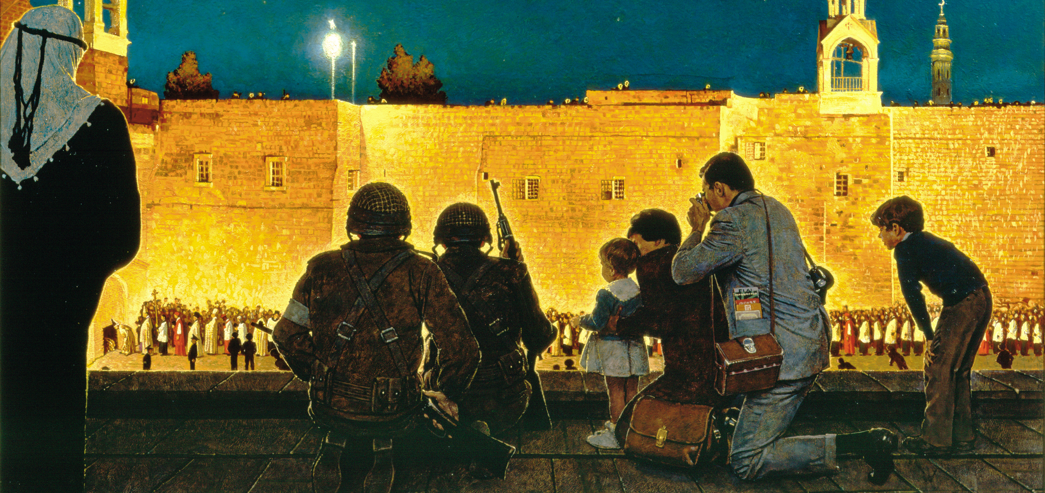
23. And the heathen shall know that Israel went into captivity for their iniquity: because they trespassed against Me, therefore I hid My face from them & gave them into the hand of their enemies. So they all fell by the sword.”
24. According to their uncleanness & according to their transgressions have I done to them & hid My face from them.
25. Therefore thus says the Lord God; Now will I bring again the captivity of Jacob & have mercy on the whole house of Israel, & will be jealous for My Holy Name.”

Slide 49
26. “After they have born their shame & all their trespasses whereby they have trespassed against Me, when they dwelt safely in their land & non made them afraid.”
27. When I have brought them again from the people & gathered them out of their enemies’ lands & am sanctified in them in the sight of many nations;
28. Then they shall know that I AM the Lord God which caused them to be led into captivity among the heathen: but I have gathered them to their own land and have left none of the any more there.
29.. Neither will I hid My face any more from them; for I have poured out My Spirit on the house of Israel, says the Lord God.”

Slide 50
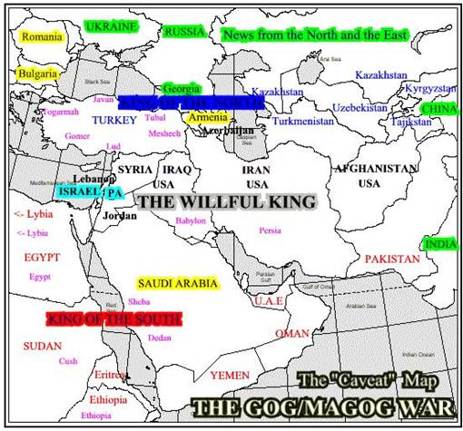

Slide 51
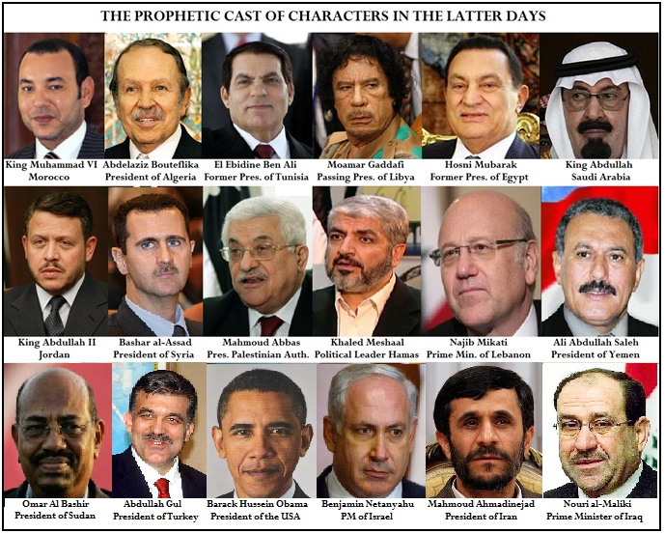

Slide 52
Gog’s Endtime War Against Israel
Ezekiel 38-39

