Slide 1
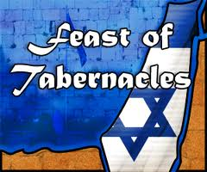
“With Joy We draw
Living Water out of the
Well of Our Salvation”
Isaiah 12:3

Slide 2
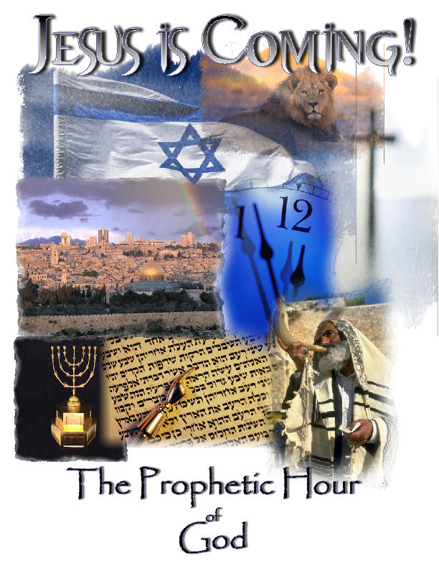
God’s Appointed
Times
Genesis 1:14
“And God said Let there be lights in the firmament of the heaven to divide the day from the night… and let them be for signs and for seasons, and for days, and for years.”
Seasons – Feasts Moedim

Slide 3
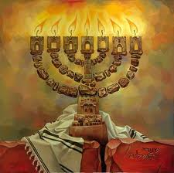
>
Jesus is Always on Time
1. Passover - Crucifixion 2.Unleavened Bread –Burial
3. First Fruits - Resurrection
50 Days
4. Pentecost
Holy Ghost Baptism
5. Trumpets
6. Atonement
7. Tabernacles
Rapture
Tribulation
Millenial Reign

Slide 4
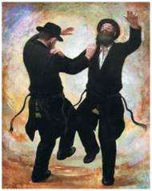
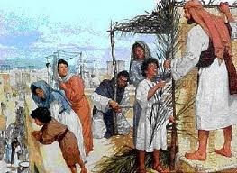
The Feast of Tabernacles Marks the End of Harvest!
The last appointed time is the greatest and most joyful festival.
Jews present themselves before the Lord in Jerusalem
Strangers from all nations come to worship the Lord!
Three major themes of Celebration
1. To remember God’s Provision in the Wilderness for 40 years,
all Israel make booths (sukkah) and live outdoors for 7 days!
2. To rejoice and give God thanks –
All the Harvest is safely in the Barn!
All the Redeemed are safely in Heaven!
3. To sacrifice 70 bulls for the Nations.
Elaborate rituals day and night for 7 days.
All 24 Courses of Priests are present.
1 Chron. 24:4-19 Rev.4:4 The 24 Elders

Slide 5
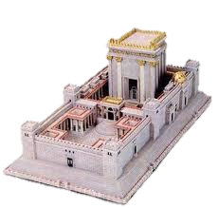
Feast of Tabernacles Sukkot Feast of Ingathering Tishrei 15-22
Deuteronomy 16:13-15 “You shall observe the Feast of Tabernacles 7 days after you have gathered in your corn an dyour wine: and you shall rejoice in the feast, you and your son, and your daughter, and your man servant and your maidservant, and the Levite that is within your gates, and the stranger,
and the fatherless, and the widow, that are among you, in the place
where the Lord your God has chosen to place His Name.”
Numbers 18:12 “All the best of the oil, and all the best
of the wine, and of the wheat, , the firstfruits of them which
they shall offer unto the Lord, them have I given thee.
Deut 31:10-12 “And Moses commanded them, saying, At the end of
every 7 years, in the solemnity of the year of release, in the Feast of Tabernacles, when all Israel is come to appear before the Lord thy God in the place which He shall chose you shall read this law before all Israel in their hearing. Gather the people togethere, men and women, children and they strangers that is with in your gates, that they may hear and may learn and fear the Lord your God, and observe to do all the words of this Law.”

Slide 6
Old Testament Scriptures - The Feast of Tabernacles
Exodus 23:16 - The Feast of Ingathering at the End of the Year
Exodus 34:22 – The Feast of Ingathering
Leviticus 23:33-43 Dwell in Booths for 7 Days
Deuteronomy 16:13 – Observe the Feast of Tabernacles 7 days after you gather in your corn and your wine.
Numbers 29:12-38 The sacrifices and offerings for Tabernacles
Ezra 3:4 – When the Jews return to the Land
Nehemiah 8:14-18 Ezra reads the Torah, they keep Sukkot
I Kings 8 - Solomon Dedicates the Temple – Feast of Tabernacles
2 Chronicles 7:8-10 Solomon dedicates the Temple
Hosea 12:9 I am the Lord your God ….will yet make you to dwell in Tabernacles
Zechariah 14: 16, 17-19 – Feast of Tabernacles during Millennium

Slide 7
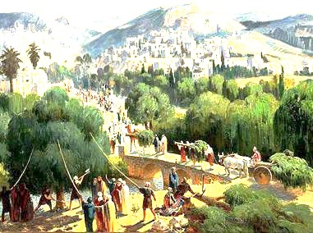
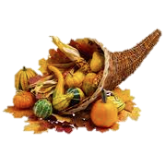
Come and Meet with Me in Jerusalem
Rejoicing in the Streets for 7 Days
“Also in the 15th day of the 7th month, when you have gathered in the fruit of the land, you shall keep a feast to the Lord for 7 days: on the 1st day shall be a Sabbath and on the 8th day shall be a Sabbath” Lev.23:38-39
Because the Entire Harvest
is Safely
in the Barn!

Slide 8
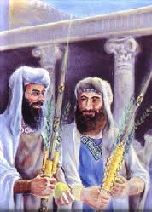
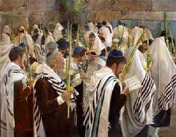
Tishrei 15th – 22nd 7 Days
“And you shall take on the 1st day the boughs of goodly trees, branches of palm trees and the boughs of thick trees, and willows of the brook, and you shall rejoice before the Lord 7 days” Lev.23:40
Party with God
for a whole Week!

Slide 9
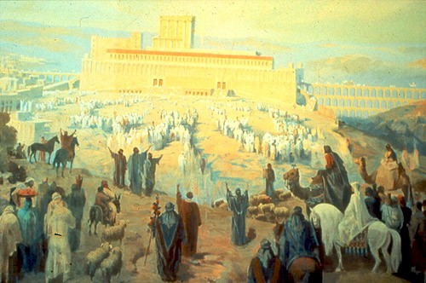
“And you shall keep a feast unto the Lord 7 days in the year. It shall be a statute forever in your generations: you shall celebrate it in the 7th month” Lev 23:41 Sukkot = Tabernacles

Slide 10
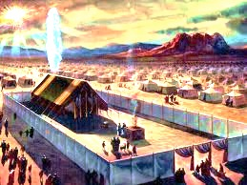
Remember God’s Supernatural Protection & Provision in the Wilderness
“You shall dwell in booths 7 days, all that are Iraelites born shall dwell in booths: that your generations may know that I made the children of Israel to dwell in booths when I brought them out of the Land of Egypt: I am the Lord your God”

Slide 11
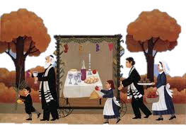
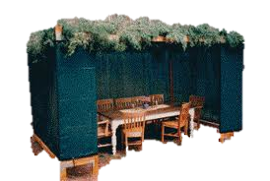
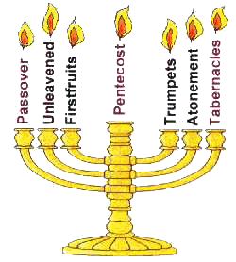
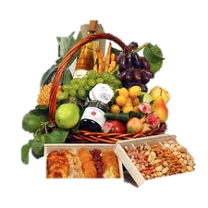
“The Great Feast”

Slide 12
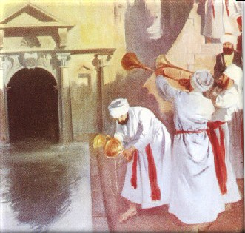
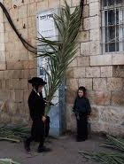
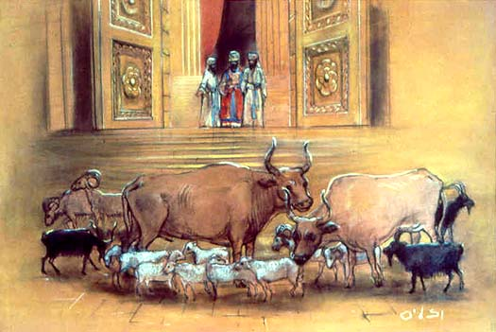
There are 3 special Ceremonies during the Day
Water Pouring Ceremony Waving Willow Branches Animal Sacrifices
The High Priest leads a joyful parade out of the Temple through the Water Gate to the Pool of Siloam carrying a golden vase to be filled with ‘living water’ singing Isaiah 12:3
A 2nd group of priests cuts 25’ willow branches and marches in rows 30’ apart, swishing the willow branches in perfect order left to right as they step ‘like a mighty rushing wind’ to the Temple
Almost 200 animals will be sacrificed during the week, most noticeably the 70 bulls offered for the Redemption of the Nations.

Slide 13
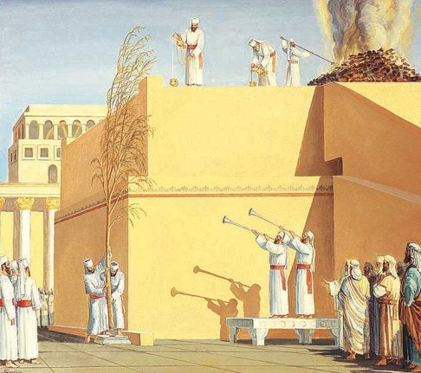
And on the Last Day
The Blood,
the Living Water,
and the Wind
Enter the Temple
all at once!
They Pray for Rain
and for
Messiah to Come!
At sound of shofar all 3 groups advance toward the brazen altar. A flute player called ‘the pierced one” signals the start. (Jesus is the pierced One who signals everything to come!)
The willow group circle the altar 7x and makes a sukkah over the altar. The 2nd group places the sacrifices on the altar. The High Priest pours the Living Water and wine
over the altar….All at once, the Blood, the Water, and the Wind enter the Temple!
And it will happen again – In the Millenium - Jesus Will Rule and Reign in Jerusalem!

Slide 14
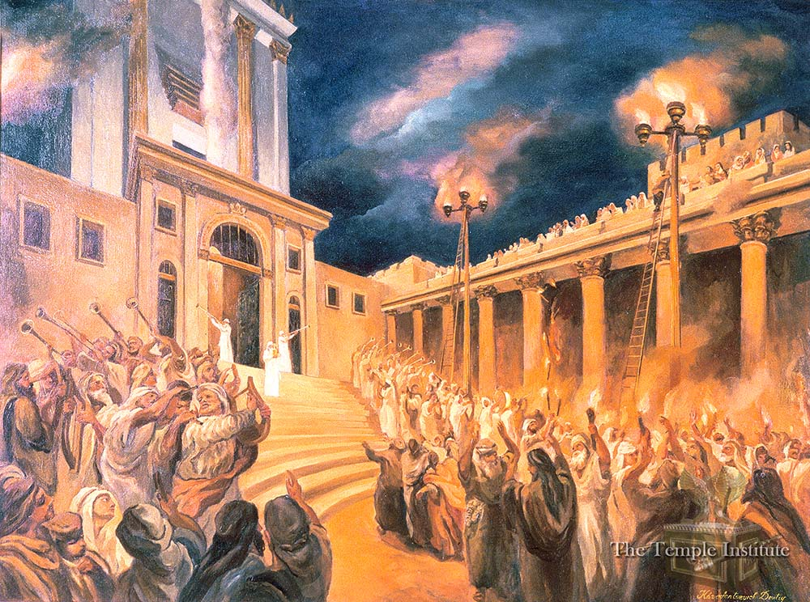
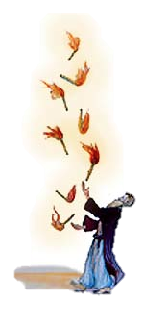
A special night ceremony was performed only during the Feast of Tabernacles. Priests & Levites entered the
Court of Women. Young priests would climb ladders 75 ft.
high to light 4 golden candlesticks with 4 golden bowls.
All Jerusalem lit up like a diamond. Light from this ceremony
Was so bright that; "There was no courtyard in Jerusalem
that was not lit up with the light” Sukkah 5:3 .
A special balcony was built so women could enjoy the ceremony while men danced below late into the night, holding torches & singing songs of praise. The light represents God’s Shekinah Glory filling the Temple.
Night Services
at the Temple
Torch Dance

Slide 15
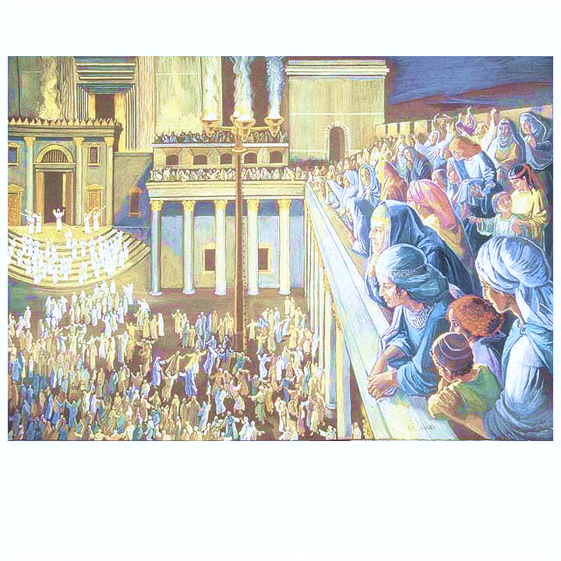
The Light of the World - the Greatest Joy –The Feast of Tabernacles!

Slide 16
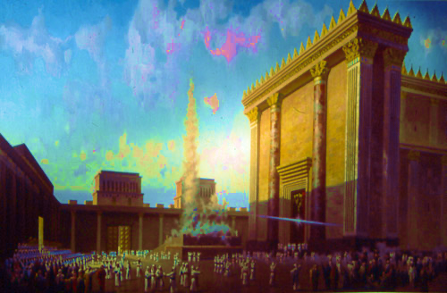
Tabernacles - The Great Feast
200 Blood Sacrifices
Special ceremonies Day and Night
All Priesthood Appears at Temple
Party and Rejoice in Jerusalem 7 days!

Slide 17
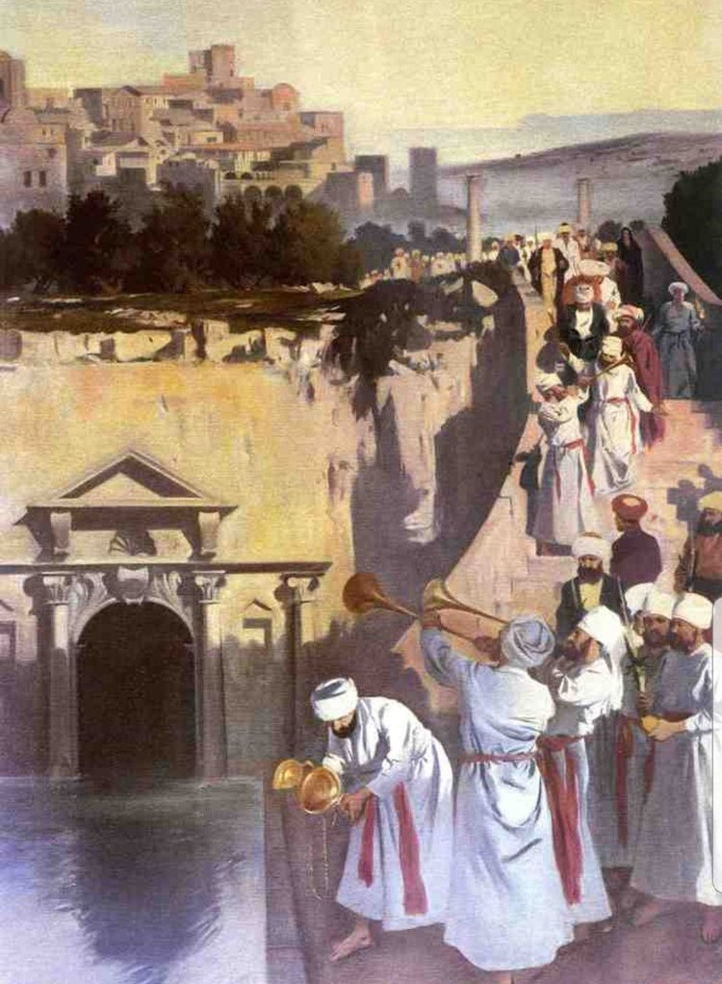
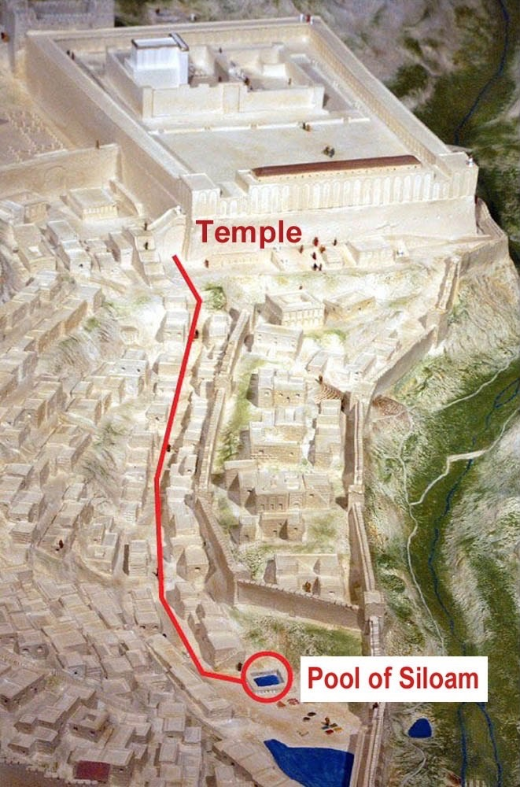
The Water Drawing Ceremony - Every Morning during Tabernacles

Slide 18
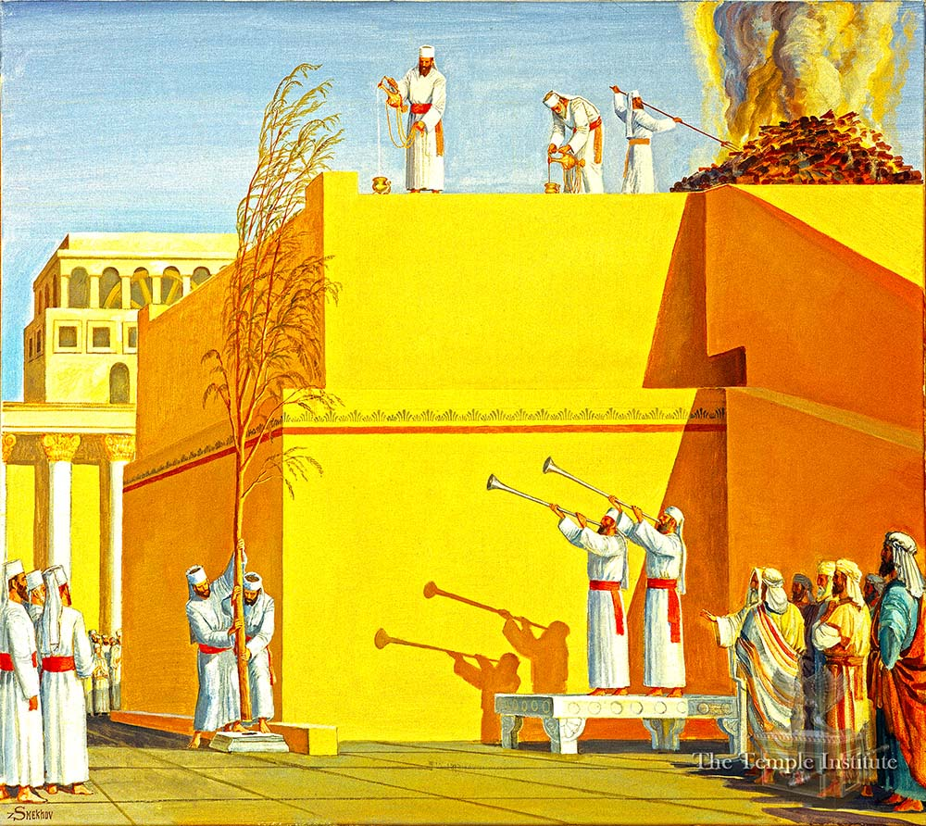
Jesus at Last Day of Tabernacles – John 7 :37-39
“In the last day, the great day of the Feast, Jesus stood, and cried, ‘If any man thirst,
let him come and drink. 38. He that believes on Me, as the Scriptures says, out of his
belly shall flow rivers of living water.
39. But by this He spoke of the Spirit, which they that believe on Him should receive:
for the Holy Ghost was not yet given; because Jesus was not yet glorified. “

Slide 19
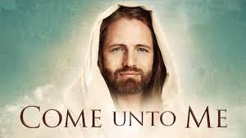
Jesus is declaring
“I am the Messiah”
“I am Here in Front of You”
“I Will Give You Living Water
“Whoever Believes in Me will Be Filled with the Holy Spirit
Living Water will Flow out of You

Slide 20
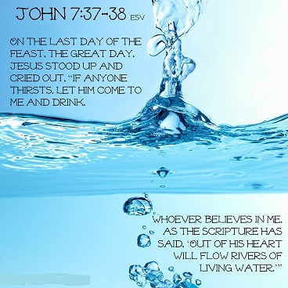
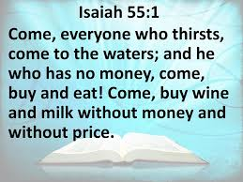
The Feast of Tabernacles Future - The Book of Revelation
Revelation 21:17
“And the Spirit and the bride say, Come.
And let him that he hears say Come
And him that is thristy, Come.
And whosoever will, let him take of the wáter of Life freely.”

Slide 21
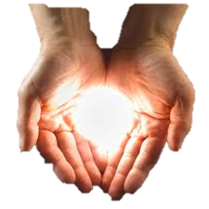
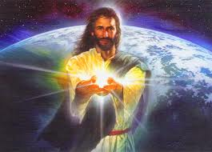
“Then Jesus spake to them, saying
‘I am the Light of the world:
he that follows me shall not walk in darkness,
but he shall have the light of life.” John 8:12
“I must work the works of Him who sent Me, while
it is day: the night comes, when no man can work. As
long as I am in the world, I am the Light of the world.”
John 9:-6
Yet a little while is the Light with you.
Walk while you have the Light, lest darkness come upon you: for he that walks in darkness knows not where he goes. While you have the Light,
believe in the light, that you may be children of light
John 12:35-36
“I am come a light into the world, that whosoever believes in Me should not abide in darkness. “ John 12:46

Slide 22
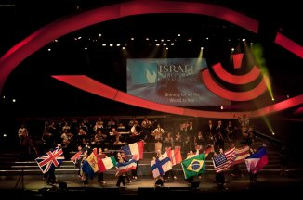
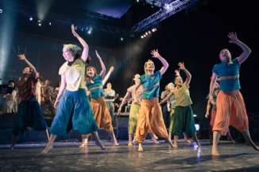
The Feast of Tabernacles/ Sukkot Themes:
“The Light of the Whole World”
“Ingathering the Final Harvest”
“The Season of Our Greatest Joy”
“The Feast”
“The Great Praise”
May Also Announce
“The Messiah’s Birth”

Slide 23
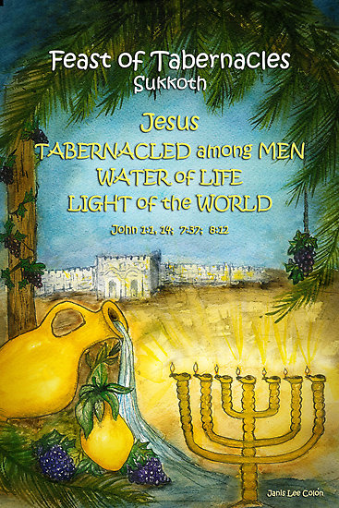
Jesus is the Word
“In the Beginning was the Word, and the Word was with God and the Word was God.” John 1:1
Jesus is the Light
“In Him was Life, and the Life was the Light of men. And the Light shines in darkness and darkness comprehends
it not.” John 1:4-5
John came to bear witness of the Light. John 1:7-8 Jesus is the true Light that lights every man that comes into the world’ John 1:9
“And the Word was made flesh, and He tabernacled among us, and we beheld His glory, the glory of the only begotten of the Father, full of grace and truth” 14
Jesus Tabernacled with Us!

Slide 24
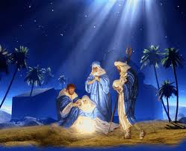
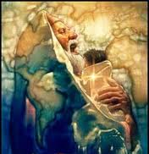
Sheep are in the Barns in Winter
There is snow in the Winter
The Biggest Crowds in Jerusalem
would have been at the Festivals –
Jesus ministered for 3 ½ Years
He Died during Passover at age 33 ½
So His birth should have happened
during the Fall Feasts!
Another Clue Will help!
John the Baptist’ Birth
John is 6 months older that Jesus
Luke 1:5-25
“The Course of Abijah”

Slide 25
“There was in the days of Herod, the King of Judea, a certain priest named Zachariah, of the course of Abia: and his wife was of the daughters of Aaron, and her name was Elizabeth.” Luke 1:5 1 Chronicles 24 gives us the Time Table

Slide 26
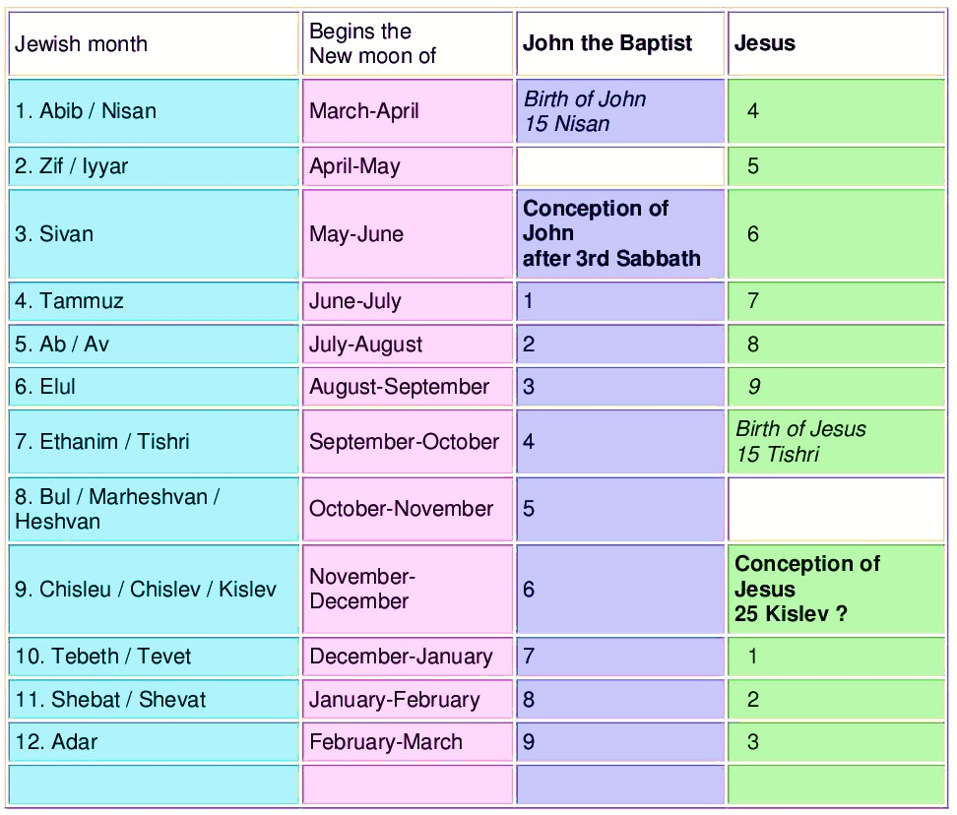
The Priestly Calendar
Tells us when John was conceived
If We can Date
John’s Birth
We can know Jesus’ birth
Unleavened
Bread
After Course of Abia
Tabernacles
John’s Birth
Passover!
Jesus’ Birth
propbably
Tabernacles
Hanukkah

Slide 27
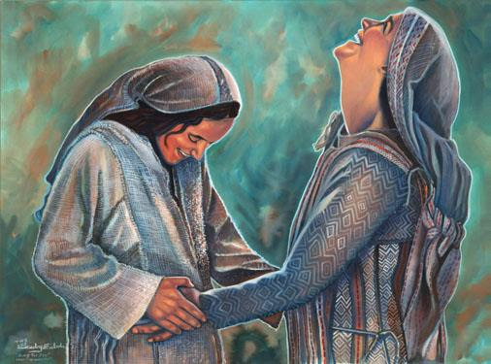
John is filled with the Holy Ghost while in His mother’s womb.
He recognizes Jesus in Mary’s womb! Luke 1:15, 41, 44

Slide 28
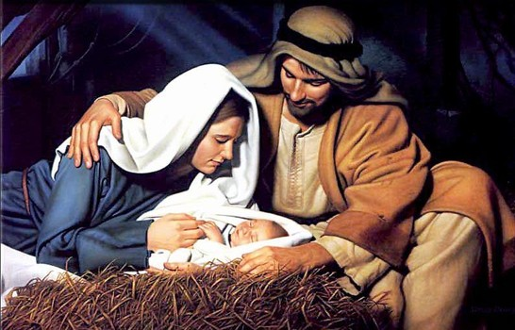
6 Months after John’s Birth is another Supernatural Birth
– Jesus is born in Bethlehem Luke 2:1-7
And it came to pass in those days that a decree went out from Caesar Augustus that all the world should be taxed.
And Joseph also went up from Galilee, to the City of David, which is called Bethlehem: because he was of the house and lineage of David
To be taxed with Mary his espoused wife, being great with child. And so it was, that
while they were there, the days were accomlished that she should bring forth her firstborn child. And she brought forth her firstborn son, and wrapped him in swaddling clothes and laid him in a manger; because there was no room for them in the inn.”

Slide 29
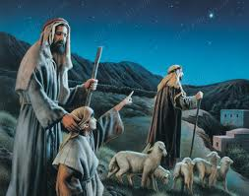
“Joy To All the World” - Luke 2:1-12
“And there were in the same country shepherds abiding in the field, keeping watch over their flock by night. And lo, the angel of the Lord came upon them, and the glory of the Lord shone round about them, and they were sore afraid.
And the angel said to them, ‘Fear not: for behold, I bring you good tidings of great Joy which shall be to all people.
“For unto you this day is born a Savior, which is Christ the Lord. And this shall be a sign to you, You shall find the babe wrapped
in swaddling clothes and lying in a manger.”

Slide 30
Since Jesus’ Birth is probably is timed
at the Fall Festivals
So is His Baptism in the River Jordan
at Age 30 Luke 3:21-23
Jesus and The Feast of Tabernacles

Slide 31
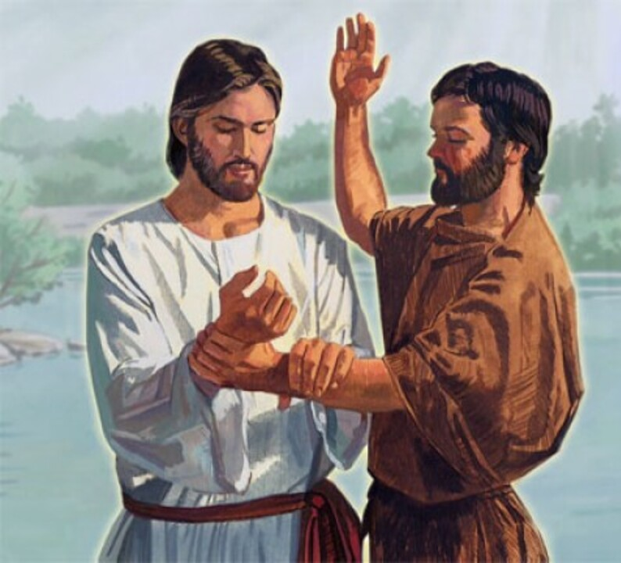
The Holy Spirit Descends
The Miracles Begin
“Then came Jesus from Galilee to Jordan to John, to be baptized of him. But John forbade Him saying,, I have need to be baptized of You, and You come to me?
And Jesus answering said to him, ‘Suffer it to be so now; for thus becomes us to fulfill all righteousness;
And Jesus, when He was baptized, came straightway out of the water: and lo, the heavens were opened to Him, and he saw the Spirit of God descending like a dove and lighting on Him, and lo, a Voice form Heaven said,
“This is My Beloved Son, in Whom I am well pleased” Matthew 3:13-17

Slide 32
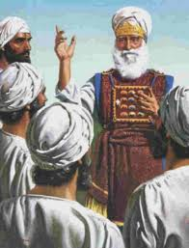
Jesus is Perfect …He has No Sin
Why does John need to Baptize Him?
Because at age 30, the High Priest
anoints every new priest
after he is baptized,
Only then can he start his ministry
Then the High Priest declares
“This is my son,
in whom I am well pleased!
God says exactly the same thing
at Jesus’s Baptism at age 30

Slide 33
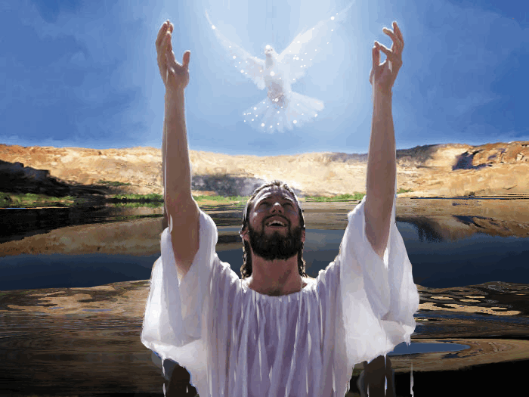
“This is My Son, in whom I am
well pleased”

Slide 34
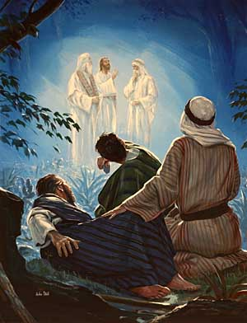
Matt 17:1-3 Jesus’ Transfiguration
“After 6 days Jesus took Peter, James and John and brought them up to a high Mt. apart. And He was transfigured before them: His face did shine as the sun, and his raiment was white as the light.
And behold there appeared to them, Moses and Elijah talking with Him.
Then Peter said, ‘Lord, it is good for us to be here: if you will, let us make 3 tabernacles, one for You, one for Moses, and one for Elijah.”
While he yet spake, Behold a bright cloud overshadowed them; and a Voice out of the cloud, which said, This is My Beloved Son, in whom I am well pleased;
Hear ye Him.”

Slide 35
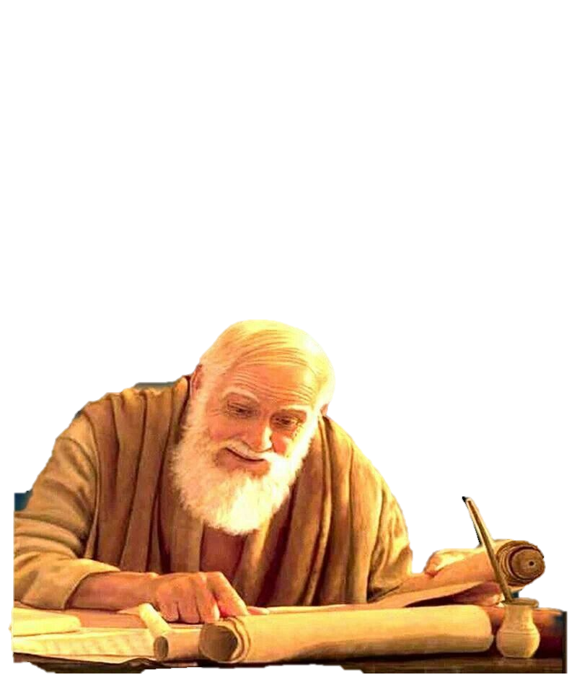
Peter testified about this very day 1 Peter 1:16-18
16. “For we have not followed cunningly devised fables, when we made known to you the power and coming of our Lord Jesus Christ, but were eyewitnesses of His majesty.
For He received from God the Father honor and glory, when there came such a voice to Him from the excellent glory, ‘ This is My Beloved Son, in whom I am well pleased.
And this voice which came from heaven we Heard, when we were with Him in the holy mount.

Slide 36
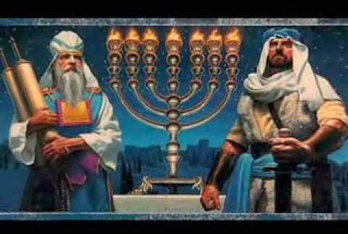
Moses & Elijah –The 2 Mighty Witnesses – Revelation 11
After 6 days from Creation (6,000 years) Moses and Elijah Will Re-appear
Moses represents the Torah - Elijah Represents all the OT prophets

Slide 37
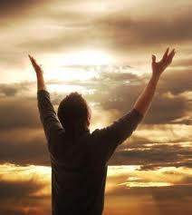
Are There Any More
Future Prophetic Events
About the Feast of Tabernacles
To Watch and Pray About ?

Slide 38
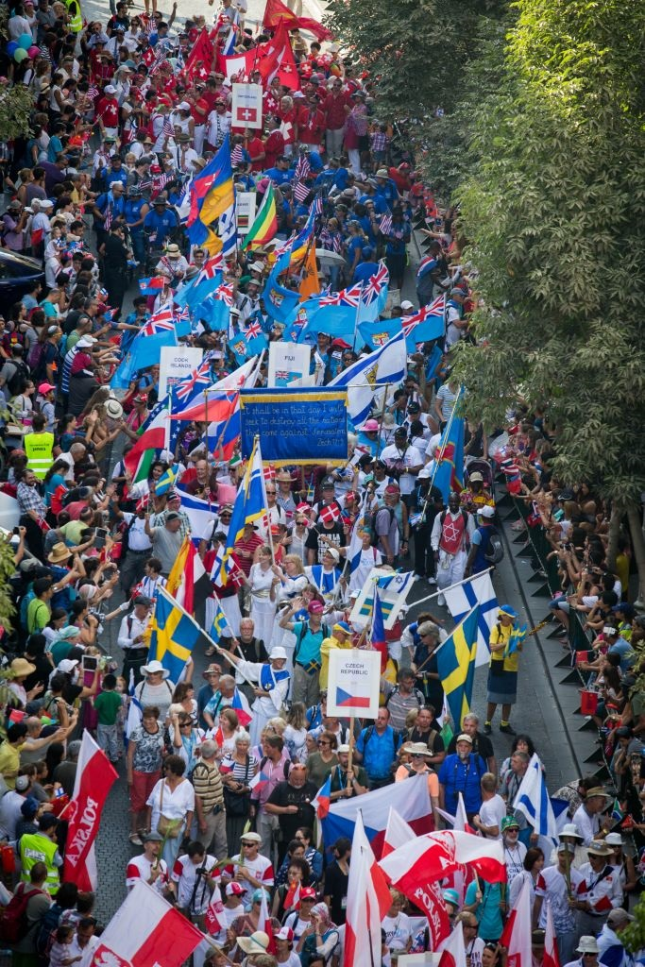
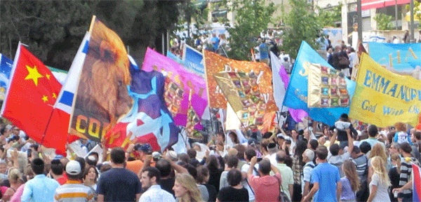
During The Millineum, God Requires all Nations to Keep the Feast of Tabernacles
16. “And it shall come to pass that every one that is left of all the nations which came against Jerusalem shall even go up from year to year to worship the King, the Lord of Hosts and to keep the Feast of Tabernacles.” Zechariah 14:16-19
17. “And t shall be, that whoso will not come up of all the families of the earth to Jerusalem to worship the King, the Lord of hosts, even on them will come no rain.
18. And if the family of Egypt will not go up, and come not, will have no rain; there shall be the plague, wherewith the Lord shall smite the heathen that come not up to keep the Feast of Tabernacles.
19. This shall be the punishment of Egypt and all the nations that comenot up to keep the Feast of Tabernacles.

Slide 39
The Wedding Supper
of the Lamb
Revelation 19:7
“Let us be glad and rejoice
and give honor
to Him, for the
Marriage of the Lamb
has come, and
His wife has made
herself ready.”
When the Sukkah
Becomes the Chuppah!

Slide 40
Revelation Chapter 21:1-3
1.“And I saw a new heaven and a new earth: for the 1st heaven and 1st earth were passed awau: and there was no more sea.
2. And I John saw the Holy City, the New Jerusalem, coming down from Heaven, prepared as a bride adorned for her husband.
3. And I heard a great voice from Heaven, saying Behold, the Tabernacle of God is with men, and He will dwell with them, and they shall be His people,
And God Himself shall be with them, and He will be their God."

Slide 41
Jesus is Our High Priest
Now Seated at the Right Hand of God
Forever Interceding for Us!
Hebrews 4:14-16
14.“Seeing then that we have a great High Priest, that is passed on into the heavens, Jesus, the Son of God,
Let us hold fast our profession.
15. For we have not a High Priest which can’t be touched with the feeling of our infirmities, but was in all points tempted
as we are, yet without sin.
16. Let us therefore come boldly into the throne of grace, that we may obtain mercy and find race to help in time of need.”

Slide 42
The Holy Spirit Tabernacles in Us
1 Corinthians 3:16-17
¹⁶ Know ye not that you are the Temple of God, and that the Spirit of God dwells in you?¹⁷ If any man defile the Temple of God, him shall God destroy; for the Temple of God is holy, which Temple you are.”
1 Corinthians 6:19-20
¹⁹ What? know you not that your body is the temple of the Holy Ghost which is in you, which ye have of God, and you are not your own?
²⁰ For you are bought with a price: therefore glorify God in your body, and in your spirit, which are God's.

Slide 43
“Come Unto Me "
“Come and Rejoice “
The Feast of Tabernacles

