Slide 1
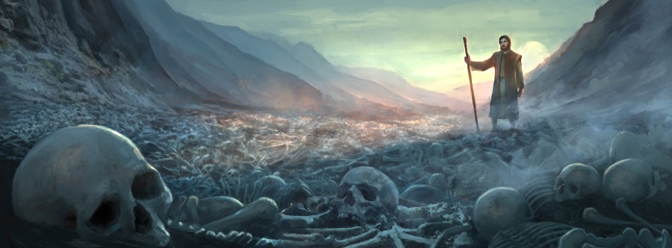
Ezekiel Chapter 37
“Vison of the Dry Bones”
God’s End Time
Restoration of Israel

Slide 2
1.The hand of the Lord was upon me, and carried me out in the spirit of the Lord, and set me down in the midst of the valley which was full of bones,
2 And caused me to pass by them round about: and, behold,
there were very many in the open valley; and, lo, they were very dry.
3 And He said unto me, Son of man, can these bones live?
And I answered, O Lord God, You know.
4 Again He said to me, Prophesy upon these bones,
and say to them, O you dry bones, hear the word of the Lord.

Slide 3
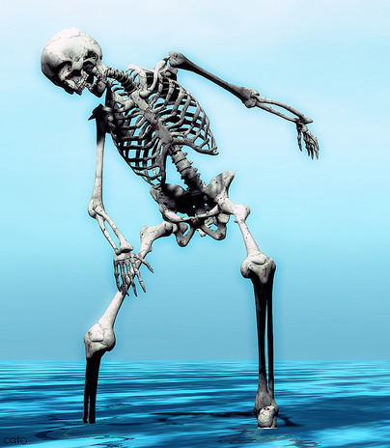
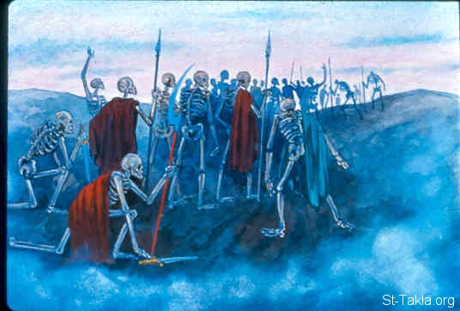
5. Thus says the Lord God to these bones;
Behold, I will cause breath to enter into you,
and you shall live:
6. And I will lay sinews upon you,
and will bring up flesh upon you,
and cover you with skin,
and put breath in you, and ye shall live;
and ye shall know that I am the Lord.
7. So I prophesied as I was commanded:
and as I prophesied, there was a noise,
and behold a shaking,
and the bones came together
bone to his bone.
8 And when I beheld, lo,
the sinews and the flesh came up upon them,
and the skin covered them above:
but there was no breath in them.

Slide 4
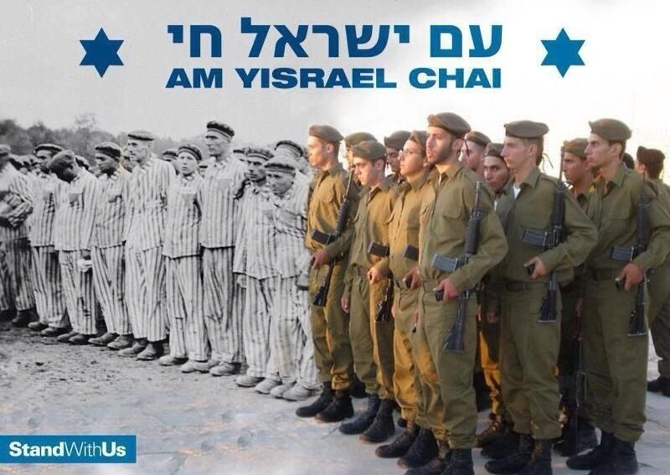
9. Then said He to me, Prophesy to the wind, prophesy, son of man,
and say to the wind, Thus says the Lord God; Come from the 4 winds,
O breath, and breathe upon these slain, that they may live.
10. So I prophesied as He commanded me, and the breath came into them,
and they lived, and stood up upon their feet, an exceeding great army.
11. Then He said to me, Son of man, these bones are the whole house of Israel: behold, they say, Our bones are dried, and our hope is lost:
we are cut off for our parts.

Slide 5
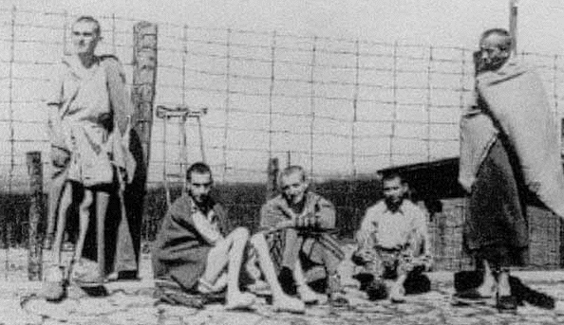
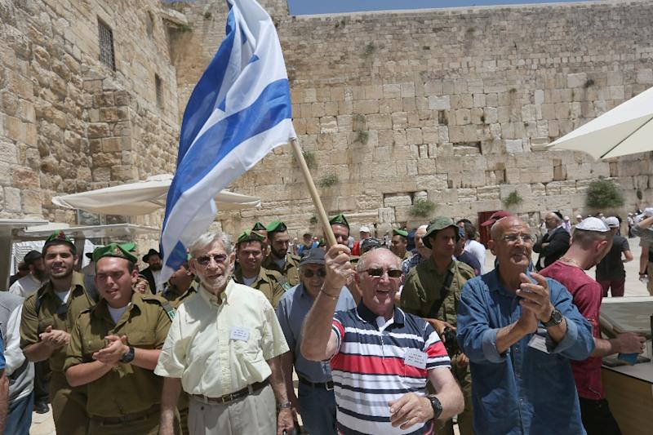
11. Then he said unto me, Son of man, these bones are the whole house of Israel: behold, they say, Our bones are dried, and our hope is lost:
we are cut off for our parts.
12. Therefore prophesy and say to them, Thus says the Lord God; Behold, O my people, I will open your graves, and cause you to come up out of your graves, and bring you into the land of Israel.
13. And you shall know that I am the Lord, when I have opened your graves,
O my people, and brought you up out of your graves,
14. And shall put my spirit in you, and you shall live,
and I shall place you in your own land: then shall you know
that I the Lord have spoken it, and performed it, says the Lord.

Slide 6
Ezekiel 37 Prophecies – God’s Mighty Work
The Jews Scattered to the Nations
Persecuted in Every Nation
Then God Begins to Move to Bring Them Home
WW1 – WW2
The Restoration of Modern State Israel
The Return of the Jews from the Nations
“Israel’s Exceeding Great Army ”

Slide 7
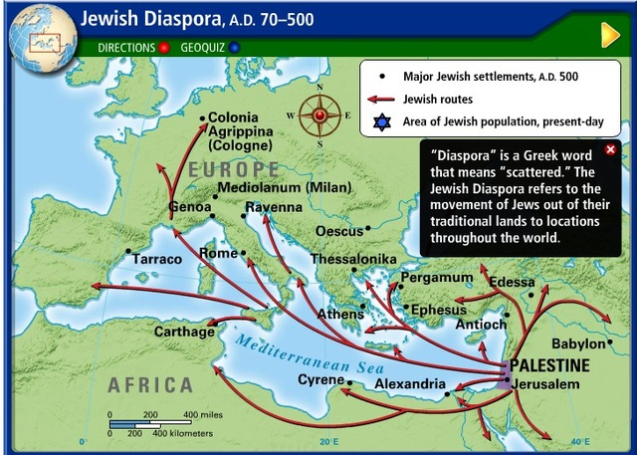
The Times of the Gentiles begins – 70 AD
The Jews were scattered to the 4 winds and the Temple destroyed –
Jews were persecuted in every country they settled, without a homeland, without a common language, and finally evicted, always forced to leave

Slide 8
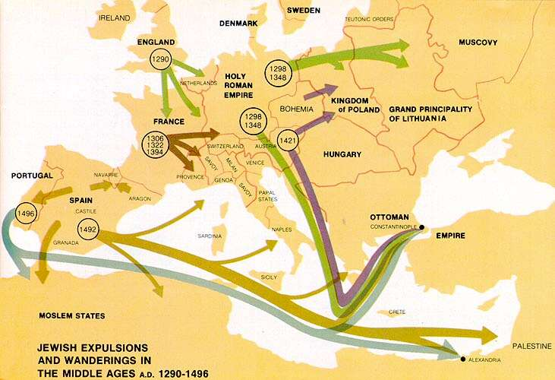
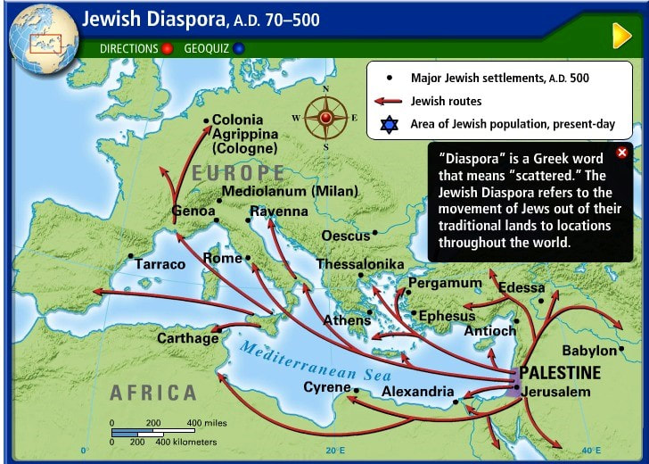

Slide 9
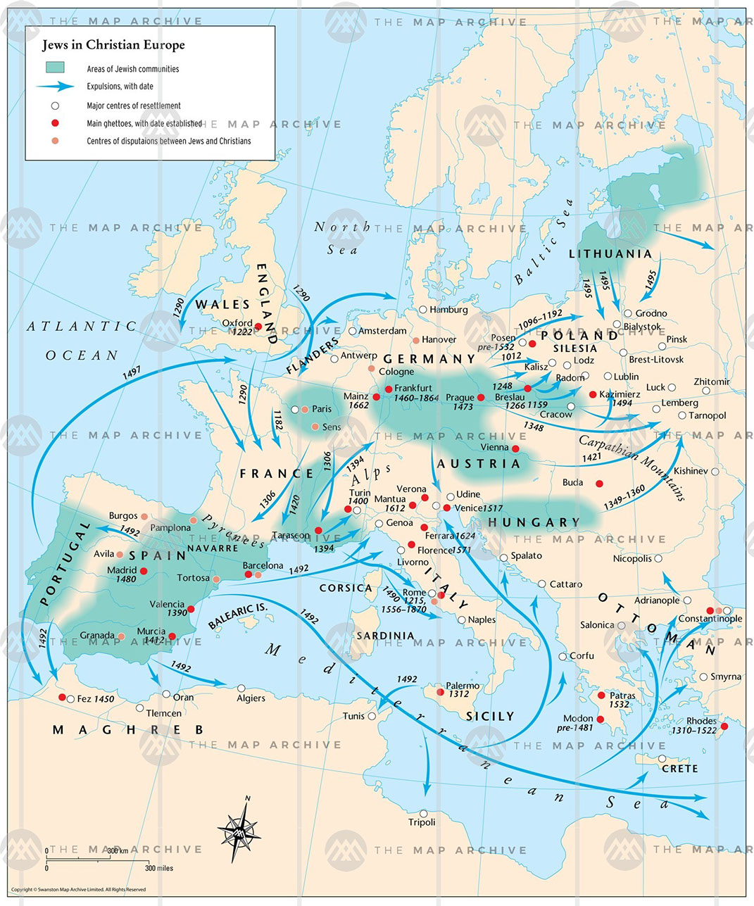
Nations that Expelled Jews
France 1250
Southern Italy 1288
England 1290
Switzerland 1294
Hungary 1360
Austria 1420
Upper Bavaria 1442
Spain 1492
Portugal 1496
Lithuania 1495
Poland early 1900’s
Russia early 1900’s
Ukraine early 1900’s
Turkey under Ottomans rule was a haven for 200,00 Jews until after WW1 and WW2 Only 14,000 Jews in Turkey- 2021

Slide 10
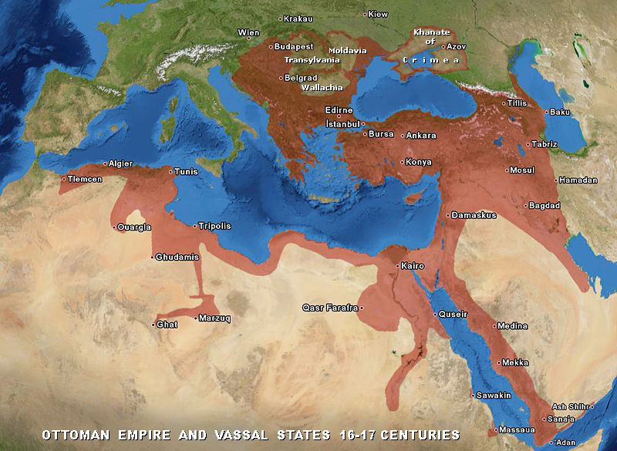
WW1 Allied Powers Defeat & Divide Ottoman Turkish Empire - 1915

Slide 11
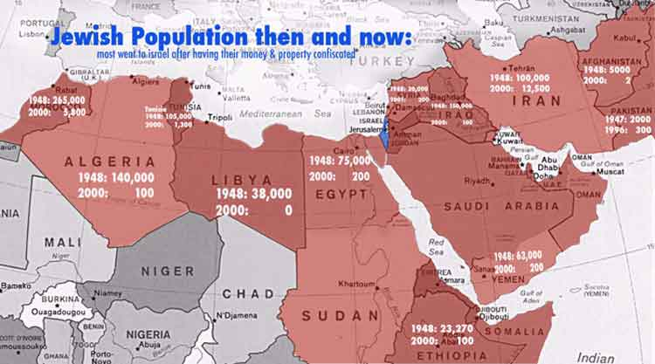
Jews Driven Out of in Arabs Nations by 1948

Slide 12
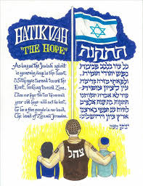
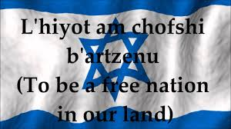
At Beginning of 20th Century - after 2000 years
God Begins to Move in Jewish Hearts Worldwide
The Desire for a Jewish Homeland is Birthed
Zionist Jewish Congress
“Next Year in Jerusalem “
HaTikvah - Israel’s National Anthem
1948

Slide 13
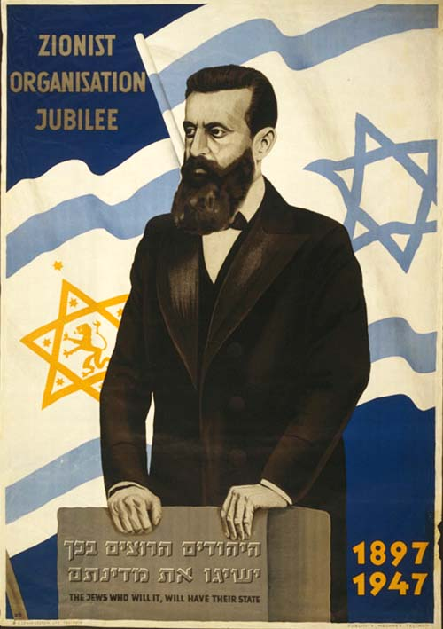
Theodore Hertzel
The Birth of Jewish Zionism
1897

Slide 14
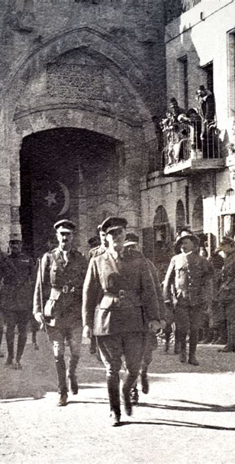
General Allenby Takes Jerusalem
Ottoman Turks Surrender 1917

Slide 15
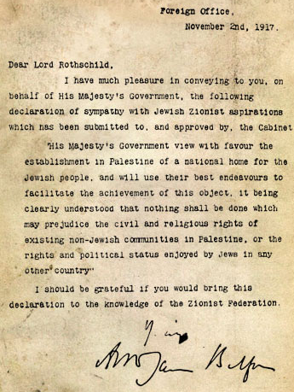
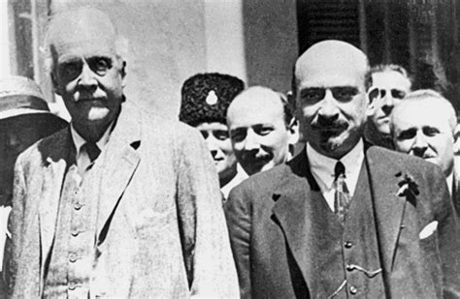
Lord Balfour & Chaim Weizman
The Balfour Declaration 1917
Declares National Homeland for Jews in Palestine
Followed by The San Remo Treaty 1920

Slide 16
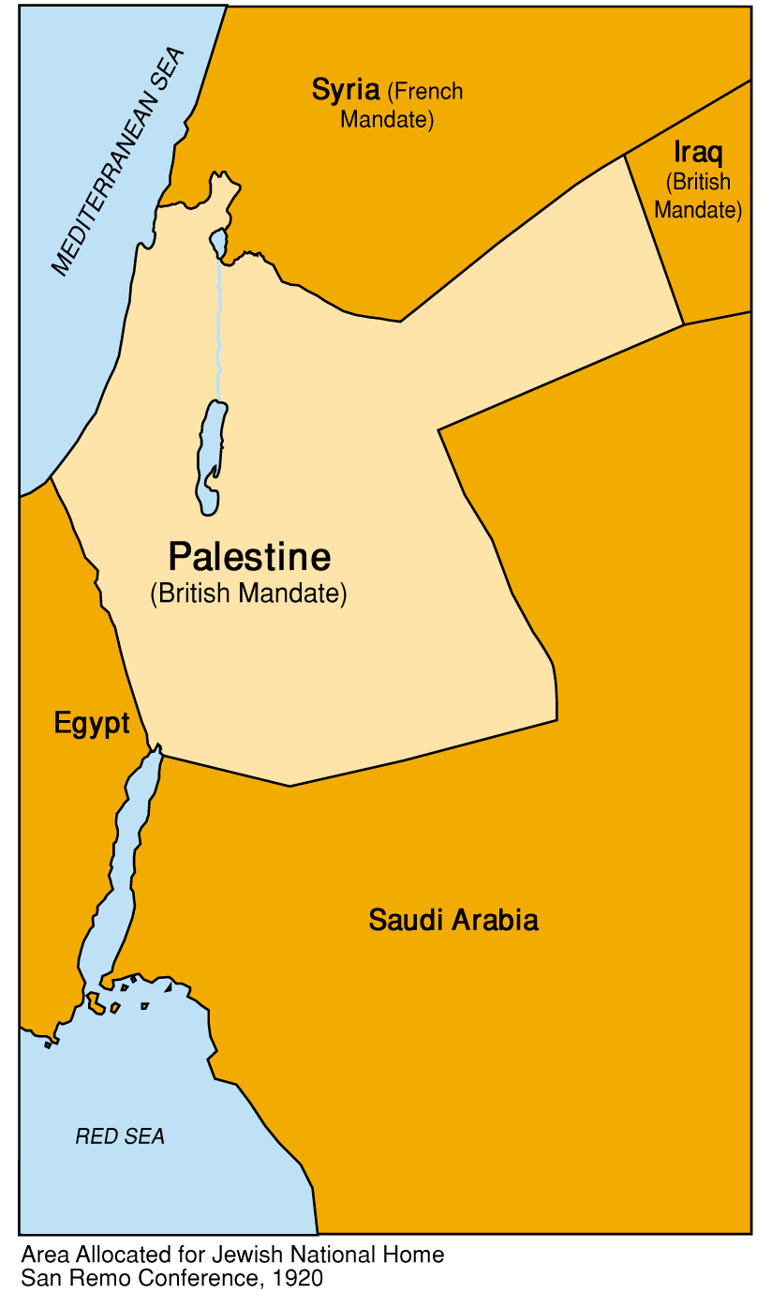
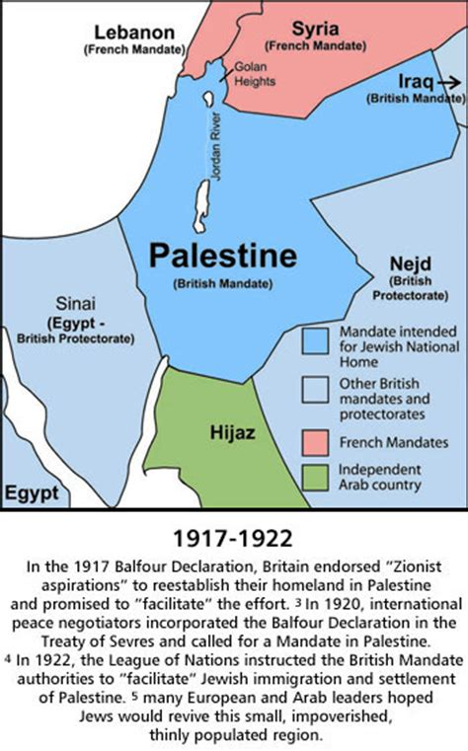
1920 San Remo Treaty Divides Ottoman Empire Creates British Mandate

Slide 17
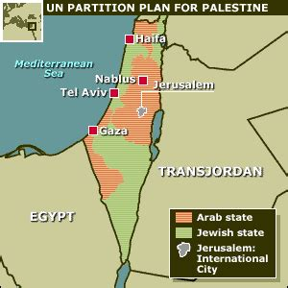
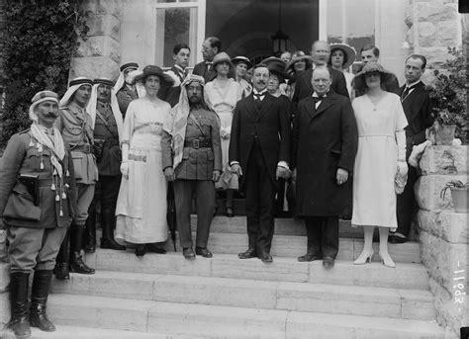
Great Britain betrays Israel
& The 1917 Balfour Treaty
Creates Trans Jordan for Arabs
T.E.Lawrence persuades Winston Churchill to divide the land promised for a Jewish homeland – gives away 77% land to Arabs creating modern country Jordan. Lawrence made a land promise to Sharif Hussein for the Arab Revolt against Ottoman Turks.

Slide 18
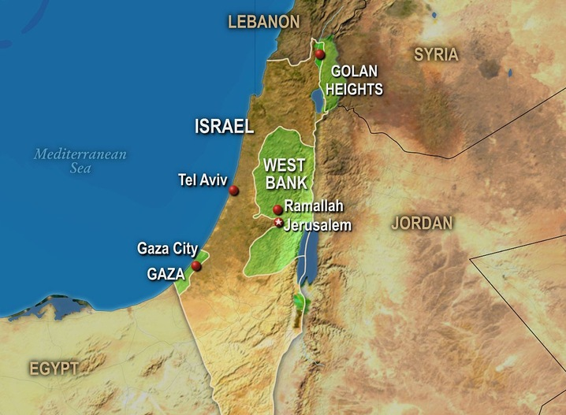
Any Peace Treaty Dividing Israel will cause God’s Wrath

Slide 19
Zechariah 12:2-3
“Behold I will make Jerusalem a cup of trembling to all the people round about, when they shall be in seige against both Judah and Jerusalem. And in that day I will make Jerusalem a burdensome stone for all people: all that burden themselves with it shall be cut in pieces , though all the people of the earth be gathered against it.”
Joel 3 :2-3 “For behold, in those days when I bring again the captivity of Judah and Jerusalem, I will also gather all nations and will bring them down to the valley of Jehoshaphat, and will plead with them there for My people and for My heritage Israel, whom they have scattered among the nations, and parted My Land.”
Isaiah 28:18 “Your covenant with death shall be disannulled, and your agreement with hell shall not stand. When the overflowing scourge shall pass through, then you shall be trodden down by it.”

Slide 20
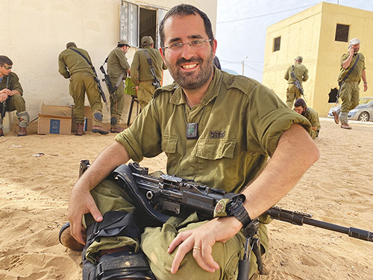
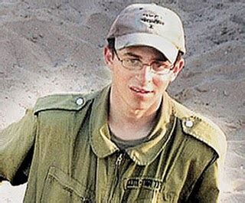
Israel’s IDF Gun Purity Law – “All Life is Precious to God”
“The IDF servicemen and women will use their weapons and force only for the purpose of their mission, only to the necessary extent and will maintain their humanity even during combat. IDF soldiers will not use their weapons and force to harm human beings who are not combatants or prisoners of war, and will do all in their power to avoid causing harm to their lives, bodies, dignity and property.”
When IDF soldier faces imminent enemy attack
1. Loud verbal warning first
2. 2nd verbal warning – chamber round
2. Fire round in the air as warning
3. Shoot at attackers legs
4. Only direct fire after fired upon
When IDF plans enemy assault against terrorist
1. Warning must be issued, by notes or texts
2. Civilians present negates IDF attack
Islamic terrorists take full advantage of Israel’s moral gun code. They stash weapons in schools, homes, and mosques. They hide behind women and children. They build vast underground tunnel systems for quick escape and to kidnap IDF soldiers.

Slide 21
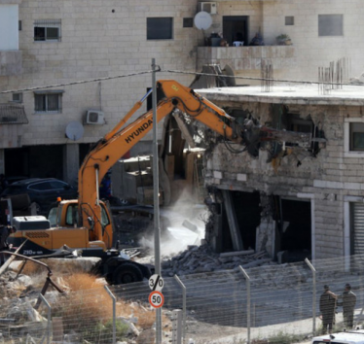
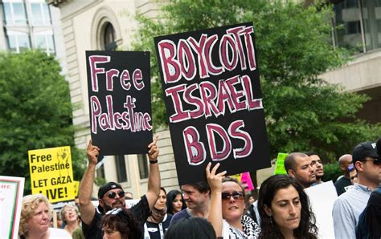
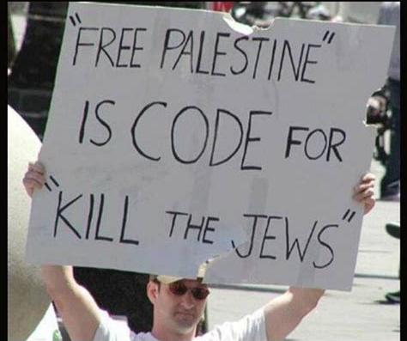
Israel’s Moral Code – Palestinian homes are used to store weapons, rockets, missiles that kill Israeli citizens. Israel’s Gov’t issues a permit to that terrorists’ home. The Palestinian Cause uses this for propaganda to promote “Boycott, Divest, Sanction”

Slide 22
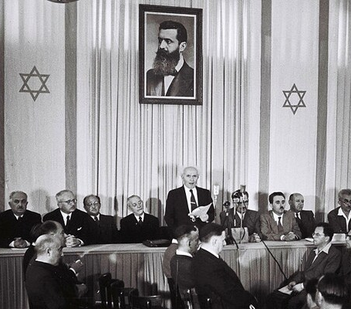
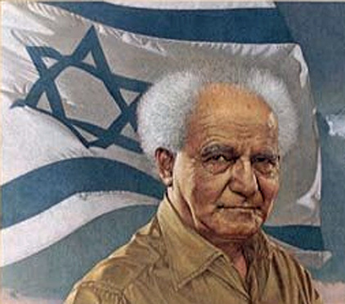
May 14, 1948 - Birth of Modern State of Israel– Isaiah 66:8
David Ben Gurion
“Who has heard such a thing? Who has seen such things? Shall the earth be made to bring forth in one day? Shall a nation be born at once? For as soon as Zion travailed, she brought forth her children.”

Slide 23
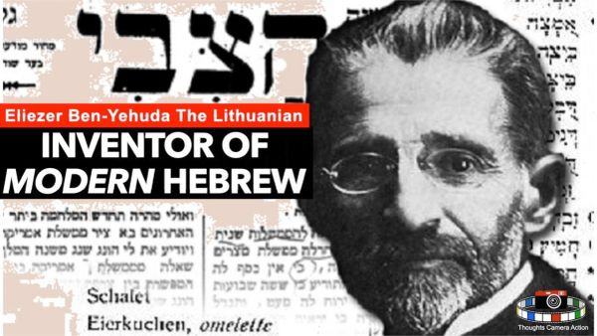
Restoration of Hebrew – Fulfilling Zephaniah 3:9
“For then will I turn to the people a pure language, that they may all call upon the name of the LORD, to serve Him with one consent.”

Slide 24
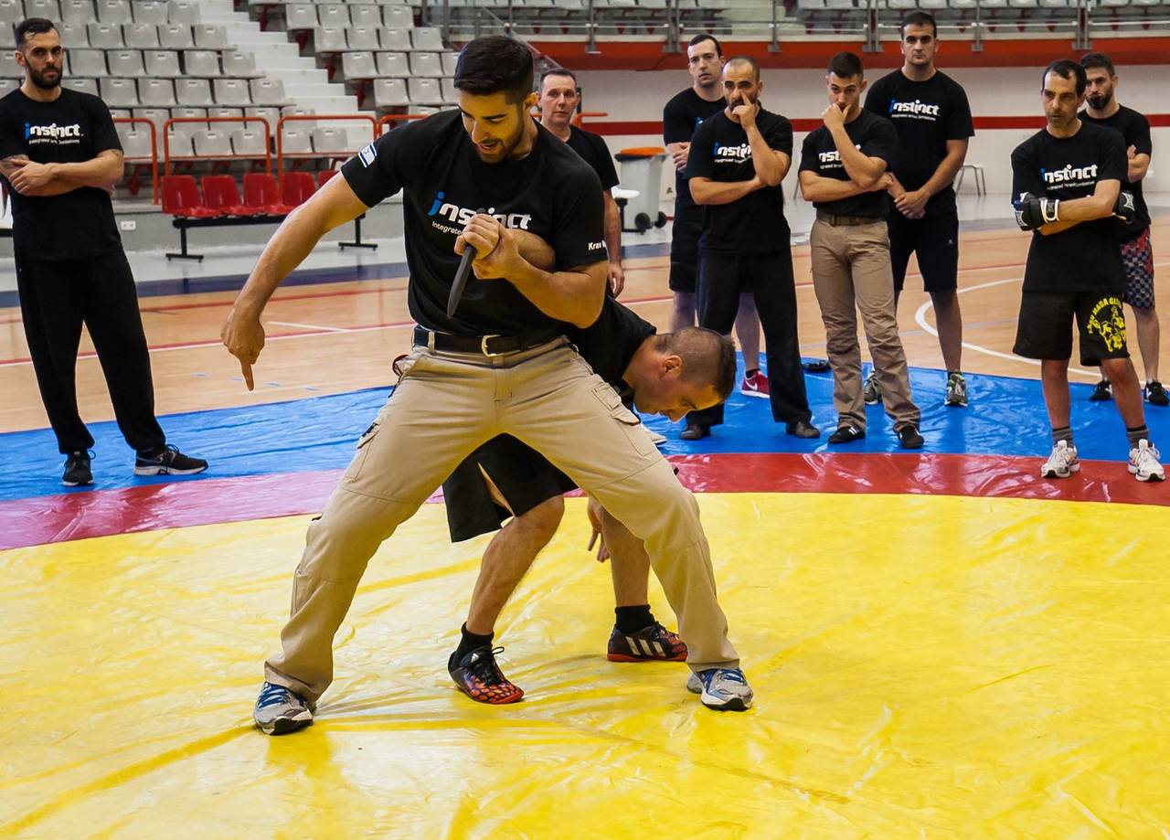
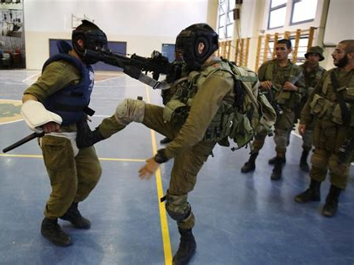
Israeli’s Invent Krav Maga
Greatest Personal Defense Method
Train Armies all over the World

Slide 25
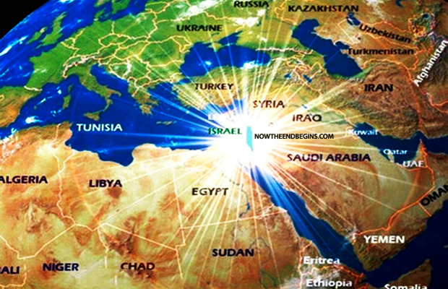
Modern Day Miracle – Return of the Jews from Every Nation

Slide 26
Back to Ezekiel Chapter 37
vs. 15-28
Jews Return Unified as One

Slide 27
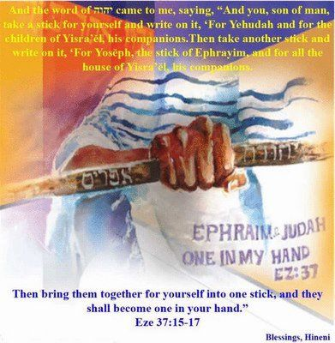
15. The word of the Lord came again to me, saying
16. Moreover, you son of man, take one stick, and write upon it, for Judah
and for the children of Israel his companions:
then take another stick, and write upon it, for Joseph,
the stick of Ephraim and for all the house of Israel his companions:
Join them one to another into one stick; and they shall become one in Your hand.

Slide 28
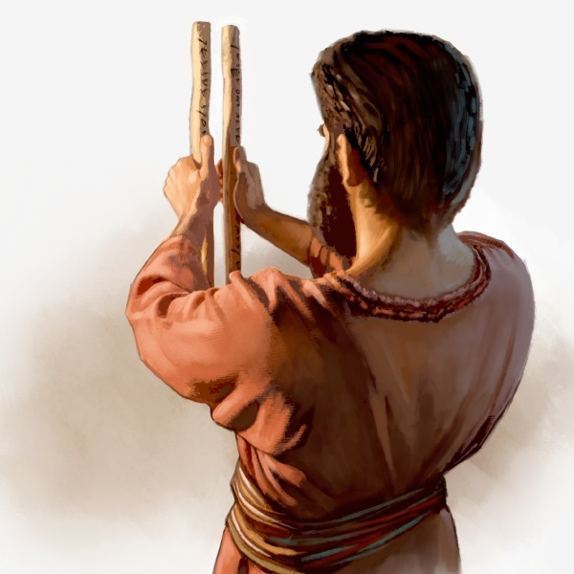
18. And when the children of your people shall speak to you,
saying, Will you not show us what You mean by these?
19. Say to them, Thus says the Lord God;
Behold, I will take the stick of Joseph,
which is in the hand of Ephraim,
and the tribes of Israel his fellows,
and will put them with him,
even with the stick of Judah, and make them one stick,
and they shall be one in My hand.
20. The sticks whereon you write shall be in your hand before their eyes.
21. And say to them, Thus says the Lord God;
Behold, I will take the children of Israel
from among the heathen whither they be gone,
and will gather them on every side,
and bring them into their own land:

Slide 29
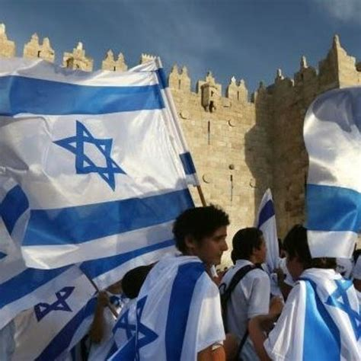
21. And say to them, Thus says the Lord God;
Behold, I will take the children of Israel from among the heathen,
whither they be gone, and will gather them on every side,
and bring them into their own land:
22. And I will make them one nation
in the land upon the mountains of Israel;
and one king shall be king to them all:
and they shall be no more 2 nations,
neither shall they be divided
into 2 kingdoms any more at all.
23. Neither shall they defile themselves any more with their idols,
nor with their detestable things, nor with any of their transgressions: but I will save them out of all their dwelling places,
wherein they have sinned, and will cleanse them:
so shall they be My people, and I will be their God.

Slide 30
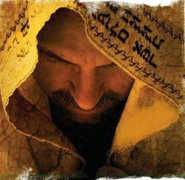
24. And David My servant shall be king over them;
and they all shall have one shepherd:
they shall also walk in My judgments,
and observe My statutes, and do them.
25. And they shall dwell in the land that I have given to Jacob My servant, wherein your fathers have dwelt; and they shall dwell therein,
even they, and their children, and their children's children for ever:
And My servant David shall be their prince for ever.

Slide 31
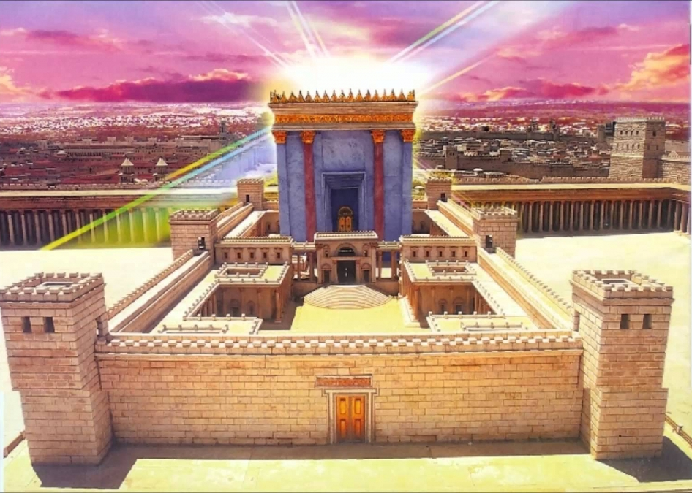
26. Moreover I will make a covenant of peace with them;
it shall be an everlasting covenant with them:
and I will place them, and multiply them,
and will set My sanctuary in the midst of them for evermore.
27. My Tabernacle also shall be with them:
yea, I will be their God, and they shall be My people.
28 And the heathen shall know that I the Lord do sanctify Israel,
When My sanctuary shall be in the midst of them for evermore.

