Slide 2
Spiritual Lesson #1
Every Word in the Bible
is Inspired by the Holy Spirit
Every Word
Every Number
Every Name
Every Place
Has meaning and will take us deeper

Slide 3
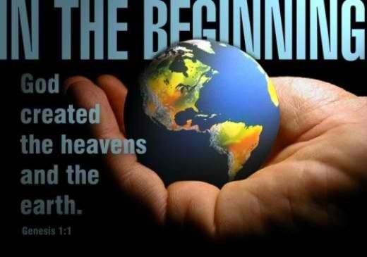
Genesis 1:1

Slide 4
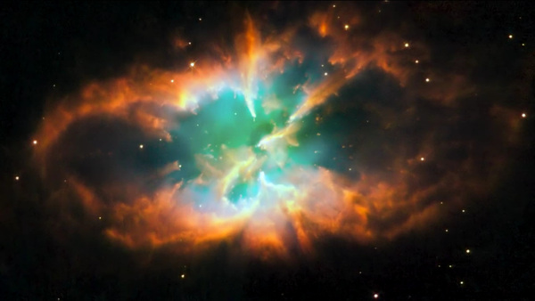
GOD
is CREATOR
Without this TRUTH you have NO FOUNDATION

Slide 5
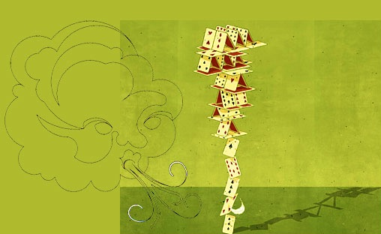
Any great plan you build will eventually collapse like a house of cards, no matter how rich, intellligent, powerful, or successful you are in life. Without GOD we are nothing. With GOD we have EVERYTHING!

Slide 6
We are now beginning a supernatural walk in Christ Jesus that will be for the rest of our lives. The Word of God will make us grounded and rooted for every good work and will train us in righteousness.
If we decide to eat the WORD of GOD ( think on, meditate it, so that it gets down on the inside of our Spirit man ….then the newly created man that is now washed by the Blood of Jesus and filled with the dunamis miracle working power of the Holy Spirit…… will grow and grow

Slide 7
And We will be able to Walk in the Spirit
We will fulfill the plan of God for your life
We can be Changed and Re-Trained
by the Word of God
Other People’s lives will be changed
by the Word working in Us!
We are responsible for Studying and Eating the Word of God
The HOLY SPIRIT is responsible for
Bringing it to our Remembrance

Slide 8
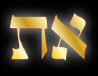
In the first 7 words in our Bible… we can find
an encrypted Hebrew code for the Plan of God
that presents a prophetic timetable
for Jesus 1st and 2nd Coming
The Mystery of
the Alef-Tav

Slide 9
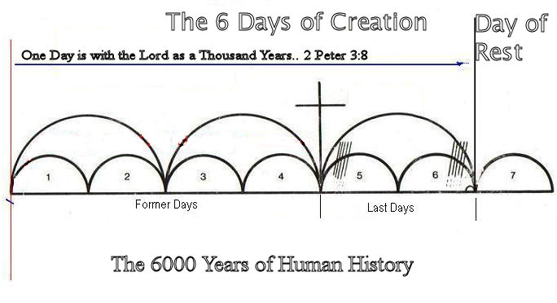
Day 7
Day 6
Day 5
Day 4
Day 3
Day 2
Day 1
“But Beloved, do not be ignorant of this one thing, One Day with the Lord is as 1000 years, and 1000 years as I Day.” 2 Peter 3:8
Adam
Jesus
Millenium
Abraham
Bible Prophecy

Slide 10
Spiritual Lesson #2
Every Spiritual Principle or Foundation
Starts in Genesis
*Law of 1st Mention
It’s the foundation scripture*

Slide 11
Spiritual Principles operate
just like physical principles.
The Law of Gravity
“What Goes UP must COME DOWN”
The Law of Reaping & Sowing
“Whatever a Man sows, so shall he also reap”
Understanding God’s Spiritual
Principals will change your life.

Slide 12
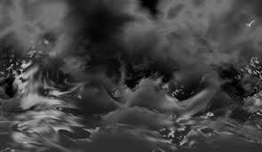
2.“And the Earth was without form, and void, and darkness was upon the face of the earth
and the Spirit of God moved
on the face of the earth.”

Slide 13
This is exactly how we were
BEFORE we were Born Again…
Without form,
Void of understanding & purpose
Walking in darkness
and we don’t even know it!
And then THE HOLY GHOST
began to move in us
Watch the progression
of our Spiritual Creation in HIM

Slide 14
3. Then God said, Let there be Light, and there was Light.
4. And God saw the Light, that it was good; and God divided the Light from the darkness. 5. And God called the Light day, and the darkness He called night. And the evening and the morning were the 1st day.”

Slide 15
God spoke and commanded LIGHT into existence
His SPOKEN WORD has the power to bring life
out of the nothingness inside of us
That same WORD spoken in faith meaning we are fully persuaded GOD is able to do what He says in His WORD….
can now bring LIFE into any area in our lives……
Mind Relationships
Will Home
Emotions work
Trust in any area

Slide 16
John 1:15 is the parallel passage, connecting OT and NT
and adds deeper revelation to Genesis.
“In the Beginning was the Word and the Word was with God and the Word was God. The same was in the Beginning. All things were made by Him and without Him was not anything made that was made. In Him was Life; and the Life was the Light of Men. And the Light shines in the darkness and the darkness comprehends it not.”
There are only 2 Kingdoms:
The Kingdom of Light
&
The Kingdom of Darkness

Slide 17
4. And God saw the Light, that it was Good;
and God divided the Light from the Darkness.”
Spiritual Lesson #3 Light Separates Darkness

Slide 18
When you ask Jesus to become Lord & Savior in your life,
He can separate all darkness in every area of your life.
When you pray, now ask the Holy Spirit who lives on the inside of you to put LIGHT in any area and separate darkness.
The Holy Spirit acts like a flashlight that searches
into the inner workings of a man,
all that is hidden and covered up
from other people
-sometimes even hidden from us

Slide 19
And with our permission,
He can empty our garbage can
From all the trash we have pressed down on the inside of us!
All our moral failures
All addiction
All strongholds,
All selfish desires
All impure thoughts
All anger & unforgiveness
Anything that separates us from Loving God with all our hearts, all our minds, with all our strength…

Slide 20
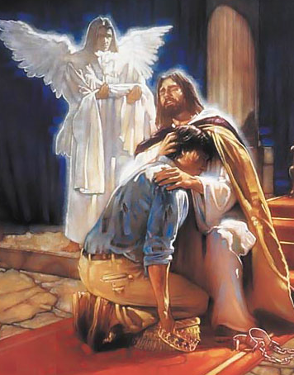
And He can show us
how to love supernaturally, people who have hurt us, used us, betrayed us, ridiculed us .
Working on the inside
Bringing Change on
the outside!

Slide 21
It’s amazing how much He loves Us!
Are You Ready to Start
a Supernatural Life in the Word

