Slide 1
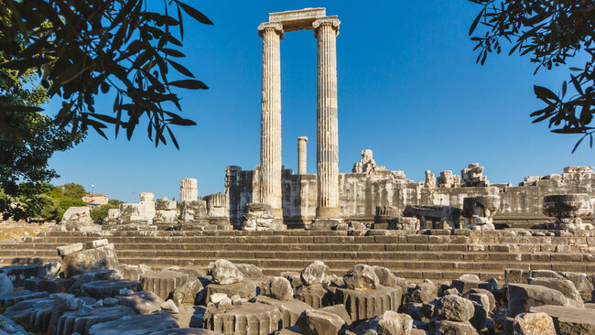
The Church of Smyrna

Slide 2
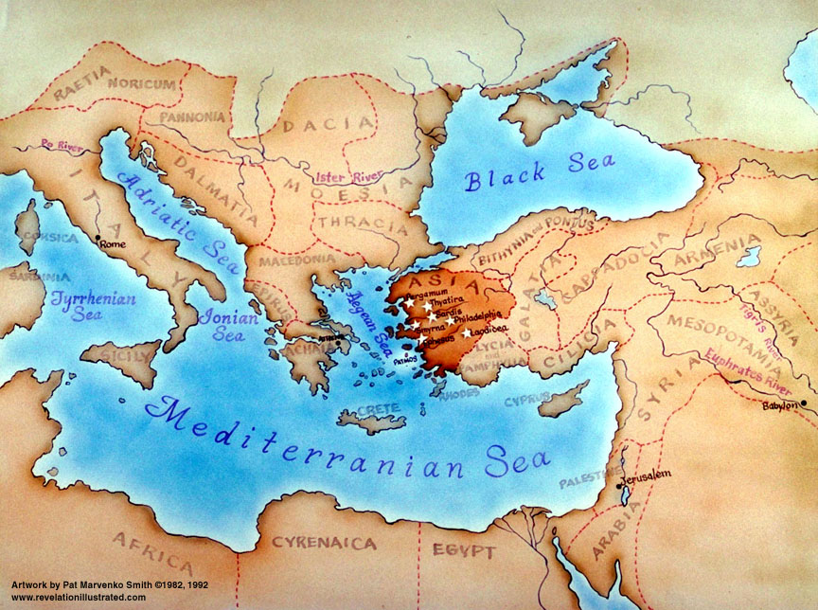

Slide 3
⁸ And unto the angel of the Church in Smyrna write; These things says the first and the last, which was dead, and is alive;
⁹ I know your works, and tribulation, and poverty, (but you are rich)
and I know the blasphemy of them which say they are Jews,
and are not, but are the synagogue of Satan.
¹⁰ Fear none of those things which you shalt suffer: behold,
the devil shall cast some of you into prison, that you may be tried;
and you shall have tribulation 10 days: be you faithful unto death,
and I will give you a crown of life.
¹¹ He that has an ear, let him hear what the Spirit says to the Churches; He that overcomes shall not be hurt of the 2nd death.

Slide 4
Report Card to Smyrna Church – Persecuted
From Jesus who is the First and the Last
Who was dead and Lives Again!
I Know:
Your Tribulation A
Your Poverty from Persecution A
Your Trouble from Blasphemers A
they are not Jews but satan’s
Comments: Don’t fear suffering
The devil will cast you into prison. You will be tried.
Trouble for 10 days. Be faithful unto death!
Reward: Overcomers, I will give you the crown of Life!
You will not be hurt by the 2nd Death!
He that has an Ear, let him Hear
What the Spirit says to the Churches

Slide 5
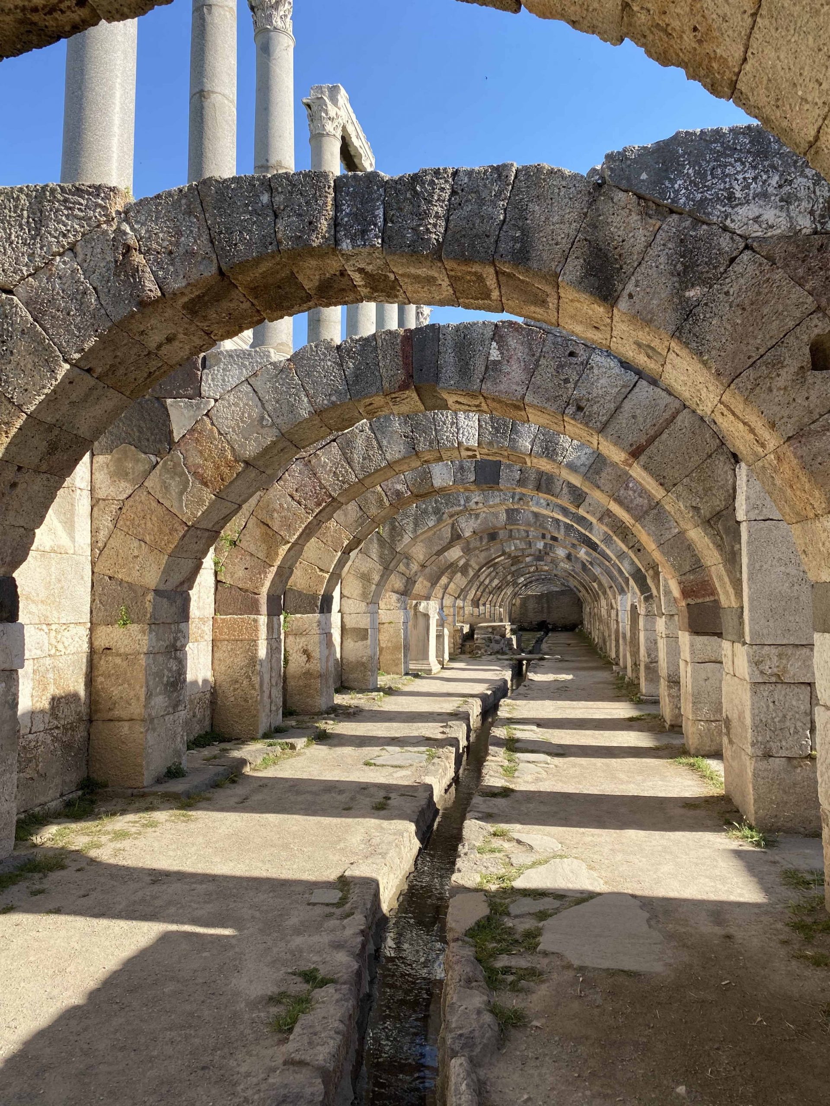
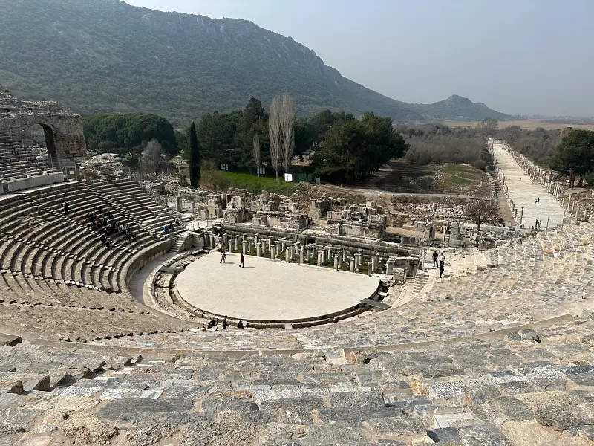

Slide 6
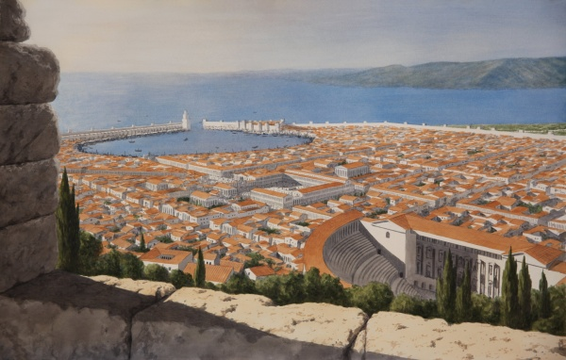
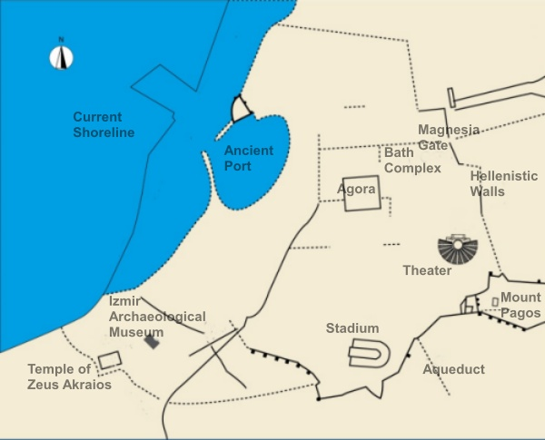
The Name Smyrna comes from Myrrh
Modern Day Turkish City of Ismir

Slide 7
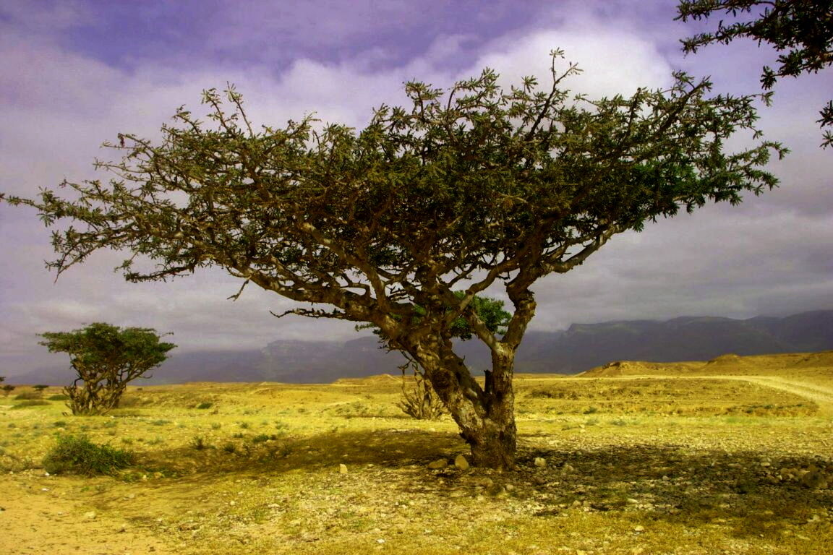
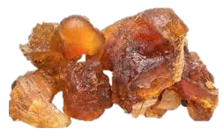
Smyrn
Ancient Smyrna was the oldest city on the Aegean Coast, along with Troy- 3000 BC
The name Myrrh comes from Hebrew root “mar” meaning “bitterness”
Small myrrh trees/bushes grow everywhere in the Middle East
and produce a gum made by cutting incisions into the bark
Myrrh was widely used in Bible times
As an ingredient for Holy Anointing Oil
As a costly perfume
As an anesthetic ointment to relieve pain As an embalming agent for burial

Slide 8
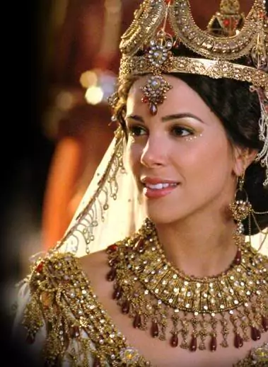
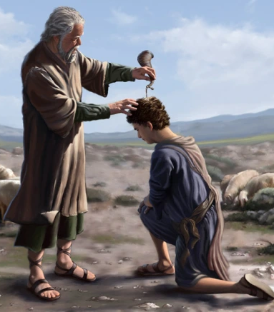
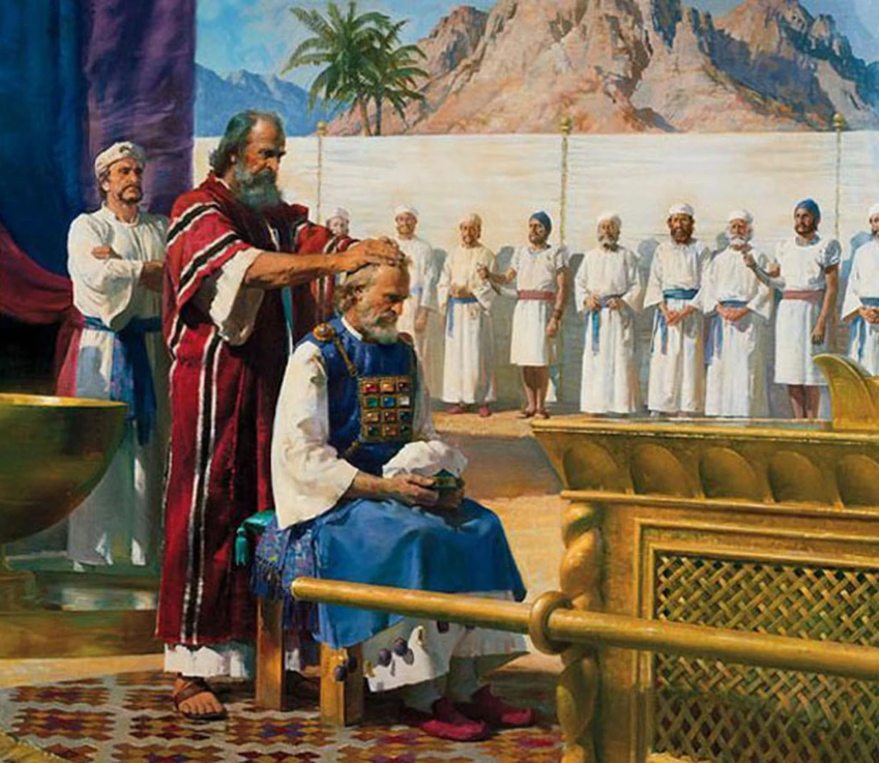
Myrrh has many uses in the Bible
#1. Exodus 30:23
Holy Anointing Oil for Priests and Temple Furniture
#2. Esther’ Chapter 2
To Anoint her Body
#3. Anointing Kings of Israel
Psalms 45, Song of Solomon

Slide 9
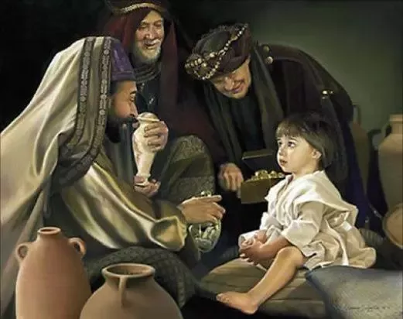
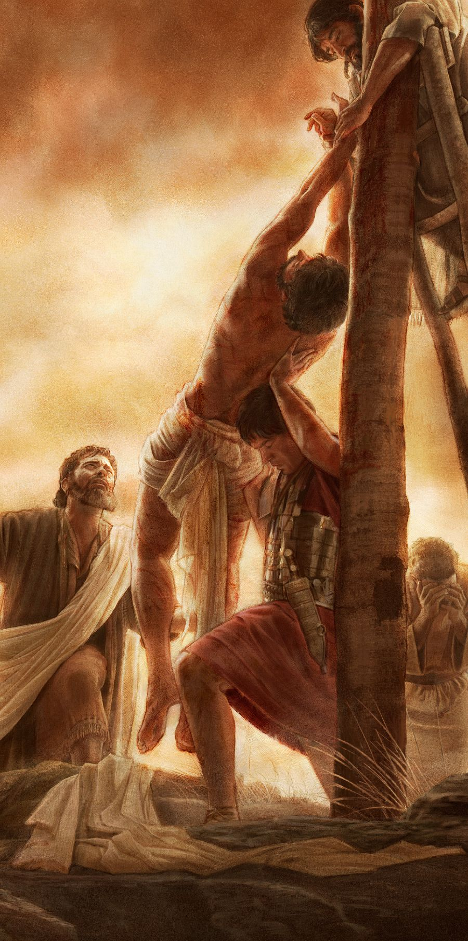
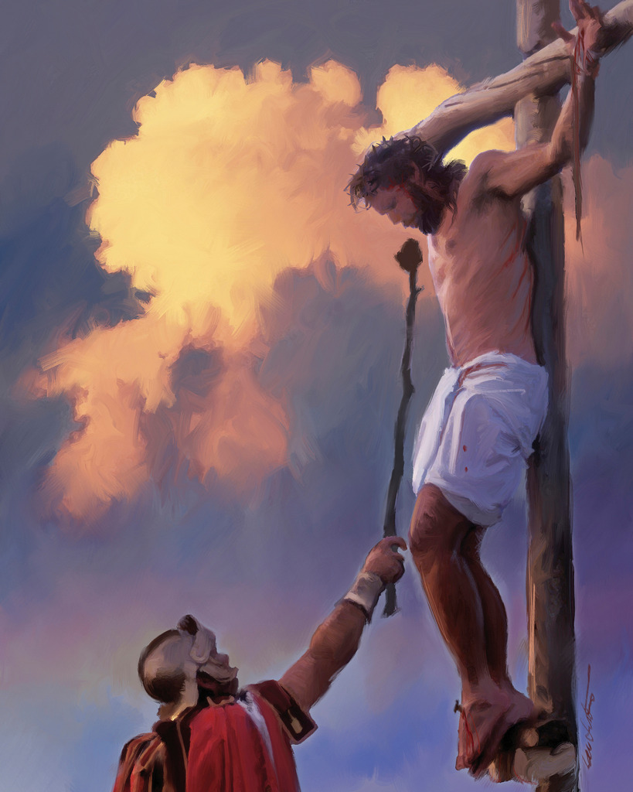
Myrrh in Jesus’ Life
#1 Matthew 2:11 And when they were come into the house, they saw the young child with Mary his mother, and fell down, and worshipped him: and when they had opened their treasures, they presented to him gifts; gold, frankincense, and myrrh.
#2 Mark 15:23. And they gave Him to drink wine mingled with myrrh:
but He received it not.
#3 John 19:39 And there came also Nicodemus, which at the first came to Jesus by night, and brought a mixture of myrrh and aloes, about 100 lb. weight.

Slide 10
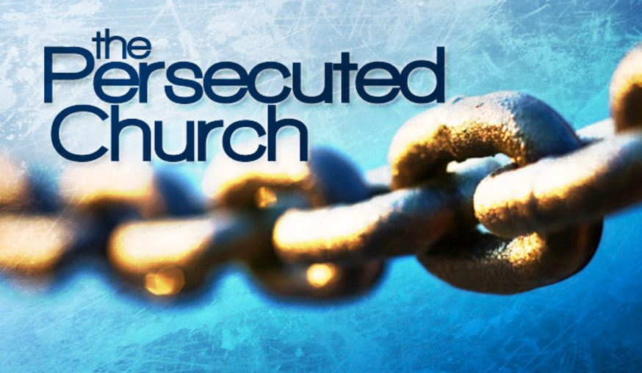
In Jesus’ Letter to the Church of Smyrna
We Meet
Past, Present & Future
Past, Present & Future

Slide 11
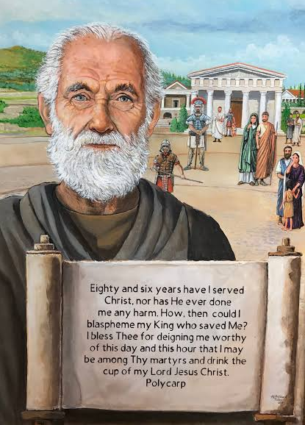
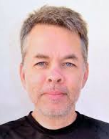
The Persecuted Church
John had a favorite young disciple named Polycarp, who later became Smyrna’s Church leader after John’s death. He was martyred at age 85 in Smyrna 156 AD.
Tied to a stake in the amphitheater, Polycarp was pierced through the heart by a Roman soldier, then burned in front of thousands of cheering Romans.
Pastor Andrew Brunson
Served 23 years in Smyrna,
Was arrested in Turkey on false charges in 2016, put in prison and almost died. He was released in 2018 only because of great pressure from Trump and the press.

Slide 12
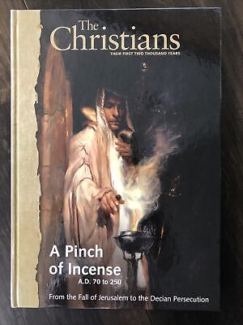
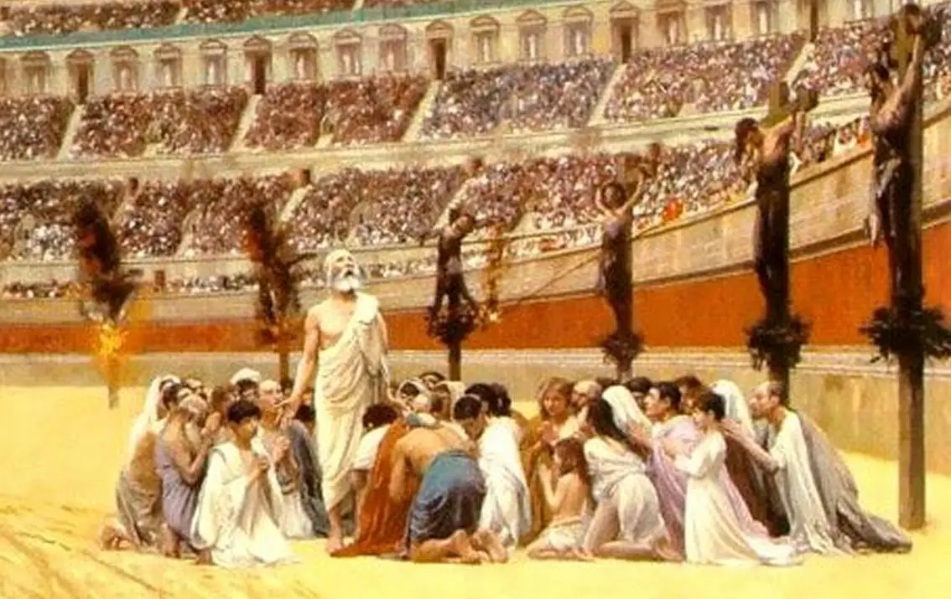
Revelation 2:9 “I know your works, and tribulation, and poverty, (but you are rich)”
Jesus told the Smyrna Church He knew the tribulation they were suffering. These believers were poor because they refused to offer incense for Roman Emperor cult worship. These Christians were not allowed in trade guilds, so lost businesses and homes. These Christians faced poverty, hunger, prison, crucifixion. They were burned alive, fed to lions, killed by gladiators - all for their faith in Jesus.

Slide 13
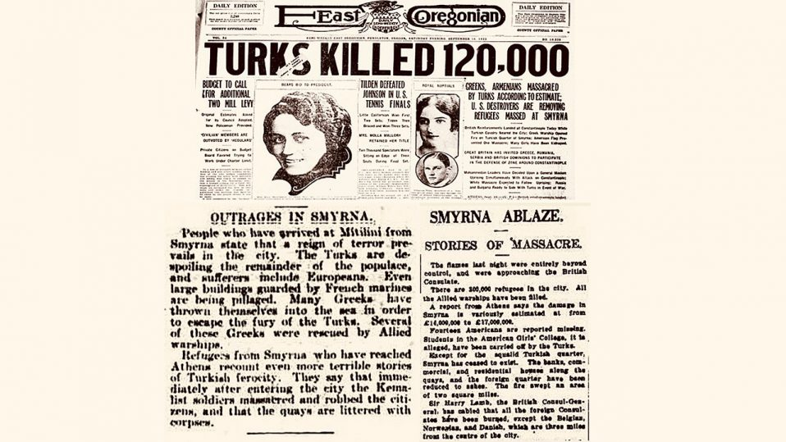
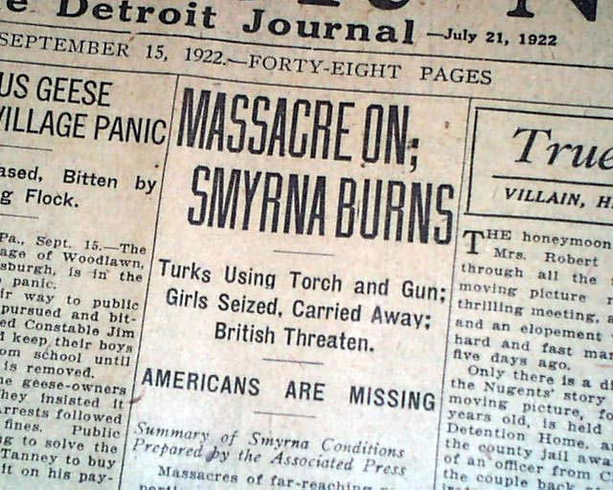
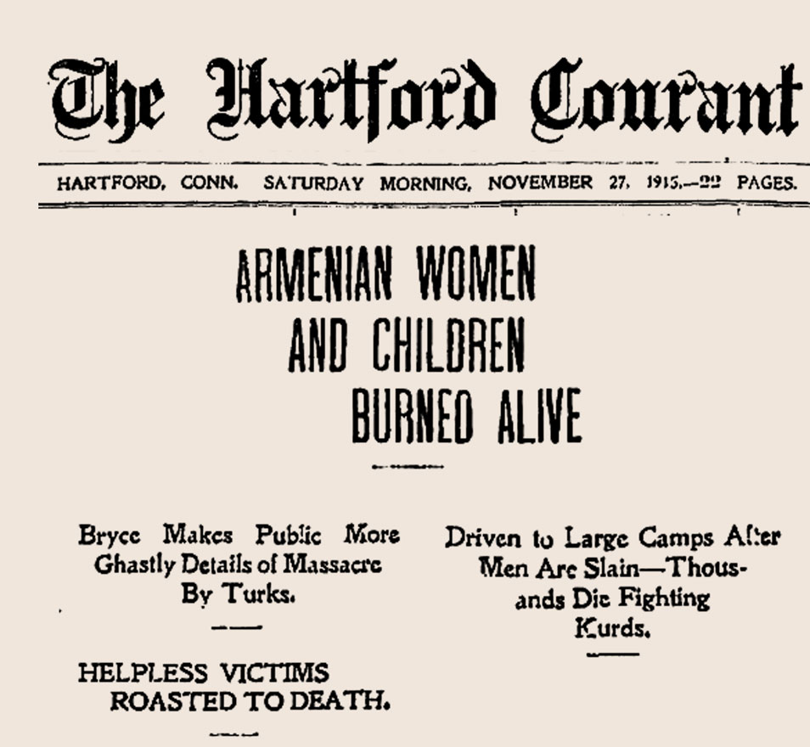
Revelation 2:10
“Fear none of those things which you shalt suffer: behold, the devil shall cast some of you into prison, that you may be tried; and you shall have tribulation 10 days: be you faithful unto death,”
What and When did Smyrna Christians Suffer for 10 Days
“Smyrna Burning – Final 10 Days of Armenian Genocide” September 13-22, 1922

Slide 14
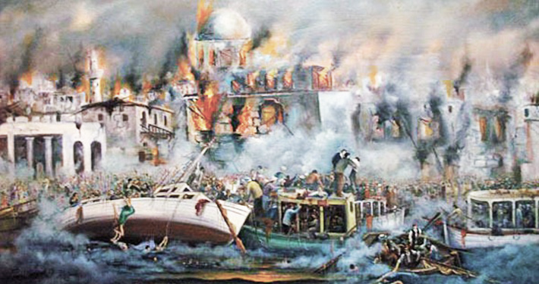
and you shall have tribulation 10 days: be you faithful unto death.”
10 Days in 1922 from September 13-22

Slide 15
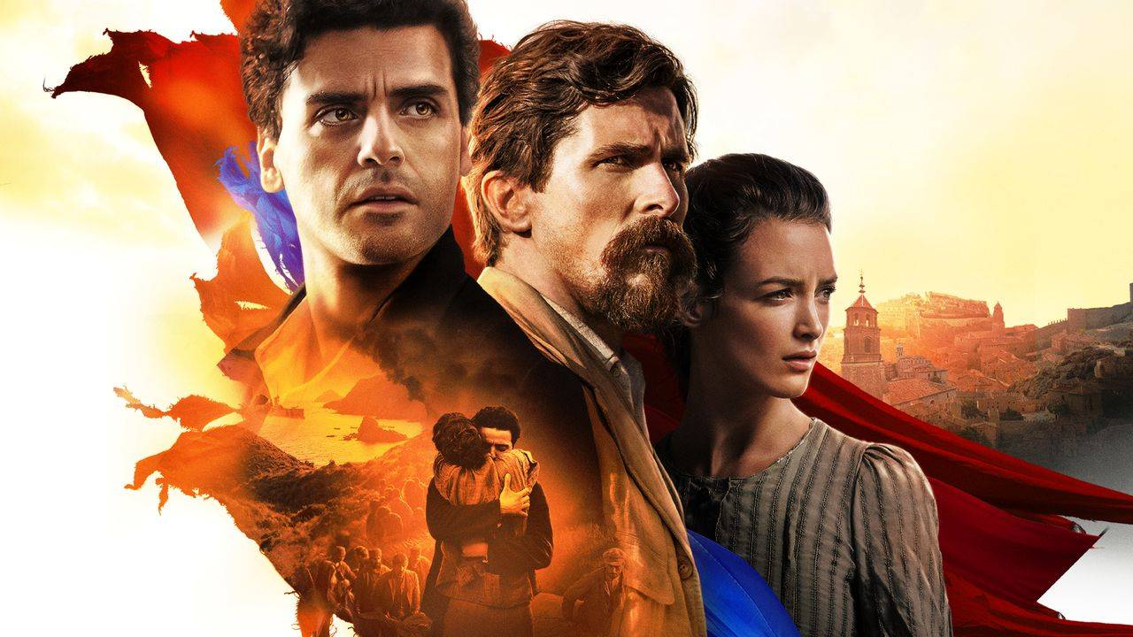
“The Promise”
A Movie about the Armenian Genocide

Slide 16
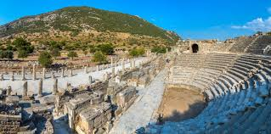
Smyrna was known as the Crown of Ionia

Slide 17
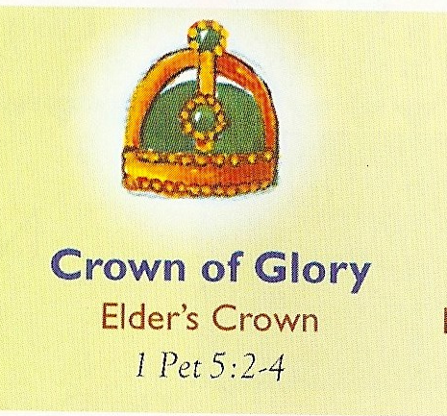
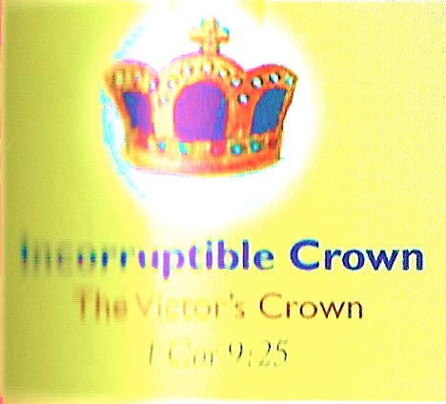
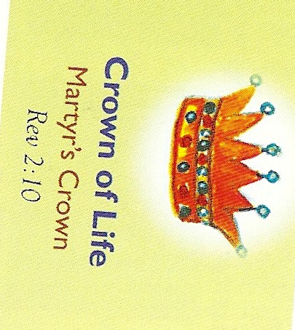
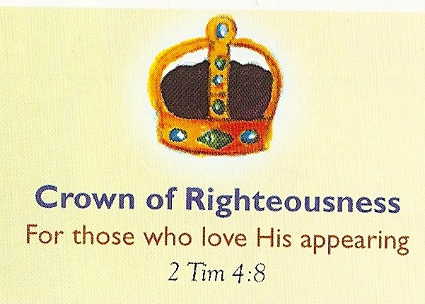
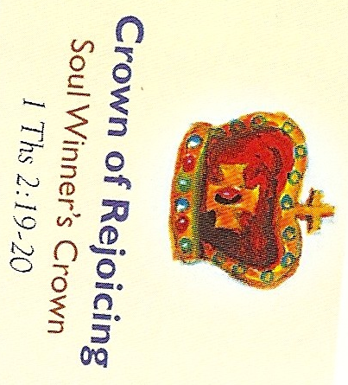
“.. And I will give you
a crown of life”
Revelation 2:10
Incorruptible Crown
The Victor’s Crown
1 Corinthians 9:25

Slide 18
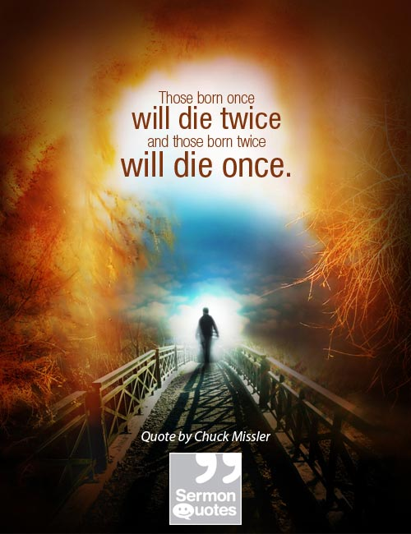
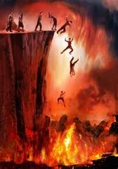
Revelation 2:11
He that has an ear, let him hear what the Spirit says to the Churches;
He that overcomes shall not be hurt of the 2nd death.
The 2nd death will be the great final
Day of the Lord (John 5:28-29)
"Marvel not at this: for the hour is coming,
in the which all that are in the graves shall hear His voice, and shall come forth;
they that have done good, unto the Resurrection of life; and they that have done evil, unto the Resurrection of damnation."
Revelation 20 describes the Great White Throne Judgment when the unsaved will be cast into the Lake of Fire because their names were not found in the Lamb’s Book of Life.
This is the 2nd Death.

Slide 19
The Church of Smyrna

