Slide 1
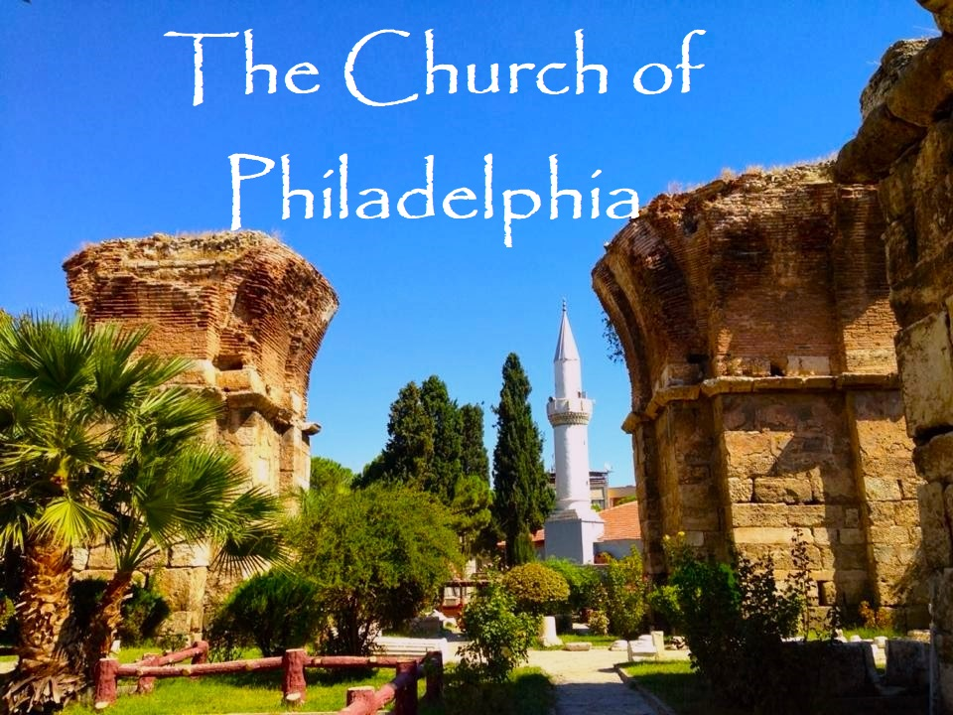

Slide 2
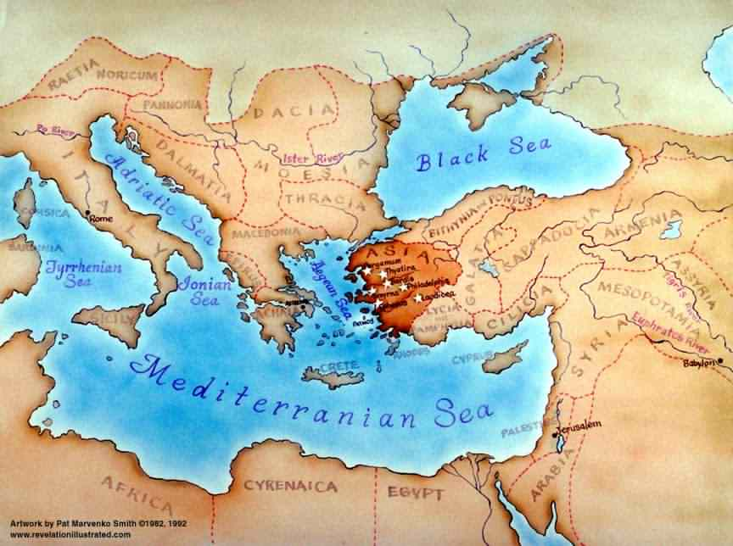

Slide 3
The Church of Philadelphia Revelation 3:7-13
⁷ And to the angel of the church in Philadelphia write; These things says He that is holy, He that is true, He that has the key of David, He that opens, and no man shuts; and shuts, and no man opens;
⁸ I know your works: behold, I have set before you an open door, and no man can shut it:
for you have a little strength, and have kept My Word, and have not denied My Name.
⁹ Behold, I will make them of the synagogue of Satan, who say they are Jews, and are not, but do lie; behold, I will make them to come and worship before your feet, and to know that I have loved you.
¹⁰ Because you hast kept the word of My patience, I also will keep you from the hour of temptation, which shall come upon all the world, to try them that dwell upon the earth.
¹¹ Behold, I come quickly: hold that fast which you have, that no man take your crown.
¹² Him that overcomes will I make a pillar in the Temple of My God, and he shall go no more out:
and I will write upon him the name of My God, and the name of the City of My God, which is New Jerusalem, which comes down out of heaven from My God: and I will write upon him My new Name.
¹³ He that has an ear, let him hear what the Spirit says unto the Churches.

Slide 4
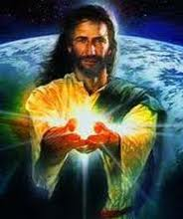
Report Card to Philadelphia - Lover of the Brethren
From Jesus who is Holy and True, and has the Key of David.
He opens and shuts doors supernaturally!
I Know:
Your Works A
Kept My Word and Patience A
Did Not Deny My Name A
Rewards:
They will know I love you,
They will worship at your feet.
I will keep you from the entire time of the Tribulation!
I will make you a pillar in My Temple – never to leave again!
I will write on you the Name of My God, the Name of New Jerusalem,
and My own new Name.
He that has an ear,
let him hear what the Spirit says to the Churches

Slide 5
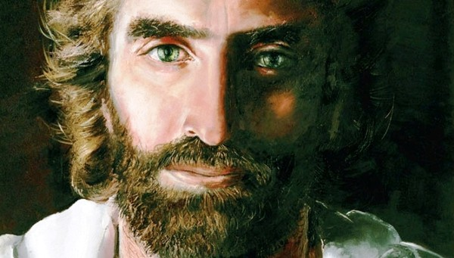
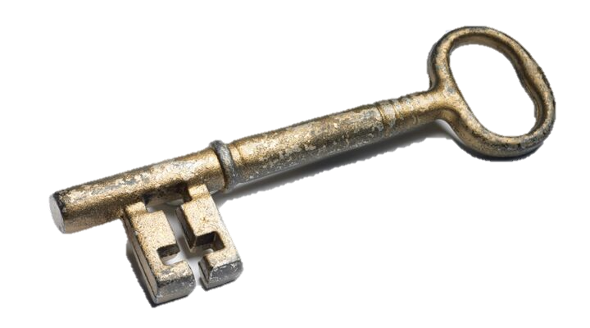
Revelation 3:7 “And to the Angel of the Church in Philadelphia, write:
These things says He that is holy, He that is true, He that has “the key of David,”
He that opens and none shall shut, and He that shuts and none opens:
In Isaiah 22:22 God speaks of Eliakim – A Prophetic Picture of the Messiah
“And the key of the house of David will I lay upon His shoulder;
so He shall open, and none shall shut; and He shall shut, and none shall open.”

Slide 6
“The Key of David” is a Messianic term found both in Revelation and Isaiah.
A key gives control or authority; therefore, whoever has the Key of David
has been given power over David’s Kingdom: over Jerusalem,
over the City of David, over the Kingdom of Israel.
Jesus has been given “the Key of David” & The throne of David
Isaiah 9:7
Of the increase of His government and peace there shall be no end,
Upon the throne of David, and upon His kingdom,
To order it, and to establish it with judgment and with justice
From henceforth even for ever.
The zeal of the Lord of hosts will perform this.
Luke 1:32
“He shall be great, and shall be called the Son of the Highest:
and the Lord God shall give unto Him the throne of his father David:”

Slide 7
Matthew 16:15-19
When Jesus asked His disciples,
Who do you say that I am ?’
And Peter replied, ”
You are the Christ (Messiah)
the Son of the Living God”
Jesus said, “Blessed are you Peter, for flesh and blood has not revealed this to you, but My Father which is in heaven. On this rock I will build My Church, and the gates of hell shall not prevail against
The Church. And I will give to you the keys of the Kingdom of heaven,: and whatsoever you bind on earth shall be bound in heaven, and whatsoever you shall loose on earth shall be loosed in heaven. “

Slide 8
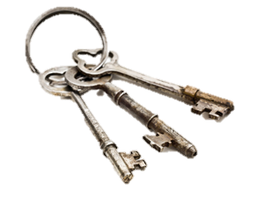
Jesus Controls the Keys
Matt 16:19 Jesus offers the Keys of the Kingdom of Heaven
to Peter & the power to bind and to loose
We have been given power to bind & Loose
Believers have an open door to Heaven
Luke 11:52 Jesus says the lawyers have taken away
the Key of knowledge
We have the Holy Spirit – the Key to all knowledge
Revelation 1:18 Jesus has the keys of hell and of death
Revelation 9:1 He controls the key to the bottomless pit

Slide 9
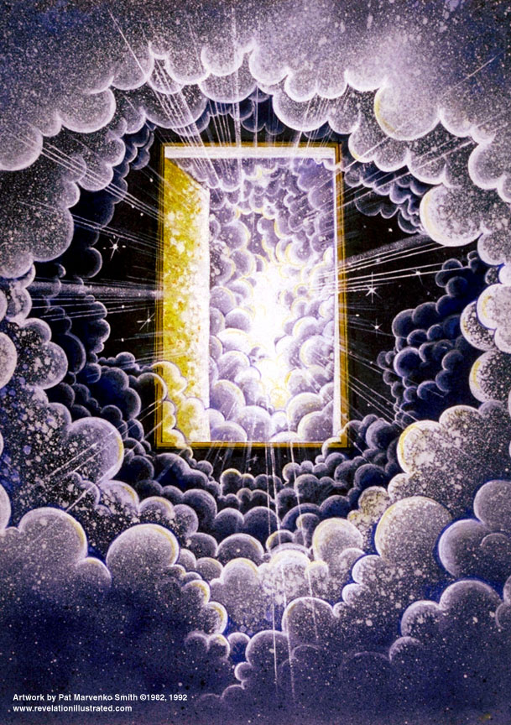
Revelation 3:8
“I know your works,
Behold I have set before you a door opened,
which none can shut”
“An Open Door” – 2 Meanings
For Missions & Ministry
For the Rapture
Revelation 4:1 - A Picture of The Rapture
”After this I looked and behold, a door was opened in heaven: and the first voice which I heard like a trumpet said, “Come up hither, and I will show you things which must be hereafter.”

Slide 10
God Opens Doors for Ministry and for His Leaders
1 Corinthians 16:9 ( Paul said )
“For a wide door for effective service has opened to me,
and there are many adversaries.”
2 Corinthians 2:12 (again Paul)
“Now when I came to Troas for the gospel of Christ
and when a door was opened for me in the Lord,
Colossians 4:3 (Paul) “Withal praying also for us,
that God would open unto us a door of utterance,
to speak the mystery of Christ…”
Isaiah 45:1
“Thus says the Lord to Cyrus His anointed
Whom I have taken by the right hand
To subdue nations before him
And to loose the loins of kings
T o open doors before him so that gates will not be shut:”

Slide 11
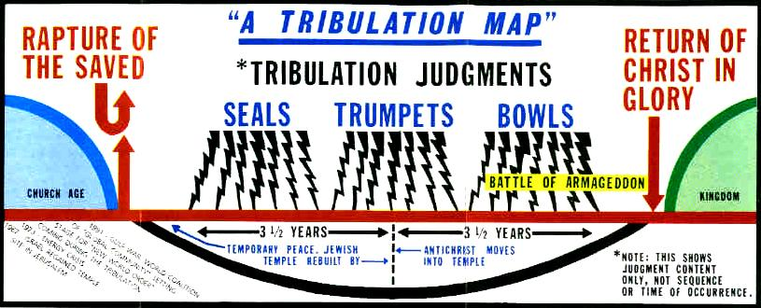
The Church of Philadelphia “The Lover of the Brethren”
“Because you have kept the word of My patience, I also will keep you from (ek- out of) the hour (the entire age) of temptation (Tribulation), which shall come upon all the world, to try them that dwell upon the earth.” Revelation 3:10

Slide 13
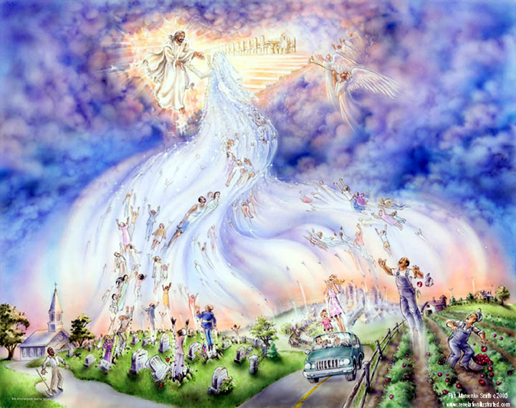

Slide 14
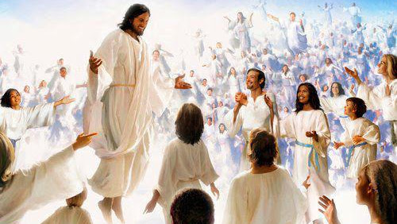
“Behold, I show you a mystery: we shall not all sleep, but we shall all be changed. In a moment, in the twinkling of an eye,, at the last trump: For the trumpet shall sound, and the dead in Christ shall be raised incorruptible, and we shall be changed.” 1 Corinthians 15:51-52

Slide 15
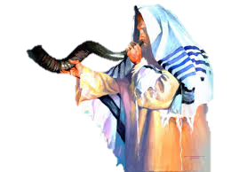
1 Thessalonians 4:14-18 Rapture Verses
“ For if we believe that Jesus died and rose again,
even so them also which sleep in Jesus will God bring with him.
For this we say unto you by the word of the Lord,
that we which are alive and remain unto the coming of the Lord
shall not prevent them which are asleep.
For the Lord himself shall descend from heaven with a shout,
with the voice of the archangel,
and with the trump of God:
and the dead in Christ shall rise first:
Then we which are alive & remain shall be caught up
together with them in the clouds,
to meet the Lord in the air:
and so shall we ever be with the Lord.
Wherefore comfort one another with these words.” –

Slide 16
The Word Rapture
is
Harpazo (Greek)
“The Catching Away”

Slide 17
Where does Jesus first refer to the Rapture in the Scriptures?
During the Last Supper, the Passover, Jesus teaches His own about His soon departure and the Rapture to come!
He only reveals this after Judas has departed to betray Him.
John 14:1-3
“Let not your heart be troubled:
you believe in God, believe also in Me.
In My Father’s house are many mansions: If it were not so, I would have told you.
I go there to prepare a place for you.
And if I go to prepare a place for you,
I will come again and receive you unto Myself
that where I am, there you may be also.”

Slide 18
The Rapture is
The Father’s Reward
for Faithfulness
for Readiness
for Righteousness
Trusting the
Precious Holy Spirit
to lead you!

Slide 19
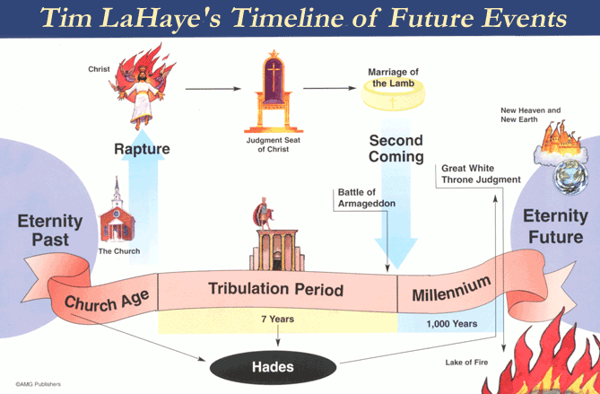
The Timing of the 2 Judgments

Slide 20
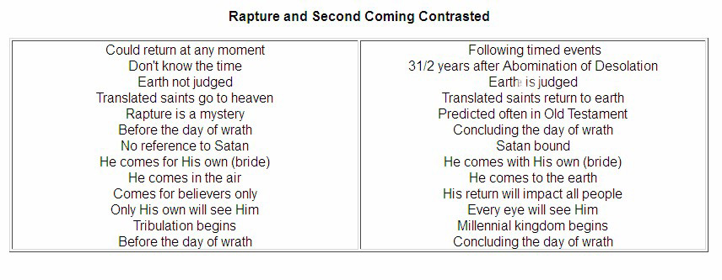
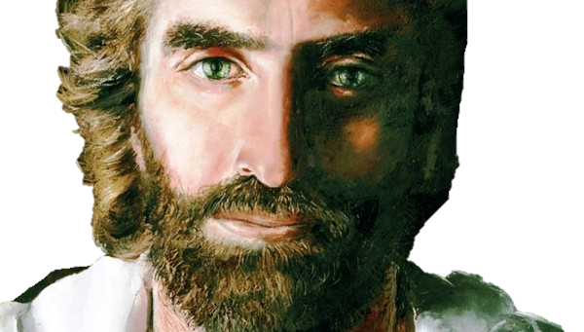

Slide 21
30 AD
457 BC
26 AD

Slide 22
8. “For you have a little strength, and did keep My Word, and did not deny My Name.”
9. Behold I will make them of the synagogue of Satan, which say they are Jews, and are not, but do lie;
Behold I will make them to come and worship before your feet, and to know that I loved you.”

Slide 23
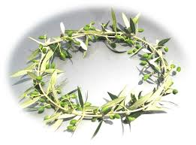
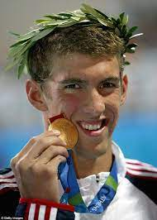
3:11 “ I come quickly: hold fast that which you have, that no man take your crown.”
This crown is for the overcomers(stephanos) who finish the race
The victors would receive a garland of laurel leaves.

Slide 24
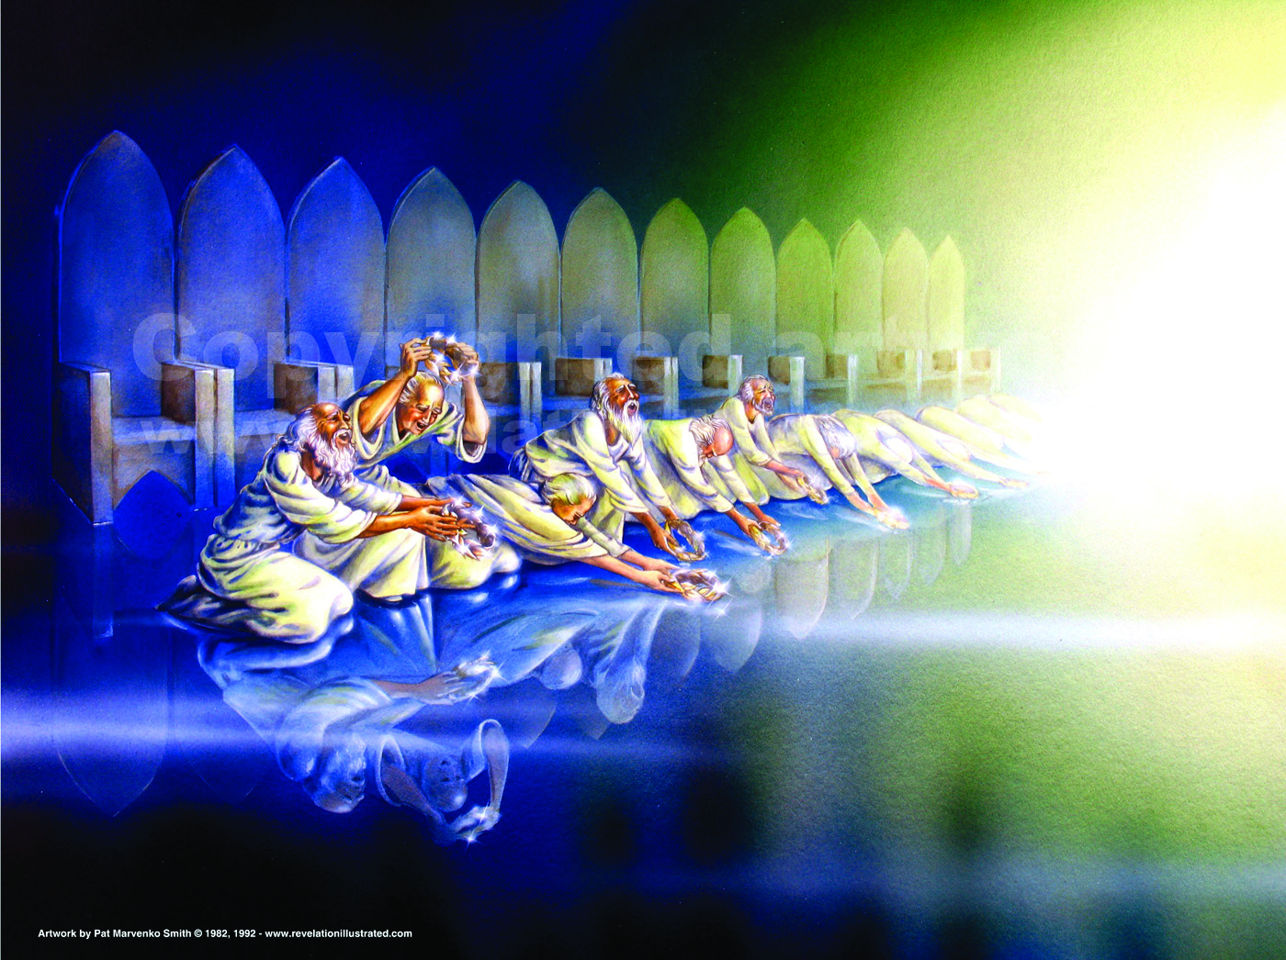
Rev 4:10 “the 24 elders fall down before Him who sits on the throne, and woship Him that lives forever and ever, and cast their crowns before the throne saying,
You are worthy, O Lord, to receive glory and honor and power, for you have created all things, and for Your pleasure they are and were created.”

Slide 25
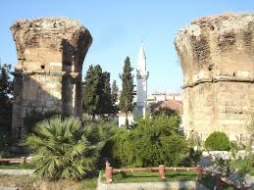
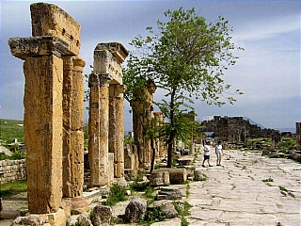
Revelation 3:12
“He that overcomes, I will make him a pillar in the Temple of My God,
and he shall go out of thee thence no more.”
Ancient Philadelphia was subject to volcanic eruptions and earthquakes. A great earthquake leveled the city in 17 AD, and then again and again for the next 20 years. The people rushed out into the fields to escape. When they returned to rebuild, they always found the pillars still standing.

Slide 26
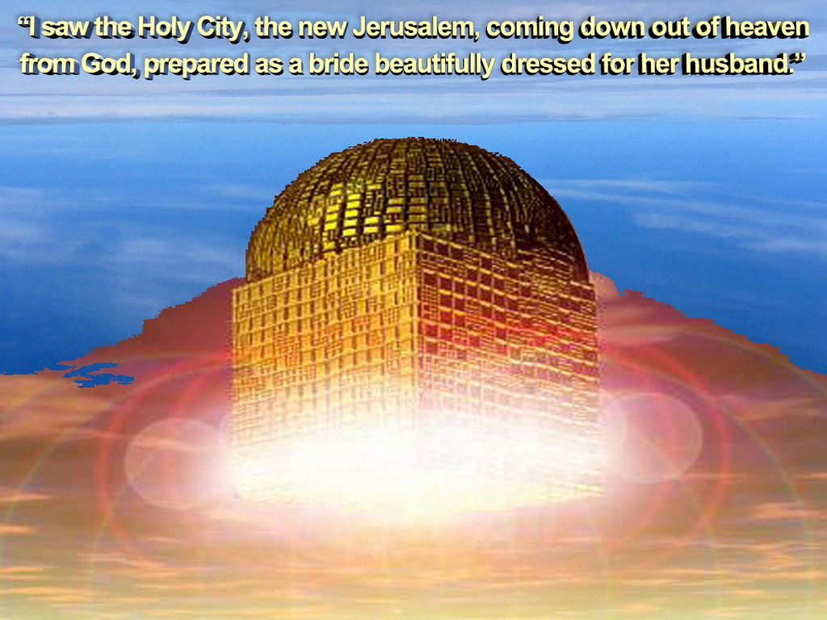
Rev.3:12 “And I will write on him the Name of My God, and the Name of the City of My God,
the New Jerusalem,
which comes down
out of heaven
from My God,
and My own new Name.”
Revelation 21:2

