Slide 1
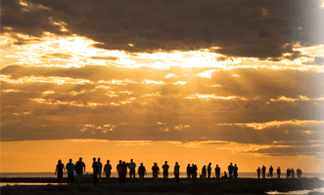
We are a Chosen Generation
Reveal to Us Your End Time Secrets

Slide 2
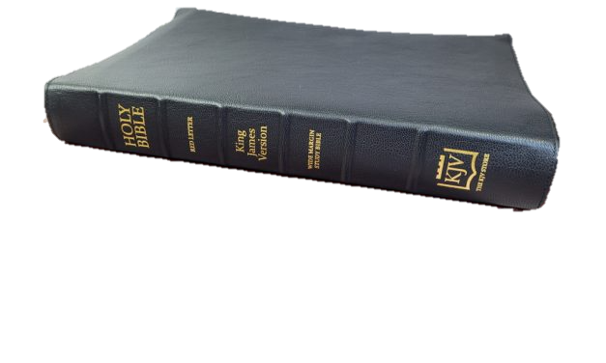

Slide 3
7 Popular End Time Teaching - Corrected by the Word of God
Real Crossing of the Red Sea - Exodus 3: 1,12; Galatians 4:25;
Real Location of Mt. Sinai
2. The Battle of Gog/Magog – Not Russia
Timing, Identity of Leader & Coalition of Countries
3. One World Religion or Harlot- Revelation Chapter 17
Kings of the East – Not China - Revelation 16:12; Gen 29:1; Judges 6:3
Identity of Anti-Christ Revelation 13: 1-10
Mark of the Beast Revelation 13:16-18
6. City of Adam & Garden of Eden - Genesis Chapter 3; Joshua 3:16
7. End Time Revival or End Time Apostasy - 2 Thessalonians 4:1-3; Luke 18:8

Slide 4
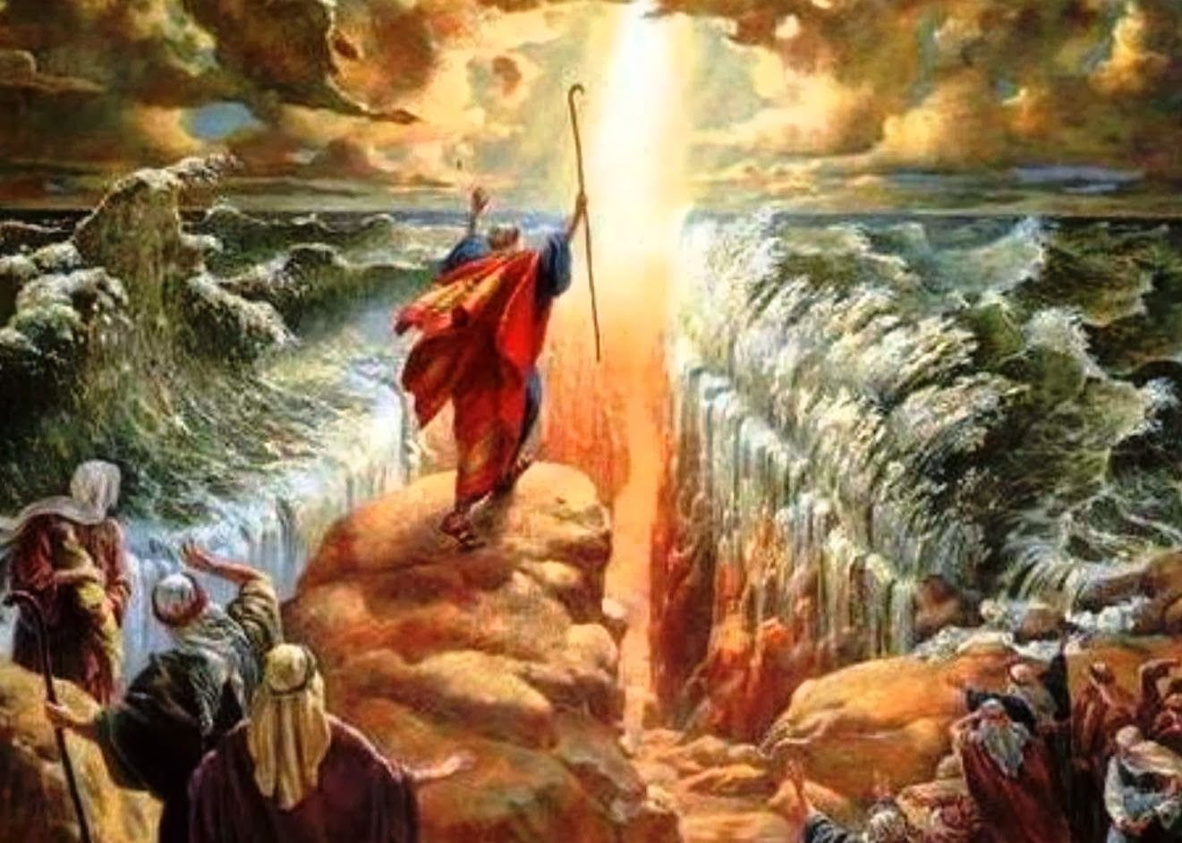
#1. Where was the Real Red Sea Crossing?
Exodus Chapter 3:1-3 – Galatians 4:25

Slide 5
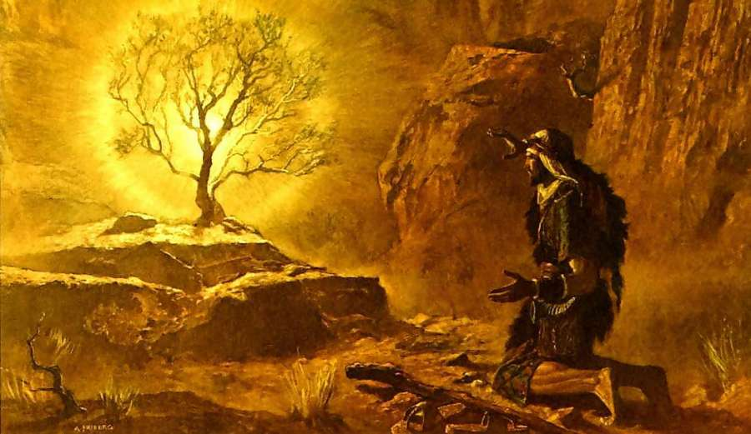
Exodus 3:1 “Now Moses kept the flock of Jethro his father-in-law; the priest of Midian:
and he led the flock to the backside of the desert, and came to the mountain of God, even to Horeb.
2. And the Angel of the Lord appeared to him in a flame of fire out of the midst of a bush.
He looked and the bush burned with fire, and the bush was not consumed.

Slide 6
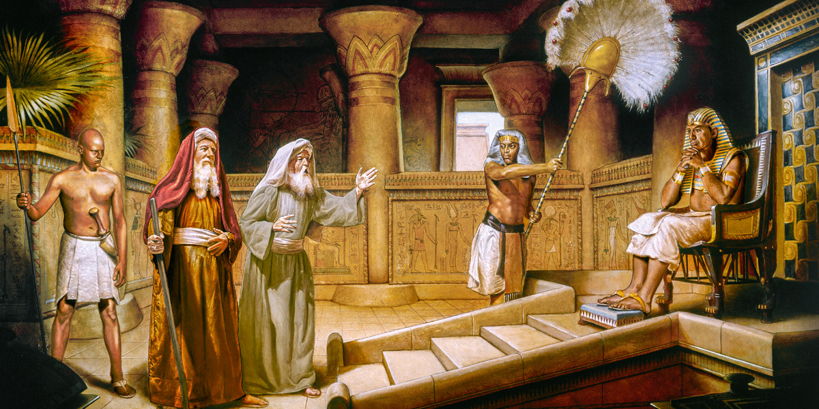
11. “And Moses said to God, Who am I that I should go forth to Pharaoh, and that I should bring forth the Children of Israel out of Egypt?
12. And God said, ‘Surely I will be with you, and this shall be a token to you that I have sent you:
When you have brought forth the people out of Egypt, you shall serve God on this mountain.”
18. And the people shall hearken to your voice, and you shall come, you and the olders of Israel to the King of Egypt, and you shall say to him, ‘The Lord God of the Hebrews has met with us: now let us go, we beseech you, 3 days journey into the wilderness, that we may sacrifice to the Lord our God. “

Slide 7
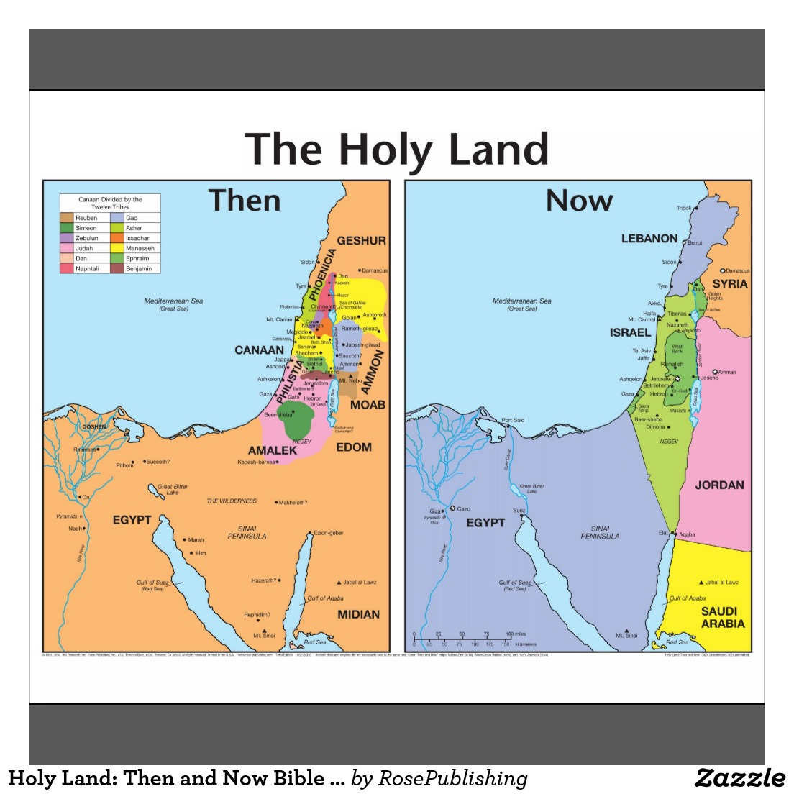

Slide 8
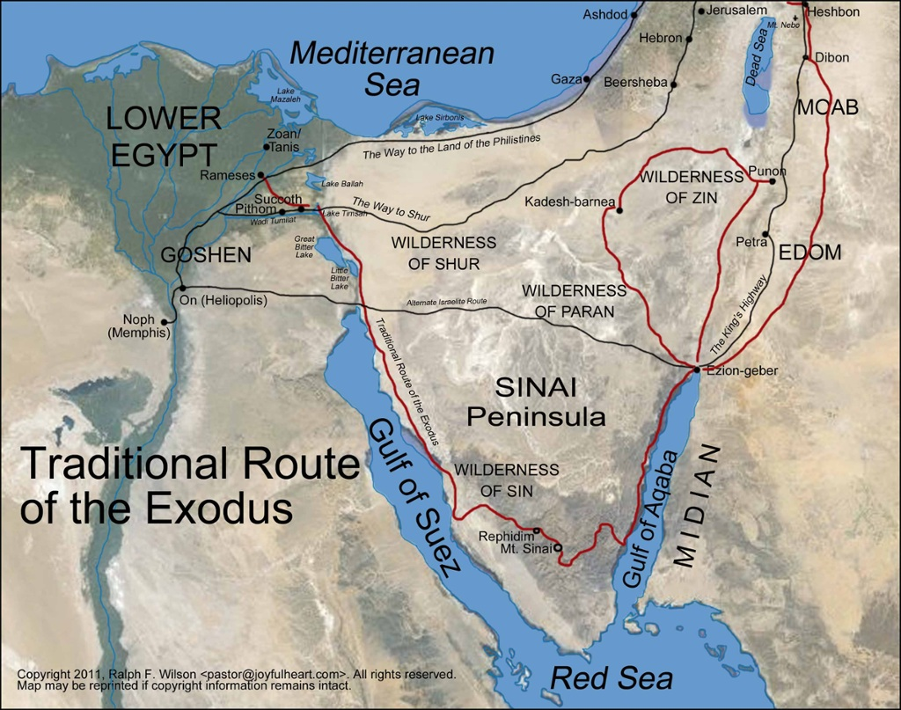
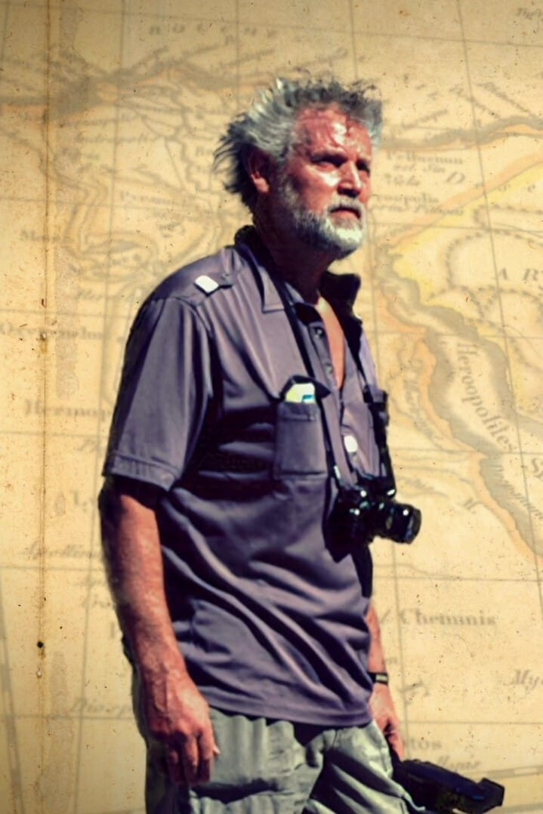
The Crossing of the Red Sea
No Biblical Archaeology found
The Traditional Mt. Sinai in Egypt
No Biblical Archaeology found
In 1978 Ron Wyatt,
a nurse anesthetist
travelled to the Sinai and Saudi Arabia to research clues he read in his Bible.
He found the real Red Sea crossing

Slide 9
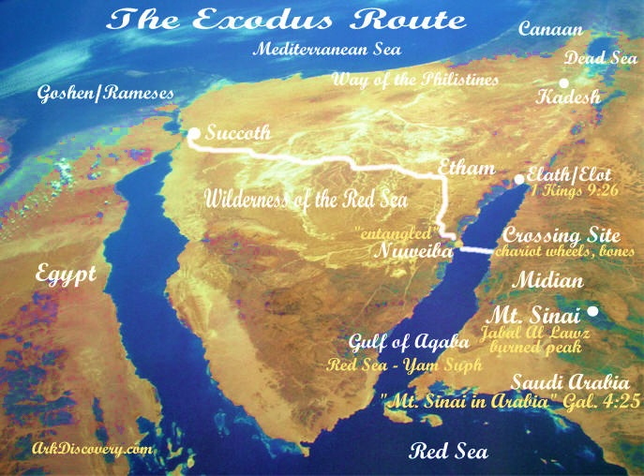
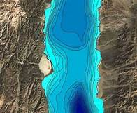
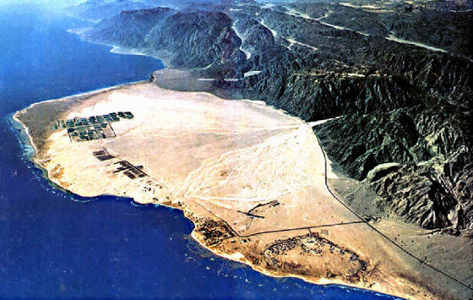
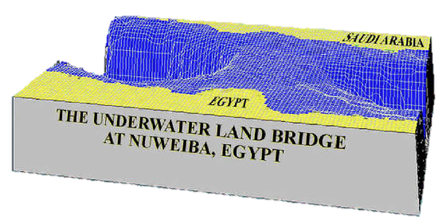
The Real Red
Sea Crossing at
Nuweiba Beach
Across Gulf of Aquaba to
Jabal Al Lawz
Saudi Arabia

Slide 10
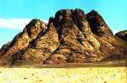
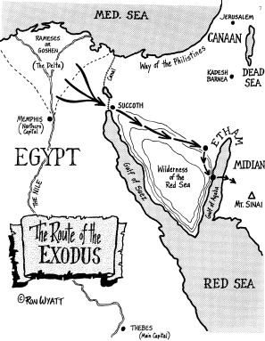
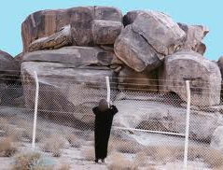
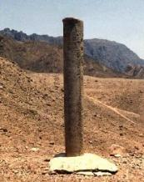
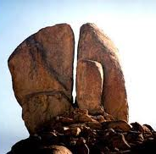
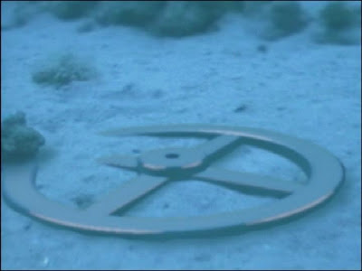
Recent Discovery
“For this Hagar is Mt Sinai
in Arabia, and answers to
Jerusalem which now is,and is
in bondage with her children”
Galatians 4:25

Slide 11
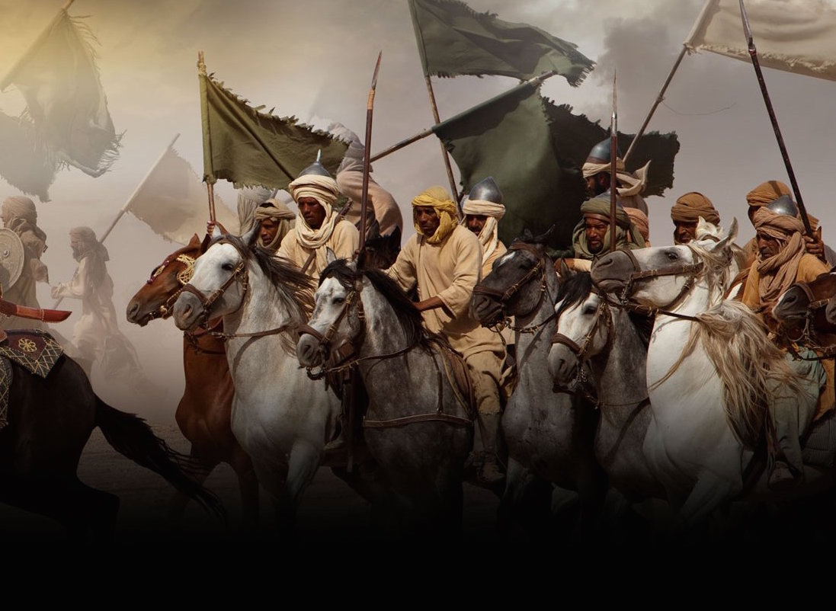
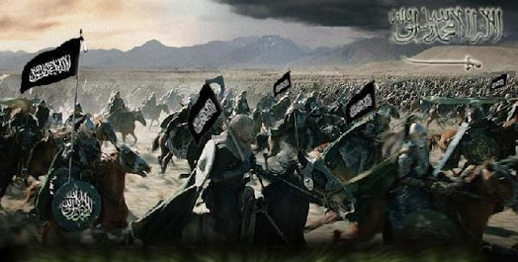
#2. The War of Gog/Magog Ezekiel Chapters 38-39
¹. And the word of the Lord came unto me, saying,
² Son of man, set thy face against Gog, the land of Magog,
the chief prince of Meshech and Tubal, and prophesy against him,
³ And say, Thus saith the Lord God; Behold, I am against thee, O Gog,
the chief prince of Meshech and Tubal:
⁴ And I will turn thee back, and put hooks into thy jaws, and I will bring thee forth,
and all thine army, horses and horsemen, all of them clothed with all sorts of armor,
a great company with bucklers and shields, all of them handling swords:

Slide 12
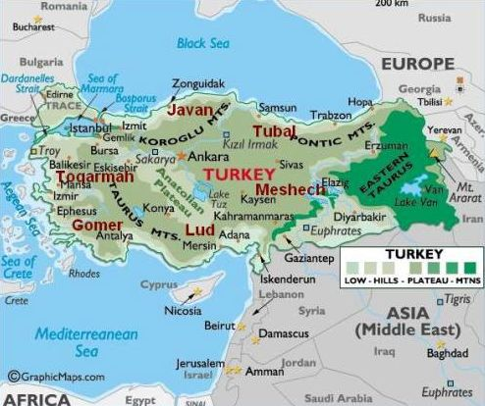
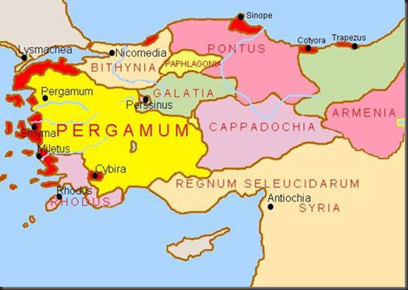
GOG is a Hebrew name translated mountain in Ezekiel 38-39
Gimel Vav Gimel means“ The most proud of the proud”
GOG - a Chief prince/or principality over Turkey – Pergamum, where satan’s throne is GOG Leads an endtime coalition of Islamic armies against Israel
Rev.2:13 “I know your works & where you dwell, even where satan’s throne is: you hold fast My name,
even in those days wherein Antipas was my faithful martyr, who was slain among you, where satan dwells.”

Slide 13
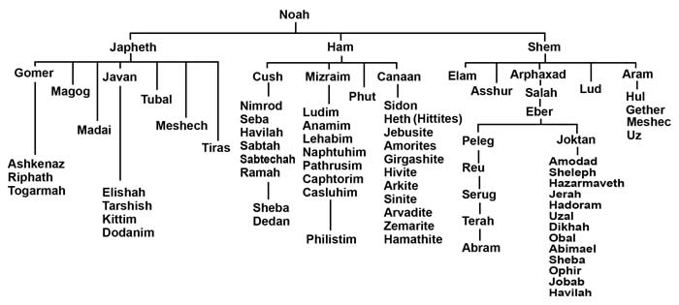
Who is Gog? Where is Magog?
38:1-2 “And the voice of the Lord came to me, saying, Son of man,
set your face against Gog, the land of Magog, the chief prince
of Meshech & Tubal, and prophesy against him. And say,
‘I am against you, O Gog, chief prince of Meshech & Tubal.’
Genesis 10 “The Table of Nations”

Slide 14
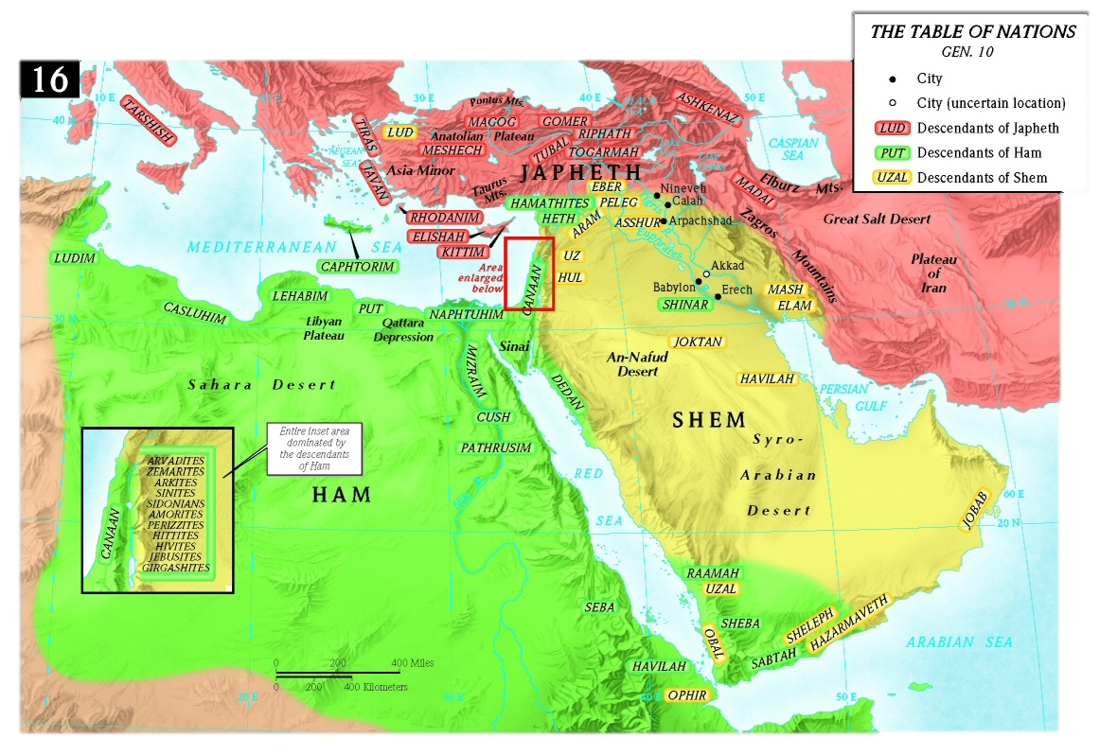

Slide 15
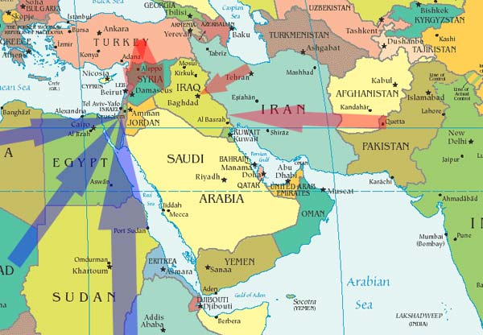
5. Persia, Ethiopia (Kush), & Libya with them: all of them with shield & buckler;
6. Gomer & all of his bands; the house of Togarmah of the north quarters, & many people with you.

Slide 16
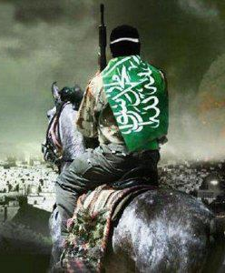
Ezekiel 38:17. “Are you he of whom I have spoken
in old time by My servants the prophets of Israel,
which prophesied in those days many years
that I would bring you against them?
Is Gog the Anti-christ?
There are over 150 verses about the Anti-christ written by almost all the Old Testament prophets: Here are some of his nicknames:
Adversary Mighty Man
Idol Shepherd Wicked One
The Assyrian Man of the Earth
Bloody & deceitful Man Prince of Tyre
Crooked Serpent Proud Man
Little Horn Rod of God’s Anger
Head of North Countries Vile Person
King of Princes Son of Perdition
Merchant Man of Sin
Prince that shall come Lawless One
Head over many countries Destroyer
King of Babylon Prince of Darkness

Slide 17
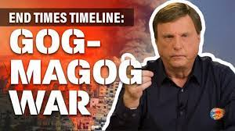
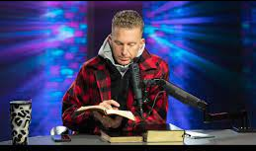
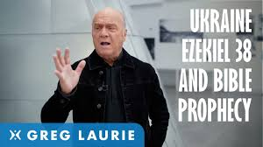
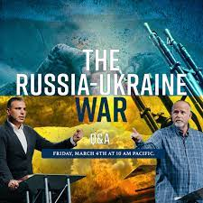
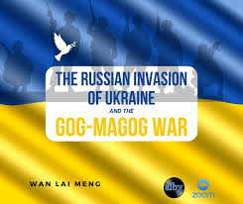
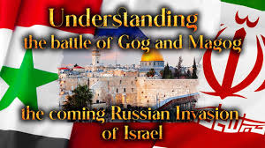
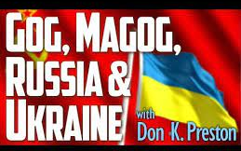
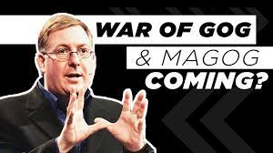
The Gog /Magog Battle in Ezekiel Chapter 38-39
IS the final Battle of Armageddon
It is NOT a pre-tribulation battle leading to the Rapture
(The current position of most popular Prophecy teachers)
Russia is NOT Gog
The Russia Ukraine Crisis is NOT beginning of Gog Magog War

Slide 18
Conclusive Parallels between Battle of Gog/Magog
and final Battle of Armageddon

Slide 19
Both Gog and Antichrist come at a time of peace and security
(Daniel 11:24, Ezekiel 38:12-13)
Both Gog and Antichrist are kings coming from the North
(Daniel 11:40-42, Joel 2:19-20; Ezekiel 38:14-16; Ezekiel 39:1-3)
Both Gog and Antichrist in league with same nations
(Daniel 11:43, Zechariah 14:14, Joel 3:11-12; Ezekiel 38:5-6)
Both Gog and Antichrist take spoil, loot and plunder
(Isaiah 10:5-7, Daniel 11:24; Ezekiel 38:10-13)
Both Gog and Antichrist are temporary leaders - both destroyed at the Battle end (Ezekiel 39:11; Daniel 7:11)
In both the Gog/Magog and Armageddon battles, the armies are confused
and attack each other (Ezekiel 38:21-22; Zechariah 14:12-13)
After this battle, Israel and all the nations will know who God is!

Slide 20
Both Gog/Magog and Armageddon end with a great earthquake (Ezekiel 38:19-20; Rev 16:18-20)
Both Gog/Magog and Armageddon experience great hailstones. (Revelation16:16-21, Ezekiel 38:22)
Both Gog/Magog and Armageddon end with the Great Supper of God (Ezekiel 39:17-20; Rev 19:17)
At the end of both battles - Christ is physically present in Israel (Ezekiel 39:7; Zech 12:9-10)
After both battles God’s name will no longer be profaned (Ezekiel 39:22, Ezekiel 39:7-8, Zechariah 12:9-10, Ezekiel 38:23)
After both battles God pours out His Spirit upon Israel (Ezekiel 39:29; Zechariah 12:10)
After both battles weapons of war are destroyed (Ezekiel 39:9; Isaiah 2:4)
After both battles God declares “It is done” (Ezekiel 39:8; Revelation 16:17)

Slide 21
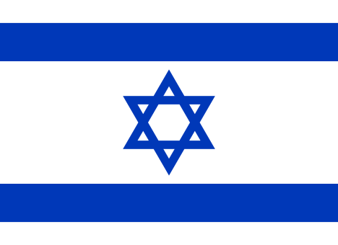
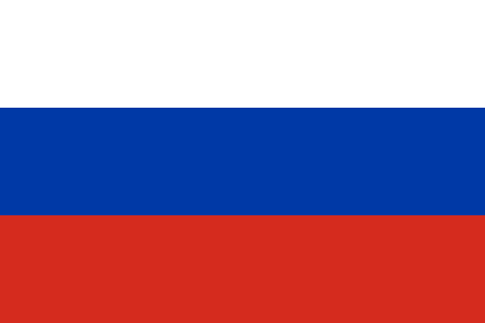
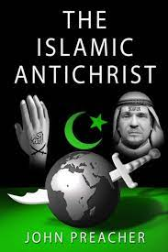
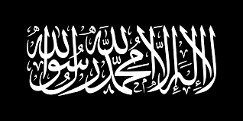
Israel’s End Time Enemies are not Russia or China
Russia is not in the Bible - can not be in Bible Prophecy
China is also not in the Bible – can not be in Bible Prophecy
The End Time Anti Christ is:
not European
Not Global Elite Bankers, New World Order
not Catholic, not the Pope
Not George Soros, Bill Gates, Elon Musk, Klaus Schwab
Not the Illuminati
The End Time Beast is a Middle East Beast
The Islamic A/C

Slide 22
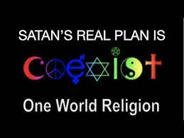
#3. New World Order / The Great Reset
One World Religion or A Harlot Religion?

Slide 23
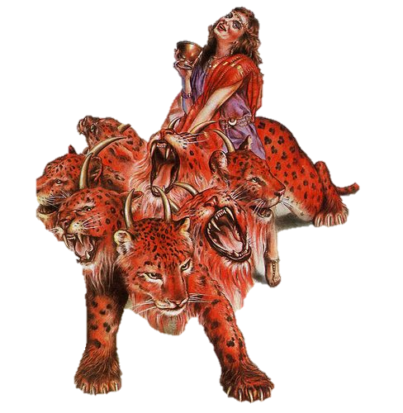
Revelation 17 – The Mystery Harlot Riding the Beast
1. And there came one of the 7 angels which had the 7 vials, and talked with me, saying unto me, Come hither; I will show unto you the judgment of the great whore that sits upon many waters
( many countries):
² With whom the kings of the earth have committed fornication, and the inhabitants of the earth have been made drunk with the wine of her fornication.
³ So he carried me away in the spirit into the wilderness (desert): and I saw a woman sit on a scarlet colored beast, full of names of blasphemy, having 7 heads and 10 horns.
⁴ And the woman was arrayed in purple and scarlet color, and decked with gold
and precious stones and pearls, having a golden cup in her hand full of abominations and filthiness of her fornication:
⁵ And upon her forehead was a name written, Mystery, Babylon The Great,
The Mother Of Harlots And Abominations Of The Earth.

Slide 24
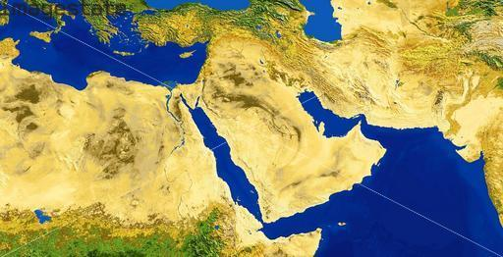
Rev. 17:1-3 “Come hither, & I will show you the judgment of the great whore that sits on many waters: with whom the kings of the earth have committed fornication, & The inhabitants of the earth have been made drunk with the wine of her fornication. And he carried me away in the Spirit into the wilderness ( desert). I saw a woman (the harlot religion Islam) sitting upon a red-colored beast ( satan). ”
Saudia Arabia is the desert of the seas!

Slide 25
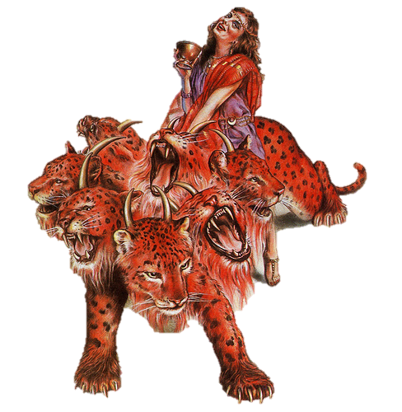
Woman riding the Beast with 7 Heads
Mystery Babylon, the Great Harlot
False Religion Controlling 7 Kingdoms
Woman Rides the Beast with 7 Heads
Mystery Babylon, the Great Harlot
False Religion Controls 7 Kingdomshe
I
nIn Bible Prophecy
Kingdoms = Heads = Mountainsi.
Kingdoms are Empires

Slide 26
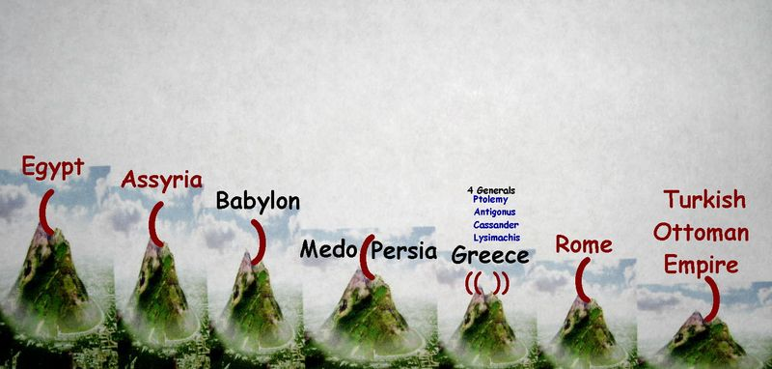
Revelation 13:3 “ And I saw one of his heads as it were wounded to death,
and his deadly wound was healed: and all the world wondered after the beast.”
1
2
7. Islam
5
3
4
6
4
“And here is the mind that has wisdom: The 7 heads are 7 mountains, on which the woman sits.
And there are 7 kings: 5 are fallen and one is, and the other is not yet come & when he comes,
he must continue a short space. And the beast that was and is not, even he is the 8th & is of
the 7 and goes into perdition’. Revelation 17:14 describes the 8th Mt. as the Anti-Christ!!

Slide 27
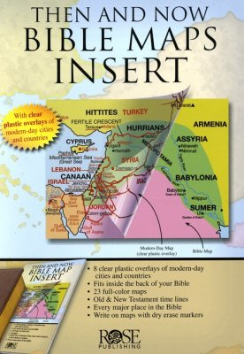
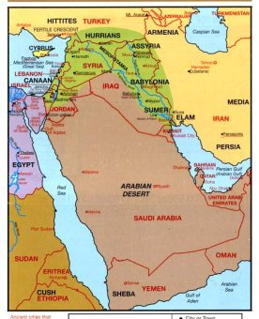
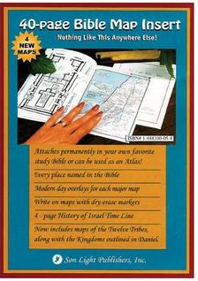
#4. Who are the Kings of the East? – Revelation 16:12 ( Mid-Trib)
² And the 6th angel poured out his bowl upon the great river Euphrates;
and the water thereof was dried up, that the way of the kings of the east might be prepared.
¹³ And I saw 3 unclean spirits like frogs come out of the mouth of the dragon,
and out of the mouth of the beast, and out of the mouth of the false prophet.
¹⁴ For they are the spirits of devils, working miracles, which go forth unto the kings of the earth and of the whole world, to gather them to the battle of that great day of God Almighty.

Slide 28
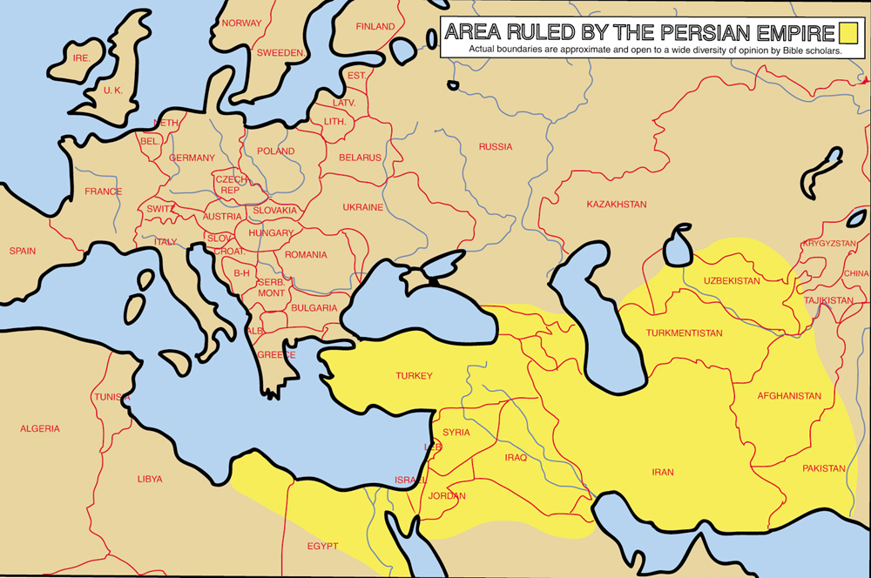
The Euphrates River is the Key to the Kings of the East
This 1800 mile long river is a natural barrier– Also Israel’s ancient border
Enemy Nations East of Euphrates:
All are Muslim Countries
Iraq
Iran
Turkey
Syria
Turkmenistan
Afghanistan
Pakistan
Uzbekistan
Old Testament Enemies - Judges 6:3
Midianites
Amalekites
“Children of the East”

Slide 29
#5. Revelation 13:1-4 “ The Kingdom of the Anti Christ”
¹ And I stood upon the sand of the sea,
and saw a beast rise up out of the sea,
having 7 heads and 10 horns, and upon his horns 10 crowns,
and upon his heads the name of blasphemy.
² And the beast which I saw was like unto a leopard,
and his feet were as the feet of a bear,
and his mouth as the mouth of a lion:
and the dragon gave him his power,
and his seat, and great authority.
³ And I saw one of his heads as it were wounded to death;
and his deadly wound was healed:
and all the world wondered after the beast
.
⁴ And they worshipped the dragon
which gave power to the beast:
and they worshipped the beast, saying,
Who is like unto the beast? Who is able to make war with him?

Slide 30
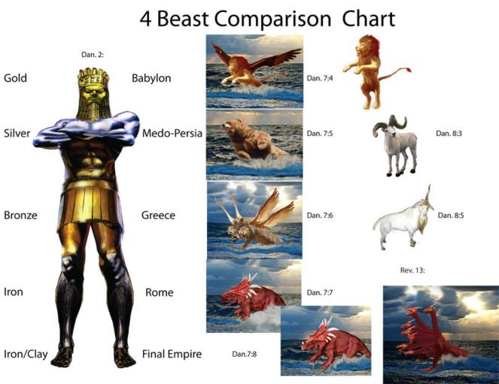
Comparing Daniel 2, Daniel 7 & Daniel 8

Slide 31
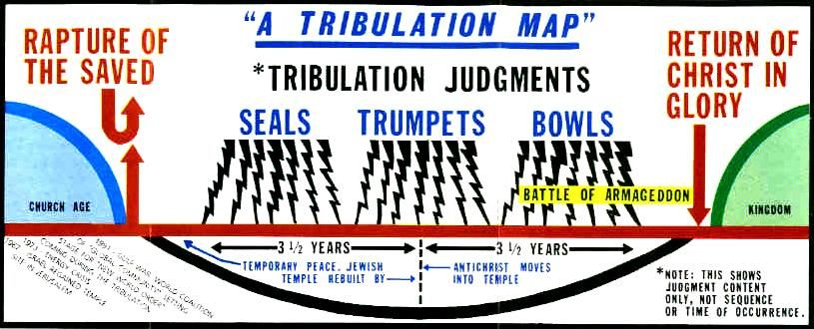
⁵ And there was given unto him a mouth speaking great things and blasphemies;
and power was given unto him to continue 42 months.
⁶ And he opened his mouth in blasphemy against God, to blaspheme His name,
and His Tabernacle, and them that dwell in heaven.
⁷ And it was given unto him to make war with the saints, and to overcome them:
and power was given him over all kindreds, and tongues, and nations.
⁸ And all that dwell upon the earth shall worship him, whose names are not written
in the book of life of the Lamb slain from the foundation of the world.
⁹ If any man have an ear, let him hear.

Slide 32
Modern Bible Maps Look into the Future
Today We Can
Identify these Kingdoms
Bear = Persian Empire
Lion = Babylon Empire
Leopard = Greek Empire

Slide 33
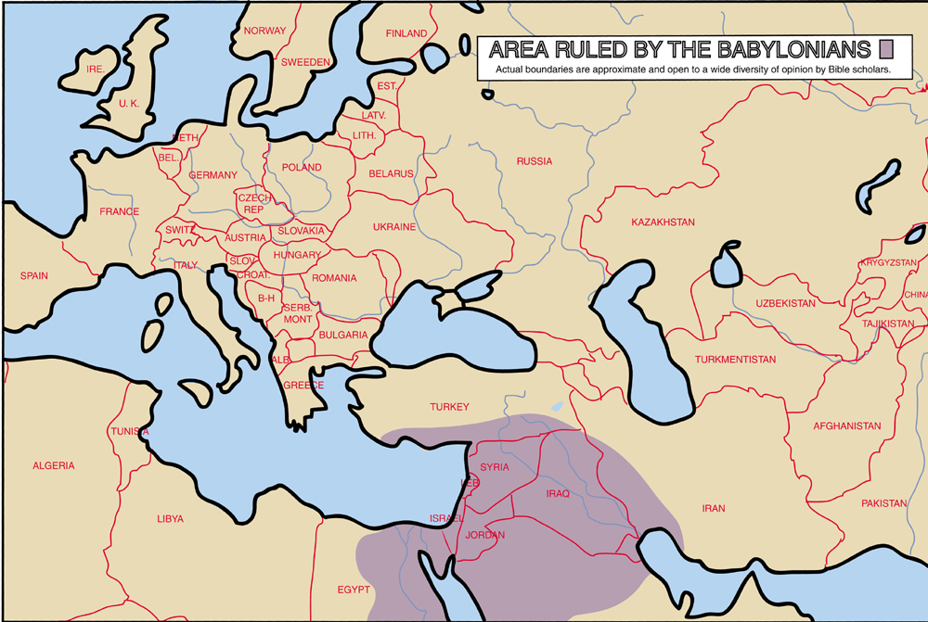

Slide 34
Persian Empire

Slide 37
#5. The Identity of the Anti-Christ
The Mark of the Beast
Current Popular Teaching about Mark of the Beast
Corona Vaccine
RDIF Chip in Hand
Artificial Intelligence
Bar Codes

Slide 38
Rev. 13:16-18 “And he causes all both small and great, rich and poor, free and bond, to receive a mark on their right arm or on their forehead – that no man might buy or sell
unless he had that mark, or the name of the beast or the number of his name.
Here is wisdom. Let him that has understanding count the number of the beast for it is the number of a man and his number is 666.”

Slide 39
God revealed to John these symbols to record for us in the Book of Revelation as the mark for the coming Anti-Christ. Assumed to be the Greek alphabet letters Chi, Xi and Stigma - they also have numerical values. Bible scholars added these together = 666.

Slide 40
#6. The True Location of the Garden of Eden
The Key is the Discovery of the City of Adam
Genesis Chapter 3:22-24
² ²And the Lord God said, Behold, the man is become as one of us, to know good and evil: and now, lest he put forth his hand, and take also of the tree of life, and eat, and live for ever:
²³ Therefore the Lord God sent him forth from the garden of Eden, to till the ground from whence he was taken.
²⁴ So he drove out the man; and he placed at the east of the garden of Eden Cherubims, and a flaming sword which turned every way, to keep the way of the tree of life.

Slide 41
¹⁴ And it came to pass, when the people removed from their tents, to pass over Jordan, and the priests bearing the ark of the covenant before the people;
¹⁵ And as they that bare the ark were come unto Jordan, and the feet of the priests that bare the ark were dipped in the brim of the water, (for Jordan overflows all his banks all the time of harvest,)
¹⁶ That the waters which came down from above stood and rose up upon a heap very far from the City Adam, that is beside Zaretan: and those that came down toward the sea of the plain, even the salt sea, failed, and were cut off: and the people passed over right against Jericho.
¹⁷ The priests that bare the Ark of the Covenant of the Lord stood firm on dry ground in the midst of Jordan, and all the Israelites passed over on dry ground, until all the people were passed clean over Jordan.
Joshua 3 : 14-17 Crossing the Jordan The Battle of Jericho

Slide 42
Where did Adam settle after
God evicted him from the Garden?
The City of Adam is across the Jordan
Across the Jordan
East of Jerusalem!

Slide 43
# 7. End Time Revival or End Time Apostasy?
2 Thessalonians 2:1-4
¹ Now we beseech you, brethren, by the coming of our Lord Jesus Christ,
and by our gathering together unto him,
² That ye be not soon shaken in mind, or be troubled, neither by spirit, nor by word,
nor by letter as from us, as that the day of Christ is at hand.
³ Let no man deceive you by any means: for that day shall not come,
except there come a falling away first, and that man of sin be revealed, the son of perdition;
⁴ Who opposes and exalts himself above all that is called God, or that is worshipped;
so that he as God sits in the Temple of God, shewing himself that he is God.
Luke 18:8
“Nevertheless, when the Son of Man comes, will He find faith on the earth?”

Slide 44
End Time Revival False Doctrines
Joel’s Army
Dominion Now
7 Mountain Mandate
Latter Rain
NAR Apostles
The Melchizedek Priesthood
The New Breed

Slide 45
2 Peter 2:20-22 - For if after they have escaped the pollutions of the world through the knowledge of the Lord and Saviour Jesus Christ, they are again entangled therein, and overcome, the latter end is worse with them than the beginning. 1 Timothy 4:1 - Now the Spirit speaks expressly, that in the latter times some shall depart from the faith,
giving heed to seducing spirits, and doctrines of devils; 2 Timothy 4:3 - For the time will come when they will not endure sound doctrine; but after their own lusts shall they heap to themselves teachers, having itching ears; Luke 8:13 - They on the rock are they, which, when they hear, receive the word with joy; and these have no root, which for a while believe, and in time of temptation fall away. 1 Timothy 4:1-3 - Now the Spirit speaketh expressly, that in the latter times some shall depart from the faith, giving heed to seducing spirits, and doctrines of devils; (Read More...) Hebrews 3:12 - Take heed, brethren, lest there be in any of you an evil heart of unbelief, in departing from the living God. 2 Peter 3:17 - Ye therefore, beloved, seeing ye know these things before, beware lest ye also,
being led away with the error of the wicked, fall from your own steadfastness. Matthew 24:12 - And because iniquity shall abound, the love of many shall wax cold.

Slide 46
We are a Chosen Generation
A Royal Priesthood, A Holy Nation ,
Chosen to Understand God’s End Time Secrets

