Slide 1
“The Place”

Slide 2
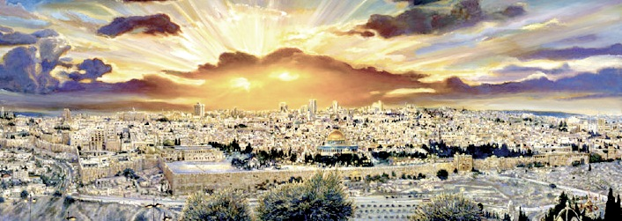
Jerusalem Belongs to the Lord!
“The Place of the Covenant”

Slide 3
So What has God’s LOVE
Got to do with Bible Prophecy?
Everything! It’s the Battle over
His Blood Covenant
The Place it started - is the Place it will be Finished

Slide 4
Why is Jerusalem the Most
Mentioned City in the Bible?
767 times
Why is Jerusalem so Important to God?
Why is Jerusalem the Focus of Bible Prophecy?

Slide 5
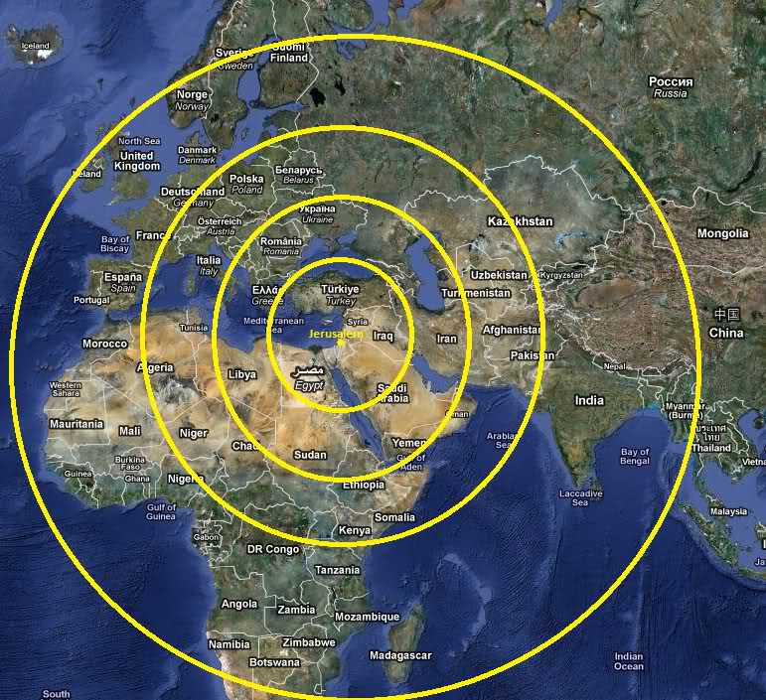
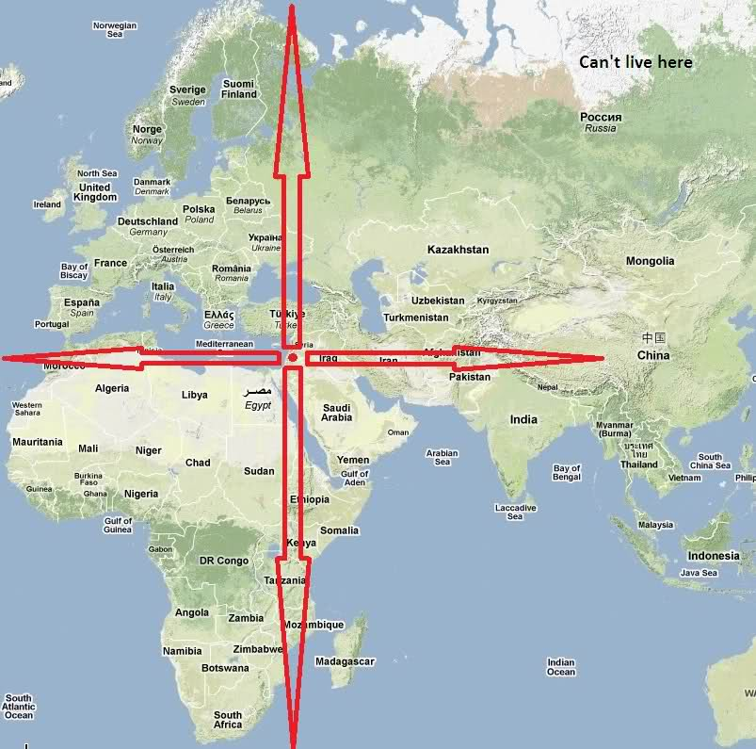
God Says Jerusalem
Is the Center of the World
And Bible Prophecy
“This is Jerusalem: I have set it in the midst of the nations and countries that are round about her.” Exeziel 5:5

Slide 6
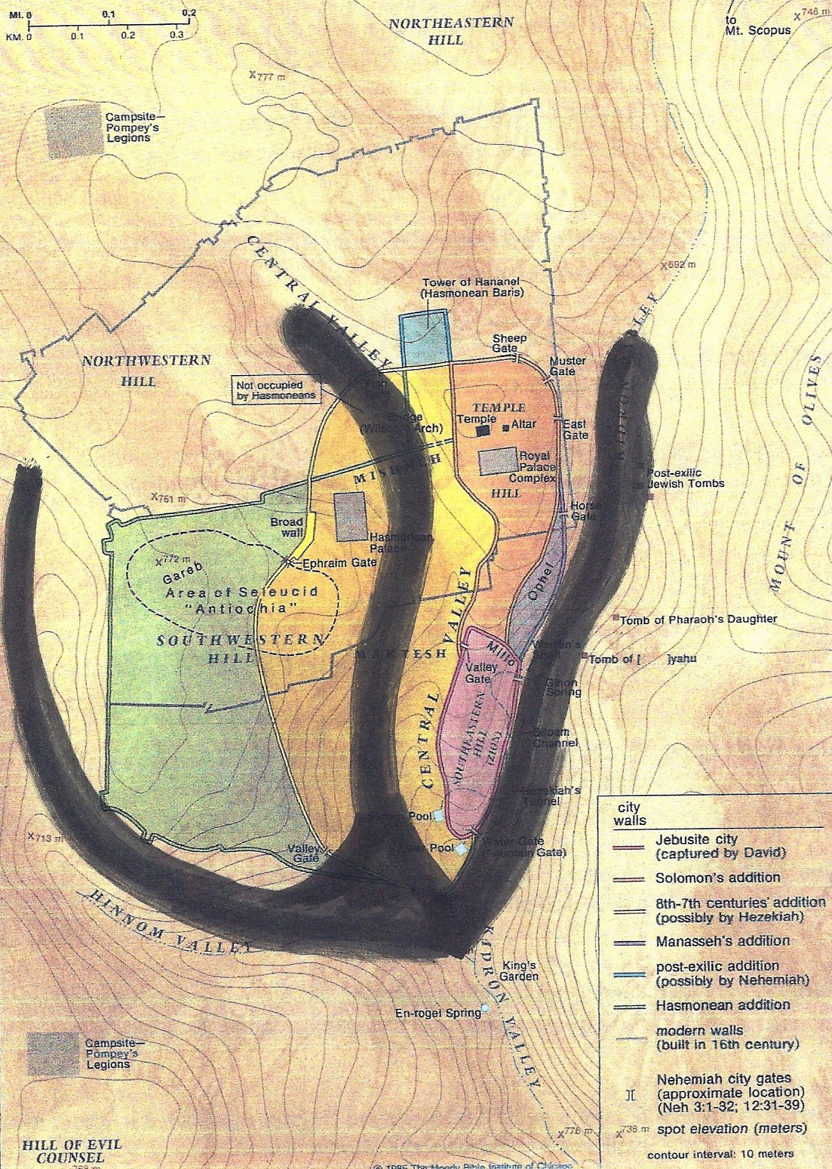
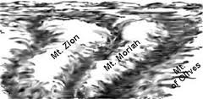
God Says He put His Name in Jerusalem
“ Jireh +Shalom”
Even the Valleys form Shin
The Name of God

Slide 7
Jerusalem Belongs to the Lord!
City of David 2 Samuel 6:10; 1 Kings 11:27; 2 Chronicles 8:11
City of God Psalm 46:4; Psalm 87:3
City of Judah 2 Chronicles 25:28
City of Joy Jeremiah 49:25
City of Peace Hebrews 7:2
City of Praise Jeremiah 49:25
City of Righteousness Isaiah 1:26
City of the Great King Psalm 48:2; Matt 5:35
City of the Lord Isaiah 60:14
City of Truth Zechariah 8:3
Faithful City Isaiah 1:26
Gate of My People Obad 1:13; Micah 1:9
Green Olive Tree Jeremiah 11:16
Holy City Neh. 11:1, 18; Isa 48:2, 52:1; Matt. 4:5, 27:53; Rev. 11:2
Holy Mountain Isa. 11:9, 56:7, 57:13, 65:25, 66:20; Ezek 20:40; Dan 9:16,20; Joel 2:1, 3:17; Zeph 3:11; Zech 8:3
Throne of the Lord Jeremiah 3:17
Zion 1 Kings 8:1; Isaiah 60:14; Zech.9:13

Slide 8
Why Do All the Nations Rage Over Who Controls Jerusalem?
Because Jesus is Coming Soon!

Slide 9
Psalm 2:1-5
“ Why do the heathen rage, and the people imagine a vain thing? The Kings of the earth set themselves & the rulers take counsel together,
Against the Lord & His Anointed One(Christ!), saying ‘Let us break their bands asunder, & cast away their cords from us”
He that sits in the Heavens shall laugh: the Lord shall have them in derision
Then shall He speak to them in His wrath, & vex them in His sore displeasure

Slide 10
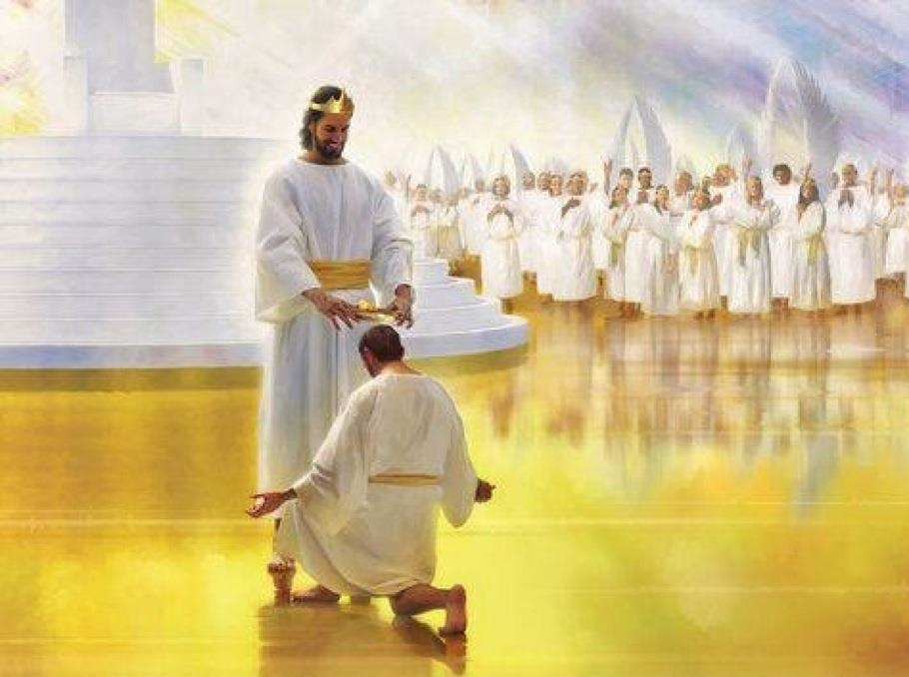
Psalm 2:6-8
“Yet have I set My King
upon My Holy hill of Zion
I will declare the decree:
the Lord has said to Me,
You are My Son;
This day have I begotten You.
Ask Me and I will give You
the heathen
for Your inheritance,
and the uttermost parts
of the earth for Your possession”

Slide 11
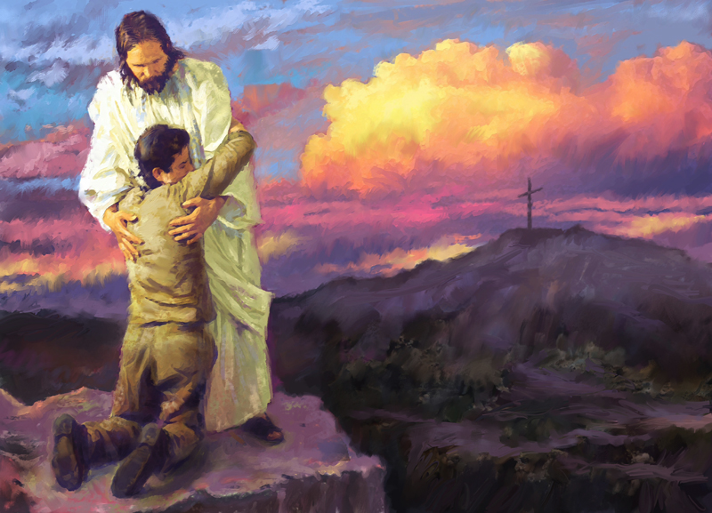
“Kiss the Son, lest He be angry
And you perish from the way,
When His Wrath is kindled
but a little.
Blessed are all they
that put their trust in Him.”
Psalm 2:9-12

Slide 12
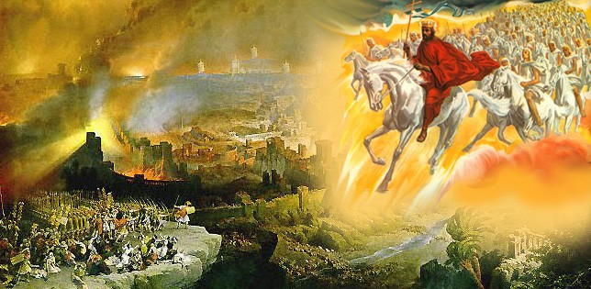
‘”Behold, I will make Jerusalem a cup of trembling to all the people round about, then they shall be in the siege both against Judah and against Jerusalem. And in that Day will I make Jerusalem a burdensome stone for all people; all that burden themselves with it shall be cut in pieces, though all the people of the earth be gathered against it. (Zechariah 12:2-3)

Slide 13
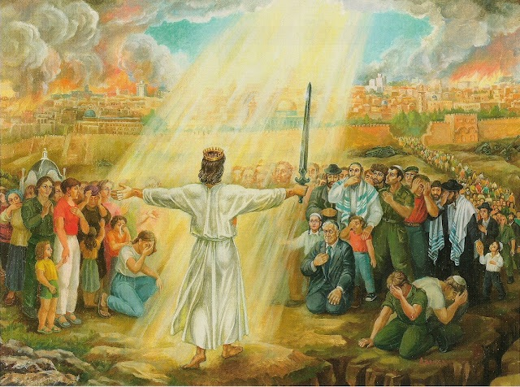
“And I will pour upon the House of David and upon the inhabitants of Jerusalem, the Spirit of Grace and Supplications: and they shall look on Me whom they have pierced. And they shall mourn for Him as one mourns for an only Son, and shall be in bitterness for Him, as one that is in bitterness for his firstborn.” Zechariah 12:10

Slide 14
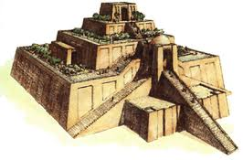
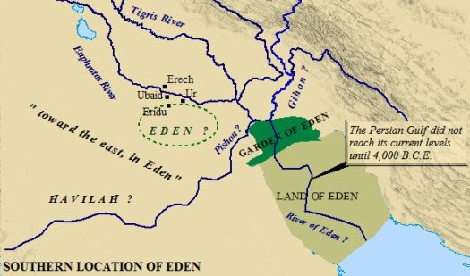
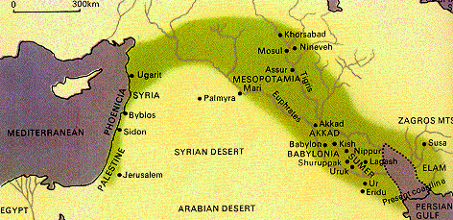
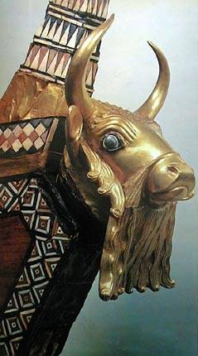
What if the Garden of Eden is NOT in Mesopotamia,
… Not in the Fertile Crescent?.... Not in Babylon
…. Not Near the Towel of Babel….. Not in modern day Iraq

Slide 15
What if Jerusalem is the Place?
The Center of the Garden of Eden
The Place of the Covenant…
The Place where He put His Name?

Slide 16
What if the exact place Adam lost the battle with sin and His Fellowship with God in the Beginning ?
Is the Same Place Jesus Will Come
to Defeat the Enemy Forever
& Restore All Fellowship at the End!

Slide 17
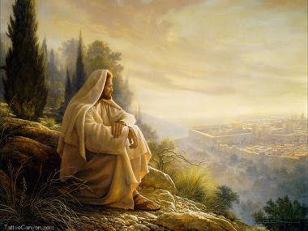
The Battle
Belongs to the Lord

Slide 18
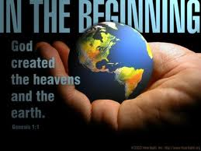
God creates everything in perfect Order.. Adam and Eve were appointed on Earth to keep charge of the Garden and everything in it….There is no sin, no sickness, nothing to worry about…. Then came the serpent….

Slide 19
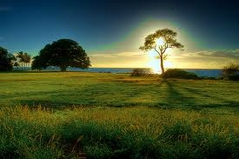
There was only One Rule They Could Disobey…
The Tree of the Knowledge of Good and Evil
The Tree of Life
“Adam, of every tree of the Garden, you may freely eat,
but of the Tree of the knowledge of Good and Evil, you shall NOT eat of it:
for in the day that you eat of it, you shall surely die.” Genesis 2 :16-17

Slide 20
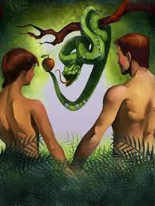
The enemy comes to lie , to kill and to destroy….
“Now there was a serpent more subtil than any beast of the field….and he said to the woman…Did God say you can not eat of the fruit of the trees? …’You shall not surely die….if you eat the fruit, you will be like as gods…..”
“And when the woman saw that the tree was good for food,
and that it was pleasant to the eyes, and a tree to be desired to make one wise, she took of the fruit and did eat, and gave also to her husband with her;
and he did eat. (3:1-6)

Slide 21
“And the eyes of both of them were opened & they knew that they were naked & they sewed fig leaves together &made themselves aprons.” vs. 7
Sin Causes Us to Hide from God!

Slide 22
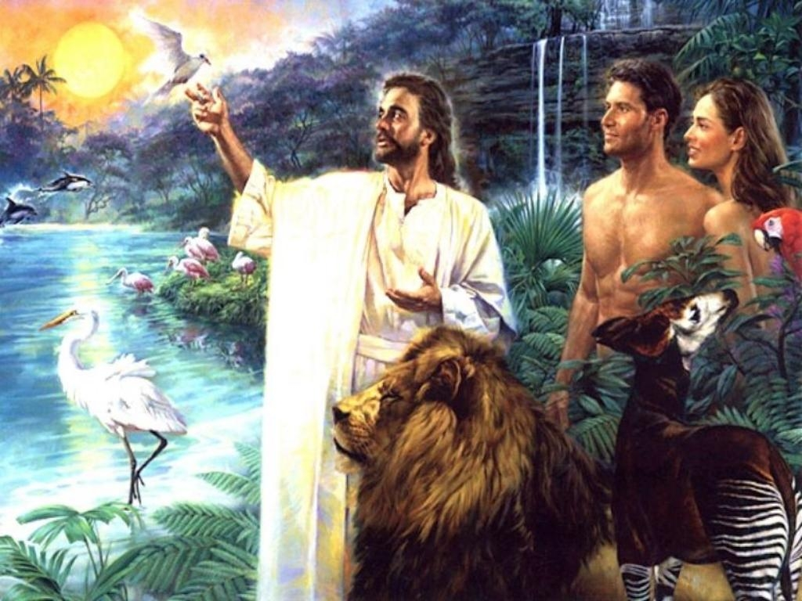
“And they heard the Voice of God walking in the Garden in the cool of the day” Gen 3:8
Sin ruins sweet fellowship between us and God!

Slide 23
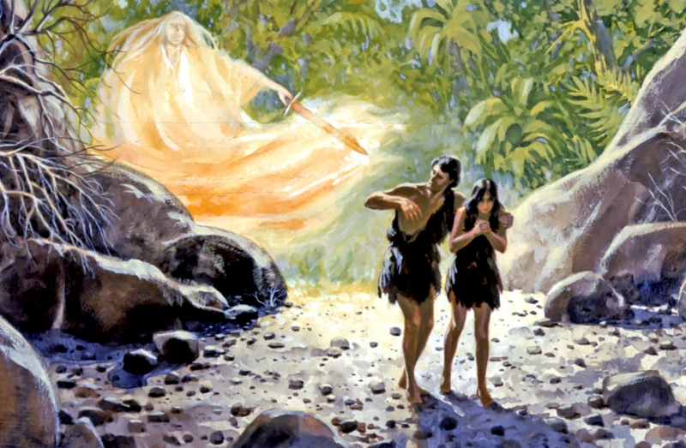
“Behold, the man is become as one of Us, to know good & evil: and now
lest he put forth his hand & take also of the Tree of Life and eat & live forever. Therefore the Lord God sent him from the garden to till the ground from which he was taken.” Genesesi 3:22-23

Slide 24
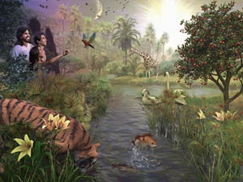
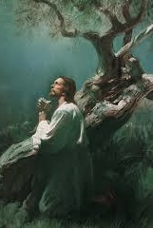
Remember the Garden was a Place of Intimate Fellowship
Adam and Eve met with God in the Garden in the cool of the day
Jesus often went to the Mt. Of Olives to Meet with God

Slide 25
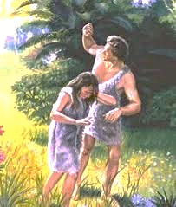
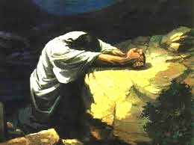
It all Happened
In the Garden!
Just as Adam and Eve were in agony after experiencing the consequences of sin –
Separated from God’s Presence!
So Jesus was in great agony over the price He would soon pay for our sins.

Slide 26
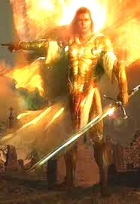
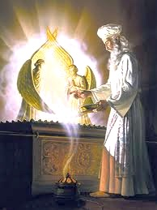
“So He drove out the man; and He placed at the east of the Garden of Eden Cherubims, and a flaming sword which turned every way ,
to keep the way of thE Tree of Life.” Genesis 3: 24

Slide 27
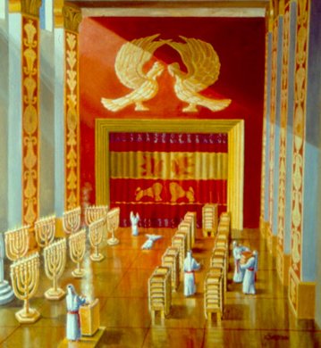
Glory
Notice 2 Cherubim on the Veil separating the Holy Place from the Holy of Holies. The Cherubim guard God’s Presence and His Glory. God gave this pattern for Israel Holy Temple to Moses on Mt. Sinai in Exodus.
This is Heaven’s pattern, as seen in Revelation Chapter 4.
Cherubim are mighty living creatures who surround His Glory!

Slide 28
Where is the Place of the Covenant?
Abraham with Melchizedek
God with Abraham
God with Jacob
He led Each One to His Place
Jerusalem

Slide 29
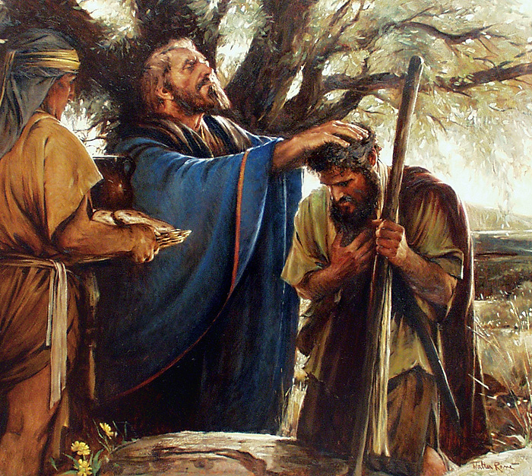
Abram pays tithes to Melchizedek, King of Salem, who has no beginning and no end “ Genesis 14 &Hebrews 7 Jerusalem is His Covenant Place

Slide 30
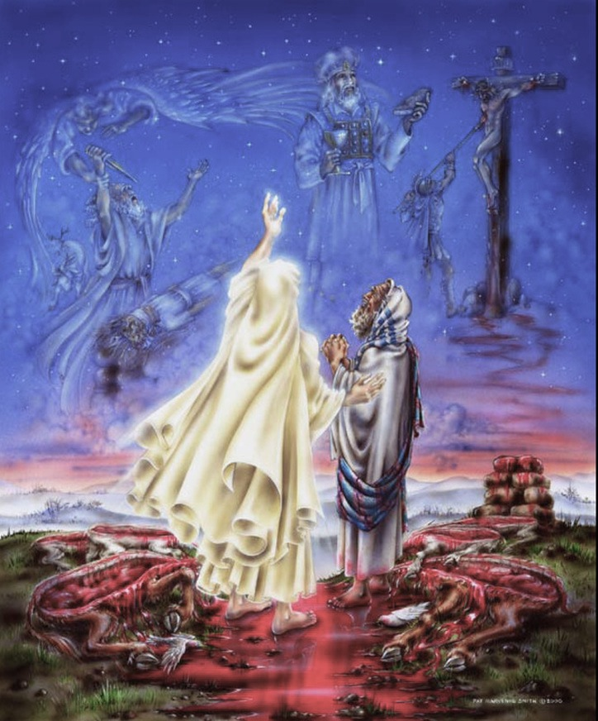
God Cuts Blood Covenant with Abram
in Jerusalem - Genensis 15
“And God said to Abraham, ‘Take Me a heifer 3 years old, and a ram 3 years old & a turtledove & a young pigeon”
And he took all these, and divided them in the midst, and laid each piece against the other: but he did not divide the birds”
And when the fowls came down on the carcases, Abram drove them away. And when the sun was going down, a deep sleep fell upon Abram: and lo, a horror of great darkness fell on him.”
“And it came to pass that when the sun went down, and it was dark, behold a smoking furnace, and a burning lamp that passed between those pieces.”

Slide 31
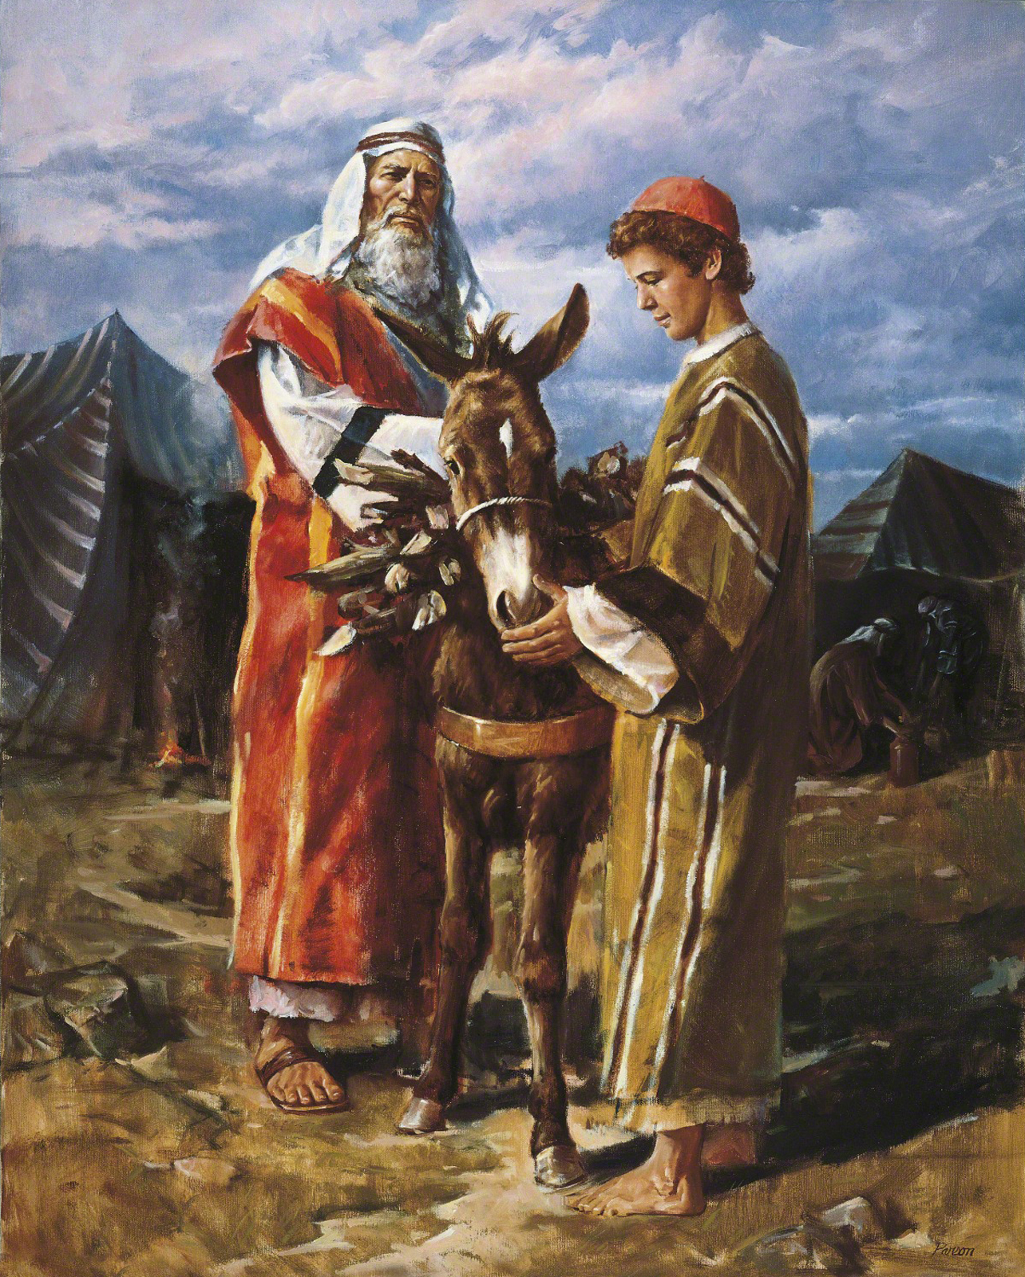
“And it came to pass after these things that God did tempt Abraham, and said to him Abraham: and he said, ‘Behold, here I am. And He said, Take now your son, your ONLY son Isaac, whom you love, and get to the land of Moriah: and offer him there for a burnt offering on one of the mountains which I will tell you of. (Gen 22:.1-2)
Mt. Moriah is the Temple Mt.
In Jerusalem!
“And on the 3rd day Abraham lifted up his eyes and saw the place afar off.” vs. 4
God offered His Son Jesus in the Place Abraham offered Isaac!

Slide 32
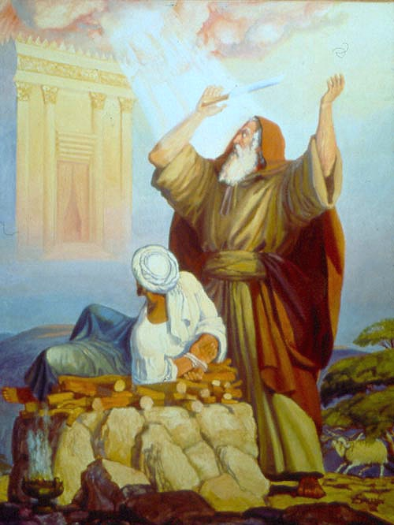
God let Abraham
see into the future –
‘By faith Abraham sojourned
in the Land of Promise, as in
a strange country, dwelling in tabernacles with Isaac & Jacob, the heirs with him of the same promise.
For he looked for a City which has foundations, whose builder and maker is GOD” Heb.11:9-10
Jerusalem
Jireh-Shalom
“And Abraham called the name of the place Jehovah-Jireh: as it
is said to this day, ‘In the Mt of
the Lord, it (He)shall be seen.”
Gen 22:14
Jireh (He shall be seen) Shalom (God’s perfect peace)

Slide 33
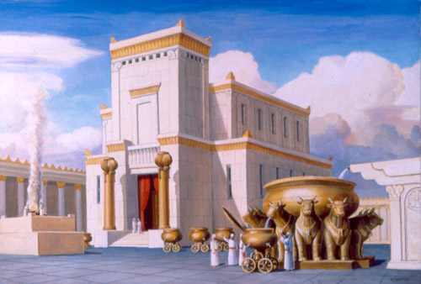
The Place of King Solomon’s Temple is Jerusalem

Slide 34
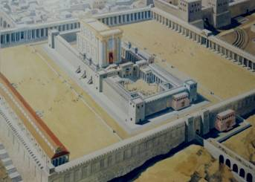
Herold’s Temple on Mt. Moriah in Jerusalem During Jesus Day!

Slide 35
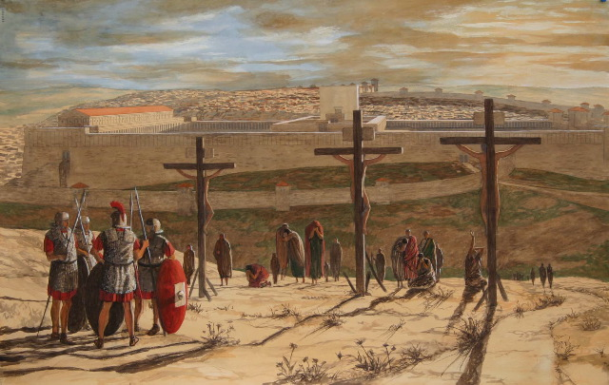
Jesus Was Crucified on the Mt of Olives
Facing the Eastern Gate ofJerusalem!

Slide 36
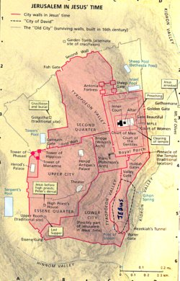
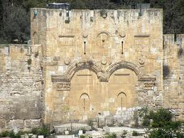
“Wherefore Jesus also, that He might sanctify the people with His own Blood,
suffered without “the gate”
Hebrews 13: 10
Golgotha - “place of the Skull” is the site priests counted the heads of Jews for Temple tax - outside the Eastern Gate
Jesus fulfils Numbers 22 –
The Red Heifer sacrifice!

Slide 37
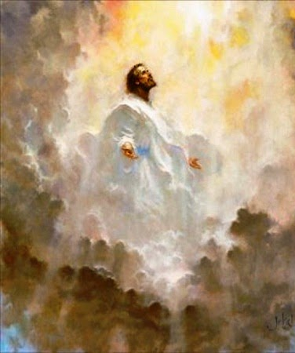
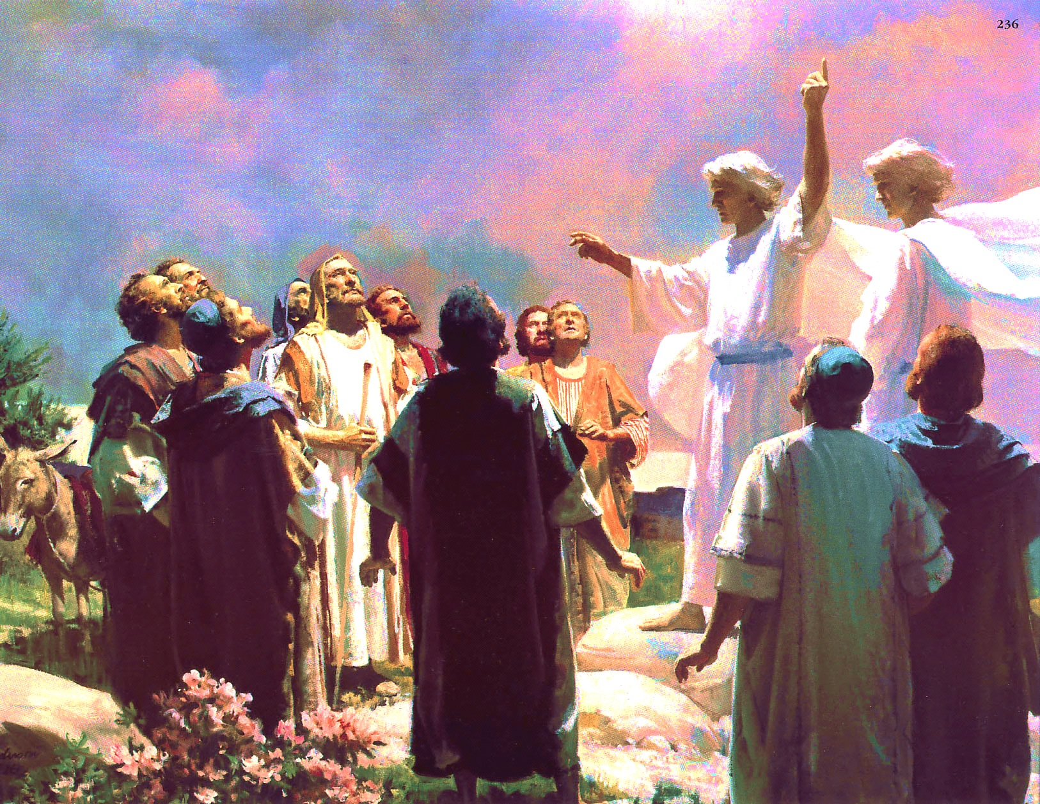
Jesus Ascends From the Mt. of Olives
“And after He had spoken these things,while they
beheld, He was taken up; and a cloud received Him out of their sight. And while they looked steadfastly toward Heaven as He went up, behold 2 men stood
by them in white apparel, which also said, You men of Galilee, why stand you gazing up to Heaven?
This same Jesus, which is taken up from you to Heaven, shall so come in like manner as you have seen Him go into Heaven;
Then they returned to Jerusalem from the Mt. called Olivet, which is from Jerusalem a sabbath’s day journey.” Acts 1:9-12

Slide 38
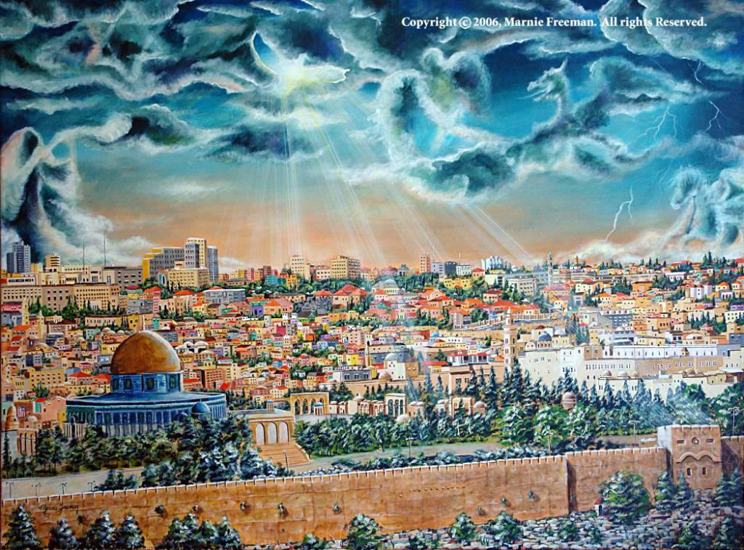
He will Stand on the Mount of Olives Again
At 2nd Coming! Zechariah 14::4

Slide 39
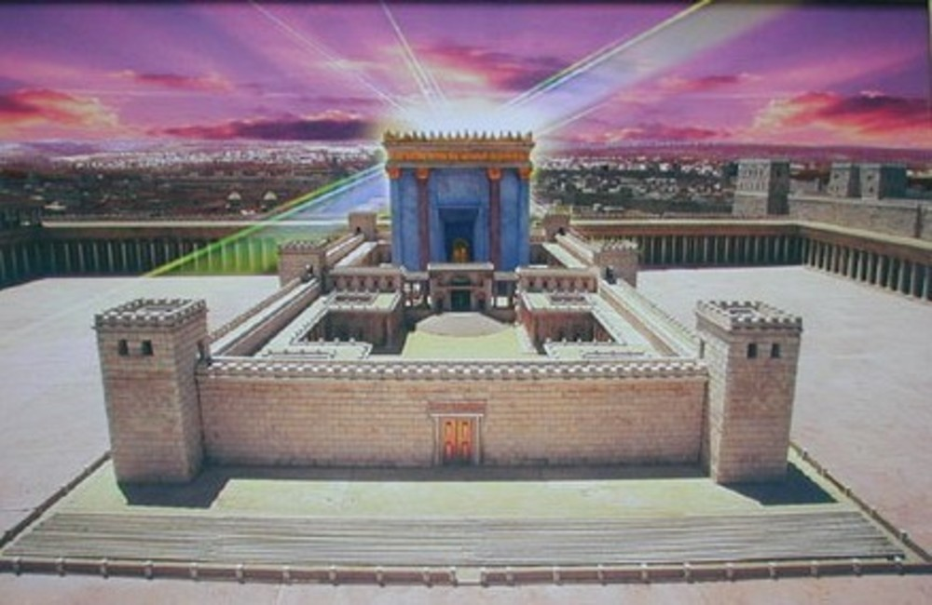
The Future Temple of Bible Prophecy will be in Jerusalem.

Slide 40
Are there any other clues that Jerusalem may be the
Center of the Garden of Eden?
What about the Rivers?
“A river went out of Eden to water the Garden; and from there
it became 4 heads. The 1st is the Pison: it encompasses the whole land of Havilah, where there is gold. The 2nd is the Gihon, the same encompassess the whole land of Ethopia,
the 3rd is the Hiddekel which goes toward the east of Assyria, and the 4th is the Euphrates. Genesis 2:10-14

Slide 41
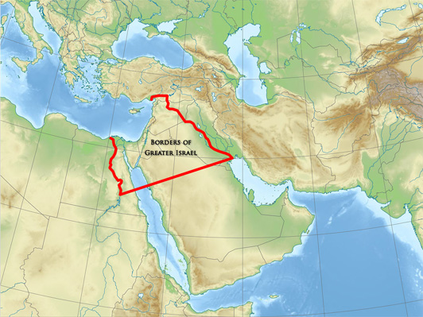
Gen. 15:18 “In the same day the Lord made a covenant with Abram, saying, Unto your seed have I given this Land, from the River of Egypt to the great river, the Euphrates!

Slide 42
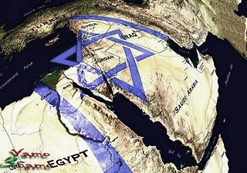
The Rivers Also Mark the Boundaries of New Jerusalem – Revelation 21
“And the city lies foursquare, the length is as large as the breadth: and he measured the City with the reed, 12,000 furlongs. The length and the breadth and the height of it are equal.” Revelation 21:16 1500 miles x 1500 miles x 1500 miles!

Slide 43
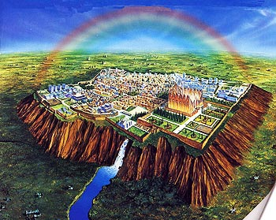
“And he showed me a pure river of water of Life, clear as crystal, preceding out of the throne of God and the Lamb. In the midst of the street and on either side of the river, there was the tree of Life….Rev. 22:1-2 The same Tree of Life in the Garden of Eden!
Zech. 14:9-11
Welcome to Your Forever Home – New Jerusalem – Heaven Comes to Earth!

Slide 44
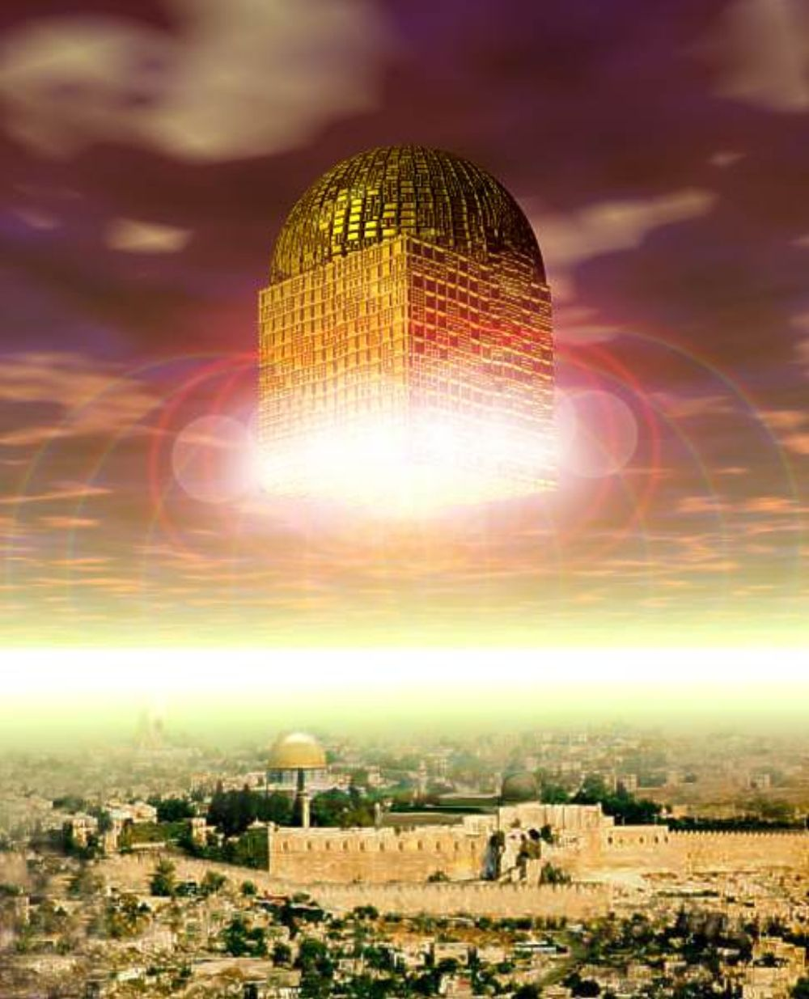
New Jerusalem comes down From Heaven to Earth- Rev. 21
The Plan of God has now come full circle!
We are restored back to the Garden of Eden!

Slide 45
Oh, There is still more!
Where did Adam settle after he was evicted from the Garden? In the City of Adam, across the Jordan , East of Jerusalem!
The Battle of Jericho
In Joshua 3:16

Slide 46
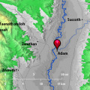
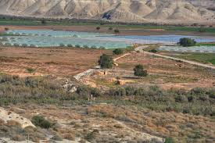
“The waters which came down from above stood and rose up upon a heap very far from the city of Adam, which is near Zaretan.” Joshua 3:16

Slide 47
Jerusalem shall be trodden down of the Gentiles,
until the times of the Gentiles be fulfilled!

Slide 48
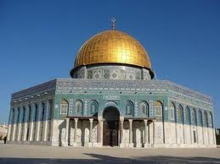
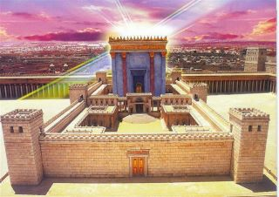
Satan will set up his anti-christ as God on the Holy Mt. in Jerusalem during the Tribulation and demand to be worshipped
The Abomination of Desolation will be removed-
Jesus will Reign from the Future Temple and God’s Glory will cover the Nations!

Slide 49
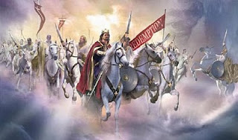
“Then shall they see the Son of Man coming in a cloud with power and great glory. When these things begin to happen, Lift up your hearts, for your Redemption draws nigh.” Luke 21:27-28“

Slide 50
So What’s Love Got to Do with It?
Everything!
Bible Prophecy is the Father’s Love Covenant!

Slide 51
When is Jesus Coming Again?
When the Lord shall build up Zion,
He shall appear in His Glory!
Zion = Jerusalem

Slide 52
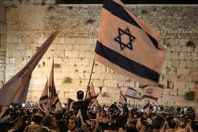
Modern Day Miracles in Jerusalem!
The Return of the JewsTo Israel from over 140 Nations!
“I will gather my outcasts from the 4 corners of the Earth”
Isaiah 11:12 No Replacement Theology!

Slide 53
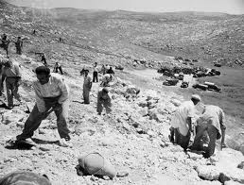
“And I will bring again the captivity of My people Israel, & they shall build the waste cities & inhabit them; & they shall plant vineyards & drink the wine; they shall also make gardens & eat the fruit of them.” Amos 9:14-15
“I will plant them upon their land and they shall no more be pulled up out of their land I have given them.”

Slide 54
Levite’s Garments Recreated!
Red Heifer for
Temple Purification
Holy Temple Vessels
High Priest’s Crown, Robes, & Ephod
“The Restitution of All Things”
Acts 3:21
Sanhedrin Re-established
Hebrew Language

Slide 55
Jerusalem Belongs To the Lord!
His Covenant Place

Slide 56
“The Place”

