Slide 1
God’s Power & Protection

Slide 2
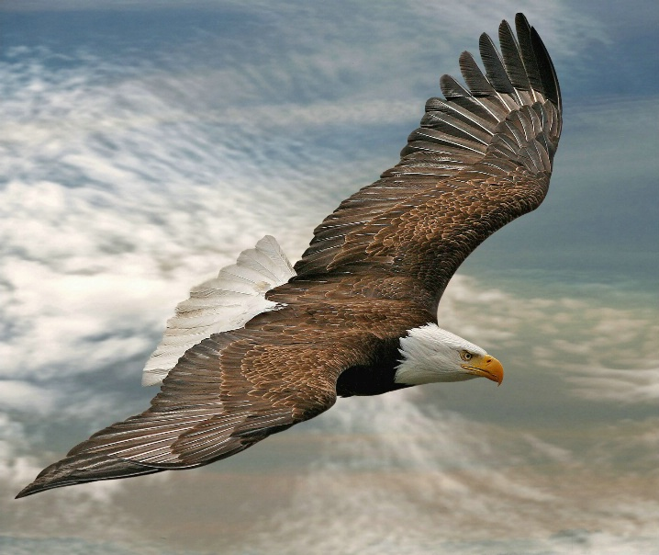
“He Will Carry You
On Eagle’s Wings”
The Power & Protection of Blood Covenant

Slide 3
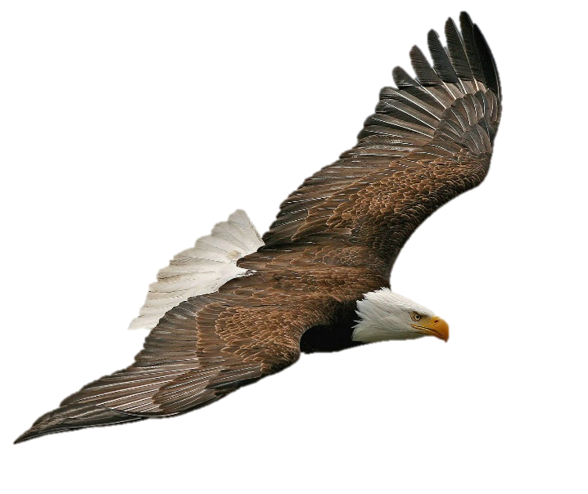
“Carried on Eagle’s Wings”
is a beautiful Hebrew idiom that will greatly help us understand God’s supernatural protection Today, Tomorrow, during
the End Times & The Day of the Lord
God Has a Forever Love
For His Covenant People
First with Israel
Then with The Church

Slide 4
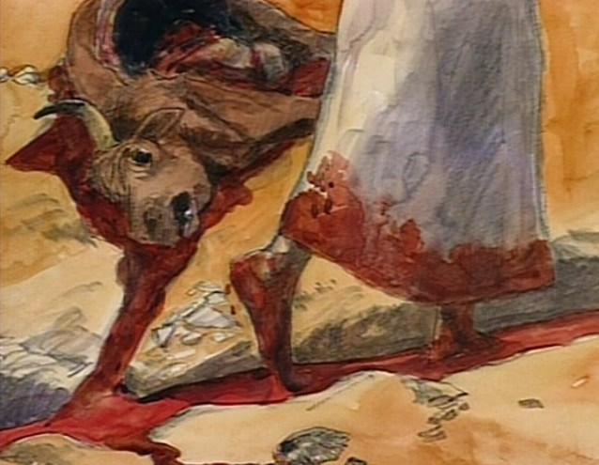
Genesis 15 – God Cuts Blood Covenant with Abram

Slide 5
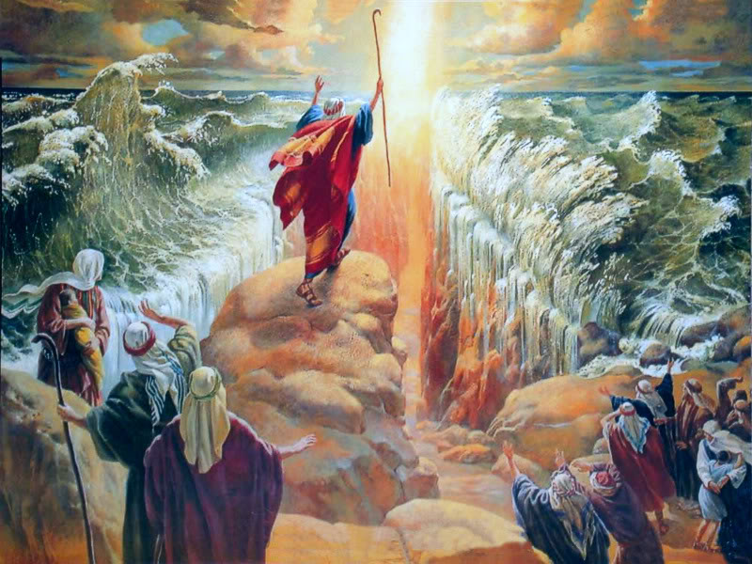
The 1st time we read of “carried on eagels’ wings” is in Exodus 19:4. Moses delivered God’s Chosen people out of slavery in Egypt. In a fury, Pharaoh chased them with 600 chariots through the high mountainous wadis all the way to the Red Sea. No way forward and the enemy behind!

Slide 6
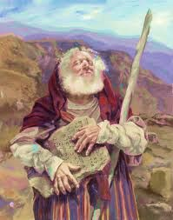
1.“In the 3rd month, when the children of Israel were gone forth out of the land of Egypt, the same day came they into the wilderness of Sinai.
2. For they were departed from Rephidim, and were come to the desert of Sinai and had pitched
in the wilderness; and there Israel camped before the mount.
3.And Moses went up to God, and the Lord called to him out of the mountain, saying ‘Thus shall you say to the House of Jacob,
and tell the children of Israel.
4.You have seen what I did to the Egyptians; and how I bare you
on eagles’ wings, and brought
you to Myself.”

Slide 7
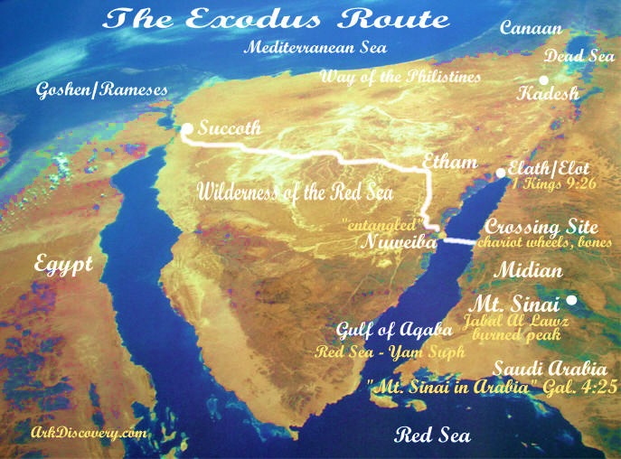
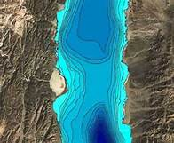
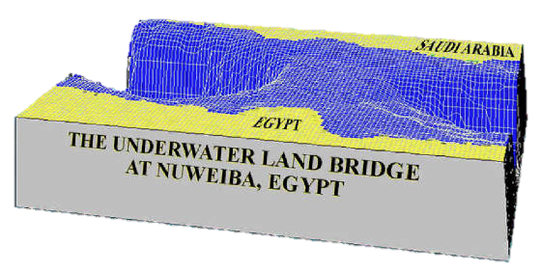
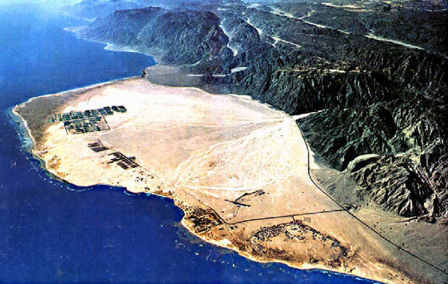
God carries Israel on Eagle’s Wings when there is no other way of escape

Slide 8
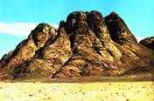
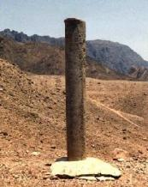
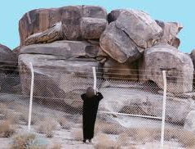
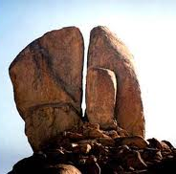
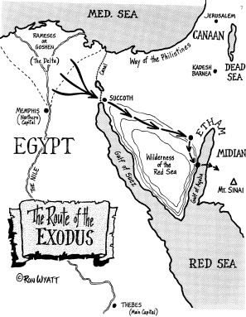
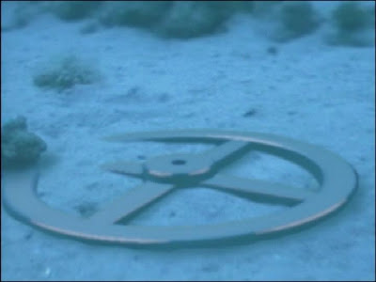
Recent Discovery
“For this Hagar is Mt. Sinai in
Arabia, and answers to Jerusalem which now is,and is in bondage
with her children” Galatians 4:25

Slide 9
Because of His Covenant with Israel
God will deliver Israel supernaturally again…
in the End Times during theTribulation…..
Just like He delivered them at the Red Sea.
….He will “carry them on Eagles’ Wings”
Revelation Chapter 12

Slide 10
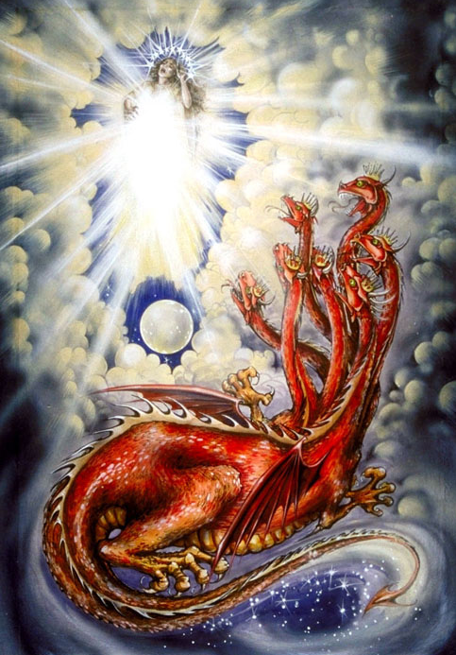
Revelation 12 – The Woman is Israel
1. And there appeared a great wonder in heaven:
a woman clothed with the sun & the moon under
her feet & on her head a crown on 12 stars
2. And she being with child cried,
travailing in birth & in pain to be delivered.
3. And there appeared another wonder in heaven
Behold, a great red dragon, having 7 heads
& 10 horns, and 7 crowns upon his heads.
4. And his tail drew 1/3 part of the stars
of heaven, and cast them to the earth.
5. And the dragon stood before the woman
who was ready to be delivered
to devour her child as soon as it was born.
6. And she brought forth a man child
who will rule all nations with a rod of iron

Slide 11
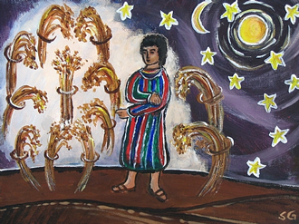
The Woman is Israel, not the Church – Israel gave birth to the Messiah!
In Genesis 37:9 - Joseph has a dream and the sun, moon, and 11 stars ( clearly understood to be his parents and 11 brothers) bow to Joseph!

Slide 12
“
13. “And when the dragon saw that he was cast to the earth, he persecuted the woman who brought forth the man child. 14. And to the woman were given 2 wings of a great eagle, that she might fly into the wilderness, into her place, where she is nourished for a time, times, and half a time from the face of the serpent.” Revelation 12:13-14 - Last 3 ½ Years of Tribulation

Slide 13
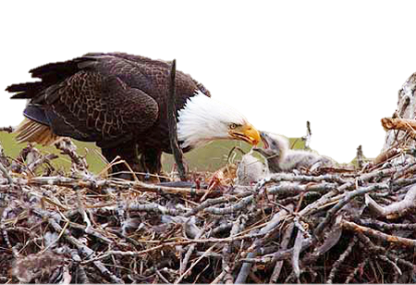
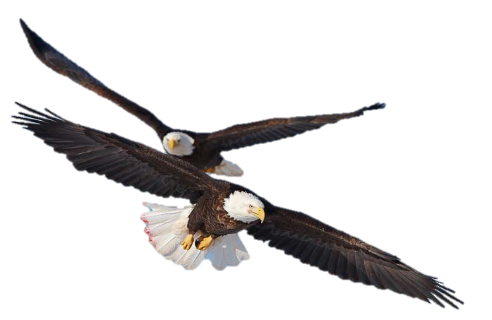
8.“When the Most High divided to the nations their inheritance,
when He separated the sons of Adam,
He set the bounds of the people according
to the number of the children of Israel.
9. For the Lord’s portion is His people:
Jacob is the lot of His inheritance
He found him in a desert land,
and in the waste howling wilderness;
He led him about, He instructed him
He kept him as the apple of his eye.
11. As an eagle stirs up her nest,
flutters over her young,
spreads abroad her wings,
takes, bears them on her wings
So the Lord alone did lead him
And there was NO strange God with him
So the Lord made him to ride on high places of the earth,
that he might eat the increase of his fields;
And He made him to suck honey out of the rock
and oil out of the flinty rock”
Deuteronomy 32

Slide 14
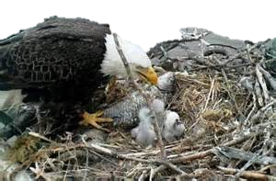
Like an Eagle watches over, nurtures,
and cares for her young
So shall the Lord God watch over
and protect Israel from her enemies
during the “Time of Jacob’s Trouble”
In the End Times
Israel shall WAIT for
Her Messiah and then
God shall renew their
Strength like an eagle

Slide 15
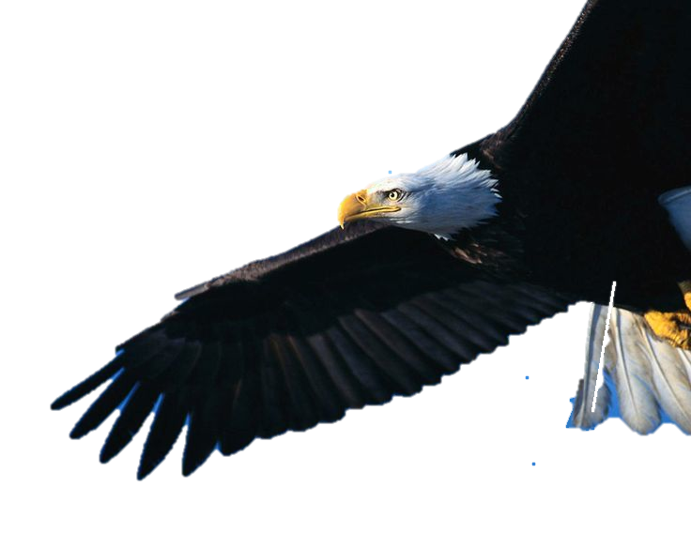
Isaiah Chapter 40 - “With Wings of Eagles”
28 “Have you not known? Have you not heard, that the everlasting God,
the Lord the Creator of the ends of the earth, does not faint, neither is weary?
There is NO searching of His understanding.
29. He gives power to the faint;
and to them that have no might,
He increases strength.
30. Even the youths shall faint and be weary
and the young men shall utterly fail
31. But those that WAIT upon the Lord,
shall renew their strength;
They shall mount up with wings as eagles
They shall run and not be weary
They shall walk and not faint

Slide 16
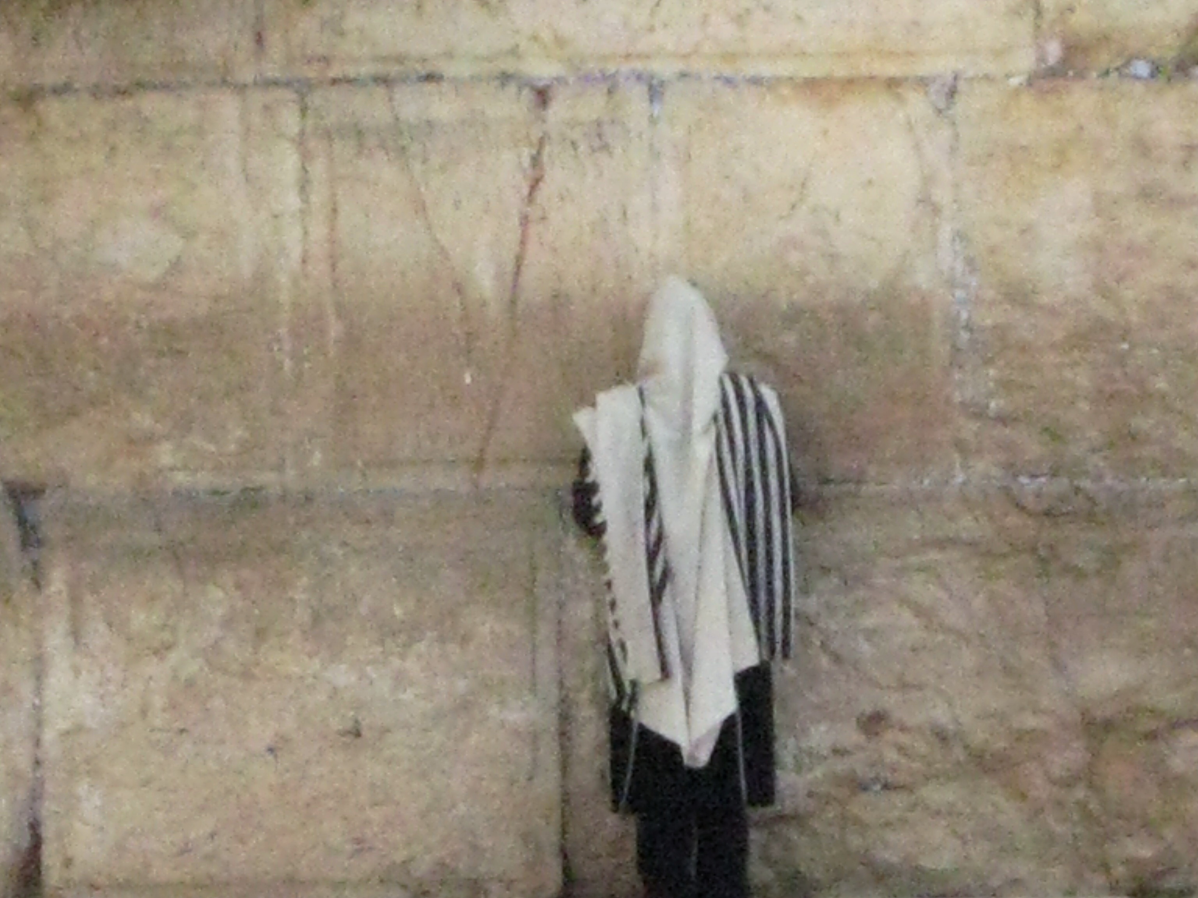
Isaiah 30:17-18
17. “0ne thousand shall flee at the rebuke of one;
at the rebuke of 5 you shall flee
till you be left as a beacon on the top of a mountain,
and as a ensign on a hill.
18. And therefore will the Lord WAIT,
that He may be gracious to you,
and therefore He will be exalted,
that He may have mercy on you:
for the Lord is a God of judgment:
blessed are all they
that WAIT on Him.
For the people shall dwell
in Zion at Jerusalem:
you shall weep no more:
He will be very gracious to you
at the voice of your cry;
When He shall hear it,
He shall answer you.”

Slide 17
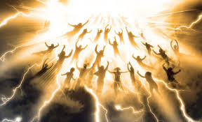
Do you know WHY Jesus is coming?
First He will come in the Clouds to Remove His Blood Covenant Church from the Tribulation to Come…..”The Day of the Lord”

Slide 18
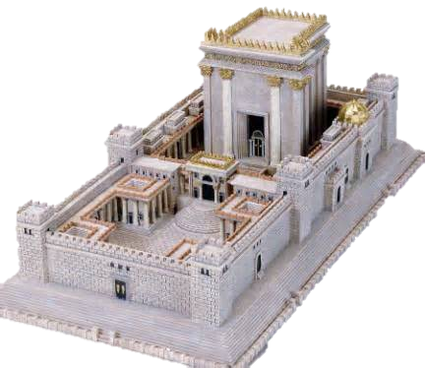
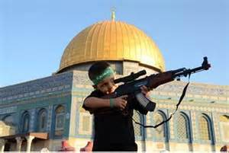
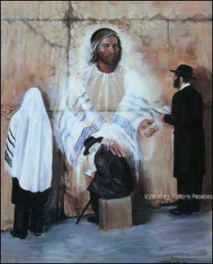
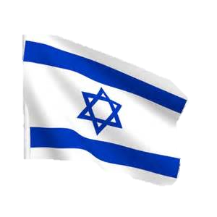
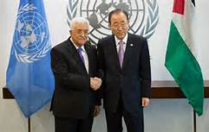
Then He will return to Redeem Israel Rescue the Jews and Liberate Jerusalem during the Tribulation

Slide 19
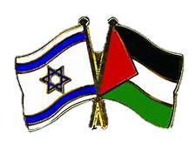
“Behold, I will make Jerusalem a cup of trembling to
ALL the people round about . . .” Zechariah 12:2
"And in that Day (the "Day of the Lord" ... the coming Apocalypse) I will make Jerusalem a burdensome stone for ALL people“ Zechariah 12:3
God says HE is the One stirring things up in Jerusalem!
Beware of all the Peace Plans
or Roadmaps to Peace!

Slide 20
"Because, even because they have seduced My people (Israel),
saying, "Peace” and there was no peace ...”
Ezekiel 13:10
"For they have healed the hurt of the daughter of My people slightly, saying, 'Peace, Peace; when there is no peace!” Jeremiah 8:11
"For you yourselves know perfectly that the Day of the Lord so comes as a thief in the night for when they say, Peace and Safety, then sudden destruction comes upon them,
as labor pains on a pregnant woman. And they shall not escape ” 1 Thessalonians 5:2-3

Slide 21
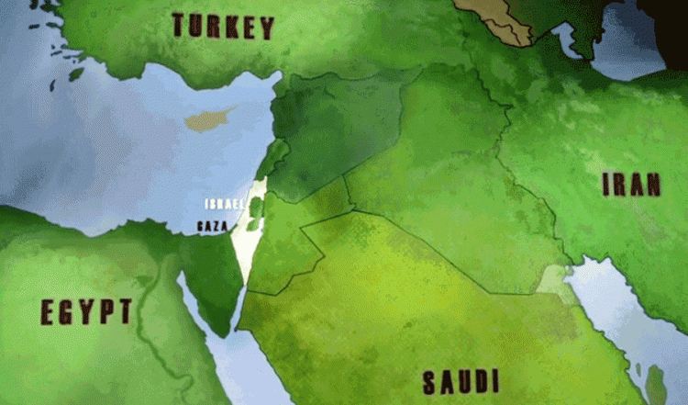
God is Angry with which Nations?
SYRIA
IRAQ
JORDAN

Slide 22
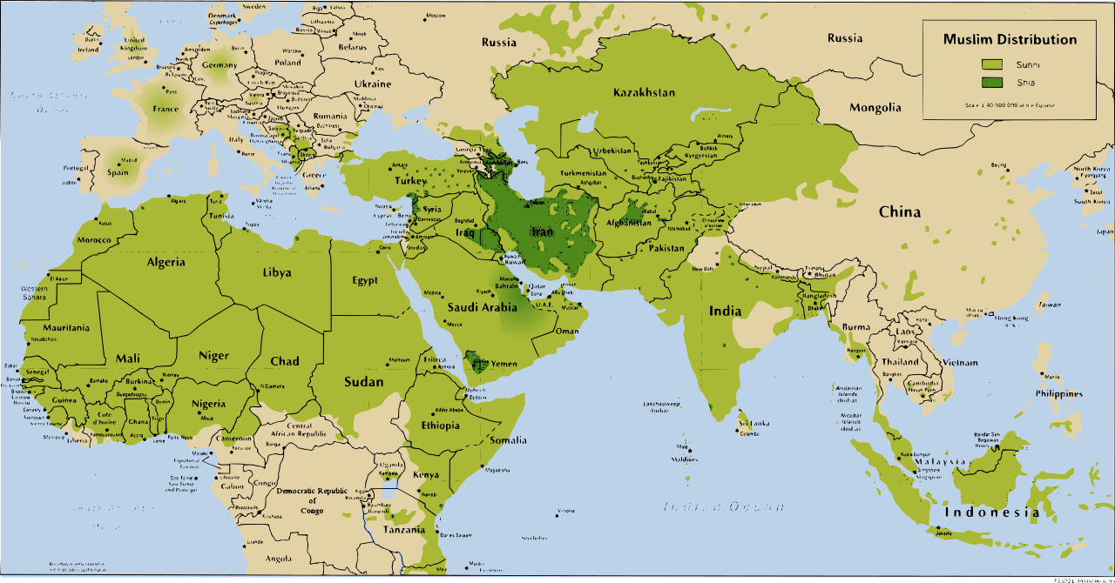
Isaiah Chapters 13-29 declare Jesus is Coming to destroy Israel’s Enemies
Isaiah 13 – Babylon Isaiah 17- Damascus & Syria
Isaiah 14:24 - Assyria Isaiah 18 – Ethiopia ( Sudan & Somalia)
Isaiah 14:28 – Philistia (gaza) Isaiah 19 - Egypt
Isaiah 15 – Moab (jordan) Isaiah 22 – Jerusalem (enemies within)
Isaiah 34:6 Edom Isaiah 23 – Tyre (Lebanon)

Slide 23
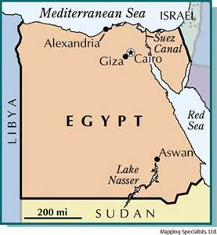
Do you know where Jesus returns and starts His battle with the ancient enemies of Israel
on the Day of the Lord?
The Mount of Olives
is His End Stop –
His Victory Stand
It looks like Jesus Comes
First to Egypt

Slide 24
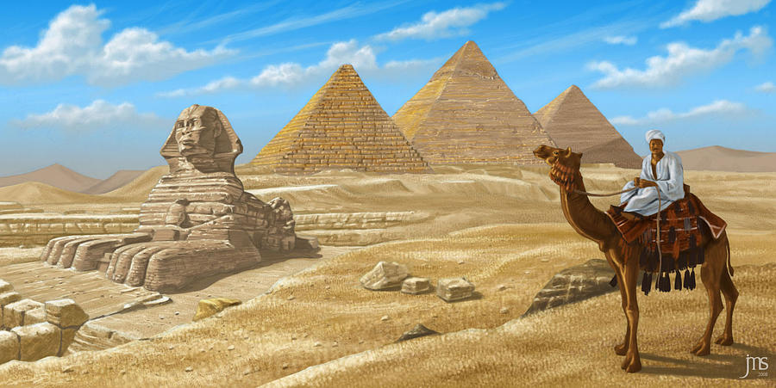
Isaiah 19:1 “The burden of Egypt. Behold, the Lord rides upon a swift cloud, and shall come into Egypt: and the idols of Egypt shall be moved at His presence, and the heart of Egypt shall melt in the midst of it.2. And I will set Egyptian against the Egyptians: & they shall fight everyone against his brother, & everyone against his neighbor; city against city, & kingdom against kingdom.”

Slide 25
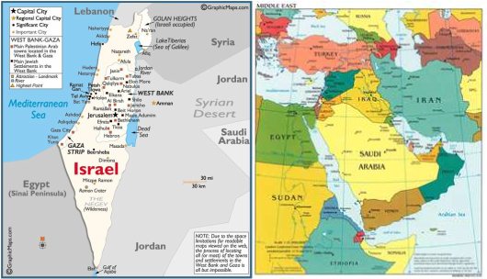
Isaiah 11:10 “And in that day there shall be a root of Jesse, which shall stand for an ensign of the people; to it shall the Gentiles seek: and His rest shall be glorious. 11. And it shall come to pass in that day, that the Lord shall set His hand again the 2nd time to recover the remnant of His people which shall be left, from Assyria, and from Egypt, and from Pathros, and from Cush, and from Elam, and from Shinar, and from Hamath, and from the island of the sea. 13. And He shall set an ensign for the nations, and shall assemble the outcasts of Israel, and gather together the dispersed of Judah from the 4 corners of the earth.”

Slide 26
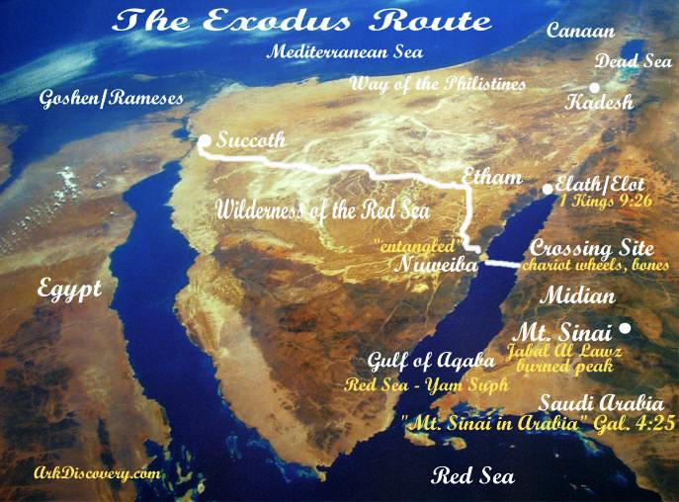
Isaiah 11:15 “And the Lord will utterly destroy the tongue of the Egyptian Sea: and with His mighty wind shall He shake His hand over the river, and shall smite it in the 7 streams, and make men go over dryshod. 16. And there shall be a highway for the remnant of His people , which shall be left, from Assyria; like as it was to Israel in the day that he came up out of the land of Egypt!”

Slide 27
Ezekiel 30:3 “For the Day is near, even the day of the Lord, a cloudy day; it shall be the time of the heathen.
4. And the sword shall come upon Egypt and great pain shall be in Ethiopia, when the slain shall fall in Egypt and they shall take away
her multitude & her foundations shall be broken down.
5. Ethiopia & Libya & Lydia & all the mingled people & Chub,
the men of the land that is in league, shall fall with them by the sword.”
Ethiopia “ Kush” Somalia, Sudan & Ethiopia
Egypt
Libya “Phut”
Lud
The Mingled People - All Arabia
Chub

Slide 29
Jesus’ War Campaign to Armageddon
Is Also God’s Wrath Path
From Egypt –Saudi Arabia – Jordan all the Way to Jerusalem

Slide 30
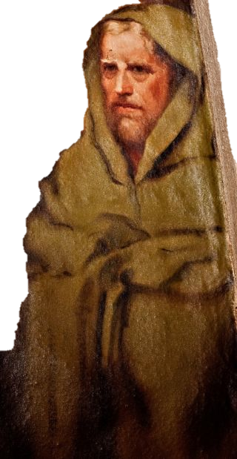
3.“God came from Teman,
and the Holy One from Mt. Paran. Selah
His glory covered the heavens,
and the whole earth was full of His praise
4.And His brightness was as the light
He had horns coming out of His hand:
and there was the hiding of His power.
5. Before Him went the pestilence
and burning coals went forth at His feet
6. He stood and measured the earth:
He beheld and drove asunder the nations
& the everlasting mountains were scattered
the perpetual hills did bow
7. I saw the tents of Cushan in affliction:
& the curtains of the land of Midian
did tremble.
Habakkuk 3:3-7

Slide 31
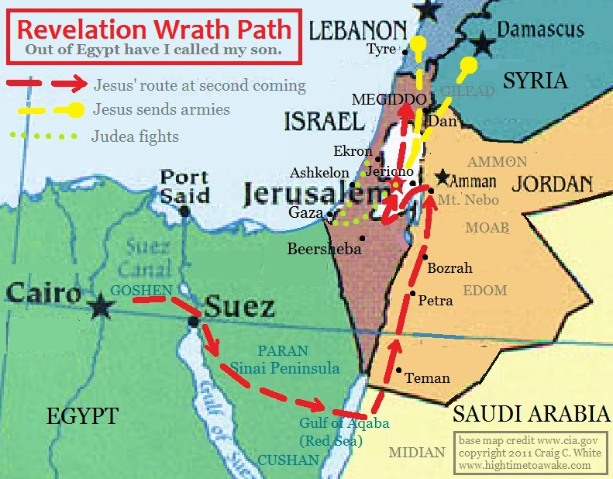

Slide 32
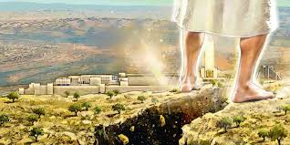
“Then shall the Lord go forth and fight against those nations, as when He fought in the day of battle. And His feet shall stand on the Mt. Of Olives, which is before Jerusalem on the east, and the Mt. of Olives shall cleave in the midst thereof toward the east and toward the west and there shall be a very great valley: “ Zechariah 14:3-4

Slide 33
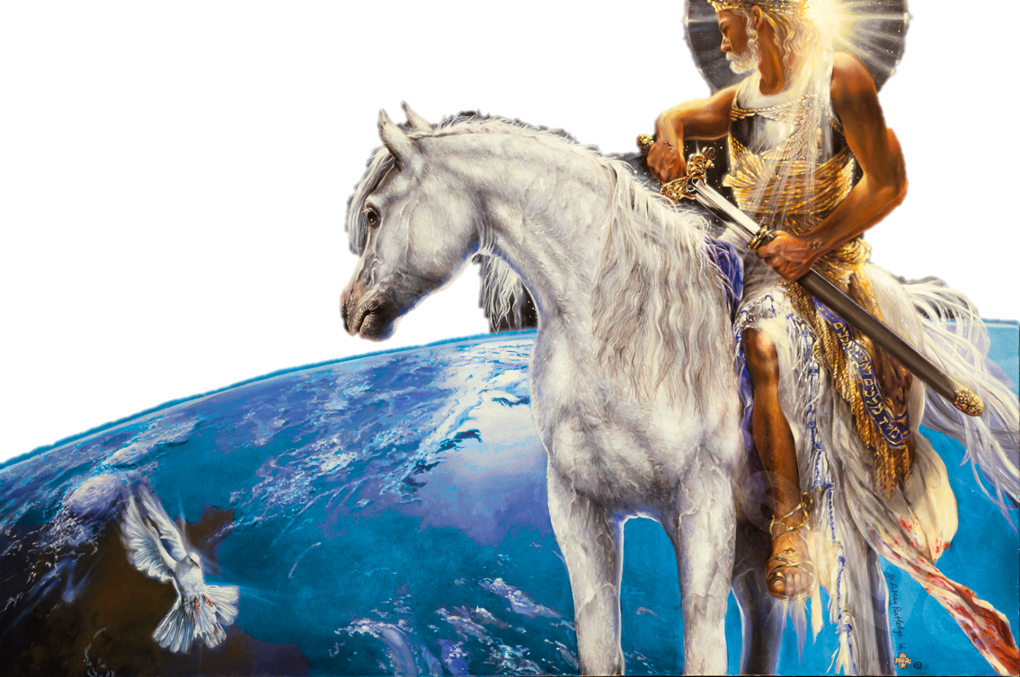
“And I saw heaven open, and behold a white horse, and He that sat upon him was called faithful & true
And in righteousness He does judge and make war.
His eyes were as a flame
of fire, & on His head
were many crowns; &
He had a name written
that no man knew,
but He himself.
And He was clothed
in a vesture dipped In
blood: and His Name
Is called The Word
Of God.”
Revelation 19:11-13

Slide 34
. “Who is this that comes from Edom ,
with dyed garments from Bozrah”
This that is glorious in His apparel,
travelling in the greatness of His strength?
I that speak in righteousness, mighty to save.
Wherefore are you red in your apparel,
and your garments like Him that treads the wine vat?
I have trodden the winepress alone; and of the people there was none
with Me: for I will tread them in My anger, and trample them in My fury;
And their blood shall be on My garments, & I will stain all my raiment.
For the Day of vengeance is in My heart, & the year of My redeemed has come. And I looked and there was none to uphold : therefore My own arm brought salvation to Me; and My fury, it upheld Me.
And I will tread down the people in My anger, and make them drunk in My fury, and I will bring down their strength to the earth.”
Isaiah 63:1-6

Slide 36
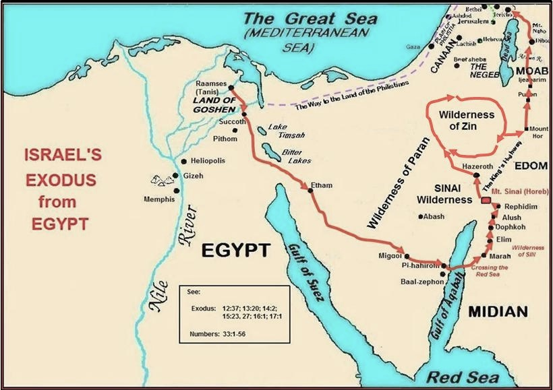

Slide 37
“Carried on Eagle’s Wings”
is a beautiful Hebrew idiom that will greatly help us understand the End Times
& The Day of the Lord
And to understand God’s Love
For His Covenant People

Slide 38
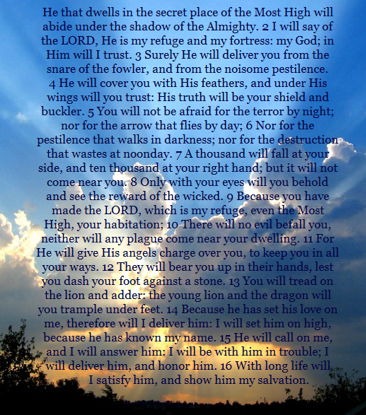
Psalm 91
“He will cover you with His Feathers, and under His Wings
You shall trust”

Slide 39
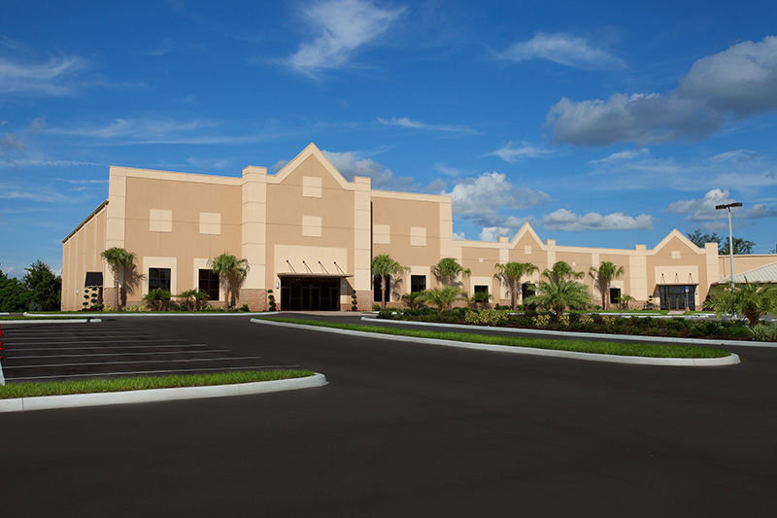
Jesus is Coming Back to Avenge His Covenant
And to Save all Israel
He will Destroy all her enemies …
What will He do for Us – The Church?
His Covenant People”
He will also Carry Us on Eagles Wings

Slide 40
“He Will Carry You
On Eagle’s Wings”
The Power &Protection of
God’s Covenant

