Slide 1
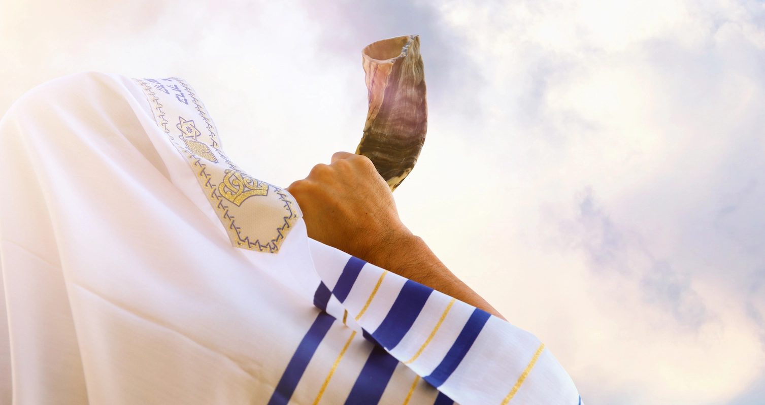
Yom Kippur
and
The Book of Revelation

Slide 2
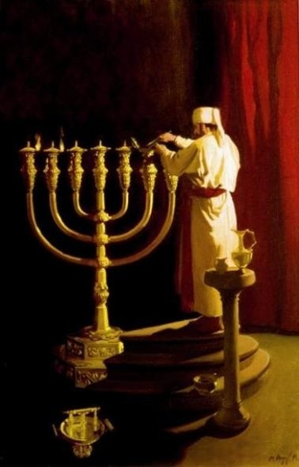
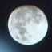
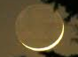
Where are We on God’s Prophetic Clock?
1. Passover 2.Unleavened Bread
3. First Fruits
50 Days
4. Pentecost
(Here We Are - Church Age)
5. Trumpets
6. Atonement
7. Tabernacles

Slide 3

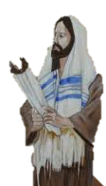
“God Opens the Books on The Feast of Trumpets
Rabbis teach that every person’s name is written in one of 3 books. On the Feast of Trumpets, God opens the 3 Books for Judgment! Sounds like Revelation 20
Great White Throne Judgment
The Doors of Heaven Open
The Righteous Go UP!
The Righteous
The Wicked
The
Undecided
The Wicked and the Undecided Go into the Days of Awe (Dread)

Slide 4
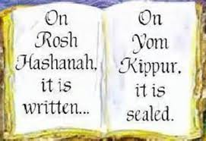
The Righeous Go up into Heaven
sounds like a Rapture to me!
The Wicked and the Undecided go into days
of dread Sounds like the Tribulation!
God’s Judgment in pronounced on Trumpets
and executed on Atonement
Names can be sealed
or Blotted out on Atonment
If people change their minds during the Tribulation … God will change His mind!

Slide 5
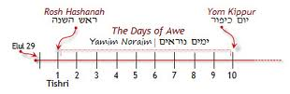
So what might happen on Earth during the Days of Awe
Ending on the Day of Atonement?
Feast of Trumpets
Yom Teruah
Day of Atonement
Yom Kippur
The Days of Awe
“Yamin Noraim”
“One Long Day”
Sighting New Moon
The Day
of the Lord
Bridal Week - Church in Heaven
In Prepared Place with Jesus
Tribulation Week – Unbelievers on Earth

Slide 6
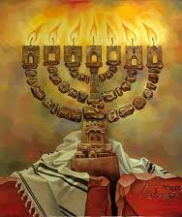
#6 Appointed Time
Yom Kippur
The Day of Atonement
On the Holiest Day
In the Holiest Month
When the Holiest Man
Enters the Holiest Place
In the Holiest City
In the Holiest Nation
For the Holiest Purpose
Holy Holy Holy
Leviticus 16:1-31; Lev. 23:26-32;
Numbers 29 1 Cor. 13:9-12

Slide 7
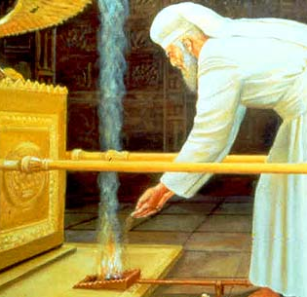
Day of Atonement
The Solemn Assembly
“The Fast”
“Face to Face’
Behind the Veil
Closing of the Door
The Day
Names Sealed or Names Blotted out
The Great Trumpet
Yom Kippur-Themes
“Also on the 10th day of the 7th month there shall be a Day of Atonement: it shall be a holy convocation. You shall afflict your souls and offer an offering made by fire to the Lord.” Levit 23 :27

Slide 8
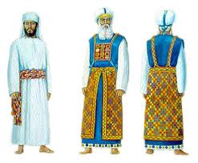
“
“Speak to Aaron your brother, that he come not at all times into the Holy Place within the veil before the Mercy Seat, which is upon the Ark; that he die not:
For I will appear in the cloud above the Mercy Seat” Leviticus 16: 2
You can tell what Feast it is By the Garment He Wears!
“He shall put on the holy linen coat and he shall have the linen breeches upon his flesh, and shall be girded with the linen girdle, and with the linen mitre shall he be attired:
these are holy garments”
Leviticus 16:4

Slide 9
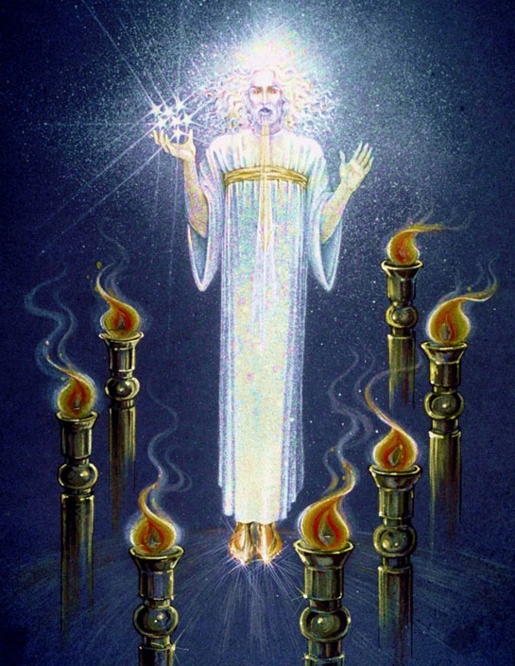

Revelation is a Yom Kippur Service – Jesus is High Priest!
‘And in the midst of the 7 candlesticks one like the Son of man, clothed with a garment down to the foot, girt about the paps with golden girdle” Revelation 1:13

Slide 10
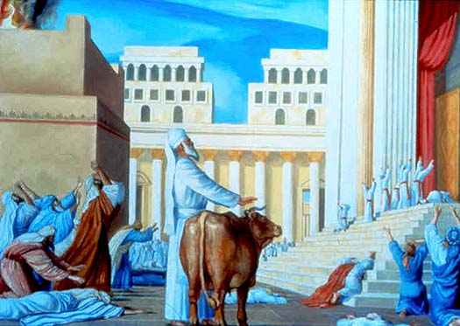
First a Bull is Sacrificed for the Priesthood
“Thus shall Aaron come into the Holy Place: with a young bull for a sin offering
and a ram for a burnt offering. (Lev.16:3)

Slide 11
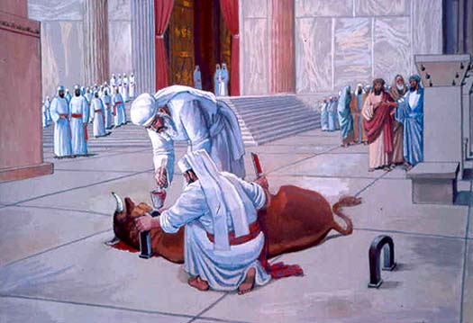
“And Aaron shall offer his bull of the sin offering, which is for himself,
and make an atonement for himself and for his house.” Leviticus 16:6

Slide 12
The 2 Goat Ceremony is Next!
“And he shall take of the congregation of the children of Israel 2 kids of goats for a sin offering, and 1 ram for a burnt offering. And he shall take the 2 goats and present them before the Lord at the door of the Tabernacle of the congregation. Lev. 16:5 & 7

Slide 13
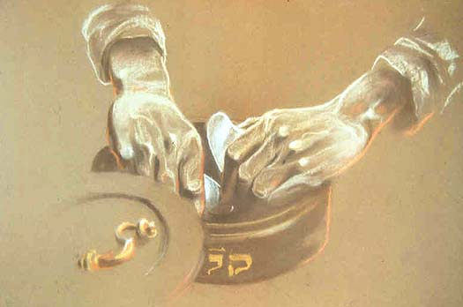
“And Aaron shall cast lots upon the 2 goats; one lot for the Lord
( Adonai) and the other lot for the scapegoat (for Azazel)” Lev. 16:8

Slide 14
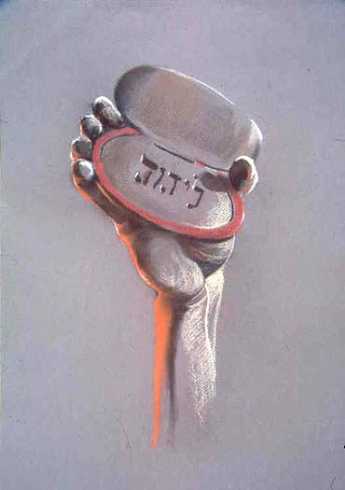
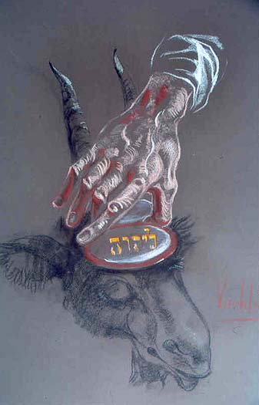
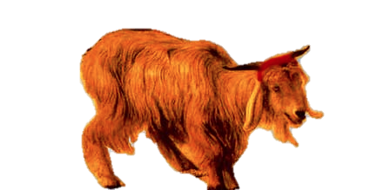
The High Priest picks one stone with his right hand and places it on right goat. The right always came up “for Adonai” The left stone engraved “for Azazel” is placed on left goat!
2 Goat Ceremony

Slide 15
The High Priest ties a Red Cord the neck of goat for Adonai. It will be sacrificed as sin offering
The Day of Atonement

Slide 16
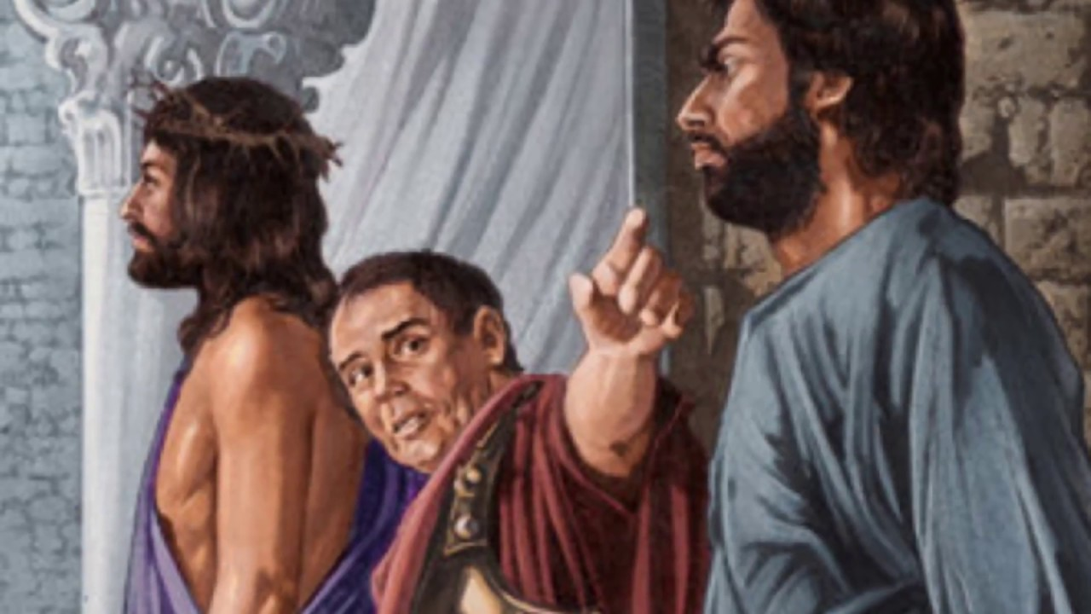
Pontius Pilate offers to free one condemned man on Passover
Jesus (Yeshua ben Joseph) or Barabbas (Yeshua bar Abbas)
Sounds Like the 2 Goat Ceremony
Jesus will die as a sacrifice for the sin of all men
Barabbas, who carries much guilt, is released.

Slide 17
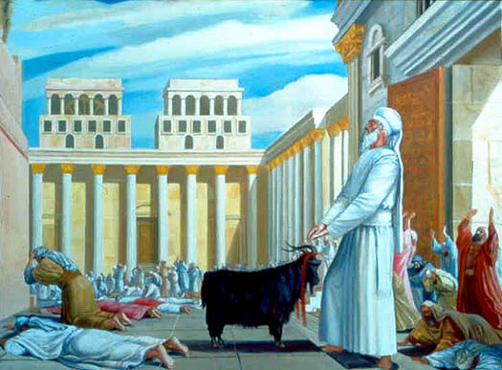
All Sin Must Leave the House of Israel!
The High Priest places his hands toward the goat for Azazel
He transfers all Israel’s iniquity to the “sin-bearer” Leviticus 16:21

Slide 18
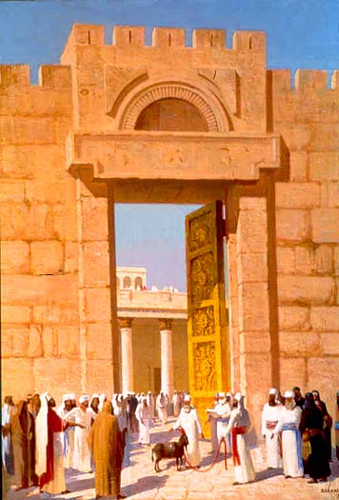
The Scapegoat is
carefully escorted to a“wilderness place”
“And the goat shall bear upon him all their iniquities into a land not inhabited: and he shall let go the goat in the wilderness.
Leviticus 16: 22
The Sin has to leave the Camp!

Slide 19
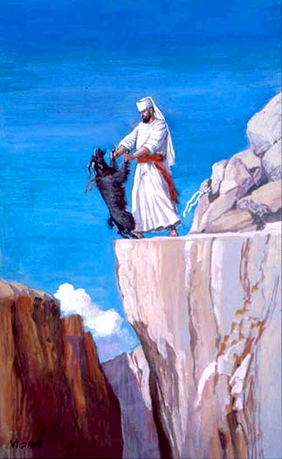
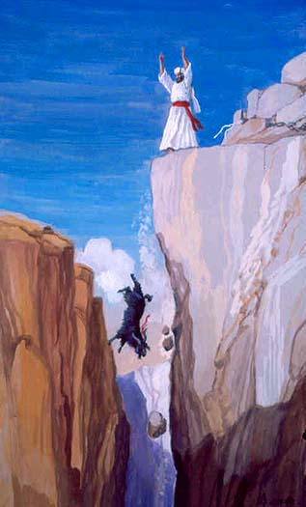
Make Sure the Sin Can’t Come Back in the Camp…….
When the Red Cord miraculously turns from scarlet to white, they knew God accepted the sacrifice for the Nation of Israel! Isaiah 1:18

Slide 20
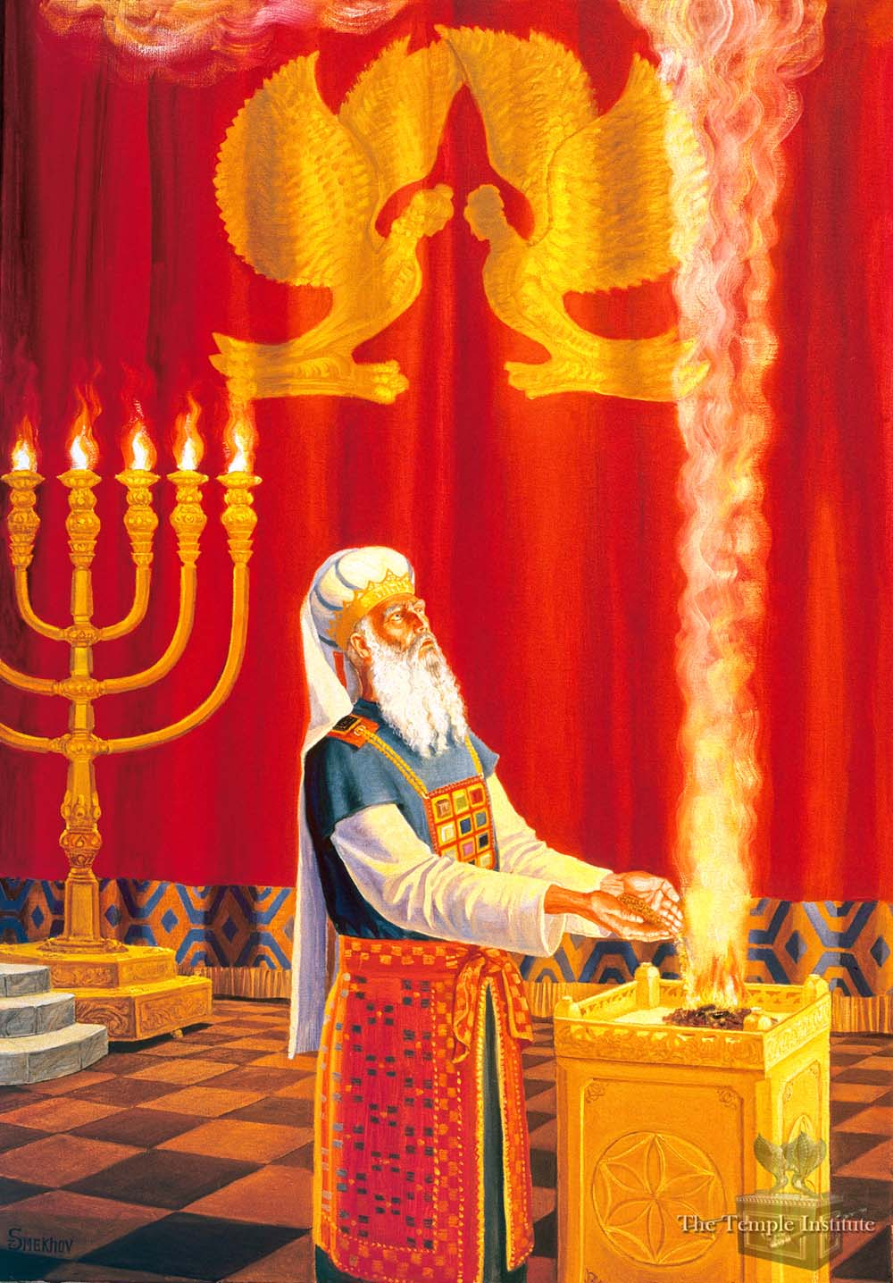
Only on Yom Kippur, Israel’s High Priest performs every act in the Temple. He lights the Golden Menorah. He inspects the animal sacrifices. He brings the burning coals from the Brazen Altar, then He scoops the Incense from the Altar of Incense.
He will step inside the veil 3 times:
once with the burning coals and the incense. The next trip he will sprinkle the blood of the bull, and the last trips to sprinkle the blood of the goat on the Mercy Seat.
When He steps into the Holy of Holies, the High Priest will change His garments to white linen

Slide 21
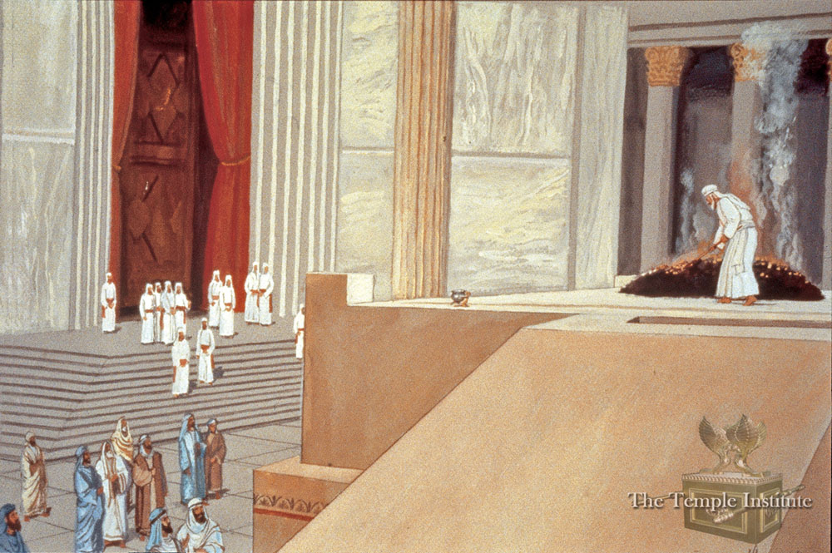
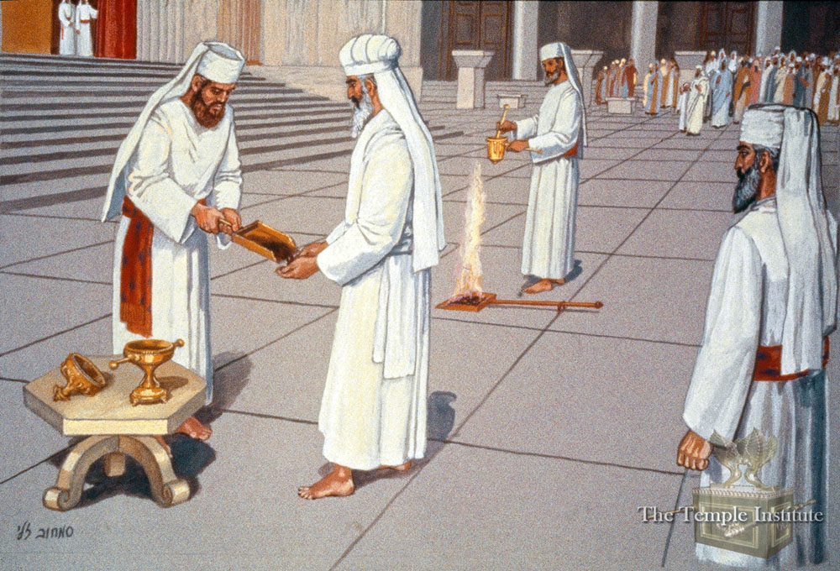
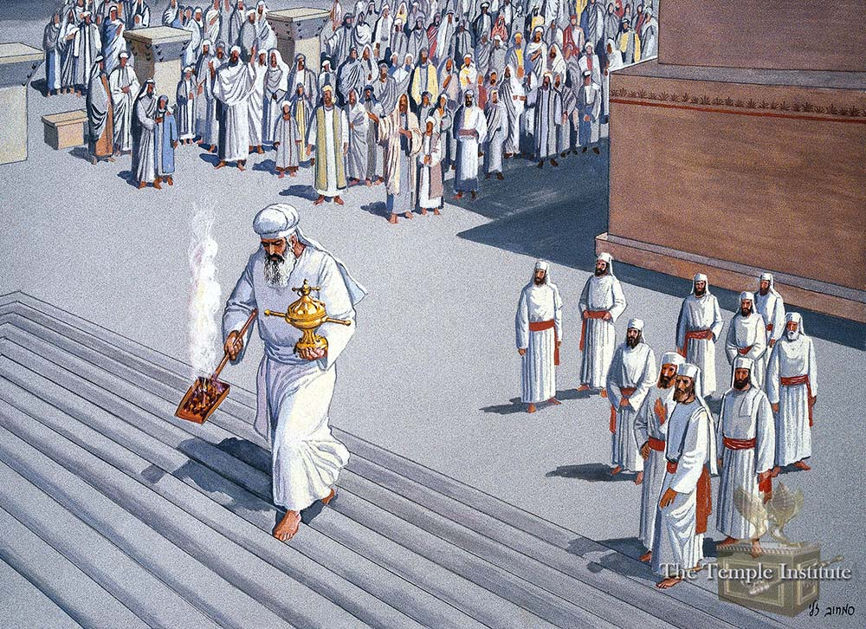
Yom Kippur Focus on
The Actions of the High Priest
The Blood Sacrifices
Entering the Holy of Holies
Meeting God Face to Face

Slide 22
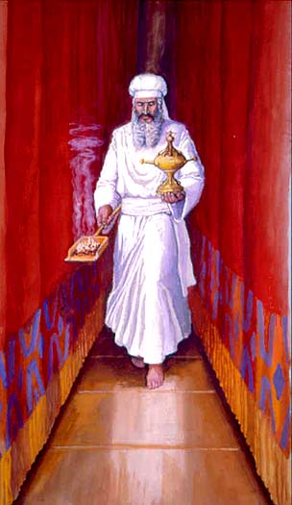
First the High Priest brings incense and the burning coals. The Holy of Holies has no light inside the room until He step behind the veil and places the incense on the burning coals.
He begins “The Walk “
Silence for 30 minutes
No One can touch him.
The people wait outside on their faces to see if God accept the sacrifices: then atonment for sin
will last for a whole year.

Slide 23
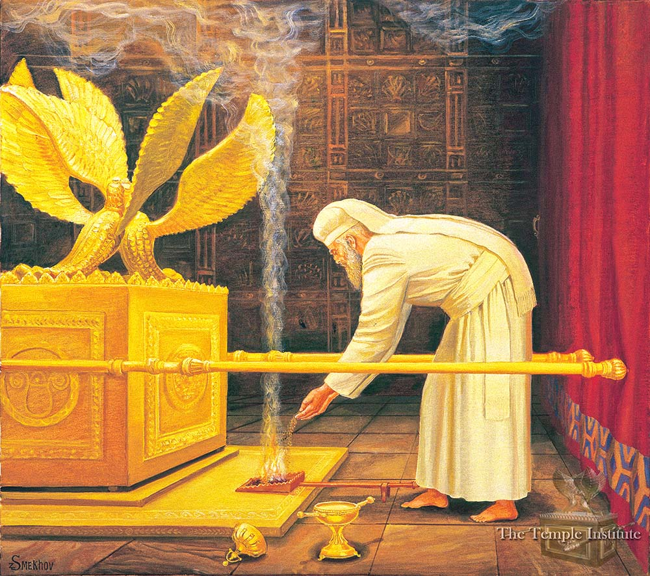
Leviticus 16:12-13. ‘ The High Priest & The Incense Ceremony
12 “And he shall take a censor full of burning coals from off the altar before the Lord, and
his hands full of sweet incense beaten small,
and bring it within the vail
13 And he shall put the incense upon the fire before the Lord, that
the cloud of incense may cover the Mercy Seat that is upon the Testimony that he not die.”

Slide 24
Revelation 8 – Jesus is Conducting a Yom Kippur Service
as the High Priest of Israel
For the Redemption of Israel as a Nation
1 “And when He had opened the 7th seal there was silence in heaven
about the space of half an hour.”
2. I saw the 7 angels which stood before God, to them were given 7 trumpets.
3. And another ángel came and stood at the altar, having a Golden censer; and there was given to him much incense, that he should offer it with the prayers of all saints upon the Golden Altar which is before the throne.
4. And the smoke of the incense which came with the prayers of the saints, ascended up before God out of the ángel’s hand.
5. And the ángel took the censer, and filled it with the fire of the altar and cast it into the earth: and there were voices, and thunderings, and lightnings, and an earthquake.

Slide 25
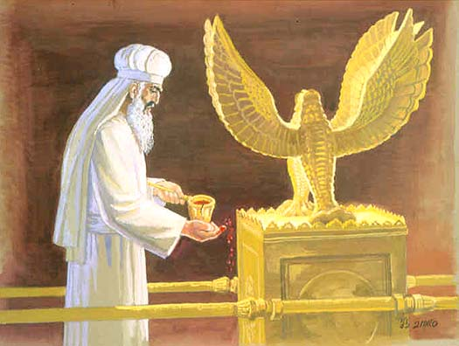
Sprinkle the Blood
7x down
“And he shall take the blood of the sacrifice and sprinkle it with his finger upon the Mercy Seat eastward; and before the Mercy Seat shall he sprinkle the blood 7 times.” Lev. 16:14-15

Slide 26
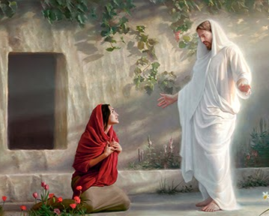
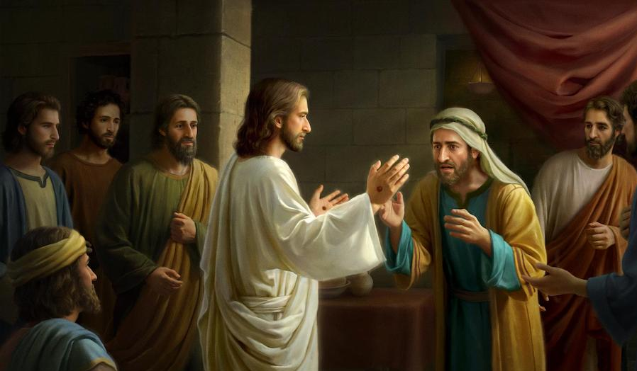
Remember when Mary sees Jesus in the Garden after the resurrection, He said to her, Touch Me not, for, for I am not yet ascended to My Father…..” John 20:17
He was on His way to the Mercy Seat in Heaven to sprinkle His Blood for Us!
Hebrews Chapter 9
Yet 8 days later, Jesus appears to His disciples and tells Thomas touch Him now. John 20:27
“Reach pit your finger and behold My hands,
Reach here your hand and thrust it into My side….”

Slide 27
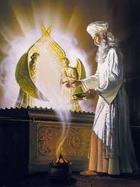
“The Day of Atonement”
Then the Glory of God
would fill
the Holy of Holies
And God would speak
to the High Priest
“I will meet with you between the cherubim”
‘Face–to-Face’

Slide 28
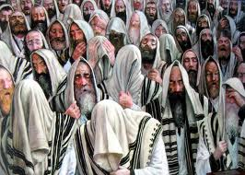
“And this shall be a statute forever to you: that in the 7th month, on the 10th Day, you shall afflict your souls, and do no work at all, whether it be one of your own country or as a stranger that sojourns among you. For on that Day , the priest shall make atonement for you, to cleanse you, that you may be clean from all your sins before the Lord. It shall be a Sabbath of rest, and you shall afflict your souls, a statute forever” Leviticus 16: 29-31
Afflict Your Souls
Day of Mourning
The Fast
The Day
The Solemn Assembly
All Themes Point to
The Tribulation

Slide 29
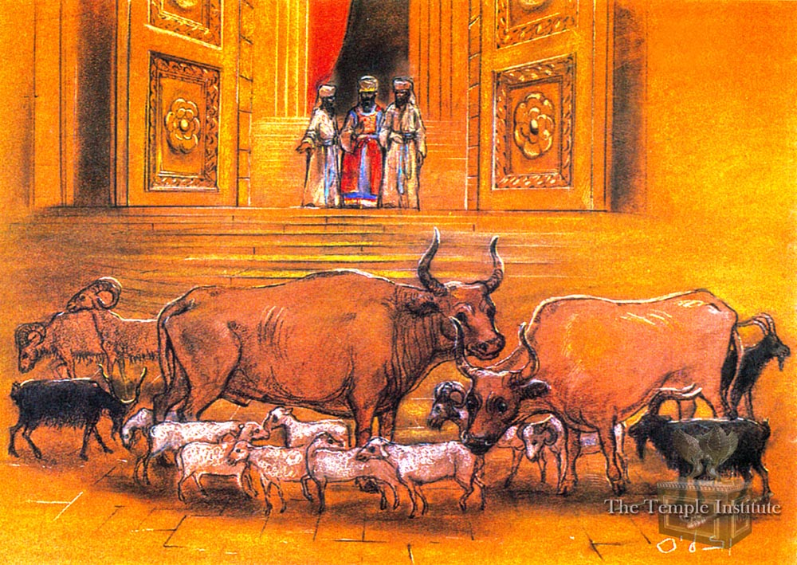
The Animal Sacrifices for Yom Kippur – Bull, Ram, 2 Goats, 7 Lambs

Slide 30
Isaiah 34:1-8 “The Lord’s Yom Kippur Sacrifice”
¹Come near, ye nations, to hear; and hearken, ye people: let the earth hear, and all that is therein; the world, and all things that come forth of it
² For the indignation of the Lord is upon all nations, and His fury upon all their armies: He has utterly destroyed them, He has delivered them to the slaughter
³ Their slain also shall be cast out, and their stink shall come up out of their carcases, and the mountains (of Israel) shall be melted with their blood.
⁴ And all the host of heaven shall be dissolved, and the heavens shall be rolled together as a scroll: and all their host shall fall down, as the leaf falls off from the vine, and as a falling fig from the fig tree. (Revelation 6th Seal)
⁵ For My sword shall be bathed in heaven: behold, it shall come down upon Idumea, and upon the people of My curse, to judgment.
⁶ The sword of the Lord is filled with blood, it is made fat with fatness, and with the blood of lambs and goats, with the fat of the kidneys of rams: for the Lord hath a sacrifice in Bozrah, and a great slaughter in the land of Edom
⁷ And the unicorns shall come down with them, and the bullocks with the bulls; and their land shall be soaked with blood, and their dust made fat with fatness.
⁸ For it is the Day of the Lord's vengeance, and the year of recompences for the controversy of Zion.

Slide 31
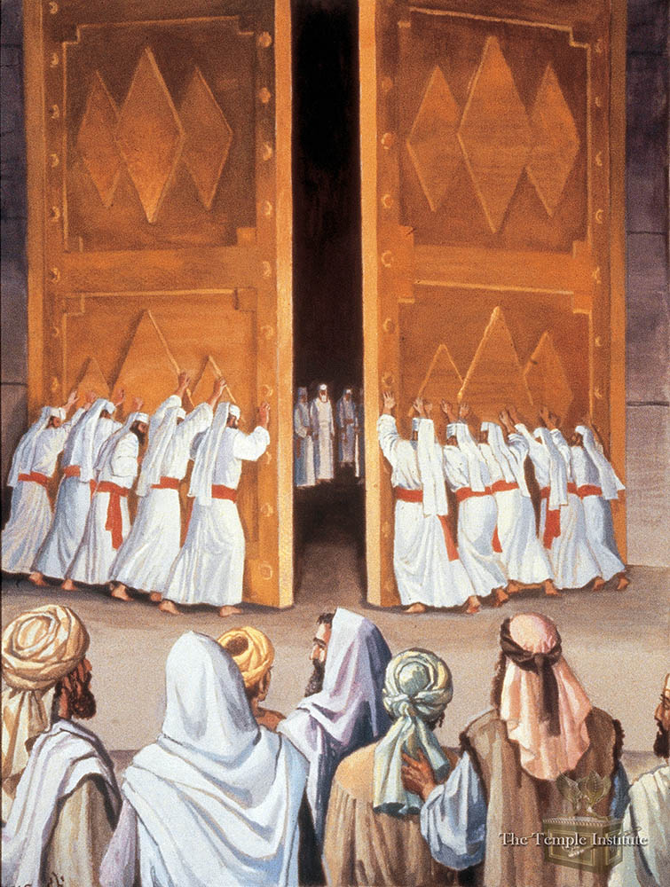
Yom Kippur ends at sundown
Great joy breaks out as
The Jews celebrate
God’s yearly atonement
for Israel as a Nation
The Great Shofar is Blown
“The Ne’ilah Ceremony”
Closing of the The Door
Remember Matthew 25
“The Parable of the 10 Virgins
The foolish were not Ready
The Door was Shut

Slide 32
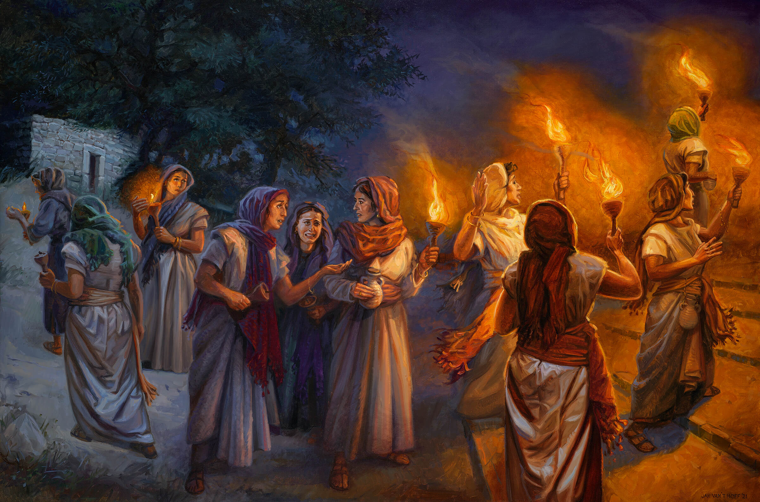
1 Then shall the kingdom of heaven be likened unto 10 virgins, which took their lamps, and went forth to meet the bridegroom.² And 5 of them were wise: 5 were foolish. ³ They that were foolish took their lamps, and took no oil with them:⁴ But the wise took oil in their vessels with their lamps.
⁵ While the bridegroom tarried, they all slumbered and slept.⁶ And at midnight there was a cry made, Behold, the bridegroom comes; go out to meet him.
⁷ Then all those virgins arose, and trimmed their lamps.⁸ And the foolish said unto the wise, Give us of your oil; for our lamps are gone out.
⁹ But the wise answered,
saying, Not so, lest there
not be enough for us
And you: but go rather to them that sell,
and buy for yourselves.
¹⁰ And while they went to
buy, the bridegroom came;
and they that were ready
went in with him to the
marriage: and
the door was shut.

Slide 33
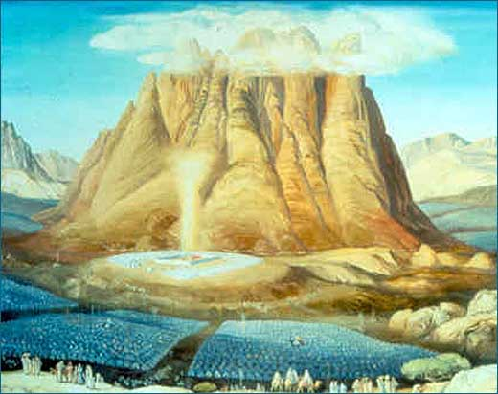
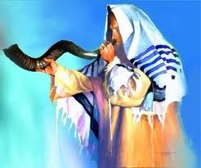
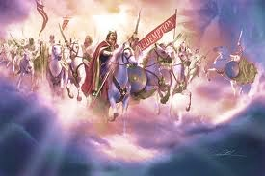
The First Trump = Pentecost
“And it came to pass on the 3rd day in the morning, that there were thunders, and a thick cloud upon the Mountain, and the voice of the Trumpet exceedinly loud, so that all the people trembled. “
Exodus 19:16
The Last Trump =
Feast of Trumpets
“In a moment, in the twinkling of an eye, at the last trump, for the trumpet shall sound and the dead shall be raised incorruptible, and we shall be changed”
1 Corinthians 15:52
The Great Trumpet = Atonement
“Amd it shall come to pass in the Day, that the great trumpet
shall be blown. And they shall come that were ready to perish
and shall worship the Lord in the Holy Mt. inJerusalem.”
Isaiah 27:13

Slide 34
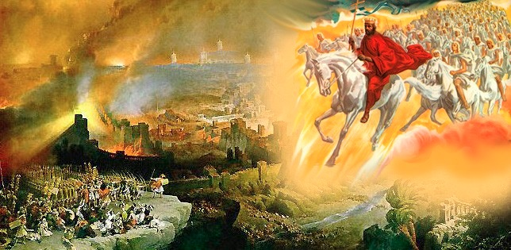
King Jesus is Coming to Fight – Battle of Armageddon – Matt 24:30-31
30.“Then shall appear the sign of the Son of Man in heaven, and then shall all the tribes
of the earth mourn, and they will see the Son of man coming in the clouds of heaven with power and great glory.
31. And He will send His angels with a great sound of a trumpet and they will gather together His elect from the 4 winds, from one end of heaven to the other.”

Slide 35
A Yom Kippur Theme - “Face to Face”
The High Priest steps into the Holy of Holies to meet with God
The Shekinah glory of God fills the room
All Israel is Still Waiting for their Messiah
To meet Him face to face
We are waiting for our glorified bodies, so we will be like Him
We will be in His Presence forever
and fully know Him face-to-face.
1st Corinthians 12:13
¹ For now we see through a glass, darkly; but then face to face:
now I know in part; but then shall I know even as also I am known.”

Slide 36
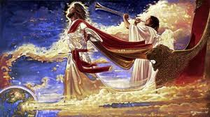
The Day of Atonement & The Battle of Armageddon are Over
The Gates of Heaven are Closed- All Souls Are Now in the Barn
Kind Jesus is Reigning on Earth - Next is the Feast of Tabernacles

