Slide 1
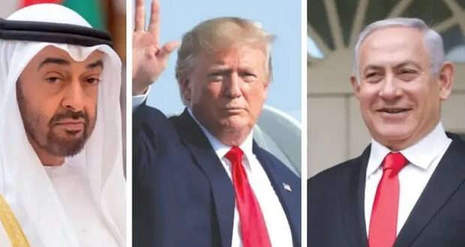
The Abraham Accord vs. The Abraham Covenant

Slide 2
Where do we find Abraham’s Covenant?
Abraham’s Covenant
Genesis 15

Slide 3
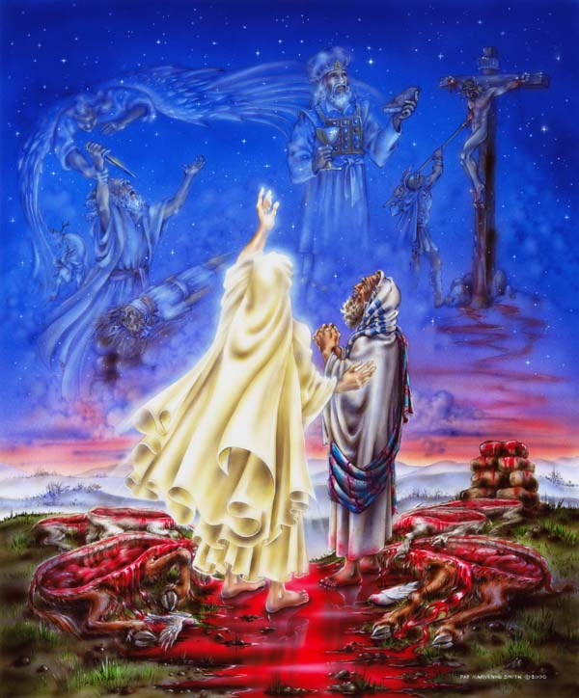
Genesis 12:1-2
God told Abram to leave the pagan land of his birth and to travel to a Land that God would show him.
Genesis 12:3
And I will bless those that bless you, and I will curse those that curse you.
God Cut an Everlasting
Covenant with Abraham
Genesis Chapter 15
A Land Covenant
Great Nation from him
Make his name great

Slide 4
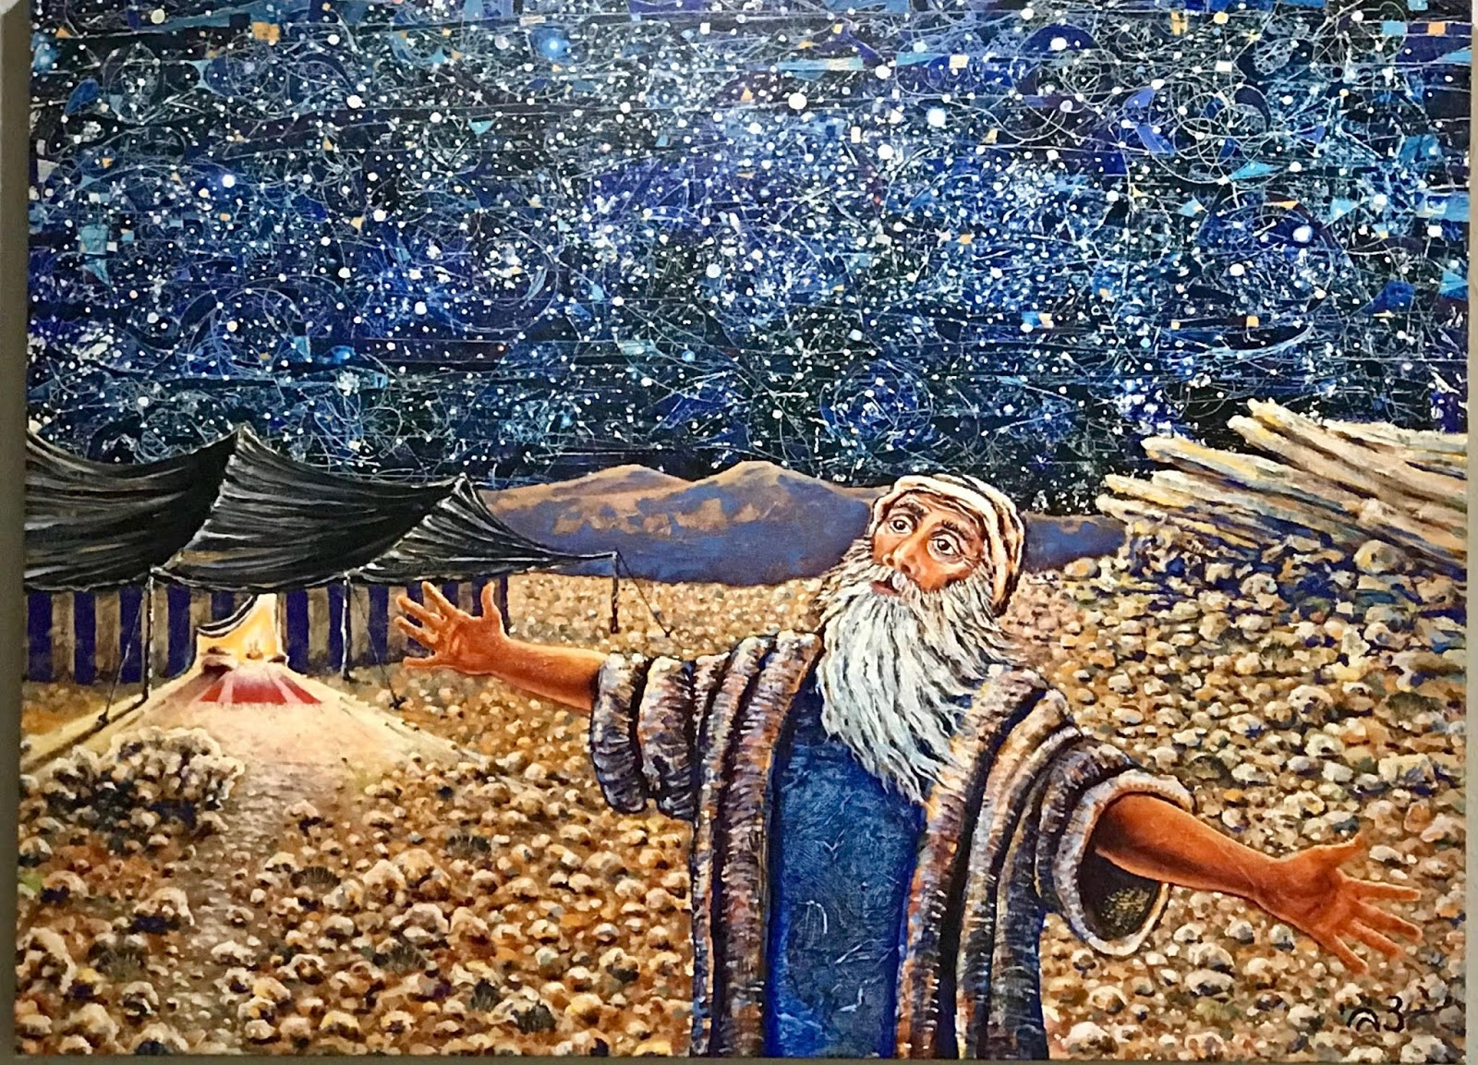
Genesis 15:5 “And God brought Abram fouth and said, Look now toward heaven, and tell the stars. If you are able to number them: God said to him, so shall your seed be
8. In the same day, the Lord made a covenant with Abram, saying Unto your seed have I given this Land, from the river of Egypt to the great river, the Euphrates..

Slide 6
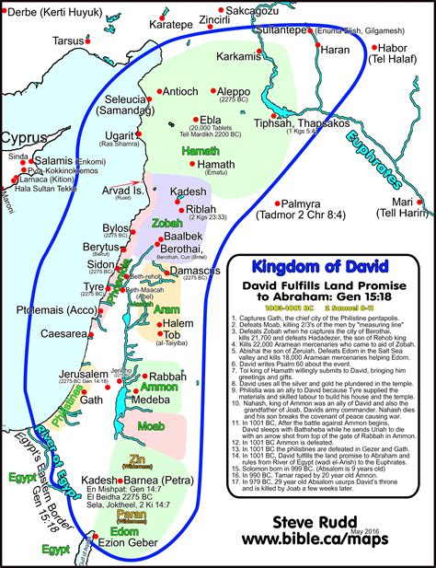
David not only believed believed in the Everlasting Land Covenant God gave to Abraham, Isaac and Jacob,
He fought many battles to fulfill it

Slide 8
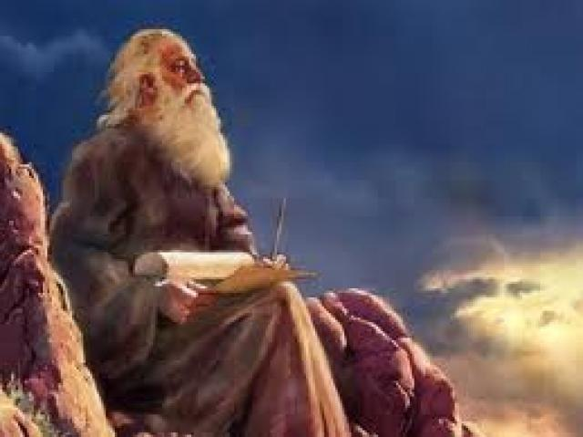
Isaiah 24:1-6
6.The earth also is defiled under the inhabitants thereof, because they have: transgressed the Laws,
changed the ordinance,
broken the everlasting covenant.”

Slide 9
The Abraham Accord
8/13/2020
Middle East Peace Treaty

Slide 10
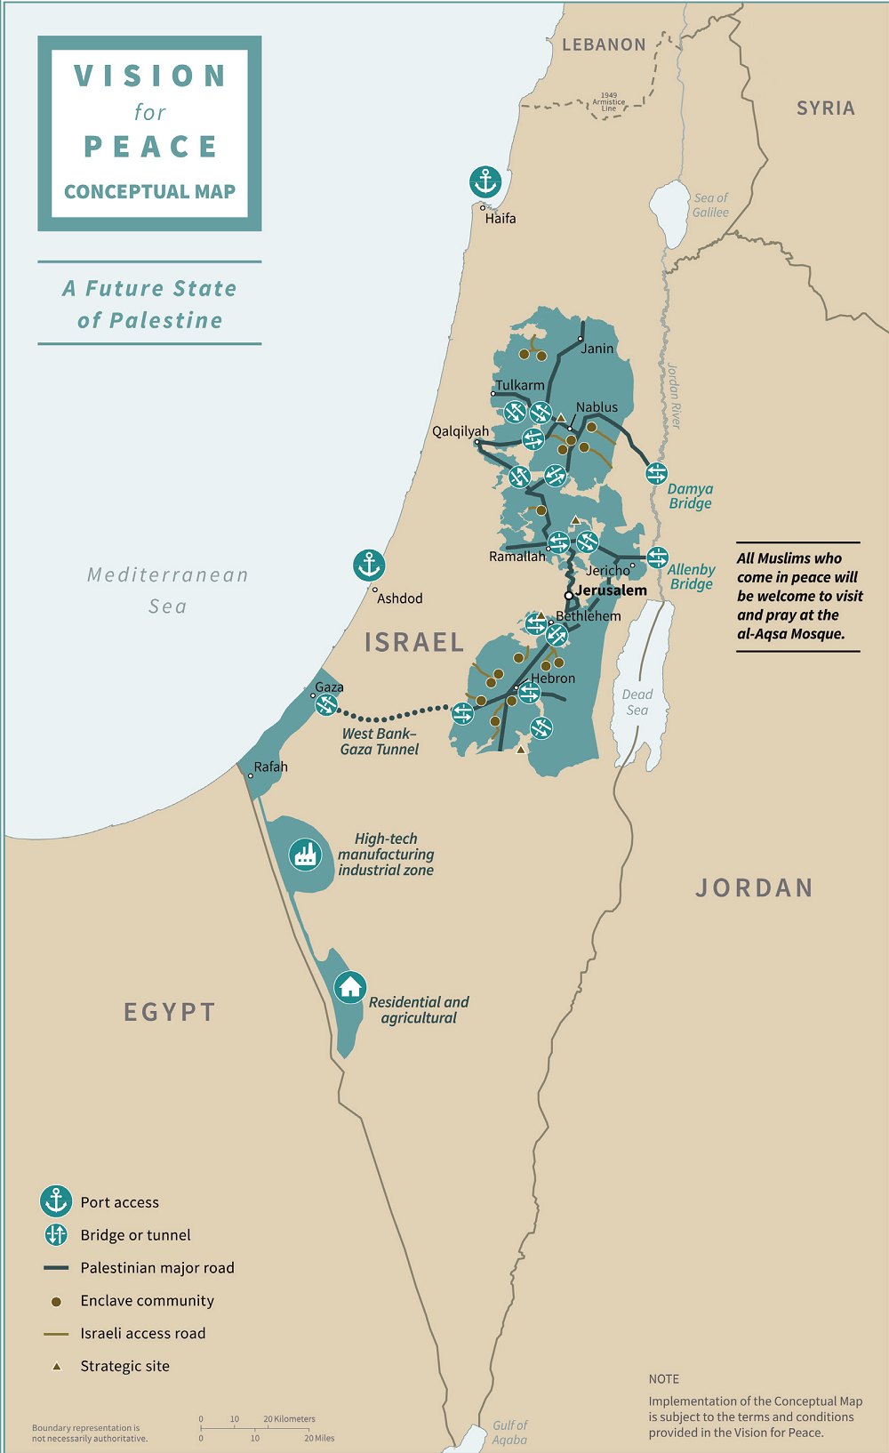

Slide 11
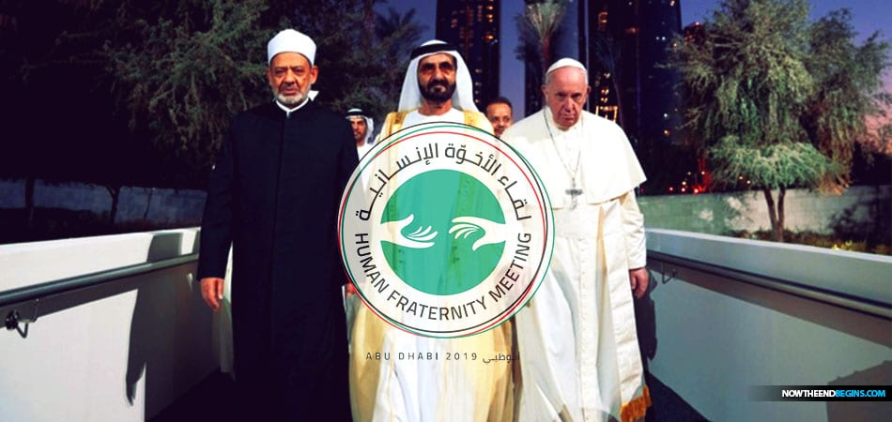
RecognizesThe 3 Great Abrahamic Faiths
Christianity, Judaism, and Islam together

Slide 12
If Israel is God’s focus in the End times,
And Islam is the End Times Beast……
What is Chrislam ?

Slide 13
Israel Will Make a
Isaiah 28: 14-15
14. Wherefore hear the Word of the Lord, you scornful men that rule people that are in Jerusalem
Because you have said, we have made a covenant with death, and with hell we are in agreement: when the overflowing scourge shal pass through, it shall not come to us, for we have made lies our refuge and under falsehood we have hidden ourselves.

Slide 14
“A Historic Breakthrough”
Significant Stepto PEACE
Diplomatic Relationship
Between Israel and UAE
Bypasses Palestinians
Great Growth
Travel, Trade. Tourism,
Communication, Commerce
Healthcare, Energy
Embassies, Ambassadors
Creation of Palestinian State
$50 Billlion iAid - Palestinians
US sale of F-35 Fighter plans
US sale of armed Drones
First time flights to UAE,
Millions more Muslims can travel to visit Jerusalem
Annexation of Judea, Samaria for Israel Removed
Israel/UAE Covid Copperation
Signed in September
More hidden details!

