Slide 1
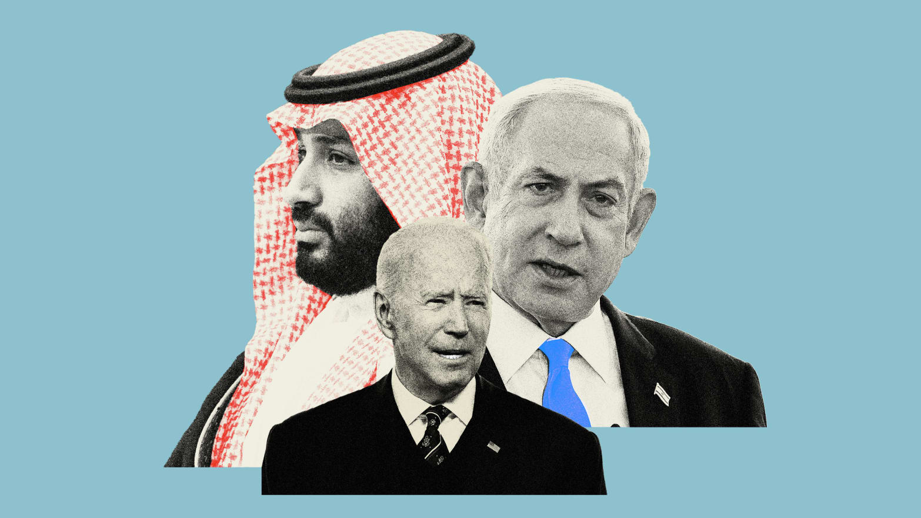
Bible Prophecy Update – A New Peace Treaty
The Coming Battle over Who Will Control Jerusalem & The Temple Mount

Slide 2
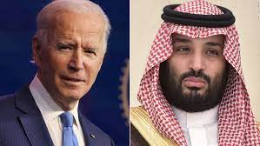
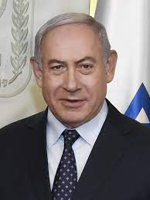
What Happens When Kings & Nations Disregard God’s Everlasting Covenant
“A Renewal of “The Abraham Accord”
Creation of a Palestinian State
UN meeting today – On 30th Anniversary of Oslo

Slide 3
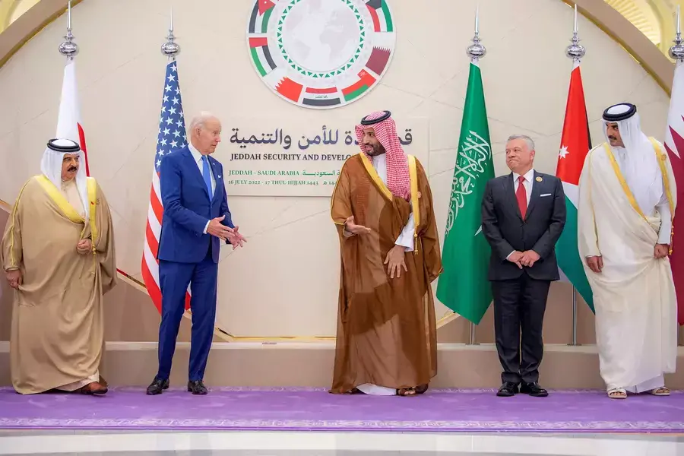
Monday, Sept 18,2023 at the UN – Saudi Arabia with Arab League, the European Union, and Egypt and Jordan present “Peace Day Effort for Middle East Peace.” A big push to normalize relations between Israel & Saudi Arabia. Concessions will be demanded of Israel to “re-invigorate the peace
Israel and Palestinians will be present but with no voice

Slide 4
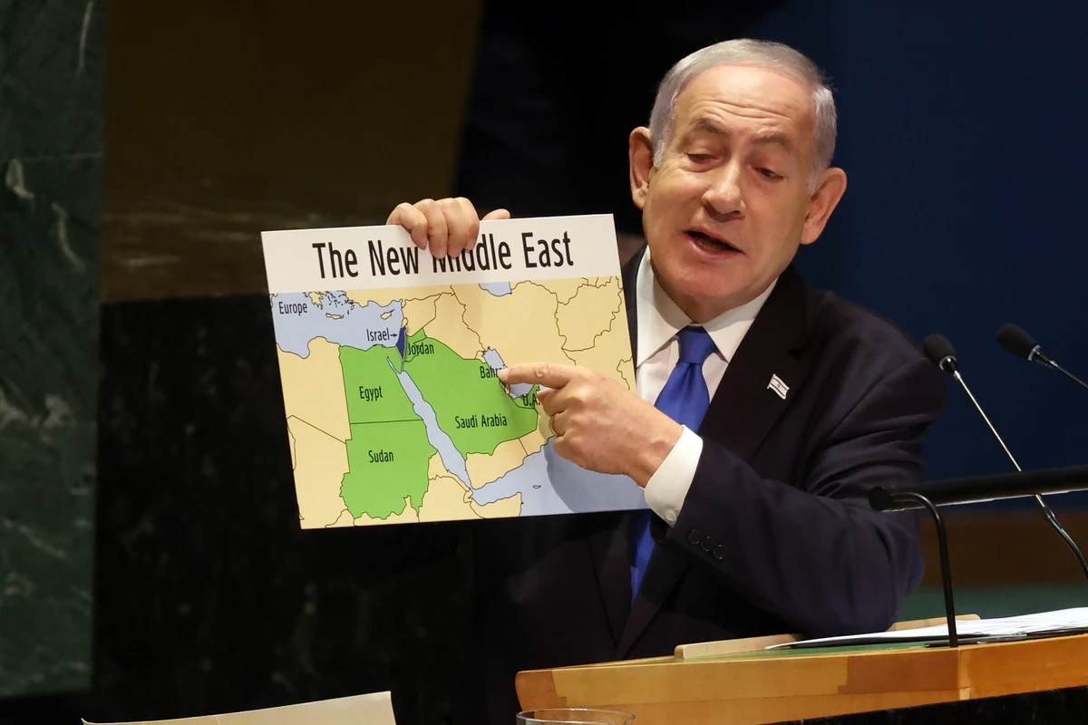
Israel’s Prime Minister is happy that there is a new Middle East Peace Coming Between Israel and the Arab nations. Saudi Arabia’s agreement will bring 6 or 6 other Arabs nations into “a new normalization” with Israel for the first time.

Slide 5
Saudi Arabi & Israel Treaty
Energy – Saudi Arabia controls Oil and Gas Prices
Security – Iran is lethal enemy of Israel & Saudi Arabia
Iran has nuclear bomb
US would give Saudi Arabia new fighter planes
Drone Technology
Saudi Arabia wants nuclear weapons
3. Air Space – Muslims get direct Flights to Jerusalem
4. Concessions – Israel must give up Land for Peace
A Palestinian State
5. Other Arab Nations will also join the Peace Accord with Israel

Slide 6
God made an “Everlasting Covenant”
with Abraham, Isaac, & Jacob
The Old Testament Prophets wrote much
About God’s Jealousy over His Land & His People
The Holy Spirit Confirms this in almost
Every Book in the Old Testament
Leviticus 26:42
“Then will I remember My Covenant with Jacob, and also
My Covenant with Isaac, and also My Covenant with Abraham
will I remember; and I will remember the Land.”

Slide 7
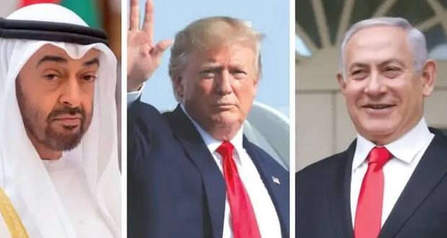
The 2020 Abraham Accord
Middle East Peace Treaty
Put Us on a Collision Course with God
‘The Road to Armageddon’

Slide 8
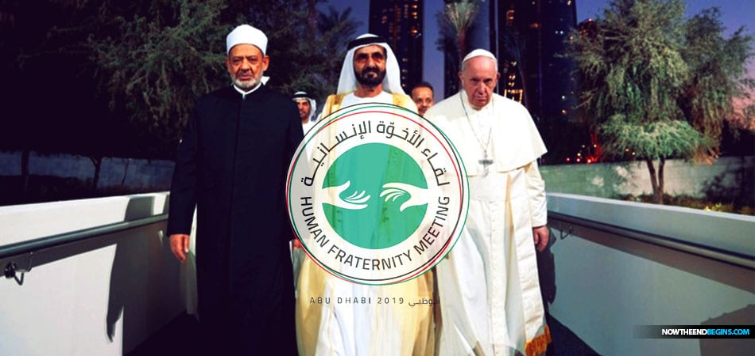
The Abraham Accord
Recognizes the 3 Great Abrahamic Faiths
Christianity, Judaism, and Islam together
There are only 2 Abrahamic Faiths – Judaism & Christianity

Slide 9
The Abraham Accord” vs. The Abraham Covenant
God Made an Everlasting Covenant
with Abraham in Genesis 15

Slide 10
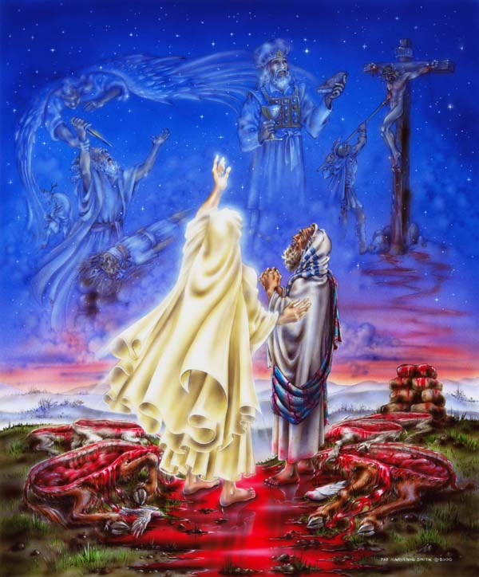
Genesis 12:1-2
God told Abram to leave the pagan land Ur of his birth and to travel to a Land that God would show him.
Genesis 12:3
‘And I will bless those that bless you, and I will curse those that curse you.’
God Cut an Everlasting
Covenant with Abraham
Genesis Chapter 15
A Land Covenant
God Promised a Great Nation would come from from Abram and He would make his name great

Slide 11
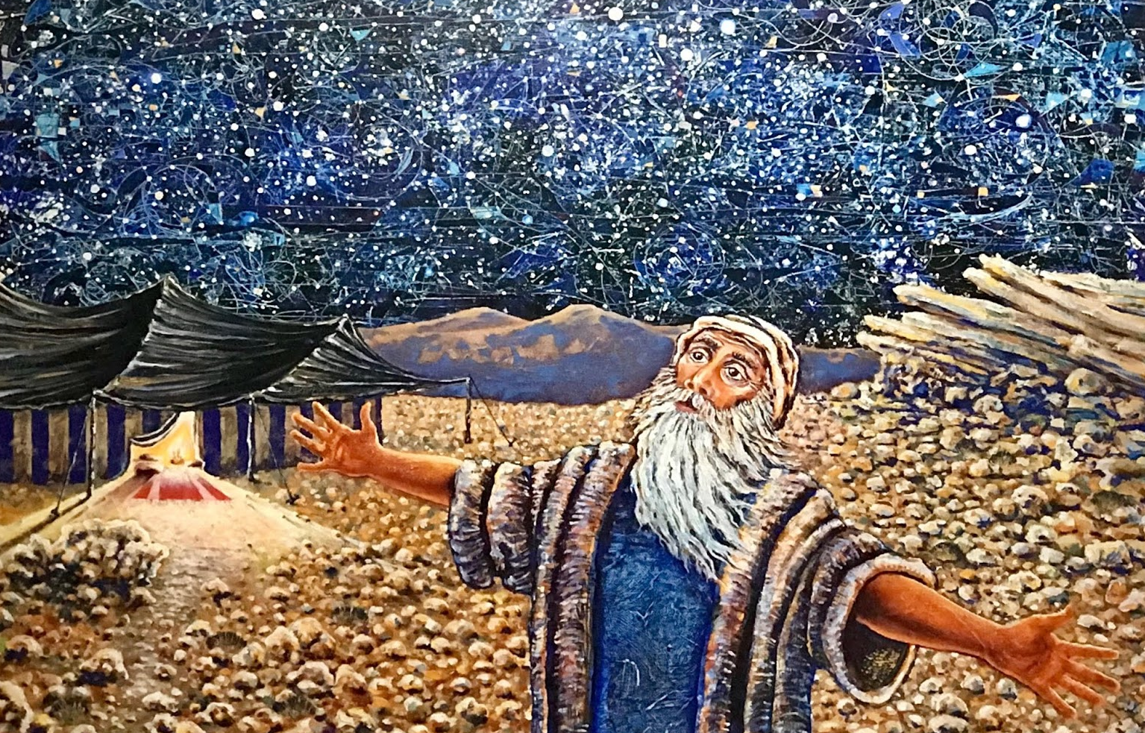
Genesis 15:5
“And God brought Abram forth and said, Look now toward heaven, and tell the stars. If you are able to number them: God said to him, so shall your seed be”

Slide 12
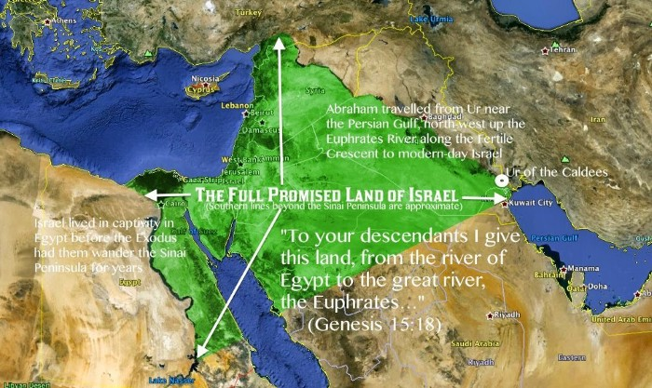
8. In the same day, the Lord made a Covenant with Abram,
Saying, Unto your seed have I given this Land,
from the river of Egypt to the great river, the Euphrates..

Slide 13
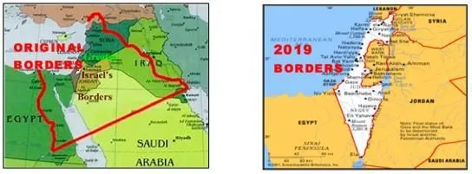
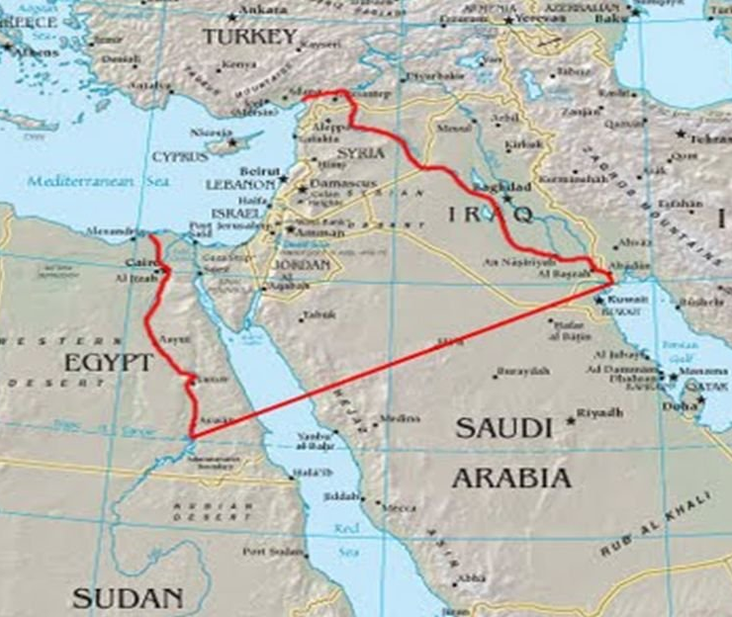
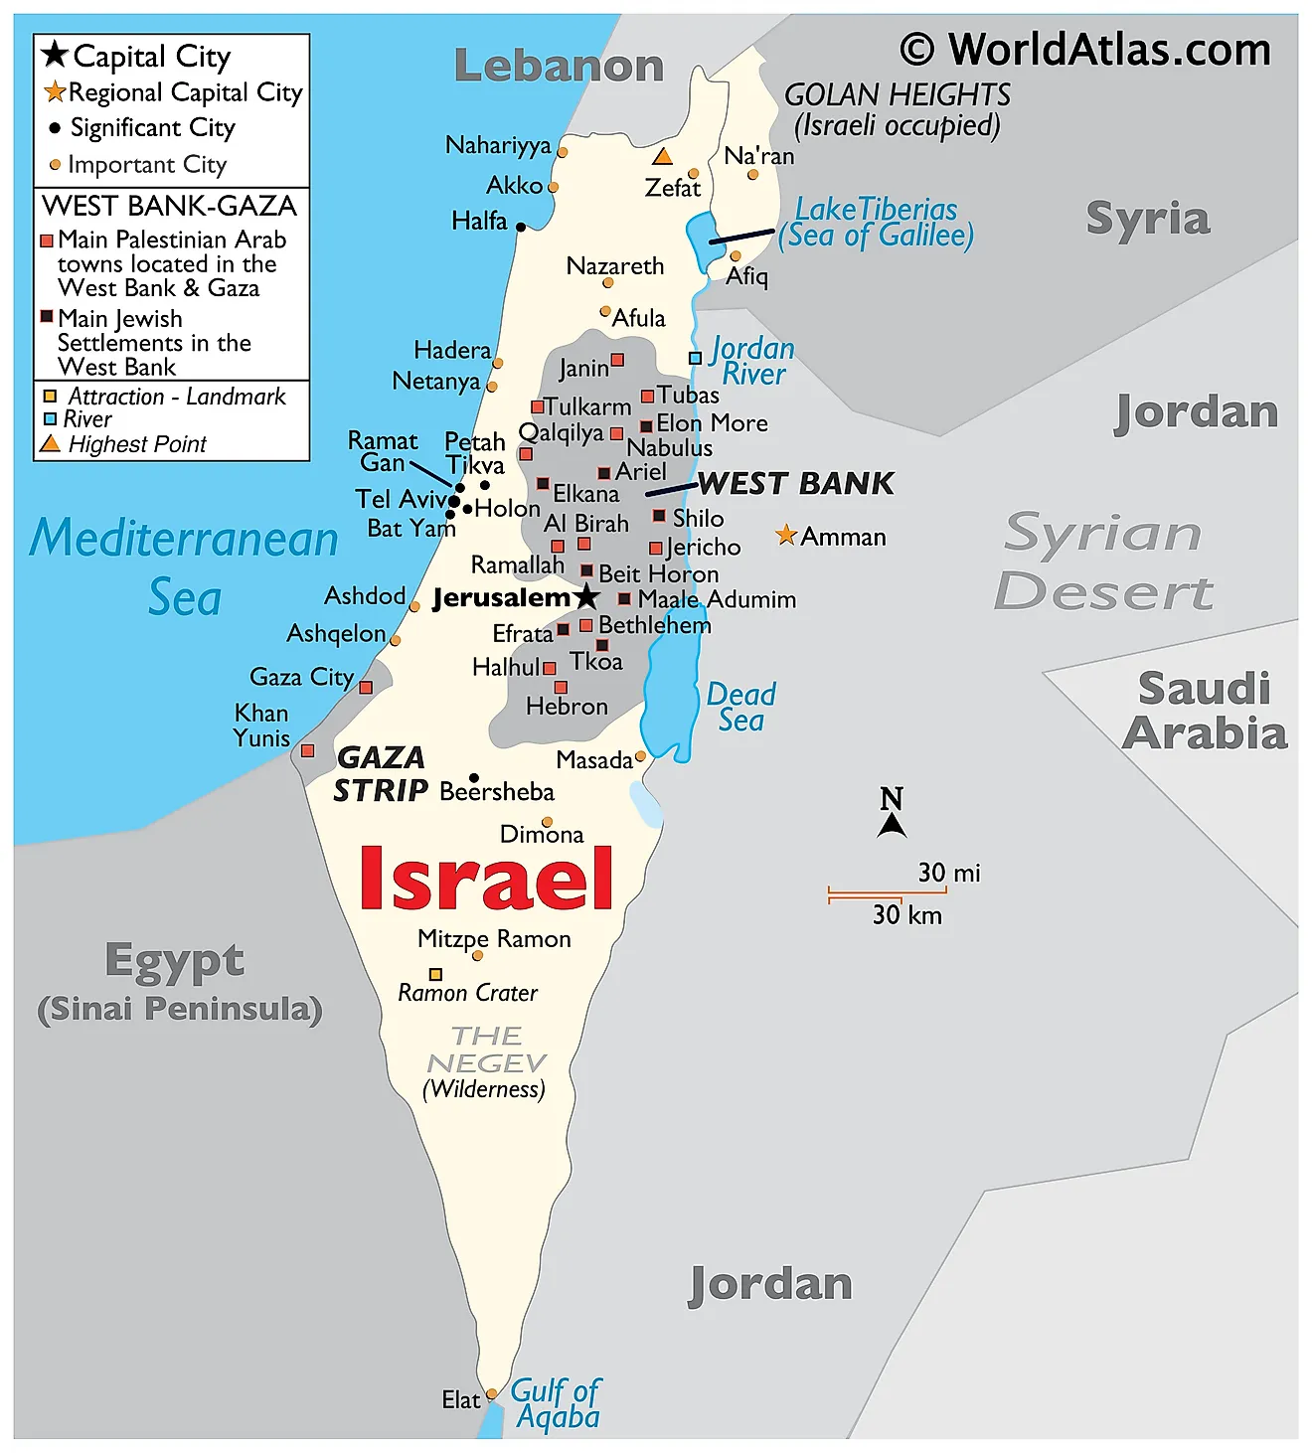
The Everlasting Covenant …..Present Day Reality

Slide 15
What are the Consequence for Breaking
God’s Everlasting Covenant with Israel?
The Wrath of God will be Poured Out on all
the Enemy Nations - Battle of Armageddon

Slide 16
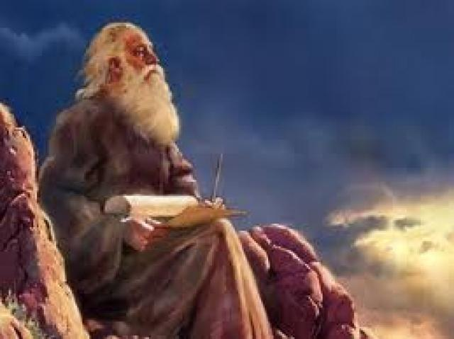
Isaiah 24:5-6
5.The earth also is defiled under the inhabitants thereof, because they have: transgressed the Law, changed the ordinance, broken the everlasting covenant.
⁶ Therefore has the curse devoured the earth, and they that dwell therein are desolate: therefore the inhabitants of the earth are burned, and few men left.

Slide 17
Jesus gave His Disciples a Wonderful Preview of the End Times on the Mt. Of Olives
Matthew Chapter 24
He talked about the Birth Pangs
But the greatest Sign He gave
them to watch for was:
“the abomination of desolation”

Slide 18
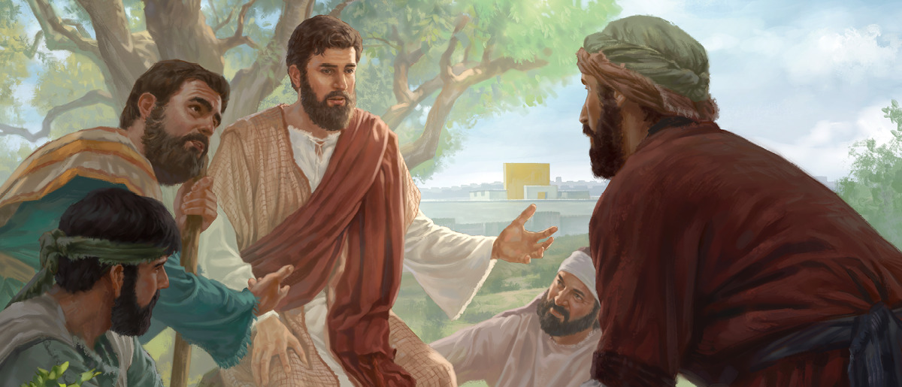
Matthew 24
¹And Jesus went out, and departed from the Temple:
and his disciples came to Him for to shew him the buildings of the Temple.
² And Jesus said unto them, See ye not all these things? verily I say unto you,
There shall not be left here one stone upon another, that shall not be thrown down.
³ And as He sat upon the Mt. of Olives, the disciples came unto Him privately,
saying, Tell us, when shall these things be? What shall be the sign of Your coming,
and of the end of the world?
⁴ And Jesus answered and said unto them, Take heed that no man deceive you.
⁵ For many shall come in My name, saying, I am Christ; and shall deceive many.

Slide 19
⁶ And ye shall hear of wars and rumors of wars: see that ye be not troubled:
for all these things must come to pass, but the end is not yet.
⁷ For nation shall rise against nation, and kingdom against kingdom:
and there shall be famines, and pestilences, and earthquakes, in divers places.
⁸ All these are the beginning of sorrows.
⁹ Then shall they deliver you up to be afflicted, and shall kill you:
and ye shall be hated of all nations for My name's sake.
¹⁰ And then shall many be offended, and shall betray one another,
and shall hate one another.
¹¹ And many false prophets shall rise, and shall deceive many.
¹² And because iniquity shall abound, the love of many shall wax cold.
¹³ But he that shall endure unto the end, the same shall be saved.
¹⁴ And this gospel of the kingdom shall be preached in all the world
for a witness unto all nations; and then shall the end come.

Slide 20
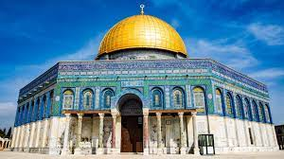
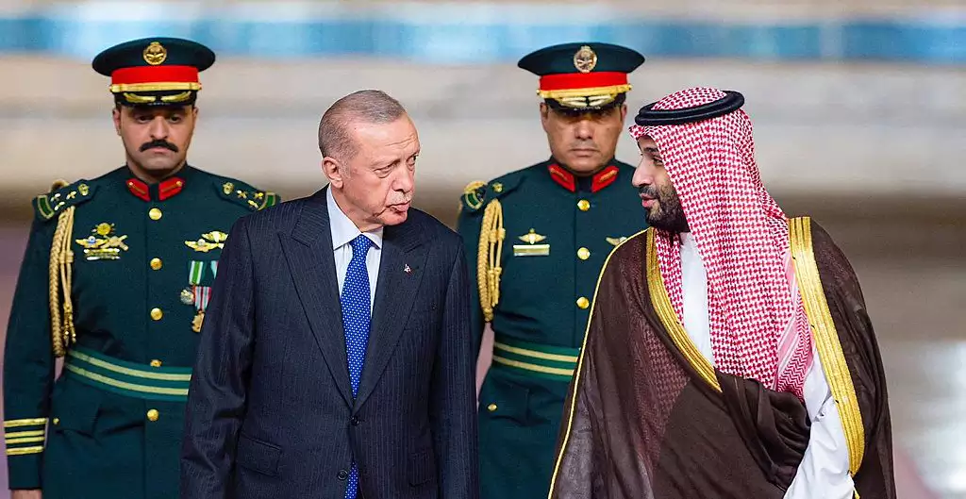
15. When you therefore shall see the abomination of desolation,
spoken of by Daniel the prophet, stand in the Holy Place,
(whoso reads, let him understand:)
There is now an
Abomination of Desolation
in the Holy Place
A renewed Abraham Accord grants Saudi Arabia control along with Jordan on the Temple Mount – Turkey, too!

Slide 21
¹⁶ Then let them which be in Judaea flee into the mountains:
¹⁷ Let him which is on the housetop not come down
to take any thing out of his house:
¹⁸ Neither let him which is in the field return back to take his clothes.
¹⁹ And woe unto them that are with child,
and to them that give suck in those days!
²⁰ But pray ye that your flight be not in the winter,
neither on the sabbath day:
²¹ For then shall be great tribulation, such as was not since
the beginning of the world to this time, no, nor ever shall be.
²² And except those days should be shortened,
there should no flesh be saved
but for the elect's sake those days shall be shortened.

Slide 22
Daniel 9:24-27 ‘Daniel’s 70 Weeks Prophecy’
²⁴ Seventy weeks are determined upon thy people and upon thy holy city,
to finish the transgression,
and to make an end of sins,
and to make reconciliation for iniquity,
and to bring in everlasting righteousness,
and to seal up the vision and prophecy,
and to anoint the most Holy.
²⁵ Know therefore and understand, that from the going forth of the commandment to restore and to build Jerusalem unto the Messiah
the Prince shall be 7 weeks, and threescore and two (62) weeks:
the street shall be built again, and the wall, even in troublous times.

Slide 23
Jesus Death
30 AD
Ezra 7- 457 BC
Nehemiah -445 BC
69 of 70 Weeks Already Completed - 1 Week (7 Years) is Left – The 7 Year Tribulation

Slide 24
²⁶ And after threescore and 2 weeks shall Messiah be cut off,
but not for Himself: and the people of the prince that shall come
shall destroy the City and the Sanctuary; the end thereof shall be with
a flood, and unto the end of the war desolations are determined.
²⁷ And he shall confirm the Covenant with many for one week:and in the midst of the week he shall cause the sacrifice and the oblation to cease,
and for the overspreading of abominations he shall make it desolate,
even until the consummation, and that determined shall be poured
upon the desolate.
“For one week”
“ for one week”

Slide 25
Israel will Make a Peace Treaty with Her Enemies
Called “A Covenant with Death”
Isaiah 28:14-18

Slide 26
Israel Will Make a
Isaiah 28: 14-15
14. Wherefore hear the Word of the Lord, you scornful men that rule people that are in Jerusalem
Because you have said, we have made a covenant with death,
and with hell we are in agreement: when the overflowing scourge shall pass through, it shall not come to us, for we have made lies our refuge and under falsehood we have hidden ourselves.

Slide 27
Isaiah 28:16-18
¹⁶ Therefore thus says the Lord God, Behold, I lay in Zion for a foundation a stone, a tried stone, a precious corner stone, a sure foundation:
he that believes shall not make haste.
¹⁷ Judgment also will I lay to the line, and righteousness to the plummet:
and the hail shall sweep away the refuge of lies,
and the waters shall overflow the hiding place.
¹⁸ And your covenant with death shall be disannulled,
and your agreement with hell shall not stand;
when the overflowing scourge shall pass through,
then ye shall be trodden down by it.

Slide 28
Zechariah 12:2-3
Behold, I will make Jerusalem a cup of trembling unto all the people round about, when they shall be in the siege both against Judah and against Jerusalem. And in that day will I make Jerusalem a burdensome stone for all people: all that burden themselves with it shall be cut in pieces, though all the people of the earth be gathered together against it.
Jeremiah 30:5-7
⁵ For thus says the Lord; We have heard a voice of trembling, of fear, and not of peace. Ask ye now, and see whether a man does travail with child? wherefore do I see every man with his hands on his loins, as a woman in travail, and all faces are turned into paleness? Alas! for that day is great, so that none is like it: it is even
the Time of Jacob's trouble, but he shall be saved out of it.

Slide 29
Zechariah 12:2-3
² Behold, I will make Jerusalem a cup of trembling unto all the people round about, when they shall be in the siege both against Judah and against Jerusalem.
³ And in that day will I make Jerusalem a burdensome stone for all people: all that burden themselves with it shall be cut in pieces, though all the people of the earth be gathered together against it.
1st Thessalonians 5:2-3
² For yourselves know perfectly that the day of the Lord so comes as
a thief in the night.³ For when they shall say, Peace and safety; then sudden destruction comes upon them, as travail upon a woman with child; and they shall not escape.

Slide 30
Ezekiel 35:10-14 “God’s Judgment Against Edom “
¹⁰ Because you have said, These 2 nations and these 2 countries shall
be mine, and we will possess it; whereas the Lord was there:
¹¹ Therefore, as I live, says the Lord God,
I will even do according to your anger, and according to your envy
which you have used out of your hatred against them;
and I will make myself known among them, when I have judged you.
¹² And you shalt know that I am the Lord, and that I have heard all your blasphemies which you have spoken against the Mountains of Israel, saying, They are laid desolate, they are given us to consume.
¹³ Thus with your mouth you have boasted against Me,
and have multiplied your words against Me: I have heard them.
¹⁴ Thus says the Lord God; When the whole earth rejoices,
I will make you desolate.

Slide 31
Ezekiel 36:5
”Therefore thus says the Lord God; Surely in the fire of My jealousy have I spoken against the residue of the heathen and against all Edom, which have appointed My land into their possession with the joy of all their heart, with despiteful minds, to cast it out for a prey”
Joel 3:1-2
“For behold, in those days and at that time, when I restore the fortunes of Judah and Jerusalem, I will gather all the nations and bring them down to the Valley of Jehoshaphat. And I will enter into judgment with them there, on behalf of My people and My heritage Israel, because they have scattered them among the nations and have divided up My land,

Slide 32
Isaiah 34:1-4
¹ Come near, ye nations, to hear; and hearken, ye people:
let the earth hear, and all that is therein;
the world, and all things that come forth of it.
² For the indignation of the Lord is upon all nations,
and His fury upon all their armies:
He has utterly destroyed them,
He has delivered them to the slaughter.
³ Their slain also shall be cast out,
and their stink shall come up out of their carcases,
and the mountains shall be melted with their blood.
⁴ And all the host of heaven shall be dissolved,
and the heavens shall be rolled together as a scroll:
and all their host shall fall down,
as the leaf falls off from the vine,
and as a falling fig from the fig tree.

Slide 33
Isaiah 34: 5-8
⁵ For My sword shall be bathed in heaven:
behold, it shall come down upon Edom,
and upon the people of My curse, to judgment.
⁶ The sword of the Lord is filled with blood,
It is made fat with fatness,
and with the blood of lambs and goats,
with the fat of the kidneys of rams:
for the Lord has a sacrifice in Bozrah,
and a great slaughter in the land of Edom.
⁷ And the unicorns shall come down with them,
and the bullocks with the bulls;
their land shall be soaked with blood,
and their dust made fat with fatness.
⁸ For it is the day of the Lord’s vengeance,
and the year of recompences for the controversy of Zion.

Slide 34
Whoever Plans to Divide the Land
God gave to Israel
Will face the Wrath of the Almighty
There will be NO Peace
in the Middle East
Until Jesus Returns as the Prince of Peace

Slide 35
Why is

Slide 36
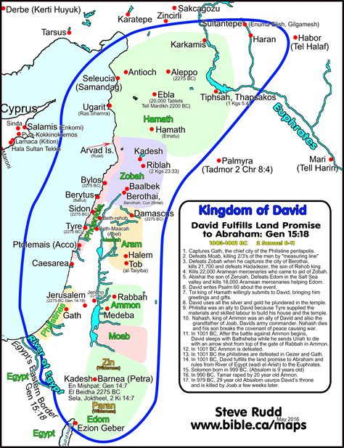
David not only believed believed in the Everlasting Land Covenant God gave to Abraham, Isaac and Jacob,
He fought many battles to fulfill it

Slide 37
The Abraham Accord asked Israel to Give Up Land for Peace
What does the Arab Nation Give Up?
What happened to the Political Careers of Trump & Netanyahu?

Slide 38
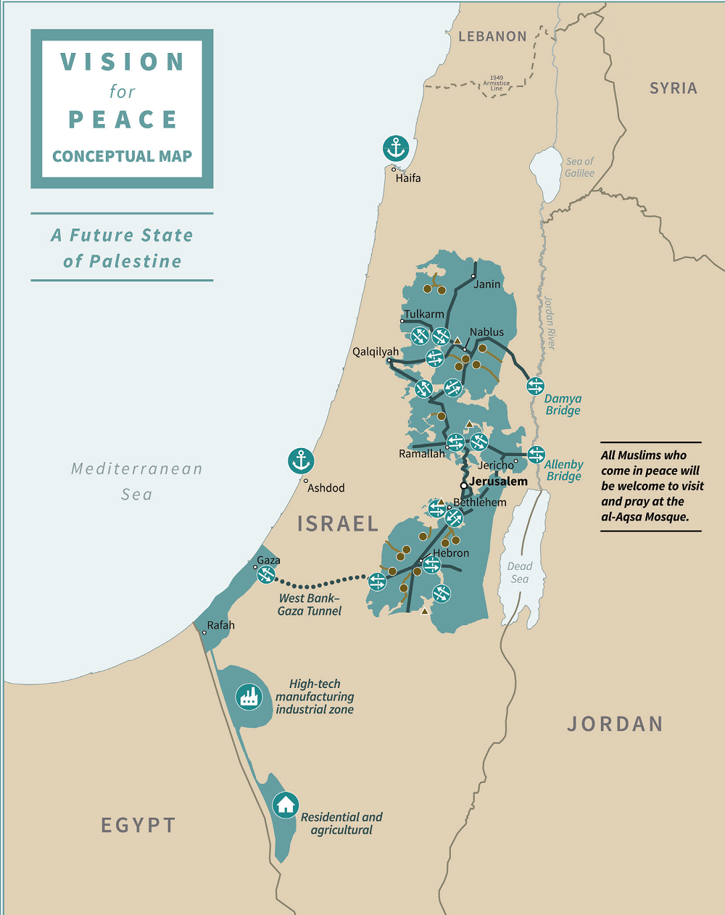
“A Historic Breakthrough”
Significant Step to PEACE
Diplomatic Relationship
Between Israel and UAE
Bypasses Palestinians
Great Growth, Travel, Trade Tourism, Communication, Commerce Healthcare, Energy
Embassies, Ambassadors
Creation of Palestinian State
$50 Billion in Aid –US gives
to the Palestinians
US sale of F-35 Fighter plans
to Arab Nations
US sale of armed Drones
First time flights to UAE,
Millions more Muslims can travel to visit Jerusalem
Annexation of Judea, Samaria for Homes in Israel Removed
Israel/UAE Covid Copperation
Signed in September, 2020
More hidden details!

Slide 39
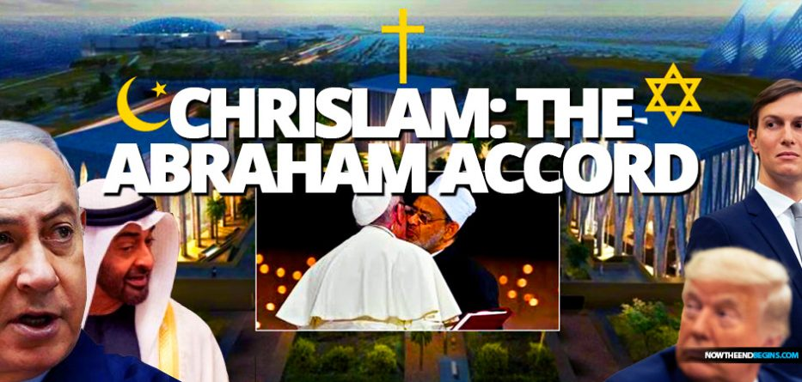
If Israel is God’s focus in the End times,
And Islam is the End Times Beast……
What is Chrislam ? An Unholy Deception

Slide 40
Jesus Warning His Disciples About Deception in the End Times –
⁴And Jesus answered and said unto them, Take heed that no man deceive you.
⁵ For many shall come in my name, saying, I am Christ; and shall deceive many.
¹¹ And many false prophets shall rise, and shall deceive many.
¹² And because iniquity shall abound, the love of many shall wax cold.
¹³ But he that shall endure unto the end, the same shall be saved.

Slide 41
The Coming Battle over Who Will Control Jerusalem & The Temple Mount

